Slide 1
Probabilistic Models on Partition Function
Yuxin Su
Group Study

Slide 2
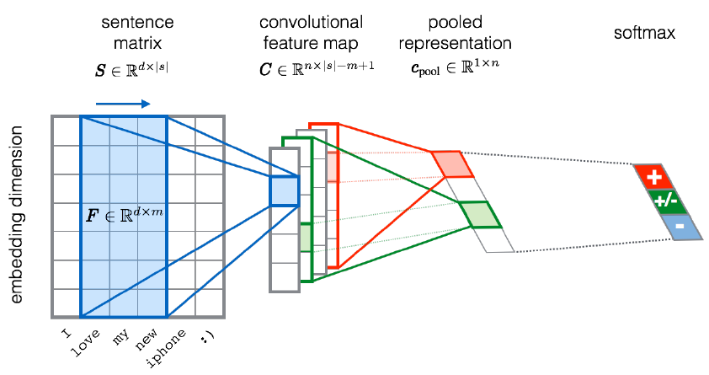
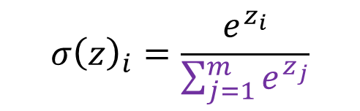
Partition Function
Tractable:
  Softmax in deep learning
$$σ{\left(z\right)}_{i}=\frac{e^{z_{i}}}{\sum_{j=1}^{m}{e^{z_{j}}}}$$
Notes:
Easy to compute, because all components are ready

Slide 3
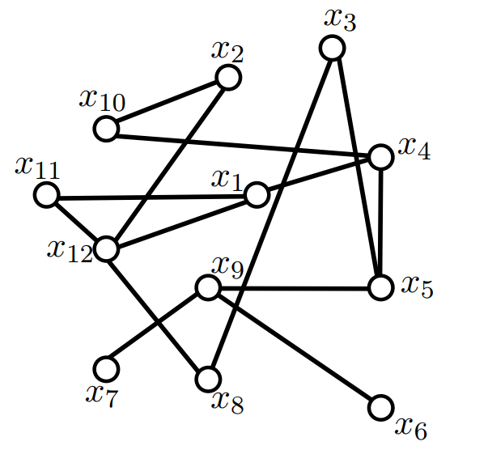
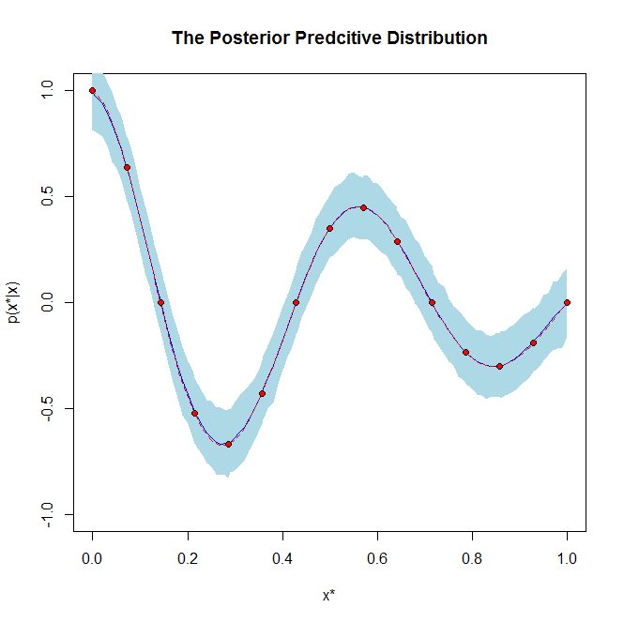
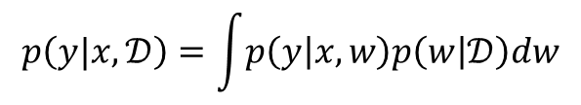
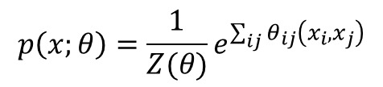
Partition Function
Many partition functions are intractable!
Pairwise Markov random field
Posterior predictive distribution
$$p\left(x;θ\right)=\frac{1}{Z(θ)}e^{\sum_{ij}{θ_{ij}\left(x_{i}, x_{j}\right)}}$$
$$p\left(y|x,𝒟\right)=\int{p\left(y | x,w\right)p\left(w | 𝒟\right)dw}$$
Notes:
probabilistic graphical models like Markov Random Field also has the similar property
when the size of network is huge, the distribution become intractable.
Second case, the continuous integral is typically intract.

Slide 4

Normalization over partitions
General form of probabilistic models:
  $$p\left(x;θ\right)=\frac{1}{Z\left(θ\right)}\tilde{p}\left(x;θ\right)$$
Partition functions:
$$Z(θ)=\sum_{x}{\tilde{p}(x;θ)}$$
$$Z(θ)=\int{\tilde{p}\left(x;θ\right)dx}$$
Notes:
p\tilde can be activation function, energy function in restricted boltzmann machine, or linear operator in linear classification, regression
partition function follows two forms.

Slide 5

Roadmap to compute the likelihood
Directly compute $p\left(x;θ\right)$ without considering $Z\left(θ\right)$
  Pseudo-likelihood
Approximate to the gradient for likelihood maximization
  MCMC-based methods

Slide 6


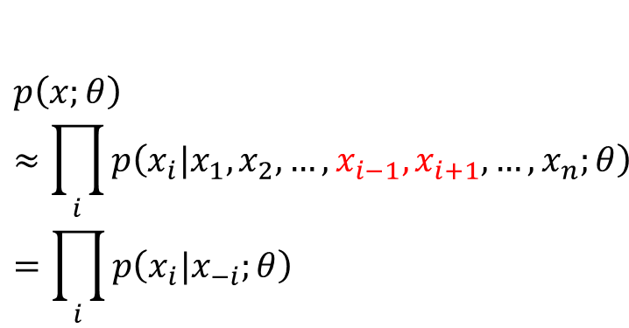
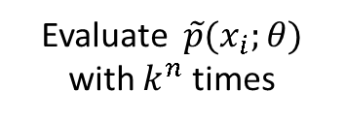




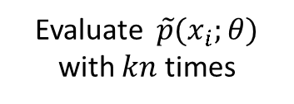

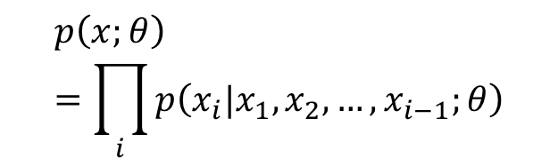

Pseudo-likelihood
Original
Approximation
$$p\left(x;θ\right)≈\prod_{i}{p\left(x_{i}|x_{1},x_{2},…,x_{i−1},x_{i+1},…,x_{n};θ\right)} \\ =\prod_{i}{p\left(x_{i}|x_{−i};θ\right)}$$
$$p\left(x;θ\right)=\prod_{i}{p\left(x_{i}|x_{1},x_{2},…,x_{i−1};θ\right)}$$
$$x_{1}$$
$$x_{2}$$
$$x_{n}$$
$$x_{1}$$
$$x_{2}$$
$$x_{n}$$
$$k$$
$$k$$
Evaluate $\tilde{p}(x_{i};θ)$ with $k^{n}$ times
Evaluate $\tilde{p}(x_{i};θ)$ with $kn$ times
Notes:
the original is chain rule.
when large portion of variables are not sensitive to results, it means the model is decomposable. Approximation seems work

Slide 7





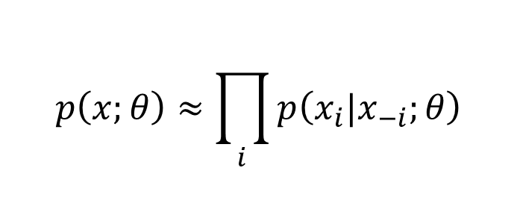



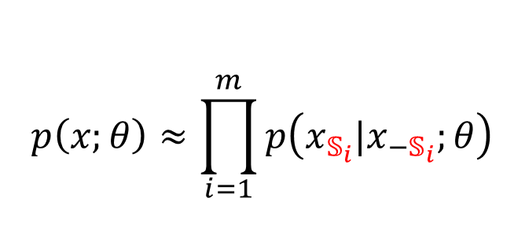




Generalized pseudo-likelihood estimator
Grouping
$$p\left(x;θ\right)≈\prod_{i=1}^{m}{p\left(x_{𝕊_{i}}|x_{−𝕊_{i}};θ\right)}$$
$$p\left(x;θ\right)≈\prod_{i}{p\left(x_{i}|x_{−i};θ\right)}$$
$$𝕊_{1}$$
$$𝕊_{2}$$
$$𝕊_{m−1}$$
$$𝕊_{m}$$
$$x_{1}$$
$$x_{3}$$
$$x_{4}$$
$$x_{…}$$
$$x_{…}$$
$$x_{…}$$
$$x_{…}$$
$$x_{n}$$
Notes:
Pseudo-likelihood perform poorly on tasks that require a good model of the full joint p (x) like sampling or density estimation
This framework makes a balance

Slide 8

Log-likelihood Gradient
$$p\left(x;θ\right)=\frac{1}{Z\left(θ\right)}\tilde{p}\left(x;θ\right)$$
The log-likelihood is:
$$\log{p\left(x;θ\right)}=\log{\tilde{p}\left(x;θ\right)}−\log{Z(θ)}$$
Decomposition on gradient:
$$∇_{θ}\log{p\left(x;θ\right)}=∇_{θ}\log{\tilde{p}\left(x;θ\right)}−∇_{θ}\log{Z(θ)}$$
Positive phase
Negative phase
Notes:
hidden units that are conditionally independent from each other given the visible units
we focus on the negative phase

Slide 9


Basis in machine learning algorithm
$$∇_{θ}\log{Z(θ)}=\frac{1}{Z}\sum_{x}{∇_{θ}\tilde{p}\left(x;θ\right)}$$
Substitute $\exp\left(\log{\tilde{p}\left(x;θ\right)}\right)$ for $\tilde{p}(x;θ)$:
$$\frac{1}{Z}\sum_{x}{∇_{θ}\exp\left(\log{\tilde{p}\left(x;θ\right)}\right)}=\sum_{x}{p\left(x;θ\right)∇_{θ}\log{\tilde{p}\left(x;θ\right)}}$$
Basis for Monte Carlo methods
$$∇_{θ}\log{Z}=𝔼_{x∼p\left(x\right)}∇_{θ}\log{\tilde{p}\left(x\right)}$$
Notes:
Substitution is ok because $\tilde{p}>0$

Slide 10
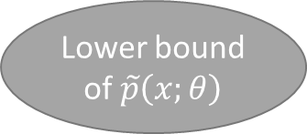
Compute the log-likelihood gradient
$$∇_{θ}\log{p\left(x;θ\right)}=∇_{θ}\log{\tilde{p}\left(x;θ\right)}−∇_{θ}Z(θ)$$
Approximation
Many methods
MCMC
Contrastive divergence (CD) algorithm
Less expensive
Fail to suppress far regions
Lower bound of $\tilde{p}\left(x;θ\right)$
Stochastic Maximum likelihood (SML)
Robust
Inaccurate when model moves fast
Notes:
CD: the cost of burning in the Markov chains from a random initialization at each step, so init from training points reduce MC time
CD could be used as an inexpensive way to initialize a model that could later be fine-tuned via more expensive MCMC methods.
SML: When steps in SGD is small, the model from the previous step will be similar to the model from the current step
initialize the Markov chains at each gradient step with their states from the previous gradient step.

Slide 11
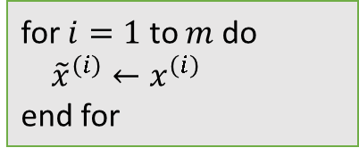
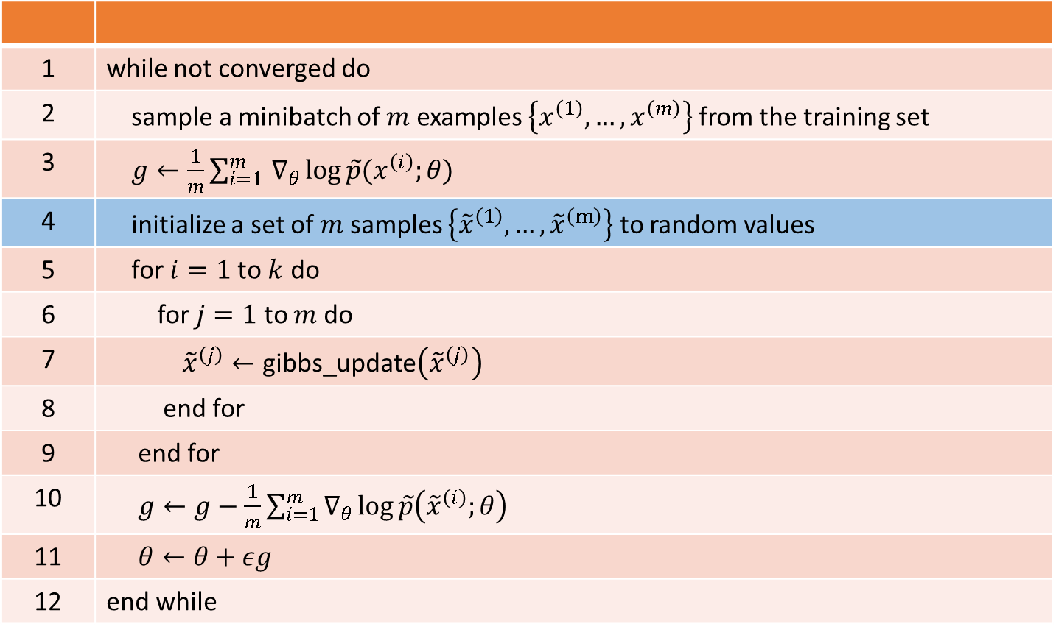
MCMC algorithm for maximizing the log-likelihood
1 | while not converged do
2 | sample a minibatch of $m$ examples $\left\{x^{\left(1\right)},…,x^{\left(m\right)}\right\}$ from the training set
3 | $g←\frac{1}{m}\sum_{i=1 }^{m}{∇_{θ}\log{\tilde{p}(x^{\left(i\right)};θ)}}$
4 | initialize a set of $m$ samples $\left\{{\tilde{x}}^{\left(1\right)},…,{\tilde{x}}^{\left(m\right)}\right\}$ to random values
5 | for $i=1$ to $k$ do
6 | for $j=1$ to $m$ do
7 | ${\tilde{x}}^{\left(j\right)}←\text{gibbs}\text{_}\text{update}\left({\tilde{x}}^{\left(j\right)}\right)$
8 | end for
9 | end for
10 | $g←g−\frac{1}{m}\sum_{i=1}^{m}{∇_{θ}\log{\tilde{p}\left({\tilde{x}}^{\left(i\right)};θ\right)}}$
11 | $θ←θ+εg$
12 | end while
SML
Replace
Move to the beginning
Contrastive divergence
for $i=1$ to $m$ do
${\tilde{x}}^{\left(i\right)}←x^{\left(i\right)}$
end for

Slide 12

Thanks!

