Slide 1
Trickle Irrigation: Congestion Relief for Communication with Network Coding: where Shannon Meets Lyapunov
Dapeng Oliver Wu
Department of Electrical and Computer Engineering
University of Florida
Joint work with Qiuyuan Huang, Jiade Li, Yun Zhu

Slide 2
Outline
Motivation and related work
Trickle architecture and overview
Description of Trickle and stability analysis
Experimental results
Conclusions

Slide 3
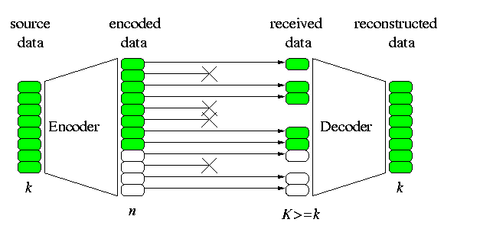
Error Control for Communication over Lossy Channels
Forward Error Correction (FEC)
  Channel coding with fixed code rate: RS code, LDPC, Turbo codes
  Rateless codes: fountain codes, LT codes, Raptor codes
Automatic Repeat reQuest (ARQ): TCP
Network coding: BATS codes, FUN-1, FUN-2 codes, RLNC

Slide 4
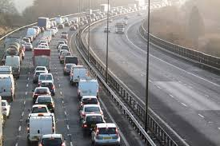
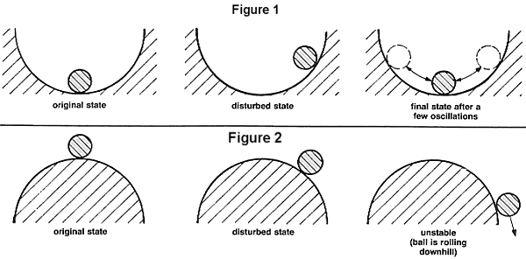
Congestion Control for Communication Networks
TCP
Network Utility Maximization (NUM)
  Use nonlinear programming techniques to solve NUM problems
  Primal/dual/primal-dual algorithms
  TCP is an online distributed algorithm that solves an NUM problem
Stochastic NUM with fading channels/interference channels/random channel contention
  Lyapunov drift (queue stability)
  Lyapunov optimization (stable queue with optimal cost)

Slide 5
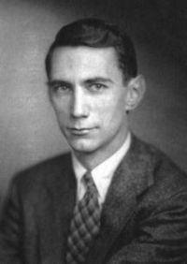
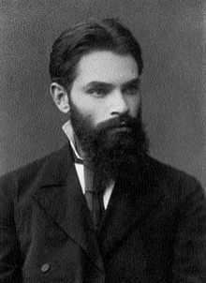
Unconsummated Union of Information Theory (Shannon) and Congestion Control Theory (Lyapunov)
Information theory studies reliable transmission and channel coding, with no consideration of congestion control
Congestion control theory: theory of controlled queues
  Control the source rate at each end host
  Control the transmission of each router
Joint study of information theory and congestion control theory, opens up a brand new research direction
Our goal is to develop congestion control techniques, well suited for network coding.

Slide 6

Back-pressure-based Congestion Control for Wireless Networks
For one flow, a downstream node creates a token to its upstream node when the downstream node finishes transmitting one packet.
For multiple flow and multiple nodes competing for channel access, only the node having a flow with maximum differential queue is allowed to transmit a packet of the flow with maximum differential queue.
Why it is called “back pressure”? Data plane vs. control plane:
  The direction of control signal flow is opposite to the direction of data flow
  The upstream node has a higher potential than the downstream node; the potential difference creates the force to push the transmission of packets from the upstream node to the downstream node.
  Hence it is called back pressure.
An upstream node is allowed to transmit to (or push) the downstream node, only when it has largest force (largest potential difference)

Slide 7
Types of Back Pressure (BP) Congestion Control
Per destination based BP congestion control
Per link based BP congestion control

Slide 8
Per-destination-based BP Congestion Control
Per-destination (PD) queueing structure:
  In PD queueing networks, every node needs to maintain a queue for each destination.
  Global approach
Pros: throughput optimal (achieving network capacity)
Cons: not scalable; the number of queues maintained in each node is equal to the number of nodes in the network

Slide 9
Per-link-based BP Congestion Control
Per-link (PL) queueing structure:
  In PL queueing networks, every node needs to maintain a queue for each of its neighboring nodes.
  Local approach
Pros: scalable; the number of queues maintained in each node is equal to the number of its neighboring nodes
Cons: not suitable for congestion control with network coding

Slide 10
Our Solution: Trickle Architecture and Control
Trickle is a lightweight, back-pressure based congestion control scheme, custom-designed for network coding

Slide 11
Overview of Trickle architecture
Each node maintains multiple TRiple-node Indexed (TRI) queues
  Each TRI queue buffers packets going through (parent, node, child) triple-nodes
  Can be easily tailored for network coding
TRI queues are dynamically created
Queue length information exchanged by piggybacking
MAC layer is based on IEEE 802.11e
Source rate control in place

Slide 12
Input Model for TRI Queue

Slide 13
Output Model for TRI Queue

Slide 14
Notations:

Slide 15
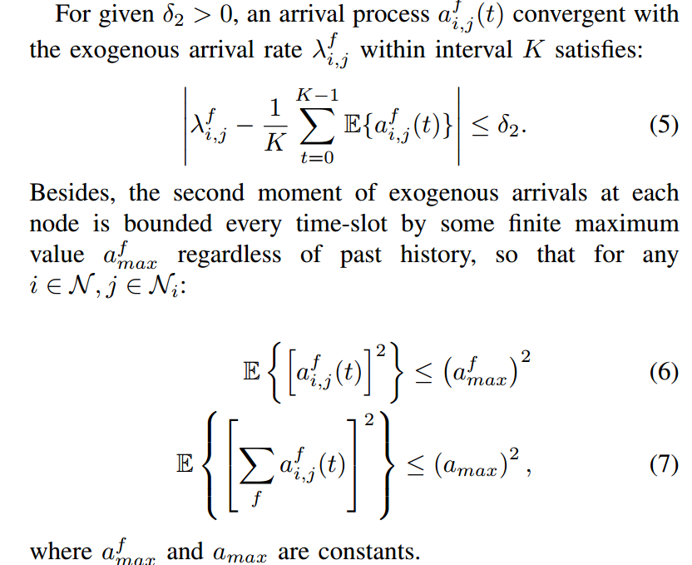
Network model
Bounded arrival rates

Slide 16
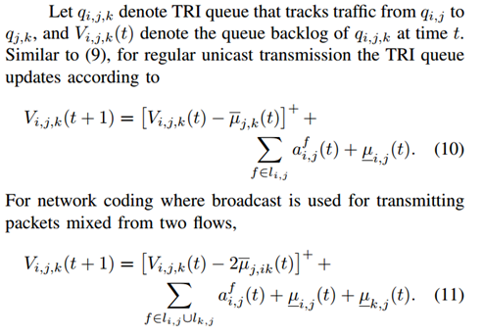
Updating Rule of TRI Queues

Slide 17
Trickle Scheduling Algorithm

Slide 18
Trickle Scheduling Algorithm is Throughput Optimal

Slide 19


Source Rate Control (AIMD)
Dynamically adjust sending rate according to queue length.
Queue length → high-threshold: multiplicative decrease
Queue length → low-threshold: additive increase

Slide 20
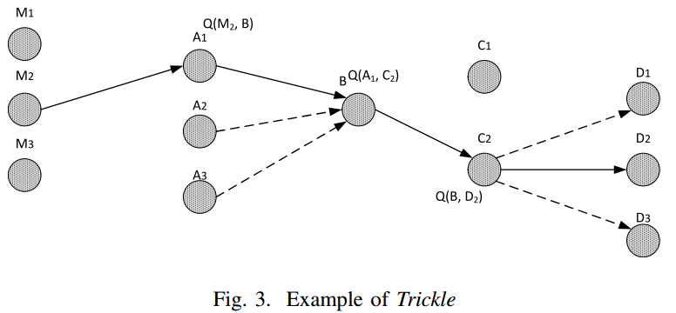
Trickle Implementation
Basic TRI queue structure – (parent, child)

Slide 21
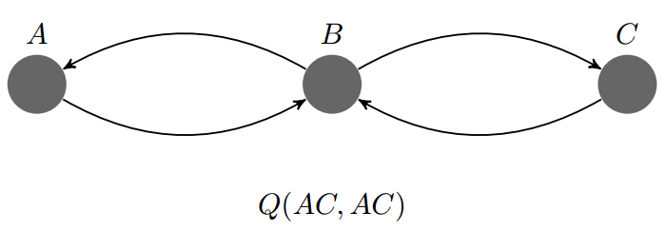
Trickle Implementation
For network-coded packets:
  Set aside an additional virtual queue -- essentially a counter, which help track the flow information for mixed packets. When one mixed packet put in a TRI queue, we count it twice.

Slide 22
Queue Info. Exchange
In order to save overhead of retrieving this information, we develop an overhearing mechanism where each node can eavesdrop its neighbors for the needed queueing information.
An extra header structure after Ethernet header in the data packet.

Slide 23
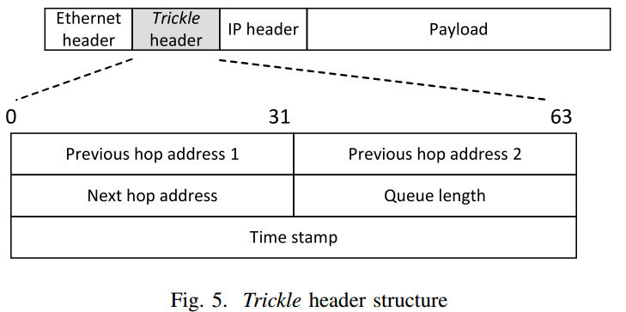
Trickle Header Structure

Slide 24
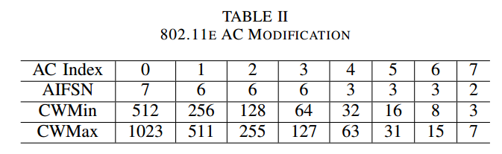
802.11e Access Category
Prioritized MAC according to ACs

Slide 25
Simulation Setup (1)
Implement FUN-1, FUN-2 [1], a BATS code [2], a fountain code (specifically, the RQ code [3]), random linear network code (RLNC) [4], and COPE [5] on QualNet. Then, we also implement the proposed Trickle algorithm on MAC layer for each of above coding schemes.
[1] Q. Huang, K. Sun, X. Li, and D. Wu, “Just fun: A joint fountain coding and network coding approach to loss-tolerant information spreading,” in Proceedings of ACM MobiHoc, 2014.
[2] S. Yang and R. W. Yeung, “Batched sparse codes,” submitted to IEEE Transactions on Information Theory.
[3] A. Shokrollahi and M. Luby, “Raptor codes,” Foundations and Trends in Communications and Information Theory, vol. 6, no. 3–4, pp. 213–322, 2011. [Online]. Available: http://dx.doi.org/10.1561/0100000060
[4] M. Wang and B. Li, “Lava: A reality check of network coding in peerto-peer live streaming,” in IEEE INFOCOM 2007, pp. 1082–1090.
[5] S. Katti, H. Rahul, W. Hu, D. Katabi, M. Medard, and J. Crowcroft,´ “Xors in the air: practical wireless network coding,” in ACM SIGCOMM Computer Communication Review, vol. 36, no. 4, 2006, pp. 243–254.

Slide 26
Simulation Setup (2)
All the experiments have the following setting: the packet size 1024 bytes; the batch size 16 packets; Trickle queue size is 150 kilobytes, which replaces the layer 3 output queue; source rate control is enabled. The time-up threshold is set to 30 milliseconds.

Slide 27
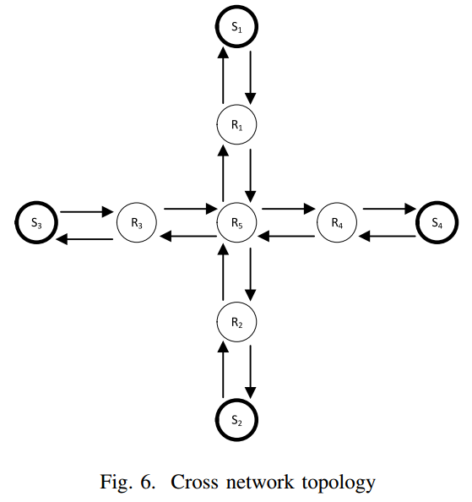
Network Topologies used in the Simulations
Cross topology in both lossless and lossy conditions
Chain topology with various number of hops under fixed packet loss rate (10%) per hop.
Chain topology

Slide 28
Effects of Busyness Ratio on Throughput (1)
Busyness ratio: the fraction of a constant time unit (e.g., one second) in which the channel is in non-idle state.
Busyness ratio is considered to be a criterion for measuring channel congestion conditions
Conducted in cross topology.

Slide 29
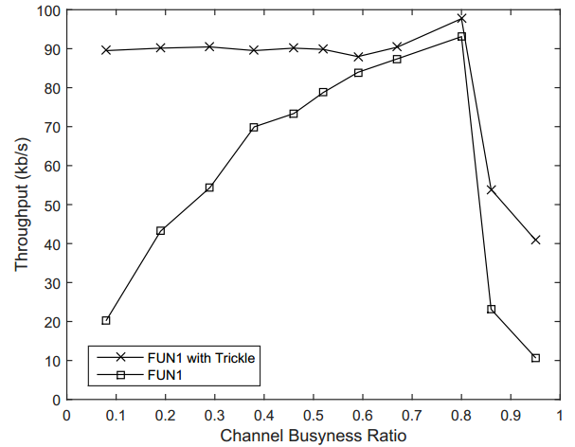
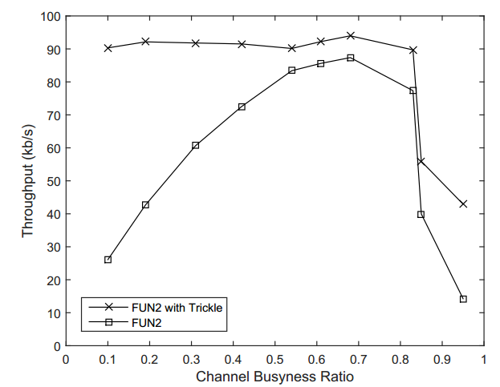
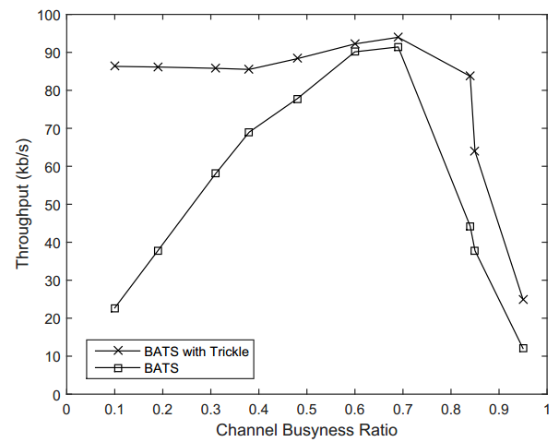
Effects of Busyness Ratio on Throughput (2)

Slide 30
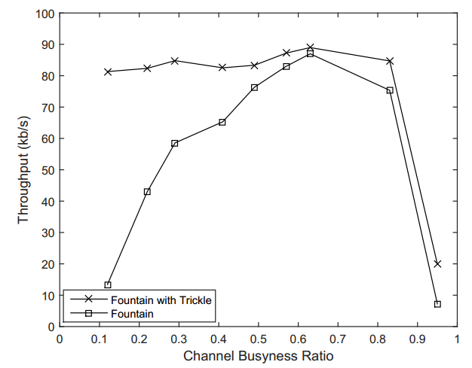
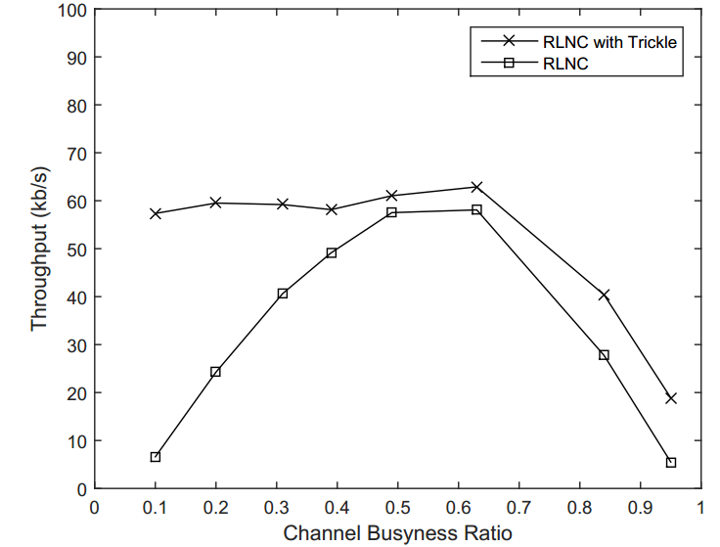
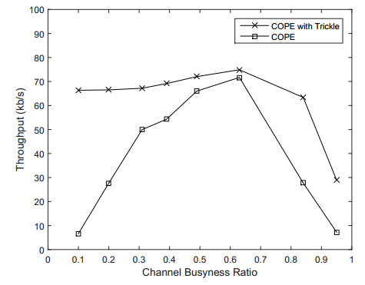
Effects of Busyness Ratio on Throughput (3)

Slide 31
Effects of Packet Loss Ratio on Throughput Performance
Conducted under lossy conditions
Still use cross topology

Slide 32
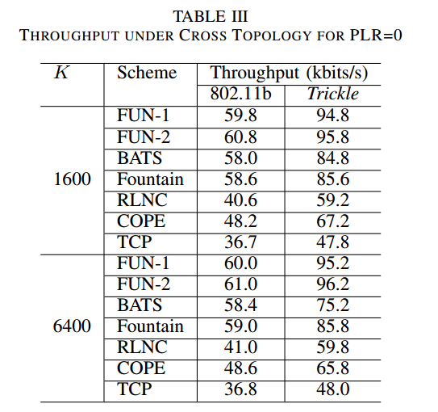
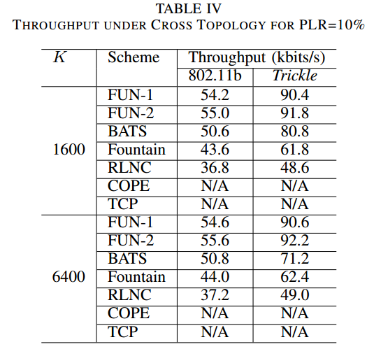
Effects of Packet Loss Ratio on Throughput Performance

Slide 33
Effects of Number of Hops on Throughput Performance
Chain topology
3 and 5 hops
3 hops:
5 hops:

Slide 34
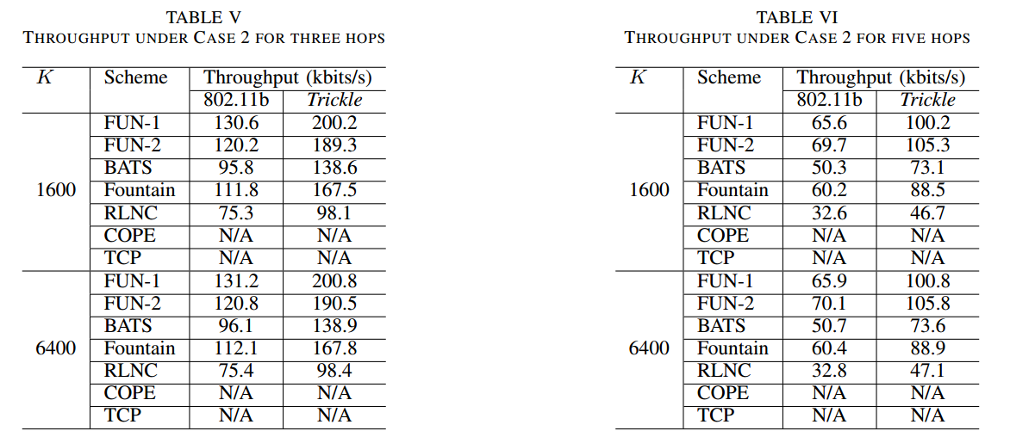
Effects of Number of Hops on Throughput Performance

Slide 35
Conclusions
This work is concerned with designing an MAC protocol for network coding, under lossy channel conditions.
Although network coding schemes such as BATS and FUN codes are effective mechanisms for communication over lossy channels, they only deal with error control but do not have congestion control capability.
To address their limitations, we proposed Trickle -- a novel back-pressure-based MAC scheduling algorithm; it maintains TRI queues at each node, which significantly reduces the number of queues and is scalable for large networks.
Our experimental results have shown that Trickle achieves much higher throughput than existing schemes.

Slide 36
Thank you!

