Slide 1
Math3360: Mathematical Imaging
Lecture 16:
Example of Image sharpening and linear image filtering
Prof. Ronald Lok Ming Lui
Department of Mathematics,
The Chinese University of Hong Kong

Slide 2

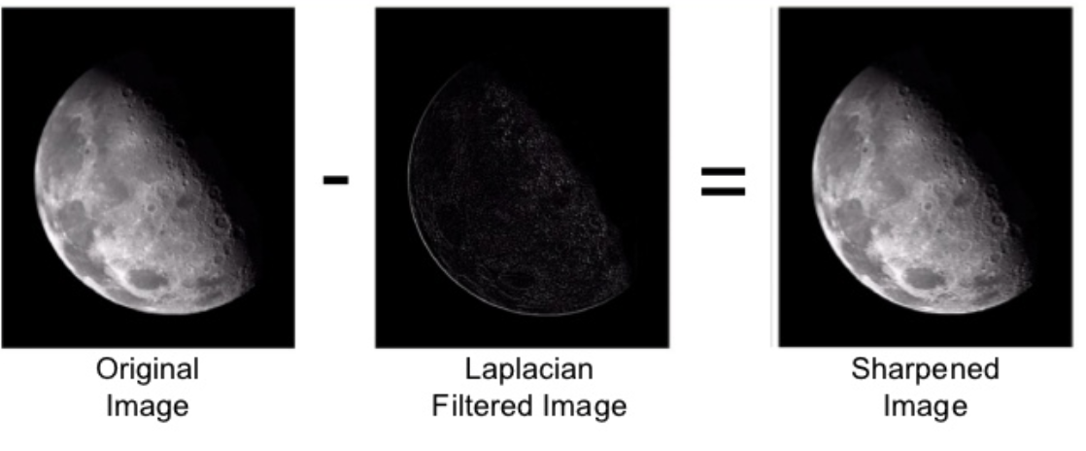
Laplacian mask

Slide 3
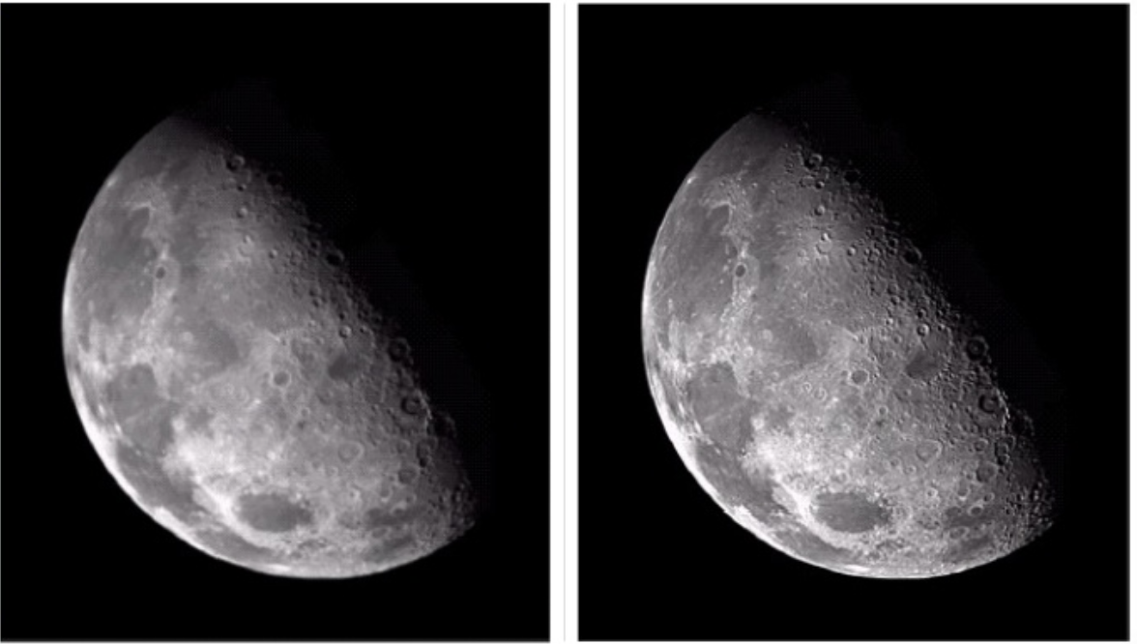
Laplacian mask
Original image
Laplacian mask

Slide 4
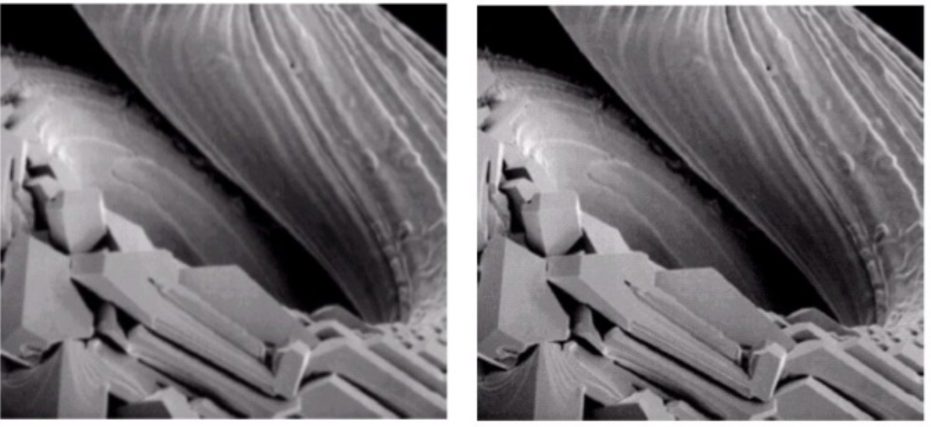
Laplacian mask
Original image
Laplacian mask

Slide 5
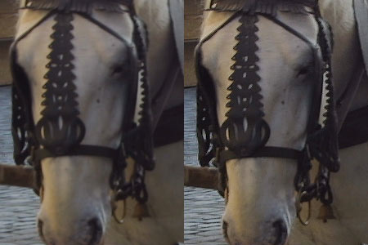
Laplacian mask
Original image
Laplacian mask

Slide 6
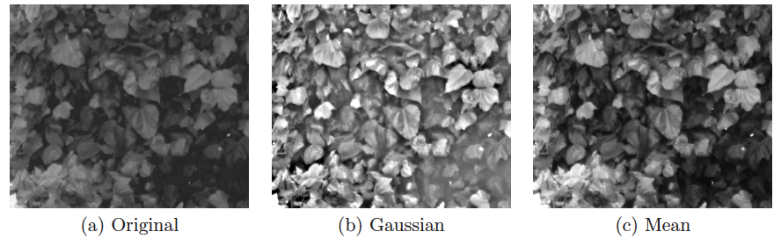
Unsharp masking

Slide 7
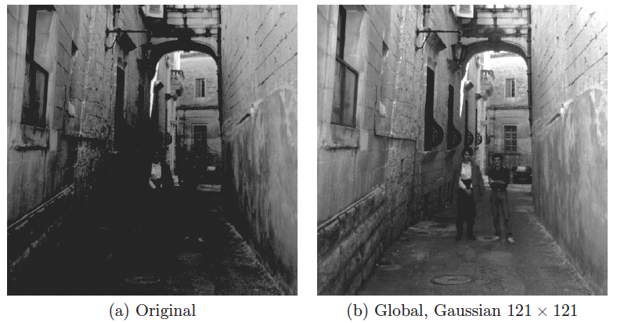
Unsharp masking

Slide 8
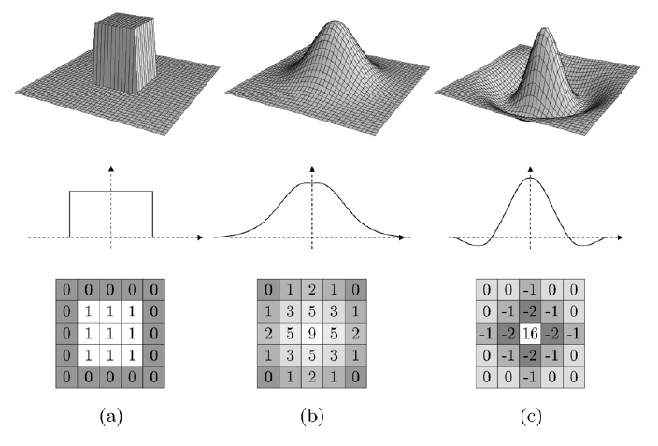
Type of filter

Slide 9
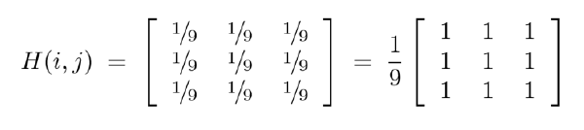
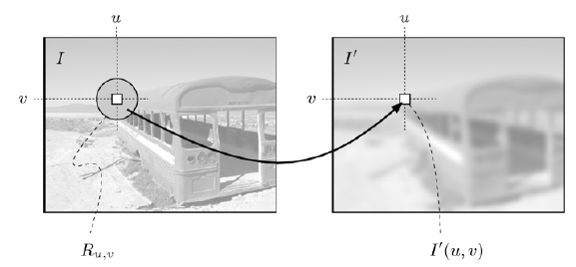
Mean filter

Slide 10
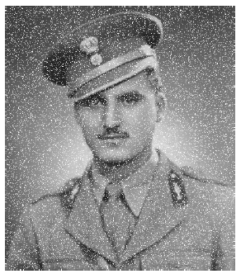
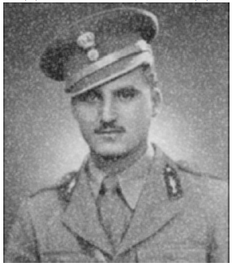
Mean filter
Impulse noise
After mean filter

Slide 11
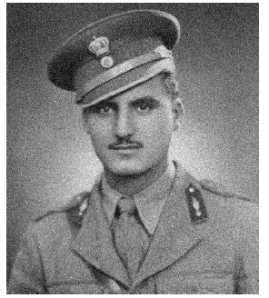
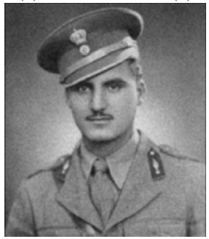
Mean filter
Gaussian noise
After mean filter

Slide 12
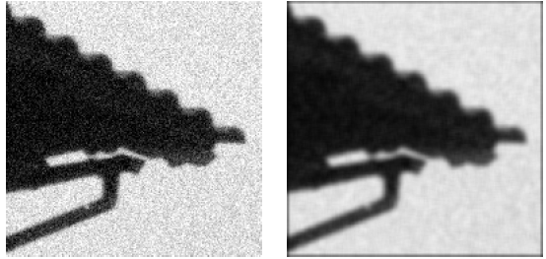
Mean filter
Real image
After mean filter

Slide 13
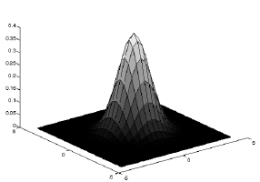
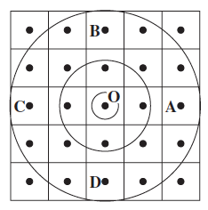
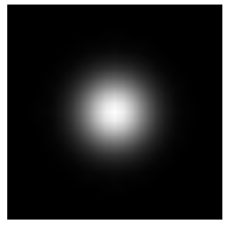
Gaussian filter
Define a function using Gaussian function
Definition of H

Slide 14
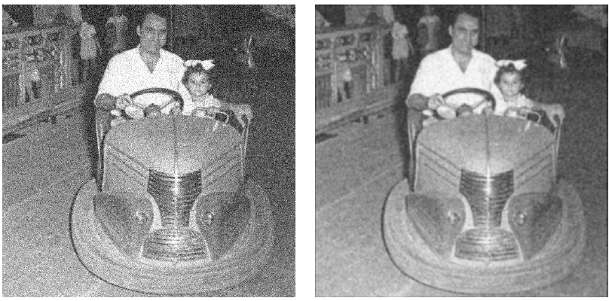
Gaussian filter
Real image
After Gaussian filter

Slide 15
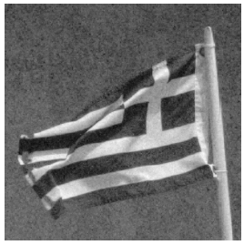
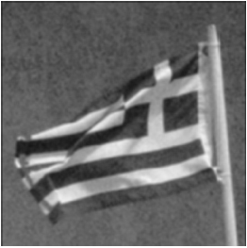
Gaussian filter
Real image
After mean filter

Slide 16
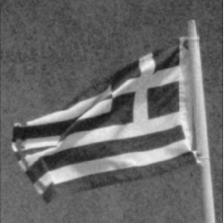
Gaussian filter
Real image
After Gaussian filter

Slide 17
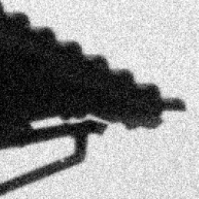
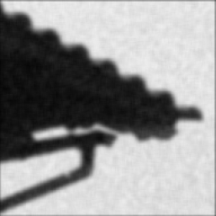
Gaussian filter
Real image
After mean filter

Slide 18

Gaussian filter
Real image
After Gaussian filter

