Slide 1
MMAT 5390: Mathematical Imaging
Prof. Ronald Lok Ming Lui Department of Mathematics,
The Chinese University of Hong Kong
Lecture 9:
Image deblurring in the frequency domain:
Direct inverse filtering, Butterworth inverse filtering,
Wiener filtering

Slide 2
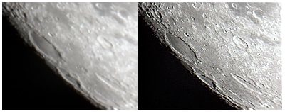
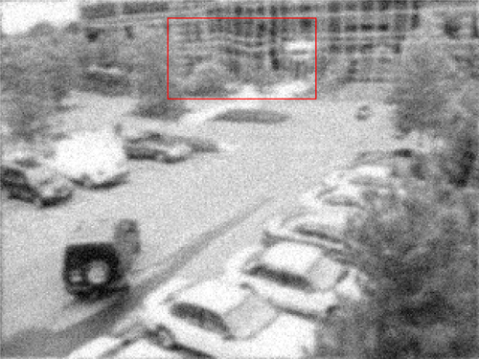
Example of turbulence blur
Blurry image
Deblurred image

Slide 3
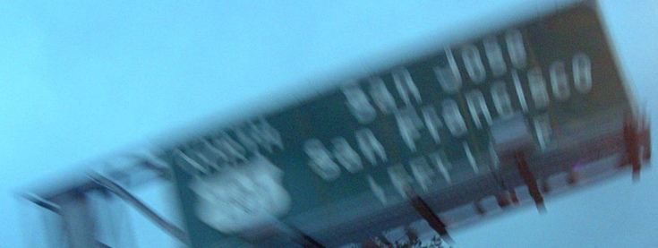
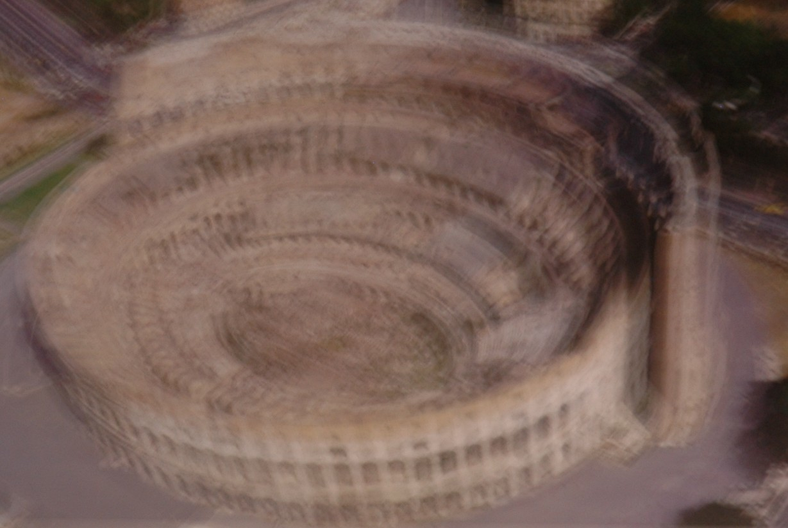
Example of motion blur

Slide 4
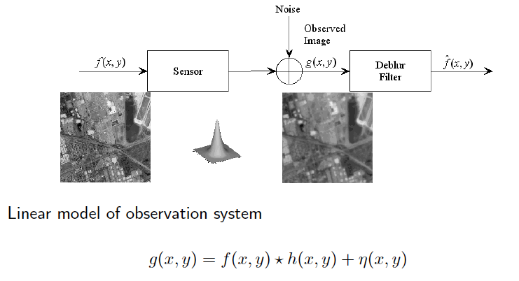
Image deblur model

Slide 5
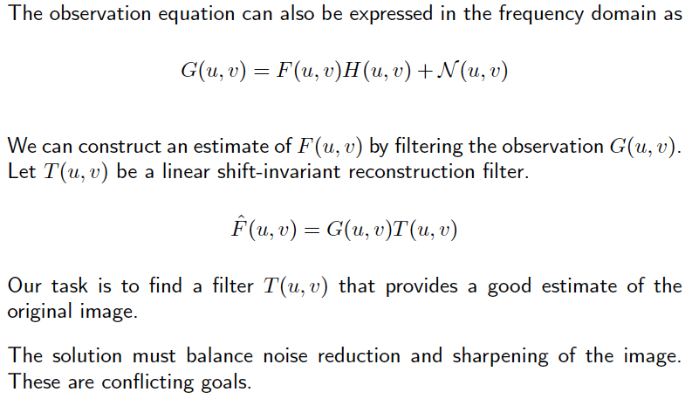
Image filtering in the frequency domain

Slide 6
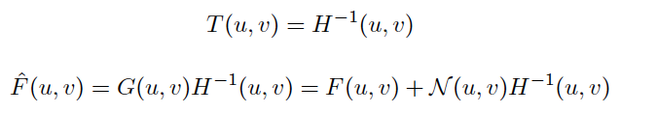
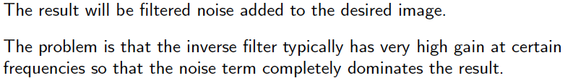
Direct inverse filter

Slide 7
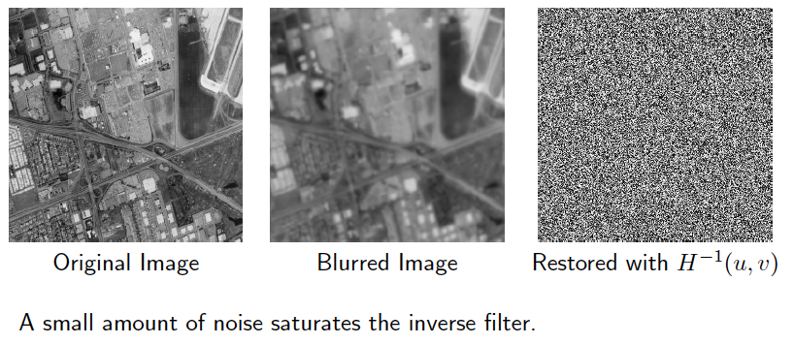
Direct inverse filter

Slide 8
Direct inverse filter

Slide 9
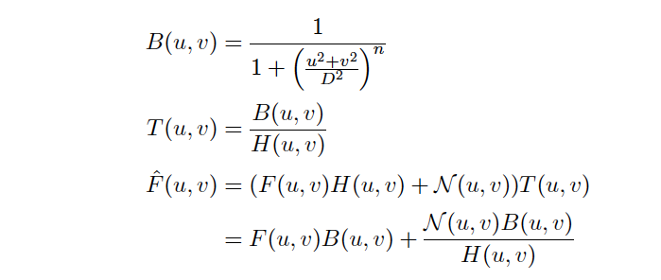
Modified inverse filter

Slide 10
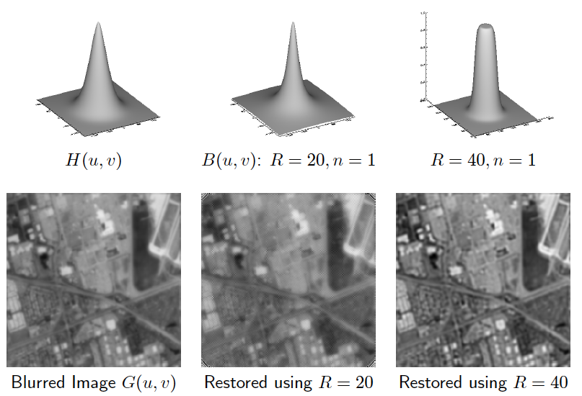
Modified inverse filter

Slide 11
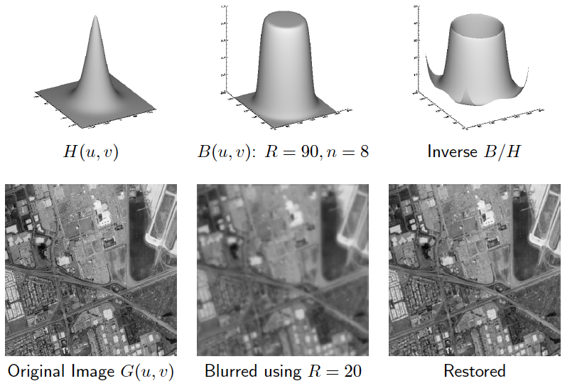
Modified inverse filter

Slide 12
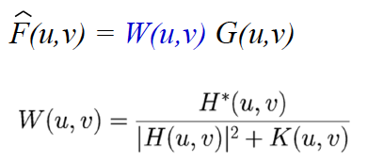
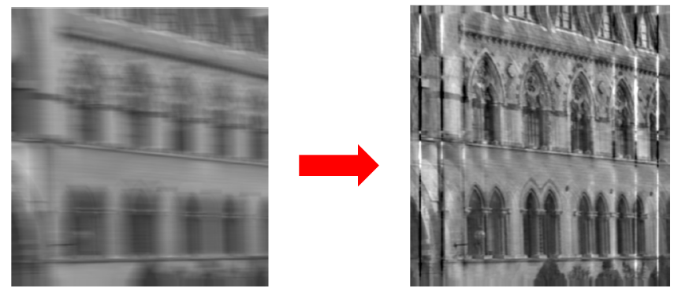
Wiener filter

Slide 13
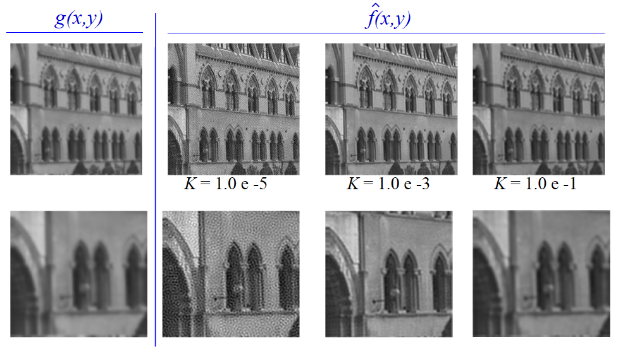
Wiener filter

Slide 14
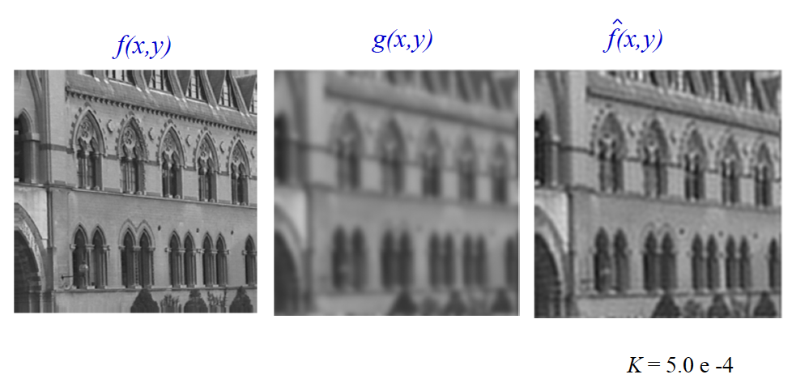
Wiener filter

Slide 15
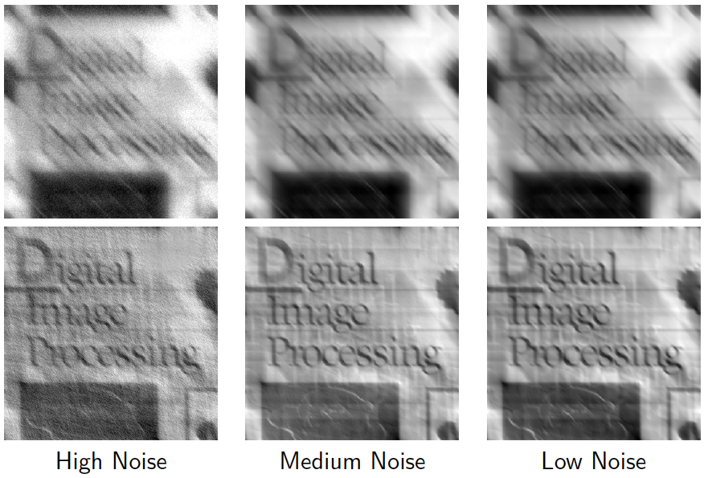
Wiener filter
Deblurred

Slide 16
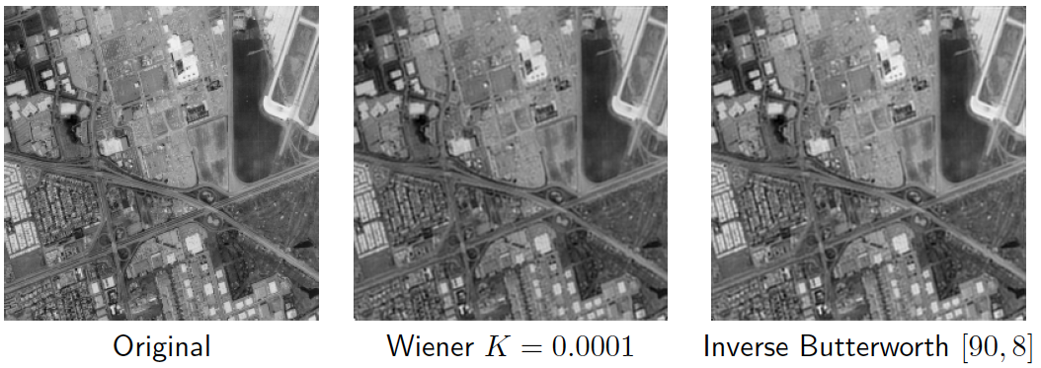
Wiener filter
Comparison

Slide 17
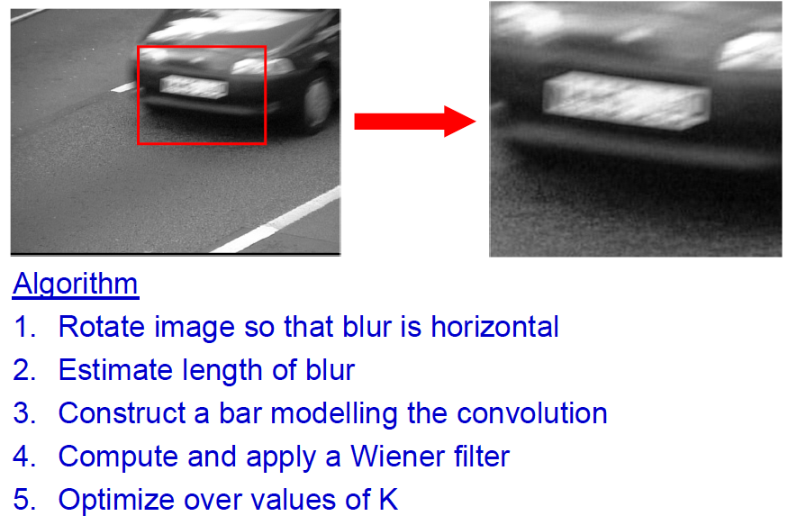
Wiener filter
Application

Slide 18
Wiener filter
Application
Zoom-in

Slide 19
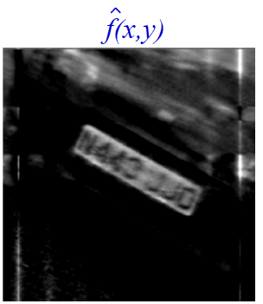
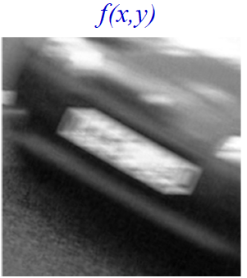
Wiener filter
Application
Blurry image
Deblurred image

