Slide 1
MMAT 5390: Mathematical Imaging
Lecture 5:
Image decomposition by DFT
Prof. Ronald Lok Ming Lui
Department of Mathematics,
The Chinese University of Hong Kong

Slide 2
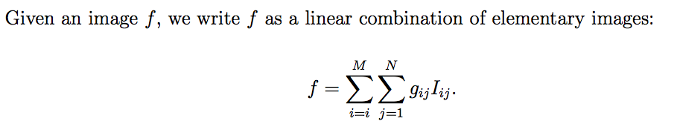
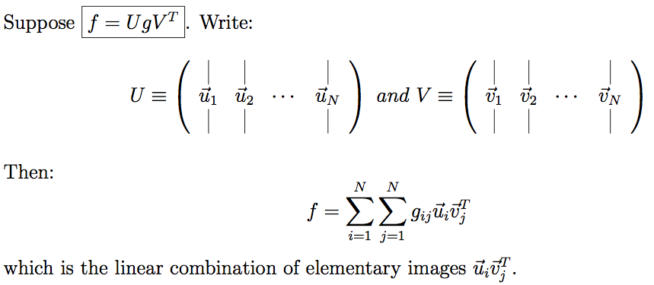
A quick revision: Image decomposition
What is image decomposition:
coefficients
Elementary images
(By truncating the terms with small coefficients, we can compress the image while preserving the important details)
Main technique for image decomposition:

Slide 3
A quick revision: Image decomposition
What is image decomposition:
coefficients
Elementary images
(By truncating the terms with small coefficients, we can compress the image while preserving the important details)
Main technique for image decomposition:

Slide 4
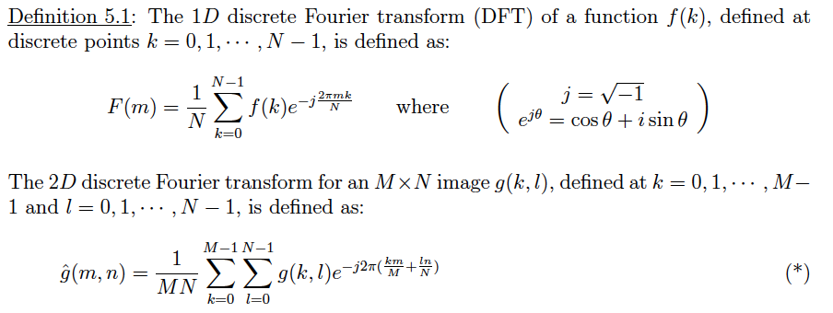
Recap: Definition of DFT
1D and 2D Discrete Fourier Transform:
  For details, please refer to Lecture Note Chapter 2

Slide 5
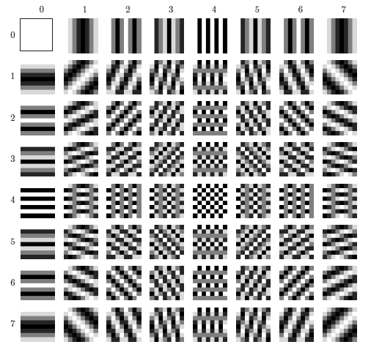
Elementary images of DFT decomposition

Slide 6
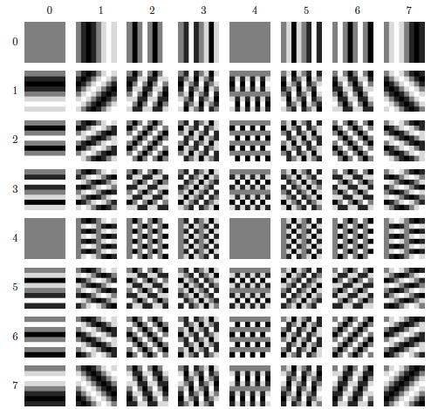
Elementary images of DFT decomposition

Slide 7
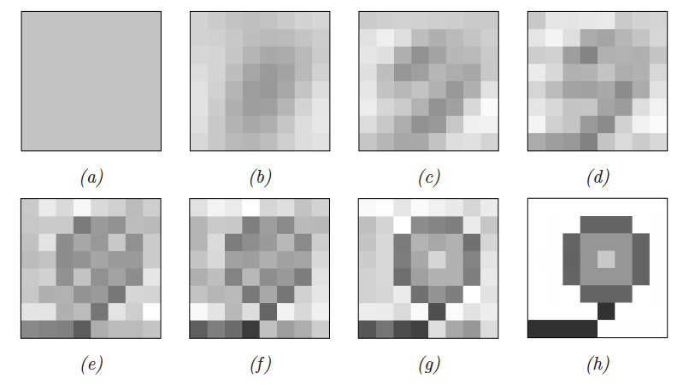
Reconstruction w/ DFT decomposition
= using 1x1 elementary images (first 1 row and first 1 column elementary images;
= using 2x2 elementary images (first 2 rows and first 2 column elementary images…and so on…

Slide 8
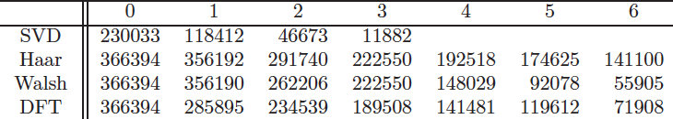
Comparison of errors
The flower example:

Slide 9
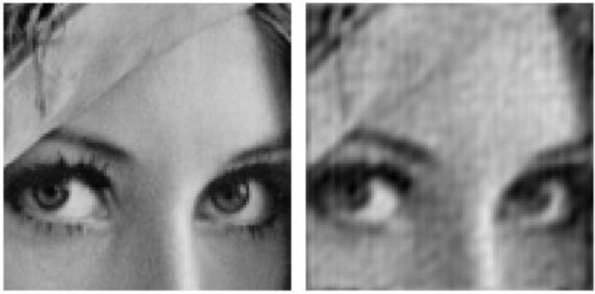
Real example
Original:
Compressed: 13.6:1
Truncating the small coefficients

Slide 10
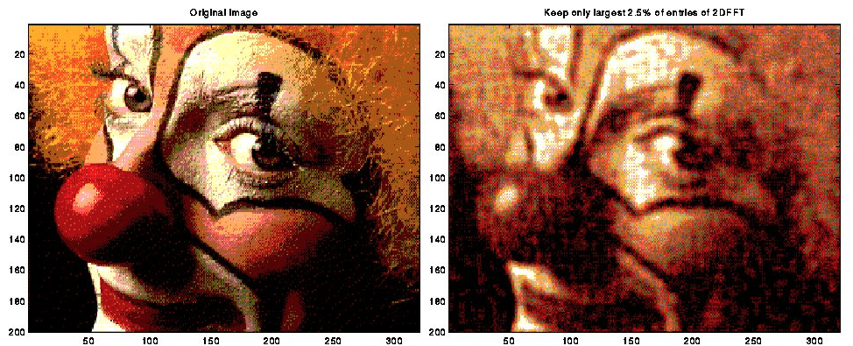
Real example
Original:
Compressed:

Slide 11
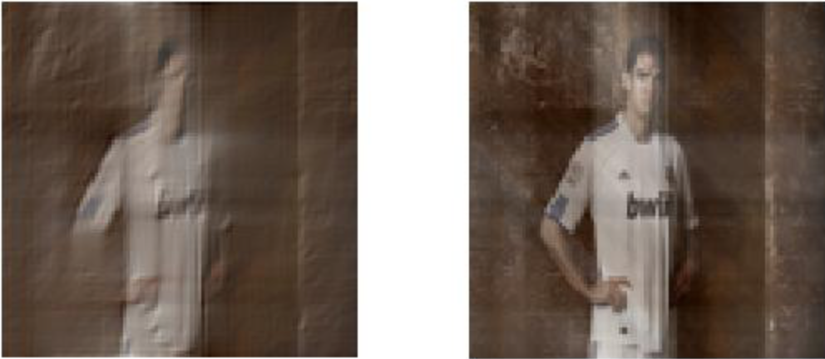
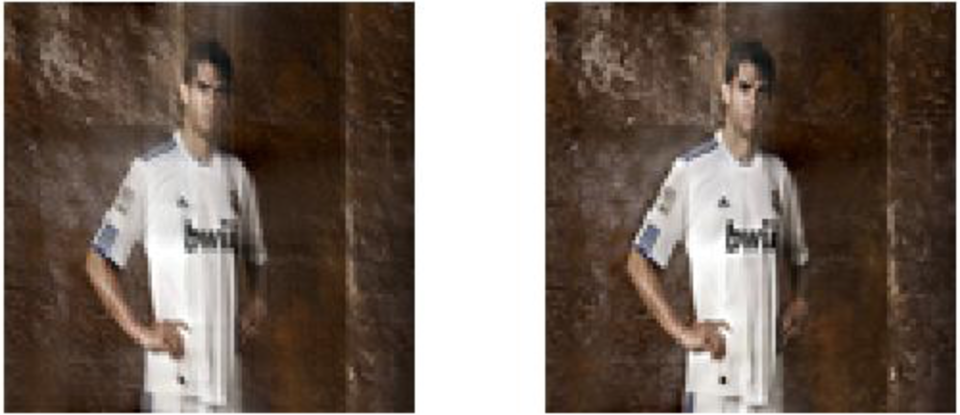
Real example
Truncate smallest X% Fourier coefficients
Truncate 70% of Fourier coefficients
Truncate 50% of Fourier coefficients
Truncate 30% of Fourier coefficients
Truncate 10% of Fourier coefficients

Slide 12
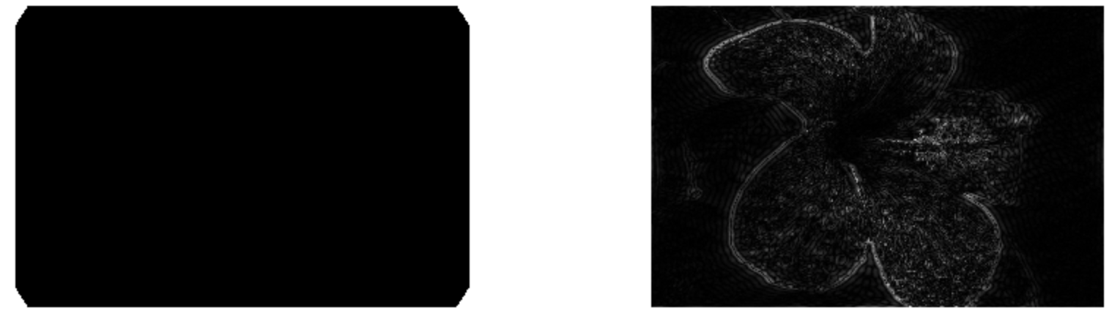
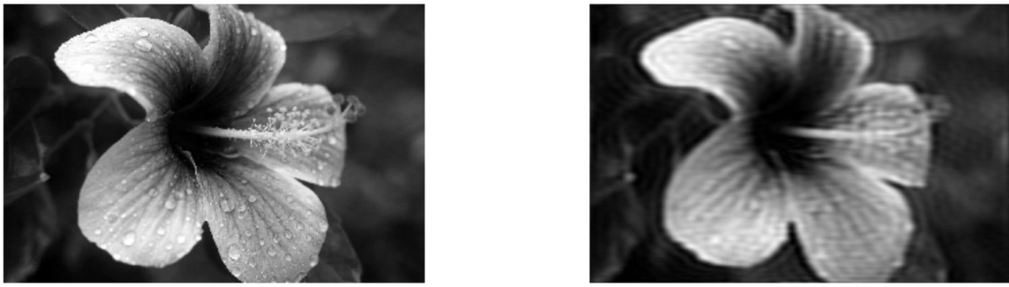
Real example
Truncate smallest X% Fourier coefficients
Difference
Image:
Original minus Compressed image
Original
Truncate ~63% of Fourier coefficients

