Slide 1
MMAT 5390: Mathematical Imaging
Lecture 13:
Total variation Denoising Model
Prof. Ronald Lok Ming Lui Department of Mathematics,
The Chinese University of Hong Kong

Slide 2
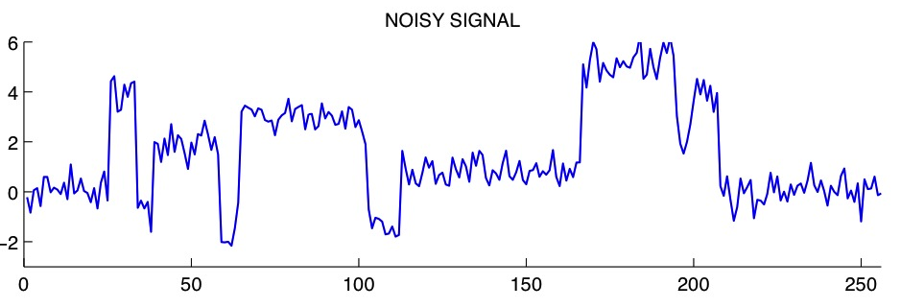
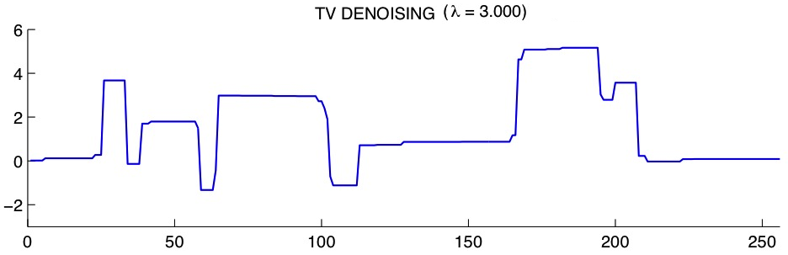
TV denoising: 1D illustration
TV denoising favor piecewise constant functions

Slide 3
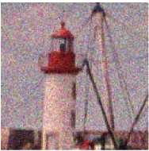
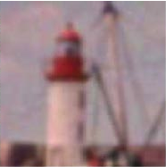
Gaussian filter
Noisy image
Gaussian filter/Isotropic diffusion

Slide 4
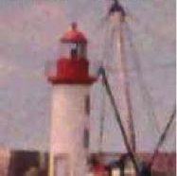
TV/ROF denoising
Noisy image
ROF

Slide 5
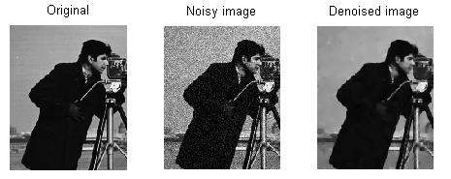
TV/ROF denoising

Slide 6
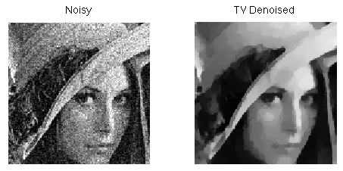
TV/ROF denoising

Slide 7
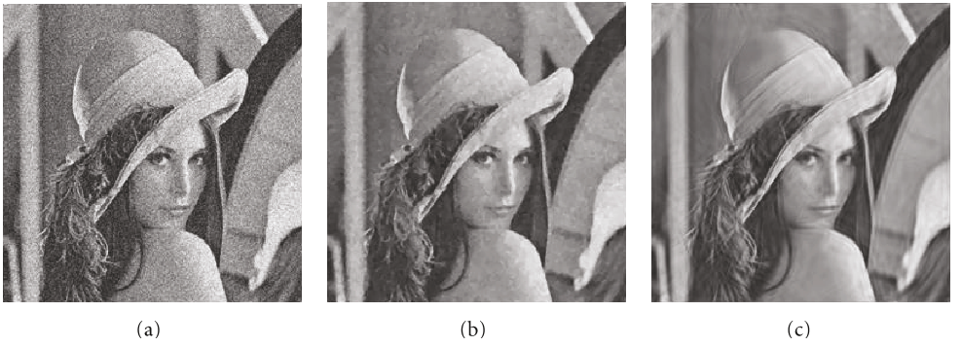
TV/ROF denoising
Intermediate
final

Slide 8
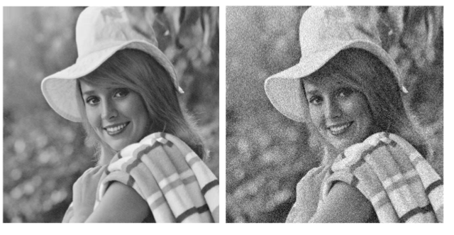
TV/ROF denoising
Intermediate
final

Slide 9
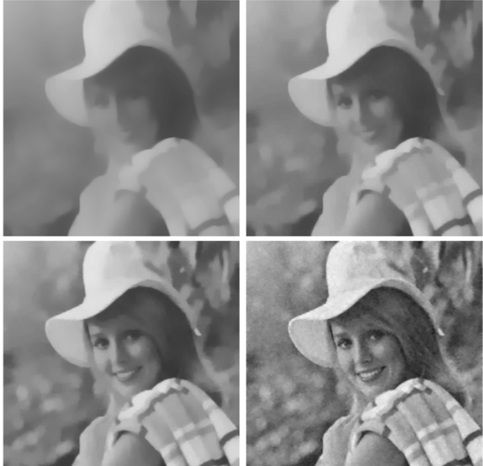
TV/ROF denoising

Slide 10
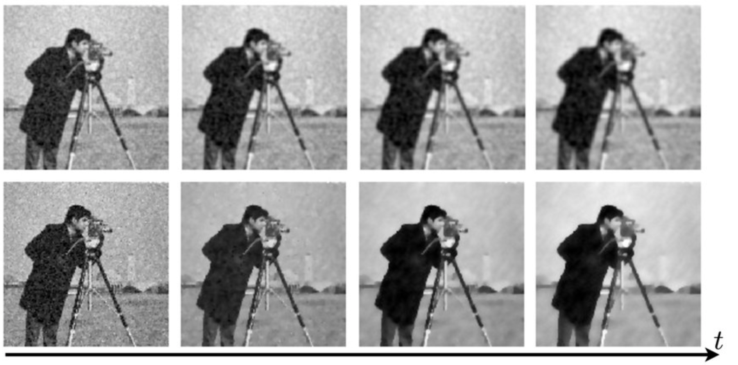
TV/ROF denoising
Top: Image denoising using L2 norm of gradient
Bottom: Image denoising using TV/ROF model

