Slide 1
MMAT 5390: Mathematical Imaging
Lecture 1:
Introduction to mathematical image processing
Prof. Ronald Lok Ming Lui Department of Mathematics,
The Chinese University of Hong Kong

Slide 2
Some Useful Information
Lecturer: Prof. Ronald Lui
Email: lmlui@math.cuhk.edu.hk
Tel: 3943-7975
Office: Lady Shaw Building 207
Lecture time: Thurs 3:30PM – 6:00PM (SC L1)
Textbook: Based on ppt & lecture notes
Course website: https://www.math.cuhk.edu.hk/course/2425/mmat5390
Other references:
Image processing: the fundamentals by Maria Petrou and Costas Petrou [Free access of online version on CUHK library]
Fundamentals of Digital Image Processing: A Practical Approach with Examples in Matlab by Chris Solomon and Toby Breckon [Free access of online version on CUHK library]
Digital Image Processing (3rd ed.) by Rafael C. Gonzalez and Richard E. Woods [Available in CUHK bookstore]

Slide 3
Some Useful Information
Assessment scheme:
Homework assignment 15%
Midterm (March 13th in class) 35%
Final (TBA). 50%
Relax + enjoy + develop interest in imaging!

Slide 4
What is our goal in MMAT 5390?
Mathematical + Image Processing
IMAGE PROCESSING TASKS:
Denoising, Segmentation, Registration, Compression,…
MATHEMATICS:
Linear algebra + Calculus
(matrix calculation, differentiation)

Slide 5
What is our goal in MMAT5390?
Topic to be covered:
Introduction to digital images and imaging problems
Image compression by image decomposition
Image denoising
Image deblurring
Image segmentation

Slide 6
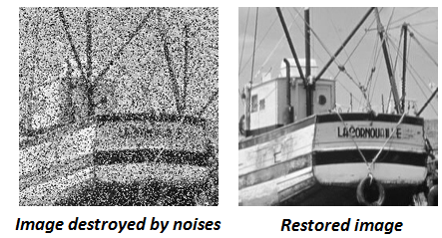
Some tastes about IMAGING
Image denoising:
Image can be corrupted by “noises” during transmission or error during capturing the image intensity
Reconstruct a “clean” (usually visually) image from the noisy one

Slide 7
Some tastes about IMAGING
Image denoising:
Image can be corrupted by “noises” during transmission or error during capturing the image intensity
Reconstruct a “clean” (usually visually) image from the noisy one

Slide 8

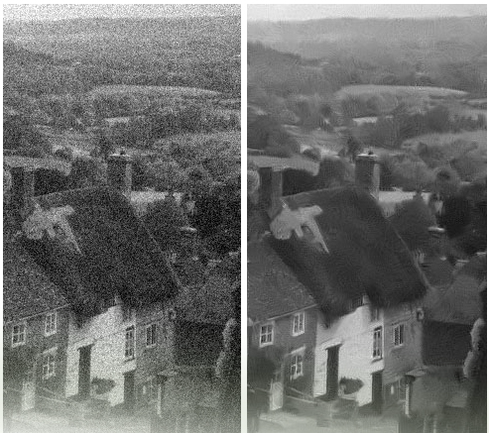
Some tastes about IMAGING
Image denoising:
Noise removed by matrix multiplication
Camera sensor problem

Slide 9
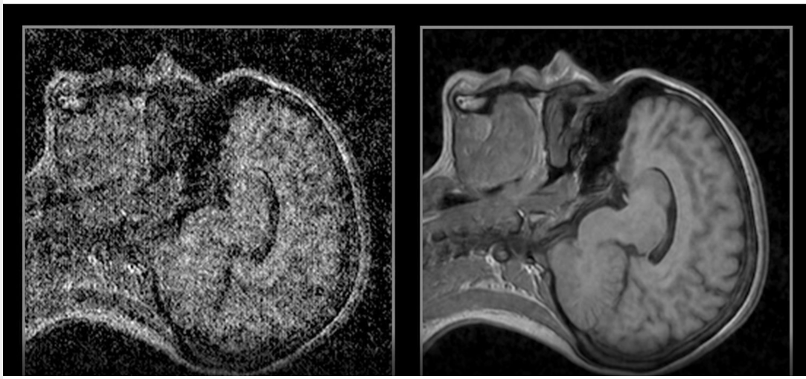
Some tastes about IMAGING
Image denoising:
Noise removed using matrix multiplication
Medical applications

Slide 10
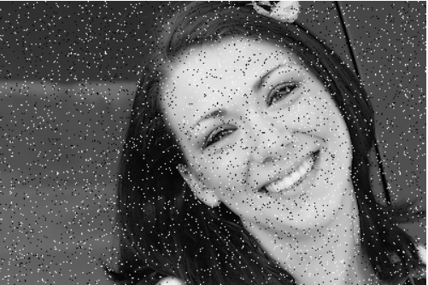
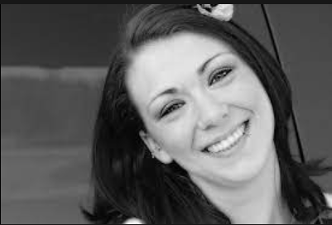
Some tastes about IMAGING
Image denoising:
Noise removed using taking median
Photo corruption

Slide 11
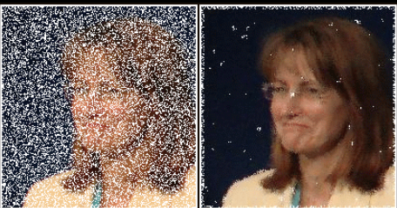
Some tastes about IMAGING
Image denoising:
Noise removed by taking median
Photo corruption

Slide 12
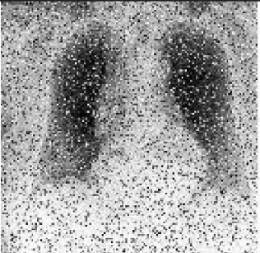
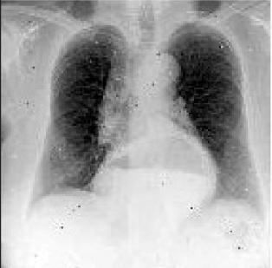
Some tastes about IMAGING
Image denoising:
Poor quality Chest X-Ray (denoised by taking median)

Slide 13


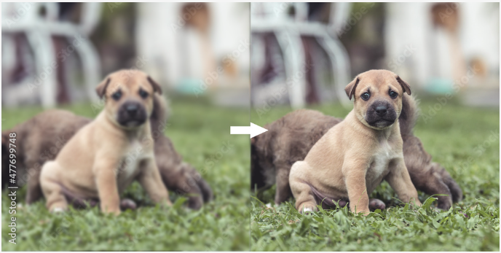
Some tastes about IMAGING
Image deblurring:
Blurry photo due to motion

Slide 14
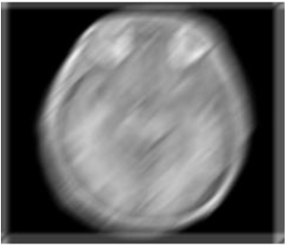
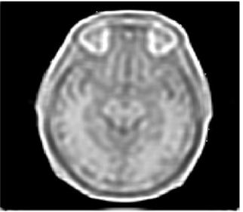
Some tastes about IMAGING
Image deblurring:
Medical image (blurry due to motion)

Slide 15
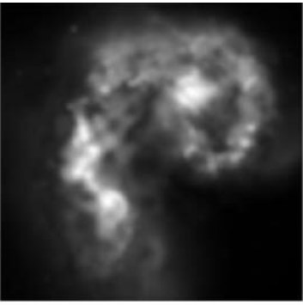
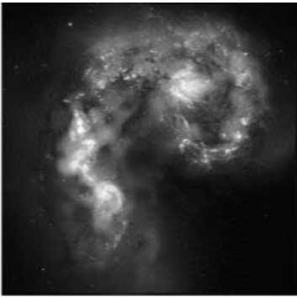
Some tastes about IMAGING
Image deblurring:
Astronomy image (blurry due to telescope limitation & turbulence)

Slide 16
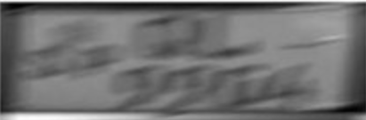
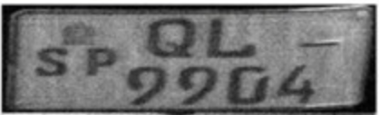
Some tastes about IMAGING
Image deblurring:
Recognition of license plate (Blurry due to vehicle motion)

Slide 17
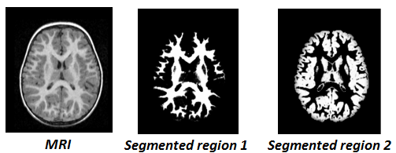
Some tastes about IMAGING
Image segmentation:
Image may contain too much information.
Need: extract useful information from an image.
Image segmentation aims to automatically extract important part or regions of an image.

Slide 18
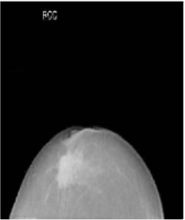
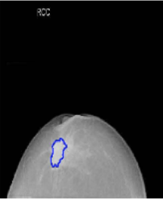
Some tastes about IMAGING
Image segmentation:
Locating breast lesion/tumor

Slide 19
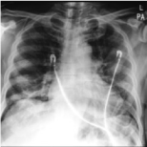

Some tastes about IMAGING
Image segmentation:
Chest X-Ray (extracting the shape of lung)
Important for Covid-19 monitoring

Slide 20
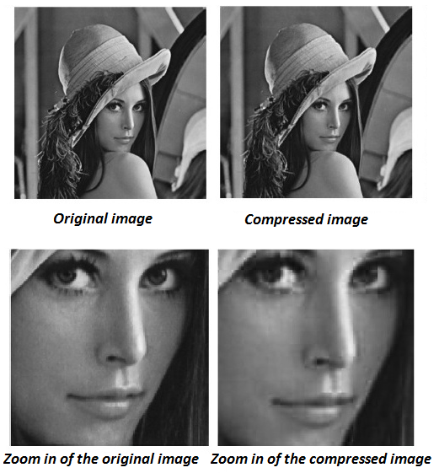
Some tastes about IMAGING
Image compression:
Image compression aims to use less storage to represent an image.
Do you know familiar JPEG compression is actually based on mathematical theories? You will learn how it works in MMAT5390.

Slide 21
Some tastes about IMAGING
Image compression:
Image compression aims to use less storage to represent an image.
Do you know familiar JPEG compression is actually based on mathematical theories? You will learn how it works in MMAT5390.
1% of the original storage

Slide 22
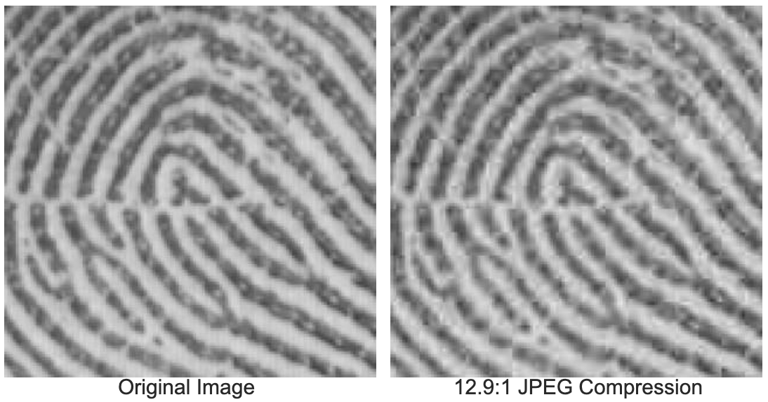
Some tastes about IMAGING
Image compression:
7% of the original storage
We will learn what FBI uses for fingerprint compression.

Slide 23
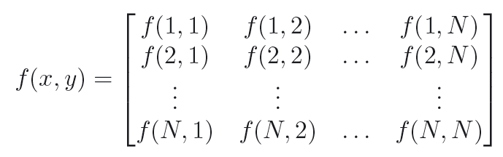


What is a digital image?
Mathematical definition:
A 2D (grayscale) digital image is a 2D function defined on a 2D domain (usually rectangular domain):
is called the brightness/intensity/grey level;
(x,y) is the spatial coordinates of the image.
Thus, a 2D digital image looks like this:
Each element in the matrix is called pixel (picture element);
Usually, and
IMAGE PROCESSING IS RELATED TO LINEAR ALGEBRA!!

Slide 24


What is a digital image?
Mathematical definition of color image:
A 2D (color) digital image is a 2D function defined on a 2D domain (usually rectangular domain):
are the intensity/brightness/grey level corresponding to R, G and B respectively ;
Combination of R, G, B forms the full spectrum of color!
WE WILL FOCUS ON: Grayscale image!

Slide 25
How do we read a digital image in Matlab?
Keep in mind: imread & imwrite!

Slide 26
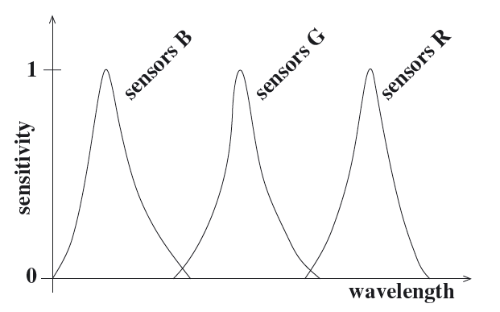
How is a digital image formed?
Sensor:
Each sensor captured the amount of photon of certain wavelength;
Typical color images consist of three color bands (RGB).
Reflected light of an object/phontons are captured by three different sets of sensors, each set made to have a different sensitivity function.
Figure 1: The spectrum of the light which reaches a sensor is multiplied with the sensitivity function of the sensor and recorded by the sensor. This recorded value is the brightness of the image in the location of the sensor and in the band of the sensor. This figure shows the sensitivity curves of three different sensor types.

Slide 27
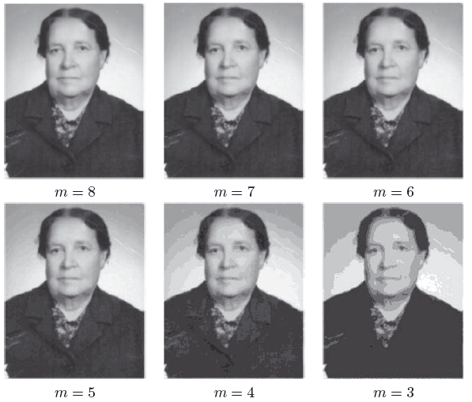
What is “Image resolution”?
Effect on different image resolution:
False contouring: reducing M

Slide 28
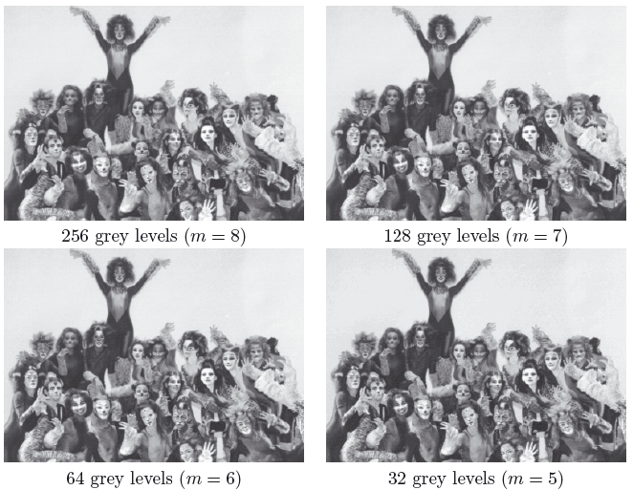
What is “Image resolution”?
Little Effect by m on a complicated image:

Slide 29
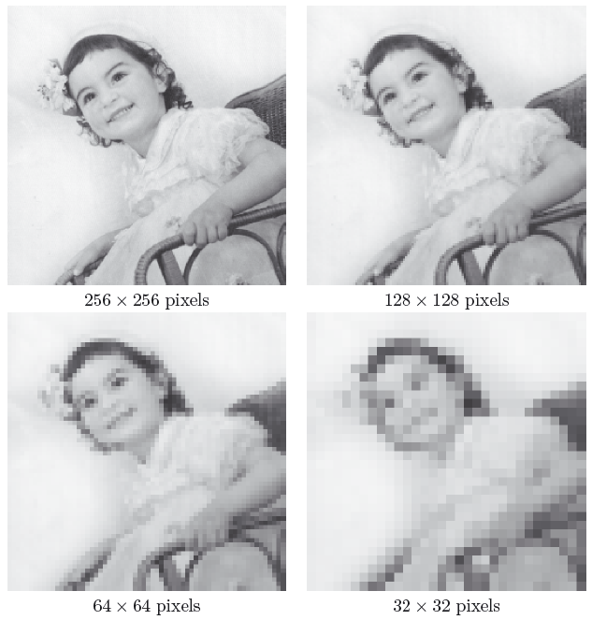
What is “Image resolution”?
Effect on different image resolution:
Checkerboard effect: reducing N

Slide 30
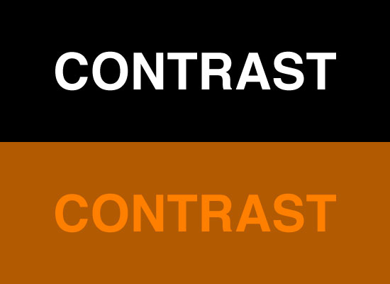
What is “Image contrast”?
Good image contrast means:
grey values present in the image range from black to white;
making use of the full range of intensity/brightness to which the human vision system is sensitive.

