Slide 1
MMAT 5390: Mathematical Imaging
Lecture 10:
Image deblurring in the frequency domain:
Constrained Least Square Filtering
Prof. Ronald Lok Ming Lui
Department of Mathematics,
The Chinese University of Hong Kong

Slide 2
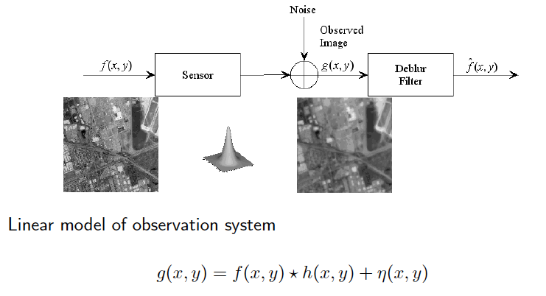
Image deblur model

Slide 3
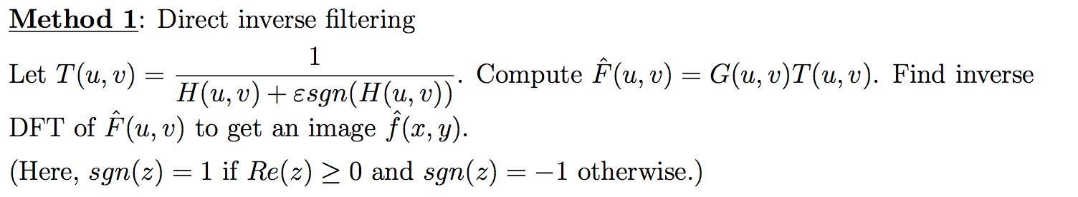
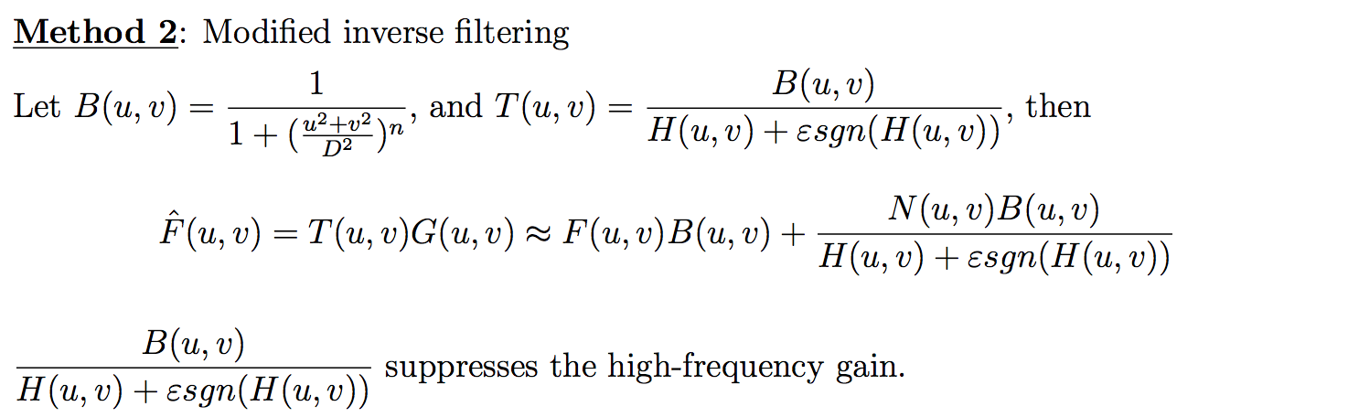
Different image deblurring algorithms

Slide 4
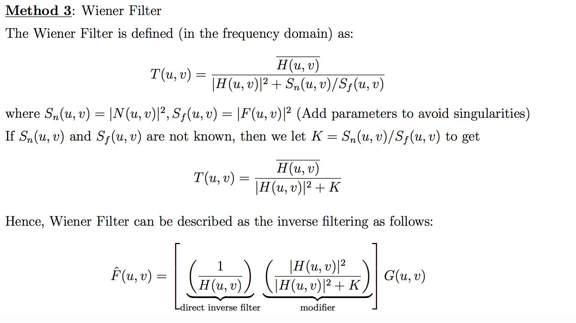
Different image deblurring algorithms

Slide 5
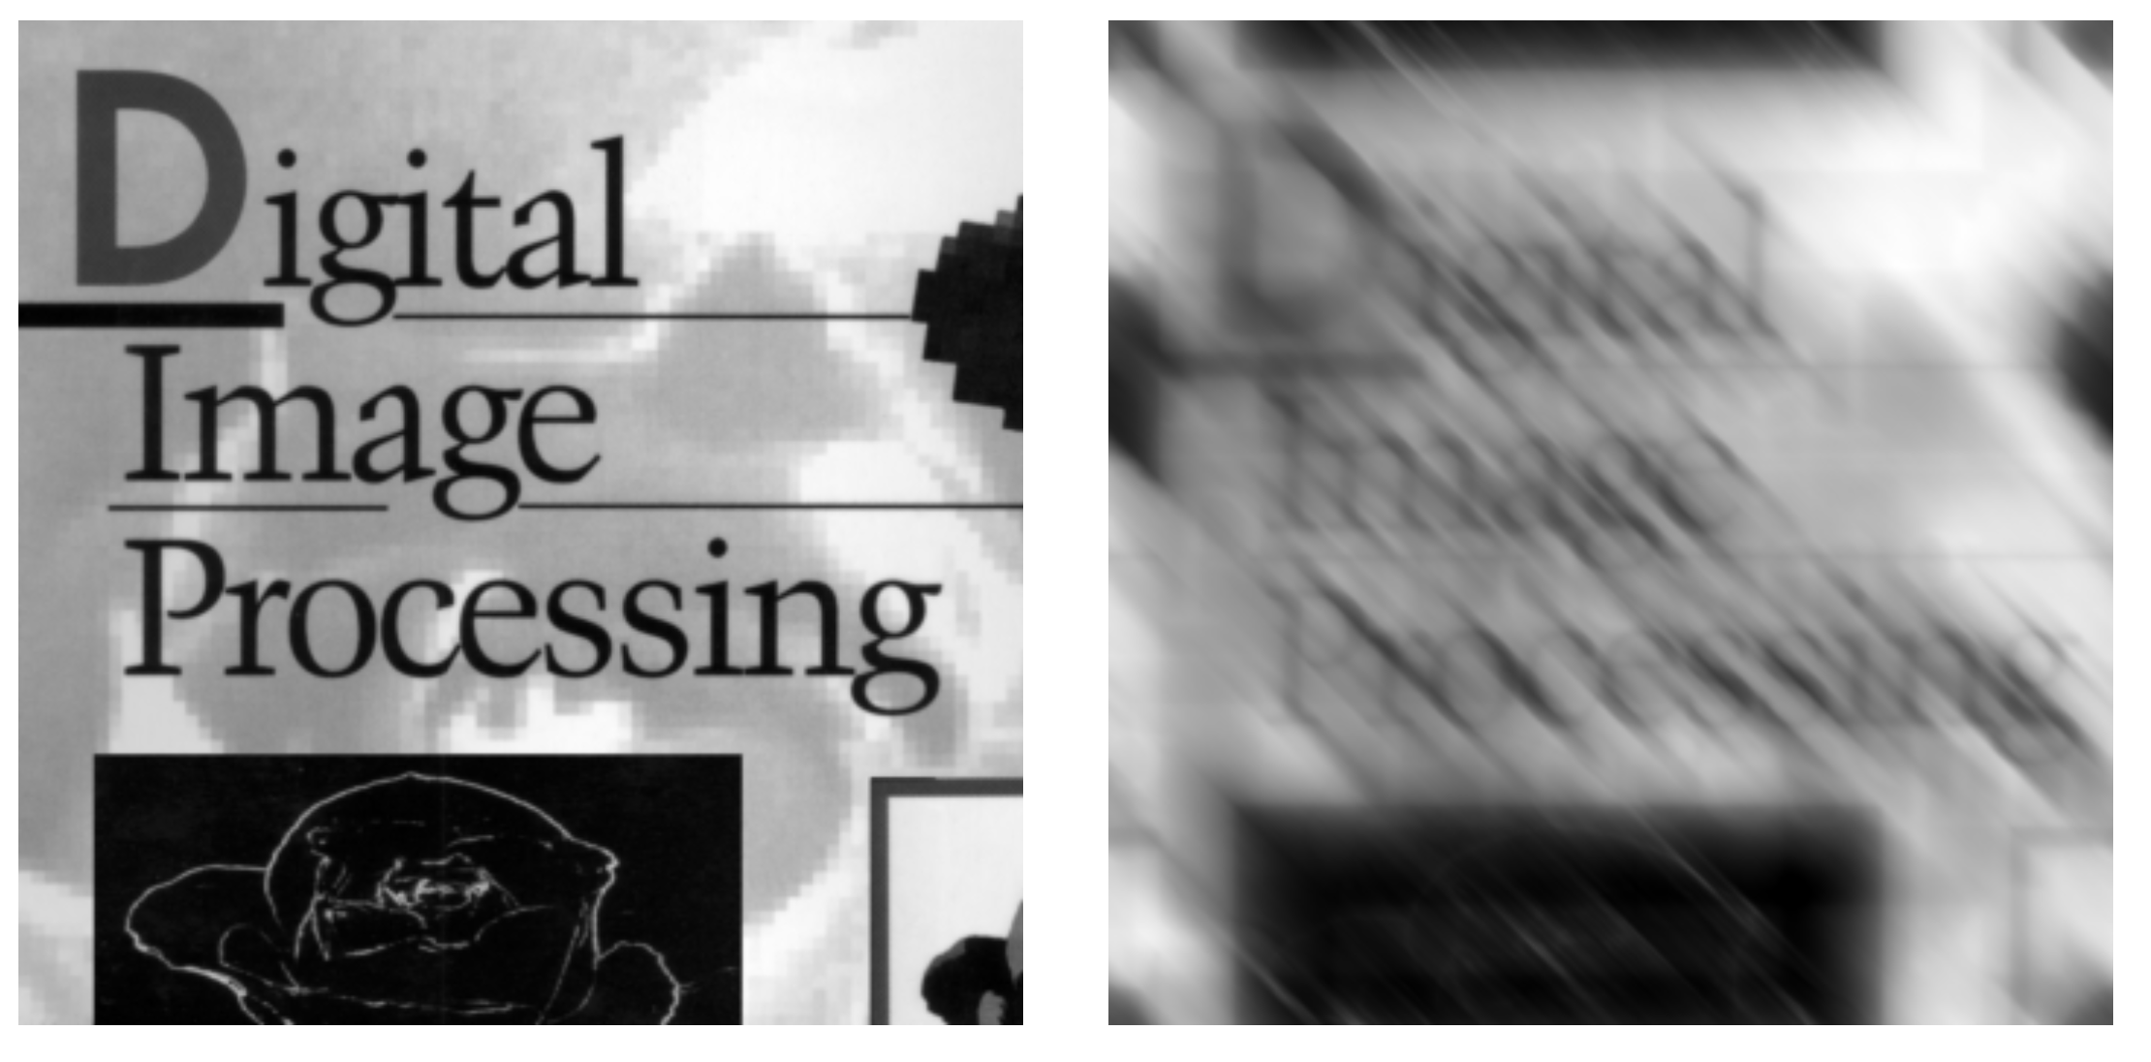
Image deblur model
Original image
Blurred image

Slide 6
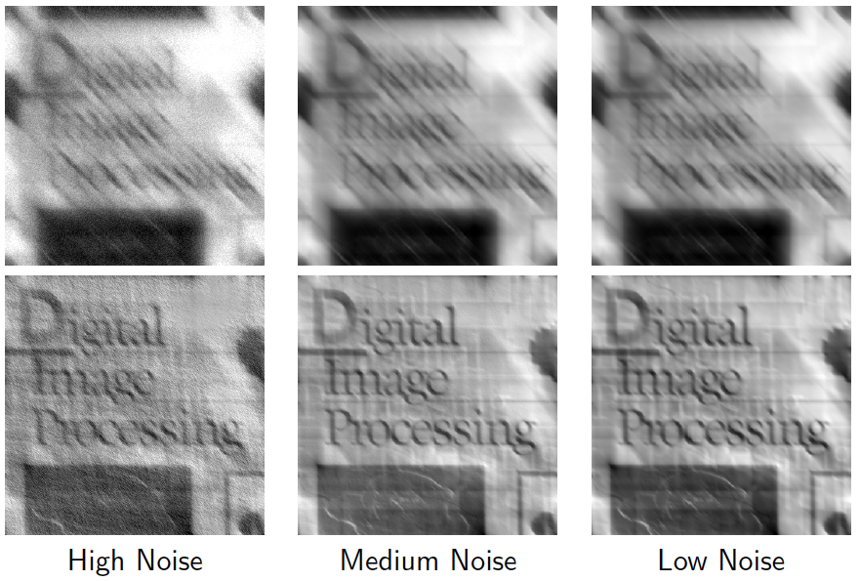
Wiener filter
Deblurred image
Deblurred image
Deblurred image

Slide 7

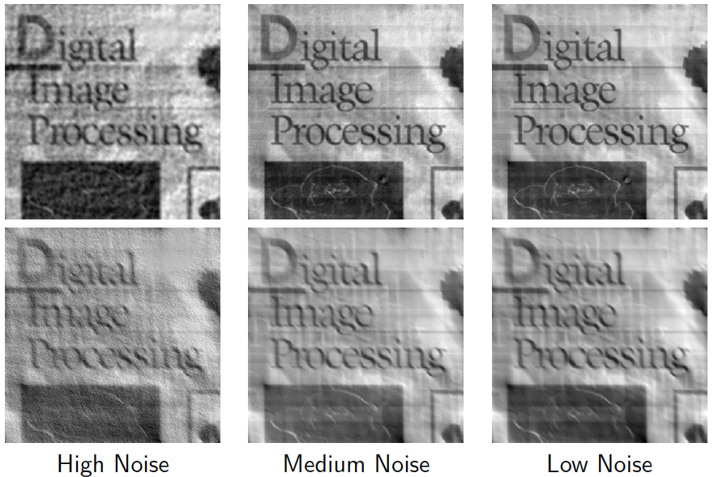
Constrained least square filtering
Constrained Least Square
Wiener filter

Slide 8
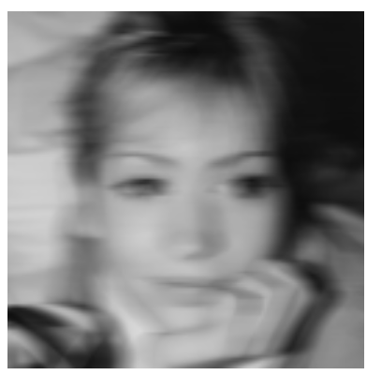
Constrained least square filtering
Blurry image without noise

Slide 9
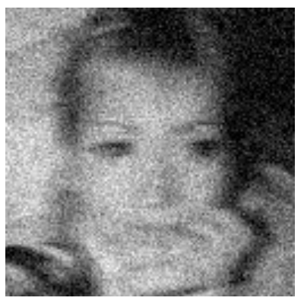
Constrained least square filtering
Blurry image without noise

Slide 10
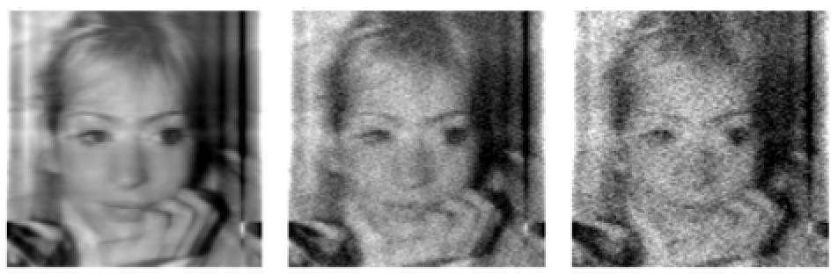
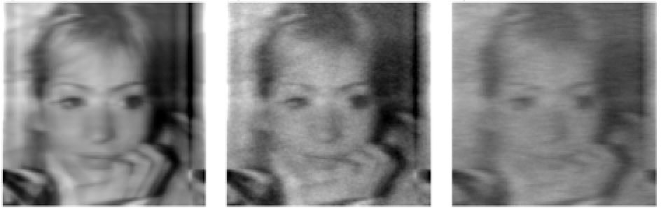
Constrained least square filtering
Blurry images
Deblurred images

