Slide 1
IS-LABEL: an Independent-Set based Labeling Scheme for Point-to-Point Distance Querying
Ada Fu, Huanhuan Wu, James Cheng, and Raymond Wong
The Department of Computer Science & Engineering
The Chinese University of Hong Kong

Slide 2
Definition
Given a static weighted graph G = (V_{G}, E_{G}, W_{G}), construct a disk-based index for processing point-to-point (P2P) distance queries or shortest path queries.
Find dist_{G}(a,f)
10
2
10
2
d
d
10
f
10
f
a
b
2
a
b
2
e
1
e
6
1
2
1
12
c
c

Slide 3
Challenges
Real-world graphs are becoming larger than memory size
  Both offline index construction and online query processing cannot be done in memory
Inefficient to answer distance queries: Dijkstra
  Query Time: O(m + n log n)
Impractical to store all pairs distances
  Index time: O(nm+n² log n), Index space: O(n²)

Slide 4
Limitations of existing work
Indexing Approaches
  High indexing cost
    Cohen et al. 2003
    Jin et al. 2012
Other approaches
  Query answer is approximate
    Baswana et al. 2006, Gubichev et al. 2010, Sarma et al. 2010
Notes:
Cohen et al. 2003: O(n⁴)
Jin et al. 2012: o(n(n+m))

Slide 5
Our Contributions
Efficient and scalable index
  Novel application of independent set
  Flexible tuning of index size
Effective labeling scheme
  Small label size
  I/O efficient labeling process
High query performance

Slide 6
Outline
Problem Definition and Challenges
Our Solution: IS-Label
  Overview
  Part I: Vertex Hierarchy
  Part II: Vertex Labeling
  Part III: Query Processing
Experimental Results
Conclusions

Slide 7
Overview
1. Vertex Hierarchy: Construct a hierarchy based on independent sets
2. Vertex Labeling: Construct a label for each vertex based on the vertex hierarchy
3. Query Processing: Process a query online using the vertex labels
Vertex Hierarchy
Vertex Labeling
Query Processing

Slide 8
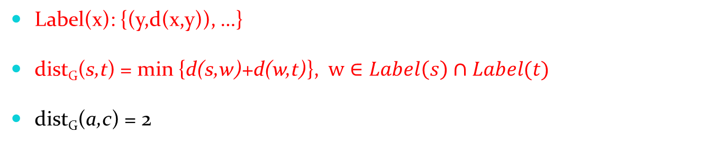
Label based distance querying (Example)
Label(c) | {(a,2),(b,1),(c,0),(e,2),(g,4)}
Label(f) | {(a,4),(e,3),(f,0),(g,2),(h,1)}
Label(i) | {(a,2),(e,1),(g,3),(i,0)}
Label(b) | {(a,1),(b,0),(e,1),(g,3)}
Label(d) | {(a,2),(d,0),(e,1),(g,1)}
Label(h) | {(a,5),(e,4),(g,1),(h,0)}
Label(e) | {(a,1),(e,0),(g,2)}
Label(a) | {(a,0),(g,3)}
Label(g) | {(g,0)}
a
d
g
b
e
h
3
c
f
i
    Label(x): {(y,d(x,y)), …}
    dist_{G}(s,t) = min {d(s,w)+d(w,t)}, $w∈Label\left(s\right)∩Label(t)$
dist_{G}(a,c) = 2

Slide 9
Part I: Vertex Hierarchy
Level assignment
Distance preservation
Vertex independence
Notes:
Level assignment:
$V_{G}=L_{1} ∪ ⋯ ∪ L_{k}$ , $L_{i} ∩ L_{j}= ∅$, $1≤i<j≤k$
Distance preservation:
$G_{1}=G$, $G_{i}=(V_{G_{i}},E_{G_{i}},W_{G_{i}})$, $V_{G_{i}}=V_{G}−L_{1}−$ $⋯ L_{i−1}$
The distance from s to t, for any s and t in $G_{i}$, remains the same as that in $G_{i−1}$
Vertex independence:
$L_{i}$ is an independent set of $G_{i}$, $1≤i<k$

Slide 10
Part I: Vertex Hierarchy (example)
Level assignment
Distance preservation
Vertex independence
a
d
g
b
e
h
a
d
g
3
b
e
h
c
f
i
4
Augmenting edge:
W(e,h)=W(e,f)+W(f,h)
G = G₁, L₁={ c, f, i }
G₂, L₂={ b, d, h }
a
g
2
3
a
g
g
e
G₃, L₃={ e }
G₄, L₄={ a }
G₅

Slide 11
Part I: Vertex Hierarchy (example)
G₁, L₁={ c, f, i }
G₂, L₂={ b, d, h }
G₃, L₃={ e }
G₄, L₄={ a }
G₅, L₅={ g }
Hierarchy
Level 5
3
g
Level 4
a
2
Level 3
e
4
Level 2
b
3
d
h
Level 1
c
f
i

Slide 12
Part I: Vertex Hierarchy
a
d
g
b
e
h
a
d
g
3
c
f
i
b
e
h
4
G = G₁, L₁={ c, f, i }
G₂
A k-level vertex hierarchy (k=2)
G_{k}: residual graph (G₂)

Slide 13
Part II: Vertex Labeling
Ancestor:
  a is an ancestor of c
  g is an ancestor of f
Label(v):
  {(u, d(u,v)) | u is an ancestor of v, d(u,v) is the minimal distance of all ascending paths to u}
  Note that d(u,v) ≥ dist_{G}(u,v)
Label (f) ={(a,4),(e,3),(f,0),(g,2),(h,1)}
Hierarchy
Level 5
3
g
Level 4
a
2
Level 3
e
4
Level 2
b
3
d
h
Level 1
c
f
i
Notes:
distG(f,e)=3, d(f,e)=4

Slide 14
Part II: Vertex Labeling (example)
Hierarchy
Label(c) | {(a,2),(b,1),(c,0),(e,2),(g,4)}
Label(f) | {(a,4),(e,3),(f,0),(g,2),(h,1)}
Label(i) | {(a,2),(e,1),(g,3),(i,0)}
Label(b) | {(a,1),(b,0),(e,1),(g,3)}
Label(d) | {(a,2),(d,0),(e,1),(g,1)}
Label(h) | {(a,5),(e,4),(g,1),(h,0)}
Label(e) | {(a,1),(e,0),(g,2)}
Label(a) | {(a,0),(g,3)}
Label(g) | {(g,0)}
Level 5
3
g
Level 4
a
2
Level 3
e
4
Level 2
b
3
d
h
Level 1
c
f
i
Notes:
g is an ancestor of f

Slide 15
Part II: Vertex Labeling (example)
a
d
g
b
e
h
a
d
g
3
b
e
h
c
f
i
4
G = G₁, L₁={ c, f, i }
G₂, L₂={ a, b, d, e, g, h }
Label(c) | {(b,1),(c,0)}
Label(f) | {(e,3),(f,0),(h,1)}
Label(i) | {(e,1),(i,0)}

Slide 16
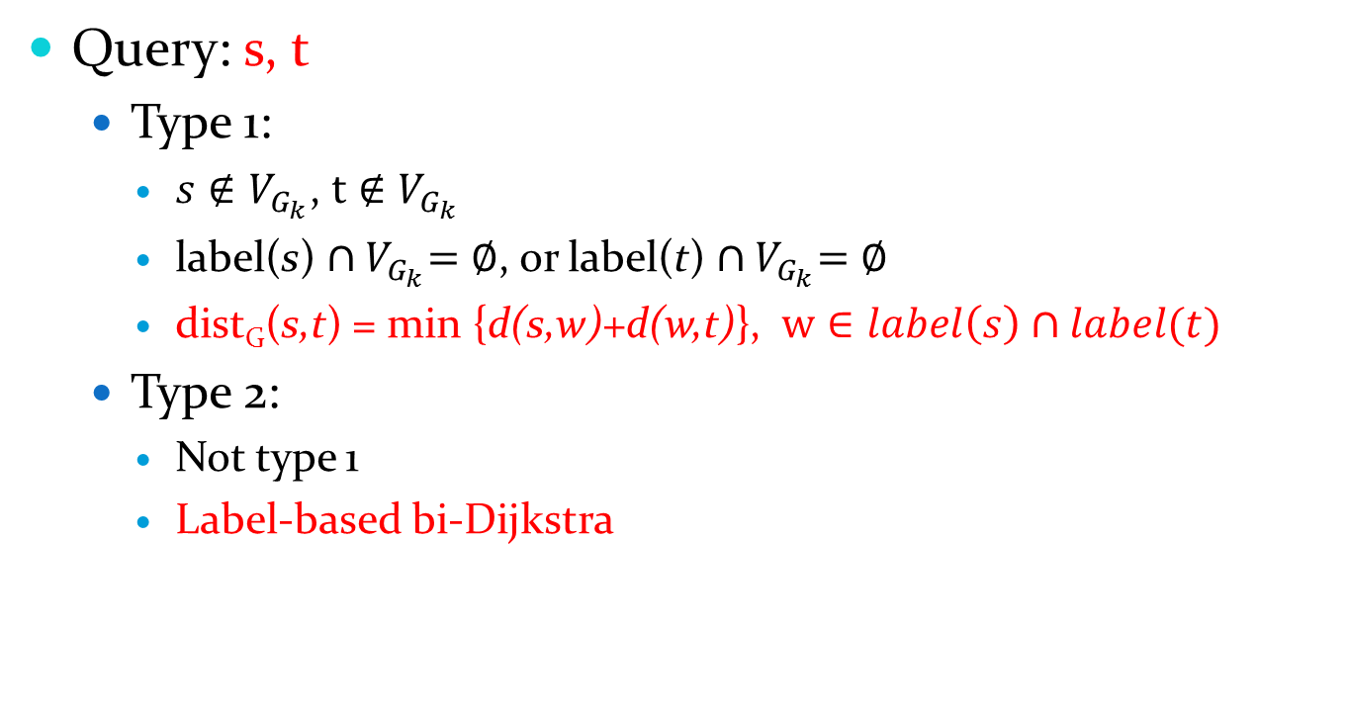
Part III: Query Processing
Query: s, t
  Type 1:
    $s∉V_{G_{k}}$, $t∉V_{G_{k}}$
    label(s) ${∩V}_{G_{k}}=∅$, or label(t) ${∩V}_{G_{k}}=∅$
    dist_{G}(s,t) = min {d(s,w)+d(w,t)}, $w∈label\left(s\right)∩label(t)$
  Type 2:
    Not type 1
    Label-based bi-Dijkstra

Slide 17
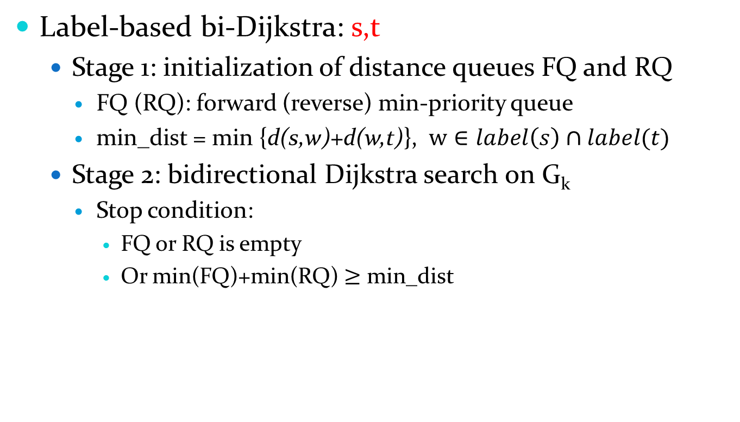
Part III: Query Processing
Label-based bi-Dijkstra: s,t
  Stage 1: initialization of distance queues FQ and RQ
    FQ (RQ): forward (reverse) min-priority queue
    min_dist = min {d(s,w)+d(w,t)}, $w∈label\left(s\right)∩label(t)$
  Stage 2: bidirectional Dijkstra search on G_{k}
    Stop condition:
      FQ or RQ is empty
      Or min(FQ)+min(RQ) $≥$ min_dist
Notes:
FQ: {$(v,d(s,v))$: $v∈V_{G_{k}}$, $(v,d\left(s,v\right))∈label(s)$}
RQ: {$(v,d(t,v))$: $v∈V_{G_{k}}$, $(v,d\left(t,v\right))∈label(t)$}

Slide 18
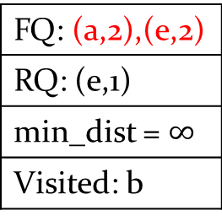
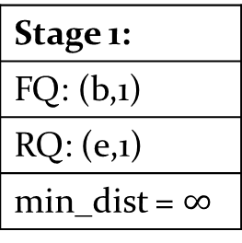
Part III: Query Processing (example)
a
d
g
b
e
h
a
d
g
Label(c) | {(b,1),(c,0)}
Label(f) | {(e,3),(f,0),(h,1)}
Label(i) | {(e,1),(i,0)}
3
c
f
i
b
e
h
4
G = G₁, L₁={ c, f, i }
G₂
Stage 2
Stage 1:
FQ: (b,1)
RQ: (e,1)
min_dist = $∞$
FQ: (a,2),(e,2)
RQ: (e,1)
min_dist = $∞$
Visited: b
s=c, t=i
FQ: (a,2),(e,2)
RQ: (a,2),(b,2),(d,2),(h,5)
min_dist = 3
Visited: b,e
min(FQ)+min(RQ)=4 > min_dist, stop
Return dist_{G}(c,i)=3

Slide 19
Outline
Problem Definition and Challenges
Our Solution: IS-Label
  Overview
  Part I: Vertex Hierarchy
  Part II: Vertex Labeling
  Part III: Query Processing
Experimental Results
Conclusions

Slide 20
Experimental Results
Communication network from Enron
Billion Triple Challenge RDF
Internet topology graph
Datasets:
Undirected | |V| | |E| | Disk size
BTC | 164.7M | 361.1M | 5.6GB
As-Skitter | 1.7M | 22.2M | 200MB
Email-Enron | 37K | 368K | 2.7MB
Directed
UK-Web | 105.9M | 297.4M | 7.4GB
Wiki-Talk | 2.4M | 5.0M | 104.2MB
Soc-sign-slashdot | 77K | 517K | 8MB
Social Network
Web Graph
Communication Network

Slide 21
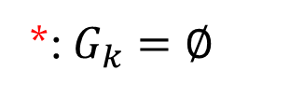
Experimental Results
Comparison with other methods
 | Index size |  | Index time (s)
Undirected | IS-Label | HCL | IS-Label | HCL
BTC | 7.1GB | - | 2057.98 | -
As-Skitter | 428.6MB | - | 487.92 | -
Email-Enron | 137.7MB | 46.4MB | 36.58 | 51780
Directed
UK-Web | 8.9GB | - | 10132.8 | -
Wiki-Talk | 85MB | - | 39.93 | -
Soc-sign-slashdot | 1GB | - | 439.47 | -
*
*
*: $G_{k}=∅$

Slide 22

Experimental Results
Comparison with other methods
 | Query time (ms)
Undirected | IS-Label | HCL
BTC | 6.35 | -
As-Skitter | 2.32 | -
Email-Enron | 0.005 | 0.294
Directed
UK-Web | 19.796 | -
Wiki-Talk | 0.011 | -
Soc-sign-slashdot | 0.007 | -
*
*
*: $G_{k}=∅$
More scalable and efficient

Slide 23
Conclusions
We developed an effective disk-based indexing method for distance and shortest path querying
  Independent set based vertex hierarchy and labeling process
  Limit the height of hierarchy to control the label size and indexing cost
  Scalable: can handle graphs orders of magnitude larger than existing work
  High query performance

Slide 24
Thank you!
Q&A

