Slide 1
Everlasting Security in Wireless Communications Networks
The Chinese University of Hong Kong
August 27,2014
Dennis Goeckel
University of Massachusetts Amherst
This work is supported by the National Science Foundation under Grants CNS-1019464, CCF-1249275, and ECCS-1309573.

Slide 2

Motivation
Everlasting Secrecy:
We are interested in keeping something secret forever. A challenge of cryptography (e.g. the VENONA project) is that recorded messages can be deciphered later:
If the primitive is shown not to be hard.
If significant computational advances are made
If the cryptographic scheme is broken.
Information-theoretic secrecy

Slide 3
Information-theoretic secrecy [Shannon, 1949]
Information is encoded in such a way that Eve gets no information about the message…if the scenario is right
Advantages:
No computational assumptions on Eve.
If the transmission is securely made, it is secure forever.

Slide 4




Shannon and the one-time pad [C. Shannon, 1949]
Consider perfect secrecy over a noiseless wireline channel:
Desire I(M,g_{K}(M))=0
?
Eve
M
g_{K}(M)
Alice
M
Bob
Pre-shared key K
Questions:
How long must K be for an N-bit message M?
How do you choose g_{K}(M)?
Notes:
Alice sends XOR of the message and the Key=> Bob is unable to decode the message because does not have the key.
Highlighted Statement Shannon show you need key as long as message which is an unfulfilling result

Slide 5
Shannon and the one-time pad [C. Shannon, 1948]
?
Eve
M
M K
Alice
(M K) K = M
Bob
Pre-shared key K
Blah.
Answers:
You need an N-bit key K for an N-bit message M.
g_{K}(M) = M K

Slide 6
The Alice-Bob-Eve Scenario in Wireless
But the channels might be noisy…it might be Eve in the parking lot
listening…
Alice
Bob
Eve
Building
…in which case Eve’s channel is worse than Bob’s. Can this help get
information-theoretic secrecy?

Slide 7
The Wiretap Channel [Wyner, 1975; Cheong and Hellman, 1978]
IT Security Basics PHY-layer Solutions Using the Network Challenges
R_{AB}: Capacity of channel from Alice to Bob
R_{AE}: Capacity of channel from Alice to Eve
R_{AB} > R_{AE}
Alice
Bob
Eve
Building
Gaussian channels:
R = log₂(1 + SNR_{AB}) – log₂(1 + SNR_{AE})
Positive rate “if Bob’s channel is better”, and Eve gets nothing.

Slide 8
The Alice-Bob-Eve Scenario in Wireless
But it might not be Eve in the parking lot listening, rather…
Alice
Bob
Eve
Building
…it might be Eve in the building!
Important Challenge: the “near Eve” problem…

Slide 9
The Alice-Bob-Eve Scenario in Wireless
…and you very likely will not know where she is.
Alice
Bob
Eve
Building
Many would argue that we have traded a long-term computational risk (cryptography) for a short-term scenario (information-theoretic secrecy) risk…no thank you!

Slide 10
Outline
Information Theoretic security basics
Potential Physical-Layer Solutions
(with Azadeh Sheikholeslami, Hossein Pishro-Nik)
3. Exploiting the Network
(with Sudarshan Vasudevan, Cagatay Capar, Don Towsley)
4. Current and Future Challenges

Slide 11
Outline
Information Theoretic security basics
Potential Physical-Layer Solutions
(with Azadeh Sheikholeslami, Hossein Pishro-Nik)
3. Exploiting the Network
(with Sudarshan Vasudevan, Cagatay Capar, Don Towsley)
4. Current and Future Challenges
Recall Goal: Keep Eve from recording a signal from which she can later extract the information.

Slide 12
Outline
Information Theoretic security basics
Potential Physical-Layer Solutions
(with Azadeh Sheikholeslami, Hossein Pishro-Nik)
3. Exploiting the Network
(with Sudarshan Vasudevan, Cagatay Capar, Don Towsley)
4. Current and Future Challenges
Recall Goal: Keep Eve from recording a signal from which she can later extract the information.

Slide 13
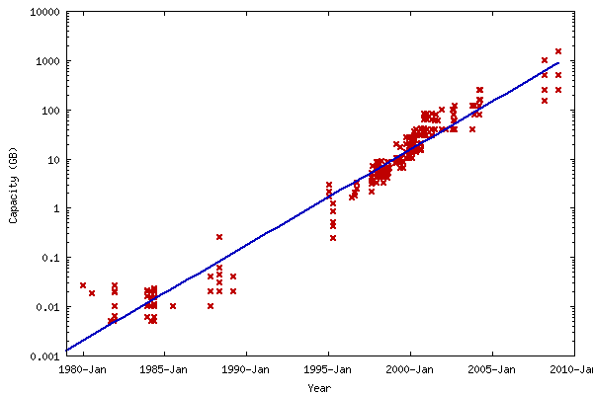
Attacking the Hardware I: Bounded Memory Model
IT Security Basics PHY-layer Solutions Using the Network Challenges
Cachin and Maurer introduced the “bounded memory model” to achieve everlasting secrecy [Cauchin and Maurer, 1997]. An eavesdropper with memory < M cannot store enough to eventually break the cipher.
However, it is hard to pick a memory size that Eve cannot use beyond:
1. The density of memories grows quickly (Moore’s Law)
2. Memories can be stacked arbitrarily subject only to (very large) space limitations.
[From “blog.dshr.org”]
4/12

Slide 14
Bounded Conversion Model
IT Security Basics PHY-layer Solutions Using the Network Challenges
Eve’s Receiver
Perhaps Cachin and Maurer attacked the wrong part of the receiver:
Analog
“Front-End”
A/D
Digital
“Back-End”
1. In the combative sender-eavesdropper game, front-end dynamic range
is a critical aspect of the receiver.
2. A/D Technology progresses very slowly.
3. High-end A/D’s are already stacked to the limit of the jitter.
1. IT security requires a channel advantage.
Idea:
Establish cryptographic security
(e.g. Diffie-Hellman)
Alice
Bob
Use a short-term cryptographic
to establish the channel advantage.
Eve

Slide 15
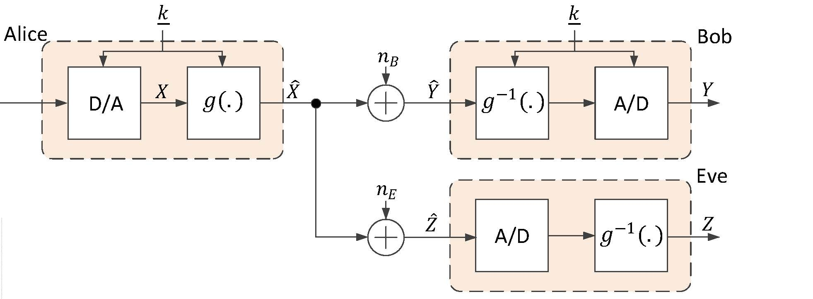
System model and approach:
IT Security Basics PHY-layer Solutions Using the Network Challenges
k
Alice and Bob pre-share an “emphemeral” cryptographic key k to
choose g(.). Note: Key will be handed to Eve after transmission.
5/12

Slide 16
System model and approach:
IT Security Basics PHY-layer Solutions Using the Network Challenges
k
Alice and Bob pre-share an “emphemeral” cryptographic key k to
choose g(.). Note: Key will be handed to Eve after transmission.
A/D is a non-linear element. Non-commutativity of non-linear
elements: potential information-theoretic security.
5/12

Slide 17
System model and approach:
IT Security Basics PHY-layer Solutions Using the Network Challenges
k
Alice and Bob pre-share an “emphemeral” cryptographic key k to
choose g(.). Note: Key will be handed to Eve after transmission.
A/D is a non-linear element. Non-commutativity of non-linear elements:
potential information-theoretic security.
Secrecy rate is a shaping gain: R_{s}=E_{g}[h(X) – h(g(X))]
h(X): differential entropy
…but, unlike traditional “shaping gains”, gain can be huge.
5/12

Slide 18
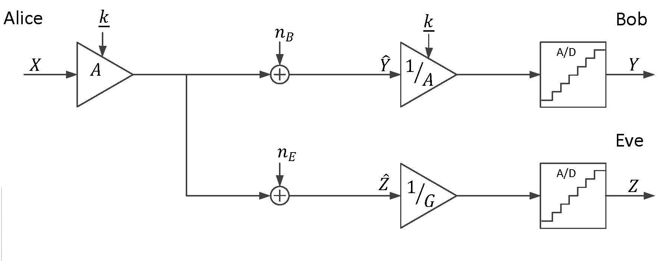
IT Security Basics PHY-layer Solutions Using the Network Challenges
Example: Rapid power modulation for secrecy:
Idea: Key used to rapidly power modulate transmitter. Bob’s receiver gain
control can follow, while Eve’s struggles.
6/12

Slide 19
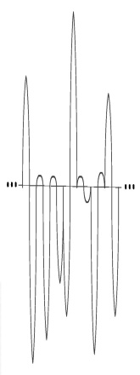
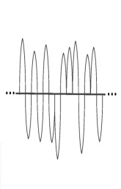
IT Security Basics PHY-layer Solutions Using the Network Challenges
Rapid power modulation for secrecy:
6/12

Slide 20
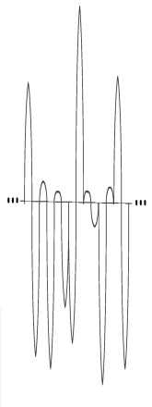
IT Security Basics PHY-layer Solutions Using the Network Challenges
Rapid power modulation for secrecy:
6/12

Slide 21
IT Security Basics PHY-layer Solutions Using the Network Challenges
Rapid power modulation for secrecy:
Bob’s gain control is correct: input well-matched to A/D span.
6/12

Slide 22
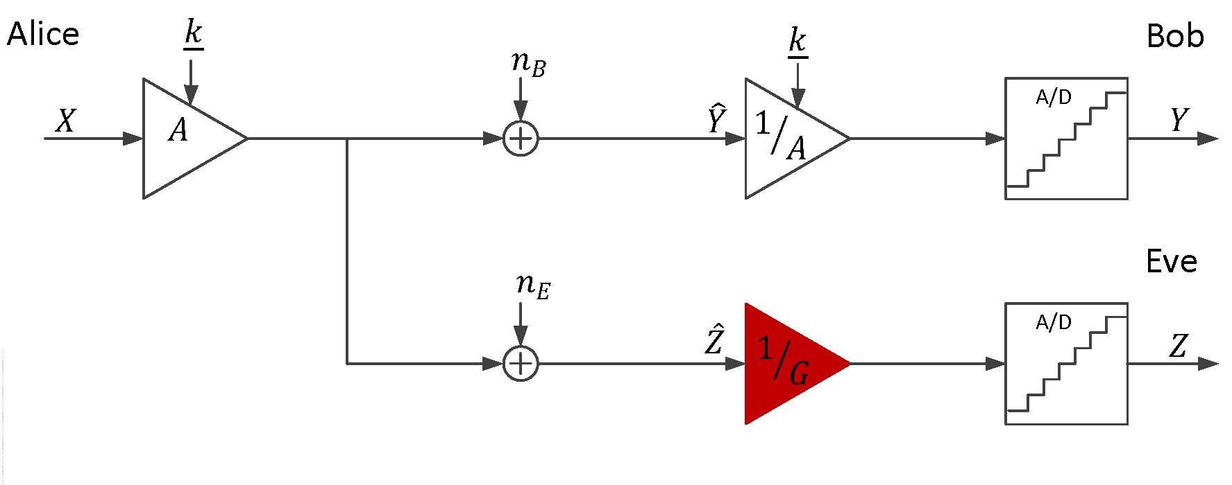
IT Security Basics PHY-layer Solutions Using the Network Challenges
Rapid power modulation for secrecy:
Alice sets her parameters to maximize R_{s}, whereas Eve tries to find
a gain G that minimizes the secrecy rate R_{s} given Alice’s choice:
R_{s}=max_{S} min_{G} R_{s}(S, G)
2. It is easy to show that the optimal strategy (for Eve) is to
pick a single gain G.
7/12

Slide 23
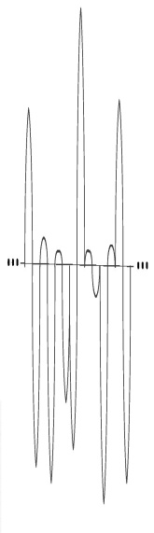
IT Security Basics PHY-layer Solutions Using the Network Challenges
Rapid power modulation for secrecy:
Large gain
Effect of A/D on the signal:
Clipping (due to overflow)
8/12

Slide 24
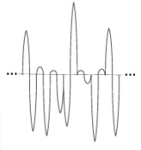
IT Security Basics PHY-layer Solutions Using the Network Challenges
Rapid power modulation for secrecy:
Small gain
Effect of A/D on the signal:
Clipping (due to overflow)
Quantization noise (uniformly distributed)
8/12

Slide 25
IT Security Basics PHY-layer Solutions Using the Network Challenges
Rapid power modulation for secrecy:
Effect of A/D on the signal:
Clipping (due to overflow)
Quantization noise (uniformly distributed)
Trade-off between choosing a large gain and a small gain:
Eve needs to compromise between more A/D overflows or less resolution.
8/12

Slide 26
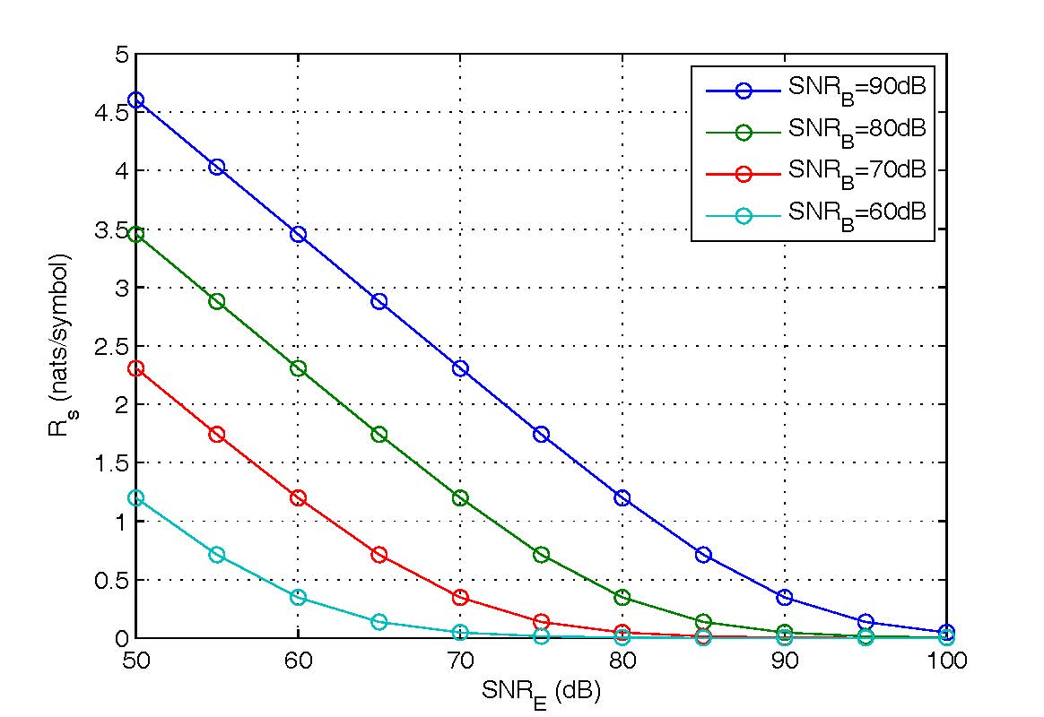

IT Security Basics PHY-layer Solutions Using the Network Challenges
(a) Public Discussion
(b) Power modulation
(Although they are not really competing techniques. Power modulation
approach could be used under public discussion.)
What if Eve picks up the transmitter?

Slide 27
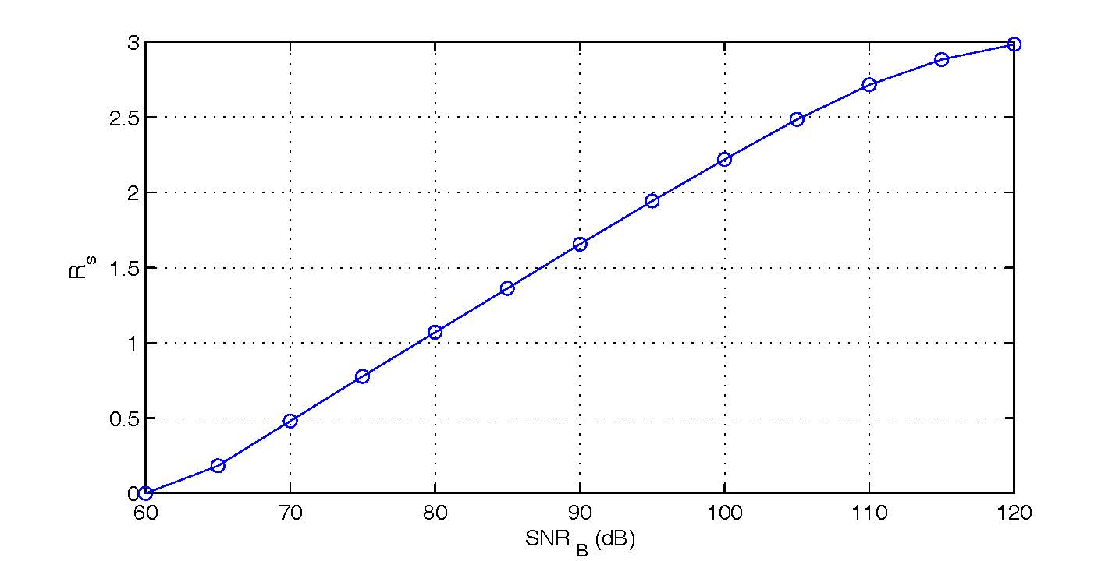
IT Security Basics PHY-layer Solutions Using the Network Challenges
Secrecy rate vs. SNR at Bob, Eve has perfect access to the signal
Noisy channel to Bob, noiseless channel to Eve.
Alice
Bob
Eve
10/12

Slide 28
IT Security Basics PHY-layer Solutions Using the Network Challenges
Other approaches:
Artificial intersymbol interference (ISI) [ISIT 2013]: Introduce intentional ISI at the transmitter, key gives Bob an advantage in equalization.
Artificial jamming [Asilomar 2014]: Key is used to add a jamming signal, which Bob can pre-cancel at the receiver – unlike seemingly similar approaches in literature, cryptographic key is handed to Eve after transmission.
Need some signal
power for Bob
Needs some jamming
to confuse Eve

Slide 29
IT Security Basics PHY-layer Solutions Using the Network Challenges
Challenges for Everlasting Secrecy (Alice-Bob-Eve):
Cryptography: Computational assumptions on eavesdropper.
Information-theoretic security: Scenario assumptions on eavesdropper.
Our approach: Assumptions on current conversion capabilities of
eavesdropper.

Slide 30
Outline
1. Information Theoretic security basics
2. Potential Physical-Layer Solutions
3. Exploiting the Network
4. Current and Future Challenges

Slide 31
IT Security Basics PHY-layer Solutions Using the Network Challenges
The Network Scale:
So far we have considered (perhaps not so successfully):
Alice
Bob
Eve
But perhaps we should consider:
Questions:
How much secret info can be shared by a network of wireless nodes in the presence of eavesdropper nodes? [Gupta/Kumar et al]
… and how many
eavesdroppers
can the network tolerate?

Slide 32

IT Security Basics PHY-layer Solutions Using the Network Challenges
Problem: Secrecy Scaling
n good guys (matched into pairs)
m bad guys.
Gupta-Kumar: n nodes each can share bits per second.
Want to achieve this throughput securely, in the presence of m eavesdroppers of unknown location.

Slide 33

IT Security Basics PHY-layer Solutions Using the Network Challenges
1-D Networks (worst-case topology)
S₁
D₂
D₁
S₂
Network (random extended network):
Nodes are placed in the interval [0, n].
Legitimate nodes randomly placed: Poisson with unit density (n good guys on average)
Eavesdroppers Poisson with λ_{e} (n) (m(n) = λ_{e} (n) n bad guys on average.)
n nodes matched into source-destination pairs uniformly at random.
n randomly located nodes -> how much secret information in the presence of m(n) eavesdroppers ?

Slide 34
IT Security Basics PHY-layer Solutions Using the Network Challenges
1-D Networks (worst-case topology)
S
Eve
D
×
A single eavesdropper of known location -> 1-D disconnected (zero secret bits)!
Why? For any node to Eve’s left, Eve is closer (has larger SINR) than the good nodes located to Eve’s right.
What to do? Answer: Nodes help each other to achieve secrecy -> Cooperation.
E: Stronger signal
B: Weaker signal
A
E
B
Cooperative Jamming:
E: Stronger signal, stronger noise
B: Weaker signal, weaker noise
A
J
E
B

Slide 35
IT Security Basics PHY-layer Solutions Using the Network Challenges
Routing Algorithm:
×
×
×
So, the idea to connect each S-D pair through a sequence of many single-cell hops + one multi-hop jump until reaching D.
Jamming works if you know where the eavesdroppers are.
But what if you don’t know where the eavesdroppers are?

Slide 36
IT Security Basics PHY-layer Solutions Using the Network Challenges
Unknown Eavesdropper Locations:
×
×
×
I know how to protect the message if eavesdroppers are spaced far apart.
But this time eavesdroppers can be anywhere.
×
×
×
kth cell
(k+10)th cell
×
×
×

Slide 37
IT Security Basics PHY-layer Solutions Using the Network Challenges
Solution comes with secret sharing at the source
S
D
Anyone who has all t packets has the message.
Anyone who misses at least one packet has no information about the message.
x: the b-bit secret message.
S generates t-1 b-bit packets w₁, w₂, …, w_{t-1} randomly, sets w_{t} to be such that
For one message, S sends t packets.
The packets are sent in separate transmissions.
Idea: Ensure an eavesdropper anywhere in the network misses at least one packet.
x = 1 0 0 1 1
w₁ = 0 1 0 1 1
w₂ = 1 0 1 1 1
w₃ = 0 0 0 1 0
w₄ = 0 1 1 0 1
random
random
random

Slide 38

IT Security Basics PHY-layer Solutions Using the Network Challenges
Unknown Eavesdropper Locations:
×
×
×
×
×
×
Divide the network into regions: Coloring the network!

Slide 39

IT Security Basics PHY-layer Solutions Using the Network Challenges
Secrecy Analysis:
×
×
×
The only potentially unsecure places: start or the end of a route.
S
Near-eavesdropper
n/logn eavesdroppers
Throughput Analysis:
Standard Scheduling applied: cells take turns in transmissions: throughput per node pair (standard).

Slide 40
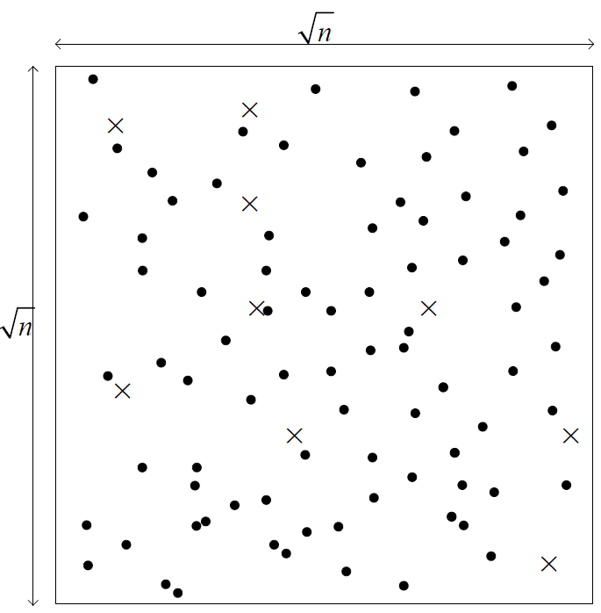
IT Security Basics PHY-layer Solutions Using the Network Challenges
Two-Dimensional Networks (Review)
(Insecure) Throughput:
bits per second (per-node throughput) [Gupta-Kumar, 2001]
bits per second (per-node throughput [Franceschetti et al, 2007]
Multi-hop route connecting source-destination pairs.
If eavesdropper locations are known:
Can route around the “holes” as long as m = o(n/logn) [Koyluoglu et al, 2011]
Also: Securing each hop individually is sufficient to secure the end-to-end route [Koyluoglu et al, 2011]

Slide 41
IT Security Basics PHY-layer Solutions Using the Network Challenges
Two-Dimensional Networks
Unknown eavesdropper location. What to do?
First answer: Try Cooperative Jamming.
At each hop, some nodes transmit artificial noise to protect the message from eavesdroppers around.
A
J
B
Can tolerate m(n) = log n eavesdroppers
(only). Is this the cost of unknown
eavesdropper positions?
[Vasudevan et al, 2011]

Slide 42
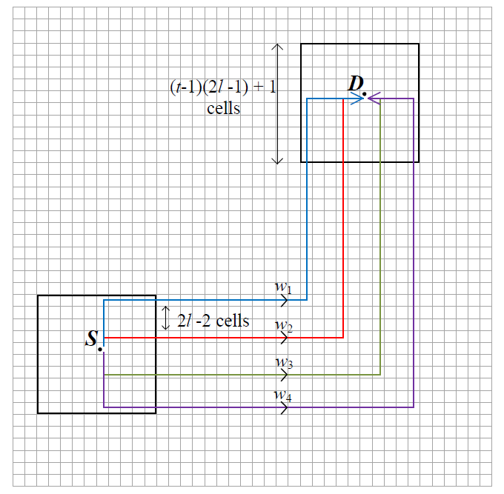
IT Security Basics PHY-layer Solutions Using the Network Challenges
Two-Dimensional Networks (Secret Sharing)
x = 1 0 0 1 1
w₁ = 0 1 0 1 1
w₂ = 1 0 1 1 1
w₃ = 0 0 0 1 0
w₄ = 0 1 1 0 1
random
random
random
An eavesdropper cannot be close to many paths at once…
Except when close to the source or the destination.
Can tolerate n/logn eavesdroppers.

Slide 43
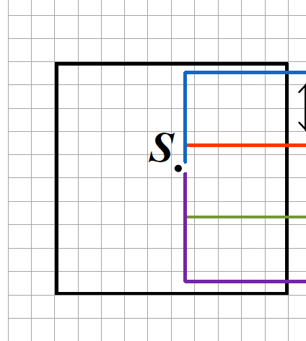
IT Security Basics PHY-layer Solutions Using the Network Challenges
What about those near eavedroppers?
Remember, the problem here was:
Near eavesdropper of unknown location.
Problem: near eavesdropper (SNR gap).
We know how to address that: Two-way scheme
(evens out the SNR gap)

Slide 44
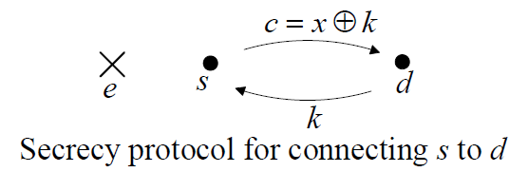
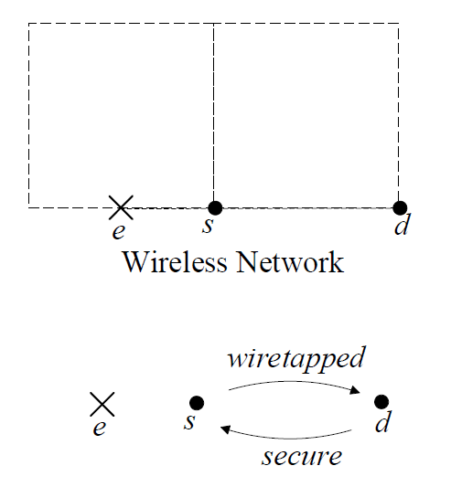
IT Security Basics PHY-layer Solutions Using the Network Challenges
The Trick: A Toy Example
1) d generates a random message k and sends it to s.
2) s replies with
(k is used as a one-time pad.)
3) d extracts x from c, k.
e misses k, cannot decode x.
An incoming connection can be very useful.
This simple trick has an important implication for wireless secrecy.
Two-way helps address the near eavesdropper problem
Two nodes + one eavesdropper
e catches whatever s says.
An incoming secure edge is sufficient for secrecy.

Slide 45
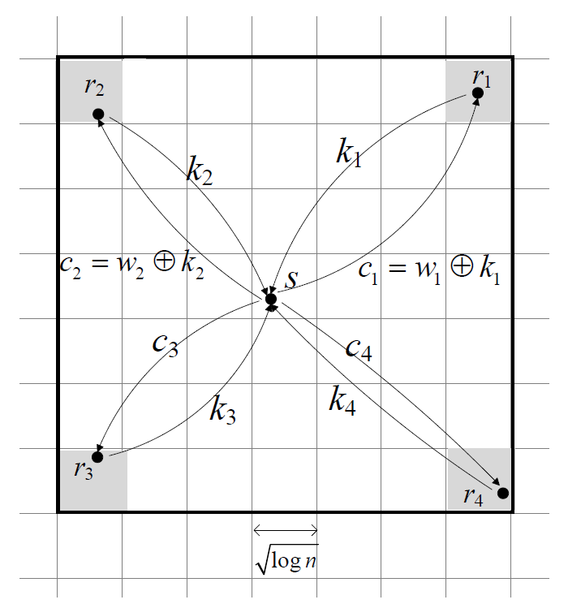
IT Security Basics PHY-layer Solutions Using the Network Challenges
Two-Dimensional Networks
Routing Algorithm: Draining, routing, delivery
Draining Phase: How we initiate at the source
Any Eve here misses k2 -> misses w2
S again generates four packets w1, w2, w3, w4.
But this time, does the two-way scheme with four relays to deliver these packets.
No Eve can be in between for all four r-s pairs.

Slide 46
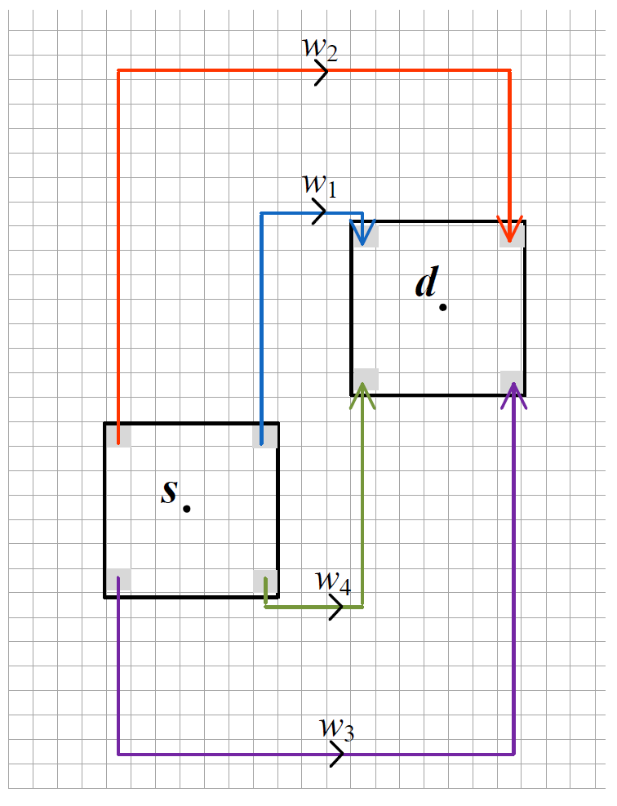
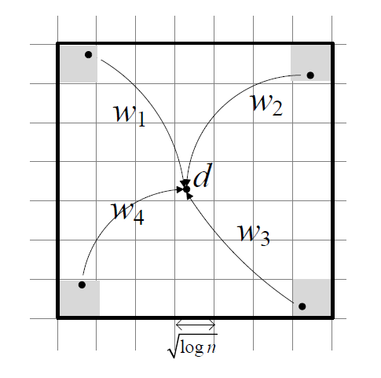
IT Security Basics PHY-layer Solutions Using the Network Challenges
Routing Phase:
Delivery Phase:
Come from four directions -> no near eavesdropper can be in between.
Carry packets on distant paths.

Slide 47
IT Security Basics PHY-layer Solutions Using the Network Challenges
Two-Dimensional Networks
Result: Network can tolerate any
number of eavesdroppers of
arbitrary location at the Gupta-Kumar
per-pair throughput.
Note: Importantly, the same technique can be used in practical networks that are:
sufficiently dense
add infrastructure
Any Eve here misses k2 -> misses w2
Come from four directions.
No Eve can be in between for all four r-s pairs.

Slide 48
IT Security Basics PHY-layer Solutions Using the Network Challenges
Summary
Information-theoretic security can provide everlasting security – if it can be secured during tranmission.
Exploit the non-commutativity of nonlinear operators to provide a physical-layer approach for disadvantaged environments, but no scheme is completely satisfying.
Perhaps the key is to exploit the network, and two-way communications.
Biggest question: Is information-theoretic security in wireless
just a waste of (mostly academic) resources?

