Slide 1
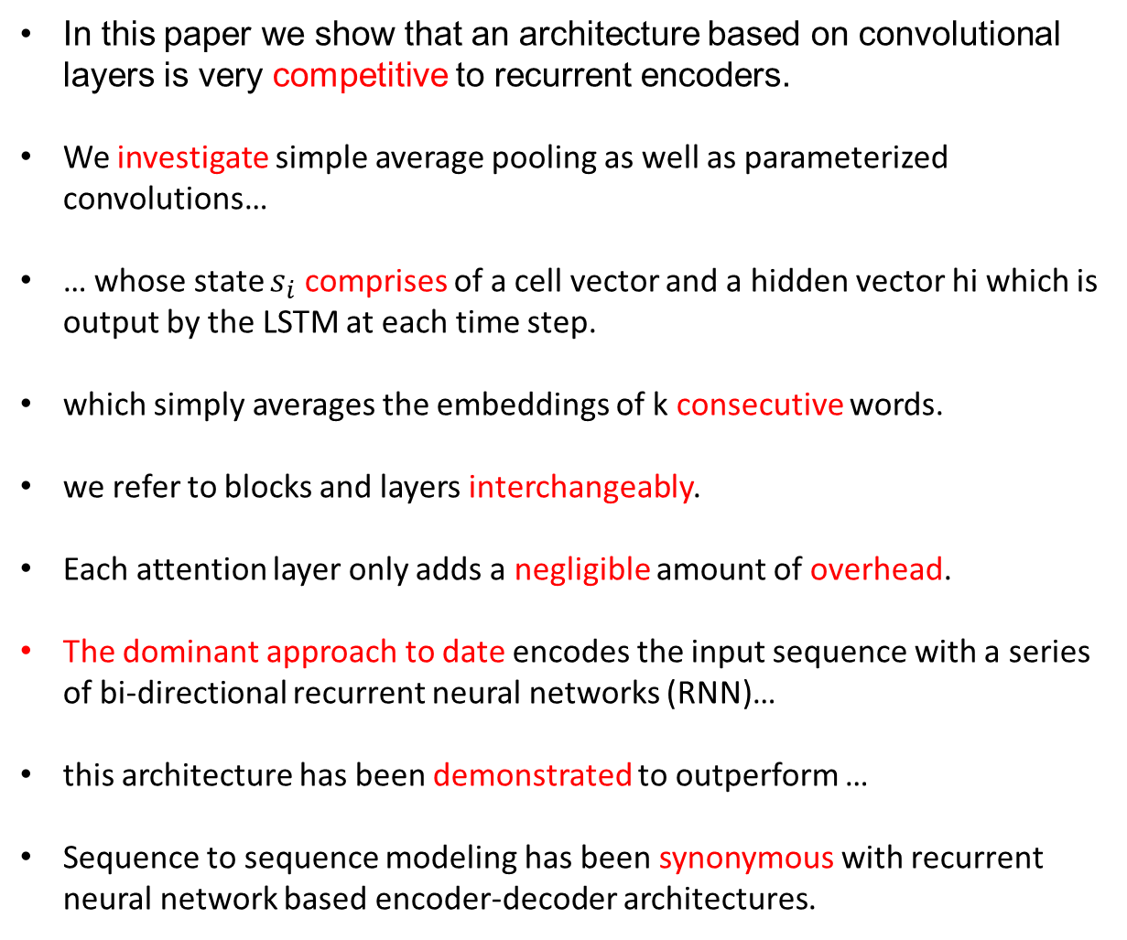
Ten Words
In this paper we show that an architecture based on convolutional layers is very competitive to recurrent encoders.
We investigate simple average pooling as well as parameterized convolutions…
… whose state $s_{i}$ comprises of a cell vector and a hidden vector hi which is output by the LSTM at each time step.
which simply averages the embeddings of k consecutive words.
we refer to blocks and layers interchangeably.
Each attention layer only adds a negligible amount of overhead.
The dominant approach to date encodes the input sequence with a series of bi-directional recurrent neural networks (RNN)…
this architecture has been demonstrated to outperform …
Sequence to sequence modeling has been synonymous with recurrent neural network based encoder-decoder architectures.

Slide 2
A Convolutional Encoder Model for Neural Machine Translation (ACL 2017)
&
Convolutional Sequence to Sequence Learning (ICML 2017)
Jonas Gehring; Micharl Auli; David Grangier; Denis Yarats; Yann N. Dauphin
Facebook AI Research
CHEN, Wang
09/25/2017

Slide 3
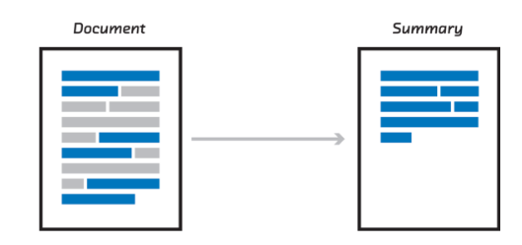


Background
$$p(y_{i+1}|y_{i},…,y_{1},X)$$
Sequence to Sequence Learning:
($x_{1}$, $x_{2}$, …, $x_{m}$) -> ($y_{1}$, $y_{2}$, …, $y_{n}$)
Examples:
  Machine translation: I like machine learning -> 我喜欢机器学习
  Summarization:
  ...

Slide 4















Background
Recurrent Neural Network (RNN) Encoder and Decoder:
LSTM or GRU
$$y_{1}$$
$$y_{2}$$
$$y_{3}$$
$$p(y_{1}|X)$$
$$p(y_{2}|y_{1},X)$$
$$p(y_{3}|y_{2},y_{1},X)$$
$$h_{1}$$
$$h_{2}$$
$$h_{3}$$
$$h_{0}$$
$$h_{4}$$
$$x_{1}$$
$$x_{2}$$
$$x_{3}$$
$$x_{4}$$
Encoder
Decoder

Slide 5
Background
Recurrent Neural Network (RNN) Encoder and Decoder:
$$y_{1}$$
$$y_{2}$$
$$y_{3}$$
$$h_{1}$$
$$h_{2}$$
$$h_{3}$$
$$h_{0}$$
$$h_{4}$$
$$x_{1}$$
$$x_{2}$$
$$x_{3}$$
$$x_{4}$$
Encoder
Decoder

Slide 6
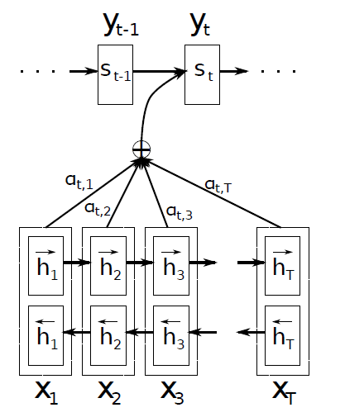















Background
RNN Encoder and Decoder with Attention:
$$y_{1}$$
$$y_{2}$$
$$y_{3}$$
$$c_{t}$$
$$s_{1}$$
$$s_{2}$$
$$h_{1}$$
$$h_{2}$$
$$h_{3}$$
$$h_{0}$$
$$h_{4}$$
$$x_{1}$$
$$x_{2}$$
$$x_{3}$$
$$x_{4}$$
Encoder
Decoder

Slide 7
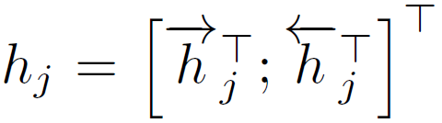
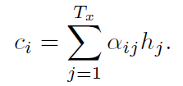
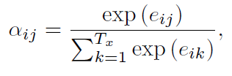


Background
RNN Encoder and Decoder with Attention:
$$c_{t}$$
Bahdanau, Dzmitry, Kyunghyun Cho, and Yoshua Bengio. "Neural machine translation by jointly learning to align and translate." ICLR (2015).

Slide 8












Limitations of RNN in machine translaiton
Difficulties in parallelization, because of temporal dependency.
Hard to train, because of backpropagation through time (BPTT).
Need a long path to capture the relations of words with long distance.
$$y_{1}$$
$$y_{2}$$
$$y_{3}$$
$$h_{1}$$
$$h_{2}$$
$$h_{3}$$
$$h_{0}$$
$$h_{4}$$
$$x_{1}$$
$$x_{2}$$
$$x_{3}$$
$$x_{4}$$
Encoder
Decoder

Slide 9
Attractive properties of CNN in MT
Easy to parallel, easy to train, shorter path to capture words relationship.
Multi-layer CNNs can create hierarchical representations.
<s>
I
love
<p>
<p>
machine
learning
<p>
<s>
I
love
machine
learning
</s>
<p>
</s>

Slide 10
Attractive properties of CNN in MT
Easy to paralyzing, easy to train, shorter path to capture words relationship.
Multi-layer CNNs can create hierarchical representations.
<s>
I
love
<p>
<p>
machine
learning
<p>
<s>
I
love
machine
learning
</s>
<p>
</s>

Slide 11
Attractive properties of CNN in MT
Easy to paralyzing, easy to train, shorter path to capture words relationship.
Multi-layer CNNs can create hierarchical representations.
<s>
I
love
<p>
<p>
machine
learning
<p>
<s>
I
love
machine
learning
</s>
<p>
</s>

Slide 12
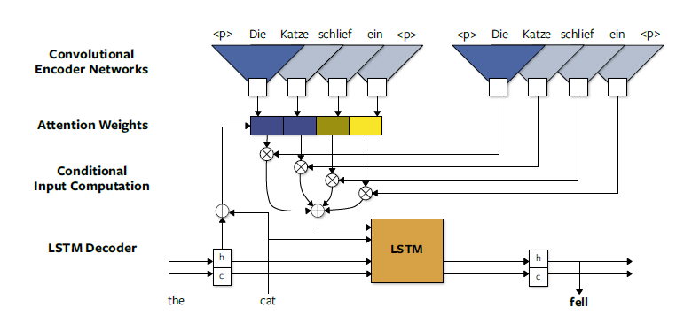
Using Convolutional Encoder in MT
CNN-a: for weight calculation
CNN-c: for weighted-sum context

Slide 13
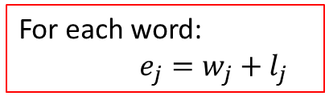
Using Convolutional Encoder in MT
CNN-a: for weight calculation
CNN-c: for weighted-sum context
For each word:
$e_{j}=w_{j}+l_{j}$
word embedding
ein
Die
position embedding
1
2
3
4

Slide 14






Using Convolutional Encoder in MT
CNN-a: for weight calculation
CNN-c: for weighted-sum context
$$z_{j}$$
$$d_{i}$$
$$g_{i}$$

Slide 15







Using Convolutional Encoder in MT
CNN-a: for weight calculation
CNN-c: for weighted-sum context
$$z_{j}$$
$$d_{i}$$
$$c_{i}$$
$$g_{i}$$
$$h_{i}$$
$$h_{i+1}$$
$$c_{i}$$
$$c_{i+1}$$

Slide 16
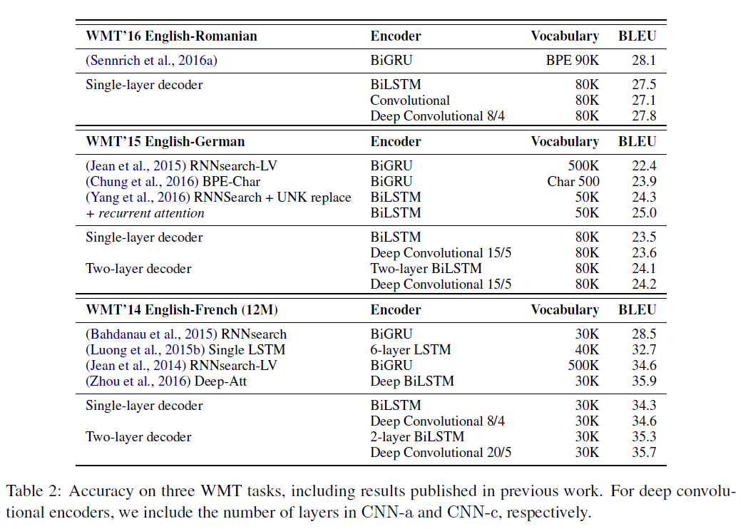
Convolutional Encoder----Experiments
2.8M
3.9M
Notes:
Competitive bleu score

Slide 17
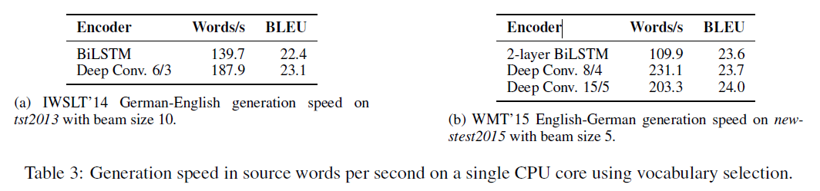
Convolutional Encoder----Experiments
Notes:
speed

Slide 18
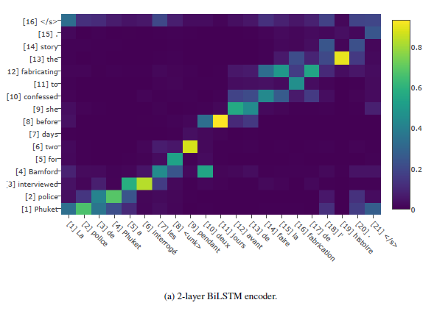
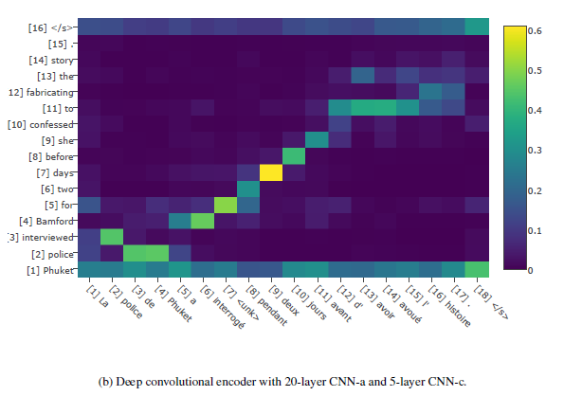
Convolutional Encoder----Experiments
For some CNN encoder models, the attention maxima were consistently shifted by one word.
We determine this per-model offset on the development sets and correct for it.

Slide 19
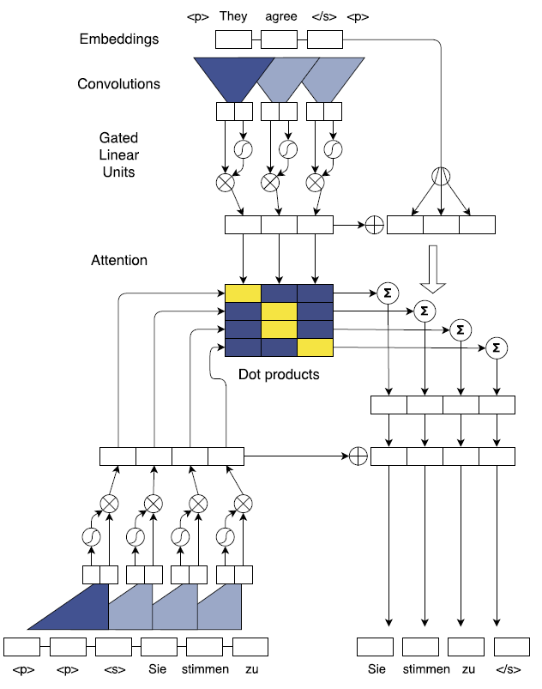

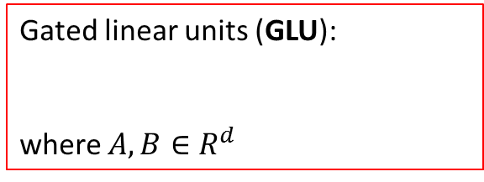
Convolutional Sequence to Sequence
Encoder
Gated linear units (GLU):
where $A, B∈R^{d}$
Decoder

Slide 20



Convolutional Sequence to Sequence
Encoder
For l = 1,2,…,L:
Encoder
$$z_{j}^{u}$$
$$z_{j}^{u}=h_{j}^{L}$$
Decoder

Slide 21









Convolutional Sequence to Sequence
For l = 1,2,…,n:
Encoder
Encoder
$$z_{i}^{u}=h_{i}^{n}$$
For l = 1,2,…,L:
$$z_{j}^{u}$$
$$e_{j}$$
$$d_{i}^{l}$$
Decoder
Decoder
$$h_{i}^{l}$$
$h_{i}^{l}=$ $h_{i}^{l}+c_{i}^{l}$
$$g_{i}$$

Slide 22
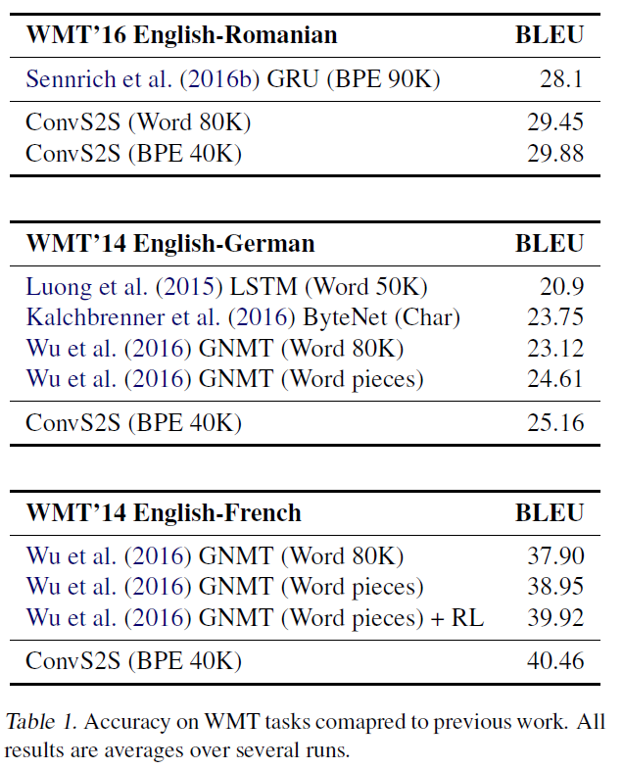
Convolutional Seq2seq----Experiments
Notes:
Better Bleu score

Slide 23
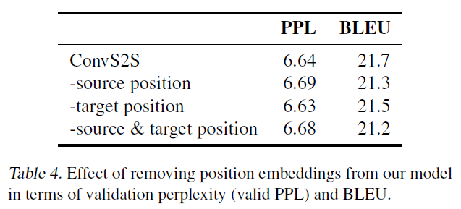
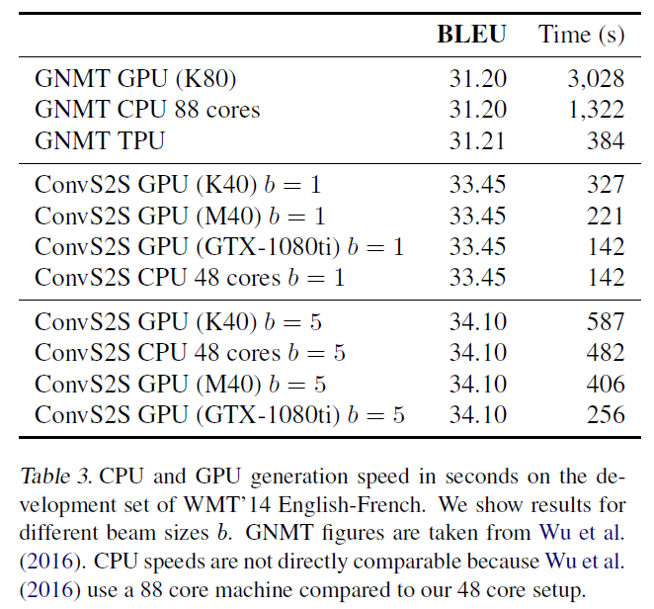
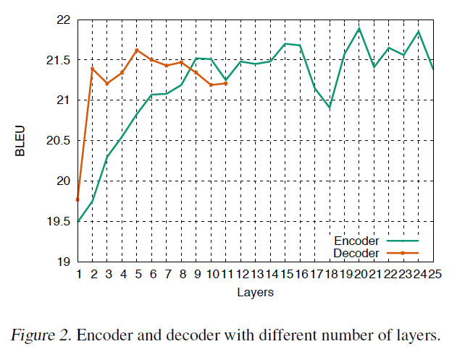
Convolutional Seq2seq----Experiments
Notes:
Speed and ablation study

Slide 24
Thank You.

Slide 25
Background
Recurrent Neural Network (RNN) Encoder and Decoder:
$$y_{1}$$
$$y_{2}$$
$$y_{3}$$
$$h_{1}$$
$$h_{2}$$
$$h_{3}$$
$$h_{0}$$
$$h_{4}$$
$$x_{1}$$
$$x_{2}$$
$$x_{3}$$
$$x_{4}$$
Encoder
Decoder

Slide 26
Background
Evaluation metrics of machine translation:
  BLEU (bilingual evaluation understudy), higher is better.
  PPL (perplexity), lower is better.

