Slide 1
Lecture 1: Introduction and Motivation
CSCI 5510 Big Data Analytics
Prof. Irwin King and Prof. Michael R. Lyu
Computer Science & Engineering Dept.
The Chinese University of Hong Kong

Slide 2







Motivation
Do you want to work in these companies?

Slide 3
Motivation of the Course
Do you want to understand what is big data? What are the main characteristics of big data?
Do you want to understand the infrastructure and techniques of big data analytics?
Do you want to know the research challenges in the area of big data learning and mining?

Slide 4
Motivation of this Lecture
Introduce the overall structure of this course
Introduce the evolution of big data
Introduce the characteristics of big data
Introduce the seven typical problems, strategies, and lessens of analyzing big data

Slide 5
Outline
Administrative
Introduction

Slide 6
Student Expectations
a positive, respectful, and engaged academic environment inside and outside the classroom;
to attend classes at regularly scheduled times without undue variations, and to receive before term-end adequate make-ups of classes that are canceled due to leave of absence of the instructor;
to receive a course syllabus;
to consult with the instructor and tutors through regularly scheduled office hours or a mutually convenient appointment;

Slide 7
Student Expectations
to have reasonable access to University facilities and equipment for assignments and/or objectives;
to have access to guidelines on University’s definition of academic misconduct;
to have reasonable access to grading instruments and/or grading criteria for individual assignments, projects, or exams and to review graded material;
to consult with each course’s faculty member regarding the petition process for graded coursework.

Slide 8
Faculty Expectations
a positive, respectful, and engaged academic environment inside and outside the classroom;
students to appear for class meetings timely;
to select qualified course tutors;
students to appear at office hours or a mutual appointment for official academic matters;
full attendance at examination, midterms, presentations, and laboratories;

Slide 9
Faculty Expectations
students to be prepared for class, appearing with appropriate materials and having completed assigned readings and homework;
full engagement within the classroom, including focus during lectures, appropriate and relevant questions, and class participation;
to cancel class due to emergency situations and to cover missed material during subsequent classes;
students to act with integrity and honesty.

Slide 10
Course Objective
To understand the current key issues on big data and the associated business/scientific data applications;
To teach the fundamental techniques and principles in achieving big data analytics with scalability and streaming capability
To interpret business models and scientific computing results
Able to apply software tools for big data analytics

Slide 11
Course Description
This course aims at teaching students the state-of-the-art big data analytics, including techniques, software, applications, and perspectives with massive data.
The class will cover, but not be limited to, the following topics:
  distributed file systems such as Google File System, Hadoop Distributed File System, CloudStore, and map-reduce technology;
  similarity search techniques for big data such as minhash, locality-sensitive hashing;
  specialized processing and algorithms for data streams;
  big data search and query technology;
  big graph analysis;
  recommendation systems for Web applications.
The applications may involve business applications such as
  online marketing, computational advertising, location-based services, social networks, recommender systems, healthcare services, also covered are scientific and astrophysics applications such as environmental sensor applications, nebula search and query, etc.

Slide 12
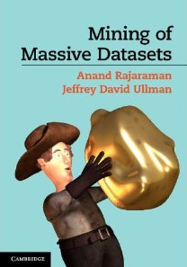
Textbook
Mining of Massive Datasets
Anand Rajaraman
  web and technology entrepreneur
  co-founder of Cambrian Ventures and Kosmix
  co-founder of Junglee Corp (acquired by Amazon for a retail platform)
Jeff Ullman
  The Stanford W. Ascherman Professor of Computer Science (Emeritus)
  Interests in database theory, database integration, data mining, and education using the information infrastructure.

Slide 13
Textbook
Amazon
  http://www.amazon.com/Mining-Massive-Datasets-Anand-Rajaraman/dp/1107015359
PDF of the book for online viewing
  http://infolab.stanford.edu/~ullman/mmds.html

Slide 14


Instructors
Prof. Irwin King
  www.cse.cuhk.edu.hk/~king
  king@cse.cuhk.edu.hk
  Office hours: TBD
Prof. Michael R. Lyu
  www.cse.cuhk.edu.hk/~lyu
  lyu@cse.cuhk.edu.hk
  Office hours: 10:00-12:00, Tuesday

Slide 15
Tutor
Mr. CHENG Chen “Robbie”
Mr. LING Guang “Zachary”
  www.cse.cuhk.edu.hk/~{cchen, gling}
  {cchen, gling}@cse.cuhk.edu.hk
  Office venue: 1024, Ho Sin-Hang Engineering Building
  Office hour: TBD

Slide 16
Time and Venue
Lecture
  Monday from 9:30 am to 12:15 pm
  KKB 101
Tutorial
  TBD
Course URL
  http://www.cse.cuhk.edu.hk/~csci5510

Slide 17
Prerequisites
Algorithms
  Basic data structures
Basic probability
  Moments, typical distributions, …
Programming
  Your choice
We provide some background, but the class will be fast paced

Slide 18
What Will We Learn?
We will learn to analyze different types of data:
  Data is high dimensional
  Data is a graph
  Data is infinite/never-ending
  Data is labeled
We will learn to use different models of computation:
  MapReduce
  Streams and online algorithms
  Single machine in-memory

Slide 19
What Will We Learn?
We will learn to solve real-world problems:
  Recommender systems
  Link analysis
  Digit handwritten recognition
  Community detection
We will learn various “tools”:
  Linear algebra (SVD, Rec. Sys., Communities)
  Optimization (stochastic gradient descent)
  Dynamic programming (frequent itemsets)
  Hashing (LSH, Bloom filters)

Slide 20
Syllabus
Week | Content | Reading Materials
1 | Introduction | Ch.1. of MMDS
2 | MapReduce | Ch.2/6. of MMDS
3 | Locality Sensitive Hashing | Ch.3. of MMDS
4 | Mining Data Streams | Ch.4. of MMDS
5 | Scalable Clustering | Ch.7. of MMDS
6 | Dimensionality Reduction | Ch.11. of MMDS
7 | Recommender systems/Matrix Factorization | Ch.9. of MMDS
8 | Massive Link Analysis | Ch.5. of MMDS
9 | Analysis of Massive Graph | Ch.10. of MMDS
10 | Large Scale SVM | SVM tutorials
11 | Online Learning | Online learning tutorials
12 | Active Learning | Active learning tutorials

Slide 21
Grade Assessment Scheme and Deadlines
Assignments (20%)
  Written assignments
  Coding
Midterm Examination (30%)
  Nov. 4, 9:30am -- 12:00 noon
  Open 1 A4-page note
Project (50%)
  Proposal
  Presentations
  Report
Deadlines (tentative)
  Oct. 13, 2013: Assignment 1
  Oct. 25, 2013: Project proposal
  Nov. 1, 2013: Peer review
  Nov. 28, 2013: Project presentation
  Dec. 1, 2013: Assignment 2
  Dec. 16, 2013: Project report

Slide 22
Class Project
Project is for everyone
Up to three persons per project group
Each group is to design and implement a big data-related project of choice
Detailed schedule will be announced later

Slide 23
Structure

Slide 24
MapReduce (Ch. 2)
R
E
D
U
C
E
Map:
  Accepts input key/value pair
  Emits intermediate key/value pair
Reduce:
  Accepts intermediate key/value* pair
  Emits output key/value pair
Very
big
data
M
A
P
Partitioning
Function
Result

Slide 25
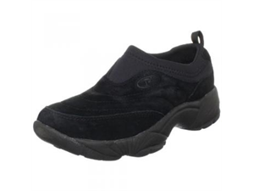
Finding Similar Items: Locality Sensitive Hashing (Ch. 3)
Many problems can be expressed as finding “similar” sets:
  Find near-neighbors in high-dimensional space
Examples:
  Pages with similar words
    For duplicate detection, classification by topic
  Customers who purchased similar products
    Products with similar customer sets
  Images with similar features
  Users who visited the similar websites

Slide 26
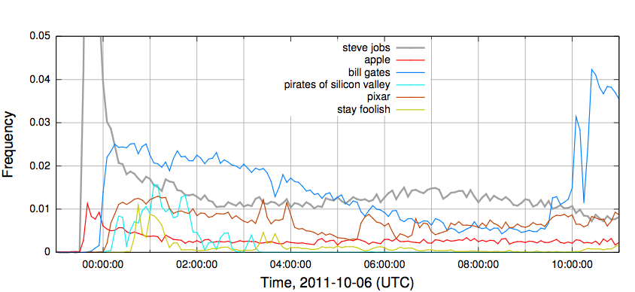
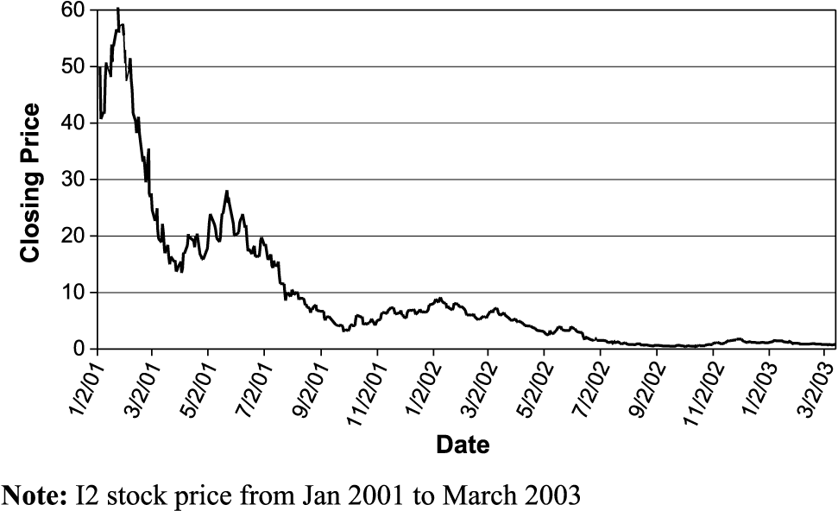
Mining Data Stream (Ch. 4)
Stream Management is important when the input rate is controlled externally:
  Google queries
  Twitter or Facebook status updates
We can think of the data as infinite and non-stationary (the distribution changes over time)

Slide 27
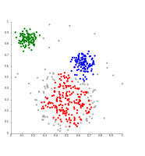
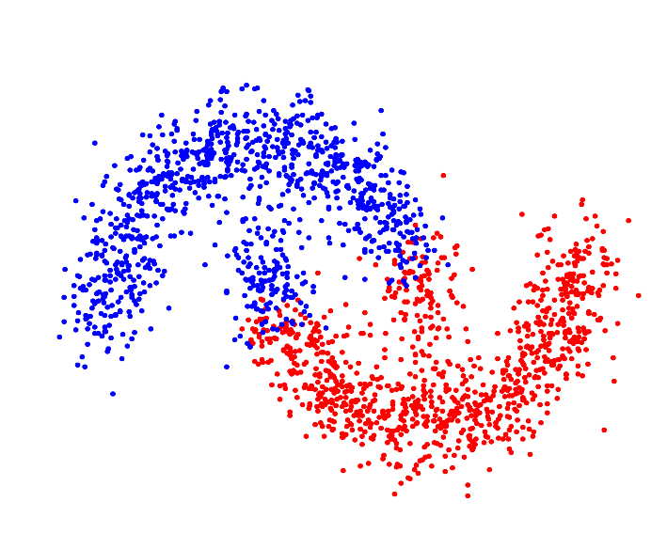
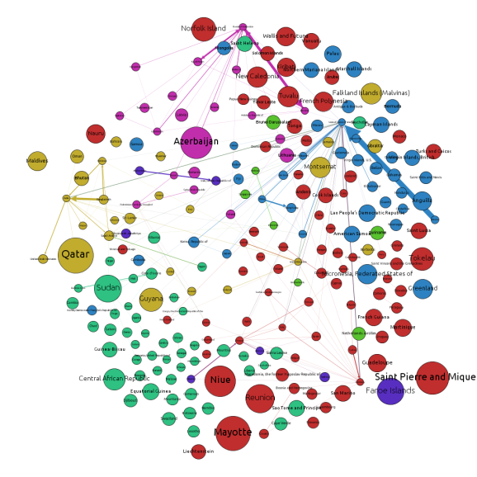
Clustering (Ch. 7)
Given a set of points, with a notion of distance between points, group the points into some number of clusters, so that
  Members of a cluster are close/similar to each other
  Members of different clusters are dissimilar
Notes:
To understand the structure of the data

Slide 28
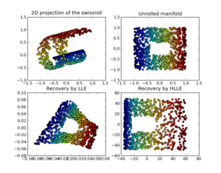
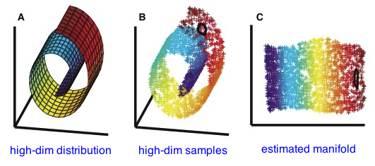
Dimensionality Reduction (Ch. 11)
Discover hidden correlations/topics
  Words that occur commonly together
Remove redundant and noisy features
  Not all words are useful
Interpretation and visualization
Easier storage and processing of the data

Slide 29


Recommender System (Ch. 9)
Main idea: Recommend items to customer x similar to previous items rated highly by x
Example:
  Movie recommendations
    Recommend movies with same actor(s),
    director, genre, …
  Websites, blogs, news
    Recommend other sites with “similar”
    content

Slide 30
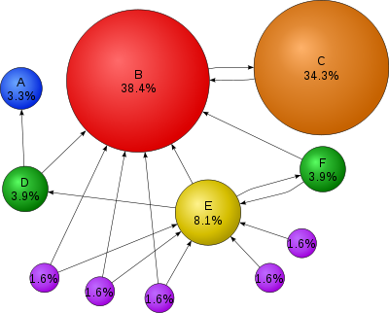
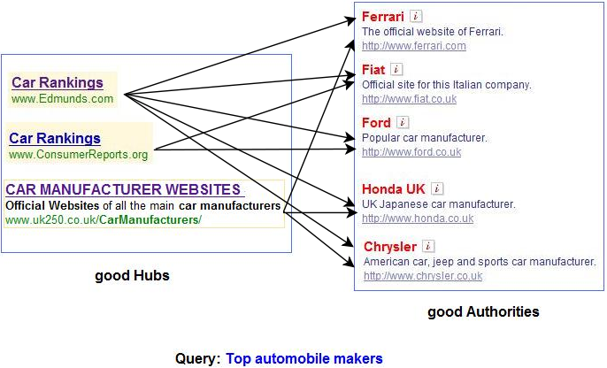
Link Analysis (Ch. 5)
Computing importance of nodes in a graph

Slide 31
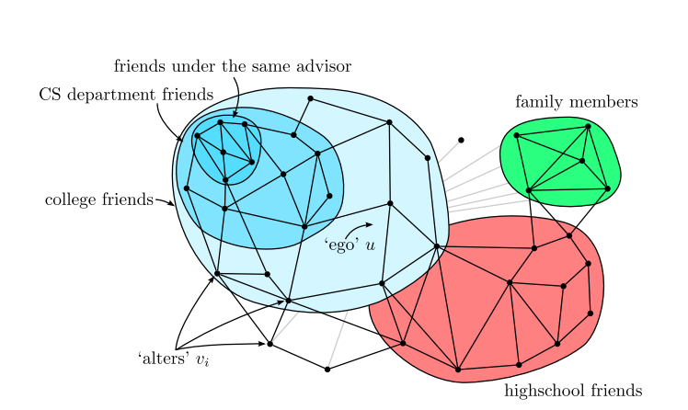
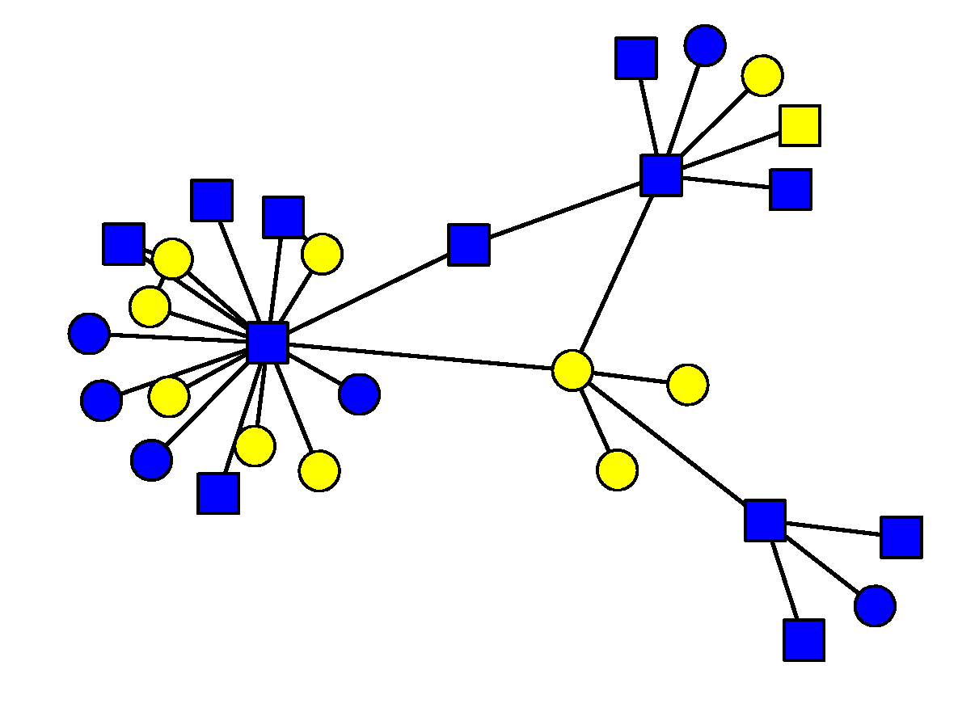
Graph Algorithms (Ch. 10)
To know properties of large-scale networks
  Scale-free distribution
  Small world effect
To understand social graph structure

Slide 32
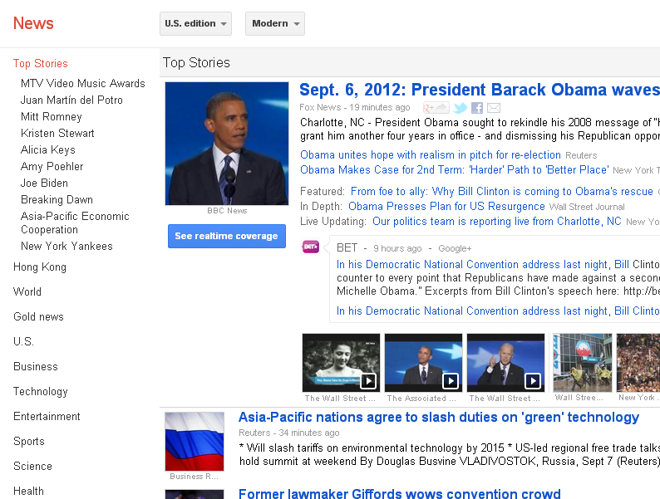
Large Scale Classification
How does a computer know whether a news is technology and health? Classification
Notes:
News change every second, volume is large

Slide 33
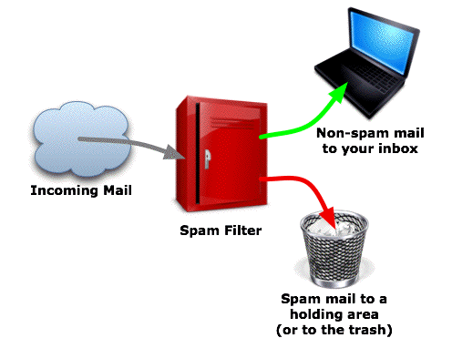
Online Learning Algorithms
How to update the decision function and make decision as a new sample comes?

Slide 34
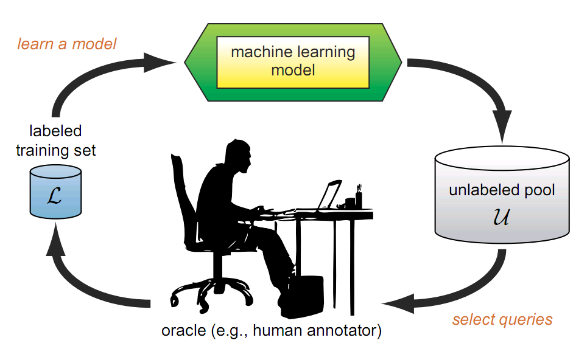
Active Learning
What is Active Learning?
  A learning algorithm is able to interactively query the user (or some other information source) to obtain the desired outputs at new data points

Slide 35
Outline
Administrative
Introduction

Slide 36
Introduction to Big Data

Slide 37
Definition of Big Data
Big data is a collection of data sets so large and complex that it becomes difficult to process using on-hand database management tools or traditional data processing applications.
From wiki

Slide 38
Evolution of Big Data
Birth: 1880 US census
Adolescence: Big Science
Modern Era: Big Business

Slide 39
Birth: 1880 US census

Slide 40
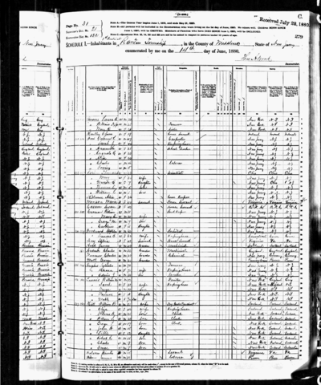
The First Big Data Challenge
1880 census
50 million people
Age, gender (sex), occupation, education level, no. of insane people in household
Notes:
Took over seven years to manually tabulate and report on the data

Slide 41
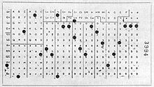
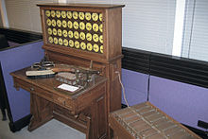
The First Big Data Solution
Hollerith Tabulating System
Punched cards – 80 variables
Used for 1890 census
6 weeks instead of 7+ years
Notes:
A mechanical device called the Hollerith Tabulating system, which worked with punch cards that could hold about 80 variables.
The HT system revolutionized the value of census data, making it actionable and increasing its value an untold amount. Analysis took six weeks instead of seven years. It allowed the government to act on information in a reasonable amount of time.
The ability to analyze the 1890 census led to an improved understanding of the populace, which the government could use to shape economic and social policies ranging from taxation to education to military conscription.

Slide 42
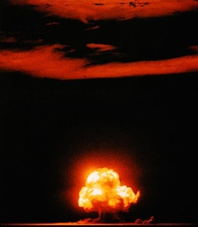
Manhattan Project (1946 - 1949)
$2 billion (approx. 26 billion in 2013)
Catalyst for “Big Science”
Notes:
The next giant leap for Big Data Analytics came with the Manhattan project, the US development of the atomic bomb during World War II.
The Manhattan project not only introduced the concept of Big Data analysis with computers, it was also the catalyst for Big Science

Slide 43
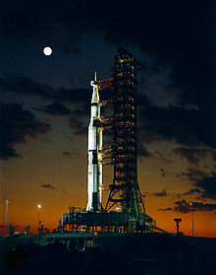
Space Program (1960s)
Began in late 1950s
An active area of big data nowadays
Notes:
It was driven by a Space Race between the Sovient Union and the United States, the launch of the first man-made objective to orbit the Earth, the USSR’s Sputnik 1, on 4 October 1957, the first Moon landing by the American Apollo 11 craft on 20 July 1969.

Slide 44
Adolescence: Big Science

Slide 45
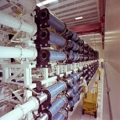
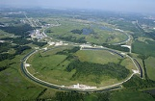
Big Science
The International Geophysical Year
  An international scientific project
  Last from Jul. 1, 1957 to Dec. 31, 1958
A synoptic collection of observational data on a global scale
Implications
  Big budgets, Big staffs, Big machines, Big laboratories
Notes:
Large Hadron Collider, costing $5 and $10 billion

Slide 46
Summary of Big Science
Laid foundation for ambitious projects
  International Biological Program
  Long Term Ecological Research Network
Ended in 1974
Many participants viewed it as a failure
Nevertheless, it was a success
  Transform the way of processing data
  Realize original incentives
  Provide a renewed legitimacy for synoptic data collection
Notes:
The project laid the foundation for more ambitious projects that gathered more specialized data for specific analysis, such as the International Biological Program and later the Long Term Ecological Research Network. Both increased the mountains of data gathered, incorporated newer analysis technologies, and push IT technology further into the spotlight.
The IBP encountered difficulties when the institutional structures, research methodologies, and data management implied by the Big Science mode of research collided with the epistemic (认识的) goals, practices, and assumptions of many of the scientists involved.
Way of processing data: collect, share, analyze, and redefine how IT can be used for data analysis
Incentives: emphasis on Big Data, implementation of the organizational structure of Big Science
Synoptic: 提纲的，概要的

Slide 47
Lessons from Big Science
Spawn new big data projects
  Weather prediction
  Physics research (supercollider data analytics)
  Astronomy images (planet detection)
  Medical research (drug interaction)
  …
Businesses latched onto its techniques, methodologies, and objectives

Slide 48
Modern Era: Big Business

Slide 49
Big Science vs. Big Business
Common
  Need technologies to work with data
  Use algorithms to mine data
Big Science
  Source: experiments and research conducted in controlled environments
  Goals: to answer questions, or prove theories
Big Business
  Source: transactions in nature and little control
  Goals: to discover new opportunities, measure efficiencies, uncover relationships
Notes:
from sources that are transactional in nature and have little control over the original of the data
Use Big Data to
uncover relationships among what was thought to be unrelated data sets

Slide 50

Big Data is Everywhere!
Lots of data is being collected and warehoused
  Web data, e-commerce
  Purchases at department/
  grocery stores
  Bank/Credit Card
  transactions
  Social Networks

Slide 51
How Much Data?
IDC reports
  2.7 billion terabytes in 2012, up 48 percent from 2011
  8 billion terabytes in 2015
Sources
  Structured corporate databases
  Unstructured data from webpages, blogs, social networking messages, …
  Countless digital sensors
Volume
  Google processes 20 PB (10¹⁵) a day of user-generated data
  Facebook
    2.5B - content items shared
    2.7B - ‘Likes’
    300M - photos uploaded
    100+PB - disk space in a single HDFS cluster
    105TB - data scanned via Hive (30min)
    70,000 - queries executed
    500+ TB (10¹²) - new data ingested
Notes:
International Data Corporation

Slide 52
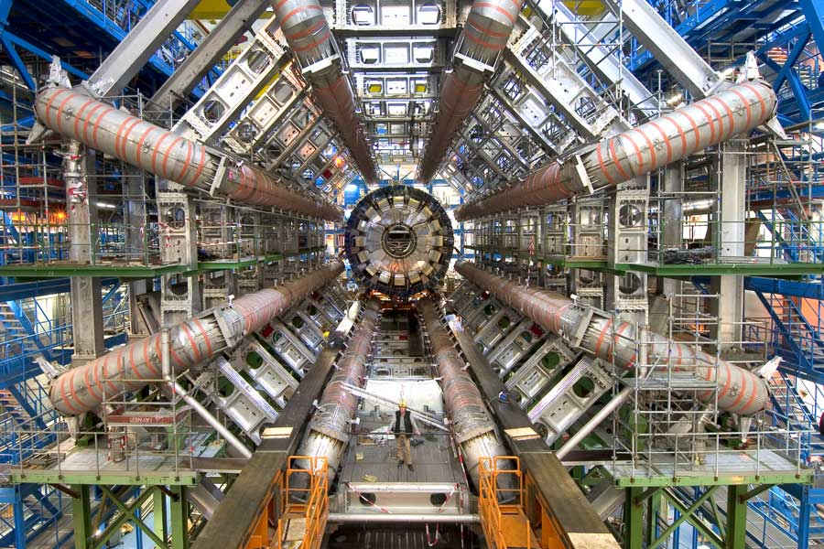
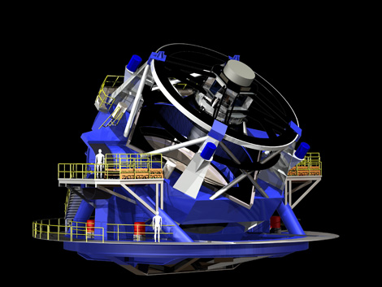
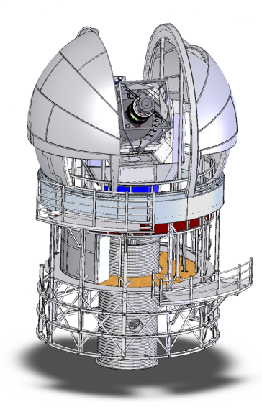
Big Science
CERN - Large Hadron Collider
  ~10 PB/year at start
  ~1000 PB in ~10 years
  2500 physicists collaborating
Large Synoptic Survey Telescope (NSF, DOE, and private donors)
  ~5-10 PB/year at start in 2012
  ~100 PB by 2025
Pan-STARRS (Haleakala, Hawaii) US Air Force
  now: 800 TB/year
  soon: 4 PB/year
Notes:
CERN – Acronym for the French "Conseil Européen pour la Recherche Nucléaire", or European Council for Nuclear Research.
Pan-STARRS – the Panoramic Survey Telescope & Rapid Response System, an innovative design for a wide-field imaging facility developed at the University of Hawaii's Institute for Astronomy.

Slide 53








Characteristics of Big Data: 4V
Volume
Velocity
Variety
Veracity
Volume
Volume
Volume
Volume
From terabytes to exabyte to zetabytes of existing data to process
Batch data, real-time data, streaming data, milliseconds to seconds to respond
Structured, semi-structured, unstructured, text, pictures, multimedia
Uncertainty due to data inconsistency & incompleteness, ambiguities, deception, model approximation
Text
Images
8 billion TB in 2015, 40 ZB in 2020
5.2TB per person
New sharing over 2.5 billion per day
new data over 500TB per day
Videos
Audios

Slide 54
Big Data Analytics
Definition: A process of inspecting, cleaning, transforming, and modeling big data with the goal of discovering useful information, suggesting conclusions, and supporting decision making
Hot in both industrial and research societies

Slide 55
Big Data Analytics
Related conferences
  IEEE Big Data
  IEEE Big Data and Distributed Systems
  WWW
  KDD
  WSDM
  CIKM
  SIGIR
  AAAI/IJCAI
  NIPS
  ICML
  TREC
  ACL
  EMNLP
  COLING
  …

Slide 56
Types of Analytics at eBay
Basically measure anything possible - A few examples:
Marketing
Buyer Experience
Finance
Trust & Safety
Technology Operations
Customer Service
Loyalty
Information Security
Infrastructure
Finding
User Behavior
Seller Experience

Slide 57
What is Data Mining?
Discovery of patterns and models that are:
  Valid: hold on new data with some certainty
  Useful: should be possible to act on the item
  Unexpected: non-obvious to the system
  Understandable: humans should be able to interpret the pattern
A particular data analytic technique

Slide 58
Data Mining Tasks
Descriptive Methods
  Find human-interpretable patterns that describe the data
Predictive Methods
  Use some variables to predict unknown or future values of other variables

Slide 59
Data Mining: Culture
Data mining overlaps with:
  Databases: Large-scale data, simple queries
  Machine learning: Small data, Complex models
  Statistics: Predictive Models
Statistics/
AI
Machine learning/
Pattern Recognition
Different cultures:
  To a DB person, data mining is an extreme form of analytic processing – queries that examine large amounts of data
    Result is the query answer
  To a stats/ML person, data-mining is the inference of models
    Result is the parameters of the model
Data Mining
Database systems

Slide 60
Relation between Data Mining and Data Analytics
Analytics include both data analysis (mining) and communication (guide decision making)
Analytics is not so much concerned with individual analyses or analysis steps, but with the entire methodology

Slide 61
Meaningfulness of Answers
A big data-analytics risk is that you will “discover” patterns that are meaningless
Statisticians call it Bonferroni’s principle:
  (roughly) if you look in more places for interesting patterns than your amount of data will support, you are bound to find crap

Slide 62
Examples of Bonferroni’s Principle
Total Information Awareness (TIA)
  In 2002, intend to mine all the data it could find, including credit-card receipts, hotel records, travel data, and many other kinds of information in order to track terrorist activity
  A big objection was that it was looking for so many vague connections that it was sure to find things that were bogus and thus violate innocents’ privacy

Slide 63
The “TIA” Story
Suppose we believe that certain groups of evil-doers are meeting occasionally in hotels to plot doing evil
We want to find (unrelated) people who at least twice have stayed at the same hotel on the same day

Slide 64
Details of The “TIA” Story
10⁹ people might be evil-doers
Examining hotel records for 1000 days
Each person stays in a hotel 1% of the time (10 days out of 1000)
Hotels hold 100 people (so 10⁵ hotels, 1% of total people)
If everyone behaves randomly (i.e., no evil-doers) will the data mining detect anything suspicious?

Slide 65
Calculation (1)
q at
some
hotel
p at
some
hotel
Same
hotel
Probability that given persons p and q will be at the same hotel on given day d:
  1/100 × 1/100 × 10⁻⁵ = 10⁻⁹.
Probability that p and q will be at the same hotel on given days d₁ and d₂:
  10⁻⁹ × 10⁻⁹ = 10⁻¹⁸.
Pairs of days:
  5×10⁵

Slide 66
Calculation (2)
Probability that p and q will be at the same hotel on some two days:
  5×10⁵ × 10⁻¹⁸ = 5×10⁻¹³
Pairs of people:
  5×10¹⁷
Expected number of “suspicious” pairs of people:
  5×10¹⁷ × 5×10⁻¹³ = 250,000

Slide 67
Summary of The “TIA” Story
Suppose there are 10 pairs of evil-doers who definitely stayed at the same hotel twice
Analysts have to sift through 250,000 candidates to find the 10 real cases
Make sure the property, e.g., two people stayed at the same hotel twice, does not allow so many possibilities that random data will surely produce “facts of interest”
Understanding Bonferroni’s Principle will help you look a little less stupid than a parapsychologist

Slide 68
Things Useful to Know
TF.IDF measure of word importance
Hash functions
Secondary storage (disk)
The base of natural logarithms
Power laws

Slide 69
In-class Practice
Go to practice

Slide 70
A Framework in Big Data Analytics*
Seven typical statistical problems
Seven lessons in learning from big data
Seven tasks of machine learning / data mining
Seven giants of data
Seven general strategies
* Work by Alexander Gray

Slide 71
Seven Typical Statistical Problems
Object detection(e.g. quasars): classification
Photometric redshift estimation: regression, conditional density estimation
Multidimensional object discovery: querying, dimension reduction, density estimation, clustering
Point-set comparison: testing and matching
Measurement errors: errors in variables
Extension to time domain: time series analysis
Observation costs: active learning

Slide 72
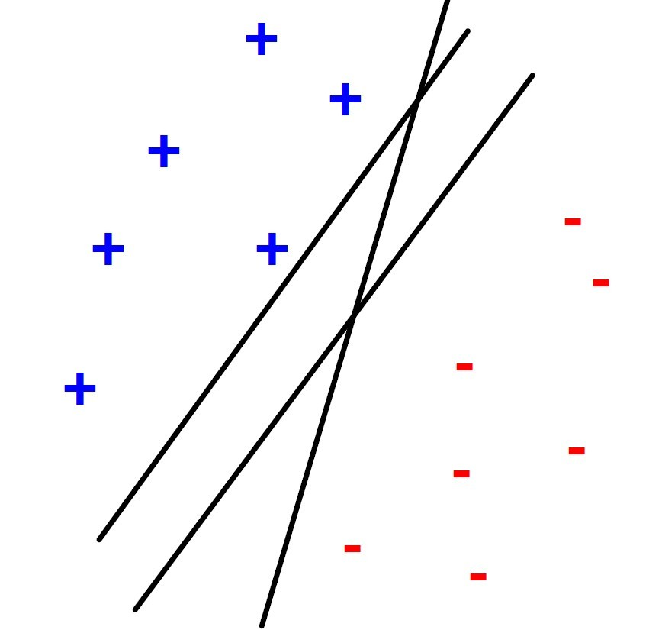
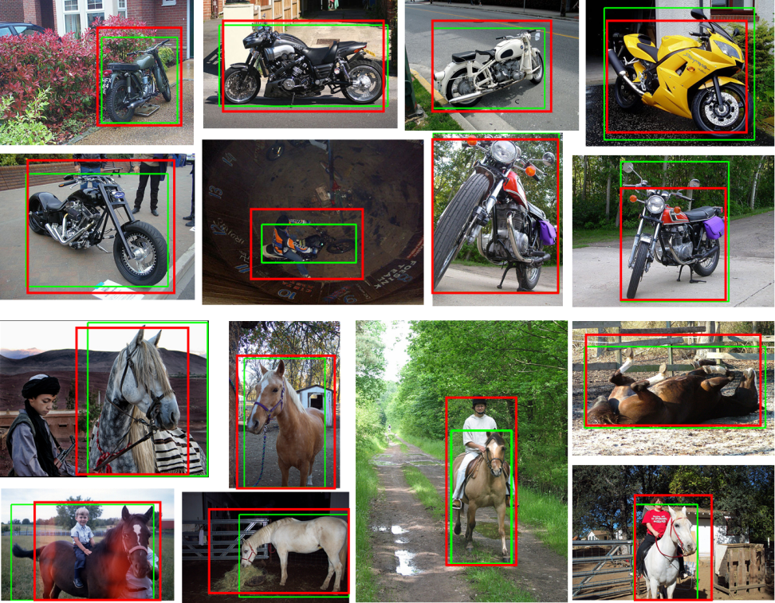
Object Detection: Classification

Slide 73
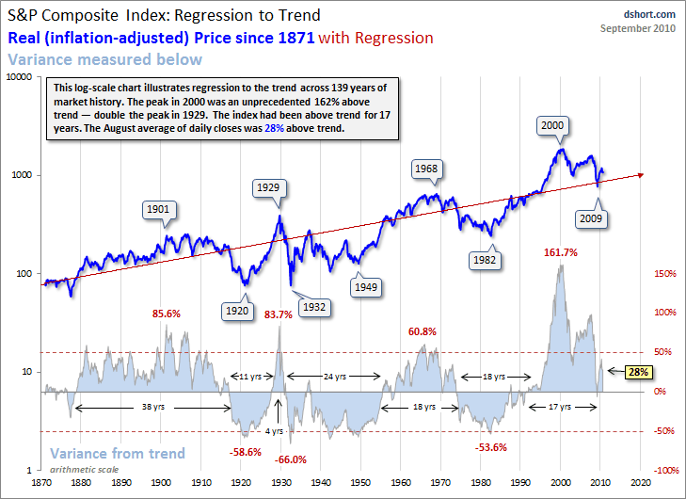
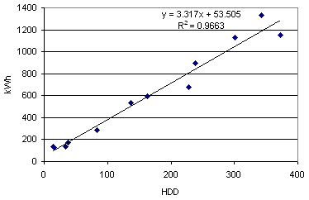
Regression/Conditional Density Estimation

Slide 74
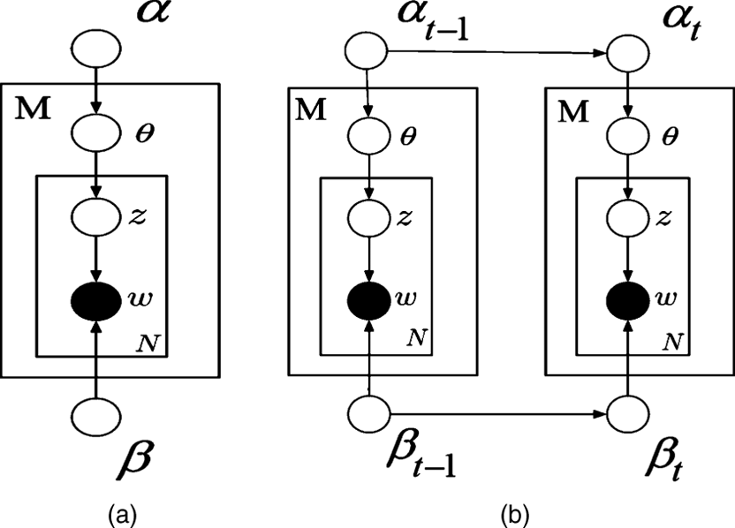
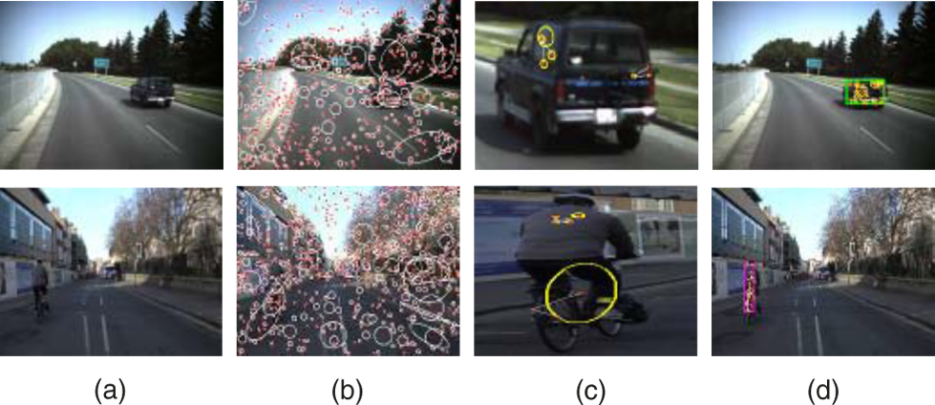
Querying/Dimension Reduction/Density Estimation/Clustering

Slide 75
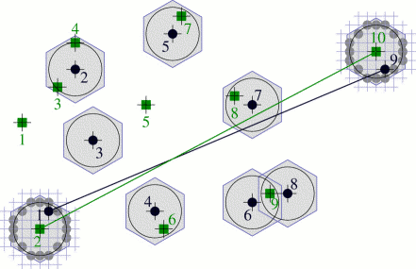
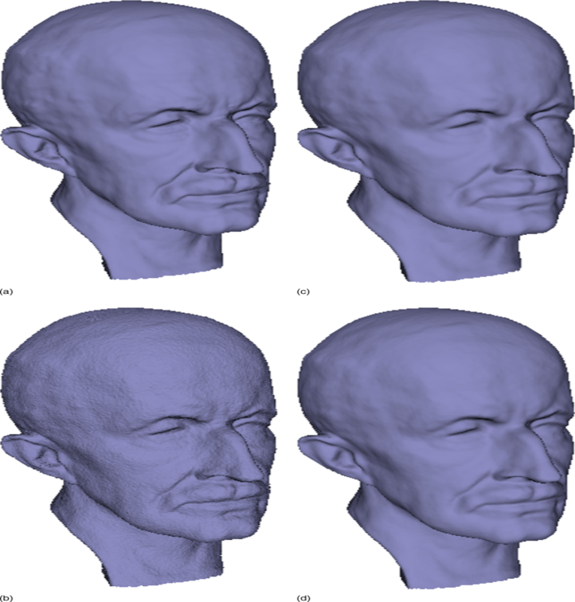
Point-set Comparison: Testing and Matching

Slide 76
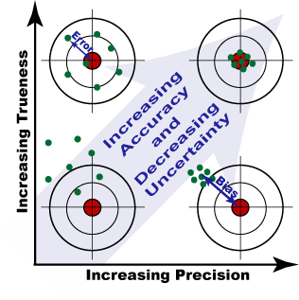
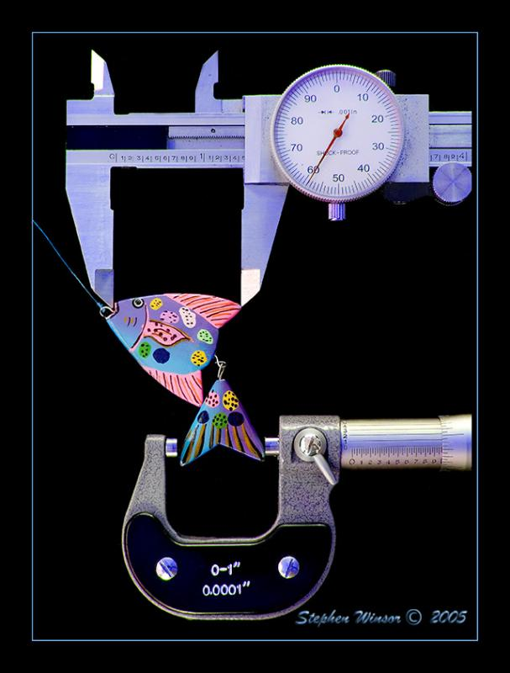
Measurement Errors: Errors in Variables

Slide 77
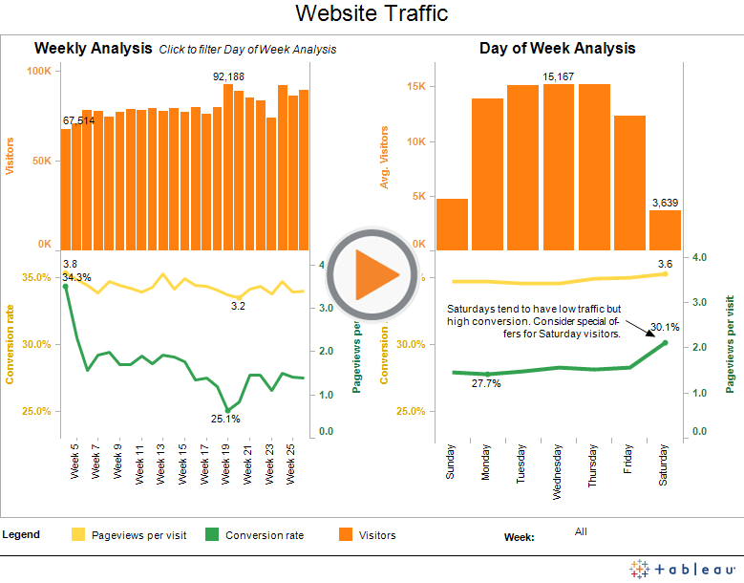
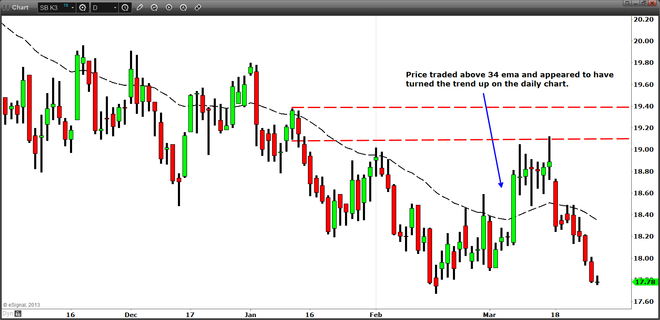
Time Series Analysis

Slide 78
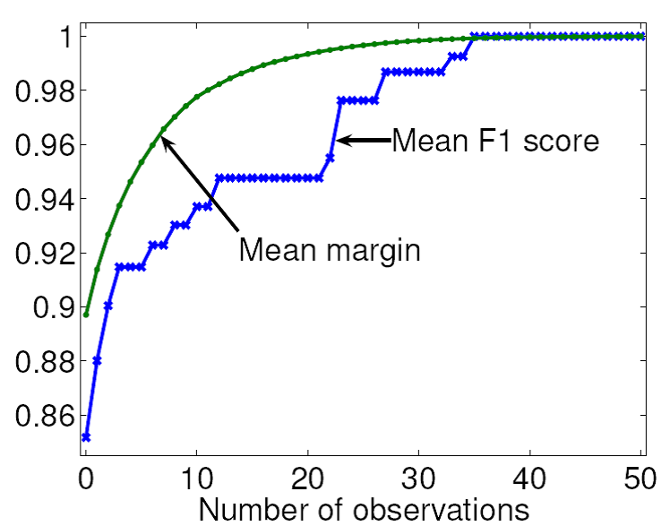
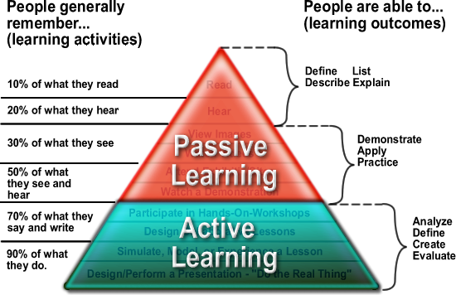
Observation Costs: Active Learning

Slide 79
Seven Lessons in Learning from Big Data
Big data is a fundamental phenomenon
The system must change
Simple solutions run out of steam
ML becomes important
Data quality becomes important
Temporal analysis become important
Prioritized sensing becomes important

Slide 80
Seven Lessons in Learning from Big Data
Big data is a fundamental phenomenon
The system must change
Simple solutions run out of steam
ML becomes important
Data quality becomes important
Temporal analysis become important
Prioritized sensing becomes important

Slide 81
Seven Lessons in Learning from Big Data
Big data is a fundamental phenomenon
The system must change
Simple solutions run out of steam
ML becomes important
Data quality becomes important
Temporal analysis become important
Prioritized sensing becomes important

Slide 82
Current Options
Subsample (e.g. then use R, Weka)
Use a simpler method (e.g. linear)
Use brute force (e.g. Hadoop)
Faster algorithm

Slide 83
What Makes this Hard?
The key bottlenecks are fundamental computer science/numerical methods problems of many types
Useful speedups are needed.
1. Error guarantees
2. Known runtime growths

Slide 84
What Makes this Hard?
The key bottlenecks are fundamental computer science/numerical methods problems of many types
Useful speedups are needed
1. Error guarantees
2. Known runtime growths

Slide 85
Seven Lessons in Learning from Big Data
Big data is a fundamental phenomenon
The system must change
Simple solutions run out of steam
ML becomes important
Data quality becomes important
Temporal analysis become important
Prioritized sensing becomes important

Slide 86
Seven Lessons in Learning from Big Data
Big data is a fundamental phenomenon
The system must change
Simple solutions run out of steam
ML becomes important
Data quality becomes important
Temporal analysis become important
Prioritized sensing becomes important

Slide 87
Seven Lessons in Learning from Big Data
Big data is a fundamental phenomenon
The system must change
Simple solutions run out of steam
ML becomes important
Data quality becomes important
Temporal analysis become important
Prioritized sensing becomes important

Slide 88
Measurement Errors
Empirical improvement in quasar detection and redshifts by incorporating measurement errors
Errors in variables:
  Kernel estimation with heteroskedastic errors in variables in general dimension [Ozakin and Gray, in prep]
    Fast evaluation of deconvolution kernel via random Fourier components
    Theoretical rigor: asymptotic consistency
    Then extend to: submanifold (high-D) KDE [Ozakin and Gray, NIPS 2010], convex adaptive KDE [Sastry and Gray, AISTATS 2011]

Slide 89
Extension to the Time Domain
Can we do everything (classification, manifold learning, clustering, etc) with time series now instead of i.i.d. vectors?
Time series representation:
  Functional data analysis, e.g. functional ICA [Mehta and Gray, SDM 2009]
  Similarity measure (kernel) for stochastic processes [Mehta and Gray, arxiv 2010]
    Computationally efficient
    Empirical improvement over previous kernels
    Theoretical rigor: generalization error bound

Slide 90
Seven Typical Tasks of Machine Learning/Data Mining
Querying: spherical range-search O(N), orthogonal range-search O(N), nearest-neighbor O(N), all-nearest-neighbors O(N²)
Density estimation: mixture of Gaussians, kernel density estimation O(N²), kernel conditional density estimation O(N³)
Classification: decision tree, nearest-neighbor classifier O(N²), kernel discriminant analysis O(N²), support vector machine O(N³) , L_{p} SVM
Regression: linear regression, LASSO, kernel regression O(N²), Gaussian process regression O(N³)
Dimension reduction: PCA, non-negative matrix factorization, kernel PCA O(N³), maximum variance unfolding O(N³); Gaussian graphical models, discrete graphical models
Clustering: k-means, mean-shift O(N²), hierarchical (FoF) clustering O(N³)
Testing and matching: MST O(N³), bipartite cross-matching O(N³), n-point correlation 2-sample testing O(N^{n}), kernel embedding
Notes:
so these are statistics that characterize a dataset, and you can use them to infer all sorts of things about distributions.
the 2-point, which appears under many names in many fields, is just the n=2 term of the n-point correlation function hierarchy, which forms the foundation for spatial statistics, and is used heavily in many sciences.

Slide 91
Seven Typical Tasks of Machine Learning/Data Mining
Querying: spherical range-search O(N), orthogonal range-search O(N), nearest-neighbor O(N), all-nearest-neighbors O(N²)
Density estimation: mixture of Gaussians, kernel density estimation O(N²), kernel conditional density estimation O(N³)
Classification: decision tree, nearest-neighbor classifier O(N²), kernel discriminant analysis O(N²), support vector machine O(N³), L_{p} SVM
Regression: linear regression, LASSO, kernel regression O(N²), Gaussian process regression O(N³)
Dimension reduction: PCA, non-negative matrix factorization, kernel PCA O(N³), maximum variance unfolding O(N³); Gaussian graphical models, discrete graphical models
Clustering: k-means, mean-shift O(N²), hierarchical (FoF) clustering O(N³)
Testing and matching: MST O(N³), bipartite cross-matching O(N³), n-point correlation 2-sample testing O(N^{n}), kernel embedding

Slide 92
Seven Typical Tasks of Machine Learning/Data Mining
Querying: spherical range-search O(N), orthogonal range-search O(N), nearest-neighbor O(N), all-nearest-neighbors O(N²)
Density estimation: mixture of Gaussians, kernel density estimation O(N²), kernel conditional density estimation O(N³)
Classification: decision tree, nearest-neighbor classifier O(N²), kernel discriminant analysis O(N²), support vector machine O(N³) , L_{p} SVM
Regression: linear regression, kernel regression O(N²), Gaussian process regression O(N³), LASSO
Dimension reduction: PCA, non-negative matrix factorization, kernel PCA O(N³), maximum variance unfolding O(N³), Gaussian graphical models, discrete graphical models
Clustering: k-means, mean-shift O(N²), hierarchical (FoF) clustering O(N³)
Testing and matching: MST O(N³), bipartite cross-matching O(N³), n-point correlation 2-sample testing O(N^{n}), kernel embedding
Computational
Problem!
Notes:
7 tasks of machine learning/data minging
1. Querying: spherical range-search O(N), orthogonal range-search O(N), nearest-neighbor O(N), all-nearest-neighbors O(N^2)
2. Density estimation: mixture of Gaussians, kernel density estimation O(N^2), kernel conditional density estimation O(N^3), submanifold density estimation[Grey, nips2010, O(N^3)], convex adaptive kernel estimation[Grey, AISTATS 2011, O(N^4)]
3. Classification:decision tree, nearest-neighbor classifier O(N^2), kernel discriminant analysis O(N^2), support vector machine O(N^3), LpSVM, non-negative SVM [Guan et al. ICDM 2011]
4. Regression: linear regression, LASSO, kernel regresssion O(N^2), Gaussian process regression O(N^3)
5. Dimension reduction: PCA, non-negative matrix factorizatino, kernel PCA O(N^3), maximum variance unfolding O(N^3); Gaussian graphical models, discrete graphical models, rank-preserving maps[Ouyang and Gray, ICML 2008] o(N^2); isometric separation maps [Gray, MLSP 2009] O(N^3), isometric NMF[Gray, MLSP 2009] O(N^3), functional ICA [Mehta and Gray, 2009], density preserving maps [Gray in prep] O(N^3)
6. Clustering: K-means, mean-shirt O(N^2), hierarchical (FoF) clustering O(N^3)
7. Testing and matching: MST O(N^3), bipartite cross-matching O(N^3), n-point correlation 2-sample testing O(N^n), kernel embedding

Slide 93
Seven “Giants” of Data
(computational problem types)
Basic statistics: means, covariances, etc.
Generalized N-body problems: distances, geometry
Graph-theoretic problems: discrete graphs
Linear-algebraic problems: matrix operations
Optimizations: unconstrained, convex
Integrations: general dimension
Alignment problems: dynamic programming, matching

Slide 94
Seven General Strategies
Divide and conquer/ indexing (trees)
Function transforms (series)
Sampling (Monte Carlo, active learning)
Locality (caching)
Streaming (online)
Parallelism (clusters, GPUs)
Problem transformation (reformulations)

Slide 95
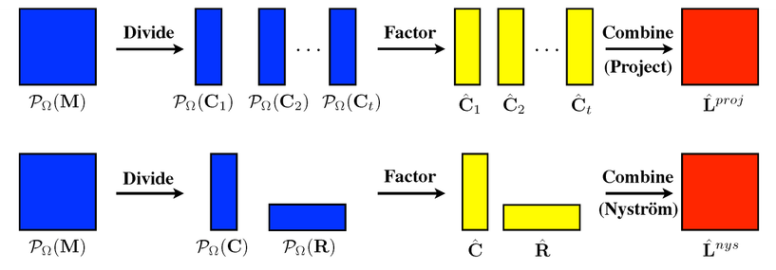
1. Divide and Conquer
Multidimensional trees:
  K-d trees [Bentley 1970], ball-trees [Omohundro 1991], spill trees [Liu, Moore, Gray, Yang,nips2004], cover tree [Beygelzimer et al.2006] , cosine tree [Holmes, Isbell, Gray, Nips 2009], subspace trees [Lee and Gray nips 2009], cone trees [Ram and Gray kdd2012], max-margin trees [Ram and Gray SDM 2012], kernel trees [Ram and Gray]

Slide 96
2. Function Transforms
Fastest approach for:
  Kernel estimation (low-ish dimension): dual-tree fast Gauss transforms (multipole/Hermite expansions) [Lee, Gray, Moore NIPS 2005], [Lee and Gray, UAI 2006]
  KDE and GP (kernel density estimation, Gaussian process regression) (high-D): random Fourier functions [Lee and Gray, in prep]
Generalized N-body approach is fundamental: like multidimensional generalization of FFT

Slide 97
3. Sampling
Fastest approach for (approximate):
PCA: cosine trees [Holmes, Gray, lsbell, NIPS 2008]
Kernel estimation: bandwidth learning [Holnes, Gray, lsbell, NIPS 2006],[Holmes, Gray, lsbell, UAI 2007], Monte Carlo multipole method (with SVD trees) [Lee & Gray, NIPS 2009], shadow densities [Kingravi et al., under review]
Nearest-neighbor: distance-approx., spill trees with random proj[Liu, Moore, Gray, Yang, NIPS 2004], rank-approximate: [Ram, Ouyang, Gray, NIPS 2009]
3. If you're going to do sampling, try smarter (e.g. stratified) sampling
Rank-approximate NN:
Best meaning-retaining approximation criterion in the face of high-dimensional distance
More accurate than LSH

Slide 98
3. Sampling
Active learning: the sampling can depend on previous samples
Linear classifiers: rigorous framework for pool-based active learning [Sastry and Gray, AISTATS 2012]
Empirically allows reduction in the number of objects that require labeling
Theoretical rigor: unbiasedness

Slide 99
4. Caching
Fastest approach for (using disk):
Nearest-neighbor, 2-point: Disk-based tree algorithms in Microsoft SQL Server [Riegel, Aditya, Budavari, Gray, in prep]
Builds k-d tree on top of built-in B-trees
Fixed-pass algorithm to build k-d tree
No. of points | MLDB(Dual tree) | Naive
40,000 | 8 seconds | 159 seconds
200,000 | 43 seconds | 3480 seconds
10,000,000 | 297 seconds | 80 hours
20,000,000 | 29 mins 27 sec | 74 days
40,000,000 | 58 mins 48 sec | 280 days
40,000,000 | 112 mins 32 sec | 2 years

Slide 100

5. Streaming/Online
Fastest approach for (approximate, or streaming):
Online learning/stochastic optimization: just use the current sample to update the gradient
SVM (squared hinge loss): stochastic Frank-Wolfe[Ouyang and Gray, SDM 2010]
SVM, LASSO, et al.: noise-adaptive stochastic approximation (NASA)[Ouyang and Gray, KDD 2010], accelerated non-smooth SGD (ANSGD) [Ouyang and Gray, ICML 2012]
faster than SGD
solves step size problem
beats all existing convergence rates
Make prediction
user
True response
Update a model

Slide 101
6. Parallelism
Fastest approach for (using many machines):
KDE, GP, n-point: distributed trees [Lee and Gray , SDM 2012 Best Paper], 6000+ cores; [March et al, Supercomputing 2012], 100K cores
Each process owns the global tree and its local tree
First log p levels built in parallel; each process determines where to send data
Asynchronous averaging; provable convergence
SVM, LASSO, et al.: distributed online optimization [Quyang and Gray, in prep]
Provable theoretical speed up for the first time
6. Parallelized fast alg. > parallelized brute force

Slide 102
7. Transformations between Problems
Change the problem type:
Linear algebra on kernel matrices → N-body inside conjugate gradient [Gray, TR 2004]
Euclidean graphs → N-body problems [March & Gray, KDD 2010]
HMM as graph → matrix factorization [Tran & Gray, in prep]
Optimizations: reformulate the objective and constraints:
Maximum variance unfolding: SDP via Burer-Monteiro convex relaxation [Vasiloglou, Gray, Anderson MLSP 2009]
Lq SVM, 0<q<1: DC programming [Guan & Gray, CSDA 2-11]
L0 SVM: mixed integer nonlinear program via perspective cuts [Guan & Gray, under review]
Do reformulations automatically [Agarwal et al, PADL 2010],[Bhat et al, POPL 2012]

Slide 103
7. Transformations between Problems
Create new ML methods with desired computational properties:
Density estimation trees: nonparametric density estimation, O(NlogN) [Ram & Gray, KDD 2011]
Local linear SVMs: nonlinear classification, O(NlogN) [Sastry & Gray, under review]
Discriminative local coding: nonlinear classification O(NlogN) [Mehta & Gray, under review]
When all else fails, change the problem

Slide 104
One-slide Takeaway
What is the structure of this course?
What is big data?
What are the characteristics of big data?
What is the history of big data?
What is big data analytics?
Is there any framework in big data analytics?

Slide 105
In-class Practice
Let us examine fragrance sales at ebay in a year. Suppose
  the best selling product sold 100,000 pieces,
  the 10th best-selling product sold 1,000 pieces,
  the 100th best selling product sold 10 pieces.
How to derive the relationship between the number of fragrance sold and the order?

Slide 106
In-class Practice
Let y be the number of sales of the x-th best-selling fragrance products in a year at ebay.
y=10⁵*x⁻²
Power law: also referred to Zipf’s law
Has the property of scale invariance
Go back
Notes:
scaling by a constant c simply multiplies the original power-law relation by the constant c^k

