Slide 1
Memory Networks
Jiani ZHANG
Tuesday, October 4, 2016
Notes:
Today, a new class of learning models, which called memory networks is known as a new trend in deep learning area.
Facebook and Google are now the key players tend to investigate on this trend.

Slide 2


Contents
MemNN : Memory Networks (2015 ICLR)
MemN2N : End-To-End Memory Networks (2015 NIPS)
NTM : Neural Turing Machines (2014 arXiv)

Slide 3
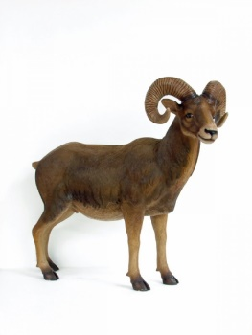
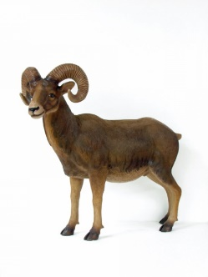
Issues
How to represent knowledge to be stored in memories?
How to decide what to write and what not to write in the memory?
Types of memory (arrays, stacks, or stored within weights of model), when they should be used, and how can they be learnt?
How to do fast retrieval of relevant knowledge from memories when the scale is huge?
How to build hierarchical memories, e.g. multiscale attention?
How to build hierarchical reasoning, e.g. composition of functions?
How to incorporate forgetting/compression of information?
How to evaluate reasoning models? Are artificial tasks a good way? Where do they break down and real tasks are needed?
Can we draw inspiration from how animal or human memories work?
types of memory
How to do fast retrieval
how to represent knowledge
what to write and what not to write

Slide 4
Some Memory Network-related Publications from Facebook AI Group
J. Weston, S. Chopra, A. Bordes. Memory Networks. ICLR 2015.
S. Sukhbaatar, A. Szlam, J. Weston, R. Fergus. End-To-End Memory Networks. NIPS 2015 (Oral).
J. Weston, A. Bordes, S. Chopra, A. M. Rush, B. van Merriënboer, A. Joulin, T. Mikolov. Towards AI-Complete Question Answering: A Set of Prerequisite Toy Tasks. ICLR 2016.
A. Bordes, N. Usunier, S. Chopra, J. Weston. Large-scale Simple Question Answering with Memory Networks. arXiv:1506.02075.
J. Dodge, A. Gane, X. Zhang, A. Bordes, S. Chopra, A. Miller, A. Szlam, J. Weston. Evaluating Prerequisite Qualities for Learning End-to-End Dialog Systems. ICLR 2016.
F. Hill, A. Bordes, S. Chopra, J. Weston. The Goldilocks Principle: Reading Children's Books with Explicit Memory Representations. ICLR 2016.
A. Miller, A. Fisch, J. Dodge, Karimi, A. H., Bordes, A., & Weston, J. . Key-Value Memory Networks for Directly Reading Documents." arXiv:1606.03126.
Notes:
We investigate these
models in the context of question answering (QA) where the long-term memory
effectively acts as a (dynamic) knowledge base, and the output is a textual
response.

Slide 5
MemNN: Memory networks
(ICLR 2015)
RNNs’ memory (encoded by hidden states and weights) is typically too small, and is not compartmentalized enough to accurately remember facts from the past (knowledge is compressed into dense vectors).
RNNs are known to have difficulty in performing memorization, for example the simple copying task of outputting the same input sequence they have just read (Zaremba & Sutskever, 2014).

Slide 6
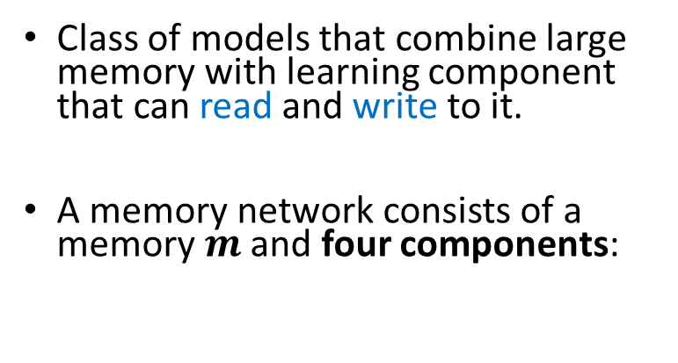



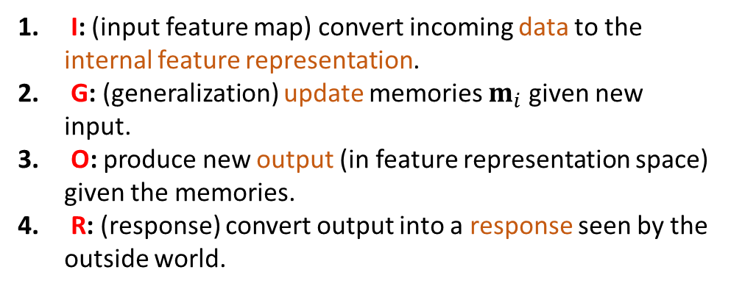

Definition of memory networks
Class of models that combine large memory with learning component that can read and write to it.
A memory network consists of a memory $m$ and four components:
I: (input feature map) convert incoming data to the internal feature representation.
G: (generalization) update memories $m_{i}$ given new input.
O: produce new output (in feature representation space) given the memories.
R: (response) convert output into a response seen by the outside world.
$$x→I(x)$$
$$m_{i}=G(m_{i},I\left(x\right),m)$$
$$o=O(I\left(x\right),m)$$
$$r=R(o)$$
Notes:
The central idea is to combine the successful learning strategies developed in the machine
learning literature for inference with a memory component that can be read and written to.
The model is then trained to learn how to operate effectively with the memory component.

Slide 7
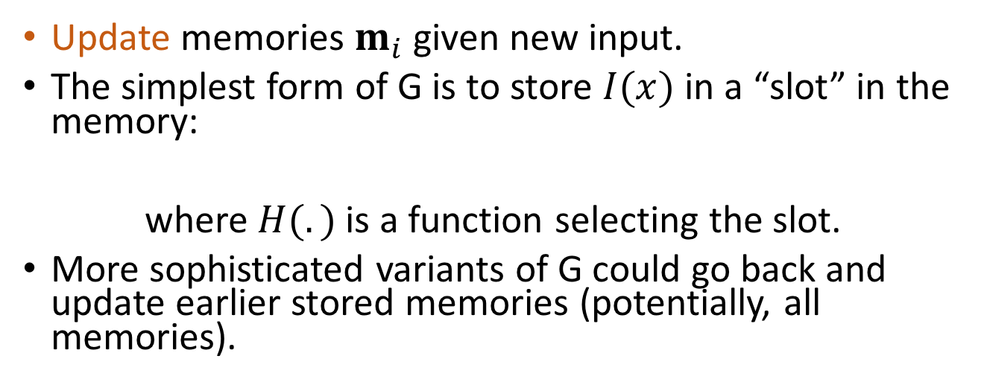
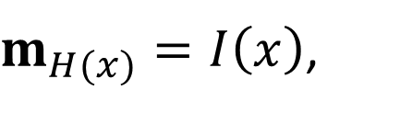
G: generalization
Update memories $m_{i}$ given new input.
The simplest form of G is to store $I(x)$ in a “slot” in the memory:
where $H(.)$is a function selecting the slot.
More sophisticated variants of G could go back and update earlier stored memories (potentially, all memories).
$m_{H(x)}=I\left(x\right)$,
0
0
1
0
Notes:
That is, G updates the index H(x) of m, but all other
parts of the memory remain untouched.

Slide 8
Task (1) Factoid QA with Single Supporting Fact
Single Supporting Fact, e.g. “where is actor”
(Very Simple) Toy reading comprehension task:
John was in the bedroom.
Bob was in the office.
John went to kitchen.
Bob travelled back home.
Where is John? A:kitchen
SUPPORTING FACT

Slide 9
(2) Factoid QA with Two Supporting Facts
Two Supporting Facts, e.g., “where is actor+object”
A harder (toy) task is to answer questions where two supporting statements have to be chained to answer the question:
John is in the playground.
Bob is in the office.
John picked up the football.
Bob went to the kitchen.
Where is the football? A:playground

Slide 10
(2) Factoid QA with Two Supporting Facts
A harder (toy) task is to answer questions where two supporting statements have to be chained to answer the question:
To answer the first question Where is the football? both John picked up the football and John is in the playground are supporting facts.
John is in the playground.
Bob is in the office.
John picked up the football.
Bob went to the kitchen.
Where is the football? A:playground
SUPPORTING FACT
SUPPORTING FACT

Slide 11
Memory Neural Networks (MemNN)
I (input): converts to bag-of-word-embeddings x.
G (generalization): stores x in next available slot m_{N}.
O (output): Loops over all memories k=1 or 2 times:
  1st loop max: finds best match m_{i} with x.
  2nd loop max: finds best match m_{J} with (x, m_{i}).
  The output o is represented with (x, m_{i,} m_{J}).
R (response): ranks all words in the dictionary given o and returns best single word. (OR: use a full RNN here)
Notes:
One particular instantiation of a memory network is where the components are neural networks. We
refer to these as memory neural networks (MemNNs).

Slide 12
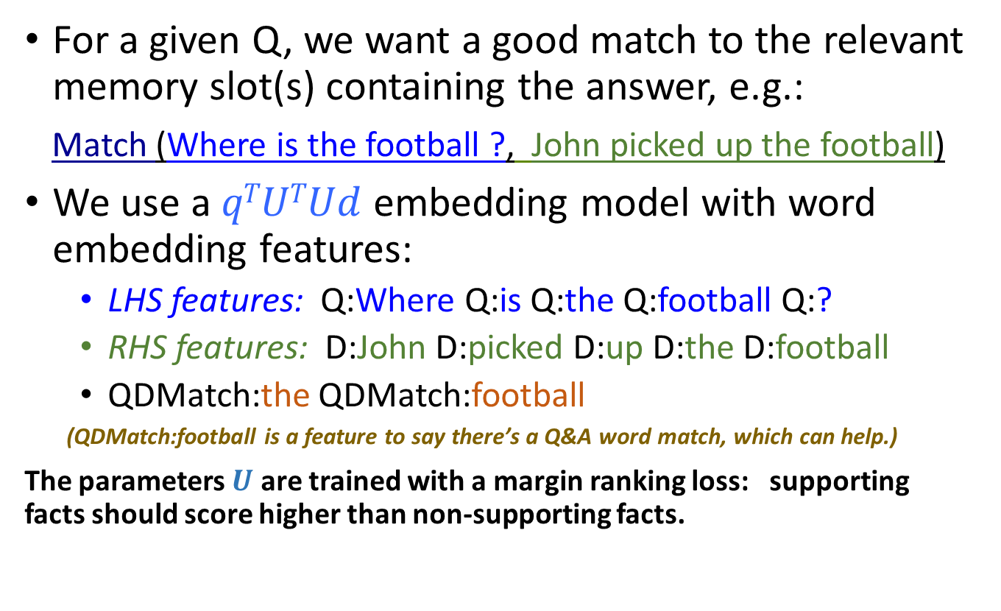
Matching function : 1st hop
For a given Q, we want a good match to the relevant memory slot(s) containing the answer, e.g.:
Match (Where is the football ?, John picked up the football)
We use a $qTUTUd$ embedding model with word embedding features:
  LHS features: Q:Where Q:is Q:the Q:football Q:?
  RHS features: D:John D:picked D:up D:the D:football
  QDMatch:the QDMatch:football
  (QDMatch:football is a feature to say there’s a Q&A word match, which can help.)
The parameters $U$ are trained with a margin ranking loss: supporting facts should score higher than non-supporting facts.

Slide 13
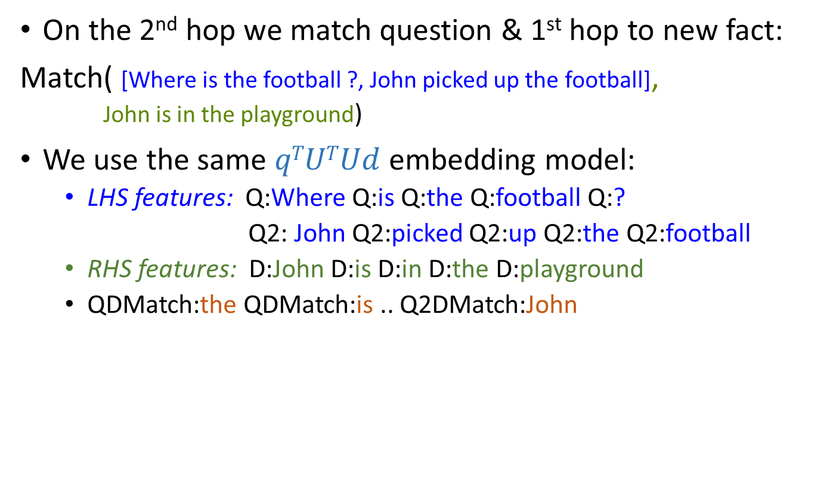
Matching function: 2nd hop
On the 2nd hop we match question & 1st hop to new fact:
Match( [Where is the football ?, John picked up the football], J John is in the playground)
We use the same $qTUTUd$ embedding model:
  LHS features: Q:Where Q:is Q:the Q:football Q:?
  Q2: John Q2:picked Q2:up Q2:the Q2:football
  RHS features: D:John D:is D:in D:the D:playground
  QDMatch:the QDMatch:is .. Q2DMatch:John

Slide 14
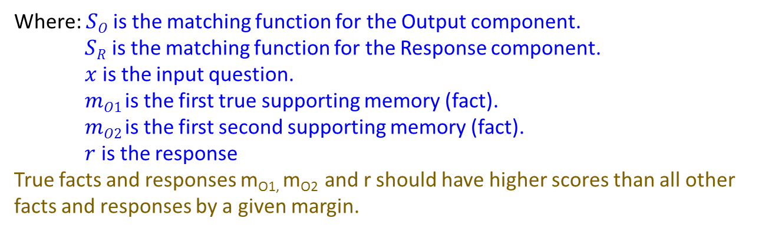
Objective function
Minimize:
Where: $SO$is the matching function for the Output component.
$SR$ is the matching function for the Response component.
$x$ is the input question.
$mO1$ is the first true supporting memory (fact).
$mO2$ is the first second supporting memory (fact).
$r$ is the response
True facts and responses m_{O1,} m_{O2} and r should have higher scores than all other facts and responses by a given margin.
Notes:
In our experiments, the scoring functions sO and sR have the same form, that of an embedding mode

Slide 15
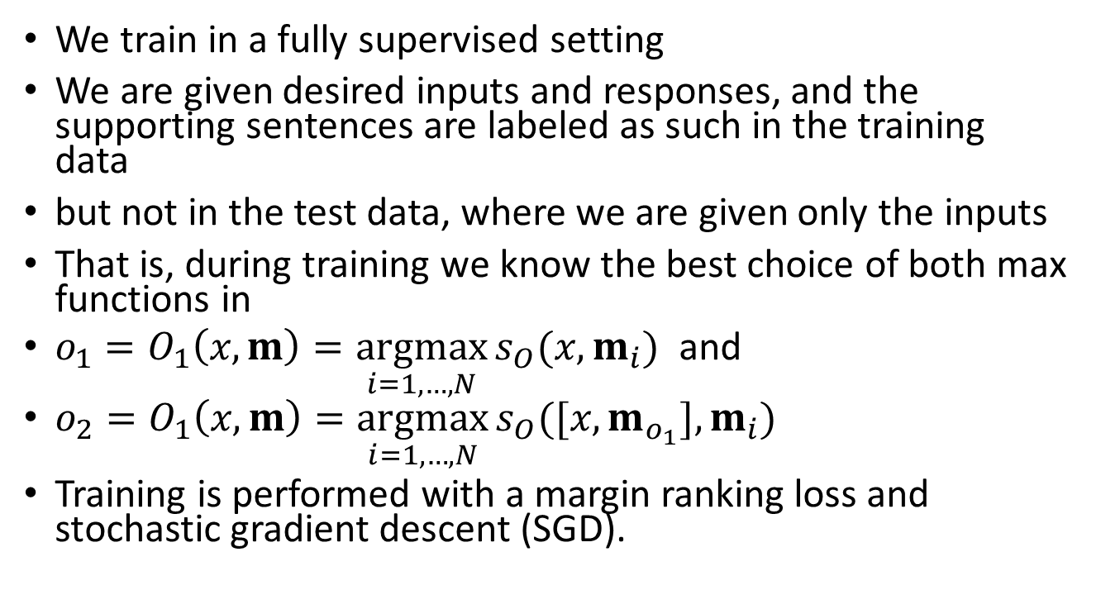
Training
We train in a fully supervised setting
We are given desired inputs and responses, and the supporting sentences are labeled as such in the training data
but not in the test data, where we are given only the inputs
That is, during training we know the best choice of both max functions in
$o_{1}=O_{1}\left(x,m\right)=\underset{i=1,…,N}{argmax}{s_{O}(x,m_{i})}$ and
$o_{2}=O_{1}\left(x,m\right)=\underset{i=1,…,N}{argmax}{s_{O}([x,m_{o_{1}}],m_{i})}$
Training is performed with a margin ranking loss and stochastic gradient descent (SGD).

Slide 16
What was next for MemNNs?
End-to-end? (doesn’t need supporting facts)
John is in the playground.
Bob is in the office.
John picked up the football.
Bob went to the kitchen.
Where is the football? A:playground
SUPPORTING FACT
SUPPORTING FACT
Requires explicit supervision

Slide 17
End-to-end Memory Network (MemN2N)
New end-to-end (MemN2N) model (Sukhbaatar ‘15):
  Reads from memory with soft attention
  Only need supervision on the final output
  Performs multiple lookups (hops) on memory
  End-to-end training with backpropagation
It is based on “Memory Networks” by [Weston, Chopra & Bordes ICLR 2015] but that had:
  Hard attention
  Requires explicit supervision of attention during training
  Only feasible for simple tasks
  Severely limits application of the model

Slide 18
Motivation
Good models exist for some data structures
  RNN for temporal structure
  ConvNet for spatial structure
Other types of dependencies
  out-of-order access
  long-term dependency
  unordered set

Slide 19
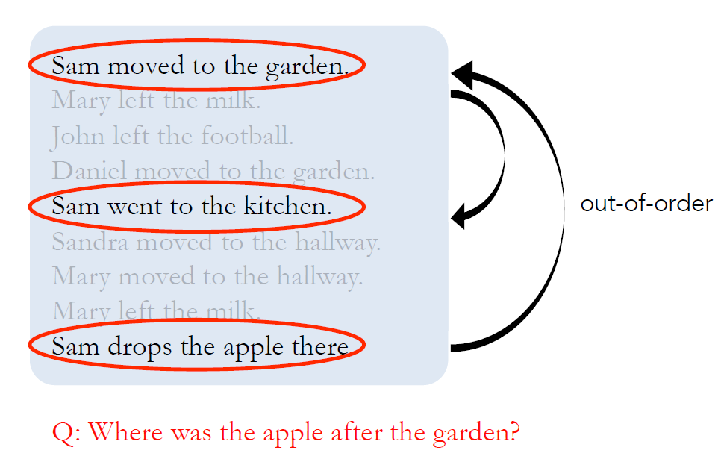
Ex. Question & Answering on story

Slide 20


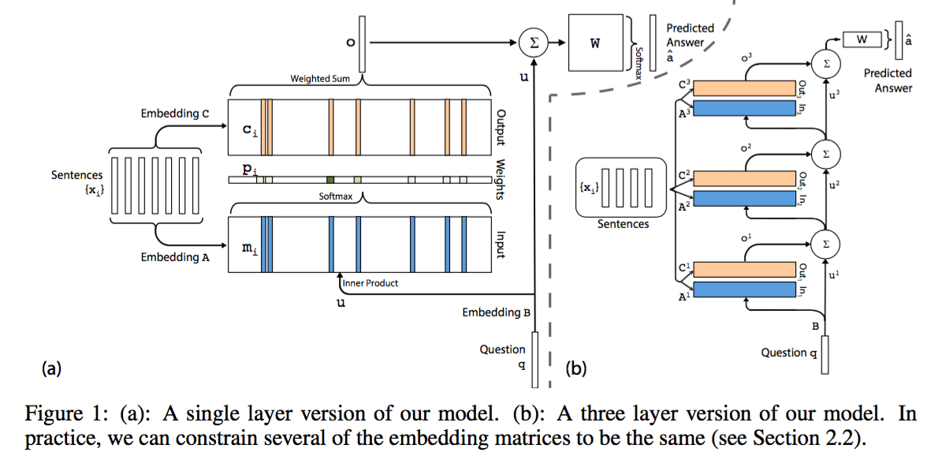

MemN2N architecture

Slide 21
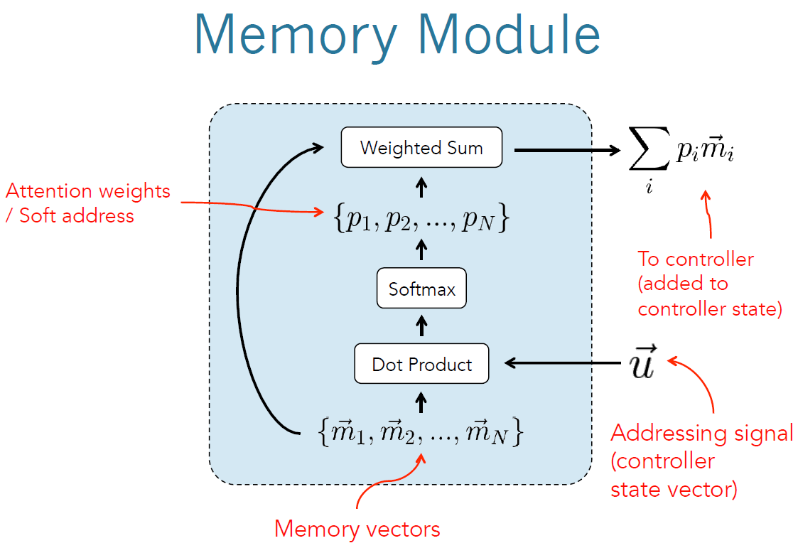
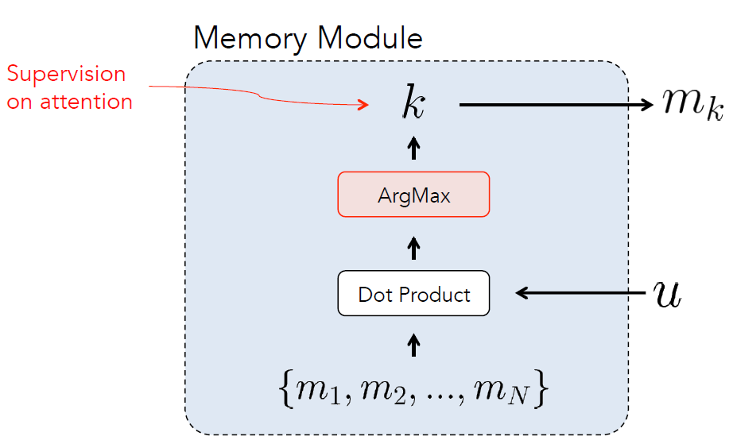
Hard Attention v.s. Soft Attention
MemNN
MemN2N

Slide 22




Question & Answering
Answer
kitchen
Memory Module
Weighted Sum
Controller
Dot product + softmax
1: Sam moved
to garden
2: Sam went
to kitchen
3: Sam drops
apple there
Where is Sam?
Question
Input story
Notes:
Here we are applying our model to QA task
But note that it can be used in other tasks such as lang model

Slide 23
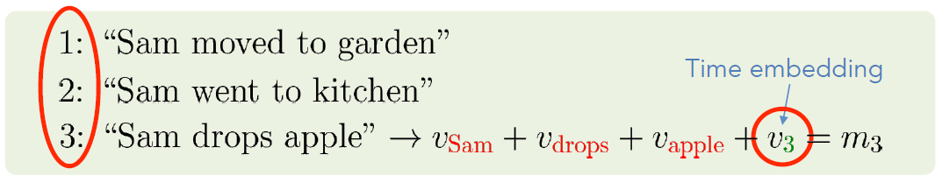
Memory Vectors
E.g.) Constructing memory vectors with Bag-of-Words (BoW)
Embed each word
Sum embedding vectors
E.g.) temporal structure: special words for time and include them in BoW
Embedding Vectors
Memory Vector
E.g.) temporal structure: special words for time and include them in BoW
Time embedding
Notes:
So far I haven’t told you about how we put things in memory
Memory vectors can take many forms
But let me give you one example when inputs are ..
…
Sometimes data might have a structure
Then you have to include them in memory vectors
Time stamp … corresponding embedding vector

Slide 24
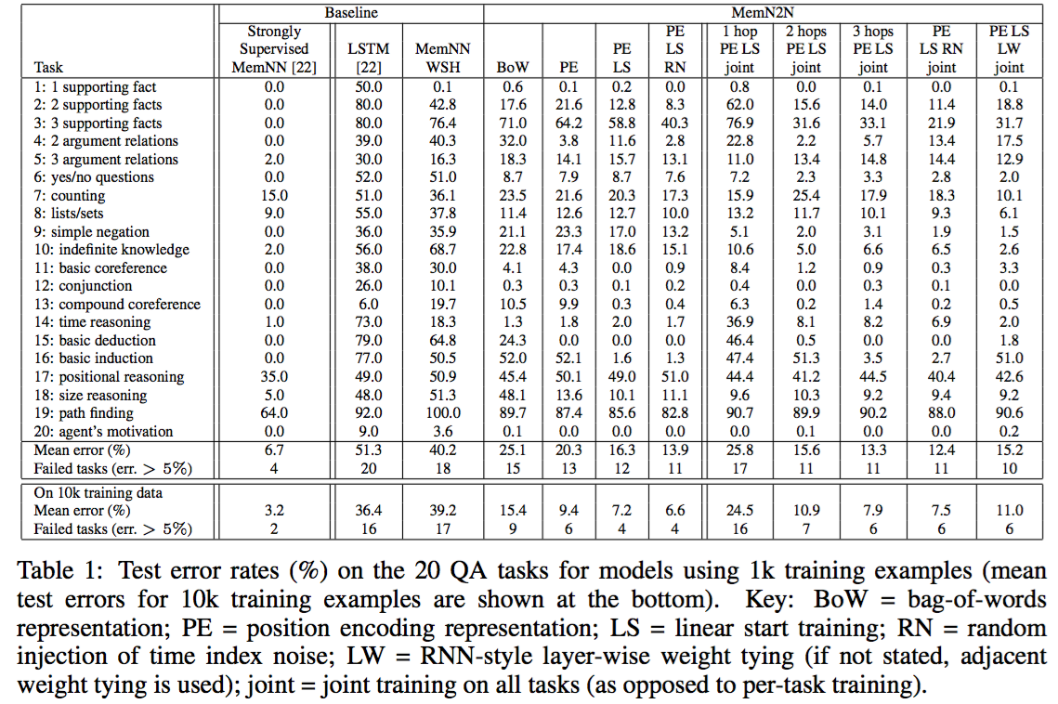
Experiments on bAbI test set

Slide 25
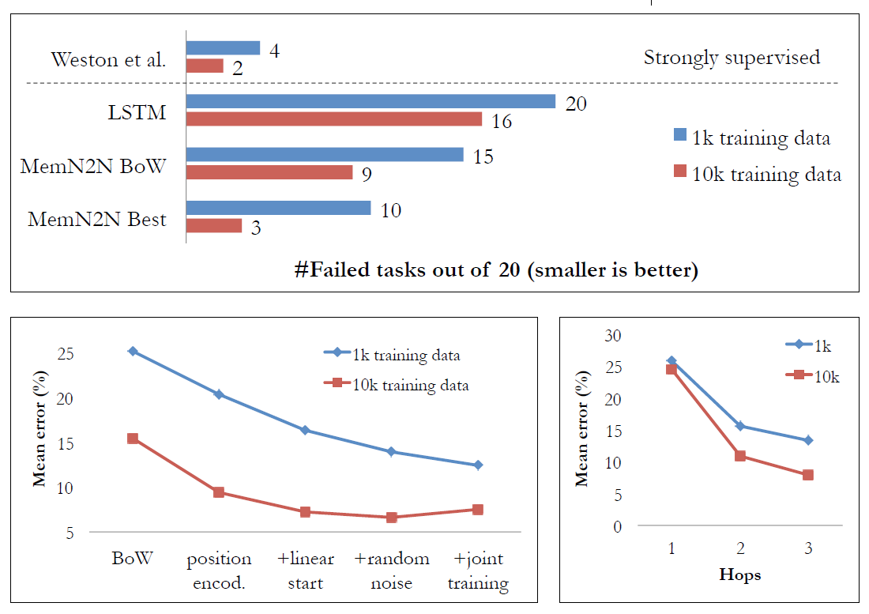
Experiments on bAbI test set

Slide 26
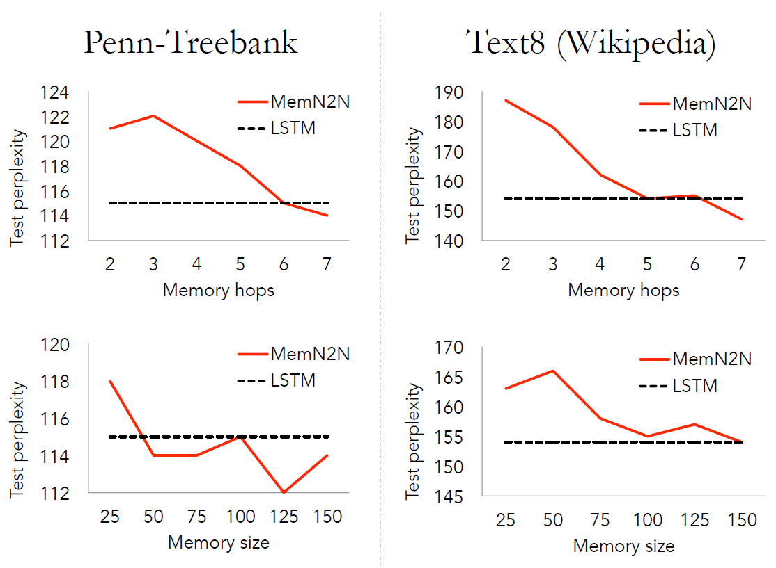
Experiments on Language modeling

Slide 27
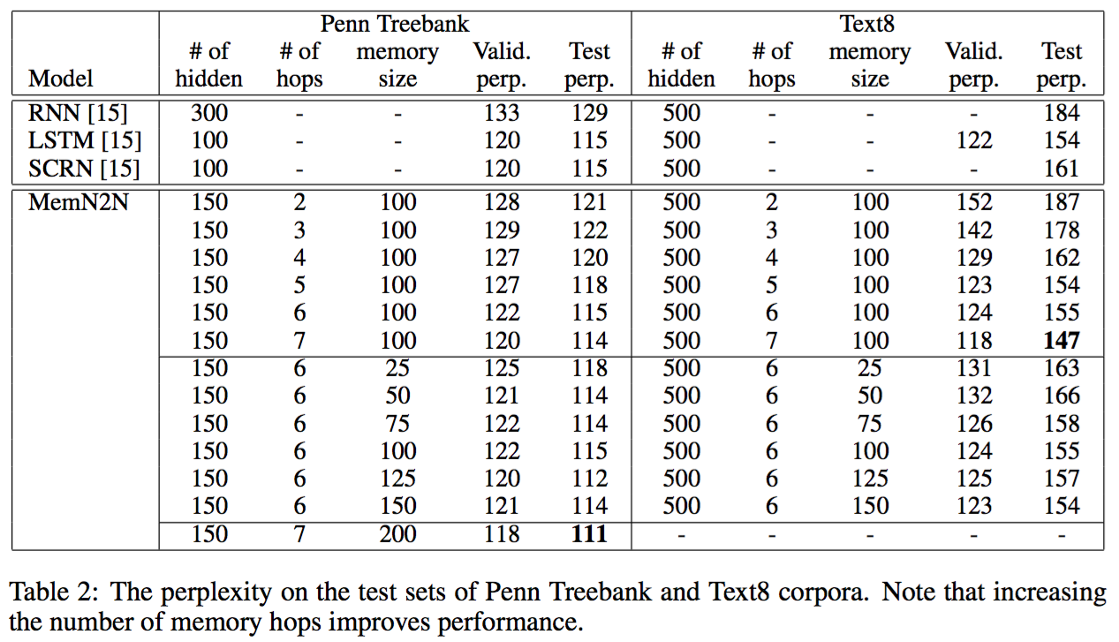

Slide 28
Next Steps
Artificial tasks to help design new methods:
  New methods that succeed on all bAbI tasks?
  Make more bAbI tasks to check other skills.
Real tasks to make sure those methods are actually useful:
  Sophisticated reasoning on bAbI tasks doesn’t always happen as clearly on real data.
  Models that work jointly on all tasks so far built.
Dream: can learn from very weak supervision:
  We would like to learn in an environment just by communicating with other agents / humans, as well as seeing other agents communicating + acting in the environment.
  E.g. a baby talking to its parents, and seeing them talk to each other.

Slide 29
FAIR: paper / data / code
Papers:
  bAbI tasks: arxiv.org/abs/1502.05698
  Memory Networks: http://arxiv.org/abs/1410.3916
  End-to-end Memory Networks: http://arxiv.org/abs/1503.08895
  Large-scale QA with MemNNs: http://arxiv.org/abs/1506.02075
  Reading Children’s Books: http://arxiv.org/abs/1511.02301
  Evaluating End-To-End Dialog: http://arxiv.org/abs/1511.06931
  Dialog-based Language Learning: http://arxiv.org/abs/1604.06045
Data:
  bAbI tasks: fb.ai/babi
  SimpleQuestions dataset (100k questions): fb.ai/babi
  Children’s Book Test dataset: fb.ai/babi
  Movie Dialog Dataest: fb.ai/babi
Code:
  Memory Networks: https://github.com/facebook/MemNN
  Simulation tasks generator: https://github.com/facebook/bAbI-tasks

Slide 30
Some Memory Network-related Publications from Google DeepMind
Graves, Alex, Greg Wayne, and Ivo Danihelka. "Neural turing machines."arXiv preprint arXiv:1410.5401 (2014).
Santoro, Adam, et al. "Meta-learning with memory-augmented neural networks." ICML 2016.
Danihelka, Ivo, et al. "Associative Long Short-Term Memory." ICML 2016.
Vinyals, Oriol, et al. "Matching Networks for One Shot Learning." NIPS 2016.

Slide 31
NTM: Neural Turing Machines (2014)
First application of Machine Learning to logical flow and external memory
Extend the capabilities of neural networks by coupling them to external memory
Enrich the capabilities of standard recurrent networks to simplify the solution of algorithmic tasks.
NTM is completely differentiable

Slide 32
Motivation
An interesting side-effect of these memory-augmented networks is the ability to keep track of intermediate computations.
LSTMs typically have a distributed representation of information in memory, and perform global changes across the whole memory cell at each step.
Unlike LSTMs, memory-augmented networks encourage (but don’t necessarily ensure) local changes in memory. This happens to help not only to find the structure in the training data, but also to generalize to sequences that are beyond the generalization power of LSTMs, such as longer sequences in algorithmic tasks
Notes:
Rather than artificially increasing the size of the hidden state in the RNN, we would like to arbitrarily increase the amount of knowledge we add to the model while making minimal changes to the model itself. Basically, we can augment the model with an independent memory that acts as a knowledge base from which the network can read and write on demand. You can think of the neural network as the processing unit (CPU), and this new external memory as the RAM.

Slide 33
Motivation
Er, the last name may be Irwin.
Oh, Irwin King!
Host’s name?
I know his first name is King.
Notes:
You can picture the value of memory-augmented networks over LSTMs through the idea of the cocktail party effect: imagine that you are at a party, trying to figure out what is the name of the host while listening to all the guests at the same time. Some may know his first name, some may know his last name; it could even be to the point where guests know only parts of his first/last name. In the end, just like with a LSTM, you could retrieve this information by coupling the signals from all the different guests. But you can imagine that it would be a lot easier if a single guest knew the full name of the host to begin with.

Slide 34
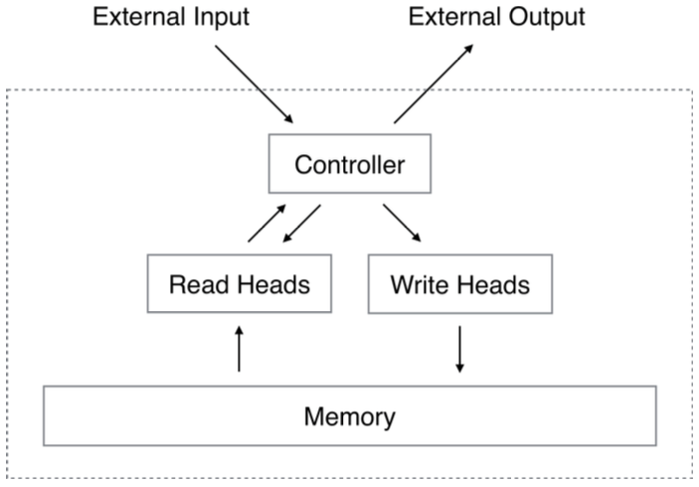
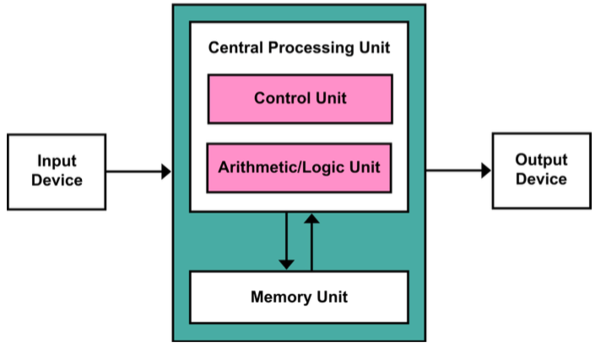
Architecture
A Neural Turing Machine (NTM) architecture contains two basic components: a neural network controller and a memory bank.
Notes:
A Neural Turing Machine (NTM) architecture contains two basic components: a neural network controller and a memory bank.
Figure 1 presents a high-level diagram of the NTM architecture. Like most neural networks, the controller interacts with the external world via input and output vectors. Unlike a standard network, it also interacts with a memory matrix using selective read and write operations. By analogy to the Turing machine we refer to the network outputs that parametrise these operations as “heads.”
During each update cycle, the controller
network receives inputs from an external environment and emits outputs in response. It also
reads to and writes from a memory matrix via a set of parallel read and write heads. The dashed
line indicates the division between the NTM circuit and the outside world.

Slide 35
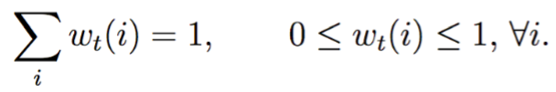
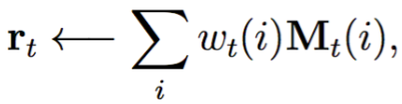
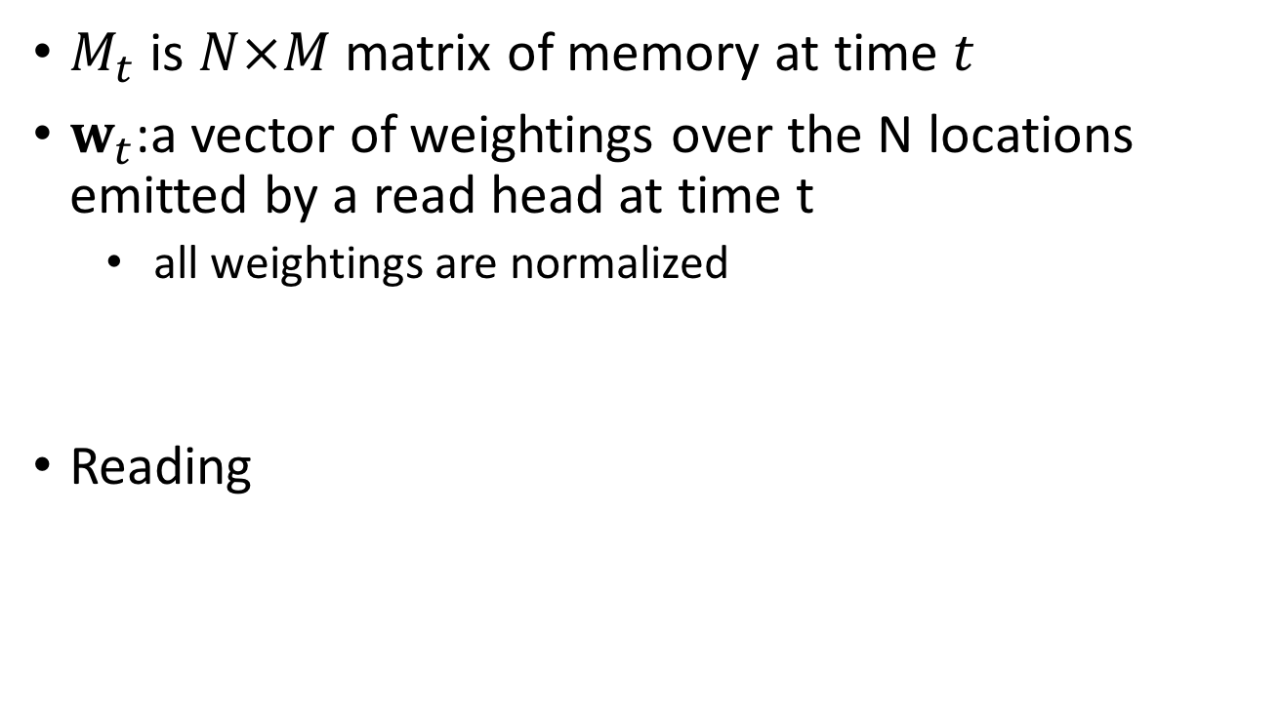
Reading
$M_{t}$ is $N×M$ matrix of memory at time $t$
$w_{t}$:a vector of weightings over the N locations emitted by a read head at time t
  all weightings are normalized
Reading

Slide 36
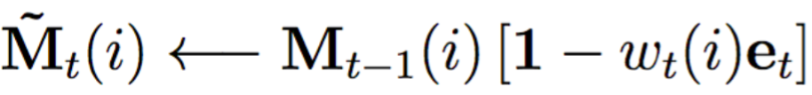
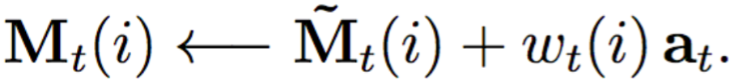
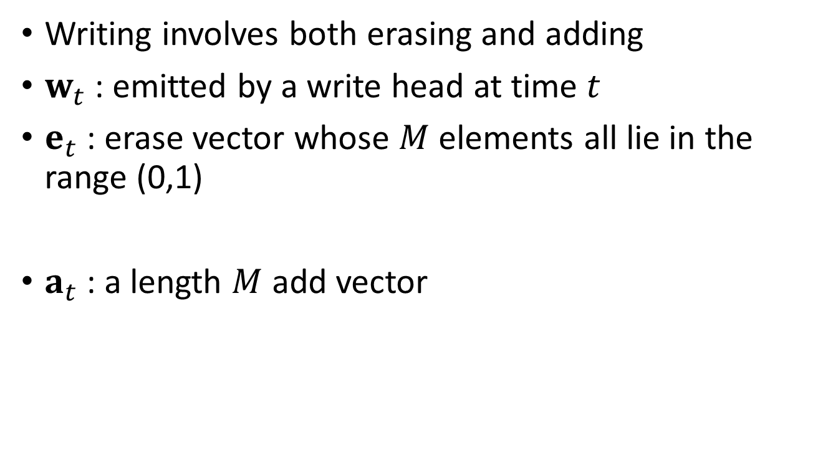
Writing
Writing involves both erasing and adding
$w_{t}$ : emitted by a write head at time $t$
$e_{t}$ : erase vector whose $M$ elements all lie in the range (0,1)
$a_{t}$ : a length $M$ add vector
Notes:
the multiplication against the memory location acts point-wise. Therefore, the elements of a memory location are reset to zero only if both the weighting at the location and the erase element are one; if either the weighting or the erase is zero, the memory is left unchanged. When multiple write heads are present, the erasures can be performed in any order, as multiplication is commutative.
Each write head also produces a length M add vector at, which is added to the memory after the erase step has been performed:

Slide 37
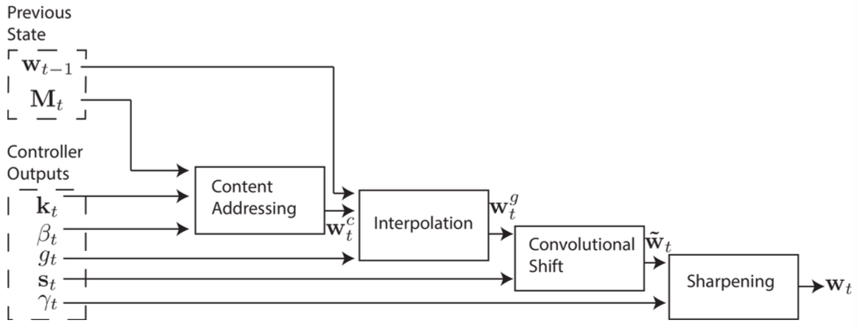
Addressing Mechanisms

Slide 38
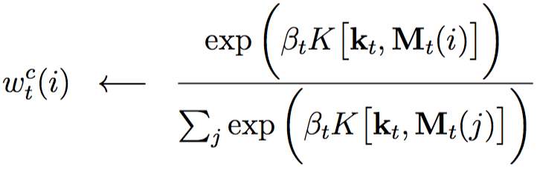
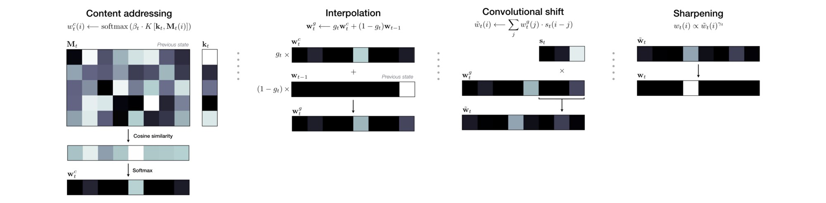


Focusing by Content
Each head produces key vector $k_{t}$ of length $M$
Generated a content based weight $w_{t}^{c}$ based on similarity measure, using ‘key strength’ $β_{t}$

Slide 39
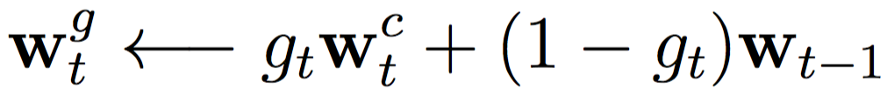

Focusing by Location–Interpolation
Each head emits a scalar interpolation gate $g_{t}$.

Slide 40
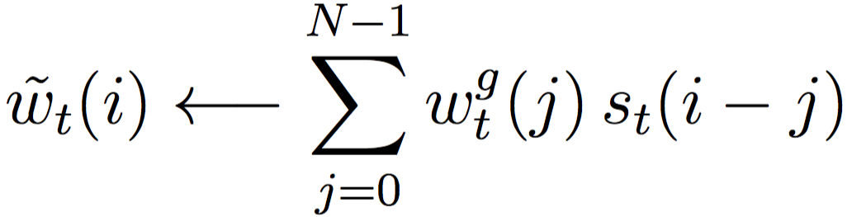

Focusing by Location— Convolutional shift
Each head emits a distribution over allowable integer shifts $s_{t}$.

Slide 41
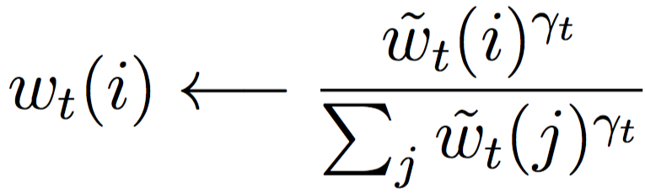

Focusing by Location—
Sharpening
Each head emits a scalar sharpening parameter $γ_{t}$.

Slide 42
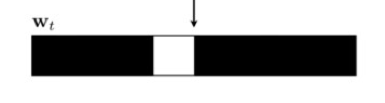
Addressing Mechanisms
This can operate in three complementary modes
  A weighting can be chosen by the content system without any modification by the location system
  A weighting produced by the content addressing system can be chosen and then shifted
  A weighting from the previous time step can be rotated without any input from the content-based addressing system

Slide 43
Controller Network Architecture
Feed Forward vs Recurrent
  The LSTM version of RNN has own internal memory complementary to M
  Hidden LSTM layers are ‘like’ registers in processor
  Allows for mix of information across multiple time-steps
  Feed Forward has better transparency

Slide 44
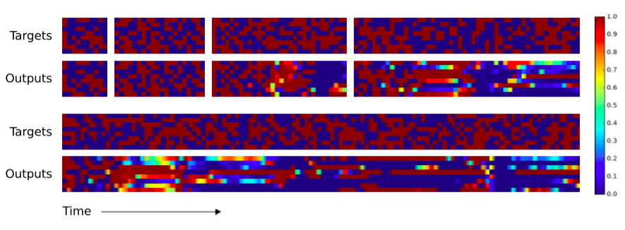
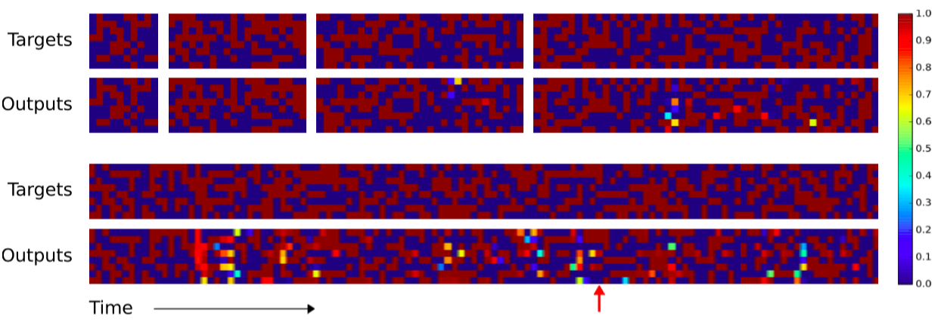
Experiments – copy task
LSTM
NTM

Slide 45
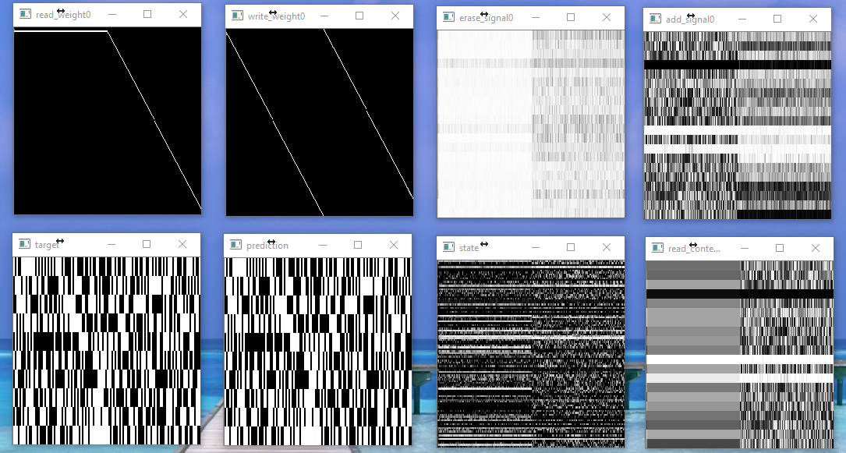
Copy Task

Slide 46
Thank you!

