Slide 1
Abstractive Summarization of Reddit Posts
with Multi-level Memory Networks
[NAACL 2019]
Group Presentation
WANG, Yue
04/15/2019

Slide 2
Outline
Background
Dataset
Method
Experiment
Conclusion

Slide 3
Background
Challenge:
  Previous abstractive summarization tasks focus on formal texts (e.g., news articles), which are not abstractive enough.
  Prior approaches neglect the different level understandings of the document (i.e., sentence-level, paragraph-level and document-level).
Contribution:
  Newly collect a large-scale abstractive summarization dataset named Reddit TIFU (the first informal texts for abstractive summarization).
  Propose a novel model named multi-level memory networks (MMN), which considers multi-level abstraction of the document and outperforms existing state-of-the-arts.

Slide 4
Dataset
Dataset is crawled from a subreddit “/r/tifu”
  https://www.reddit.com/r/tifu/
The important rules under this subreddit:
  The title must make an attempt to encapsulate the nature of your f***up
  All posts must end with a TL;DR summary that is descriptive of your f***up and its consequences.
Smart adaption:
  The title →short summary
  The TL;DR summary → long summary
Notes:
There is no existing suitable datasets
Usually one document with one summary
Or one document with multiple summaries written by different annotators, but not annotated with topic

Slide 5
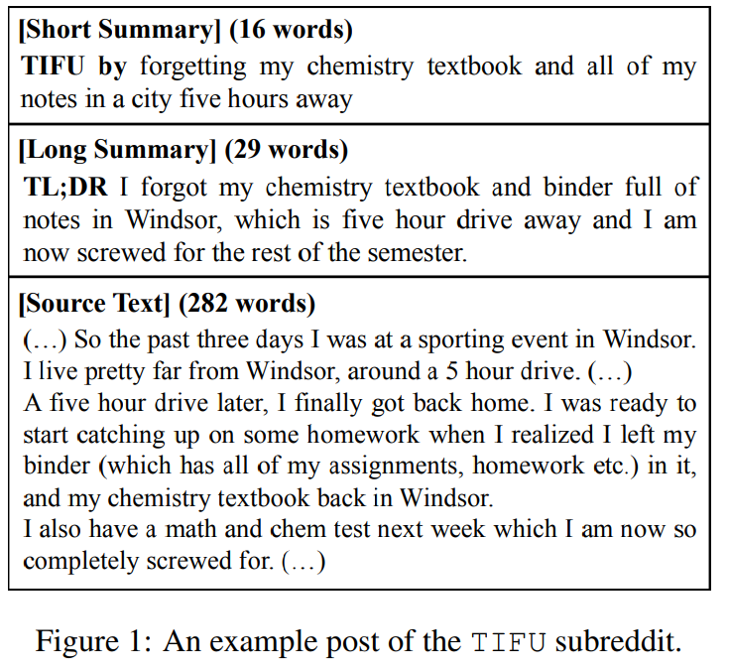
Dataset
Example:

Slide 6
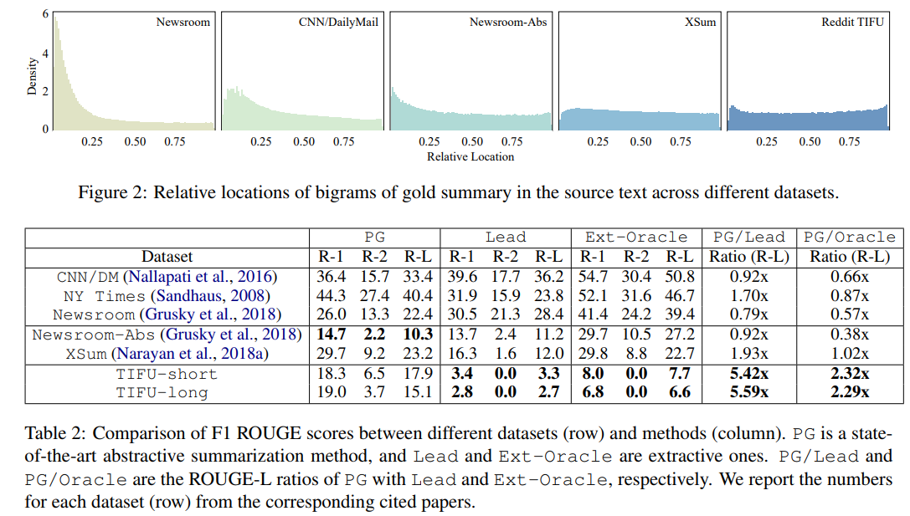
Dataset
Weak lead bias
Strong abstractness

Slide 7
Method
Multi-level Memory Networks (MMN)
The advantages of MMN
  Better handle long range dependency
  Build representations of not only multiple levels but also multiple ranges (e.g. sentences, paragraphs, and the whole document)
The key components of MMN
  Multi-level Memory
    Memory Writing with Dilated Convolution
    Normalized Gated Tanh Units
  State-Based Sequence Generation
    Read multi-level layers in the encoder

Slide 8
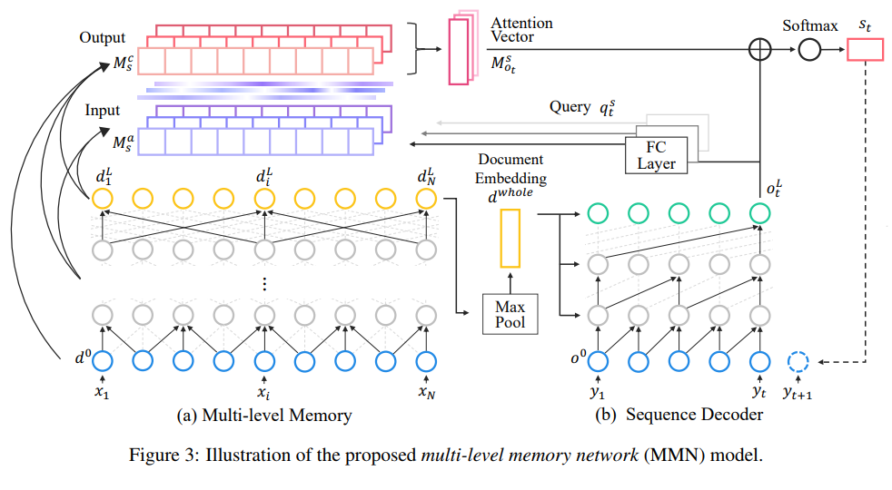
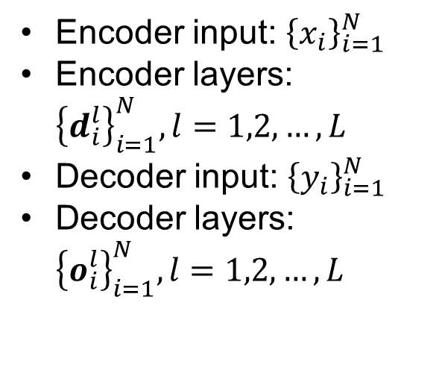
Method
Encoder input: ${\left\{x_{i}\right\}}_{i=1}^{N}$
Encoder layers: ${\left\{d_{i}^{l}\right\}}_{i=1}^{N}, l=1,2,…,L$
Decoder input: ${\left\{y_{i}\right\}}_{i=1}^{N}$
Decoder layers: ${\left\{o_{i}^{l}\right\}}_{i=1}^{N}, l=1,2,…,L$

Slide 9
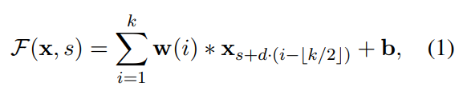
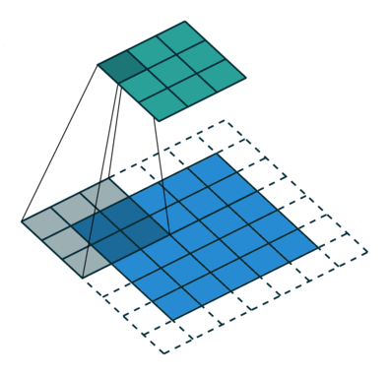
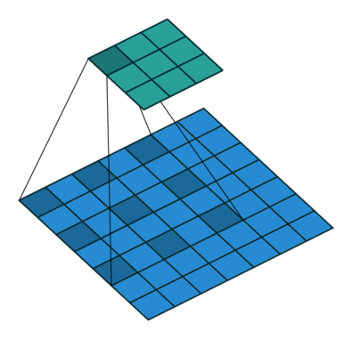

Method
Construction of Multi-level Memory
  Memory Writing with Dilated Convolution:
  By stacking multi-layer dilated convolutions, we get:
    ${\left\{d_{i}^{l}\right\}}_{i=1}^{N}, l=1,2,…,L$
Standard Convolution (d=1)
Dilated Convolution (d=2)

Slide 10
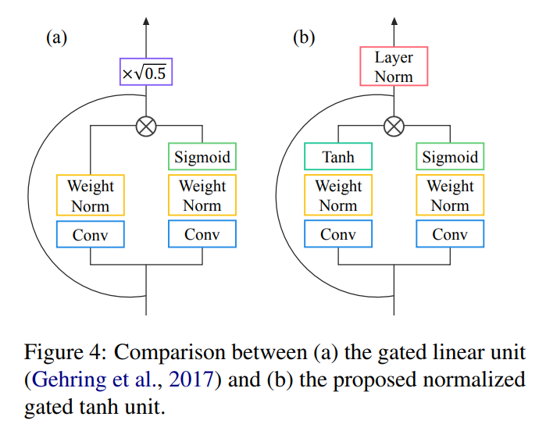

Method
Normalized Gated Tanh Units

Slide 11
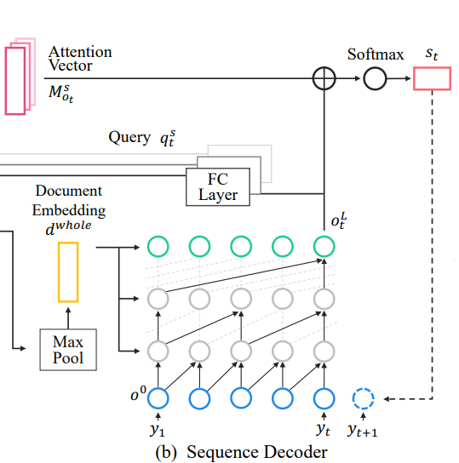

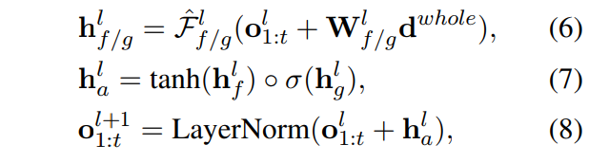

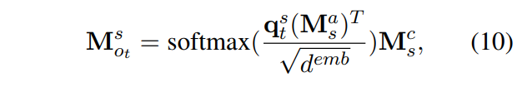

Method
State-Based Sequence Generation

Slide 12
Method
Difference between MMN with ConvS2S
  MMN can be viewed as an extension of ConvS2S
  The term “Memory network” is inappropriately employed to some extent
    Attention → Memory network
 | ConvS2S | MMN | Motivation
Convolution Type | Standard convolution | Dilated convolution | Capture larger range
Convolution Output Unit | Gated Tanh Units | Normalized Gated Tanh Units | Empirical found
During decoding | Only look at the final layer of the encoder | Based on different level memories of the encoder | Simulate different level of abstraction

Slide 13
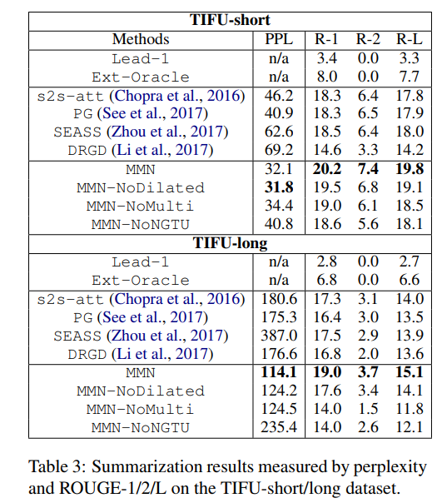
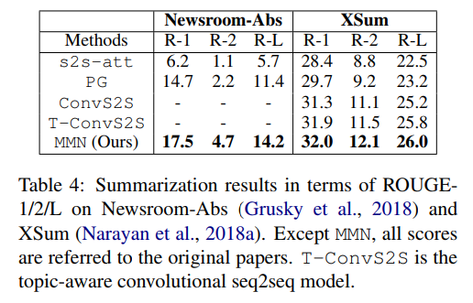
Experiments
Qualitative Results
Notes:
$$a^{′}=l_{1}^{1},l_{2}^{2},l_{2}^{3}…,l_{1}^{n}$$
$$a^{′′}=l_{2}^{1},l_{1}^{2},l_{2}^{3}…,l_{2}^{m}$$

Slide 14
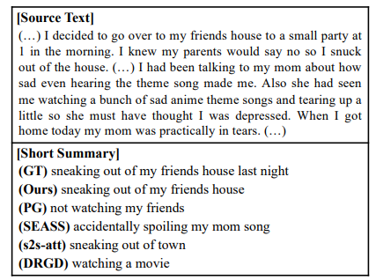
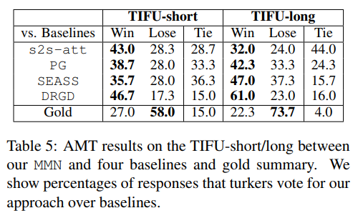
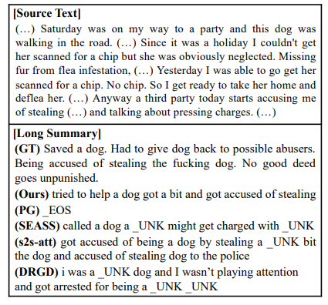
Experiments
Quantitative Results
  User preference
  Summary examples

Slide 15
Conclusion
A new dataset Reddit TIFU for abstractive summarization on informal online texts
A novel summarization model named multi-level memory networks (MMN)

Slide 16
Conclusion
Thanks

