Slide 1
How to measure 45 minutes using two identical wires?
How do we measure forty-five minutes using two identical wires, each of which takes an hour to burn. We have matchsticks with us. The wires burn non-uniformly. So, for example, the two halves of a wire might burn in 10 minute and 50 minutes respectively.
Notes:
Opaque [o'pek] as a black box.
Convoluted ['kɑnvəlutɪd] complex
Departure [dɪ'pɑrtʃɚ] difference
Scarce [skɛrs] lacking
obfuscated ['ɑbfʌsket] vague [veɡ]
Headroom ['hɛdrum]
Oracle ['ɔrəkl]
Confound [kən'faʊnd] mix they together
Akin [ə'kɪn] similar

Slide 2
How to measure 45 minutes using two identical wires?
Solution:
Light up three of the four ends of the two wires. Once one wire is completely burnt, light up the fourth end. At 45 minutes, both wires are burnt completely.
Notes:
Opaque [o'pek] as a black box.
Convoluted ['kɑnvəlutɪd] complex
Departure [dɪ'pɑrtʃɚ] difference
Scarce [skɛrs] lacking
obfuscated ['ɑbfʌsket] vague [veɡ]
Headroom ['hɛdrum]
Oracle ['ɔrəkl]
Confound [kən'faʊnd] mix they together
Akin [ə'kɪn] similar

Slide 3
Ten Words
We frame Question Answering (QA) as a Reinforcement Learning task.
We assume that the environment is opaque; the agent has no access to its parameters, activations or gradients.
These questions are hard to answer by design because they use convoluted language.
The major departure from the standard MT setting is that our model reformulates utterances in the same language.
While the parallel corpora are available for many language pairs , English-English corpora are scarce.
Clues are obfuscated queries such as This ‘Father of Our Country’ didn’t really chop down a cherry tree.
Here we find that the different sources of rewrites provide comparable headroom: the oracle Exact Match is near 50, while the oracle F1 is close to 58.
We analyze the top hypothesis instead of the final output of the full AQA agent to avoid confounding effects from the answer selection step.
At the same time it learns to modify surface forms in ways akin to stemming and morphological analysis.
Notes:
Opaque [o'pek] as a black box.
Convoluted ['kɑnvəlutɪd] complex
Departure [dɪ'pɑrtʃɚ] difference
Scarce [skɛrs] lacking
obfuscated ['ɑbfʌsket] confused, vague [veɡ]
Headroom [‘hɛdrum], 上升空间, distance
Oracle ['ɔrəkl]
Confound [kən'faʊnd] mix they together
Akin [ə'kɪn] similar

Slide 4
Ask the Right Questions: Active Question Reformulation with Reinforcement Learning
Christian Buck et al. Google
ICLR 2018, Oral
Wang CHEN
13/02/2018

Slide 5
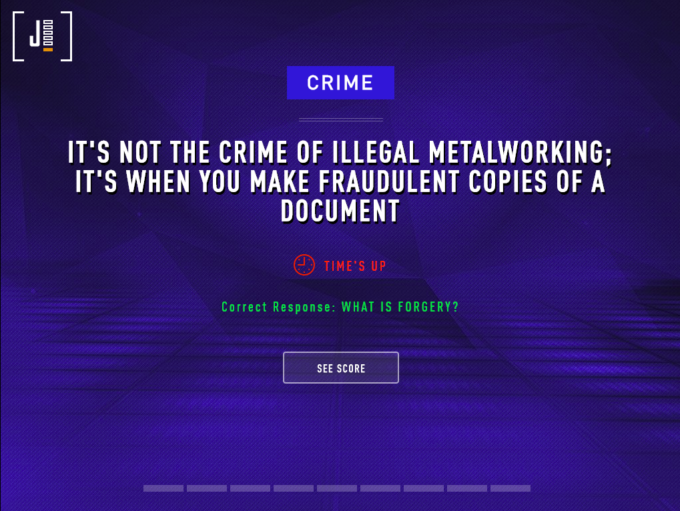
Problem Description
Jeopardy! Questions Answering from related context:

Slide 6
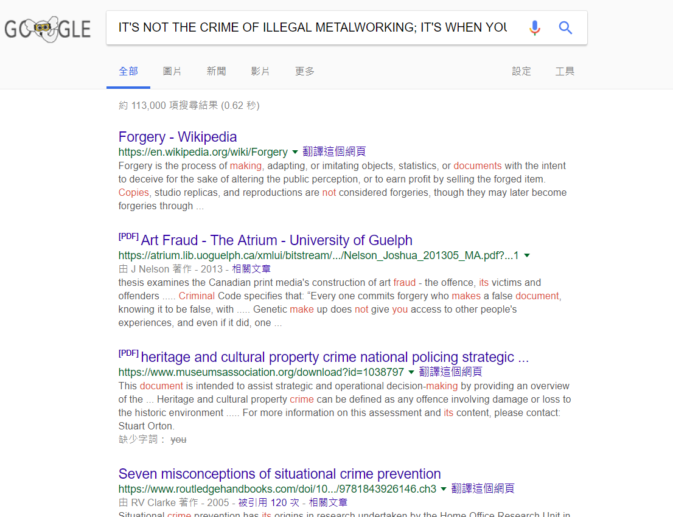
Problem Description
How to get the context related to the Jeopardy! question?
Search by google, and use the snippets on the first page (top 10) as the related snippets
Concatenate all snippets as the context
Finally get (query, context, answer)

Slide 7
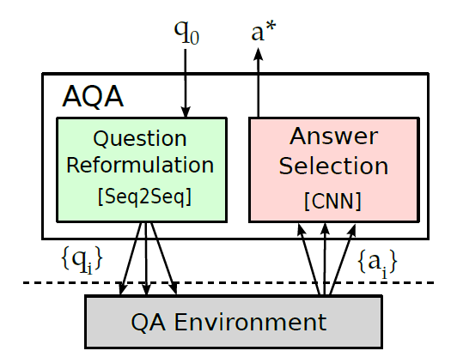

The Framework in this paper
Active Question Answering (AQA): frame QA as a reinforcement learning task
Question Reformulation:
  Input: the original question $q_{0}$
  Output: reformulated questions {$q_{1}$, $q_{2}$, …, $q_{i}$, $q_{n}$}
QA Environment (a black box)
  Input: {$q_{1}$, $q_{2}$, …, $q_{i}$, $q_{n}$} + related snippets
  Output: answers {$a_{1}$, $a_{2}$, …, $a_{i}$, $a_{n}$}
Answer Selection
  Input: {$a_{1}$, $a_{2}$, …, $a_{i}$, $a_{n}$}
  Output: the best answer $a^{∗}$

Slide 8

The Framework in this paper
Active Question Answering (AQA): frame QA as a reinforcement learning task
Question Reformulation:
  Input: the original question $q_{0}$
  Output: reformulated questions {$q_{1}$, $q_{2}$, …, $q_{i}$, $q_{n}$}
QA Environment (a black box)
  Input: {$q_{1}$, $q_{2}$, …, $q_{i}$, $q_{n}$} + related snippets
  Output: answers {$a_{1}$, $a_{2}$, …, $a_{i}$, $a_{n}$}
Answer Selection
  Input: {$a_{1}$, $a_{2}$, …, $a_{i}$, $a_{n}$}
  Output: the best answer $a^{∗}$

Slide 9
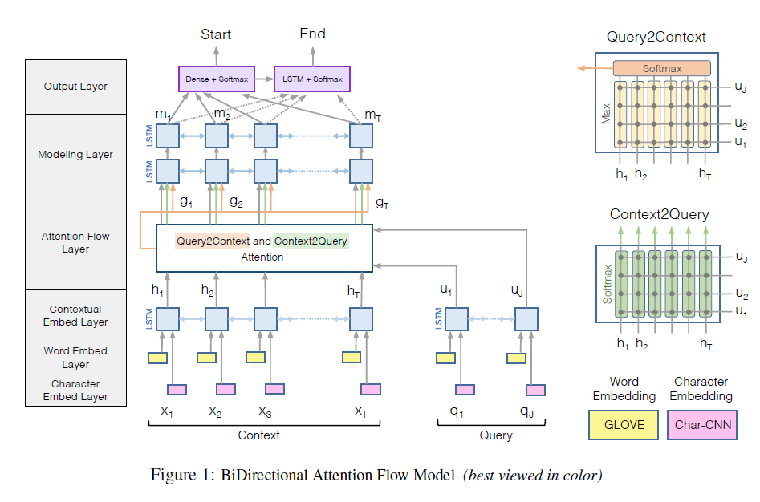
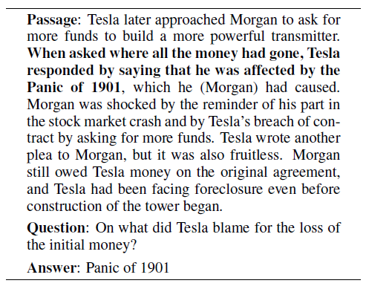
The QA Environment
BiDirectional Attention Flow (BiDAF) [Seo et al., 2017]

Slide 10

The Framework in this paper
Active Question Answering (AQA): frame QA as a reinforcement learning task
Question Reformulation:
  Input: the original question $q_{0}$
  Output: reformulated questions {$q_{1}$, $q_{2}$, …, $q_{i}$, $q_{n}$}
QA Environment (a black box)
  Input: {$q_{1}$, $q_{2}$, …, $q_{i}$, $q_{n}$} + related snippets
  Output: answers {$a_{1}$, $a_{2}$, …, $a_{i}$, $a_{n}$}
Answer Selection
  Input: {$a_{1}$, $a_{2}$, …, $a_{i}$, $a_{n}$}
  Output: the best answer $a^{∗}$

Slide 11
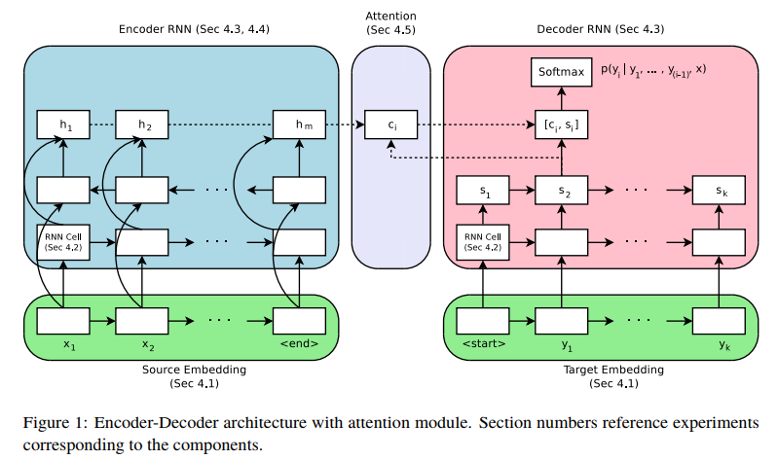
Question Reformulation Model
Attention-based encoder-decoder model
Key Problem:
While parallel corpora are available for many language pairs (e.g. English-French), English-English corpora are scarce.
Solution:
Zero-shot translation + a few training steps on desired language pair
[Britz et al. (2017)]

Slide 12
Question Reformulation Model
Zero-shot translation [Johnson et al. 2016]
  Train the model on English->Spanish, English->French, French->English
  and Spanish->English
    Add two special tokens to the data indicating the source and target languages.
  Then we can use the model to English->English translation.
  However, the quality is poor.
After a few training steps on English->English pair, the quality is much better.
<FromEnglish> <ToSpanish> Hello, how are you? -> Hola, ¿cómo estás?
(Paralex database of qustion paraphrases)
Zero-shot < monolingual < zero-shot + a few training steps on desired pairs < bridging

Slide 13
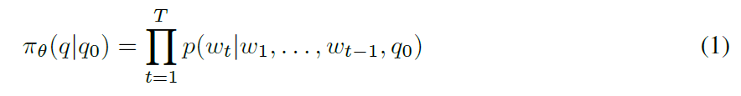

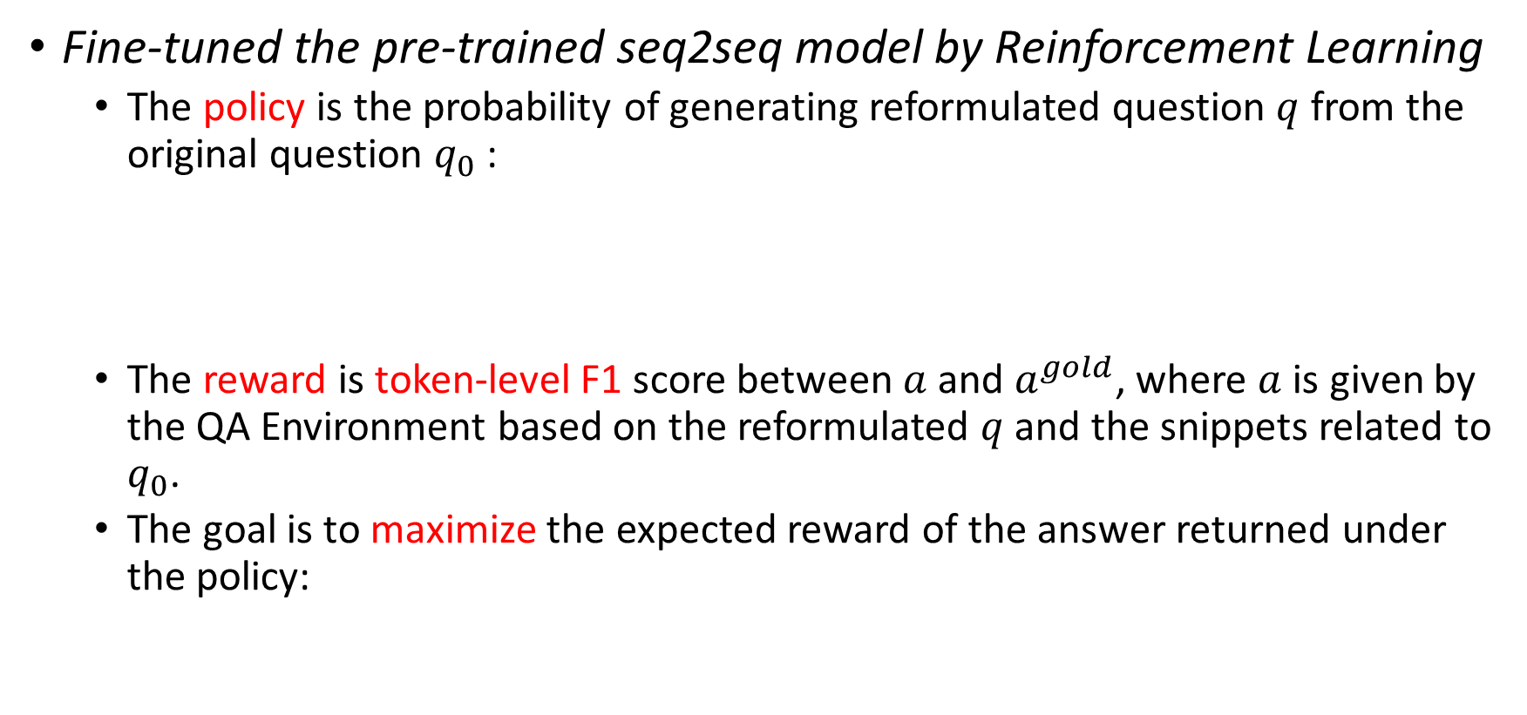
Question Reformulation Model
Fine-tuned the pre-trained seq2seq model by Reinforcement Learning
  The policy is the probability of generating reformulated question $q$ from the original question $q_{0}$ :
  The reward is token-level F1 score between $a$ and $a^{gold}$, where $a$ is given by the QA Environment based on the reformulated $q$ and the snippets related to $q_{0}$.
  The goal is to maximize the expected reward of the answer returned under the policy:

Slide 14
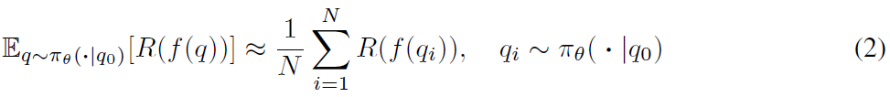
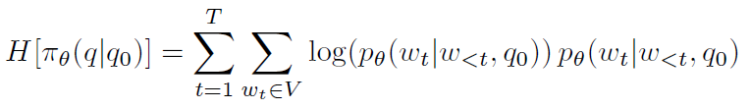

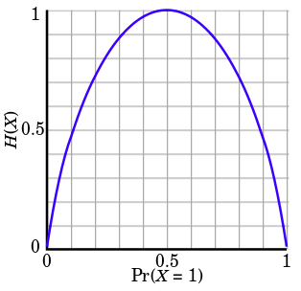
Question Reformulation Model
Fine-tuned the pre-trained seq2seq model by Reinforcement Learning
  The expected reward cannot be computed in closed form, but can compute an unbiased estimate with Monte Carlo sampling:
  The final objective:
-
Baseline reward:
to lower the variance and stabilize the training
Entropy regularization:
to make more exploration

Slide 15

The Framework in this paper
Active Question Answering (AQA): frame QA as a reinforcement learning task
Question Reformulation:
  Input: the original question $q_{0}$
  Output: reformulated questions {$q_{1}$, $q_{2}$, …, $q_{i}$, $q_{n}$}
QA Environment (a black box)
  Input: {$q_{1}$, $q_{2}$, …, $q_{i}$, $q_{n}$} + related snippets
  Output: answers {$a_{1}$, $a_{2}$, …, $a_{i}$, $a_{n}$}
Answer Selection
  Input: {$a_{1}$, $a_{2}$, …, $a_{i}$, $a_{n}$}
  Output: the best answer $a^{∗}$

Slide 16
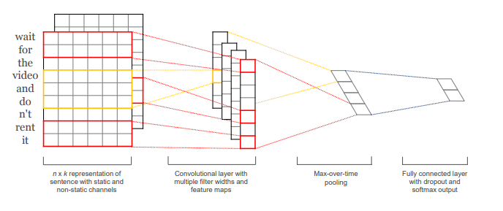
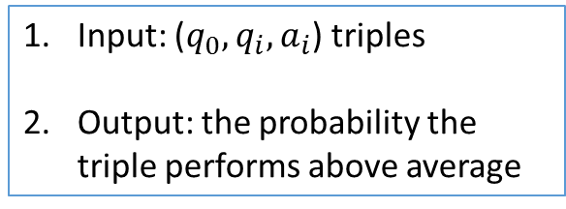
Answer Selection Model
1D CNN + Max-pooling + fully connected + binary classification
Input: ($q_{0}, q_{i}, a_{i}$) triples
Output: the probability the triple performs above average
Training: Binary Classification
Dataset Building:
  The triples, whose answer’s F1 score is above the others’ average F1 score, are labeled as positive.
[Yoom Kim, 2014]
(Similar but not the same)

Slide 17
QA Experiments
Dataset: SearchQA
  Preprocessed Jeopardy! question + answer + searched snippets related to the question from Google’s top search results
 | Number of Examples
Training | 99,820
Validation | 13,393
Testing | 27,248
Initial training of BiDAF model
The training set is used thrice
RL-based tuning of the reformulator
Training of answer selector

Slide 18
The Framework Training
Active Question Answering (AQA): frame QA as a reinforcement learning task
1. Pre-train the reformulator:
  Zero-shot + a few training steps on desired pairs
  Dataset: multilingual U.N. Parallel Corpus; Paralex
2. Pre-train the QA environment (BiDAF)
  Dataset: SearchQA
2. RL-based tuning of the reformulator
  Reinforcement learning
  Dataset: SearchQA
3. Answer selector training
  Binary classification
  Dataset: SearchQA

Slide 19
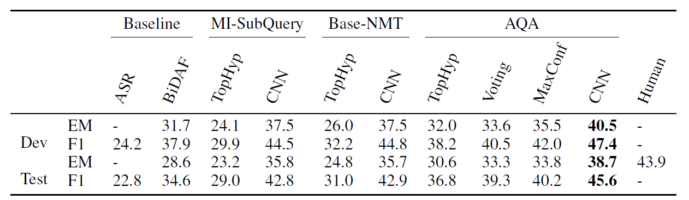

QA Experiments
Quantitative, N=20
ASR: Attention Sum Reader
MI-SubQuery: a rule-based question refomulator
Base-NMT: attention-based seq2seq model without RL tuning
AQA: the proposed active question answering framework
TopHyp: only use the top hypothesis (reformulation)
Voting: use the BiDAF score to do answer selection
MaxConf: select the answer with the single highest BiDAF score
CNN: use the proposed learned answer selector
EM: exact match

Slide 20
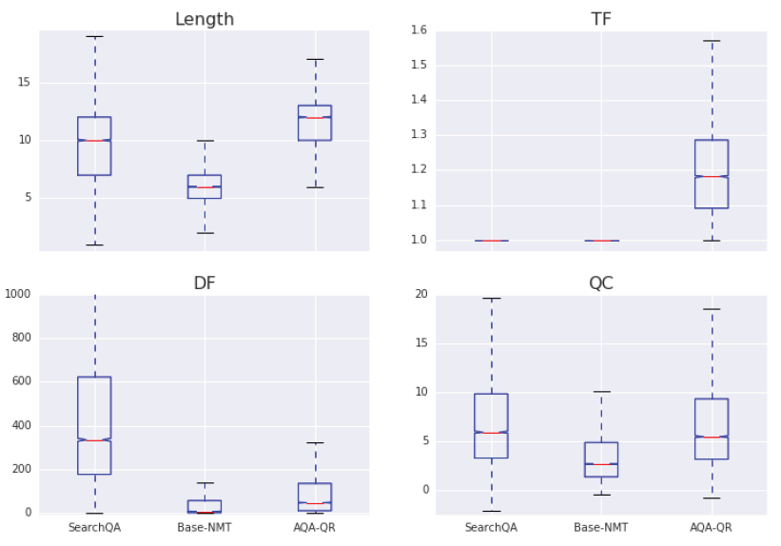
QA Experiments
Question Qualitative
Term Frequency
More repeated terms (higher TF)
longer
AQA-QR
More informative context terms than SearchQA (lower DF)
Document Frequency
Question Clarity
Similar question clarity (QC) with SearchQA

Slide 21
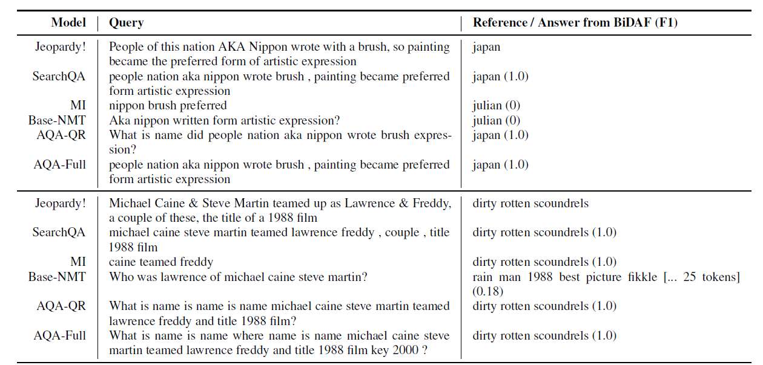
QA Experiments
Reformulation Examples

Slide 22
References
M. Seo, A. Kembhavi, A. Farhadi, and H. Hajishirzi. Bidirectional Attention Flow for Machine Comprehension. In Proceedings of ICLR, 2017.
D. Britz, A. Goldie, M. Luong, and Q. Le. Massive exploration of neural machine translation architectures. http://arxiv.org/abs/1703.03906, 2017.
M. Johnson, M. Schuster, Q.V. Le, M. Krikun, Y. Wu, Z. Chen, N. Thorat, F. Viégas, M. Wattenberg, G. Corrado, M. Hughes, and J. Dean. Google’s Multilingual Neural Machine Translation System: Enabling Zero-Shot Translation. http://arxiv.org/abs/1611.04558, 2016.
Yoom Kim. Convolutional Neural Networks for Sentence Classification.
http://arxiv.org/abs/1703.03906, 2017.

