Slide 1
Network Coding for Distributed Storage
Alex Dimakis
based on collaborations with
Dimitris Papailiopoulos
Arash Saber Tehrani
USC

Slide 2
overview
Storing Distributed information using codes. The repair problem
Functional Repair and Exact Repair. Minimum Storage and Minimum Bandwidth Regenerating codes. The state of the art.
Some new simple Min-Bandwidth Regenerating codes.
Interference Alignment and Open problems

Slide 3
how to store using erasure codes
n=3
n=4
k=2
A
A
File or data object
A
A
B
B
B
B
A+B
A+B
(3,2) MDS code, (single parity) used in RAID 5
A+2B
(4,2) MDS code. Tolerates any 2 failures
Used in RAID 6
3
Notes:
This is another example a code with n=4, k=2. In the right we have a good erasure code (any 2 suffice). Notice that
2 is the minimum number of packets required to have any hope of recovering so in that sense good-erasure codes introduce redundancy in an optimal way. Here, we compare it to replication. Now assume we store each packet on a storage node. If we lose each node with probability ½ , we can calculate the probability that we cannot recover the data. It is clear the erasure codes outperform repetition.
Reed-Solomon, LT codes and Raptor codes are all good erasure codes that have numerous applications.

Slide 4
erasure codes are reliable
(4,2) MDS erasure code (any 2 suffice to recover)
Replication
File or data object
A
A
A
A
B
B
vs
B
A+B
B
A+2B
4
Notes:
This is another example a code with n=4, k=2. In the right we have a good erasure code (any 2 suffice). Notice that
2 is the minimum number of packets required to have any hope of recovering so in that sense good-erasure codes introduce redundancy in an optimal way. Here, we compare it to replication. Now assume we store each packet on a storage node. If we lose each node with probability ½ , we can calculate the probability that we cannot recover the data. It is clear the erasure codes outperform repetition.
Reed-Solomon, LT codes and Raptor codes are all good erasure codes that have numerous applications.

Slide 5

erasure codes are reliable
(4,2) MDS erasure code (any 2 suffice to recover)
Replication
File or data object
A
A
A
A
B
vs
Coding is introducing redundancy in an optimal way.
Very useful in practice
i.e. Reed-Solomon codes, Fountain Codes, (LT and Raptor)…
B
B
A+B
Still, current storage architectures use replication.
Replication= repetition code (rate goes to zero to achieve vanishing probability of error)
B
A+2B
Can we improve storage efficiency?
5
Notes:
This is another example a code with n=4, k=2. In the right we have a good erasure code (any 2 suffice). Notice that
2 is the minimum number of packets required to have any hope of recovering so in that sense good-erasure codes introduce redundancy in an optimal way. Here, we compare it to replication. Now assume we store each packet on a storage node. If we lose each node with probability ½ , we can calculate the probability that we cannot recover the data. It is clear the erasure codes outperform repetition.
Reed-Solomon, LT codes and Raptor codes are all good erasure codes that have numerous applications.

Slide 6
storing with an (n,k) code
An (n,k) erasure code provides a way to:
Take k packets and generate n packets of the same size such that
Any k out of n suffice to reconstruct the original k
Optimal reliability for that given redundancy. Well-known and used frequently, e.g. Reed-Solomon codes, Array codes, LDPC and Turbo codes.
Assume that each packet is stored at a different node, distributed in a network.

Slide 7




Coding+Storage Networks = New open problems
A
Issues:
Communication
Update complexity
Repair communication
B
Network traffic
?
7
Notes:
We want to use coding for reliable storage, in decentralized networks. Coding theory is a classical subject, but there a few issues here that are novel in the decentralized setup. Let me illustrate:
First, is that now data packets and encoded packets are over different nodes in a network. So we will be talking about data NODES and storage NODES, and everything will be moving in a network. Both for sensor networks and p2p networks communication bandwidth is one of the most precious resources. So we want to minimize the amount of communication that happens in our network, to construct the erasure code. How much information is required?
If nodes are distributed, coordinating who sends which packets where can be difficult. Ideally we would like to construct the codes by having nodes acting randomly and independently. How much coordination is required?
Finally a question that has not been addressed in classical coding theory is the issues of dynamic changes in the network (and hence the code). If we lose one storage node, and we want to generate a new one, by using encoded data, how do we do that?

Slide 8
(4,2) MDS Codes: Evenodd
a
c
a+c
b+c
b
d
b+d
a+b+d
Total data object size= 4GB
k=2 n=4 , binary MDS code used in RAID systems
M. Blaum and J. Bruck ( IEEE Trans. Comp., Vol. 44 , Feb 95)

Slide 9

We can reconstruct after any 2 failures
a
c
a+c
b+c
b
d
b+d
a+b+d
1GB
1GB

Slide 10
We can reconstruct after any 2 failures
a
c
a+c
b+c
b
d
b+d
a+b+d
c = a + (a+c)
d = b + (b+d)

Slide 11
The Repair problem
Ok, great, we can tolerate n-k disk failures without losing data.
If we have 1 failure however, how do we rebuild the redundancy in a new disk?
Naïve repair: send k blocks.
Filesize B, B/k per block.
a
b
c
d
?
?
?
e

Slide 12
The Repair problem
Ok, great, we can tolerate n-k disk failures without losing data.
If we have 1 failure however, how do we rebuild the redundancy in a new disk?
Naïve repair: send k blocks.
Filesize B, B/k per block.
a
b
c
d
?
?
?
e
Do I need to reconstruct the
Whole data object to repair
one failure?

Slide 13
The Repair problem
Ok, great, we can tolerate n-k disk failures without losing data.
If we have 1 failure however, how do we rebuild the redundancy in a new disk?
Naïve repair: send k blocks.
Filesize B, B/k per block
a
b
c
d
?
?
?
e
Functional repair: e can be different from a. Maintains the any k out of n reliability property.
Exact repair: e is exactly equal to a.

Slide 14

The Repair problem
Ok, great, we can tolerate n-k disk failures without losing data.
If we have 1 failure however, how do we rebuild the lost blocks in a new disk?
Naïve repair: send k blocks.
Filesize B, B/k per block
a
b
c
d
?
?
It is possible to functionally repair a code by communicating only
As opposed to naïve repair cost of B bits.
(Regenerating Codes)
?
e

Slide 15
Exact repair with 3GB
a
c
a+c
b+c
b
d
b+d
a+b+d
a?
1GB
a = (b+d) + (a+b+d)
b?
b = d + (b+d)

Slide 16
Systematic repair with 1.5GB
Reconstructing all the data: 4GB
Repairing a single node: 3GB
3 equations were aligned, solvable for a,b
a
c
a+c
b+c
b
d
b+d
a+b+d
a?
1GB
a = (b+d) + (a+b+d)
b?
b = d + (b+d)

Slide 17
Repairing the last node
a
c
a+c
b+c
b
d
b+d
a+b+d
b+c = (c+d) + (b+d)
a+b+d = a + (b+d)

Slide 18

What is known about repair
Information theoretic results suggest that k –factor benefits are possible in repair communication and disk I/O.
We have explicit constructions for binary (and other small GF) for k,k+2 (Zhang, Dimakis, Bruck, 2010).
We try to repair existing codes in addition to designing new codes. Recent results for Evenodd, RDP.
Working on Reed-Solomon or other simple constructions
http://tinyurl.com/storagecoding

Slide 19
Repair=Maintaining redundancy
k=7 , n=14
Total data B=7 MB
Each packet =1 MB
A single repair costs 7 MB in network traffic!
x1
p7
x2
p6
?
x3
p5
x4
p4
p3
x5
p2
x6
p1
x7

Slide 20
Repair=Maintaining redundancy
k=7 , n=14
Total data B=7 MB
Each packet =1 MB
A single repair costs 7 MB in network traffic!
x1
p7
The amount of network traffic required to reconstruct lost data blocks is the main argument against the use of erasure codes in P2P Storage applications
(Pamies-Juarez et al, Rodrigues & Liskov, Utard & Vernois, Weatherspoon et al, Dumincuo & Biersack)
x2
p6
?
x3
p5
x4
p4
p3
x5
p2
x6
p1
x7

Slide 21
Proof sketch: Information flow graph
a
a
data
collector
2GB
b
b
∞
S
β
data
collector
c
c
β
∞
β
e
d
d
α =2 GB
2+2 β ≥4 GB → β ≥1 GB
Total repair comm. ≥3 GB

Slide 22
Proof sketch: reduction to multicasting
data
collector
a
a
data
collector
data
collector
b
b
S

c
c
data
collector


e
d
d
data
collector
data
collector
Repairing a code = multicasting on the information flow graph.
sufficient iff minimum of the min cuts is larger than file size M.
(Ahlswede et al. Koetter & Medard, Ho et al.)

Slide 23
Numerical example
File size M=20MB , k=20, n=25
Reed-Solomon : Store α=1MB , repair βd=20MB
MinStorage-RC : Store α=1MB , repair βd=4.8MB
MinBandwidth RC : Store α=1.65MB , repair βd=1.65MB
Fundamental Tradeoff: What other points are achievable?

Slide 24
The infinite graph for Repair
β
β
x₁
α
α
α
α
x₂
d
d
α
β
β
α
…
α
α
d
d
x_{n}
data
collector
k
data
collector

Slide 25
Storage-Communication tradeoff
Theorem 3: for any (n,k) code, where each node stores α bits, repairs from d existing nodes and downloads dβ=γ bits, the feasible region is piecewise linear function described as follows:

Slide 26
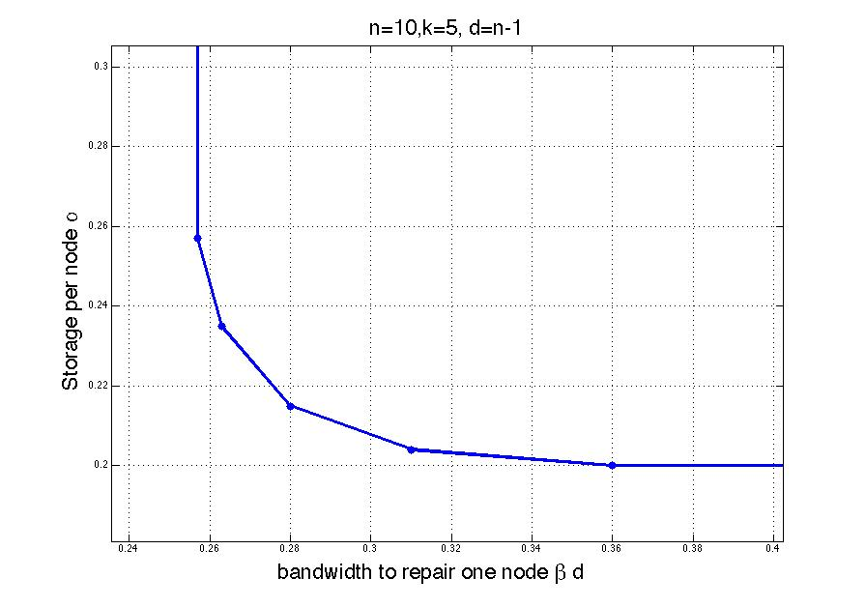
Storage-Communication tradeoff
Min-Bandwidth Regenerating code
α
Min-Storage Regenerating code
γ=βd
(D, Godfrey, Wu, Wainwright, Ramchandran, IT Transactions (2010) )

Slide 27
Key problem: Exact repair
From Theorem 1, a (4,2) MDS code can be repaired by downloading
What if we require perfect reconstruction?
a
1mb
1mb
b
?
c
?
e=a
?
d

Slide 28
Repair vs Exact Repair
x₁?
β
β
x₁
α
α
α
α
x₂
d
d
α
β
β
…
α
α
Functional Repair= Multicasting
Exact repair= Multicasting with intermediate nodes having (overlapping) requests.
Cut set region might not be achievable
Linear codes might not suffice (Dougherty et al.)
α
d
d
x_{n}
data
collector
k
data
collector

Slide 29
overview
Storing Distributed information using codes. The repair problem
Functional Repair and Exact Repair. Minimum Storage and Minimum Bandwidth Regenerating codes. The state of the art.
Some new simple Min-Bandwidth Regenerating codes.
Interference Alignment and Open problems

Slide 30
Exact Storage-Communication tradeoff?
Exact repair feasible?
α
γ=βd

Slide 31
What is known about exact repair
For (n,k=2) E-MSR repair can match cutset bound. [WD ISIT’09]
(n=5,k=3) E-MSR systematic code exists (Cullina,D,Ho, Allerton’09)
For k/n <=1/2 E-MSR repair can match cutset bound
[Rashmi, Shah, Kumar, Ramchandran (2010)]
E-MBR for all n,k, for d=n-1 matches cut-set bound.
[Suh, Ramchandran (2010) ]

Slide 32
What is known about exact repair
What can be done for high rates?
Recently the symbol extension technique (Cadambe, Jafar, Maleki) and independently (Suh, Ramchandran) was shown to approach cut-set bound for E-MSR, for all (k,n,d).
(However requires enormous field size and sub-packetization.)
Shows that linear codes suffice to approach cut-set region for exact repair, for the whole range of parameters.

Slide 33
Exact Storage-Communication tradeoff?
Min-Bandwidth Regenerating code
α
E-MBR Point
E-MSR Point
Min-Storage Regenerating code
γ=βd

Slide 34
overview
Storing Distributed information using codes. The repair problem
Functional Repair and Exact Repair. Minimum Storage and Minimum Bandwidth Regenerating codes. The state of the art.
Some new simple Min-Bandwidth Regenerating codes.
Interference Alignment and Open problems

Slide 35
Simple regenerating codes
File is Separated in m blocks
Adjacency matrix of an expander graph.
Every k right nodes are adjacent to m left nodes.
n
m
An MDS
code produces T blocks.
Each coded block is stored in r nodes.
Each storage node
Stores d coded blocks.

Slide 36
Simple regenerating codes
File is Separated in m blocks
Adjacency matrix of an expander graph.
Every k right nodes are adjacent to m left nodes.
n
m
An MDS
code produces T blocks.
Each coded block is stored in r nodes.
Each storage node
Stores d coded blocks.
Claim 1: This code has the (n,k) recovery property.

Slide 37
Simple regenerating codes
Choose k right nodes
They must know m left nodes
File is Separated in m blocks
Adjacency matrix of an expander graph.
Every k right nodes are adjacent to m left nodes.
n
m
An MDS
code produces T blocks.
Each coded block is stored in r nodes.
Each storage node
Stores d coded blocks.
Claim 1: This code has the (n,k) recovery property.

Slide 38
Simple regenerating codes
But each packet is replicated r times. Find copy in another node.
d packets lost
File is Separated in m blocks
Adjacency matrix of an expander graph.
Every k right nodes are adjacent to m left nodes.
n
m
An MDS
code produces T blocks.
Each coded block is stored in r nodes.
Each storage node
Stores d coded blocks.
Claim 2: I can do easy lookup repair.
[Rashmi et al. 2010, El Rouayheb & Ramchandran 2010]

Slide 39
Simple regenerating codes
But each packet is replicated r times. Find copy in another node.
d packets lost
File is Separated in m blocks
Adjacency matrix of an expander graph.
Every k right nodes are adjacent to m left nodes.
n
m
An MDS
code produces T blocks.
Each coded block is stored in r nodes.
Each storage node
Stores d coded blocks.
Claim 2: I can do easy lookup repair.
[Rashmi et al. 2010, El Rouayheb & Ramchandran 2010]

Slide 40
Simple regenerating codes
File is Separated in m blocks
Adjacency matrix of an expander graph.
Every k right nodes are adjacent to m left nodes.
n
m
An MDS
code produces T blocks.
Each coded block is stored in r nodes.
Each storage node
Stores d coded blocks.
Great. Now everything depends on which graph I use and how much expansion it has.

Slide 41
Simple regenerating codes
Rashmi et al. used the edge-vertex bipartite graph of the complete graph. Vertices=storage nodes. Edges= coded packets.
d=n-1, r=2
Expansion: Every k nodes are adjacent to
kd – (k choose 2) edges.
Remarkably this matches the cut-set bound for the E-MBR point.

Slide 42
Extending this idea
Lookup repair allows very easy uncoded repair and modular designs. Random matrices and Steiner systems proposed by [El Rouayheb et al.]
Note that for d< n-1 it is possible to beat the previous E-MBR bound. This is because lookup repair does not require every set of d surviving nodes to suffice to repair.
E-MBR region for lookup repair remains open.
r ≥ 2 since two copies of each packet are required for easy repair. In practice higher rates are more attractive.
This corresponds to a repetition code! Lets replace it with a sparse intermediate code.

Slide 43
Simple regenerating codes
File is Separated in m blocks
Adjacency matrix of an expander graph.
Every k right nodes are adjacent to m left nodes.
n
m
+
+
A code (possibly MDS code) produces T blocks.
Each coded block is stored in r=1.5 nodes.
Each storage node
Stores d coded blocks.

Slide 44
Simple regenerating codes
d packets lost
File is Separated in m blocks
Adjacency matrix of an expander graph.
Every k right nodes are adjacent to m left nodes.
n
m
+
+
An MDS
code produces T blocks.
Each coded block is stored in r nodes.
Each storage node
Stores d coded blocks.
Claim: I can still do easy lookup repair.
[Dimakis et al. to appear]

Slide 45
Simple regenerating codes
d packets lost
File is Separated in m blocks
Adjacency matrix of an expander graph.
Every k right nodes are adjacent to m left nodes.
n
m
+
+
An MDS
code produces T blocks.
Each coded block is stored in r nodes.
Each storage node
Stores d coded blocks.
Claim: I can still do easy lookup repair. 2d disk IO and communication
[Dimakis et al. to appear]

Slide 46
Two excellent expanders to try at home
The Petersen Graph. n=10, T=15 edges.
Every k=7 nodes are adjacent to m=13 (or more) edges, i.e. left nodes.
The ring. n vertices and edges. Maximum girth. Minimizes d which is important for some applications.
[Dimakis et al. to appear]

Slide 47
Example ring RC
Every k nodes adjacent to at least k+1 edges.
Example pick k=19, n=22. Use a ring of 22 nodes.
n=22
m=20
An MDS
code produces T blocks.
Each storage node
Stores d coded blocks.
Each coded block is stored in r=2 nodes.

Slide 48
Ring RC vs RS
k=19, n=22 Ring RC. Assume B=20MB.
Each Node stores d=2 packets. α= 2MB.Total storage =44MB
1/rate= 44/20 = 2.2 storage overhead
Can tolerate 3 node failures.
For one failure. d=2 surviving nodes are used for exact repair. Communication to repair γ= 2MB. Disk IO to repair=2MB.
k=19, n=22 Reed Solomon with naïve repair. Assume B=20MB.
Each Node stores α= 20MB/ 19 =1.05 MB. Total storage= 23.1
1/rate= 22/19 = 1.15 storage overhead
Can tolerate 3 node failures.
For one failure. d=19 surviving nodes are used for exact repair. Communication to repair γ= 19 MB. Disk IO to repair=19 MB.
Double storage, 10 times less resources to repair.
[Dimakis et al. to appear]

Slide 49
overview
Storing Distributed information using codes. The repair problem
Functional Repair and Exact Repair. Minimum Storage and Minimum Bandwidth Regenerating codes. The state of the art.
Some new simple Min-Bandwidth Regenerating codes.
Interference Alignment and Open problems

Slide 50
Interference alignment
Imagine getting three linear equations in four variables.
In general none of the variables is recoverable. (only a subspace).
A₁+2A₂+ B₁+B₂=y₁
2A₁+A₂+ B₁+B₂=y₂
B₁+B₂=y₃
The coefficients of some variables lie in a lower dimensional subspace and can be canceled out.
How to form codes that have multiple alignments at the same time?

Slide 51
Exact Repair-(4,2) example
x1
x3
x1+x3
x1+2x3
2⁻¹
x2
x4
x2+x4
2x2+3x4
1
1
1
1
3⁻¹
x3+x4
x1+x2+x3+x4
2⁻¹x1+2 3⁻¹x2+x3+x4
x1?
x2?
(Wu and D. , ISIT 2009)
51
Notes:
51

Slide 52
What is known about E-MSR repair
Given an error-correcting code find the repair coefficients that reduce communication (over a field)
Both problems reduce to rank minimization subject to full rank constraints. Polynomial reduction from one to the other.
(Papailiopoulos & D. Asilomar 2010)
Given some channel matrices find the beamforming matrices that maximize the DoF
(Cadambe and Jafar, Suh and Tse)

Slide 53

Security during Repair ?
Repair bandwidth in the presence of byzantine adversaries?
a
b
c
e
d
Incorrect linear equations

Slide 54
Open Problems in distributed storage
Cut-Set region matches exact repair region ?
Repairing codes with a small finite field limit ?
Dealing with bit-errors (security) and privacy ?
(Dikaliotis,D, Ho, ISIT’10)
What is the role of (non-trivial) network topologies ?
Cooperative repair (Shum et al.)
Lookup repair region ? Disk IO region ?
What are the limits of interference alignment techniques ?
Repairing existing codes used in storage (e.g. EvenOdd, B-Code, Reed-Solomon etc) ?
Real world implementation, benefits over HDFS for Mapreduce ?
54

Slide 55
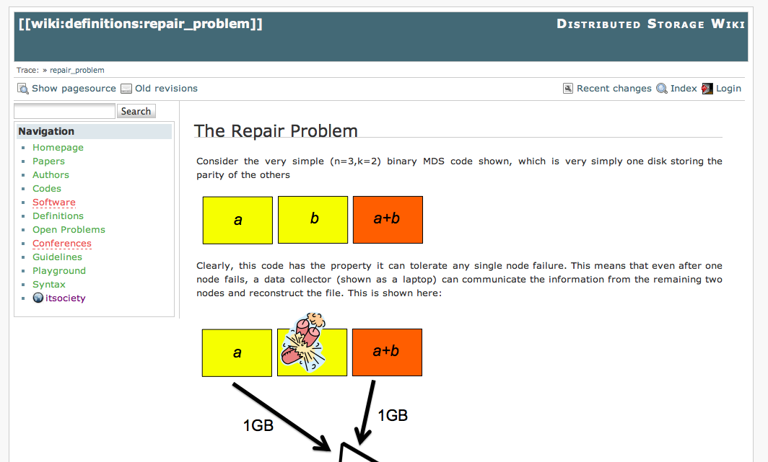
Coding for Storage wiki

Slide 56
fin
56

Slide 57
Conclusions
We proposed a theoretical framework for analyzing encoded information representations
Repair reduces to network coding and flow arguments completely characterize what is possible.
We identified and characterized a tradeoff between repair bandwidth and communication for any storage system.
Numerous interesting questions in coding for data centers- repair/updates/disk IO vs network bandwidth.
Systematic, deterministic, small finite field constructions are very interesting for real applications.
57

Slide 58
Exact Repair-(4,2) example
x1
x3
x1+x3
x1+2x3
2⁻¹
x2
x4
x2+x4
2x2+3x4
1
1
1
1
3⁻¹
x3+x4
x1+x2+x3+x4
2⁻¹x1+2 3⁻¹x2+x3+x4
x1?
x2?
(Wu and D. , ISIT 2009)
58
Notes:
58

Slide 59
Exact Repair-interference alignment
1 | 0
0 | 1
0 | 0
0 | 0
v₂
1 | 1
0 | 0
0 | 0
1 | 0
0 | 1
=
0 | 0 | 1 | 1
v₃
1 | 1
1 | 0
0 | 1
1 | 0
0 | 1
=
1 | 1 | 1 | 1
v₄
2⁻¹ | 3⁻¹
1 | 0
0 | 2
2 | 0
0 | 3
=
2⁻¹ | 23⁻¹ | 1 | 1

Slide 60










Exact Repair-interference alignment
1 | 0
0 | 1
0 | 0
0 | 0
1 | 1
0 | 0
0 | 0
1 | 0
0 | 1
=
1 | 1
1 | 0
0 | 1
1 | 0
0 | 1
=
2⁻¹ | 3⁻¹
1 | 0
0 | 2
2 | 0
0 | 3
=
[Cadambe-Jafar 2008, Cadambe-Jafar-Maleki-2010]

Slide 61
Exact Repair-interference alignment
Choose same V’ and V
1 | 0
0 | 1
0 | 0
0 | 0
1 | 1
0 | 0
0 | 0
1 | 0
0 | 1
=
Want this in the span of V’
1 | 1
1 | 0
0 | 1
1 | 0
0 | 1
=
2⁻¹ | 3⁻¹
1 | 0
0 | 2
2 | 0
0 | 3
=
We want this full rank
Make all A diagonal iid

Slide 62

Exact Repair-interference alignment
We have to choose V, V’ so that all the rows in
Are contained in the rowspan of
The A matrices assumed iid diagonal, no assumption other than that they commute

Slide 63





Exact Repair-interference alignment
Ok. Lets start by choosing V’ to be one vector w
Must be in the rowspan of

Slide 64



Exact Repair-interference alignment
And fold it back in…

Slide 65
Exact Repair-interference alignment
And fold it back in…
And again fold it back in….
And again fold it back in….

