Slide 1
The Influence of Buddhism on Chinese Language
Prof. Dr. Hamar Imre, Eötvös Loránd University, Budapest

Slide 2


Slide 3
Buddhist conquest of China: Indianization
Chinese conquest of Buddhism: Sinification
Modification of Chinese Buddhism
Chinese indigenous culture
Central Asia?

Slide 4
Translators on the silk road mainly from Central Asia:
安: (安息) parthus
支 :(月支) schitan
康: (康居) Sogdian
From India
竺 (天竺)

Slide 5
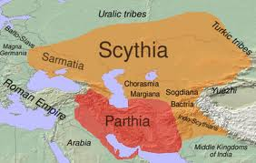
Pártus birodalom (Kr.e. 238 - Kr. u. 226)

Slide 6
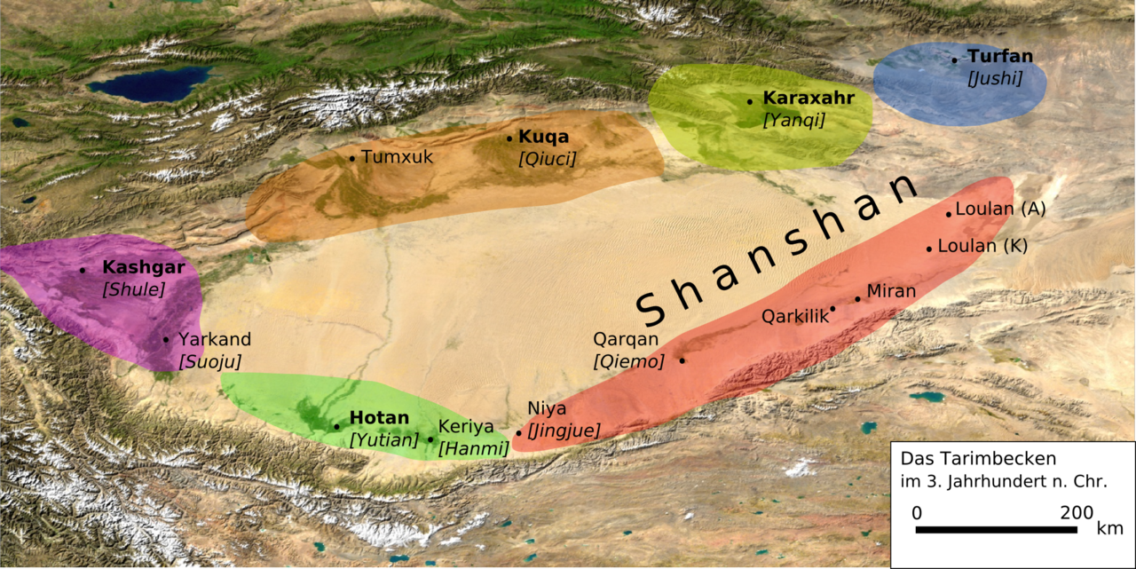
Geography

Slide 7
Two rivers
Yurungkash 白玉河 (White Jade)
Karakash 黑玉河 (Black Jade)
They join near Koxlax (some 200 km north of Khotan), from where it continues north as the Khotan River passing Piqanlik

Slide 8
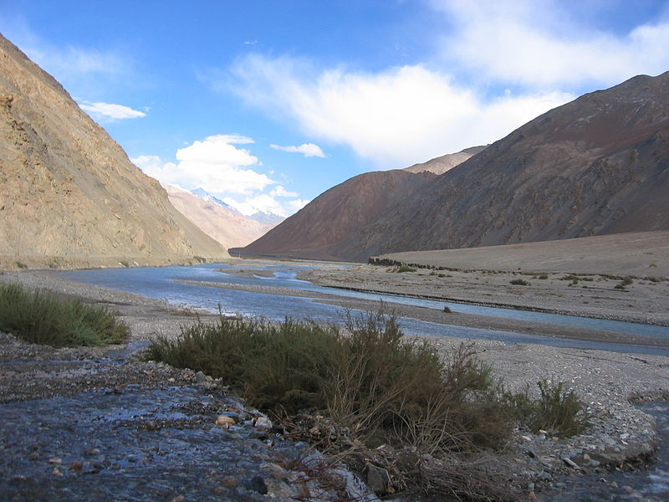
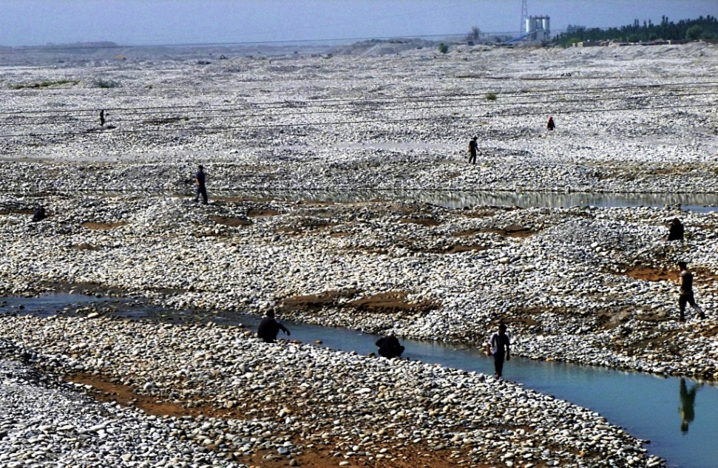

Slide 9
people
Legend: migrants from India
Shanpula cemetery (30 km east of Khotan): nomads from Eurasian steppe

Slide 10
Han History
19,300 people
3300 housholds

Slide 11
language
Iranian language contemporary with Middle Persian and Sogdian with vocabulary borrowed from Sanskrit

Slide 12
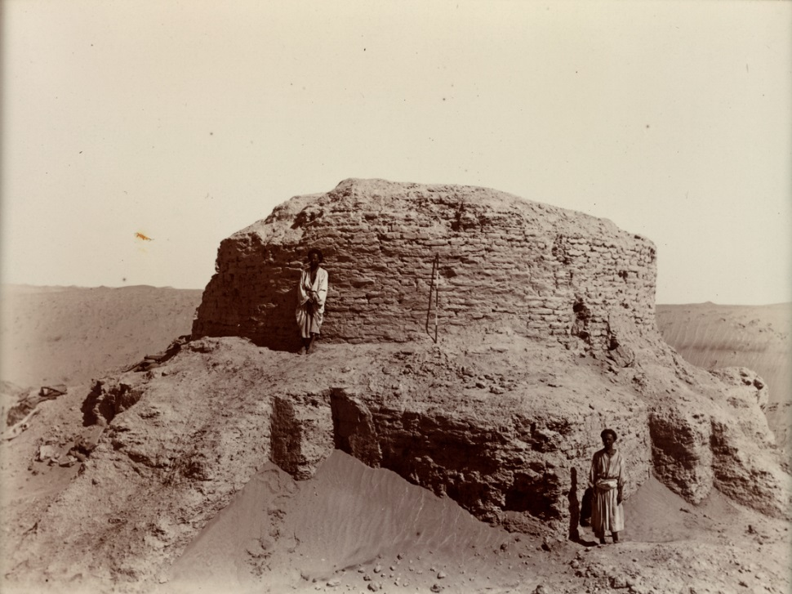
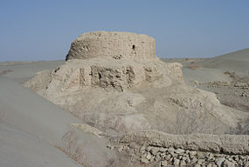
Rawak

Slide 13
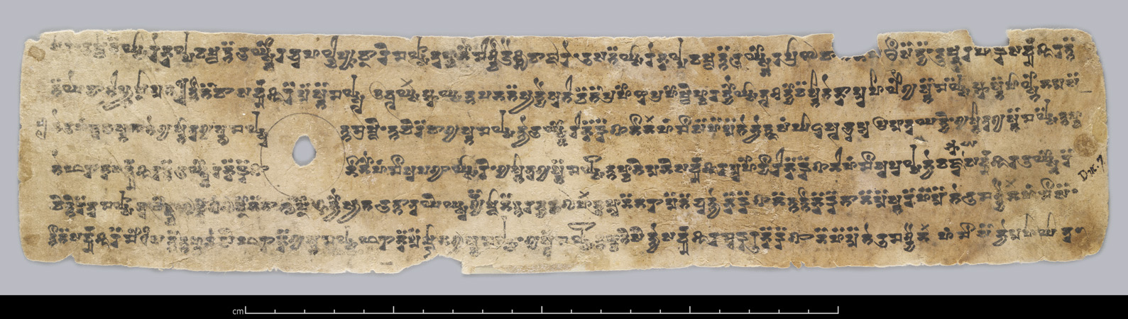
Dandan Uiliq

Slide 14
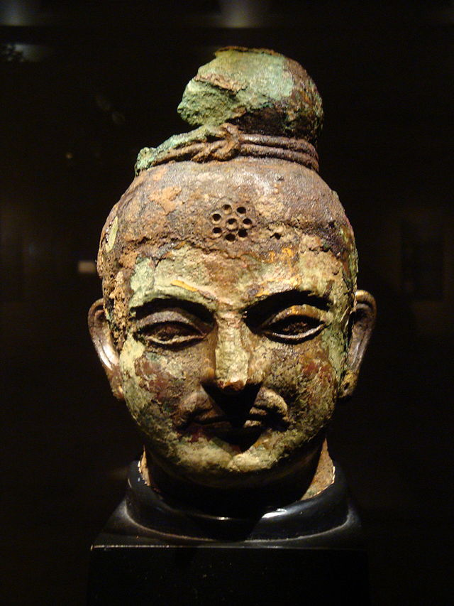
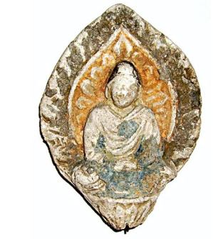

Slide 15
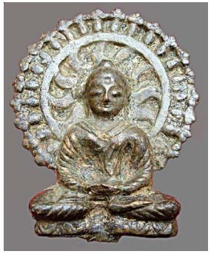

Slide 16
Book of Zambasta (23.4–5):
The Khotanese do not value the Law at all in Khotanese. They understand it badly in Indian, (but) in Khotanese it does not seem to them the Law. For the Chinese, (however,) the Law is in Chinese. In Kashmirian it is very agreeable, and they learn it in Kashmirian so that they can understand the meaning of it,as well. To the Khotanese, (however,) that seems to be the Law whose meaning they do not understand at all. When they hear it together with the meaning, it seems to them a different Law.

Slide 17
Book of Zambasta chapter 23:
“Since I have translated this into Khotanese, may I surely become a Buddha. Through these merits, may all beings realize best bodhi.”

Slide 18
Early translations
By Team (communication?)
Closely follow the Sanskrit
Vernacular elements (earliest sources)
the original text
translator
Difficult to understand
Often includes commentary

Slide 19
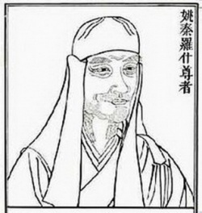
Kumarajiva 鳩摩羅什 (344–413/409)
Kucha 龜茲
Buddhist hybrid Chinese
Mahayana

Slide 20
New vocabulary
Transliteration: 般若，涅槃
New meaning:法，業
New concepts:
From Indian 緣起，輪迴，
From China:
Philosophical concepts 事事無礙法界，理事無礙法界
Technical terms 科判，來意

Slide 21
Laiyi 來意
’the meaning of apperance’,
to explain why the certain sections of Avataṃsaka sūtra appear after each other in the sequence they actually do.

Slide 22
two kinds of commentaries
Zhu 注 ’interlinear commentary’
Shu 疏 ’expounding commentary’.

Slide 23
The first expounding commentary
Daosheng 道生﹕ Miaofa lianhuajing shu妙法蓮花經疏
- Central concept (zong 宗)
- classification of teaching (panjiao 判教)
- outline (kepan, kewen 科判﹐科文 )
- below this 此下
- A to B A至B

Slide 24
華嚴經註疏
智儼: 大方廣華嚴經搜玄分齊通智方軌
李通玄:新華嚴經論
法藏: 華嚴經探玄記
慧苑: 續華嚴經略疏刊定記
澄觀: 大方廣佛華嚴經疏
澄觀: 大方廣佛華嚴經隨疏演義

Slide 25
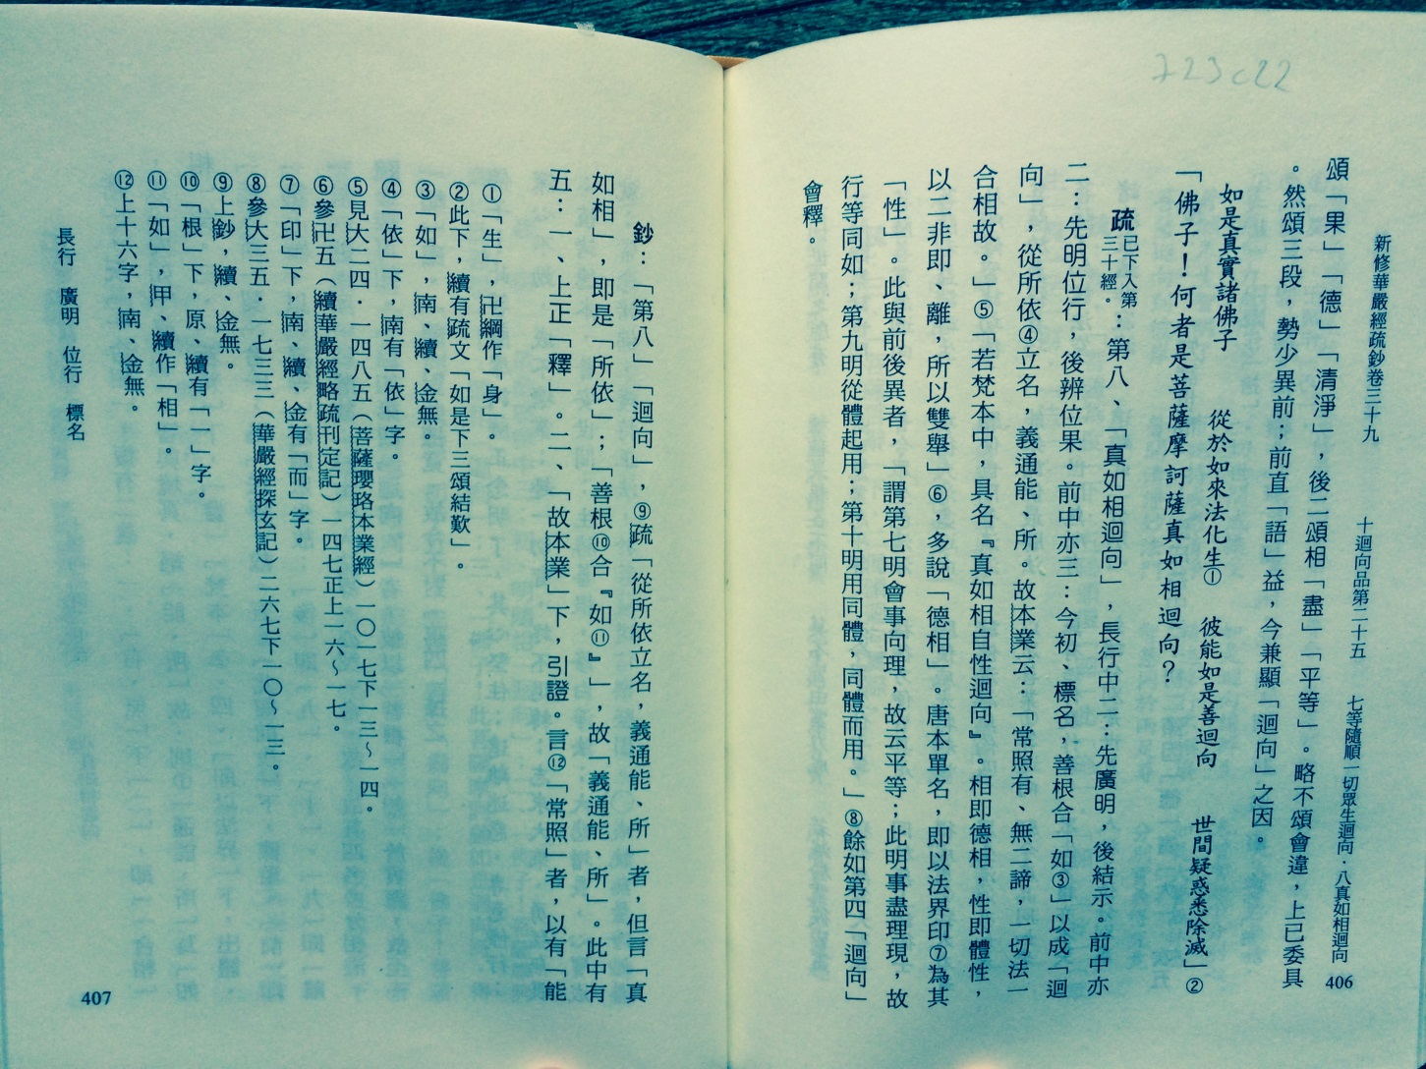

Slide 26
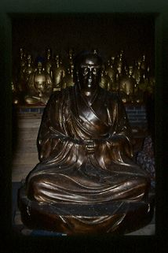
Chengguan

Slide 27

Xiantongsi 顯通寺

Slide 28
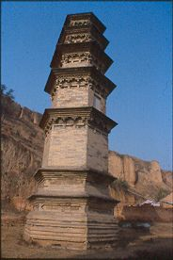
Miaojue ta 妙覺塔

Slide 29
大方廣佛華嚴經
佛子！諸菩薩摩訶薩應云何知如來、應、正等覺心？佛子！如來心、意、識俱不可得，但應以智無量故，知如來心。」

Slide 30
大方廣佛華嚴經疏
今初。言如來心意識俱不可得者。約體遮詮也。但應以智無量故。知如來心者寄用表詮。

Slide 31
大方廣佛華嚴經隨疏演義鈔
第四出現意業。疏約體遮詮下釋此段經。疏文有三。初總釋文意。二別敘異釋。三會釋歸宗。今初。心即是王。就王辯體。智則是所。約所明用。體則表詮不逮故但遮詮。用則相可照著故寄表詮。然用亦有遮詮。同體故。無分量故。若一向遮則無由顯妙。故寄表詮以辯玄極。而言寄者。謂寄所顯王寄用顯體。又用及心所皆有遮義。今但寄表以顯於深。

Slide 32
大方廣佛華嚴經疏
然此一文古有多說。一云識等有二。一染二淨。佛地無彼有漏染心心所。而有淨分心及心所。

Slide 33
疏。然此一文下。第二別敘異釋。於中二。先標。後一云下別說。略有三說。不離一宗即分為三。初二師即法相宗。二結前生後。三敘法性宗。就初師中有五。一正明。二解妨。三反成。四引證。五重解妨。今初。言無彼有漏染心心所而有淨分者。唯有八識心王及二十一心所。即遍行五別境五善十一也

Slide 34
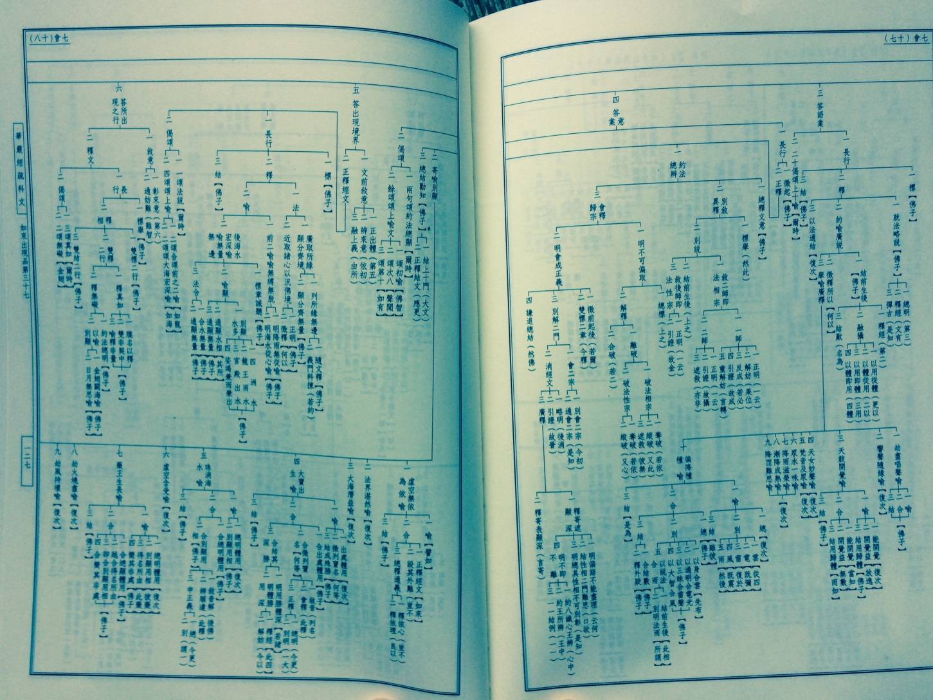

Slide 35

Thomas Aquinas, Tommaso d'Aquino (1225-1274)

Slide 36
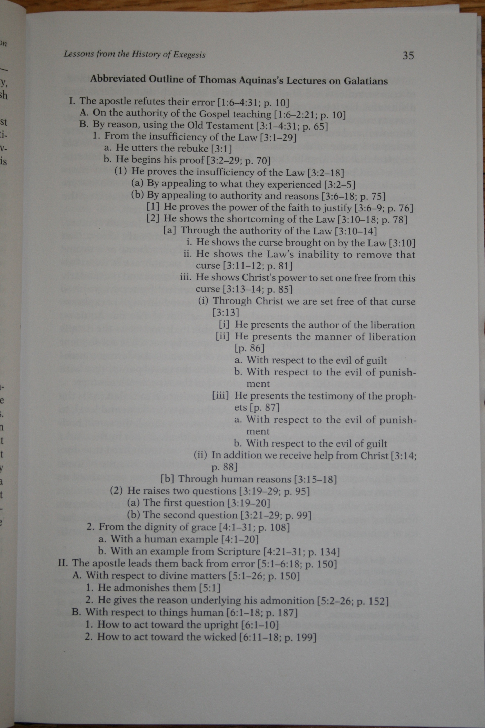

Slide 37
