Slide 1
3D Printed Museum Competition
Recreating Hong Kong in the 1960s & 1970s

Slide 2
1. How to prepare your 3D model? -3D modeling from zero -3D scanning and touch-up -Exploring 3D model from the web 2. 3D printing and post-processing

Slide 3
1. How to prepare your 3D model?

Slide 4
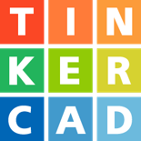

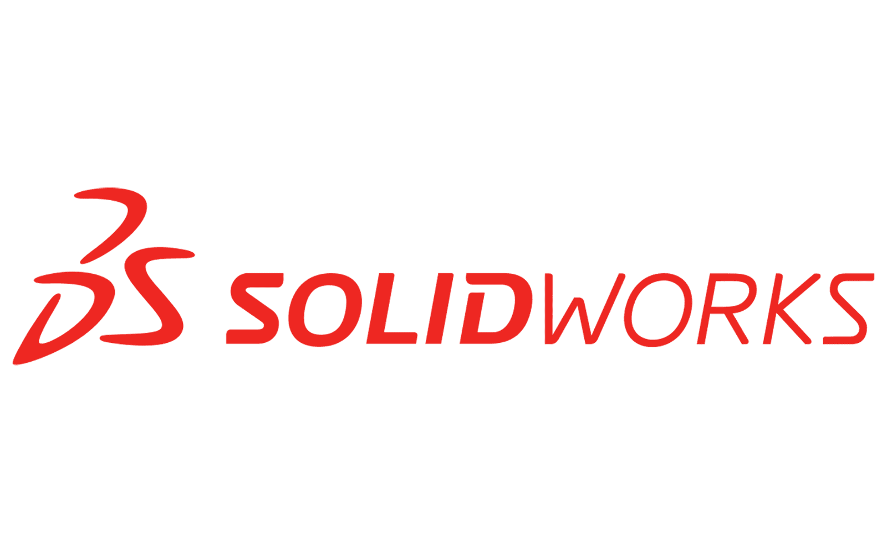

3D Modeling from Zero
You can create your 3D model by different computer-aided design(CAD) software

Slide 5

Tinkercad
Tinkercad is a free web app
For 3D design electronics and coding
Online tutorial: https://www.tinkercad.com/learn
Export file type: .stl, .obj
Difficulty:
Notes:
Pros & cons

Slide 6
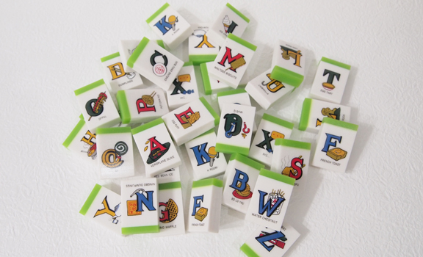
Tinkercad
Pros:
Easy-to-use for beginners
Cloud-based: can save your projects on the internet and continue your design whenever you want
Provide templates like geometrical shapes and letters for easy modeling
Cons:
Hard to creating complex sculpts
Resolution of objects aren’t very high
Photo credit: https://www.likemagazine.com.hk/
Notes:
Pros & cons

Slide 7

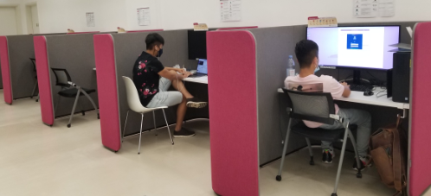
Blender
Blender is free and open-source 3D creation suite.
For 3D Modeling, 3D Printing and 3D Scanning clean up.
Online tutorial: https://www.blender.org/support/tutorials/
Software installed on high-performance workstations in the Learning Garden and MakerSpace.
Difficulty:
Notes:
Pros & cons

Slide 8
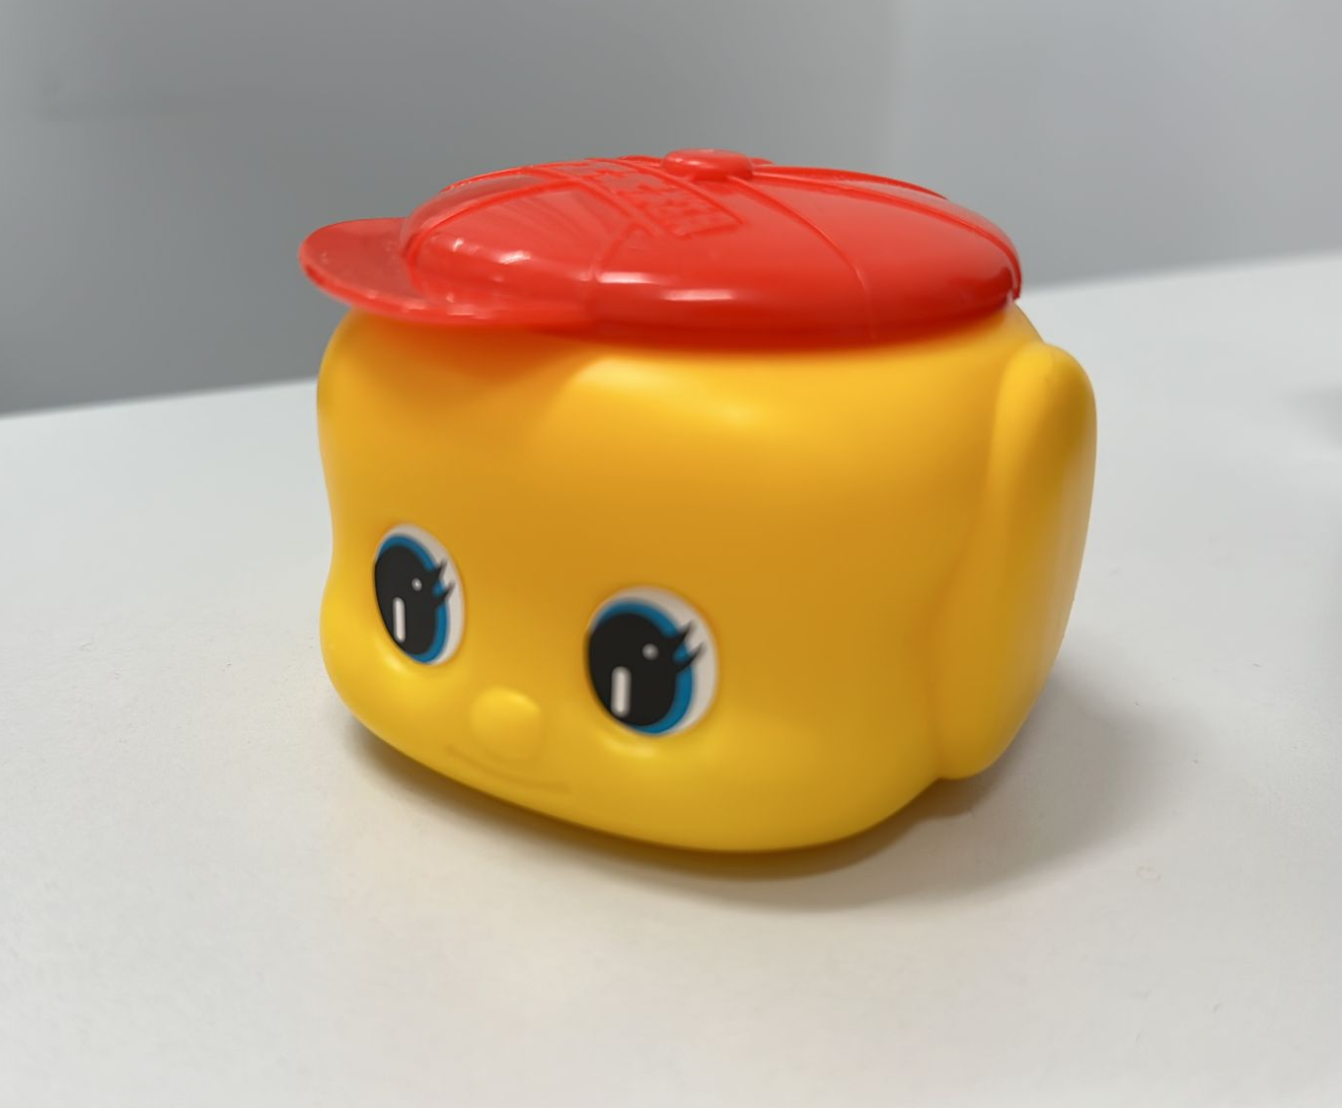
Blender
Pros:
Available for both Windows and macOS platforms
Provide precise 3D object placement and manipulation tools
More advanced modeling and rendering supporting quality work
Cons
Slow rendering times and crashes during complex projects
Difficult for beginners to grasp all of its features and functionalities
Complex software interface
Notes:
Pros & cons

Slide 9
Solidworks
Easy-to-use 2D and 3D product development solutions accessible
For CAD 3D Designs and product developments. Capable of creating a CAD 3D Model
Online tutorial: https://www.youtube.com/watch?v=CiBwrjUeB8U
Software installed on high-performance workstations in the Learning Garden and MakerSpace
Difficulty:
Notes:
Pros & cons

Slide 10
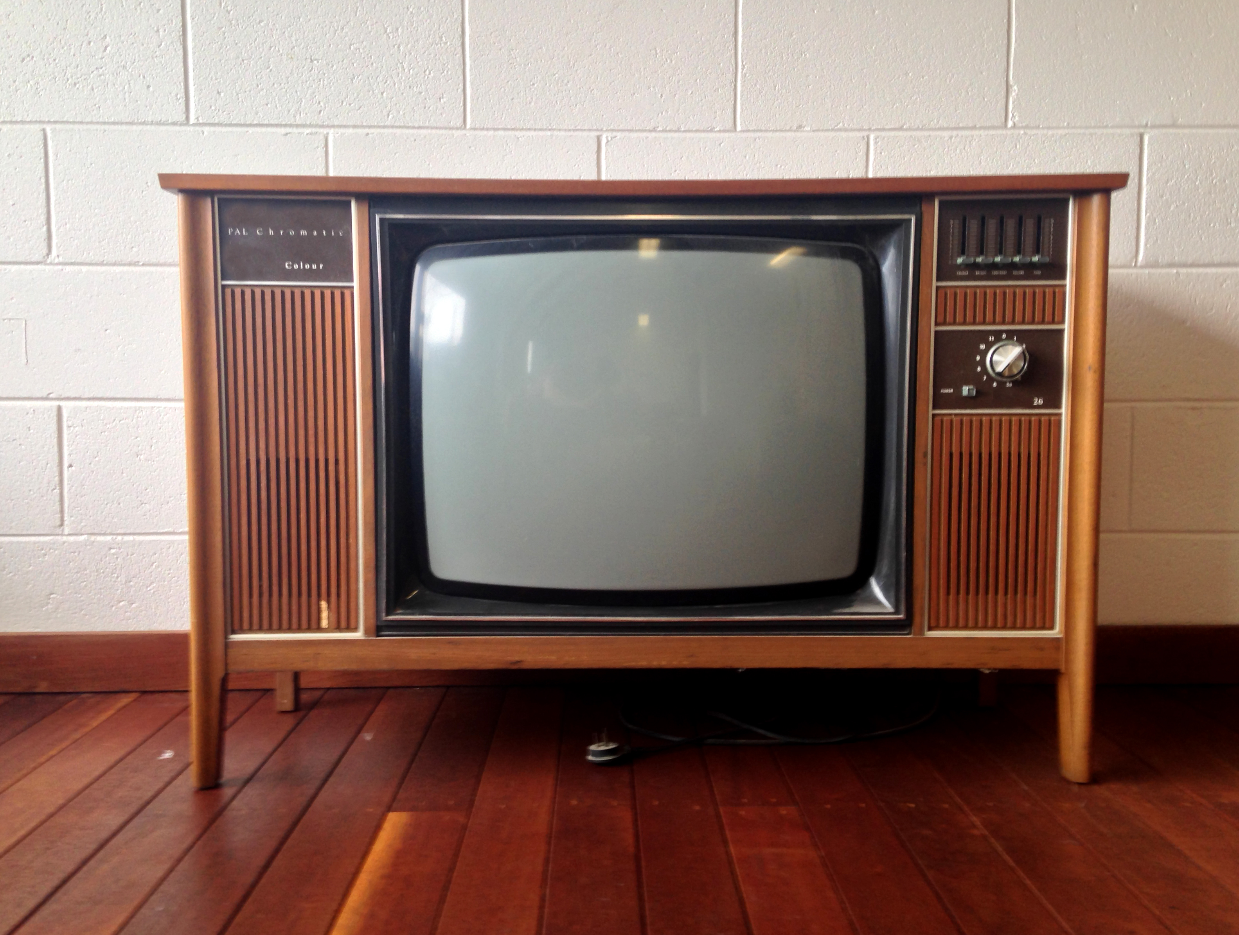
Solidworks
Pros:
User-Friendly Interface
Excels in assembly modeling, enabling the design of complex mechanical systems
Provide a comprehensive set of design and engineering tools, including parametric modeling, assemblies, and simulation
Cons
Cost and Hardware requirement is high
SolidWorks is designed for Windows only
Photo credit: FreeImages.com/meltingdog
Notes:
Pros & cons

Slide 11

ZBrush
For 3D Scanning clean up, 3D Printing, 3D Modeling, 3D Sculpting
Online tutorial: https://pixologic.com/zclassroom/workshop/getting-started-with-maxon-zbrush
Software installed on high-performance workstations in the Learning Garden and MakerSpace
Difficulty:
Notes:
Pros & cons

Slide 12
ZBrush
Pros:
Advanced sculpting capabilities
Integration with other 3D software
Cons
Difficult for beginners to grasp all of its features and functionalities
Complex software interface
Notes:
Pros & cons

Slide 13
3D scanning and touch-up

Slide 14


3D Scanning
There are many mobile apps for 3D Scanning, such as:
Metascan
Ploycam

Slide 15
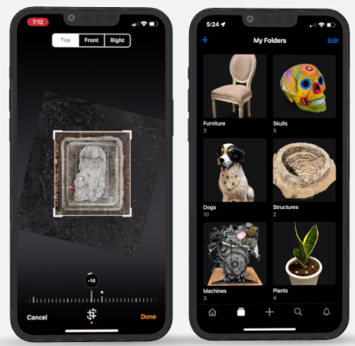

[object File]
Metascan
Metascan is a 3D scanning app for iOS and web
Build scale-accurate models of spaces in real-time
Export to popular formats: .stl, .obj
Requirement :
supports any iPhone or iPad from 2015 or later that runs iOS 15 or above.
LiDAR Mode requires a device with LiDAR Scanner, such as an iPhone 12 Pro or iPad Pro 2020.
User guide: https://metascan.ai/support
Download :
Notes:
QR code for download
1-2 mins video for how-to-use

Slide 16
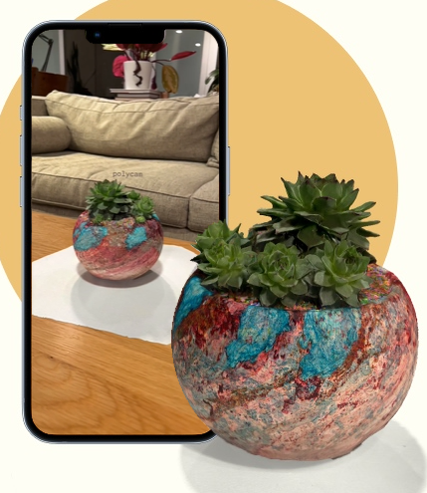

[object File]
Polycam
Polycam is a 3D scanning app for iOS, web and Android
Provide ‘’Photo Mode’’ and ‘’LiDAR Mode’’ for scanning Object
Export to popular formats :.stl, .obj
User guide: https://learn.poly.cam/about
Download :
Notes:
QR code for download
1-2 mins video for how-to-use

Slide 17


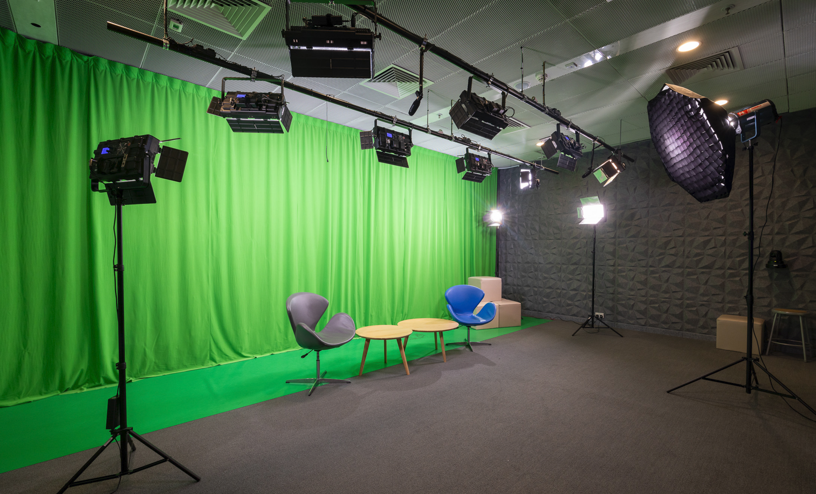
[object File]
Tips for scanning
DOs
Make sure your camera lenses are clean
Use a high pixel camera
Plan your orbits to capture all sides of the object
DON’Ts
Moving objects or camera quickly
Shiny, dark, hairy or clear object
Learning Garden & Makerspace provides accessories to support your 3D scanning:
Creative Media Studio
Tripod
Turntable
Lightbox

Slide 18
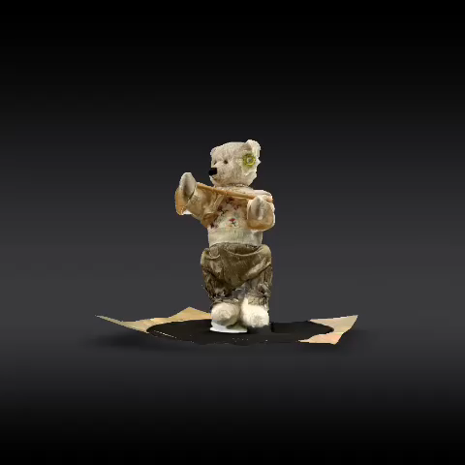

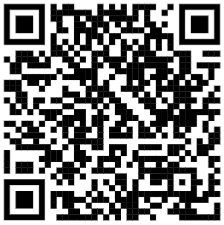
[object File]
Touch-up your scanning
After the scanning, CAD software such as Blender, ZBrush can help to clean up the 3D model before using in any other applications.
Blender online tutorials
ZBrush online tutorials

Slide 19
Exploring 3D model from the web

Slide 20



Online platform
There are some platforms for downloading printable 3D models:

Slide 21
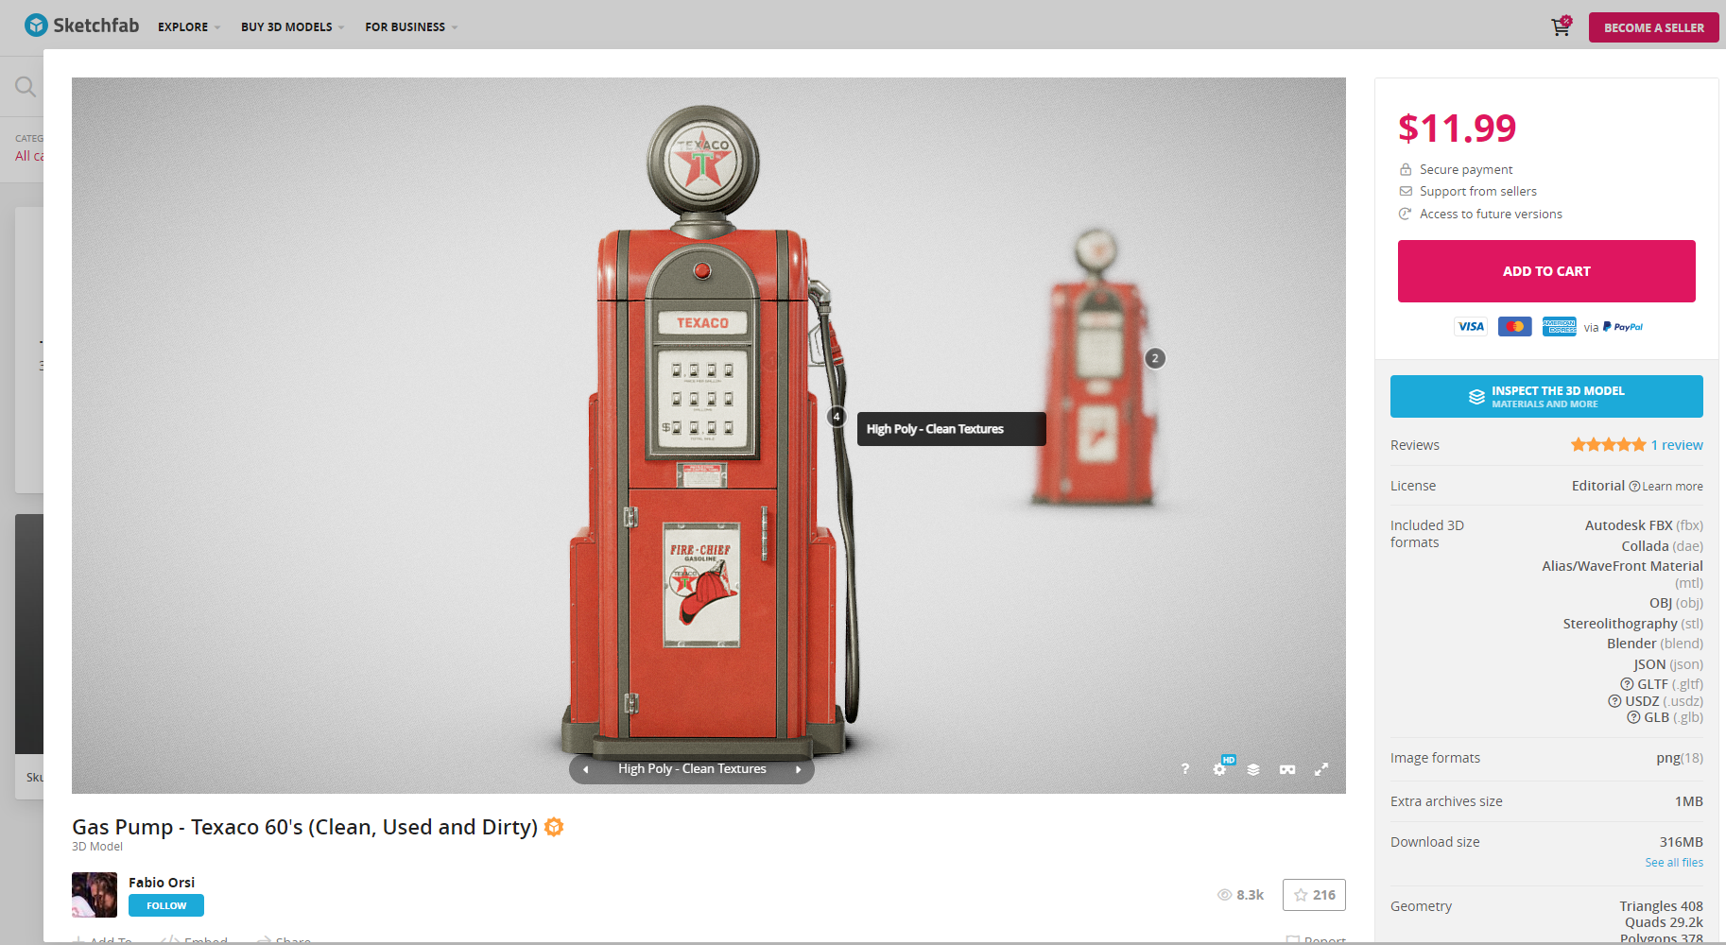
https://sketchfab.com/
Sketchfab is a 3D modeling platform to publish, share, discover, buy and sell 3Dcontent
Check downloadable formats
Notes:
Platform screen cap

Slide 22
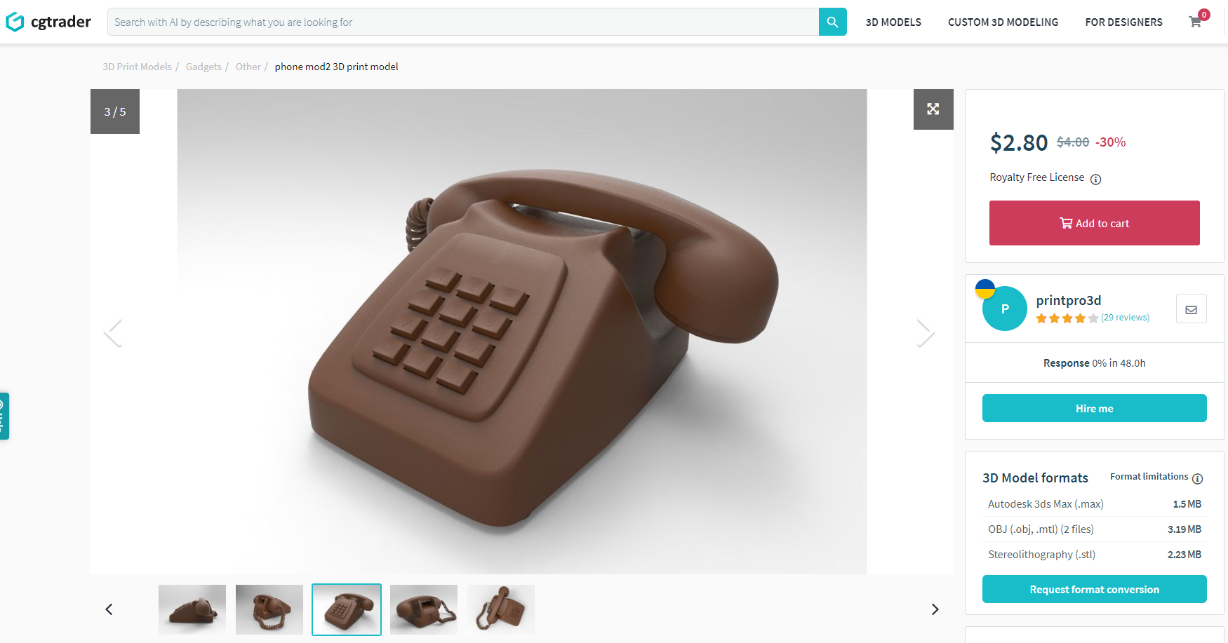
Yeggi is a search engine for printable 3D models. It collects and index 4.9 million printable 3d model files from all websites
https://www.yeggi.com/
Notes:
Platform screen cap

Slide 23

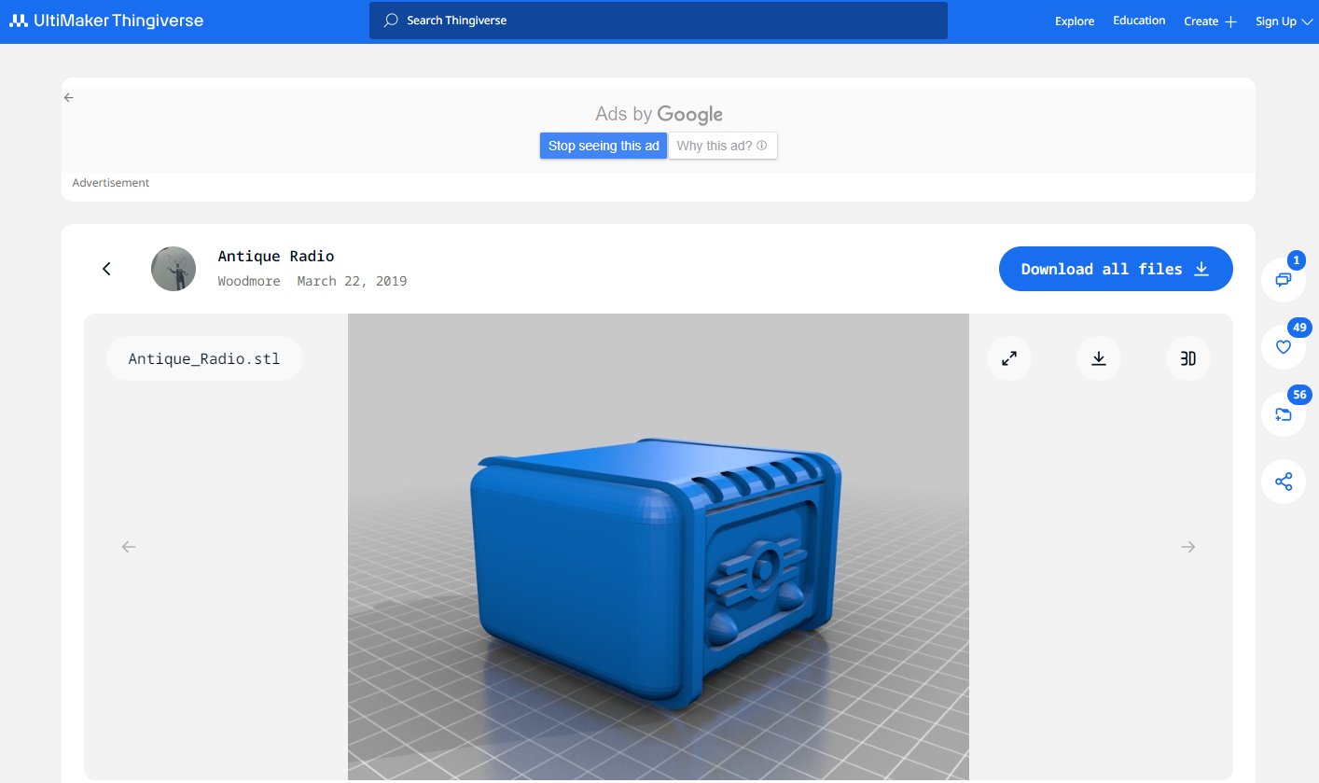
Thingiverse is a community of makers, hobbyists, educators, professionals, and many others who all have a passion for turning digital designs into real life objects via 3D printing. Many printable 3D models can be found here and some creators share their printing setting as well in “Thing Details”.
Notes:
Platform screen cap

Slide 24
2. 3D printing and post-processing

Slide 25
3D Printing
Learning Garden & MakerSpace is applying 3 kind of 3D printing technology:
FDM - Fused Deposition Modeling
SLA - Stereolithography
Polyjet

Slide 26
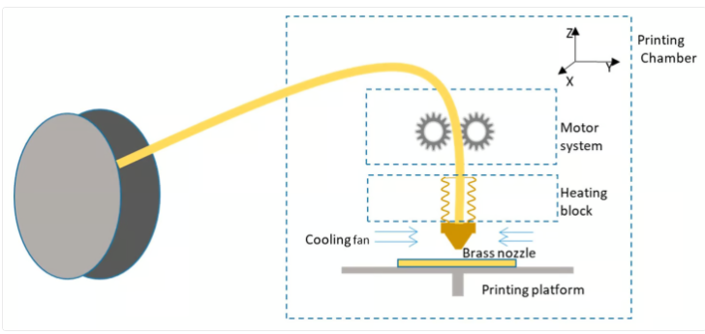
FDM- Technical principle
Fused deposition modeling, or FDM for short, is a material extrusion method of additive manufacturing where materials are extruded through a nozzle and joined together to create 3D objects.
Materials provided: PLA, PVA, TPU

Slide 27
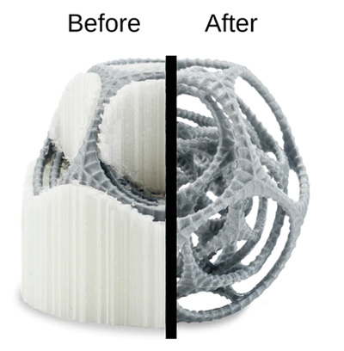
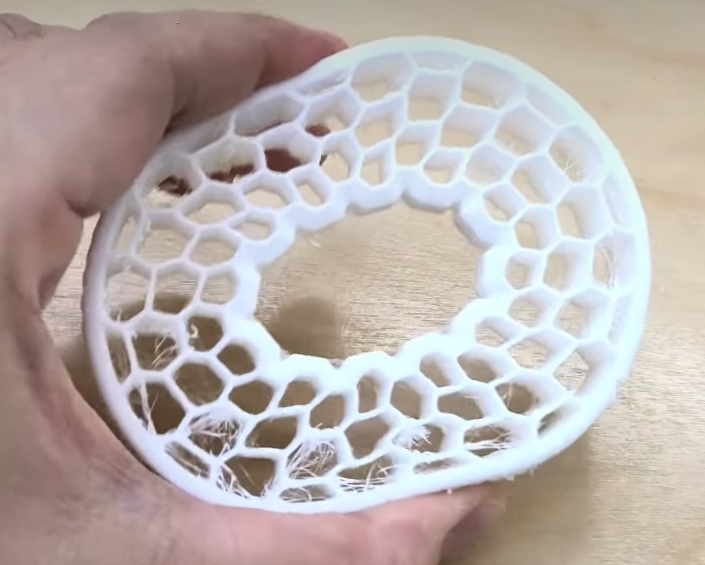
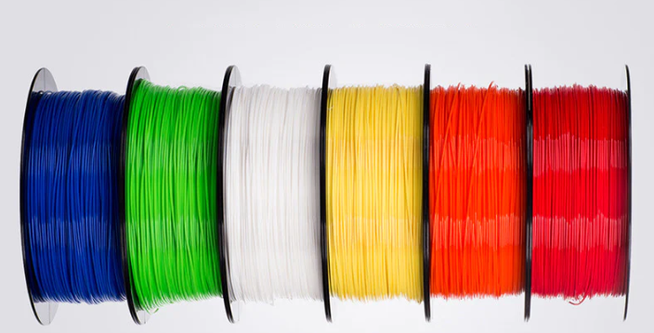
FDM – Materials
PLA is one of the most widely used materials in 3D printing
Pros:
Low Cost
Stiff and good strength
Good dimensional accuracy
Cons:
Color limitation
Filament may become brittle and break
PVA is commonly used as support structure material for 3D printing. It can be easily removed by dissolving in warm water
Pros:
Great water dissolvable support material
Cons:
Airtight storage containers required
TPU is elastic, melt-processable and can be processed on extrusion, blow, injection and compression molding equipment.
Pros:
High elasticity and resilience
Abrasion resistance
Cons:
Difficult to post-process
Filament settings must be carefully controlled

Slide 28
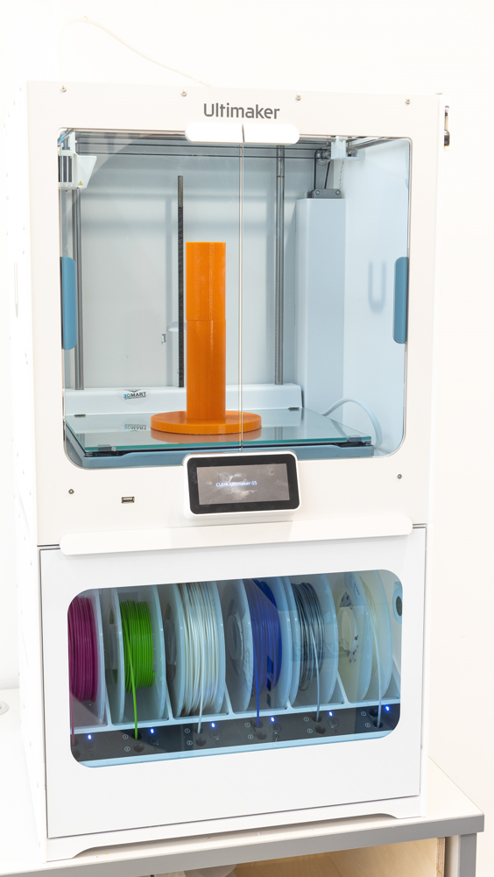
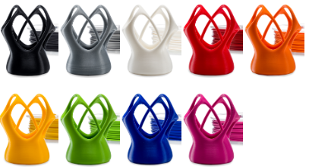
FDM – Ultmaker S5
Available material : PLA, PVA and TPU
Support file type: .stl, .obj
Build volume:
330 x 240 x 300 mm
Printing Cost:
Material charge HK$1 per gram (Basic charge HK$20)

Slide 29
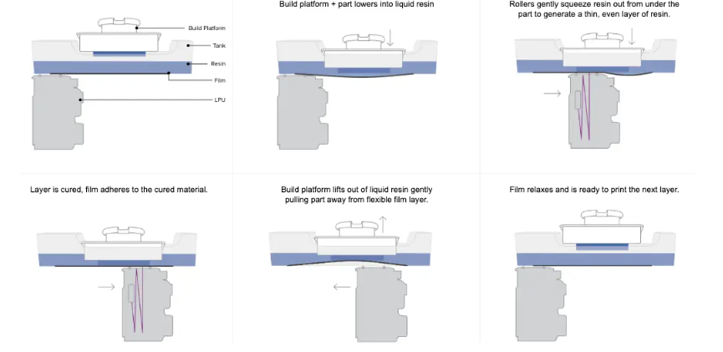
SLA - Technical principle
SLA uses a laser to cure a liquid resin into a physical piece through a process called photopolymerization.
Common material : Resin

Slide 30
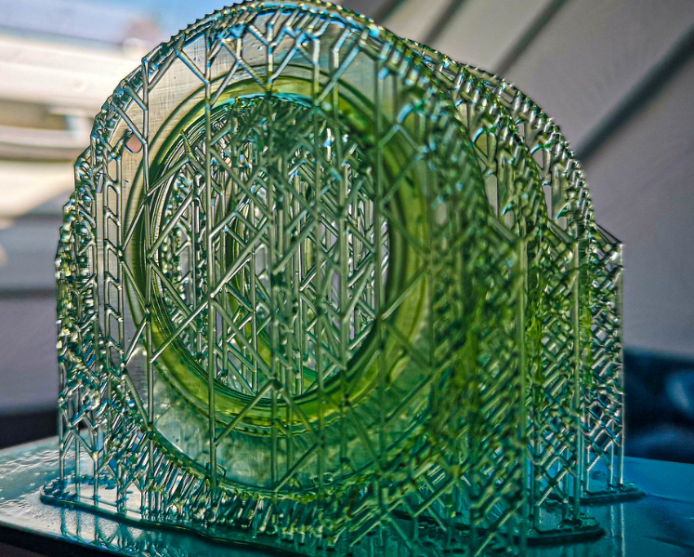
SLA - Material
Resin is suitable for Function prototyping, patterns, molds and tooling.
Pros:
Highly versatile material selection
Highest resolution and accuracy
Surface smoothness
Cons:
Expensive
large-size objects cannot be printed at once
Many supporting structures.

Slide 31
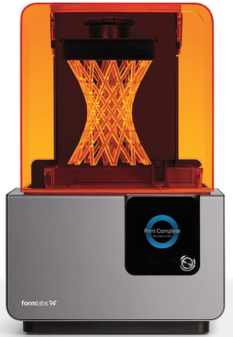
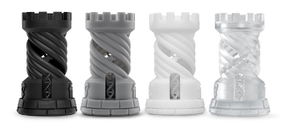
SLA – Formlabs Form 2
Available material : Resin
Support file type: .STL, .OBJ
Build volume:
145 x 145 x 175 mm
Printing Cost:
Material charge HK$ 6 per gram (Basic charge HK$20)

Slide 32

Polyjet - Technical principle
PolyJet is a revolutionary multi-material jetting photopolymer 3D printing technology that offers a wide range of capabilities, including the creation of complex geometries, intricate details, full-color combinations, transparencies, and flexible parts - all in a single model.

Slide 33
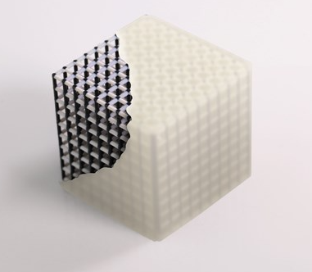
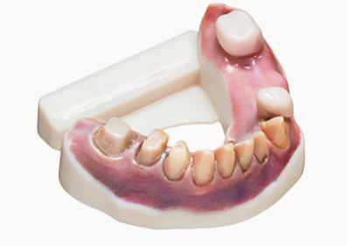
Polyjet - Material
VeroUltra™ the newest formulation of Vero opaque photopolymer resins. It enables printing extremely thin parts while offering richer colors with richer textures and high quality texts.
Pros:
Allows for multiple materials and colors
High accuracy and quality
Cons:
Always requires support structures and 100% infill

Slide 34
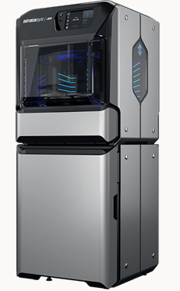
Polyjet – Stratasys J55 Prime Printer
Support file type: .stl, .obj(with .mtl for texture) or .3mf
Build volume:
Round Print Tray with up to 1,174cm2 (182 in2 )
Print Height: 190mm
Printing Cost:
Material charge HK$2 per gram

Slide 35
Post-processing work

Slide 36
Post-processing work
Support Removal
Priming & Painting
Epoxy Coating
Gluing
Sanding
Smoothing
Polishing
More details:
https://all3dp.com/2/fdm-3d-printing-post-processing-an-overview-for-beginners/

