Slide 1
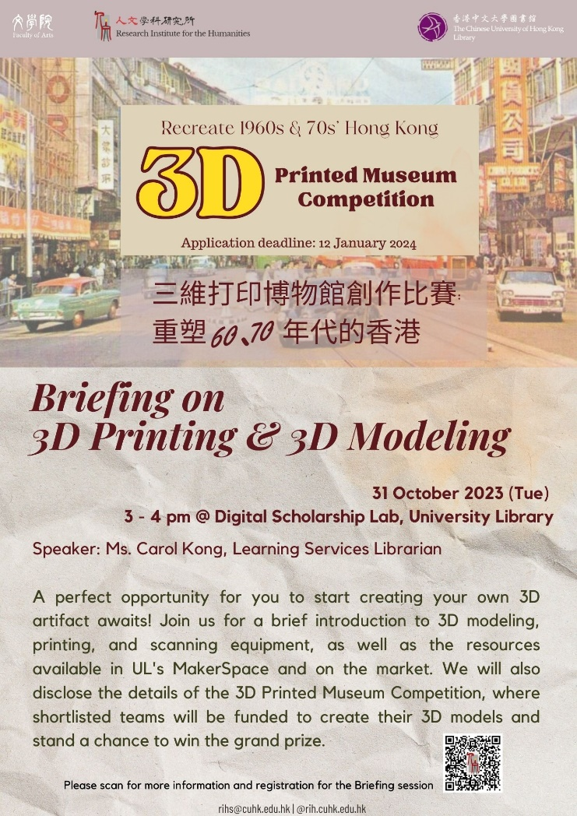

Slide 2
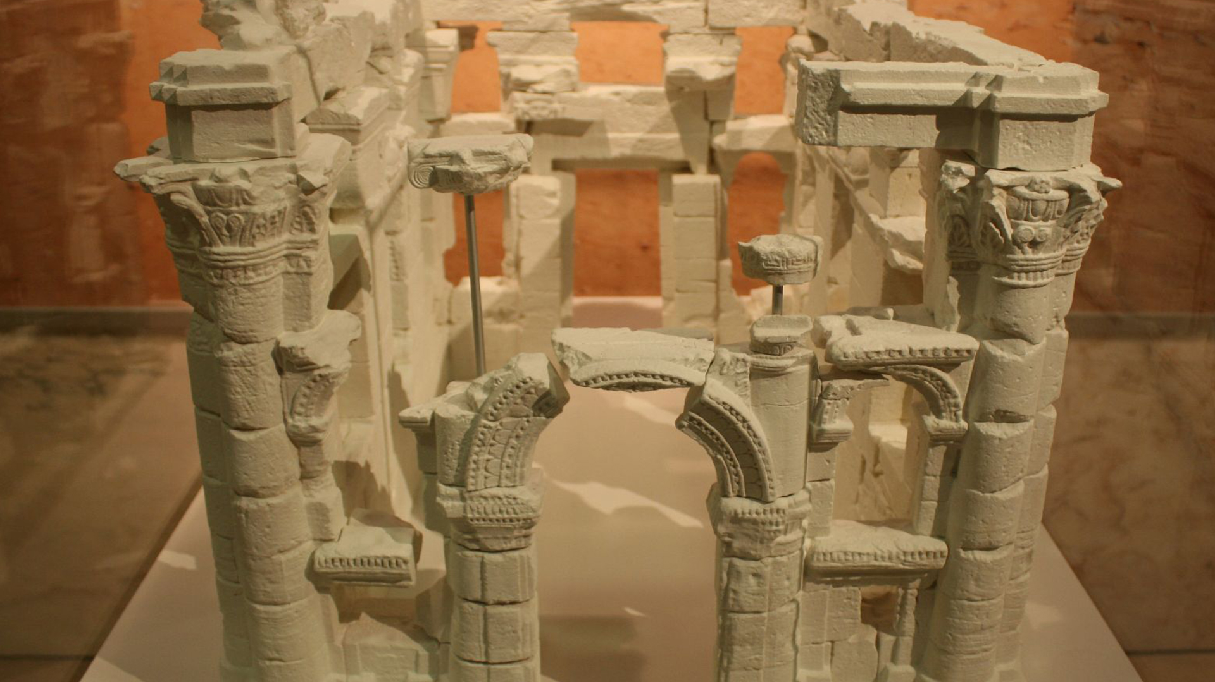
3-D Printing and the Humanities

Slide 3
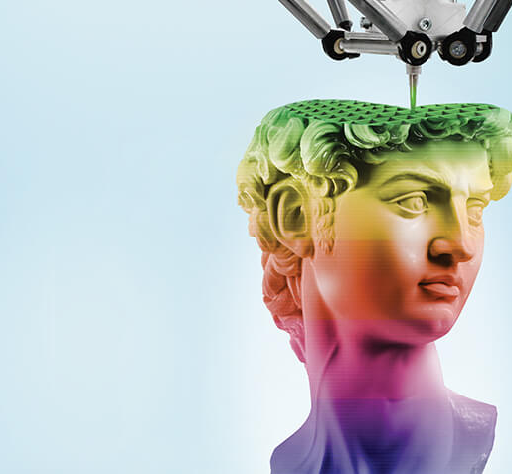
What is 3-D Printing?
At the most basic level 3-D printing is like 2-D printing: reproducing an image/object
It is also known as additive manufacturing, i.e. a process of creating three-dimensional objects by adding layers of material based on digital designs.
3D printing involves three main steps: design, slicing, and printing
Slicing: creating a layered model of the object that can they be reproduced layer by layer

Slide 4
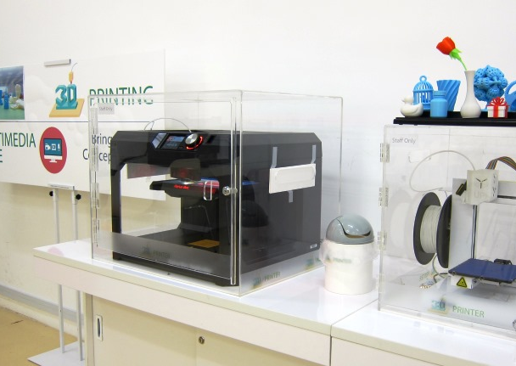
What is it good for?
Applications : Automotive industry, aerospace, healthcare (prosthetics, custom implants), architecture, fashion, consumer products, etc.
Advantages: Rapid prototyping, customization, cost-effective production, complex geometries, reduced waste, creative freedom, and accessibility

Slide 5
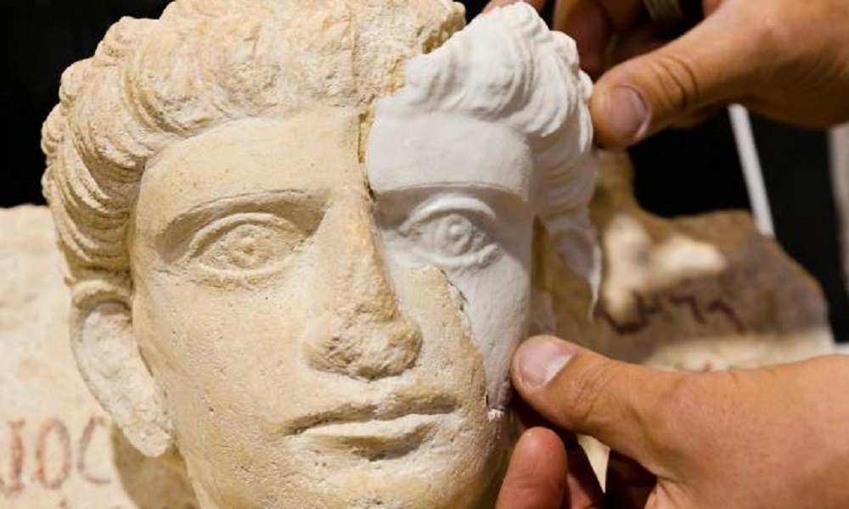
3-D Printing for Humanists
3-Printing has many applications in the Humanities
Especially in museum studies, art history, urban history, etc.
Encourages humanists to move away from the page into physical space which is equally important for human experience and expression.
Encourages design-thinking and spatial awareness
Can replace, substitute, be used to repair priceless objects
You end up with a product!

Slide 6
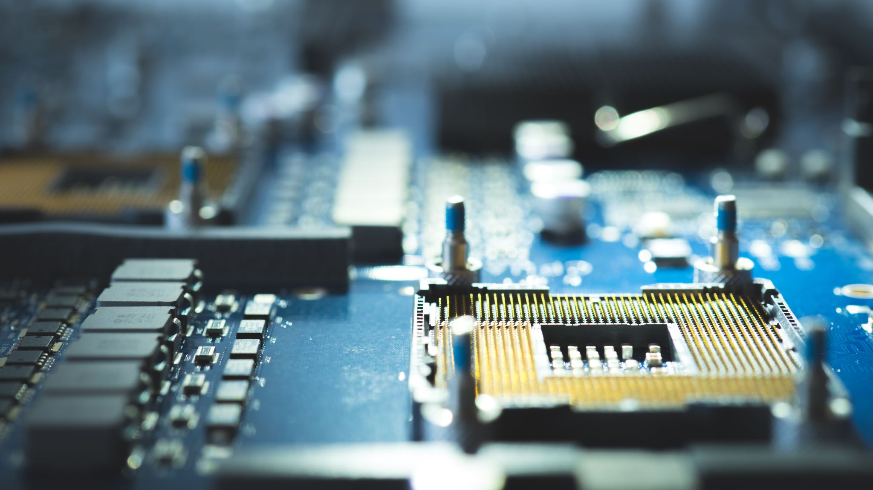
Some Examples of 3-D Printing for Humanities

Slide 7
Restoring Historical Artefacts Using Custom Prothetics

Slide 8

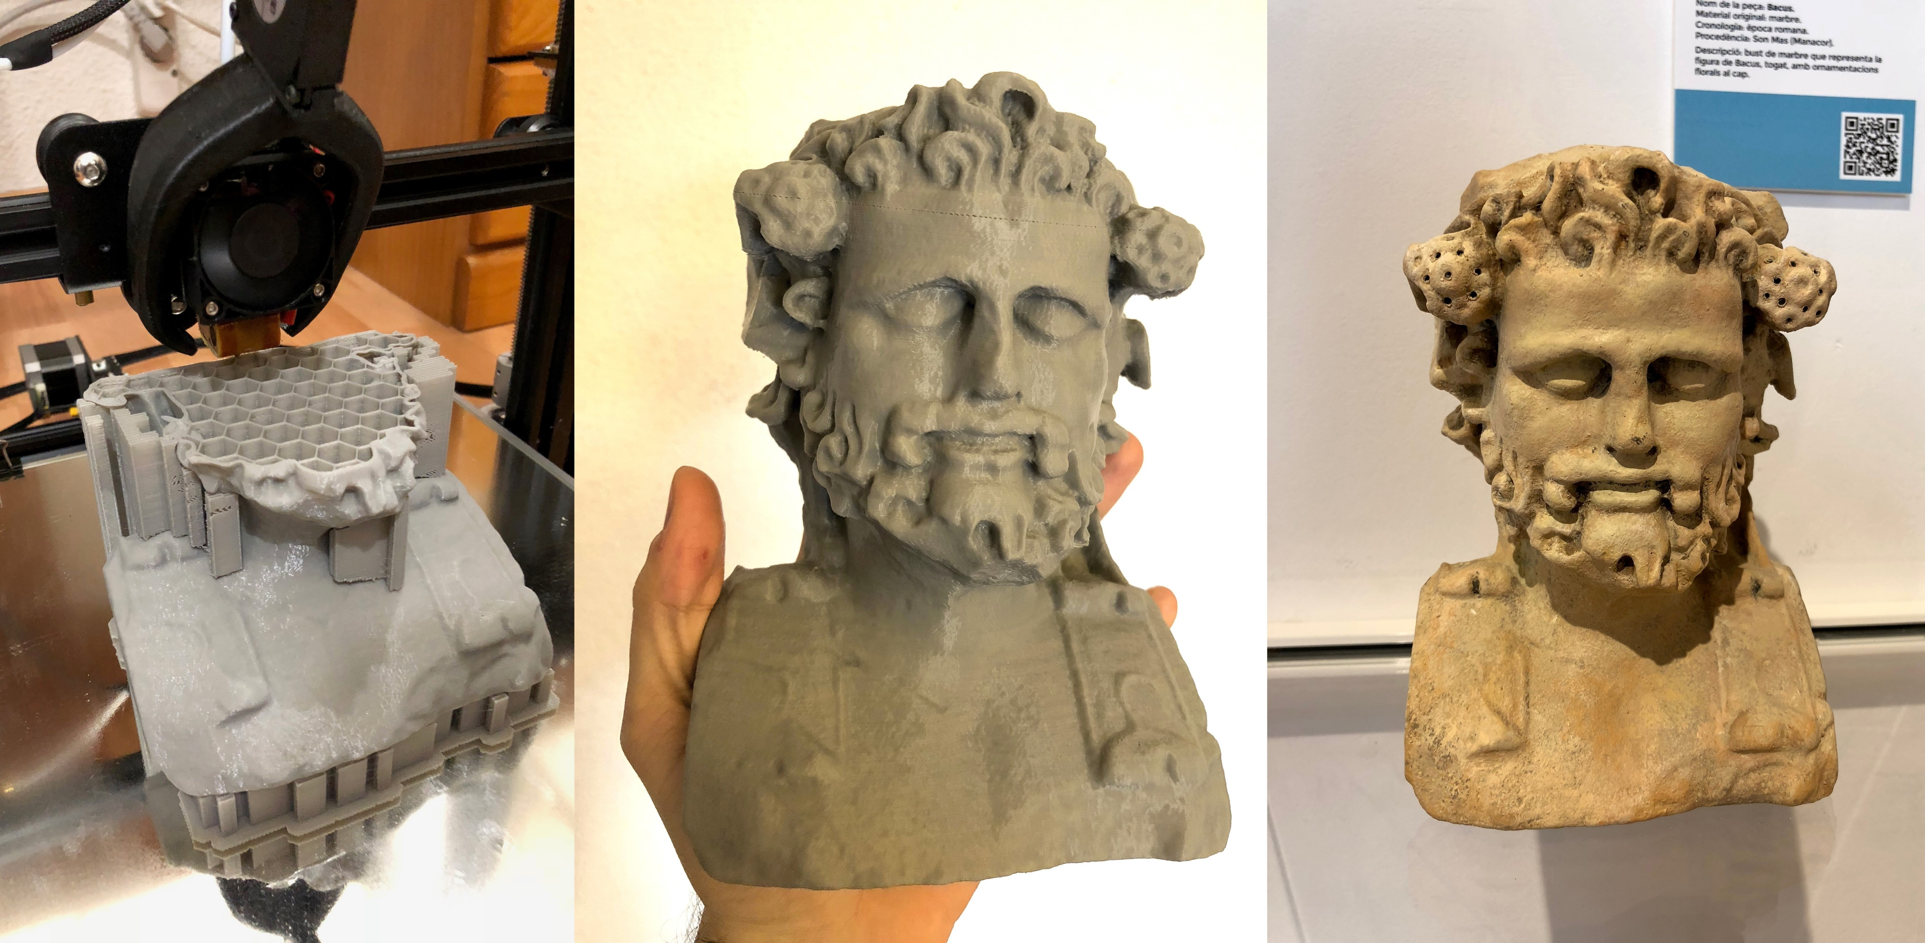
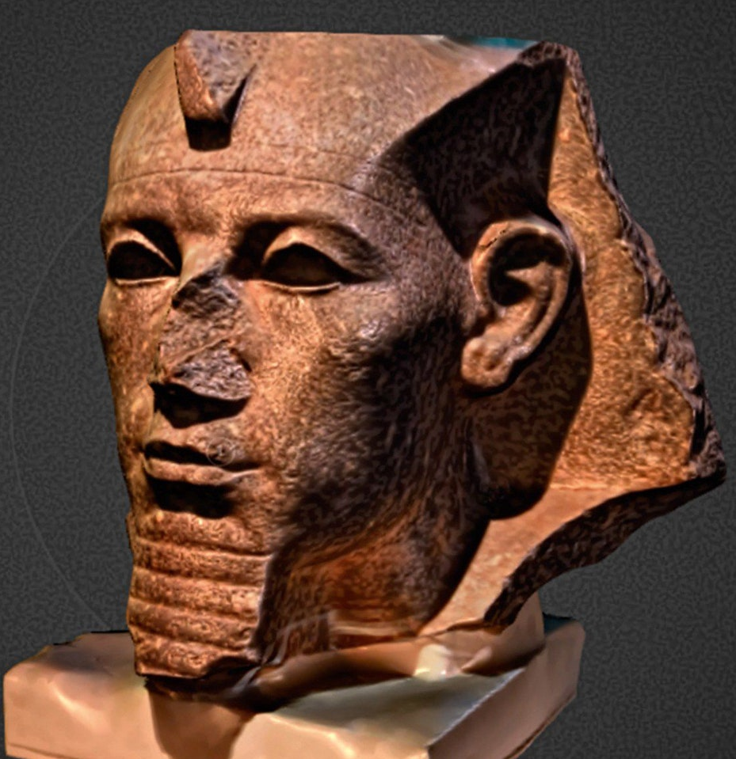
Democratizing Collections with the British Museum

Slide 9
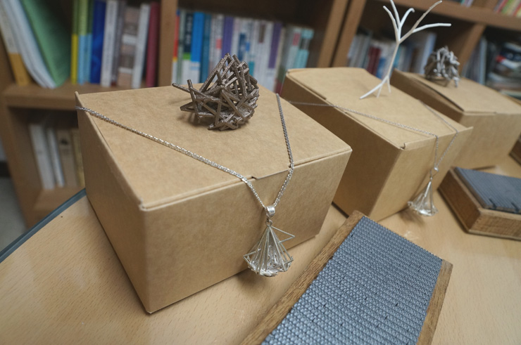
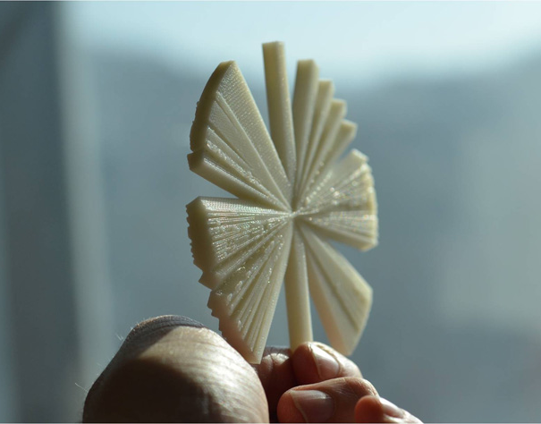
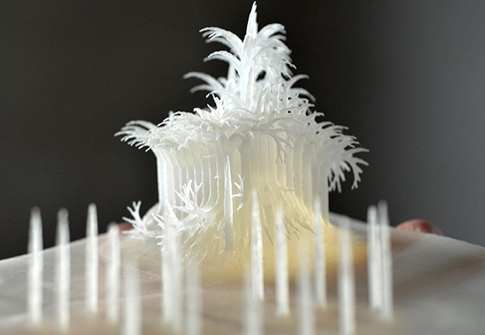
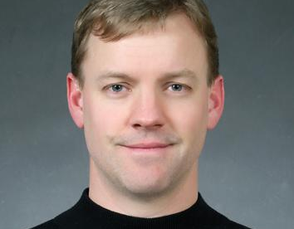
Three Poetry Sculptures by Wayne de Fremery based on Unicode of canonical Korean poems

Slide 10
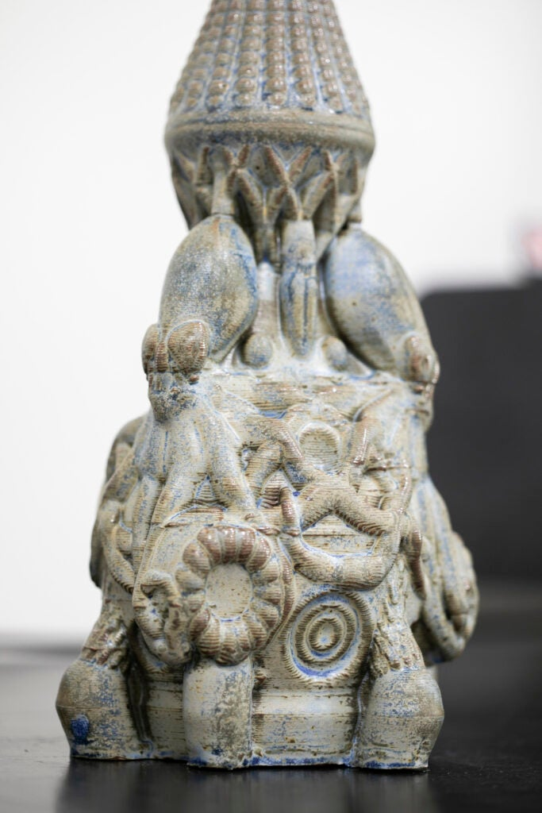
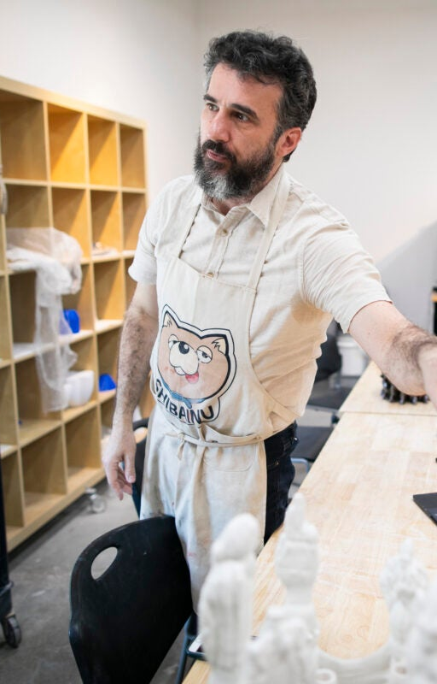
3-D Printing Clay by Artist at Harvard

Slide 11
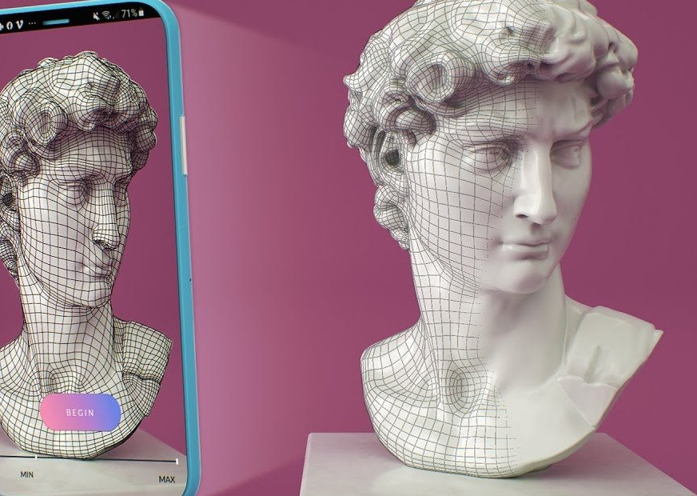
How do I 3-D Print?
You can download pre-existing models in STL format: e.g. Sketchfab.
Alternatively, you can design a model in CAD software (STL format)
Final option is to 3-D scan an object using an app on your phone.
Don’t forget about copyright and fair use!
Printing in different colours and materials (including flexible material [TPU 95A])
At CUHK, using the 3-D printers is free.
However, there is a charge for the filament by gram.

Slide 12
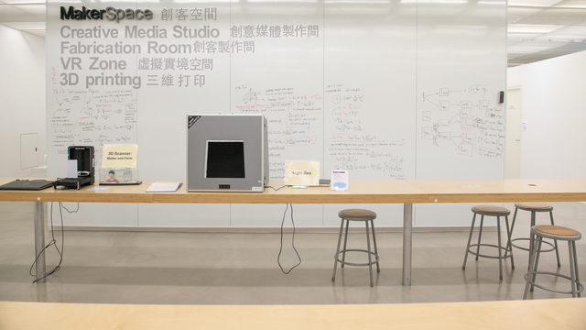
Visit to MakerSpace

Slide 14
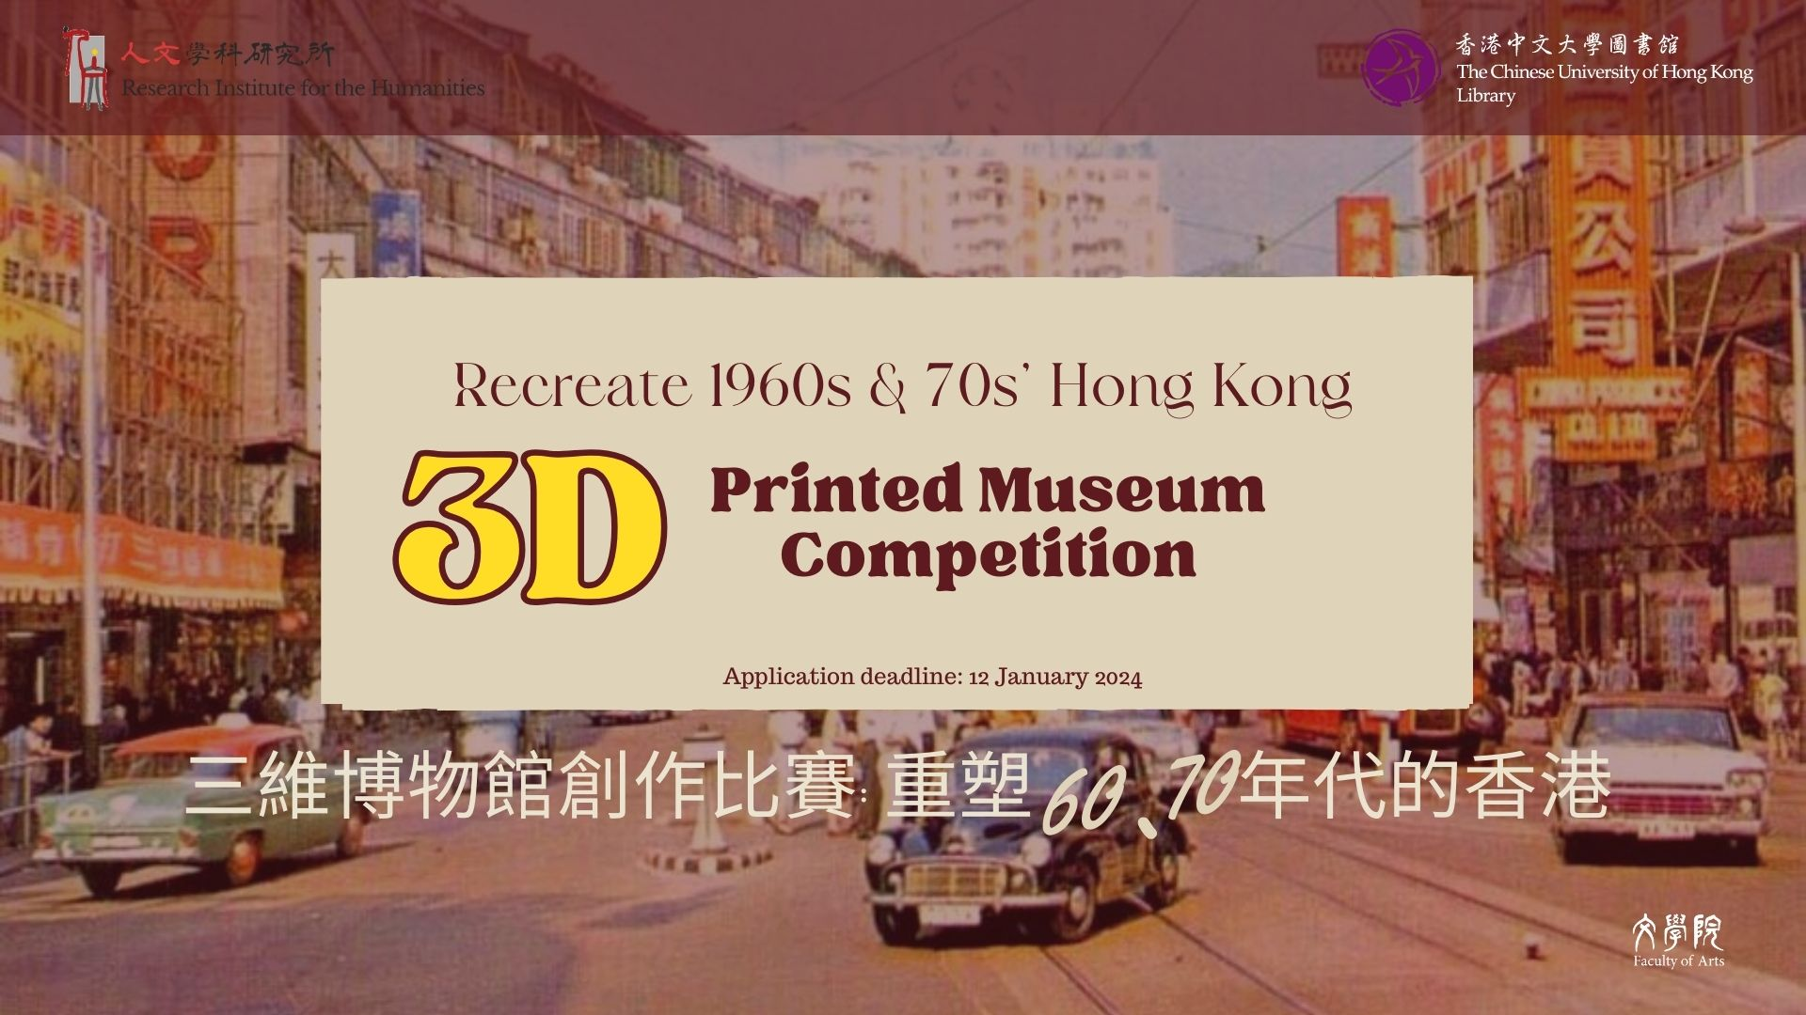


Slide 15
