Slide 1


QC mapping
Ronald Lui
Department of Mathematics
The Chinese University of Hong Kong

Slide 2
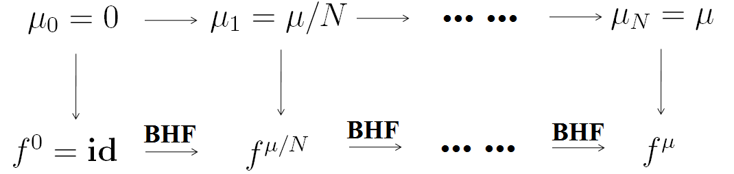
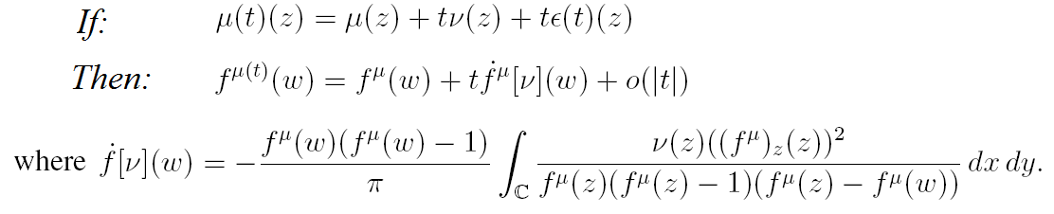
Beltrami Holomorphic Flow

Slide 3
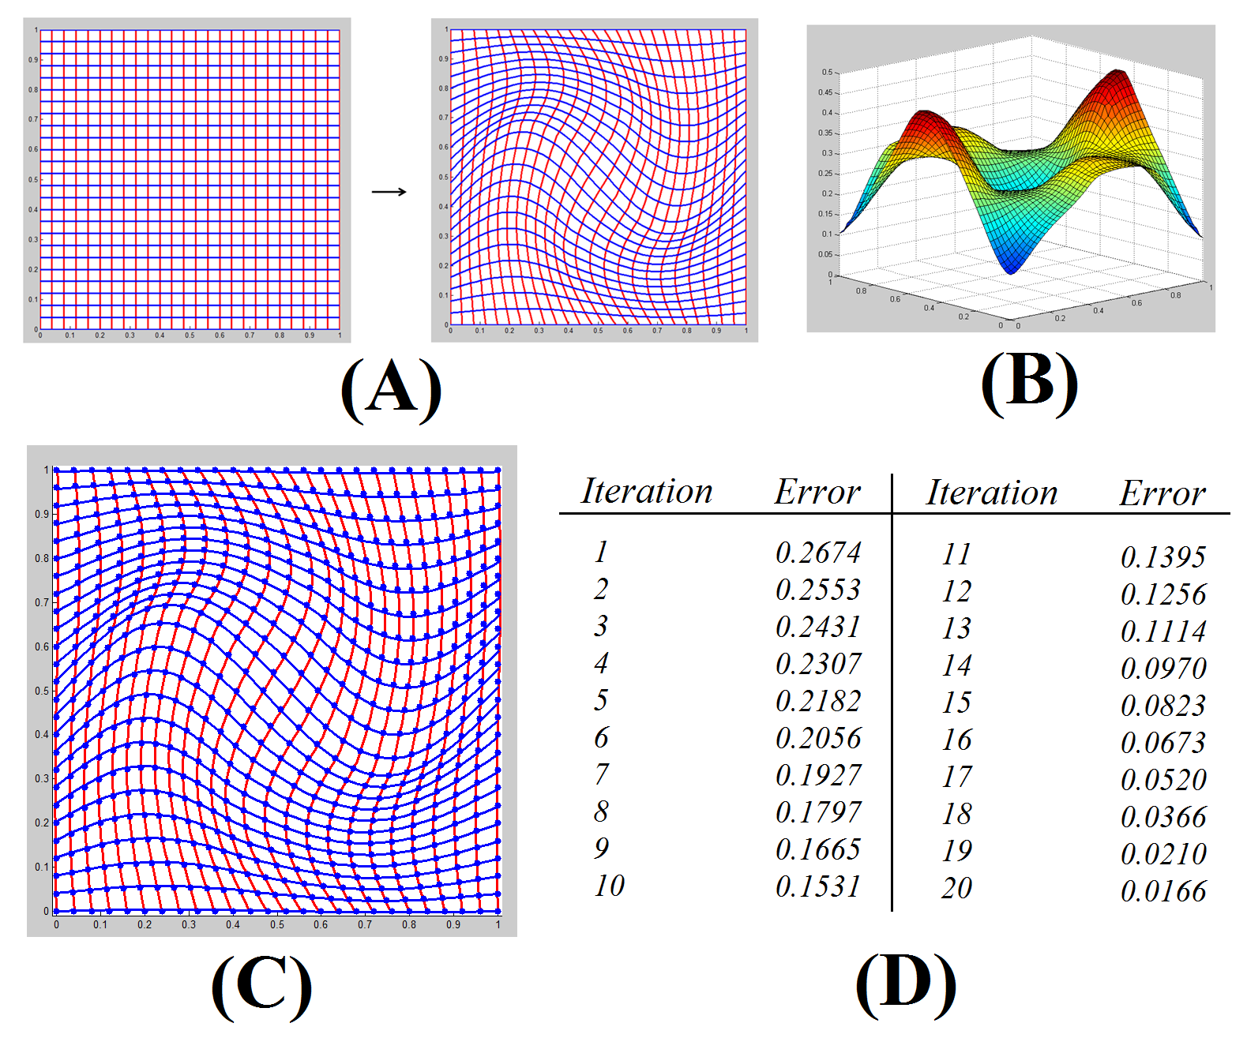
Beltrami Holomorphic Flow

Slide 4
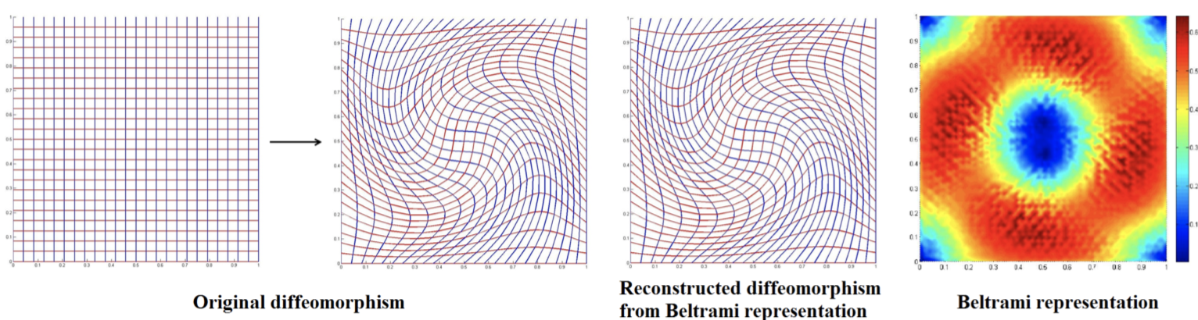
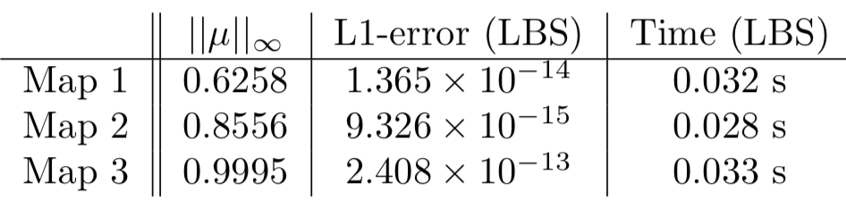
Linear Beltrami Solver

Slide 5
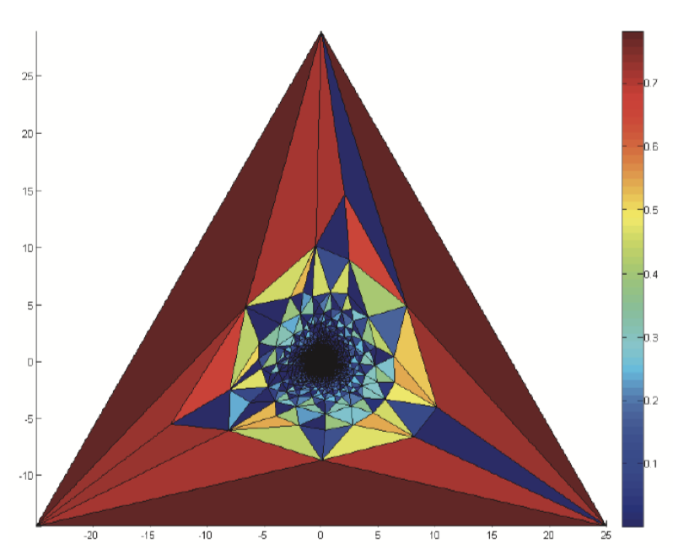
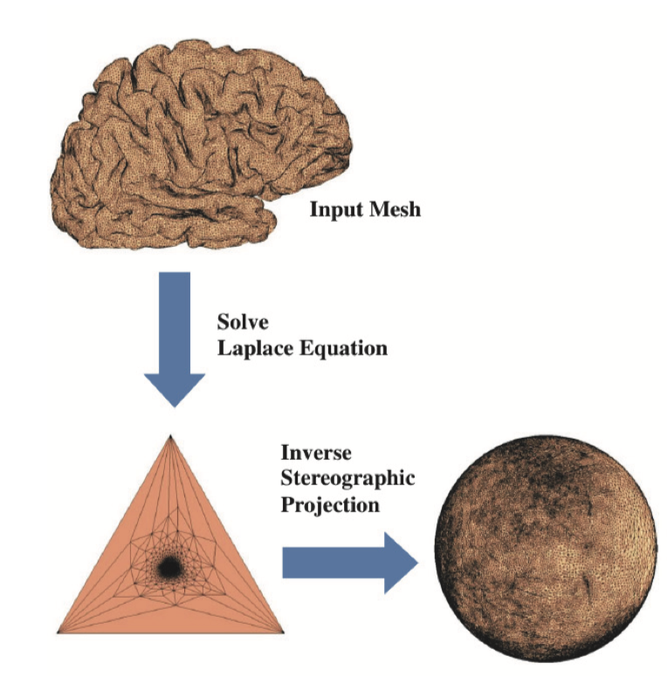
Fast Spherical Conformal Parameterization
Large conformality distortion near the north pole

Slide 6
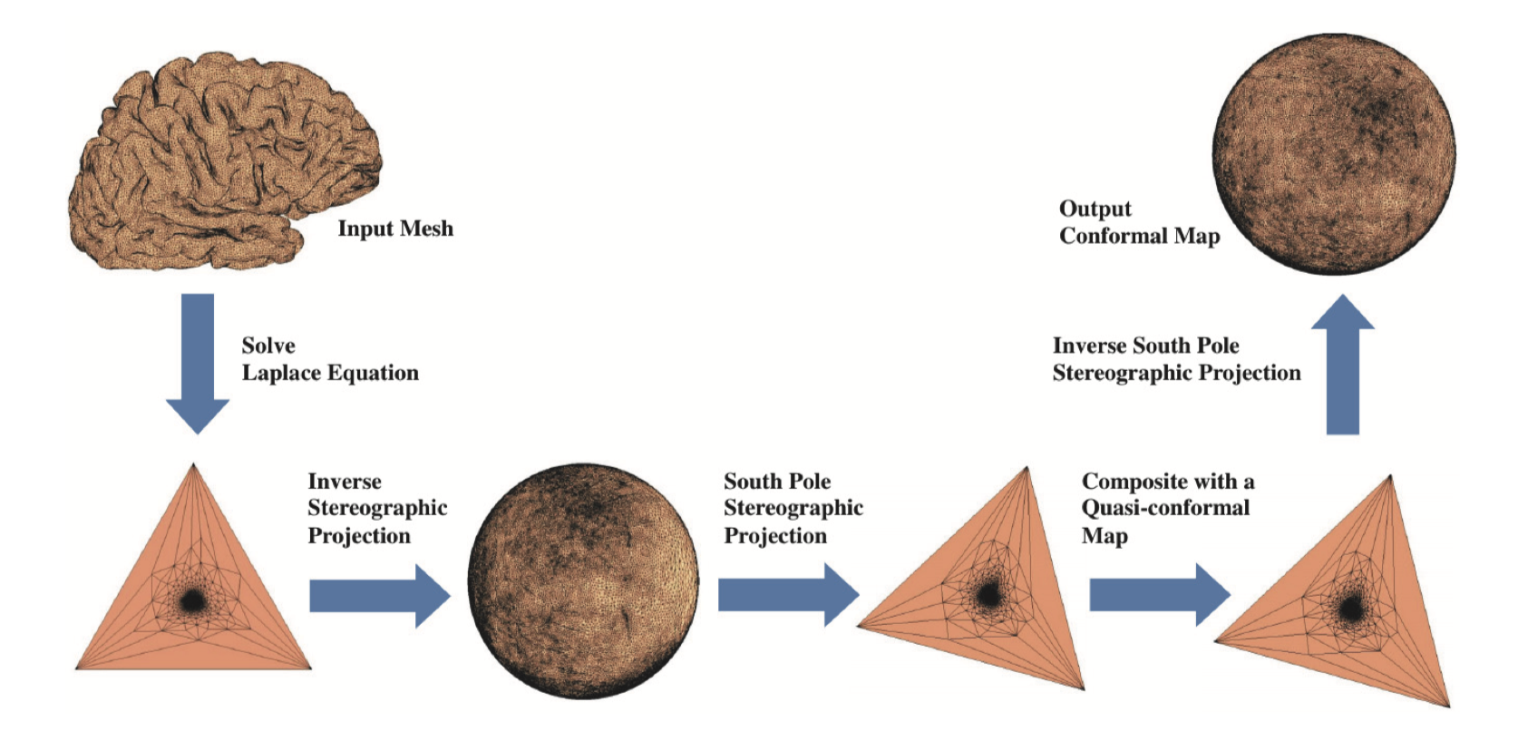
Fast Spherical Conformal Parameterization

Slide 7
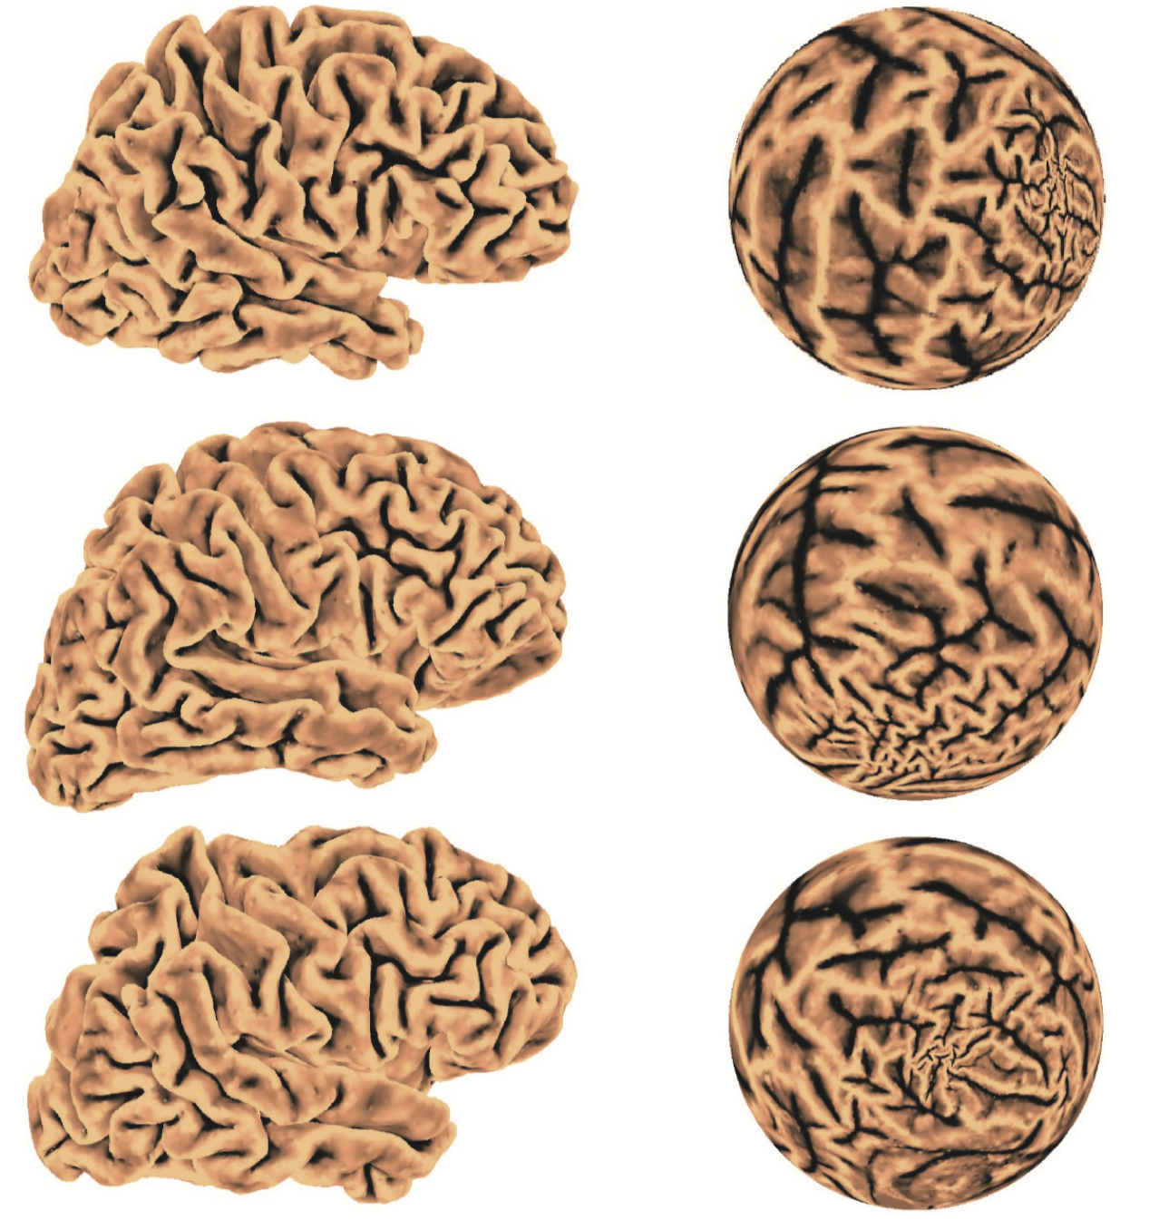
Fast Spherical Conformal Parameterization

Slide 8
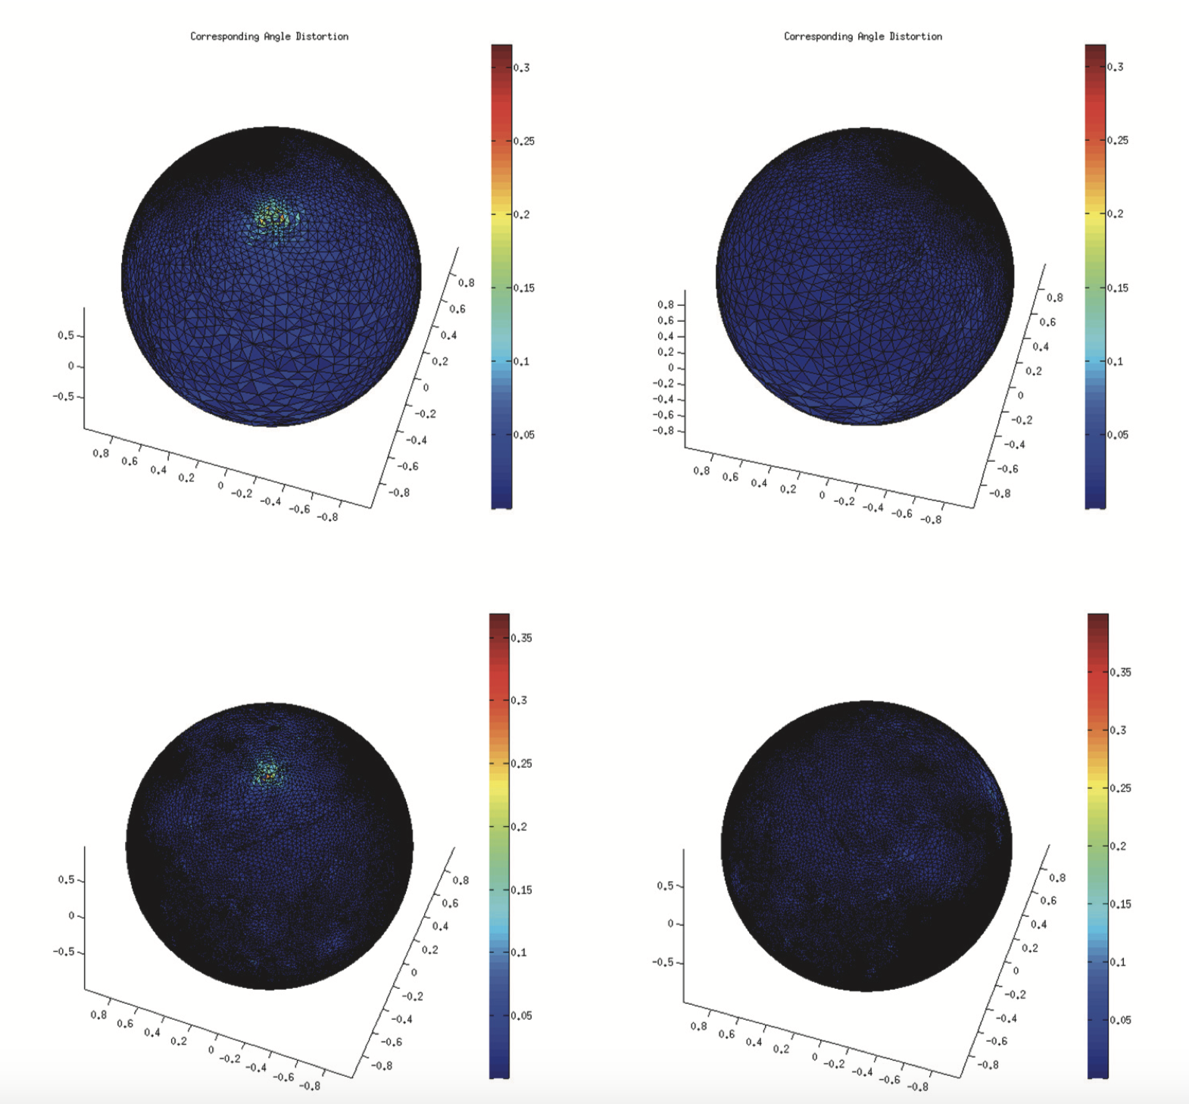
Fast Spherical Conformal Parameterization

Slide 9
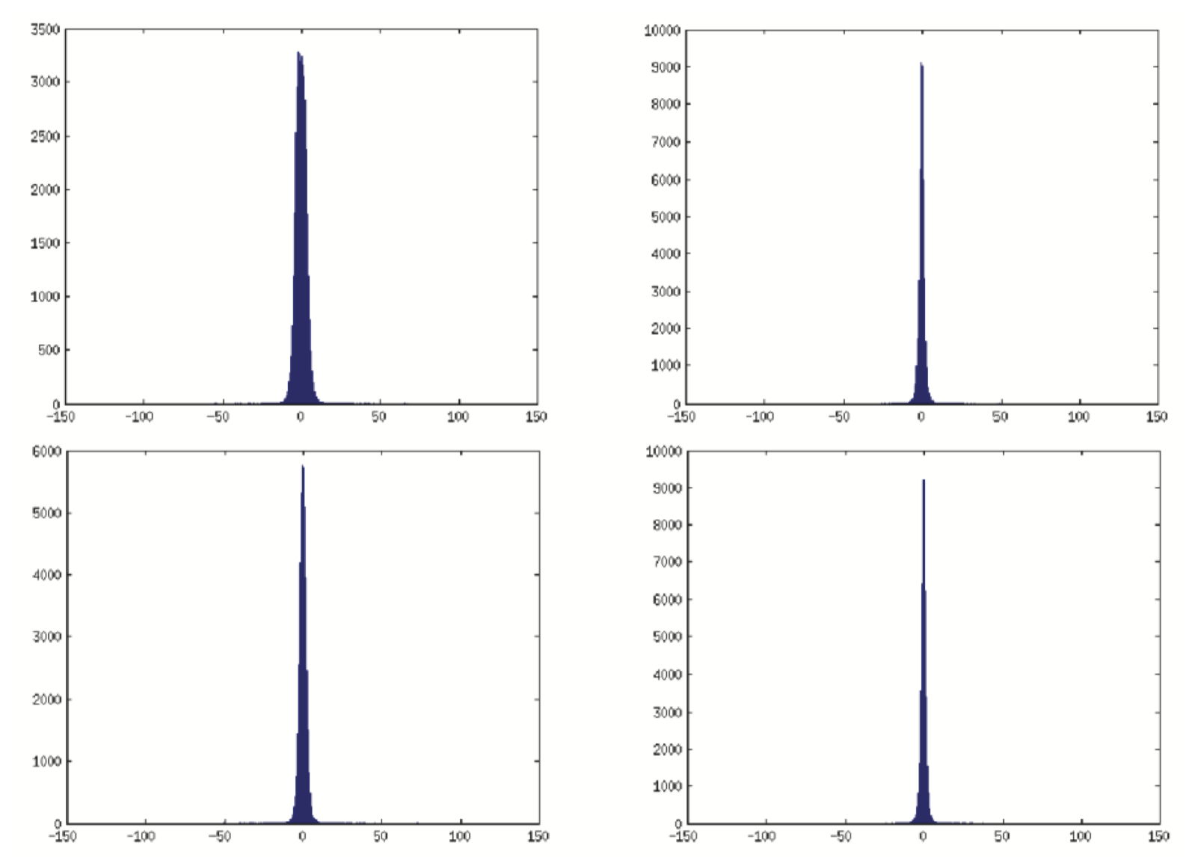
Fast Spherical Conformal Parameterization

Slide 10
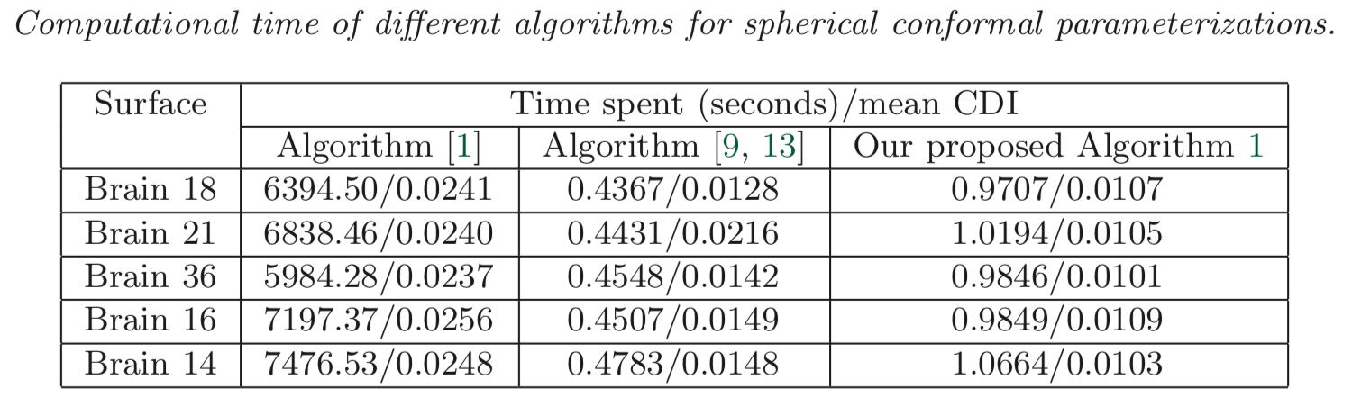
Fast Spherical Conformal Parameterization

Slide 11
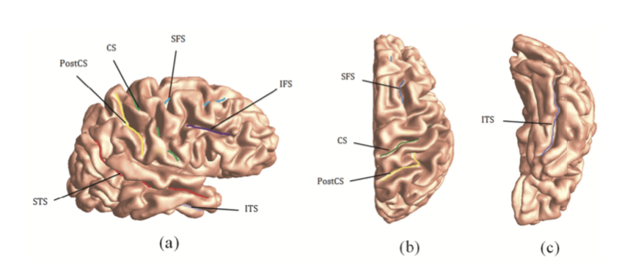
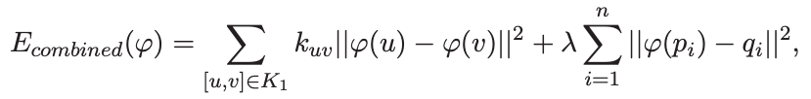
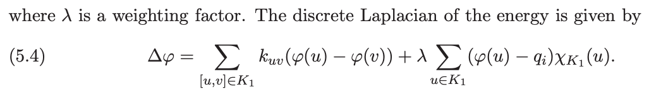

Brain landmark matching parameterization
Landmark-matching optimized spherical harmonic parameterization

Slide 12
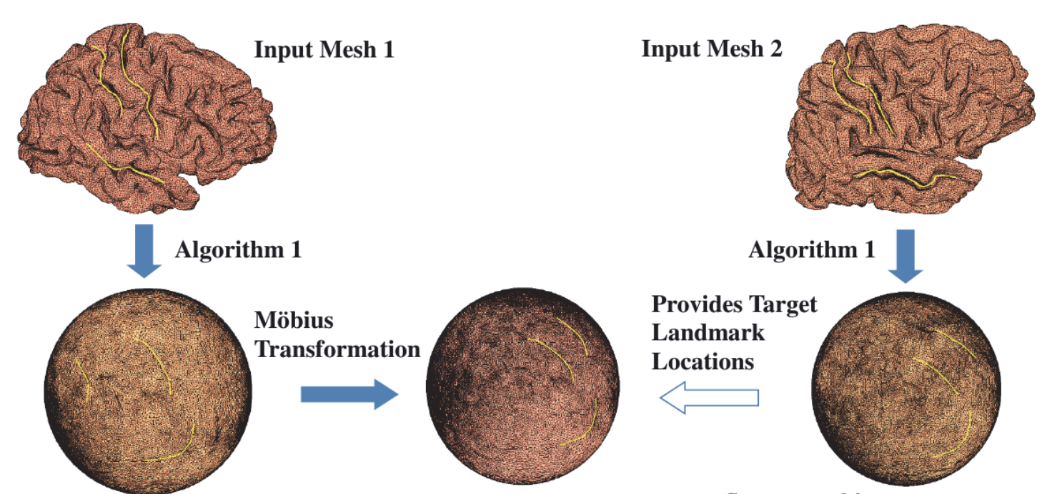
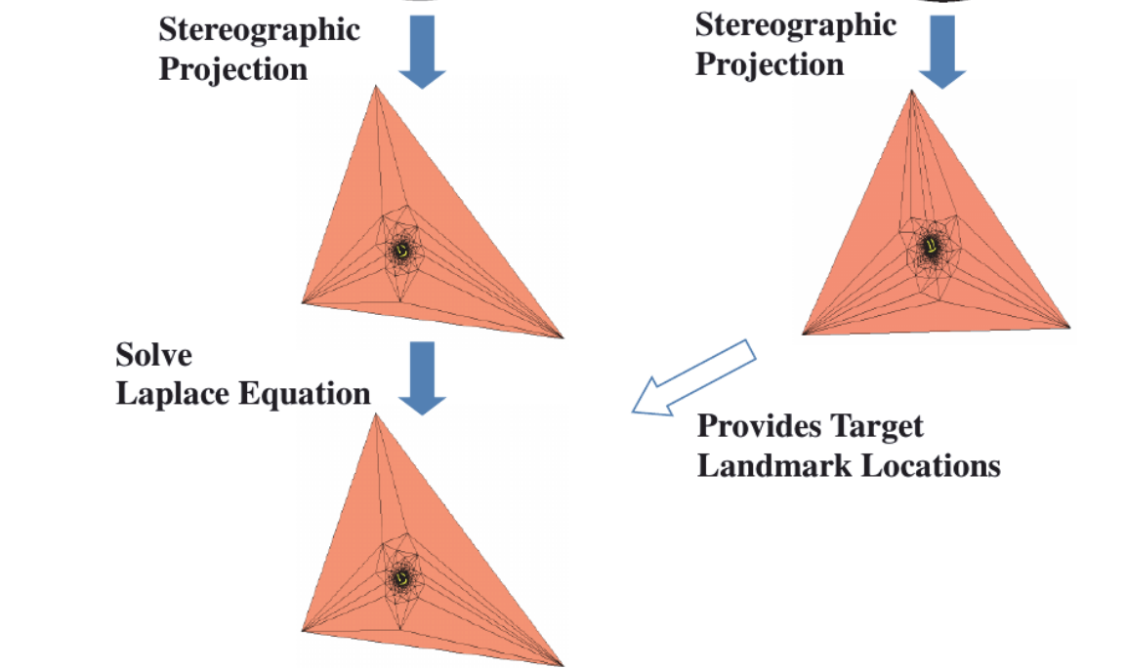
Brain landmark matching parameterization

Slide 13
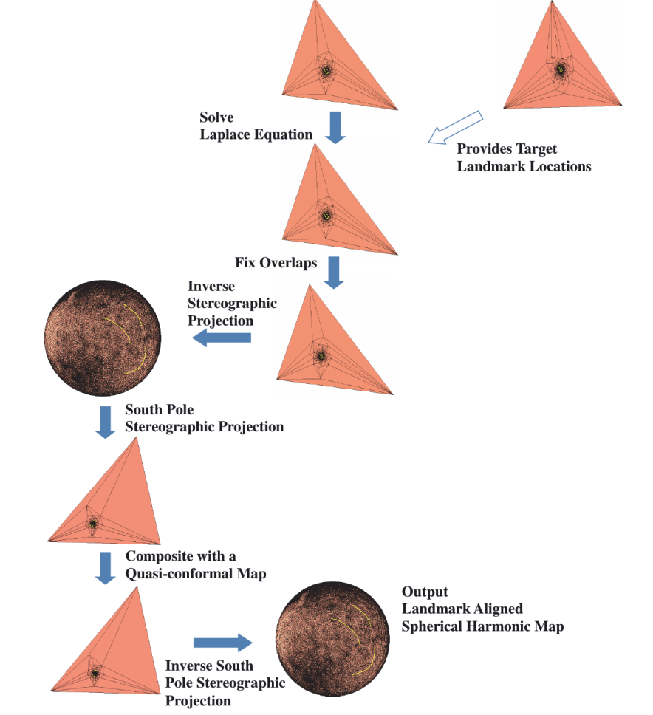

Slide 14
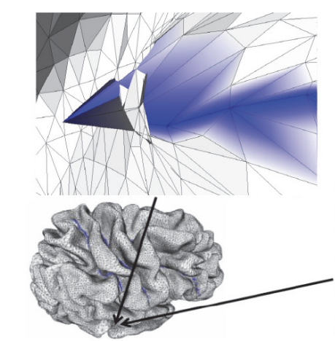
Brain landmark matching parameterization

Slide 15
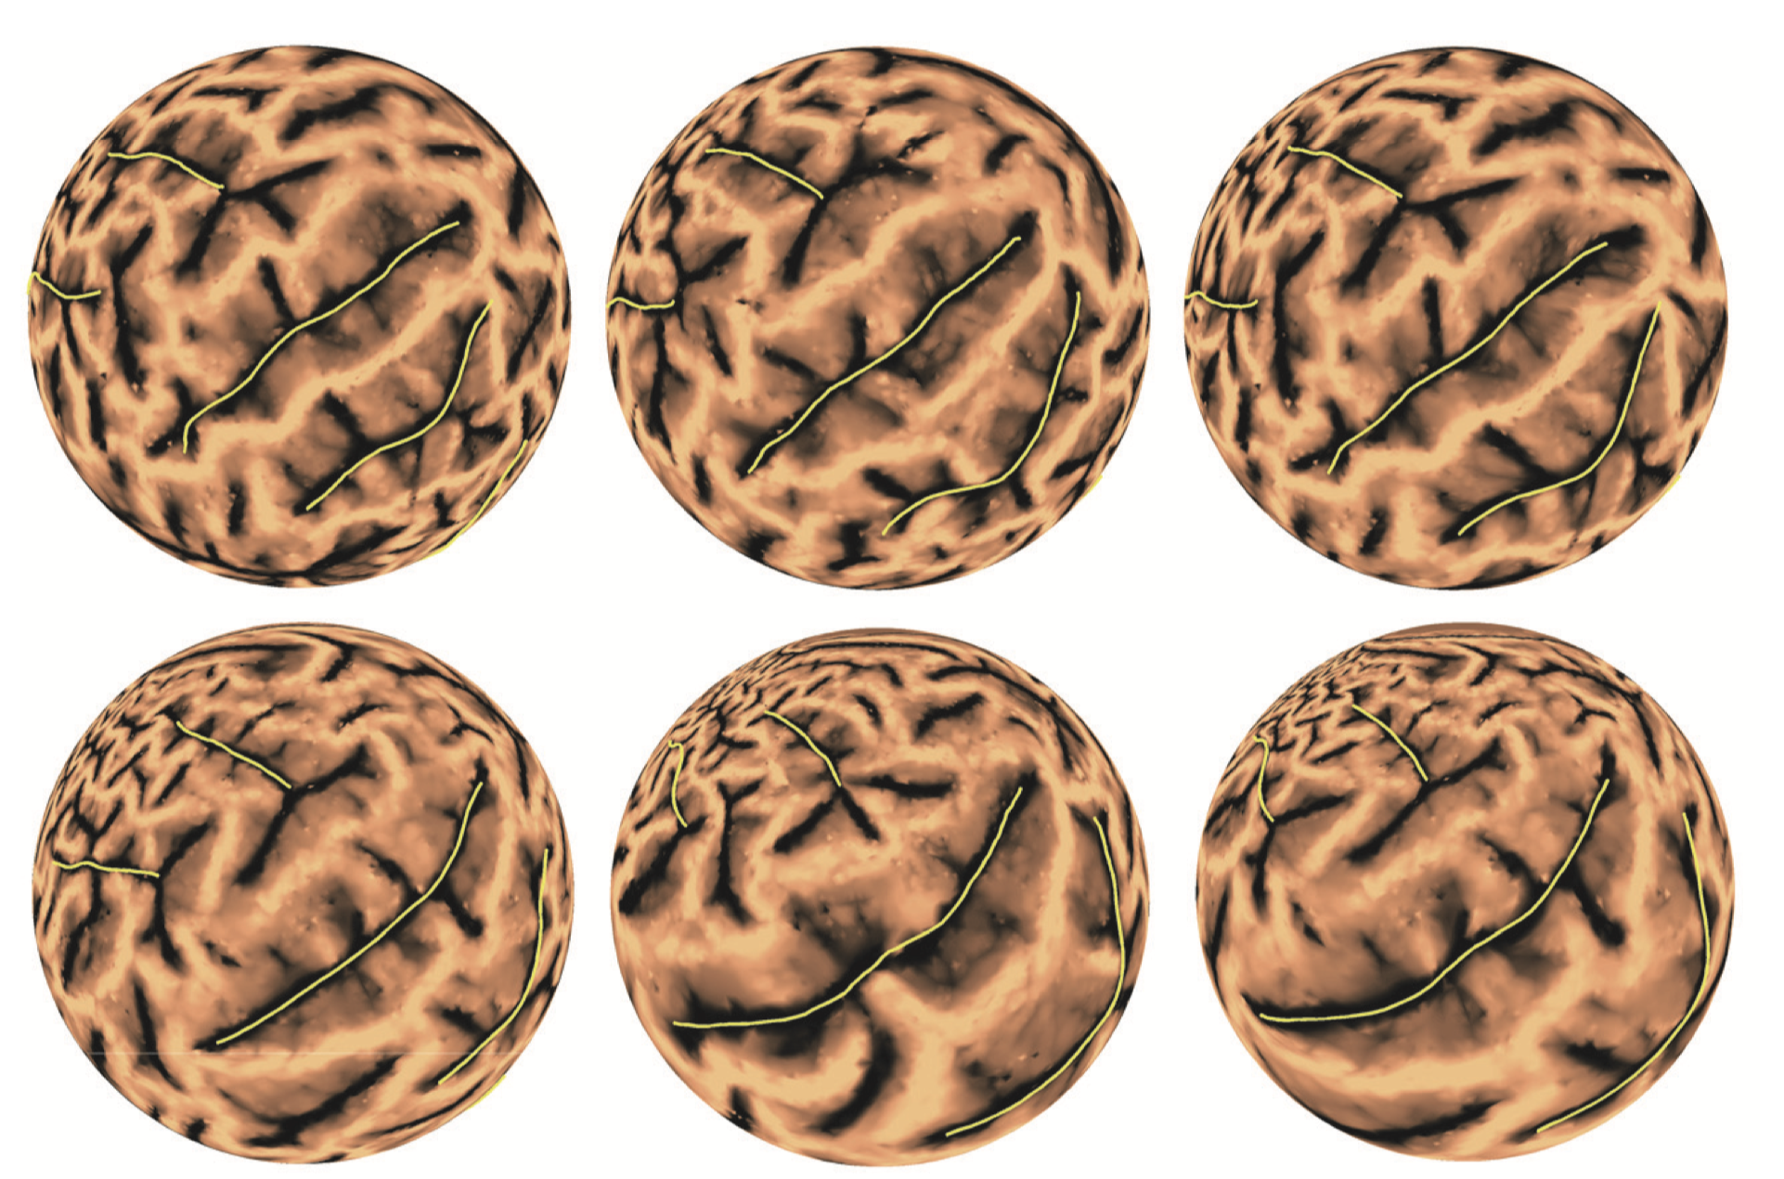
Brain landmark matching parameterization
Initial
Target
Transformed

