Slide 1
Summer Exchange Programme Briefing Session
11 Jan 2024 | 15:00-16:00

Slide 2
Where to go?
01
02
03
04
05
06
Trip to Australia
Trip to Japan
Service Trip to Jiangxi with Diligentia College
13 - 28 May 2024
23 - 28 May 2024
Early June(TBC)
Trip to Xinjiang
Trip to UK
Trip to Korea
9 - 16 Jun 2024
24 Jun - 2 Jul 2024
2 - 22 Jul 2024

Slide 3
01
Trip to Australia
UWA Experience: Australian Culture & Critical Thinking

Slide 4
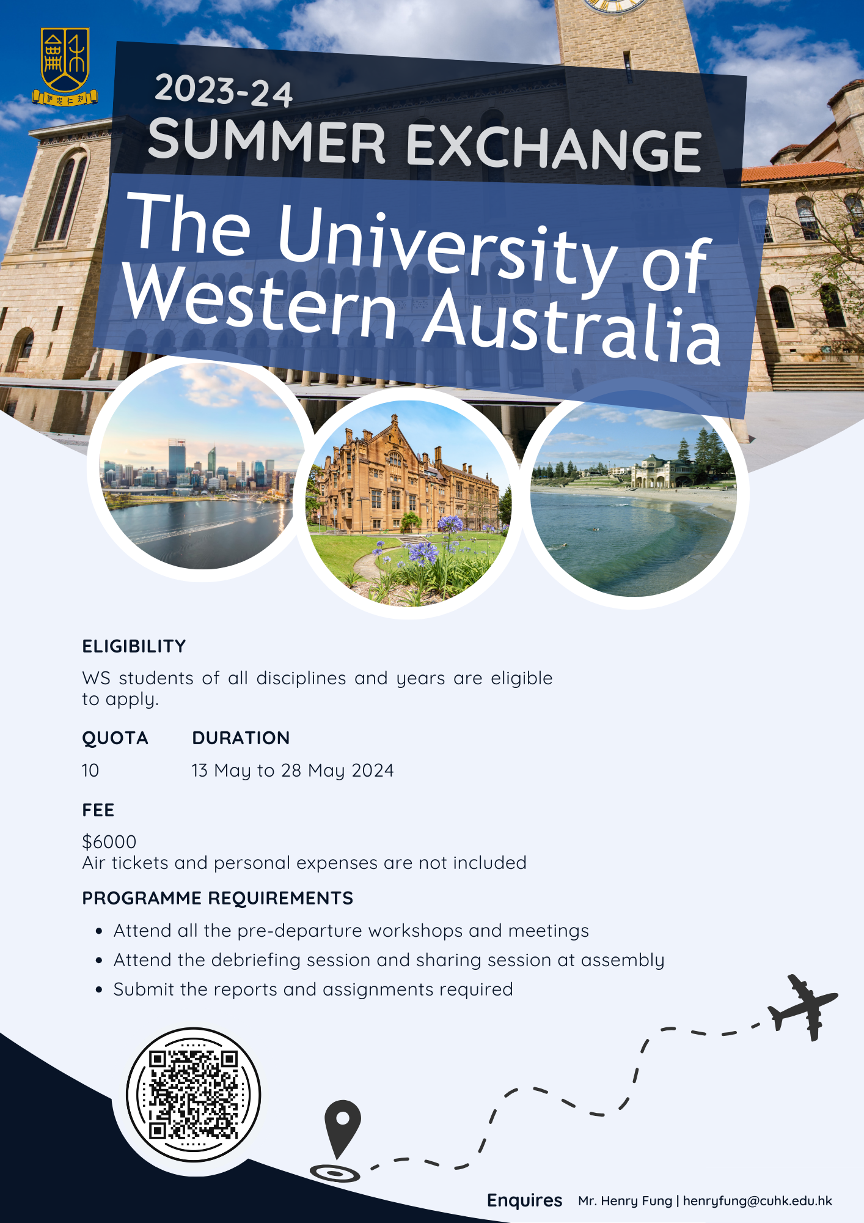
About the study trip
The University of Western Australia
11 May – 26 May 2024
Fee: $6,000
(Including course fee, homestay)
Quota: 10

Slide 5
About the study trip
To raise standards in English and enhance the use of the language plus cultural exposure
Students from LWS College (local / non-local) who can communicate in English
Accommodation: homestay

Slide 6
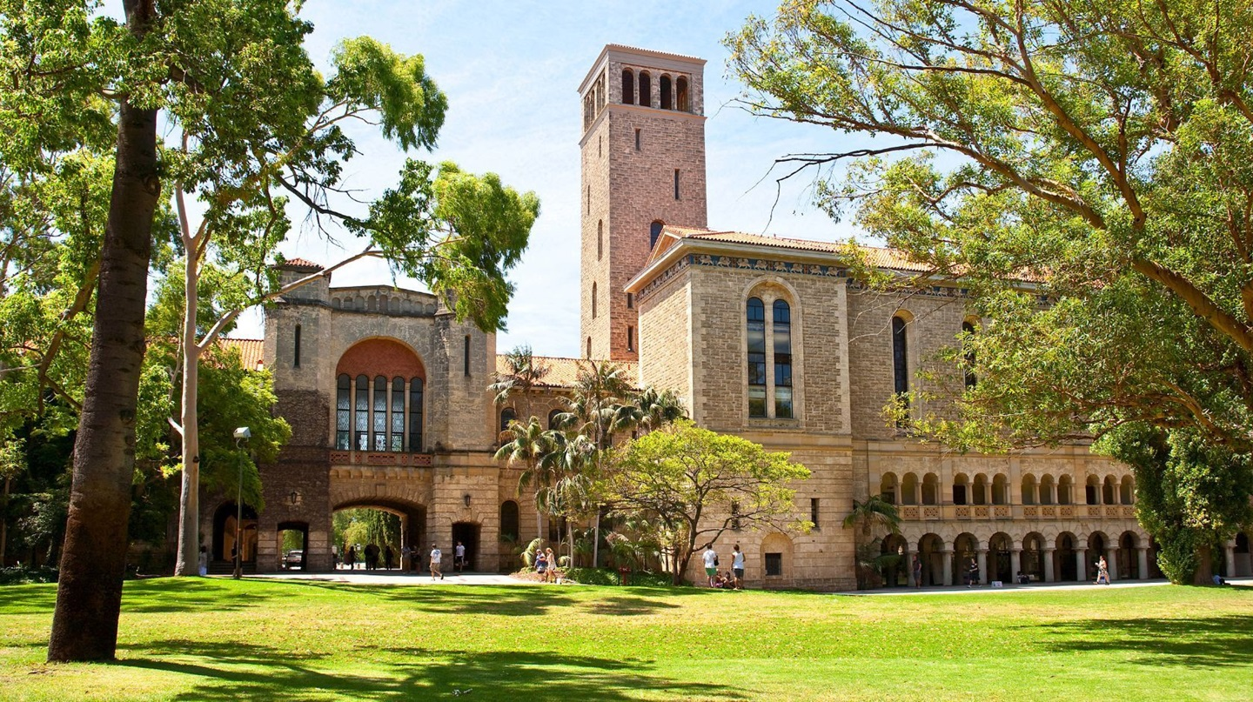

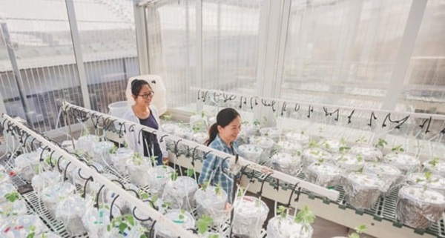

About UWA
Established in 1911
QS World University Ranking 2024: 72
Located in Perth
More than 25,000 students

Slide 7
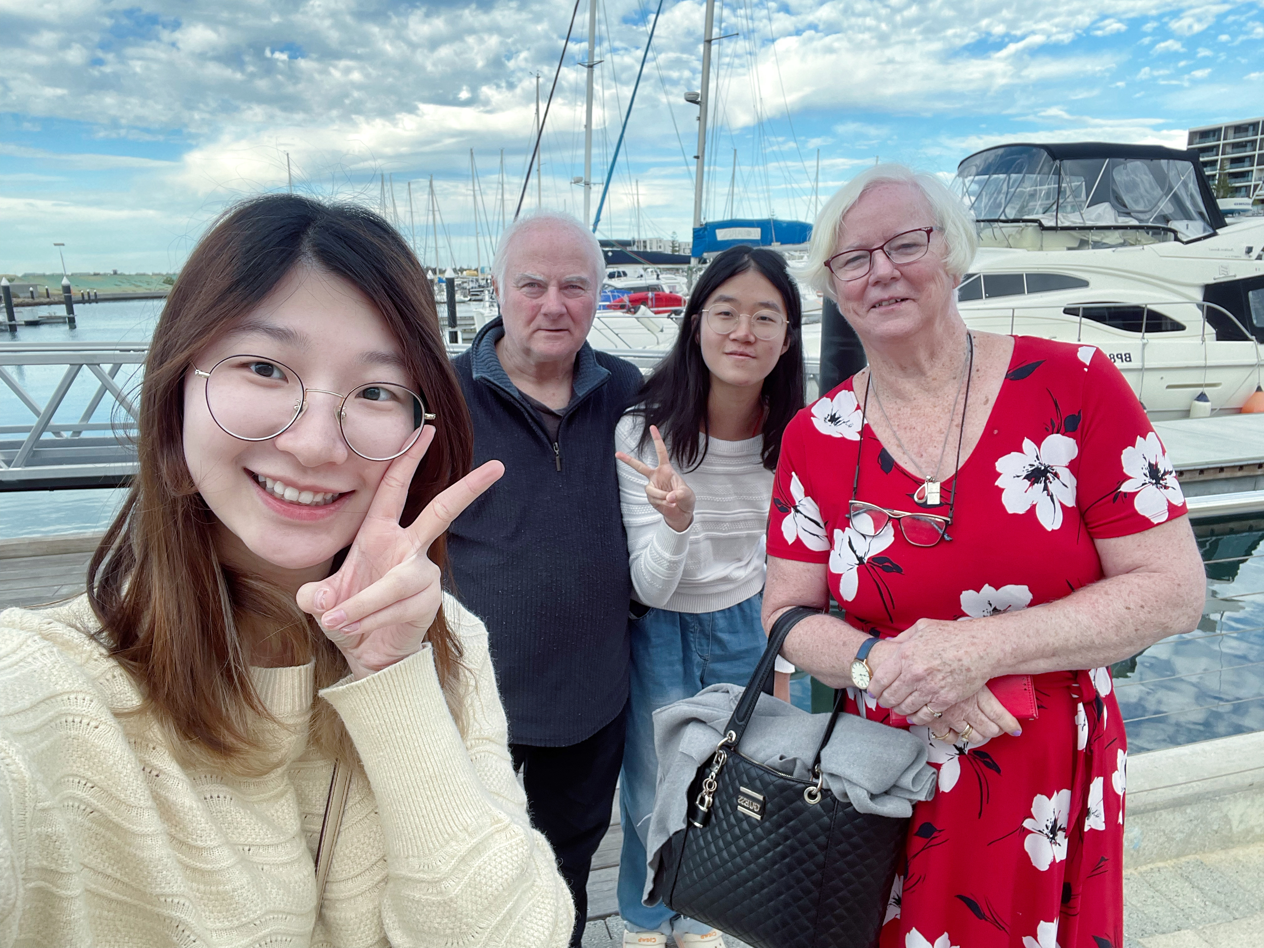
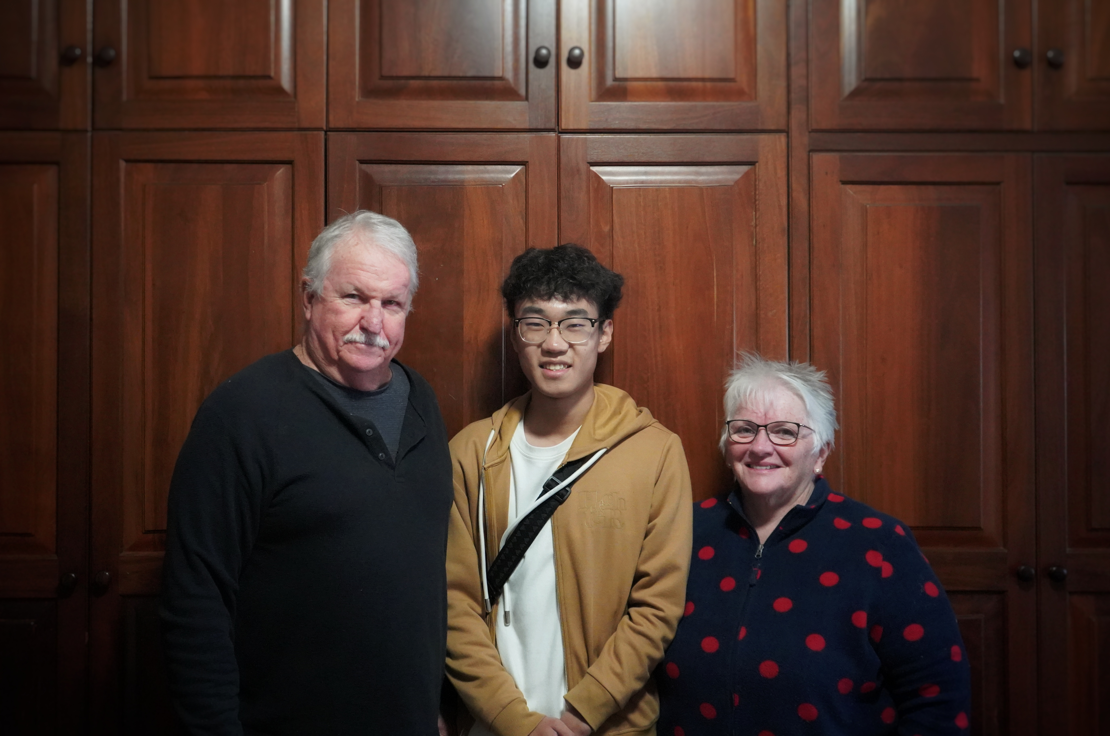
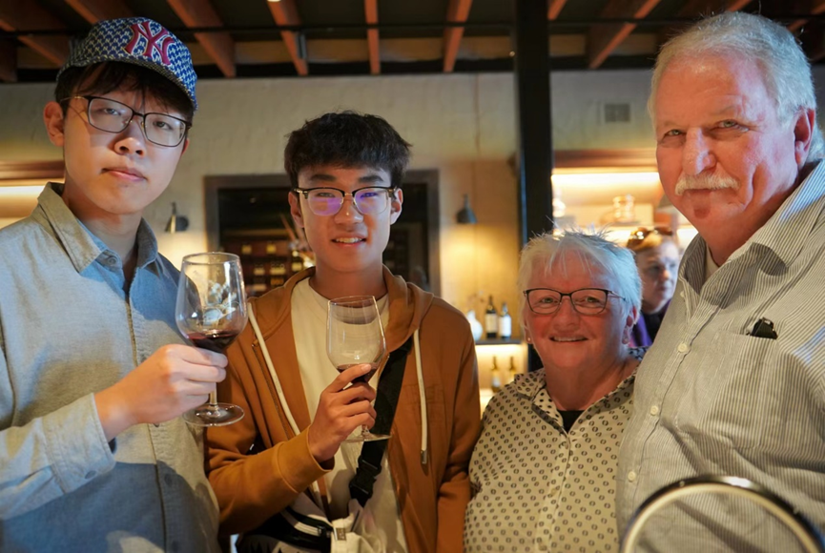
Homestay
What is Homestay?
Live with a local family
Experience local culture
Become a part of the family and learn how they live.
You will
Share meal
Learn customs
Hear stories
Enjoy traditions with the people
See beyond the usual tourist trail

Slide 8
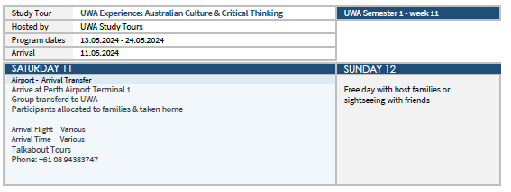

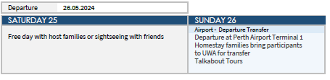
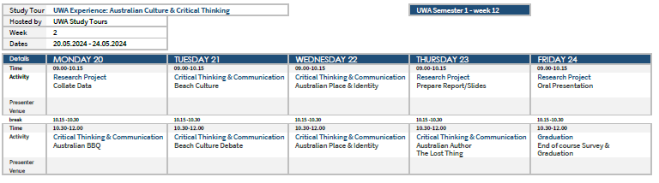
About the programme

Slide 9
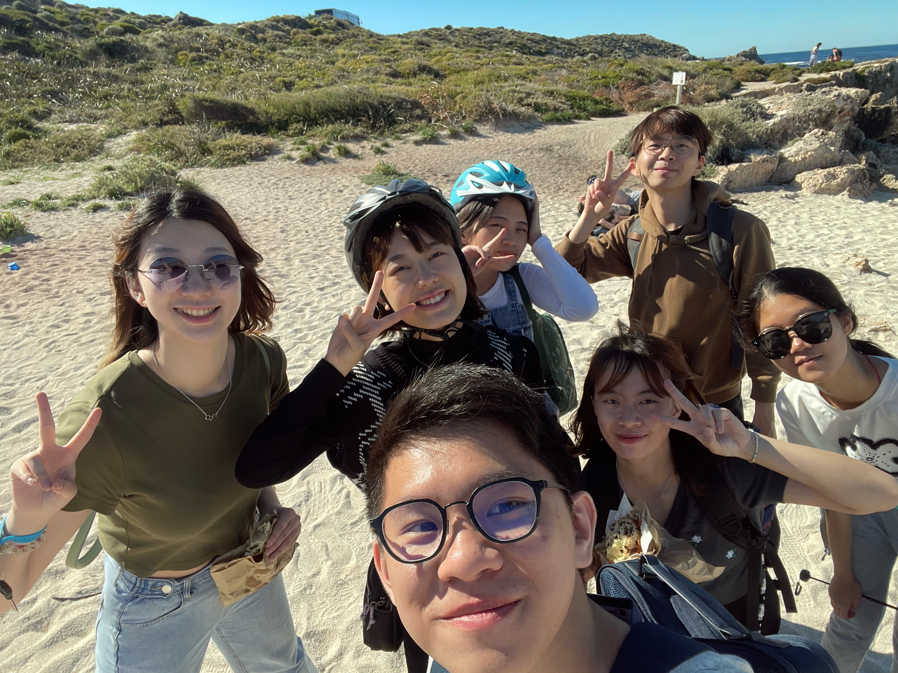
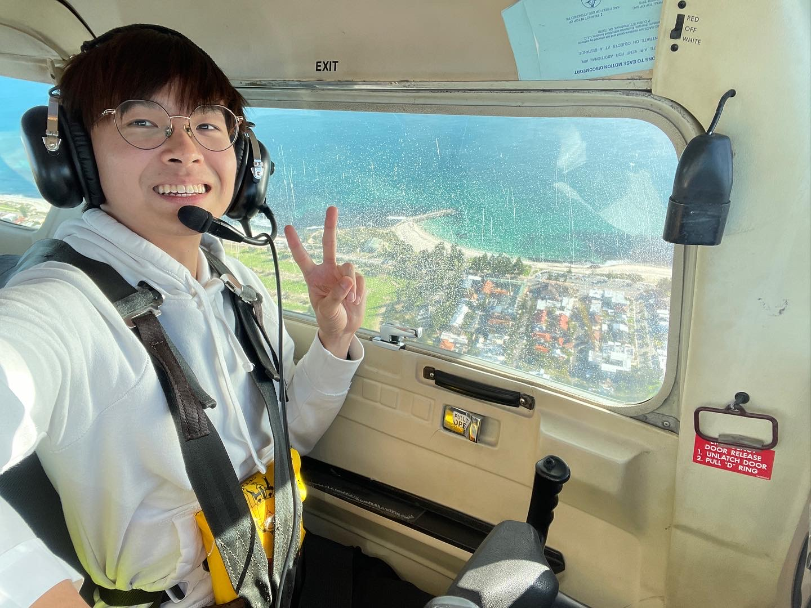
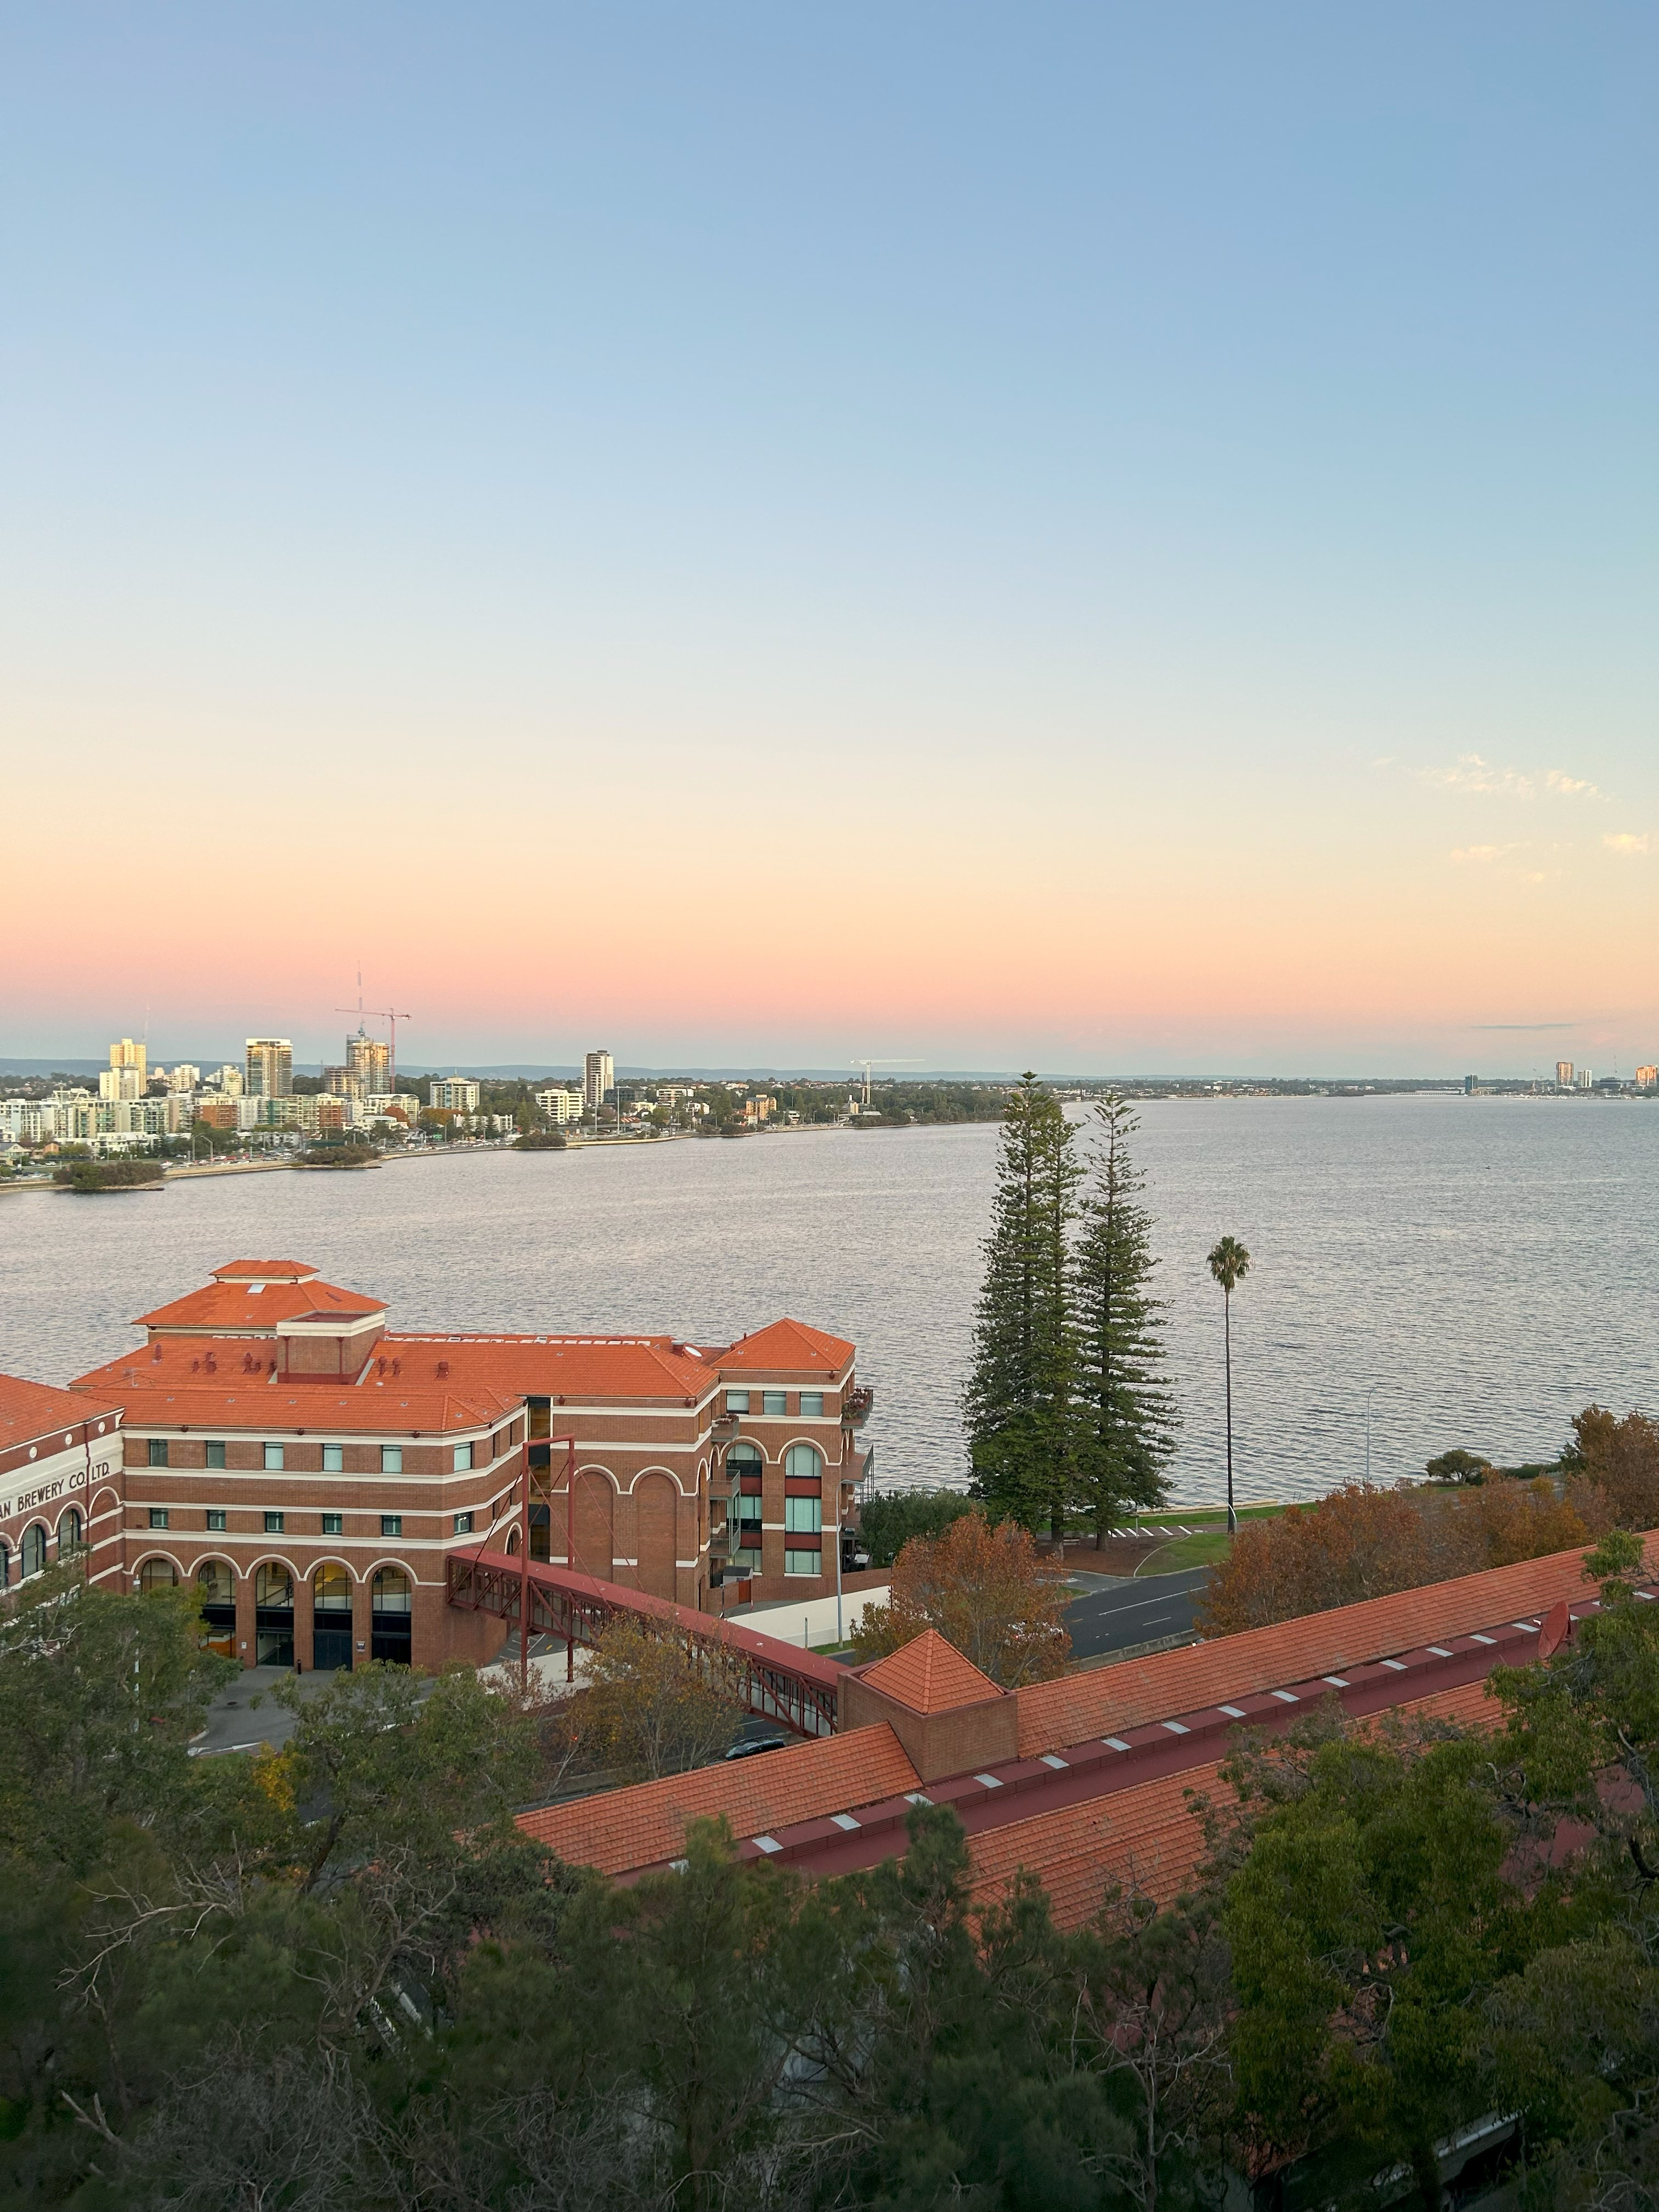
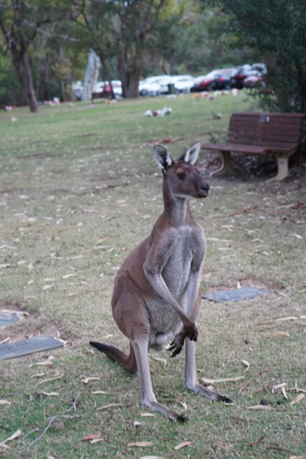

Photos from the students

Slide 10
02
Trip to Japan

Slide 11

About the trip
23 – 28 May 2024
Tokyo, Tokyo International University, TeamLab
Fee: $5,000
(Include programme fee)
Quota: 10

Slide 12
03
Culture and Heritage Trip to Jiangxi with Diligentia College, CUHK (SZ)

Slide 13
About the trip
29 May – 3 Jun 2024 (TBC)
Co-organise with Diligentia College, CUHK (SZ)
Jiangxi, China
In-depth project regarding the culture / history
Fee: $1,000 (TBC)
(Include programme fee, accommodation, transportation)
Quota: 5

Slide 14
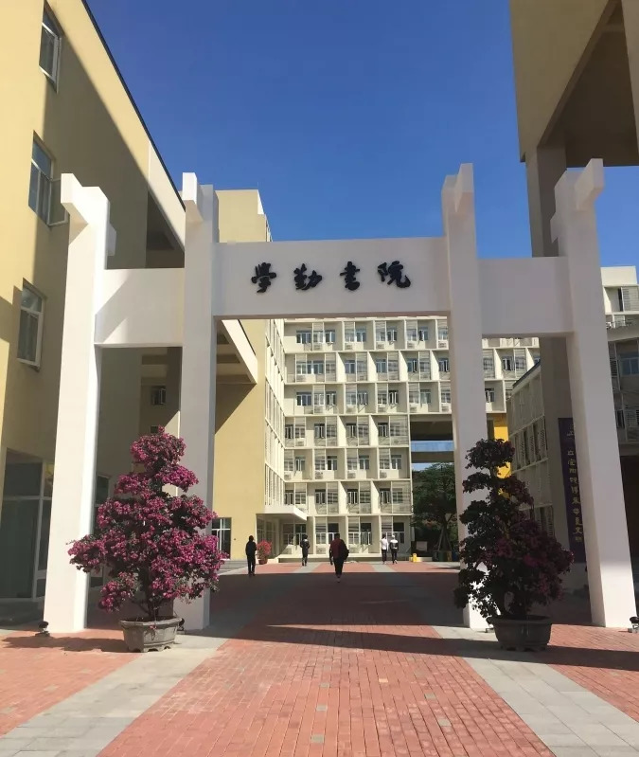

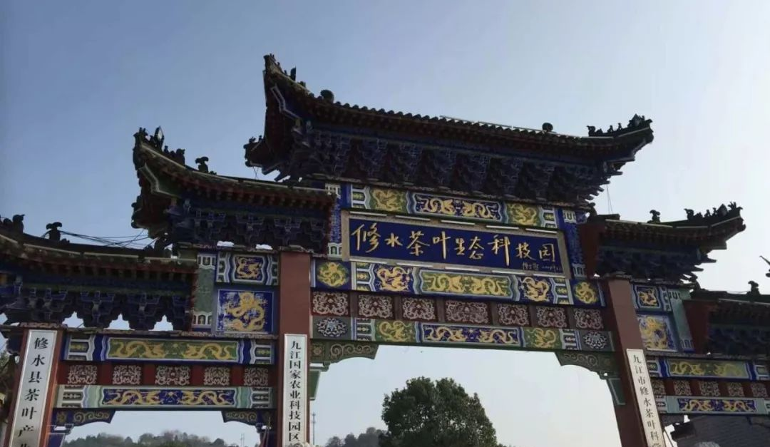
About the trip
暫定6月初
到訪江西修水縣
與深圳中大學勤書院合作的交流團
透過考察，了解江西的經濟發展及歷史文化

Slide 15
About 江西修水縣
修水縣是江西省九江市下轄縣，位於贛西北。 整體地形「八山半水一分田，半分道路和莊園」。 歷史悠久，自古稱“文章奧府”，為“濂溪弦鐸之地，山谷桑梓之鄉”。 文化底蘊豐富，歷代共辦書院25所，私塾不計其數，培養出黃庭堅、陳三立等文學大家。 具有光明革命傳統，是秋收起義主要策源地、第一支工農革命軍發源地；茶業、桑蠶業發達，有雙井茶、黃龍茶、寧紅茶等名茶品牌。

Slide 16
04
Trip to Xinjiang

Slide 17
About Xinjiang
新疆維吾爾自治區是中華人民共和國西北部的一個自治區，也是中國陸地面積第一大的省級行政區。自治區由新疆省改置，成立於 1955 年，首府位於烏魯木齊。新疆是維吾爾族、漢族、哈薩克族、回族、柯爾克孜族、蒙古族、錫伯族、塔吉克族、東鄉族等 19 個民族世代居住的地方 , 新疆維吾爾自治區現轄 4 個地級市、 5 個地區、 5 個自治州。

Slide 18
About 新疆醫科大學
新疆醫科大學及中文大學於2010年起已有交流合作，於2013-19年更多次舉辦交流活動，擴寬兩地學生的視野。 學校秉持著“以民為本、以公益為本、惠及民生”的宗旨，培育學生。學校亦有8所直屬附屬醫院，以人民為中心的發展思想，以滿足疑難危重疾病救治和新疆、週邊國家特高發疾病臨床需求為導向，圍繞絲綢之路經濟帶核心區醫療服務中心建設。

Slide 19

About the trip
9 – 16 June 2024
烏魯木齊 & 克拉瑪依市
新疆醫科大學 & 新疆醫科大學附屬之醫院
Quota: 20
Fee: $1,200
Including programme fee, air ticket and accommodation
透過考察、體驗文化及參觀歷史建築、自然風光，從而促進對中國西部的了解

Slide 20
Itinerary
Day 1
Day 2
Day 3
Day 4
香港>新疆
新疆醫科大學
新疆醫科大學第一附屬醫院
維吾爾自治區博物館
天池
Day 5
Day 6
Day 7
Day 8
新疆醫科大學第一附屬中醫院
烏魯木齊大巴扎
克拉瑪依市
新疆醫科大學第三附屬醫院
烏魯木齊六館一心博物館
新疆>香港

Slide 21
05
Trip to UK
Heritage Trip to UK

Slide 22

About the tour
School of Museum, University of Leicester
24 June – 2 July 2024
Fee: $5,000 / $7,500
(Including programme fee, accommodation, air ticket)
Quota: 15

Slide 23
About the tour
Visiting London, Leicester and Bristol
Lead students to conduct on-site inspections of local UNESCO world cultural heritage sites in the UK and visit local natural history academic research institutions.
Improve young students' understanding of the protection and utilization mechanisms of world cultural heritage
Accommodation: Hostel

Slide 24
Itinerary(TBC)
Day 1
Day 2
Day 3
Day 4
HK>London
London
University of Leicester
Oxford
Stratford Upon Avon
Day 5
Day 6
Day 7
Day 8
Day 9
Bristol
Stonehenge
Bath
Free activity
Cardiff
London>
HK

Slide 25
06
Trip to Korea
Language Enhancement: Experiential Learning Trip to Korea

Slide 26
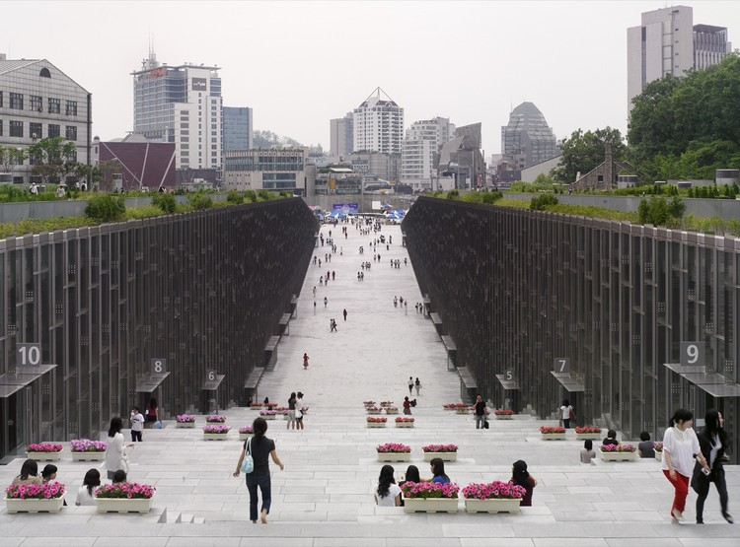
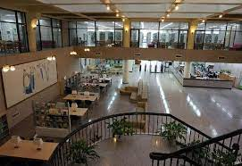
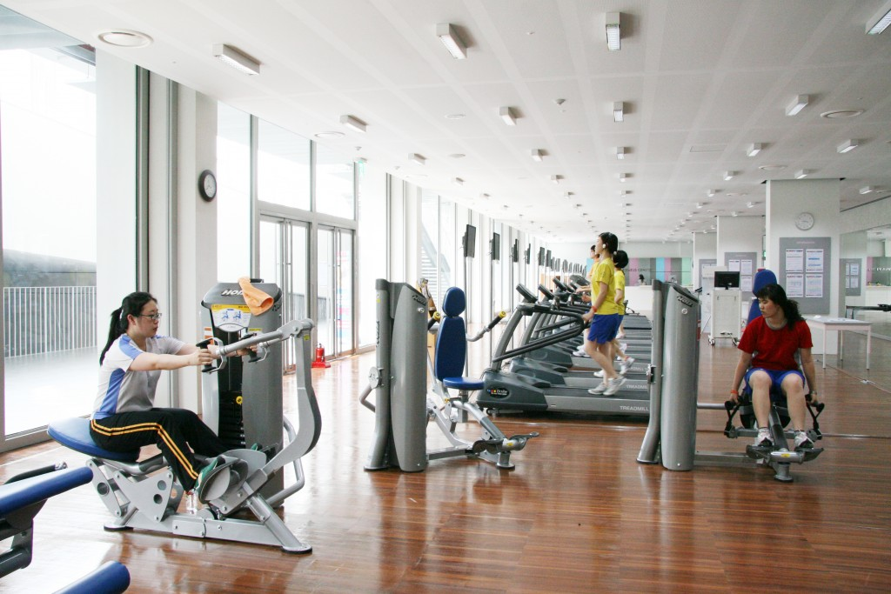
About EWHA
Established in 1886
One of the world's largest female educational institutes
Strive to pursue globalization, professionalism and scientific education

Slide 27

About the Study Trip
2 - 22 July 2024
Culture class &Language Class (for credit transfer*)
Fee: $5,000
Including programme fee, accommodation
Quota: 10
Welcome all students to join**
* Subject to RES approval
**Subject to the partner institution arrangement

Slide 28
Requirment

Slide 29
Requirment
Before the Trip
After the trip
Attend all the Pre-Departure Meeting
May need to interview
Submit Individual Project
Submit Group Project
Attend sharing Session

Slide 30
Scholarship
S056 顧鐵華費肇芬伉儷體驗學習獎學金
S056Ti Hua KOO and Dorothy VEE KOO Experiential Learning Trip Scholarship
There will be up to 4 awards of up to HK$5,000 each individually. The annual total amount is up to HK$20,000
Be accepted in College recognized overseas short-term exchange programmes
Mainland China, Taiwan, Macau or region of Silk Road and "One Belt One Road"

Slide 31
Summary
Trip | Date | Fee ($) | Quota | Application Deadline
Australia | 13 - 28 May 2024 | 6000 | 10 | 31 Jan 2023
Japan | 23 - 28 May 2024 | 5000 (TBC) | 10
Jiangxi | Early June(TBC) | 1000 (TBC) | 4
Xinjiang | 9 - 16 Jun 2024 | 1200 | 20 | 31 Jan 2023
UK | 24 Jun - 2 Jul 2024 | 5000/7500 | 15 | 31 Jan 2023
Korea | 2 - 22 Jul 2024 | 5000 | 10 | 31 Jan 2023

Slide 32
Q&A

