Slide 1
Parallel Programming Lab
PHYS 4061

Slide 2
Today’s Content
Get a feel of MPI program
A (quite realistic) case of solid state physics simulation with computer

Slide 3
Cluster Access
Temporary account, will be deleted after the lab
Try to login with
secure shell client (Lab PC), or
Mobaxterm (Lab PC, Windows), or
Terminal (Mac)
You are not required to qsub for TODAY ONLY, such usage is NOT allowed for research work
Host | cluster2.phy.cuhk.edu.hk
Username | 4061_XX
Password | comp2021

Slide 4
# Example login command
[localhost]$ ssh 4061_01@cluster2.phy.cuhk.edu.hk
The authenticity of host 'cluster2.phy.cuhk.edu.hk (137.189.40.10)' can't be established.
RSA key fingerprint is SHA256:LvEoayZ5scNxJF/4KRFVRW0rq/7jSJQ6GBgHs2kszSI.
Are you sure you want to continue connecting (yes/no)? Yes
Warning: Permanently added 'cluster2.phy.cuhk.edu.hk' (RSA) to the list of known hosts.
4061_01@cluster2.phy.cuhk.edu.hk's password: [Type your password]
Welcome to cluster2. Here are things to note:
…
[4061_01@gateway ~]$ ssh mu01
[4061_01@mu01 ~]$ module load intel_parallel_studio_xe_2015
[4061_01@mu01 ~]$ which icc
/opt/intel/bin/icc

Slide 5


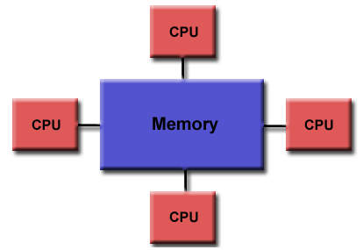
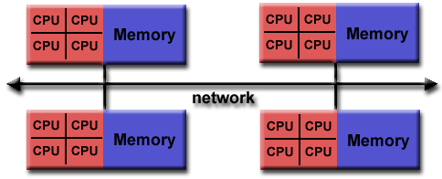
Did your program run like this?
Serial program cannot use multiple processors!
For shared memory parallelism:
OpenMP (https://hpc.llnl.gov/tuts/openMP/)
For multiple computers, use the distributed memory parallelism:
Message Passing Interface (MPI)
Shared memory model
Distributed share memory

Slide 6
Message Passing Interface (MPI)

Slide 7

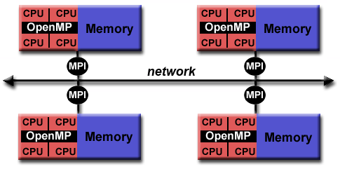
Computing Cluster
Multiple machines
connected by high-speed communication
Each machine has multiple core

Slide 8
MPI - Introduction
What is MPI?
Standardized and portable message-passing system
High performance of parallel computing
What can MPI do?
Handle data passing
What MPI cannot do?
Help you parallelize your algorithm (You need to design the “parallelism” by yourself!)
Distributed share memory

Slide 9
Programming Paradigm - Minimalist
launch
Serial
Spawn: MPI_INIT
Parallel
How many we are:
MPI_COMM_SIZE
Who I am:
MPI_COMM_RANK
Communication:
MPI_SEND
MPI_RECV
6 Fundamental operations
Despawn: MPI_FINALIZE
return

Slide 10
[4061_01@gateway ~]$ ssh mu01
[4061_01@mu01 ~]$ module load intel_parallel_studio_xe_2015
[4061_01@mu01 ~]$ which icc
/opt/intel/bin/icc
(vasp) [4061_07@mu01 ~]$
(vasp) [4061_07@mu01 ~]$ ls
4061_example
(vasp) [4061_07@mu01 ~]$ cd 4061_example/
(vasp) [4061_07@mu01 4061_example]$ ls
hello MC
(vasp) [4061_07@mu01 4061_example]$ cd hello/
(vasp) [4061_07@mu01 hello]$ ls
hello.c
(vasp) [4061_07@mu01 hello]$

Slide 11
Example 3
#include <stdio.h>
#include <string.h>
#include <mpi.h>
#define MASTER 0 //set the first process as master to send message
#define TAG 1 //set the communication key
int main(int argc, char* argv[])
{
MPI_Status status;
char Hostname[81];
char Buffer[81] = "Me";
char myname[81];
int myRank, nTasks, Slave;
MPI_Init(&argc, &argv);
MPI_Comm_rank(MPI_COMM_WORLD, &myRank);
MPI_Comm_size(MPI_COMM_WORLD, &nTasks);
gethostname(Hostname,80);
if (myRank == MASTER) { //here is master process need to do
sprintf(myname,"%d",myRank);
for (Slave = 1; Slave < nTasks; Slave++) {
MPI_Send(myname,80, MPI_CHAR, Slave, TAG,
MPI_COMM_WORLD);
}
}
else{//here is slave process need to do
MPI_Recv(Buffer, 80, MPI_CHAR, MASTER, TAG,
MPI_COMM_WORLD, &status);
}
printf("Hello World from Host %s rank %d : Master is %s\n",Hostname,myRank,Buffer);
MPI_Finalize();
return 0;
} /* end main */
Hello world

Slide 12
Running MPI Programs
Compiling:
mpiicc hello.c
Running:
mpirun –np 12 ./a.out
mpirun: The process manager
-np N: use N threads
a.out: executable
[4061_30@mu01 4061_example]$ mpirun -np 12 ./a.out
Hello World from Host mu01 rank 0 : Master is Me
Hello World from Host mu01 rank 1 : Master is 0
Hello World from Host mu01 rank 2 : Master is 0
Hello World from Host mu01 rank 3 : Master is 0
…

Slide 13
So after all, more threads == better?
Since the hello world code is too fast to get intuitive sense
Let’s study this problem with a more complex example

Slide 14

Ex2: Pi with Monte Carlo
Pick random points $(x,y)$ within a box of $L×L$
The probability
$$P\left(x^{2}+y^{2}≤L^{2}\right)=\frac{π}{4}$$

Slide 15
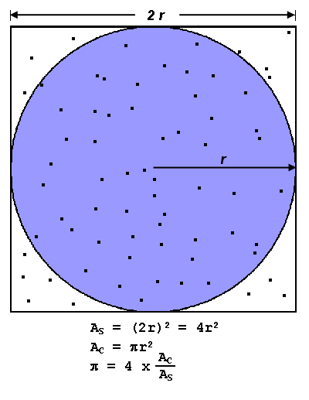
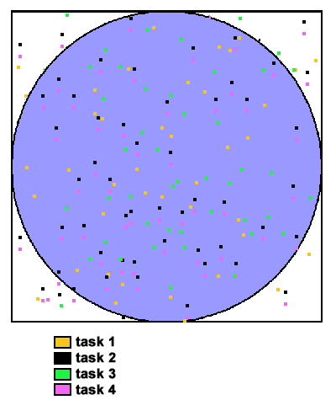

Slide 16
Ex2: Pi with Monte Carlo
A possible model for parallelism:
Master
Slaves
Generate random numbers
Send series of random points to slave
Sum the number and give another group
Count and report the number
Receive array of point
Double Array
Integer

Slide 17
Slaves
Master
Send a negative number
Wait for some one to submit
If receive a negative value
If receive a positive value
Wait for positions
Next step
Record the result
Check and record
Generate a groups of positions and send back
If all jobs run out
Send back the result
Record the result

Slide 18
#include <stdio.h>
#include <stdlib.h>
#include <mpi.h>
// Master rank = 0
#define Master 0
// Each send gives CHUNK_SIZE points, and this represents the number of points to be tested at each job
#define CHUNK_SIZE 1000000
// Total number of jobs
#define RUN 1000
// Some constant flags to send
#define SUBMIT 1
#define DELIVER 0
int main(int argc, char *argv[]){
double start, end;
MPI_Init(&argc, &argv); //Init MPI
int rank;
MPI_Comm_rank(MPI_COMM_WORLD, &rank);
MPI_Barrier(MPI_COMM_WORLD); /* keep all process start at same time */
start = MPI_Wtime(); //record the start time
if (rank == Master) {
doMaster();
} else {
doSlave();
}
MPI_Barrier(MPI_COMM_WORLD); /* Stop the processes until all processes in the communicator complete . */
end = MPI_Wtime(); //record the end time
MPI_Finalize();
if (rank == 0) { /* use time on master node */
printf("Runtime = %f\n", end-start);
}
return 0;
}

Slide 19
void doMaster(){
MPI_Status status;
double randBuf[CHUNK_SIZE * 2]; //Each point has two coordinates.
long recvBuf; //This variable is used to receive results
long nIn = 0, nTotal = 0;
int i,j,k;
srand(0);
while (RUN>k) {
// Wait for someone to submit
MPI_Recv(&recvBuf, 1, MPI_LONG, MPI_ANY_SOURCE, SUBMIT, MPI_COMM_WORLD, &status);
// MPI_ANY_SOURCE represents that the process will attempt to accept information from all processes
if (recvBuf >= 0) { //This section will record the results of each job
nTotal += CHUNK_SIZE; //the number of points tested in a job
nIn += recvBuf; //the number of points distributed in the circle in a job
printf("%d %d Pi = %.20lf after %ld sampling.\n",k,status.MPI_SOURCE, 4.0 * nIn / nTotal, nTotal);
}
// Prepare a new chunk of data
for (i = 0; i < CHUNK_SIZE * 2; i++) { //This section will generate a new job
randBuf[i] = rand() * 1.0 / RAND_MAX;
}
// Send a chunk of data, status.MPI_SOURCE represents the process that just finished the work
MPI_Send(randBuf, CHUNK_SIZE * 2, MPI_DOUBLE, status.MPI_SOURCE, DELIVER, MPI_COMM_WORLD);
k++;
}
}

Slide 20
void doSlave(){
MPI_Status status;
double randBuf[CHUNK_SIZE * 2]; //Each point has two coordinates. The even number of the array is the x-axis coordinate and the odd number is the y-axis coordinate
long nIn = -1l; //Set a negative number
int i,k=0;
MPI_Send(&nIn, 1, MPI_LONG, Master, SUBMIT, MPI_COMM_WORLD); //send a negative number to master indicates that the process is ready
int size;
MPI_Comm_size(MPI_COMM_WORLD, &size);
while (RUN/(size-1)>k) { //size-1 is the total number of slave
// receive a data trunk, get the positions of all points in this job
MPI_Recv(randBuf, CHUNK_SIZE * 2, MPI_DOUBLE, Master, DELIVER, MPI_COMM_WORLD, &status);
nIn = 0; // reset counter
for (i = 0; i < CHUNK_SIZE ; i++) { //test x^2+y^2, test how many dots are inside the circle
if (randBuf[2 * i] * randBuf[2 * i] + randBuf[2 * i + 1] * randBuf[2 * i + 1] <= 1.0)
nIn++;
}
// send back the result
MPI_Send(&nIn, 1, MPI_LONG, Master, SUBMIT, MPI_COMM_WORLD);
k++;
}
}

Slide 21
About time
If we do total 1000000000 points
Number of p/threads | Time(s)
1 | 21.331907
2 | 20.67289
4 | 22.512994
8 | 24.189721
10 | 24.824944

Slide 22
Ex2: Pi with Monte Carlo
An improved model:
Slaves
Master
Arrange tasks
Generate random numbers
Save data
Just wait
Report result
Sum the number and give the result

Slide 23
Time vs number of threads
Number of threads | Time(s)
1 | 20.50903
2 | 10.54253
4 | 6.048605
8 | 3.186363
10 | 2.550814
15 | 2.551384
20 | 2.593344

Slide 24
(vasp) [4061_07@mu01 hello]$
(vasp) [4061_07@mu01 hello]$ cd ../
(vasp) [4061_07@mu01 4061_example]$ ls
hello MC
(vasp) [4061_07@mu01 4061_example]$ cd MC/
(vasp) [4061_07@mu01 MC]$ ls
MC1.c MC2.c
(vasp) [4061_07@mu01 MC]$ mpiicc MC1.c -o a.out
(vasp) [4061_07@mu01 MC]$ mpiicc MC2.c -o b.out
(vasp) [4061_07@mu01 MC]$ mpirun -np 5 a.out
(vasp) [4061_07@mu01 MC]$ mpirun -np 5 b.out
Try to make sure RUN/(size-1) is an integer !!!

Slide 25
What can we learn from this example?
Parallel processes can speed up the works with proper construction of code
The potential for acceleration depends on the proportion of parts that can be paralleled. At the same time, we should also avoid the latency and waiting
With the increase of processes, the overall run time gain will saturate
Parallelism is not only a programming skill, but also a thinking about reasonable arrangement!

Slide 26
VASP

Slide 27
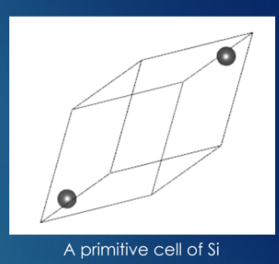
VASP - Introduction
What is VASP?
VASP attempt to solve the electronic Schrödinger equation given the positions of the nuclei and the number of electrons in order to yield useful information such as electron densities, energies and other properties of the system.
https://www.vasp.at/wiki/index.php/The_VASP_Manual

Slide 28
Demo part
(vasp) [4061_07@mu01 MC]$
(vasp) [4061_07@mu01 MC]$ cd ../VASP/
(vasp) [4061_07@mu01 VASP]$ ls
example_Si
(vasp) [4061_07@mu01 VASP]$ cd example_Si/
(vasp) [4061_07@mu01 example_Si]$ ls
INCAR KPOINTS POSCAR POTCAR run.sh
(vasp) [4061_07@mu01 example_Si]$ qsub run.sh
77685.mu01
(vasp) [4061_07@mu01 example_Si]$ ls
CHG CHGCAR CONTCAR DOSCAR EIGENVAL IBZKPT INCAR KPOINTS LOG myjob.err myjob.out OSZICAR OUTCAR PCDAT POSCAR POTCAR REPORT run.sh vasprun.xml WAVECAR XDATCAR
(vasp) [4061_07@mu01 example_Si]$

Slide 29
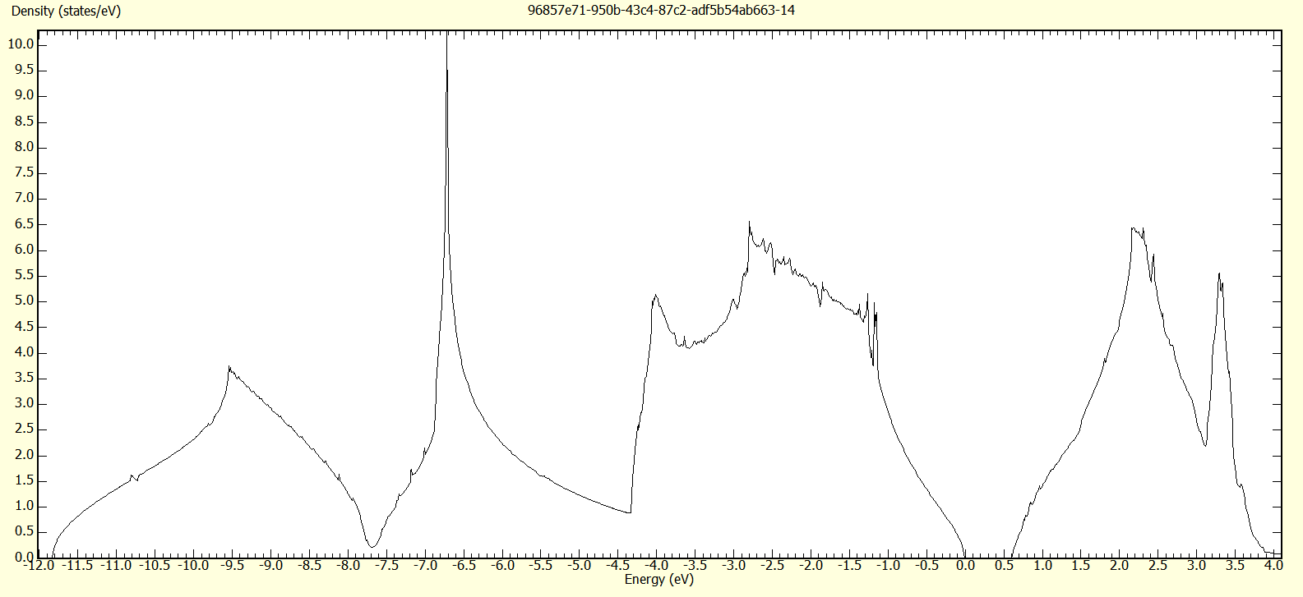
Results
Predicted values:
Lattice constant: 5.4663 Angstrom (Experiment 5.431 Angstrom)
Band gap: ~0.6eV (Experiment: 1.11eV)
Density of state:
Fermi level
Band gap

