Slide 1


Transforming Students Through Critical Reflection and Teacher-Student Interaction for a Capstone Course
Prof. Ian Morley
Department of History
Chinese University of Hong Kong

Slide 2
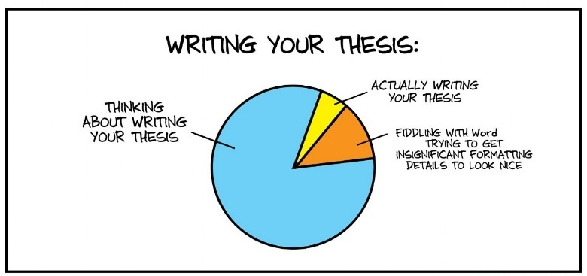

Slide 3
Project Overview
Connections, present to past
Pedagogical interactions
Enhancement of thesis writing experience
Promotion of deep learning
Elimination of educational obstacles
Encouragement of teacher-student communication
Elevation in ‘good’ research practices

Slide 4
Quantifiable Outcomes (HIST4801/2)
Enrich the learning environment
Skill build
Reflective practice
Deeper learning framework
CoP
Peer review (amongst teaching staff)

