Slide 1

Student Exchange Programme
2023-2024
“The world is a book and those who do not travel read only one page.” – St. Augustine

Slide 2
Where to Exchange?
14.5 full-time equivalent (FTE) (available in academic year/term)
17 universities in 12 countries including Australia, Canada, Denmark, Finland, Japan, Korea, Singapore, Sweden, The Netherlands, United Kingdom and United States

Slide 3










Where to Exchange?
Asia

Slide 4






Where to Exchange?
Australia
Canada

Slide 5












Where to Exchange?
Europe
Finland
Sweden
Switzerland
Denmark
Sweden
The Netherlands

Slide 6




Where to Exchange?
United Kingdom

Slide 7






Where to Exchange?
United States

Slide 8
Exchange period
 | 2023 |  |  |  | 2024
 | 9 | 10 | 11 | 12 | 1 | 2 | 3 | 4 | 5 | 6 | 7 | 8
Term 1
Term 2
Year
Duration
One academic year
One term (1st or 2nd term)
*note that the exchange period to The University of New South Wales is a bit different
Remark:
Exact study period varies among institutions

Slide 9
Are you Eligible?
Have a valid TOEFL or IELTS score report if required
(counting from on or after 1 Sep 2021)
In good academic and disciplinary standing (most of the institutions require CGPA >=3) at CUHK
Have basic knowledge of the country or region where you intend to study
Should display maturity and responsibility in social conduct
physically and emotionally healthy
Applicants must be registered full-time undergraduate students at the time of application and while on exchange
Ready to be an exchange student representing CUHK & LWS College
Have to complete the course registered with passing grades in the exchanged university
Willing to share your exchange experience with fellow students when you are back

Slide 10

When considering of your choices…
You MUST think about:
Your personal and cultural interests
Can you meet the Programme requirement?
  Check GPA
  Check Language
Do the institutions offer courses of your study area?
  Check available discipline and remarks
Can you afford the cost of living of the country?

Slide 11
Details of Host Institution
Country | Host Institution | FTE | T1 | T2 | YR | Language Requirement | Remarks
Japan | Doshisha University | 1 |  |  |  | Japanese Intermediate (N3)
 | Kansai University | 1 |  |  |  | Japanese Intermediate (N3)
Singapore | National University of Singapore | 0.5 |  |  |  | n/a | NOT For Faculty of BA students
Australia | The University of New South Wales | 1 |  |  |  | TOEFL (IBT) / IELTS
Finland | Tampere University (Former name: University of Tampere) | 0.5 |  |  |  | TOEFL (IBT) / IELTS | Yr 2 or above

Slide 12
Details of Host Institution
Country | Host Institution | FTE | T1 | T2 | YR | Language Requirement | Remarks
Denmark | Technical University of Denmark | 0.5 |  |  |  | TOEFL (IBT) / IELTS | For Faculty of ERG & SCI students only
Switzerland | University of Geneva | 0.5 |  |  |  | French A2
Netherlands | Maastricht University | 0.5 |  |  |  | TOEFL (IBT) / IELTS | For Business Administration, Department of Economics and the Global Finance and Economics Programme students only Yr 2 or above
UK | University of Aberdeen | 0.5 |  |  |  | IELTS | Yr 2 or above
United States | University of Washington | 0.5 |  |  |  | TOEFL (IBT) / IELTS | Yr 2 or above
 | Northeastern University | 1 |  |  |  | TOEFL (IBT) / IELTS

Slide 13
IMPORTANT
PLEASE MAKE SURE YOU FULFILL ALL THE REQUIREMENTS LISTED WHEN YOU MAKE YOUR CHOICE !!
(Especially for the language requirement ! A valid certificate/ proof is required before you go to the exchange)

Slide 14
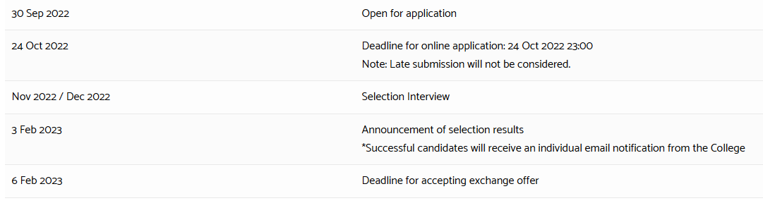
Important Dates

Slide 15

Money matters
Regular CUHK tuition fee and related fees (Student Union Fee)
Accommodation (host university / off-campus accommodation fee)
Other fees include:
Health Insurance
Meal Plans
Airfare
Miscellaneous (books, stationery, personal expenses, transportation, etc.)

Slide 16
Estimated cost of living (Reference Only)
Destination | Annual cost of living | Converted to HKD
Australia | ~AUS 30,540 (http://www.studyat.uwa.edu.au/about/accommodation/costs) | ~180,800
Canada | ~CAN 14,000 (http://www.uottawa.ca/financial-aid-awards/) | ~81,000
Denmark | ~DKK 96,000 (http://www.dtu.dk/english/Education/International-Student-Guide/For-admitted-students/Living-expenses) | ~109,000
Finland | ~EUR 10,900 (http://www.uta.fi/admissions/student-life) | ~92,300
Japan | ~Yen 1,320,000 (https://www.quora.com/What-is-the-monthly-average-cost-of-living-in-Japan-for-a-single-fresher-working-engineer-Outside-Tokyo) | ~97,900
Korea | USD 12,000 (http://www.adventureteaching.com/our-blog/expat-life/living-cost-korea/) | ~93,000
Netherland | ~EUR12,000 (https://www.educations.com/study-guides/europe/study-in-netherlands/student-accommodation-5838) | ~110,400
Singapore | ~ S 10,000 (http://www.nus.edu.sg/oam/financialaid/financial-tuition-fees-coaup.html) | ~55,700
Sweden | ~SEK 96,000 (https://studyinsweden.se/life-in-sweden/cost-of-living/) | ~83,600
Switzerland | ~CHF 23,500 (http://sae.epfl.ch/cost-of-living) | ~183,500
UK | ~£15,360 (http://www.ed.ac.uk/studying/international/finance/cost-of-living) | ~145,500
USA | ~USD 18,000 (http://www.studying-in-us.org/cost-of-living-in-the-united-states/) | ~139,600
Notes
The above figures are for reference only and subject to change due to inflation and vary according to lifestyle and preferences of individuals.
The estimated cost of living includes on-campus accommodation, food and basic personal expenses at host institution.

Slide 17
Available Scholarship / Financial Aid
CUHK Student Exchange Financial Aid and Scholarship Scheme (FASS) http://www.oal.cuhk.edu.hk/index.php
Can apply when you accept the exchange offer
Office of Admissions and Financial Aid
http://www.oafa.cuhk.edu.hk/safs/scholarships/scholarships-for-overseas-studies
Government Grant and Loan
http://www.sfaa.gov.hk/tc/index.htm

Slide 18

FAQ
Q: Can I apply for the exchange programme if I have not yet taken the language test before the application deadline?
(Given that you decide to choose the universities that have requirement on the TOEFL/IELTS score)
A: Yes, but you must provide a proof of your order/details of the IELTS / TOEFL test.
Please reminded the deadline of updating the test result, i.e. Jan 2023, to College.
For Language test, scores from the same sitting are counted only. Combined certificate is not counted.

Slide 19

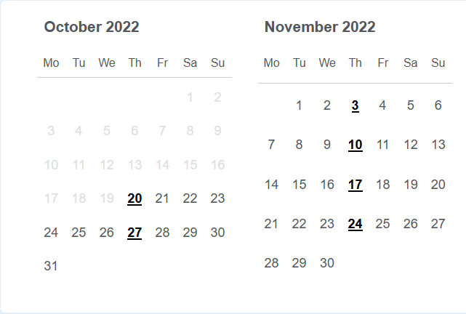
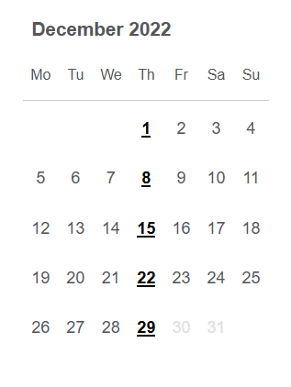
IELTS Test Dates
Fees: HKD 2,300
Source: https://www.idp.com/hongkong/ielts-hk/ielts-hongkong-test-dates/
Source: https://ieltsregistration.britishcouncil.org/orsnbc/iol/find-test

Slide 20
TOEFL (IBT) Test Dates
In order to meet the deadline of updating your test result to the College, i.e. Jan 2022, make sure you obtain the test result by this deadline
TOEFL (IBT) test schedule:
http://www.ets.org/bin/getprogram.cgi?urlSource=toefl&newRegURL=&test=TOEFL&greClosed=new&greClosedCountry=China&browserType=&toeflType=&redirect=&t_country1=group_HongKong

Slide 21
FAQ
Q: Can I accept offers from both OAL and College?
A: Can accept one offer only if you apply & receive nominations from both OAL and the Colleges in the first placement round
2nd placement round: No new applications will be accepted, eligible students will be invited to apply for the second round via email

Slide 22
FAQ
Q: Which term does the required GPA refer to? Does the GPA in question mean the cumulated one or the term one only?
A: The required GPA refers to the cumulated GPA in Term 1, 2022-2023.
Please be reminded of updating it to the College on or before Jan 2023.

Slide 23
FAQ
Q: Do I need to apply for extension of study period for the exchange?
A: All final Year Undergraduate Students who are shortlisted must seek their major Department’s pre-approval for extension of student period at CUHK by completing the “Application for Extension of Study Period” form. They CANNOT choose the 2nd term programmes.
Please download the form here:
http://www.ws.cuhk.edu.hk/file/extension
Note
If students’ expected graduation term is the first term of the current academic year (i.e. 2023-24, Term 1), they are ineligible to apply for the exchange programmes.

Slide 24
FAQ
Q: Are credits transferable?
A: Credits may be transferred back to CUHK in accordance with appropriate regulations of CUHK
You should consult with your department’s academic staff in selecting courses
http://www.res.cuhk.edu.hk/en-gb/cusis/transfer-credit-exemption

Slide 25
Selection Interview
Shortlisted students will be invited to interview
Interview panel: Staff/ Teachers from Lee Woo Sing College
Evaluation will be based on 5 categories of personal attributes

Slide 26
Evaluation Criteria
Personal Attributes
A: Commitment and Potential: Objectives, study plan and goal setting
B: Determination & Enthusiasm: Preparation work done, level of understanding of the institution and the Country
C: Personality & Suitability: Adaptability/ Maturity/ Personal suitability/ Interpersonal skills
D: Communication: Language proficiency/ presentation & communication skills
E: Achievements & Contributions: College ambassador/ Extra-curricular activities/ Awards & honors

Slide 27

Selection process
After the interview:
  Priority for each institution will be given to student who has the highest scores and there after (the score will not be announced)
  Applicant who have never exchanged before during his study years in CUHK will be considered first

Slide 28
Selection process
Procedure | Action Item
Early Jan – mid Jan | Change of choices and update results
Mid Jan 2023 | Update your latest Accumulated GPA and language test results
3 Feb 2023 | Announcement of selection results by email
On or before 6 Feb 2023 | Accepting your offer
  Complete and sign the offer letter
  pay a deposit of $1500. The deposit is fully refundable upon completion of exchange programme and fulfillment of other requirements, for example students should enroll at least full time credit load at their intuition and get a pass on all subjects.
  You may be required to attend a debriefing session and a sharing session after you return from the exchange programme if needed.

Slide 29
FAQ
Q: What if I cannot attend the interview?
A: If you are shortlisted, you must attend the interview if you would like us to process your application.
Students must submit a good cause request for rescheduling the interview. Experiential Learning and Global Engagement Committee would determine on a case by case basis.
Q: How the College contact me about the application states?
A: Every important message will be delivered to you via your email. Make sure you check your email account frequently once you apply for the exchange.
Q: What will be the following if I accept the exchange offer?
A: After you accept the offer and finish the procedure required, a study advisor from OAL will contact you soon to arrange your case with you. Be patient!

Slide 30
Want to know more?
OAL Website
http://www.oal.cuhk.edu.hk/index.php/study-abroad-a-exchanges-for-cuhk-students/term-time-exchange/applying
College Website
http://www.ws.cuhk.edu.hk/student-information/cross-cultural-experience/term-exchange-programmes

Slide 31
If you have any questions, please contact wscollege@cuhk.edu.hk. Thank you.

