Slide 1
The Department of Japanese Studies at
The Chinese University of Hong Kong
Admissions Talk (2023 intake)

Slide 2
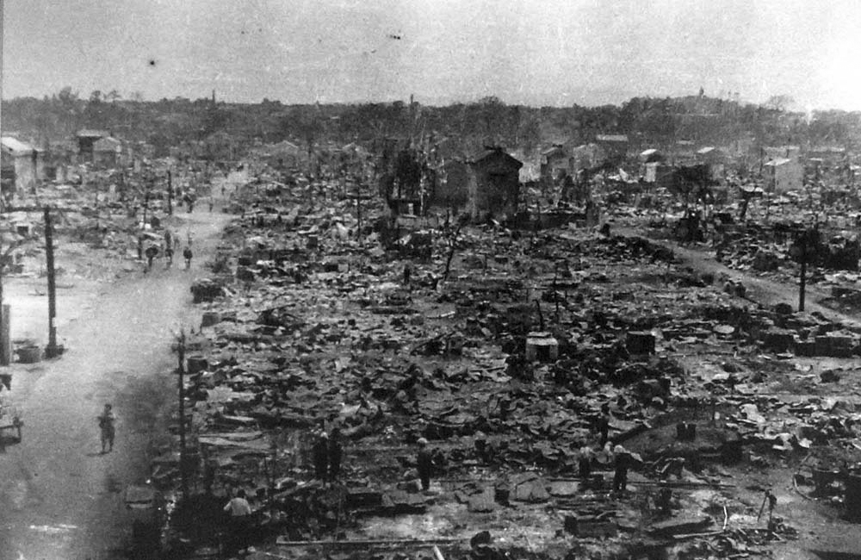
Tokyo in ruins: 1945
https://www.google.com.hk/search?q=tokyo+1945+images&safe=off&biw=1090&bih=611&tbm=isch&imgil=l3VPBfsUKaULwM%253A%253Bhttps%253A%252F%252Fencrypted-tbn3.gstatic.com%252Fimages%253Fq%253Dtbn%253AANd9GcRPBadfLC4HBw9kTaAVvDDQCQKIsfSJbas7oaQh6wdXJBccsDCi%253B1000%253B650%253BZ1PZrwPCpvAazM%253Bhttp%25253A%25252F%25252Fcommons.wikimedia.org%25252Fwiki%25252FFile%25253ATokyo_kush_1945-5.jpg&source=iu&usg=__2Qih6fdJfE8JFxDI8colF64dpqQ%3D&sa=X&ei=t3VtU6ugNoP2kQWU2IDYDg&ved=0CCwQ9QEwAQ#facrc=_&imgdii=_&imgrc=l3VPBfsUKaULwM%253A%3BZ1PZrwPCpvAazM%3Bhttp%253A%252F%252Fupload.wikimedia.org%252Fwikipedia%252Fcommons%252Fb%252Fbc%252FTokyo_kush_1945-5.jpg%3Bhttp%253A%252F%252Fcommons.wikimedia.org%252Fwiki%252FFile%253ATokyo_kush_1945-5.jpg%3B1000%3B650

Slide 3
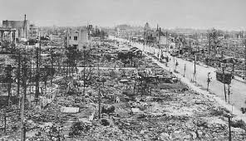
1945: Sendai 仙台
https://www.google.com.hk/search?safe=off&hl=en&site=imghp&tbm=isch&source=hp&biw=1090&bih=611&q=sendai+1945&oq=sendai+1945&gs_l=img.3...3357.5419.0.5558.11.9.0.2.0.0.324.1280.0j4j0j2.6.0....0...1ac.1.43.img..6.5.930.k8Og9Jl9cz8#facrc=_&imgrc=xdcBeHAXWoLvOM%253A%3B9xFv6QtbWNrKeM%3Bhttp%253A%252F%252Fww2db.com%252Fimages%252Fbattle_bombtokyo24.jpg%3Bhttp%253A%252F%252Fww2db.com%252Fimage.php%253Fimage_id%253D7534%3B573%3B329

Slide 4

1945: Total defeat and surrender
http://belfercenter.ksg.harvard.edu/publication/19548/planning_the_peace_and_enforcing_the_surrender.html

Slide 5
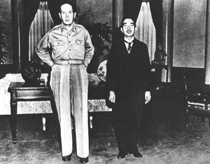
Occupied by the Allied Forces
http://www.wa-pedia.com/history/american_occupation_japan.shtml

Slide 6
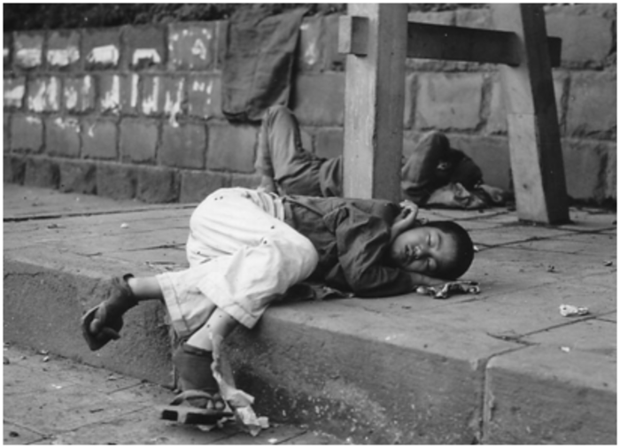
Japan 1946: lacked infrastructure and a functioning economy, and death by starvation was still common
https://www.google.com.hk/search?safe=off&hl=en&site=imghp&tbm=isch&source=hp&biw=1090&bih=611&q=tokyo+1945&oq=tokyo+1945&gs_l=img.12...0.0.0.1914.0.0.0.0.0.0.0.0..0.0....0...1ac..43.img..0.0.0.dVBnGEFdGGA#facrc=_&imgdii=_&imgrc=rL3TNc92YLrRRM%253A%3BeZ_PIFQHGiL5mM%3Bhttp%253A%252F%252Fwww.japanfocus.org%252Fdata%252Fhomeless_orphan_in_postwar_tokyo.png%3Bhttp%253A%252F%252Fwww.japanfocus.org%252F-cary-karacas%252F3474%3B700%3B506

Slide 7
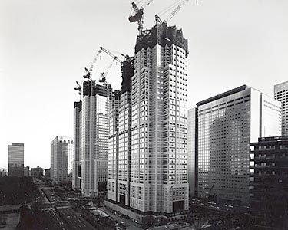
Japan 1970: the “economic miracle”
http://moa.wfu.edu/exhibits/temporary-exhibits/exhibit-gazing-at-the-contemporary-world/

Slide 8
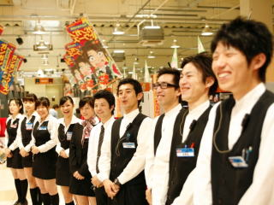
Why is the quality of customer service so high?
https://www.google.com.hk/search?safe=off&hl=en&biw=1090&bih=611&site=imghp&tbm=isch&sa=1&q=japan+service&oq=japan+service&gs_l=img.3..0i24l10.14548.14548.0.16898.1.1.0.0.0.0.216.216.2-1.1.0....0...1c.1.43.img..0.1.210.qZcgnfcr2WQ#facrc=_&imgdii=_&imgrc=2iF-mED_aJqN3M%253A%3BhEP2MEObXcFtKM%3Bhttp%253A%252F%252F3.bp.blogspot.com%252F-D_BglX5XCu8%252FTo5ZhkLGooI%252FAAAAAAAAAlM%252FAN1Hj3EpBdM%252Fs1600%252F%252525E5%252525BA%25252597%252525E5%25252593%252525A1.jpg%3Bhttp%253A%252F%252Ftokyoroomfinder.blogspot.com%252F2011%252F10%252Fcustomer-service-in-japan.html%3B320%3B240

Slide 9
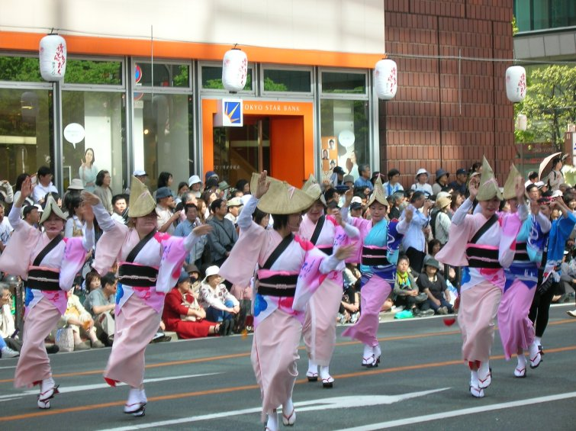
Why do traditions survive?
http://www.kcpstudentlife.com/wp-content/uploads/2011/08/Japanese-Spring-festival-Hakata-Donkatu-Festival.jpg

Slide 10
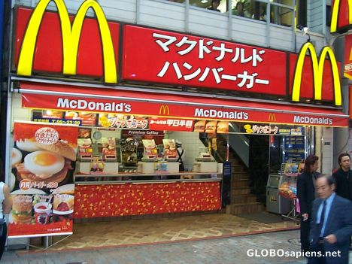
Is McDonalds the same in Japan and Hong Kong?
http://www.globosapiens.net/paulsadler/picture-mcdonalds-in-shinjuku-tokyo-6554.html

Slide 11
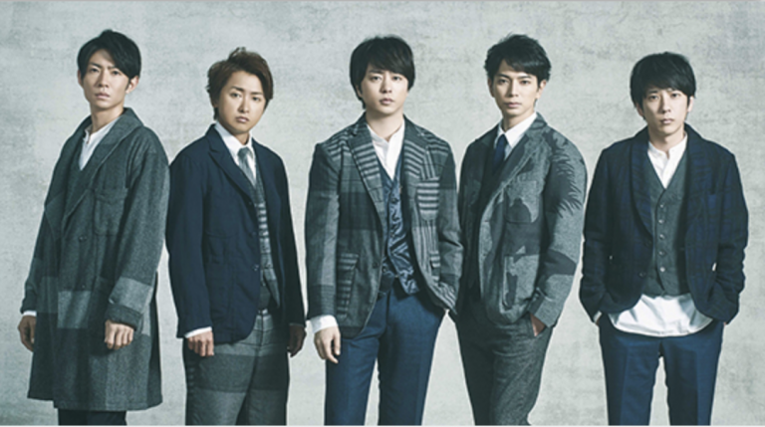
Why are Japanese entertainment companies so successful?
http://nihongomanabu.com/2018/01/07/arashi-release-new-single-find-answer-21st-feb-2018//

Slide 12

What is the attraction of BL comics for its female readers?
http://www.fanpop.com/clubs/yaoi/images/17927103/title/date-masamune-sanada-yukimura-photo

Slide 13
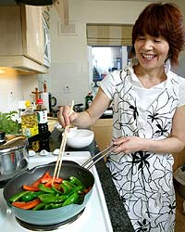
Why do many women still aspire to be housewives?
https://www.google.com.hk/search?safe=off&hl=en&biw=1090&bih=611&site=imghp&tbm=isch&sa=1&q=kurihara+harumi&oq=kurihara+harumi&gs_l=img.3..0j0i24l2.41997.44904.0.45168.15.10.0.3.3.0.266.1295.0j2j4.6.0....0...1c.1.43.img..6.9.1328.DMV40nLiwX8#facrc=_&imgdii=_&imgrc=6w73lkLpfv4hjM%253A%3BbUG3HmgXoDwTdM%3Bhttp%253A%252F%252Fi.telegraph.co.uk%252Fmultimedia%252Farchive%252F01043%252Fwine-graphics-2004_1043531a.jpg%3Bhttp%253A%252F%252Fwww.telegraph.co.uk%252Ffoodanddrink%252F4816341%252FThe-sun-rises-on-the-Japanese-Delia.html%3B200%3B250

Slide 14
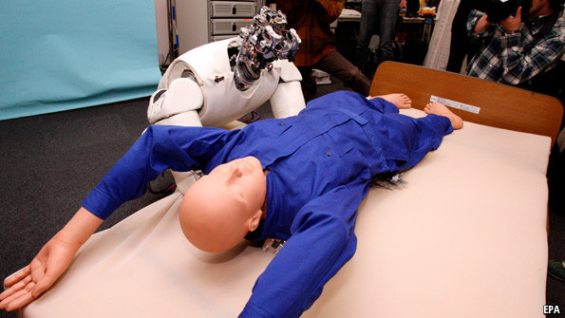
How is Japan managing its elder care problem?
https://www.google.com.hk/search?safe=off&hl=en&biw=1090&bih=611&site=imghp&tbm=isch&sa=1&q=robot+elder+care&oq=robot+elder+care&gs_l=img.3..0i24.90972.94556.0.94596.16.12.0.3.3.1.309.1992.0j3j4j2.9.0....0...1c.1.43.img..5.11.1761.nnuSj_VNd_A#facrc=_&imgdii=_&imgrc=kEd-S-eiq-2jQM%253A%3BwjXb1X7PfPYa2M%3Bhttp%253A%252F%252Fcdn.static-economist.com%252Fsites%252Fdefault%252Ffiles%252Fimages%252F2013%252F05%252Fblogs%252Fbabbage%252F20130511_stp502.jpg%3Bhttp%253A%252F%252Fwww.economist.com%252Fblogs%252Fbabbage%252F2013%252F05%252Fautomation-elderly%3B595%3B335

Slide 15
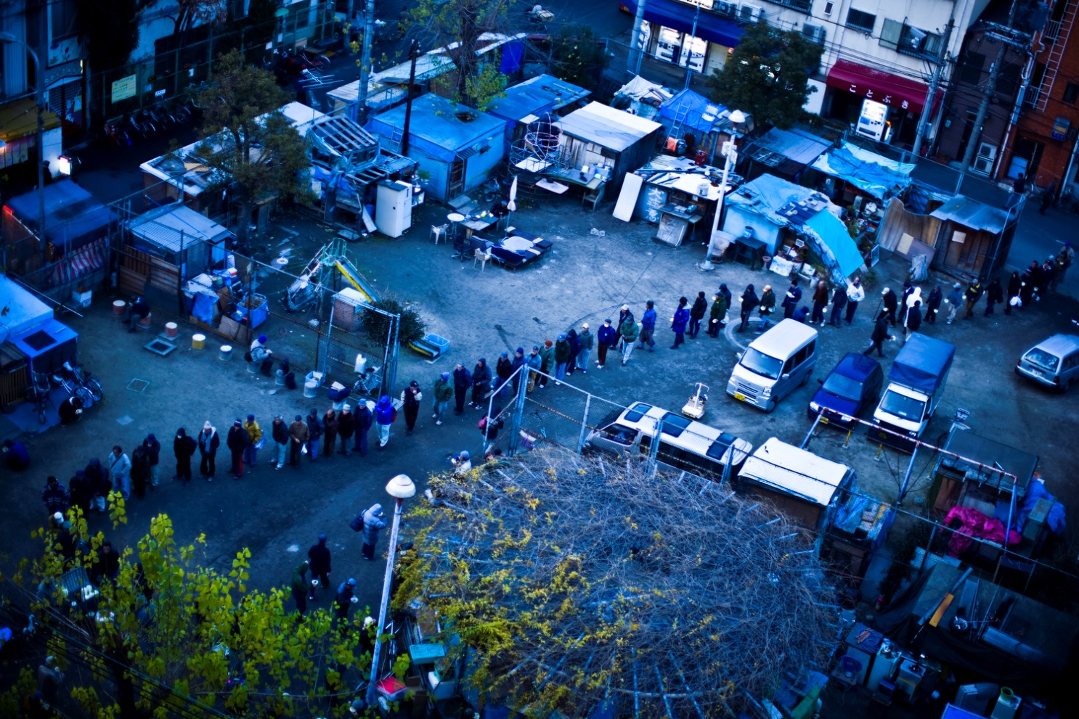
Why are there so many homeless people and why are they hidden in certain urban neighborhoods?
http://www.newyorker.com/online/blogs/photobooth/2012/12/photos-japan-jobs-crisis-shiho-fukada.html#slide_ss_0=1

Slide 16
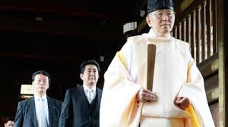
Why do Japanese Prime Ministers insist on visiting Yasukuni shrine? 靖国神社
http://www.google.com.hk/imgres?imgurl=&imgrefurl=http%3A%2F%2Fvovworld.vn%2Fen-us%2FNews%2FChina-Russia-criticize-Japanese-PMs-visit-to-Yasukuni-Shrine%2F206056.vov&h=0&w=0&tbnid=M45NBypndeAgDM&zoom=1&tbnh=168&tbnw=300&docid=Ozb8kOyjc4NZhM&hl=en&tbm=isch&ei=GPlsU4DJB8_q8AWgxoHQCQ&ved=0CAUQsCUoAQ

Slide 17
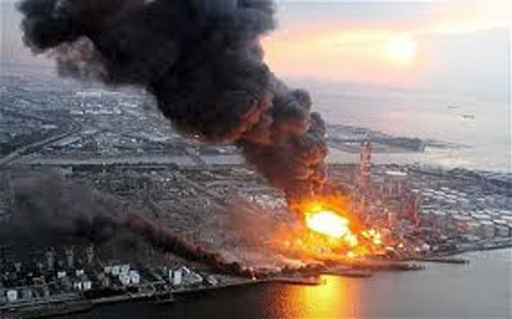
In such a developed country, how could a major electric company lose control of their nuclear reactor?
http://www.greatbarrierreef.org.au/fukushima/

Slide 18
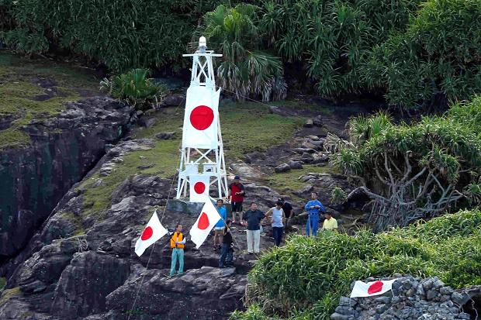
Why do some people insist that the Diaoyutai islands belong to Japan? Who are those people?
http://www.thetimes.co.uk/tto/news/world/asia/article3512344.ece

Slide 19
What is Japanese studies?
Japanese studies as an area studies encourages inter-disciplinary approaches in pursuing knowledge and emphasizes multiple angles and perspectives in analyzing Japan.
Japanese studies departments can be found at major universities worldwide such as Oxford University, Cambridge University, Peking University, and the National University of Singapore.

Slide 20
What will I learn at the Department of Japanese Studies, CUHK?
Our Department emphasizes the study of Japanese society, culture, and language as an integrated package.
We expect students to develop a specialized area of knowledge within Japanese studies through a final-year research project produced through close interaction with a supervisor.
We emphasize experiential learning through our mandatory one-year exchange program in Japan, and we encourage short-term programs and internships.

Slide 21
Why should I choose this programme?
  Excellent and dedicated teaching staff (Award winning)
  Unrivaled success at the Japanese language proficiency examination (N1) (high passing rate)
  Guaranteed exchange experience at top universities in Japan
  Balanced curriculum that teaches Japanese studies and language.

Slide 22
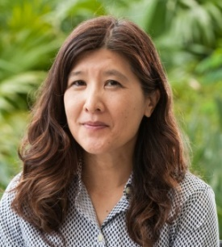
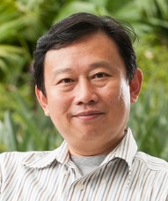
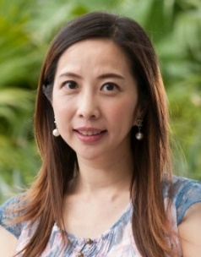
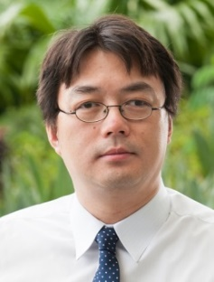
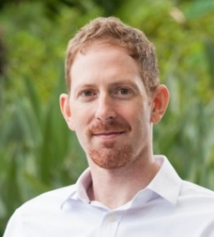
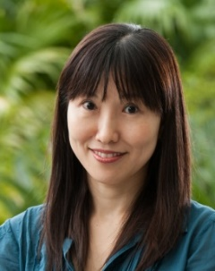
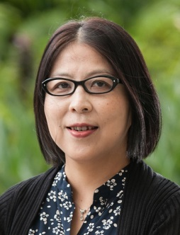
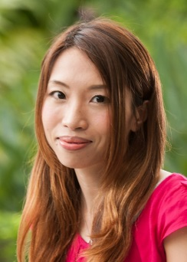
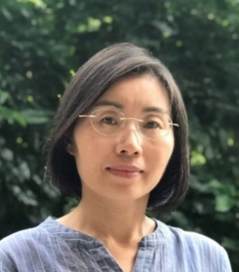
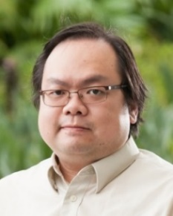
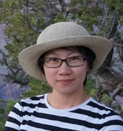
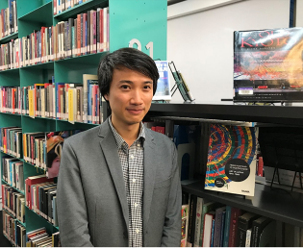
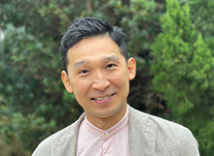
Caring teachers who are international experts in their field
Chair Prof. Ben Ng Prof. Kinnia Yau Prof. Ho Chi Ming Prof. Jeremy Prof. Nana Gagne
Prof. Lynne Nakano Ph.D. (Princeton) Ph.D. (Tokyo) Ph.D. (Tsukuba) Yellen Ph.D. (Yale)
Ph.D. (Yale) History Film Studies Linguistics Ph.D. (Harvard) Anthropology
Anthropology History
Dr. Sanae Ueda Dr. Reijiro Aoyama Ms. Winkki Choi Dr. Carol Guo Mr. Henry Lau Dr. Chalyn Lin Dr. Simon Tu
Ph.D. (Kyoto U Ph.D. (Peking) Ph.D. MA (GRIPS) (Niigata) MA (CUHK) Ph.D. (CUHK) Ph.D. (CUHK)
of Foreign
Studies)

Slide 23
Japanese Language Proficiency Test (N1) Results
Year | Applicants | No. of Students who passed | Percentage
2010 | 29 | 26 | 89.66%
2011 | 27 | 24 | 88.89%
2012 | 26 | 24 | 92.31%
2013 | 21 | 18 | 85.71%
2014 | 29 | 24 | 82.76%
2015 | 26 | 22 | 84.6%
2016 | 24 | 20 | 83.3%
2017 | 25 | 24 | 96%
2018 | 27 | 25 | 93%
2019 | 26 | 18 | 70%
2021 | 24 | 22 | 91.6%

Slide 24
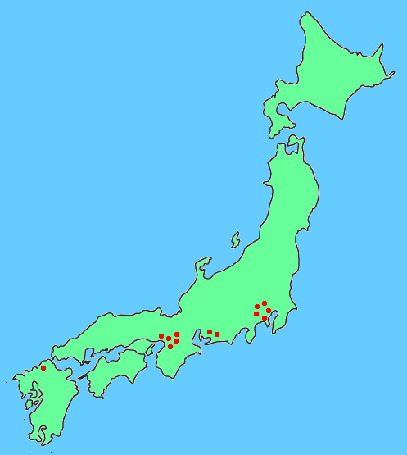
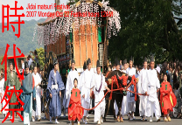
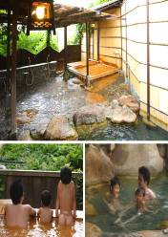
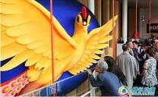

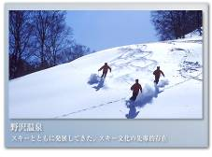
Exchange Partners Universities in Japan
北海道大學 (北海道)
上智大學 (東京)
東京外國語大學 (東京)
立教大學 (東京)
東京學藝大學 （東京）
一橋大學（東京）
明治大學（東京）
早稻田大學 (東京)
杏林大學 (東京)
學習院大學 (東京)
筑波大學 (茨城県)
名古屋大學 (名古屋)
名古屋商科大學 (名古屋)
立命館大學（京都）
京都大學（京都）
關西外國語大學 (大阪)
關西學院大學 (大阪)
大阪國際大學 (大阪)
大阪大學（大阪）
廣島大學 (廣島縣)
九州大學（九州）

Slide 25
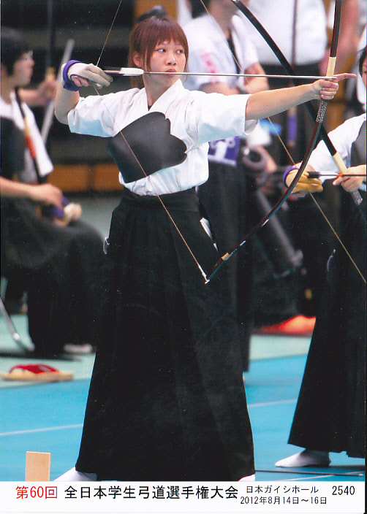
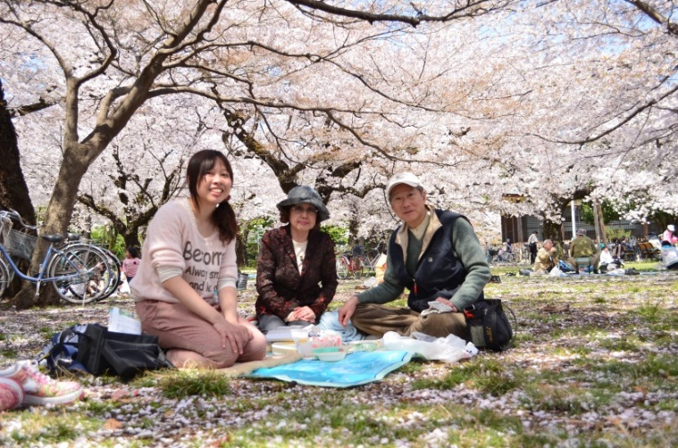
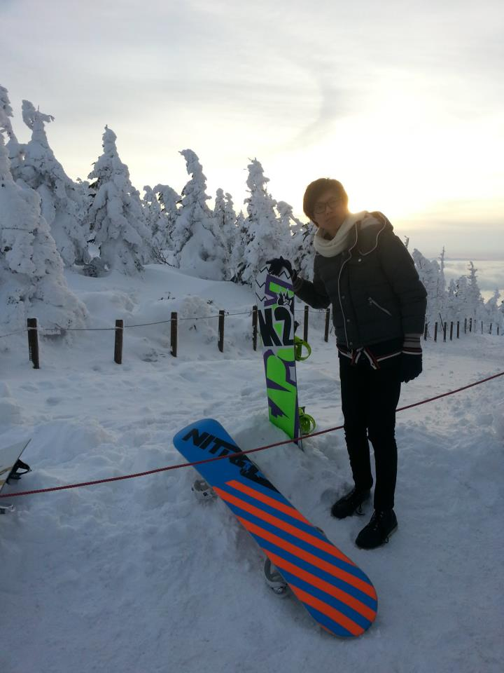
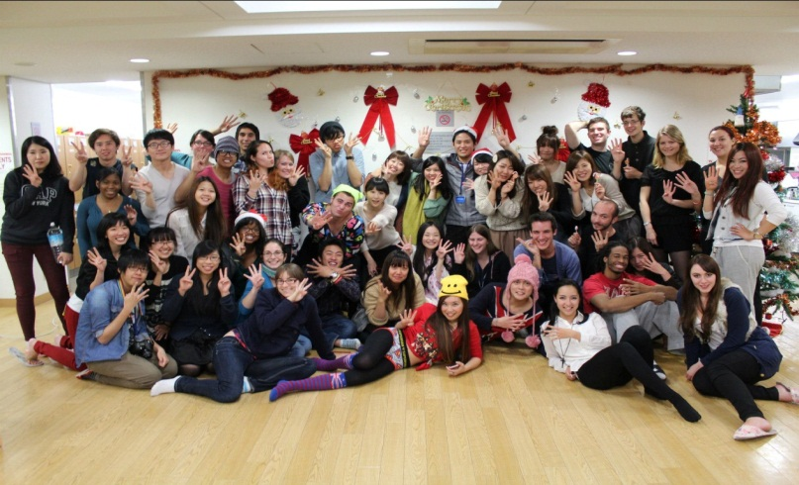
Year of Exchange

Slide 26
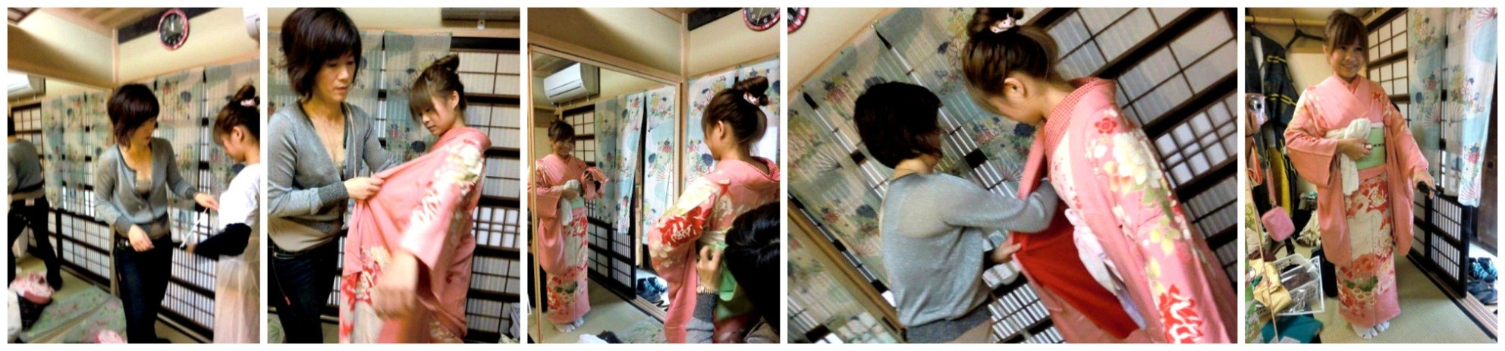
Year of exchange

Slide 27
Exchange year
Study Japanese language according to level
Take content courses in English or Japanese (Examples: Psychology, Business, Japanese religion, Japanese economy)
Participate in club activities along with Japanese students (recent examples: orchestra, archery, baseball, tea ceremony, glider club)
Join activities, homestays, and trips organized for exchange students; meet people from around the world.

Slide 28
Examples of JAS Final-Year Projects
Japanese Corporate Culture: Female Workers Views on Career Advancement
Japanese Fashion Magazines and the Construction of Body Images among University Students
Song of Earth: Case Study of an Environmental Club
Meanings of Fan Behaviors: Female Fans of Johnny’s Idol Groups

Slide 29
Internship programmes
Our internship partners included: JAL, Mitsui, Mizuho, Resona Bank (Japan), Lee Kum Kee, Hyogo Business & Tourism Centre (HK), Vector Group, etc.
Please note that the internships are available on a competitive basis
Programme duration: summer, 2 weeks – 2 months

Slide 30
Advantages of joining
Internship Programme
Gain working experience before you graduate
Prepare a Curriculum Vitae which is attractive to your potential employer(s) in the future
→ Increase the possibility of being hired
Better understanding of a particular field
Motivation for further studies

Slide 31
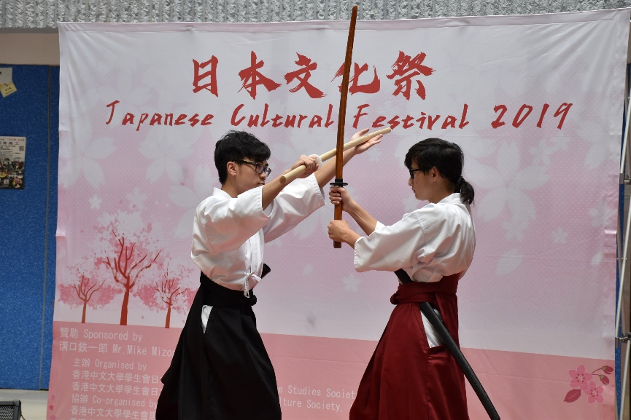
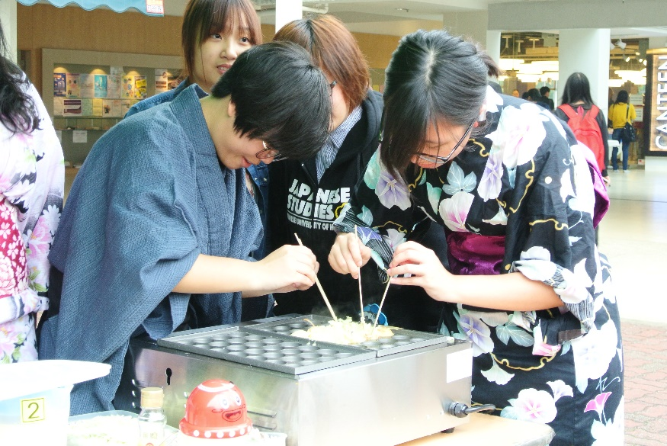
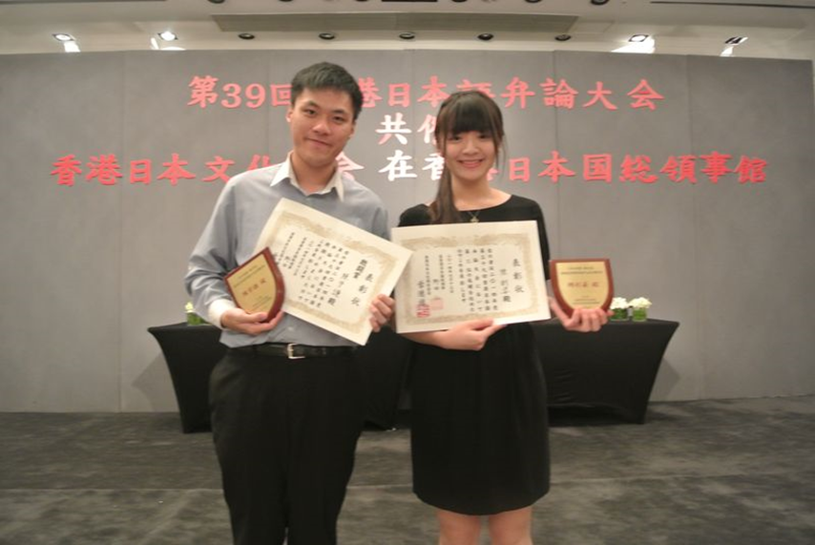
Student Activities
Cultural Festival and Japanese Speech Contest

Slide 32
Streams
Stream in Japanese Business and Management
  Combines Japanese Studies and Management Department courses
  Training in business, management, and Japanese language
Stream in Japan in Global Perspective
  Combines Japanese Studies, Sociology, and Anthropology courses
  Provides inter-disciplinary training in understanding Japan’s place in the region and the world
  Stream in Japanese Language and Linguistics
  Combines Japanese Studies and Linguistics courses
  Streams involve taking courses in other departments such as Anthropology, Linguistics, Management, Sociology, etc.
Notes:
32
32

Slide 33

Scholarship received by JAS major students (2019-2020)
Scholarships | No. of Recipients | Amount per head/per year
JASSO | 10 | JPY800,000
Mizoguchi Scholarship | 1 | HK$30,000
Nissin Scholarship | 5 | HK$6,000
Resona Scholarship | 4 | HK$10,000
Japan Society | 1 | HK$10,000
College Scholarships | 6 | HK$16,000*
CUHK Exchange Travel Grant | 20 | HK$1,500
OAL Exchange Scholarship | 6 | HK$228,000*
Total 53 HK$944,000

Slide 34
Yasumoto Financial Aid Funding Allocation (2022-2023)
Student | Funding Allocated
Student 1 | $35,600
Student 2 | $50,700
Student 3 | $66,000
Student 4 | $57,400
Student 5 | $13,000
Student 6 | $16,800
Student 7 | $44,700
Student 8 | $69,000
Student 9 | $26,800
Student 10 | $38,000
Total | $418,000
Notes:
34

Slide 35
畢業生就業動向Employment trends
Employment rate就業/升學率：100%
（摘自Employment Survey of 2017-2019Graduates）

Slide 36
Career Paths
Private Sector | Public Service and Semi-Quasi Govt. Org. | Further Education
International Banking & Finance (Mitsui, Mizuho, Nomura) | Government service (e.g. AO, EO) | MBA
Japanese firms (Sanrio, Bandai, ANA) | Educators, University and Secondary School | Law Degrees
Multi-national firms (PricewaterhouseCoopers, Ernst & Young, Warner Bro.) | Police Force | MA (Georgetown, University of Tokyo, etc)
Local firms and self-starting entrepreneurs (IT, trading, entertainment) | Tourism | Ph.D. (Waseda, Tsukuba, U. of Pittsburgh etc)

Slide 37

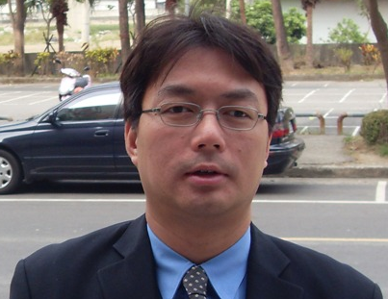

1995 Graduate ：何志明
香港中文大學 · 日本研究系 · 副教授
Prof. Ho Chi Ming
Notes:
37

Slide 38

1997 Graduate ：文立 Lap
Diyixian.com. Limited 行政總裁

Slide 39
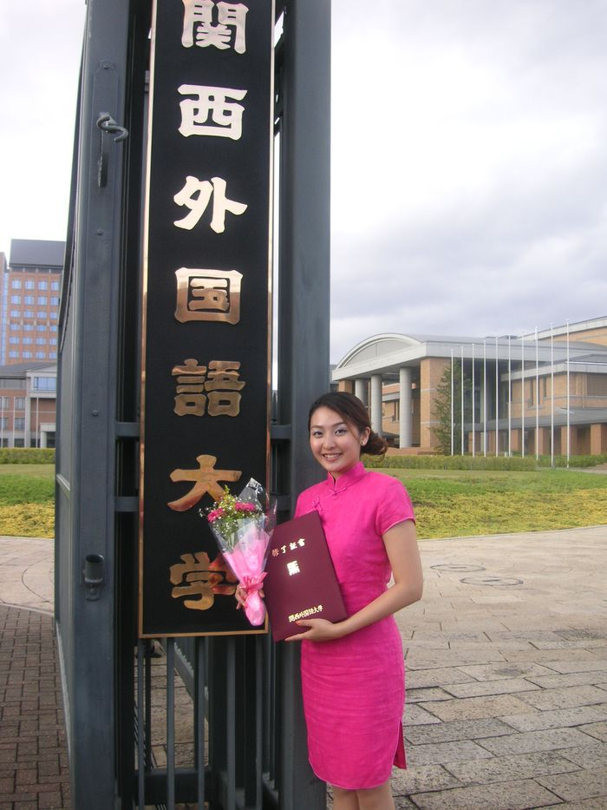
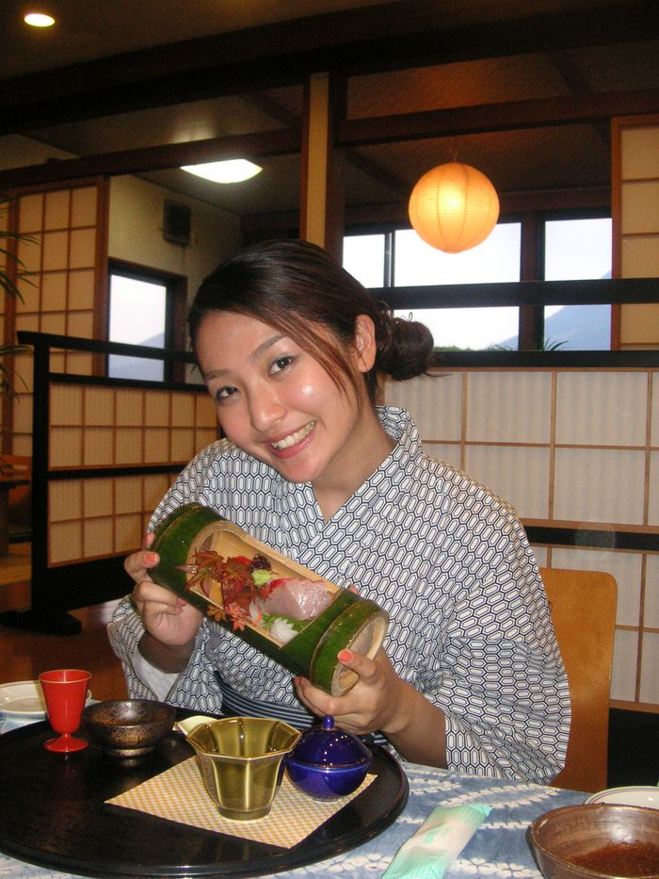
2008 Graduate ：賀穎君 Kimmy
高級政務主任(Senior Administrative Officer)
政府資訊科技總監辦公室 (策略發展)
Notes:
39

Slide 40
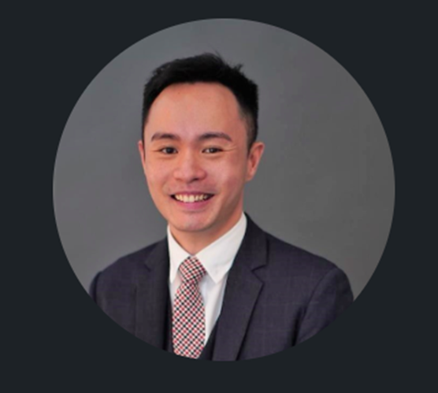
2009 Graduate : 李欣然 Sunny
Manager, The Hongkong and Shanghai Hotels (under Peninsula Hotel Group)

Slide 41
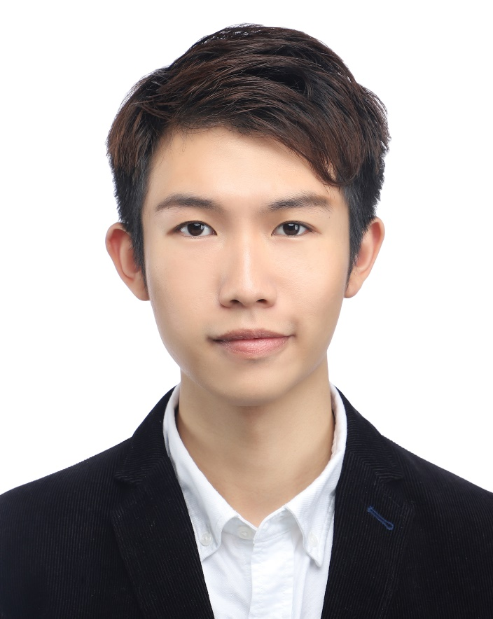
2019 Graduate : 錢冠廷 Keni
Official Languages Officer 法定語文主任
Civil Service Bureau, HKSAR Government
香港特別行政區政府 公務員事務局

Slide 42
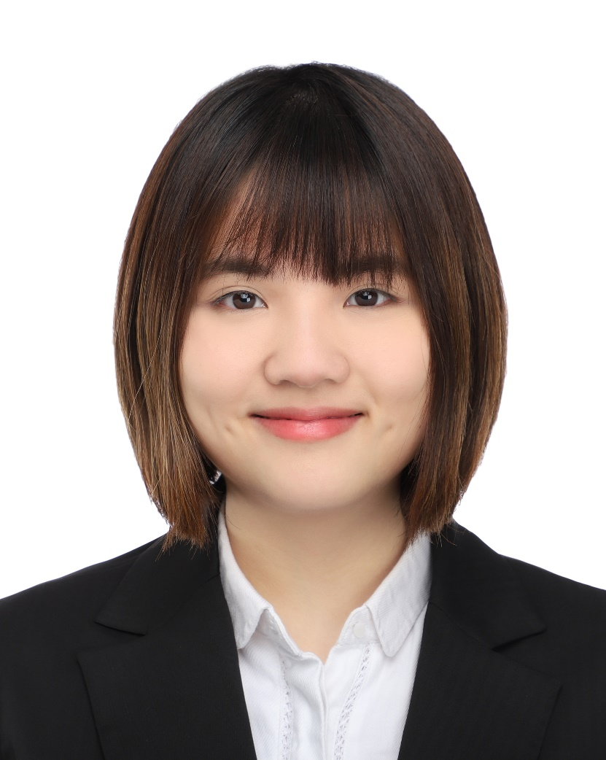
2019 Graduate : 何詠琳 Minnie
Customer Service Associate, Dow Jones

Slide 43
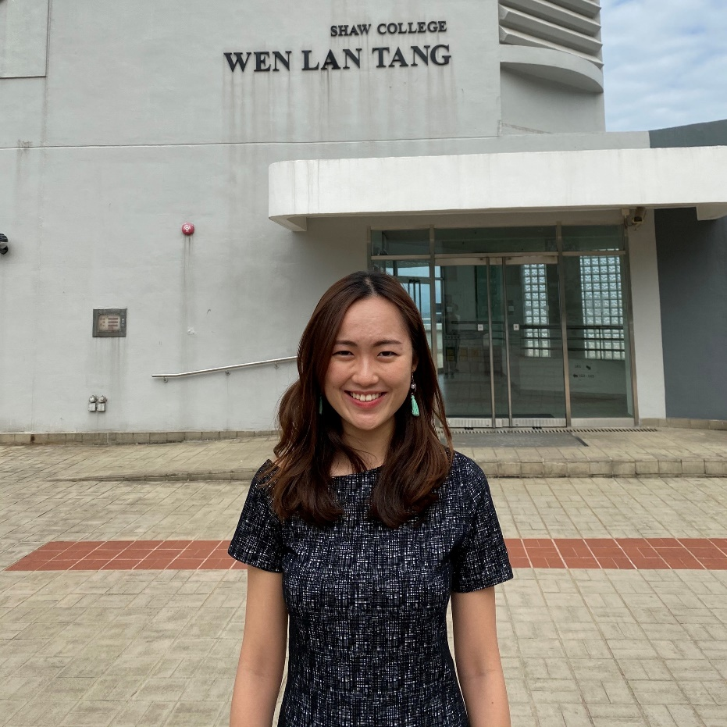
2019 Graduate : 周子琳 Jenna
Studying in the Juris Doctor Programme, CUHK (from 2019)

Slide 44
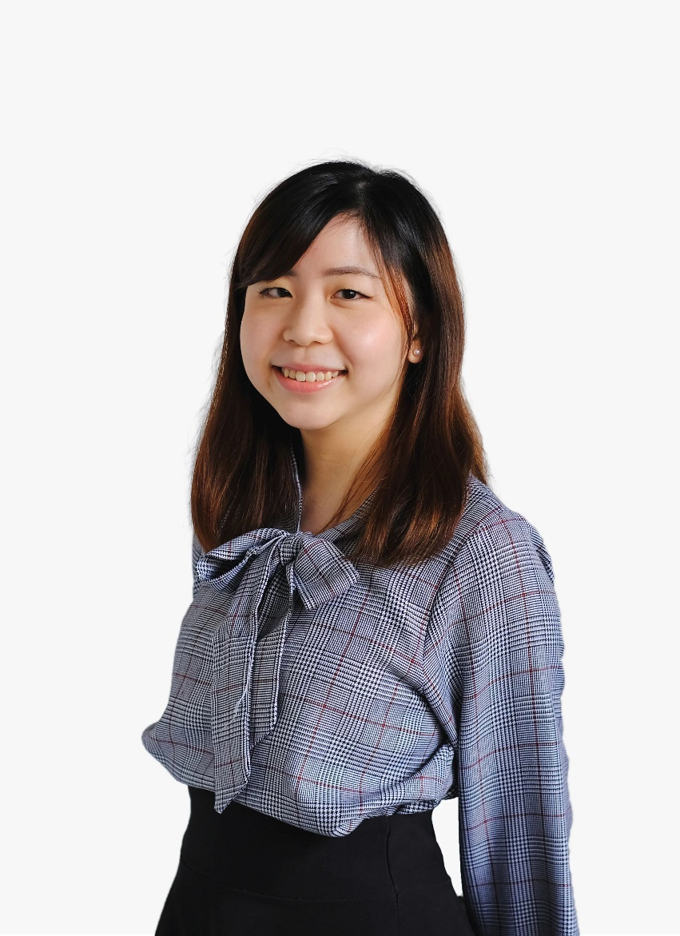
2019 Graduate : 譚懿德 Caro
Studying in the Master of Journalism Programme HKU (from 2020)

Slide 45
Entrance Requirements
Best 5 subjects
University admission requirements: 3 in Chinese, 3 in English, 2 in Math, 2 in Liberal Studies + 3 in best 2 electives (Japanese language and M1/M2 are mutually exclusive, i.e. only one can be counted as elective but not both)

Slide 46
JAS Admission Statistics 2021
(Best 5 subjects)
 |  | Upper Q | Median | Lower Q
JS4068 | Japanese Studies | 26 | 24 | 23

Slide 47
Non-JUPAS (local and non-local)
Quota varies over years
IB score: 33
GCE A-Level: AAB or above

Slide 48
Senior-year Entrants
Quota: 5 (2023)
Study 2 years to graduate (no exchange year)
Students can apply for one-term/one-year exchange from the University central quota. Students involved must apply for suspension of study and extension of expected graduation date.
Minimum CGPA: 3.5

Slide 49
Japanese language?
The Department accommodates all levels of Japanese language ability from incoming students.
Having studied Japanese language before is not necessarily an advantage in gaining admission to the Department (for 4 year program).
Rather, the Department values students who have taken the initiative to develop and educate themselves.

Slide 50
Interview: July 2023
The Department will invite some 60 students to attend interviews following the release of JUPAS results in July 2023.
Students who show that they are outstanding in the areas below may be elevated in our priority ranking:
  Ability to express oneself clearly in English
  Curiosity and self-motivation to learn
  Evidence of self-directed study and development
  Capacity for critical and independent thinking
  Leadership and teamwork skills

Slide 51
Thank you for your interest in our Department!
We encourage you to apply!
For more information, please contact:
japanese-studies@cuhk.edu.hk or call 3943 6563

