Slide 1
4. Expectation and Variance Joint PMFs

Slide 2
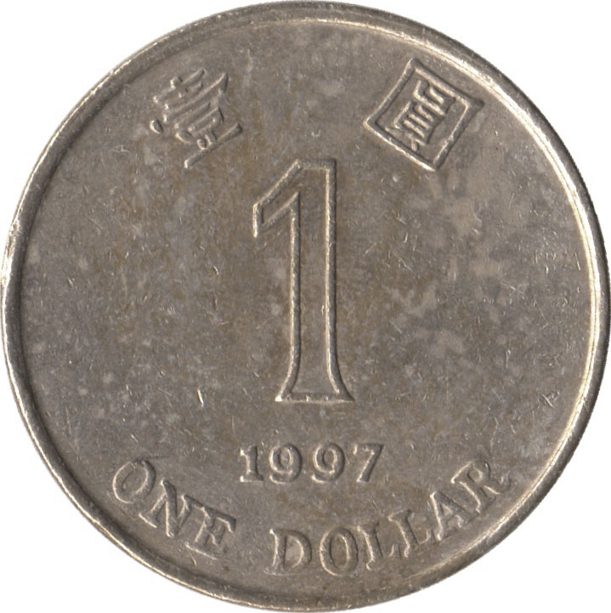

Expected value
The expected value (expectation) of a random variable X with p.m.f. p is
E[X] = ∑_{x} x p(x)
Example
N = number of Hs

Slide 3
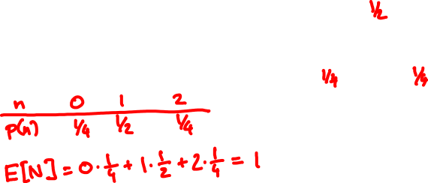
Expected value
Example
N = number of Hs
The expectation is the average value the random variable takes when experiment is done many times

Slide 4
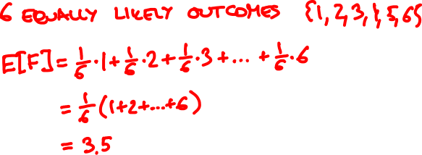

F = face value of fair 6-sided die

Slide 5
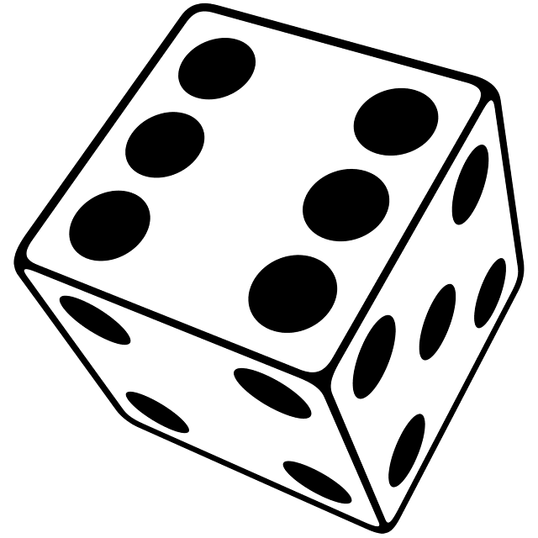

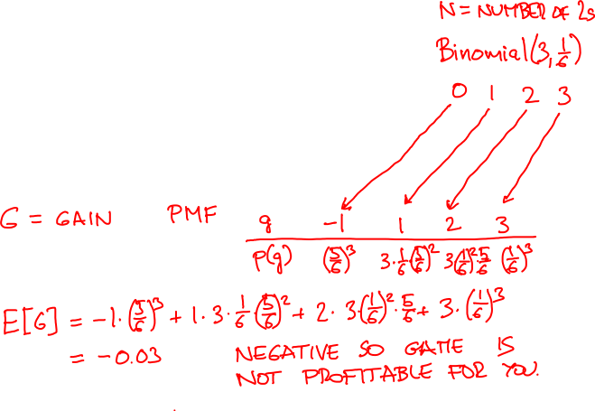
If appears k times, you win $k.
If it doesn’t appear, you lose $1.

Slide 6



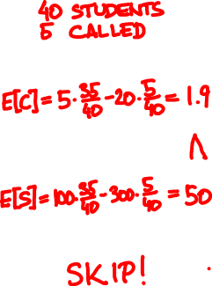
Utility
Should I go to tutorial?
not called
called
+5
-20
Come
+100
-300
Skip
F
35/40
5/40

Slide 7
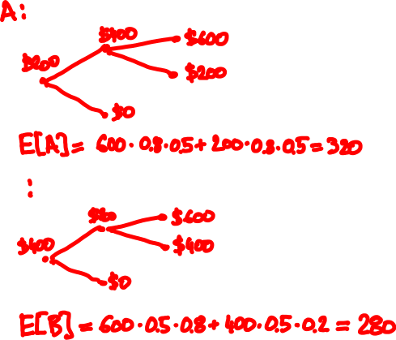
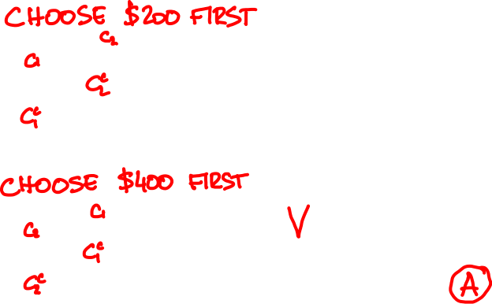
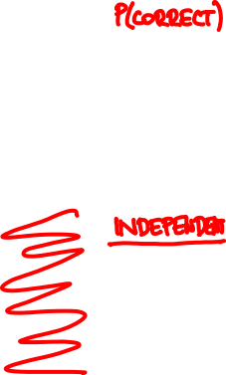
80%
50%

Slide 8
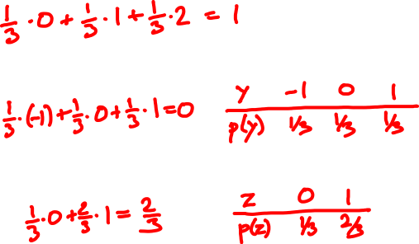
Expectation of a function
x
0 1 2
p.m.f. of X:
p(x)
1/3 1/3 1/3
E[X] =
E[X – 1]=
E[(X – 1)²]=

Slide 9
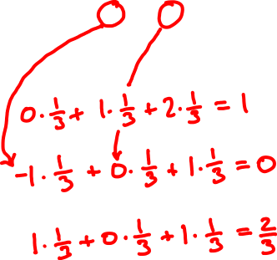
Expectation of a function, again
x
0 1 2
p.m.f. of X:
p(x)
1/3 1/3 1/3
E[X] =
E[X – 1]=
E[(X – 1)²]=
E[f(X)] = ∑_{x} f(x) p(x)

Slide 10

1km
☀️
⛈
🚶🏻‍♀️
🚍
60%
40%
5km/h
30km/h

Slide 11
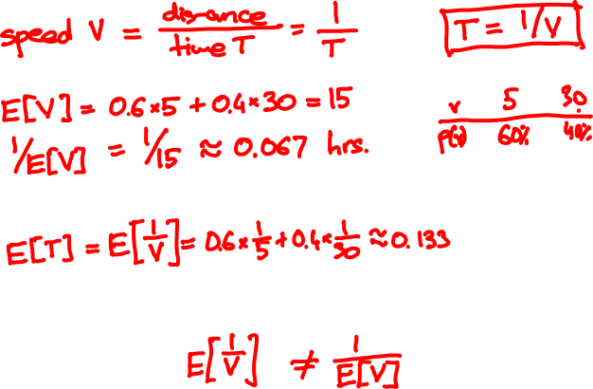

Slide 12

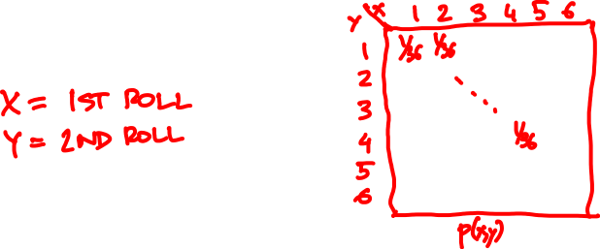
Joint probability mass function
The joint PMF of random variables X, Y is the bivariate function
p(x, y) = P(X = x, Y = y)
Example

Slide 13
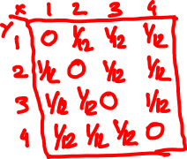
There is a bag with 4 cards:
1
2
3
4
You draw two without replacement. What is the joint PMF of the face values?

Slide 14

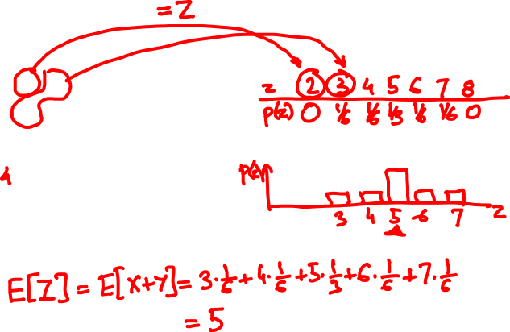
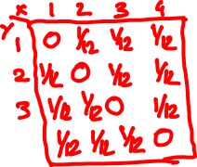
What is the PMF of the sum?
What is the expected value?

Slide 15
PMF and expectation of a function
Z = f(X, Y) has PMF
p_{Z}(z) = ∑_{x, y: f(x, y) = z} p_{XY}(x, y)
and expected value
E[Z] = ∑_{x, y} f(x, y) p_{XY}(x, y)

Slide 16
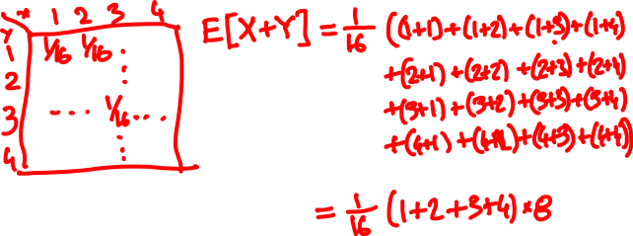
What if the cards are drawn with replacement?

Slide 17
Marginal probabilities
X
1
2
3
4
Y
0 | 1/12 | 1/12 | 1/12
1/12 | 0 | 1/12 | 1/12
1/12 | 1/12 | 0 | 1/12
1/12 | 1/12 | 1/12 | 0
1/4
1/4
1/4
1/4
1
2
P(Y = y) = ∑_{x} P(X = x, Y = y)
3
4
1/4 | 1/4 | 1/4 | 1/4
1
P(X = x) = ∑_{y} P(X = x, Y = y)

Slide 18
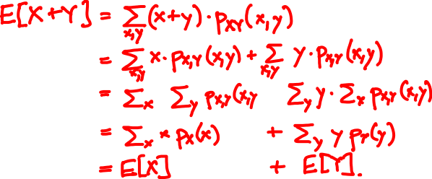

Linearity of expectation
For every two random variables X and Y
E[X + Y] = E[X] + E[Y]

Slide 19
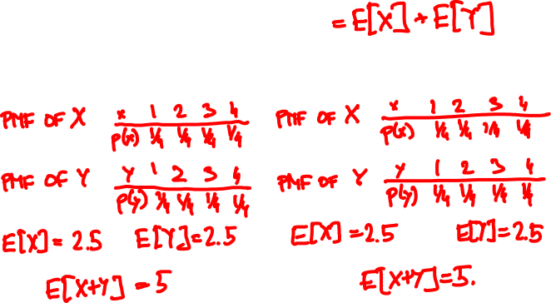
1
2
3
4
E[X + Y]
without replacement
with replacement

Slide 20

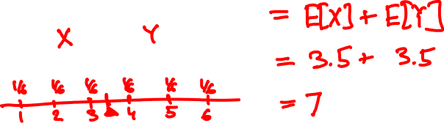
E[X + Y] = ?

Slide 21
The indicator (Bernoulli) random variable
Perform a trial that succeeds with probability p and fails with probability 1 – p.
x
0 1
p(x)
p(x)
1 – p p
p = 0.5
If X is Bernoulli(p) then
E[X] = p
p(x)
p = 0.4

Slide 22
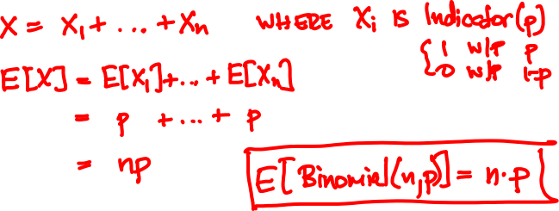
Mean of the Binomial
Binomial(n, p): Perform n independent trials, each of which succeeds with probability p.
X = number of successes

Slide 23
Binomial(10, 0.5)
Binomial(50, 0.5)
Binomial(10, 0.3)
Binomial(50, 0.3)

Slide 24
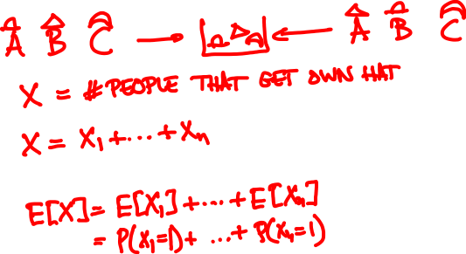


n people throw their hats in a box and each picks one out at random. On average, how many get back their own hat?

Slide 25
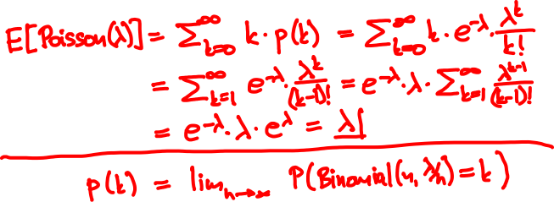

Mean of the Poisson
Poisson(λ) approximates Binomial(n, λ/n) for large n
p(k) = e^{-λ} λ^{k}/k!
k = 0, 1, 2, 3, …

Slide 26


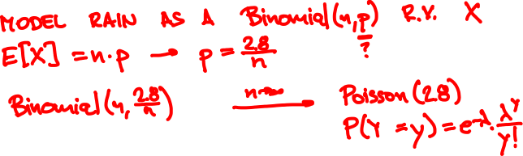
Raindrops
Rain is falling on your head at an average speed of 2.8 drops/second.
0
1

Slide 27

Raindrops
0
1
Number of drops N is Binomial(n, 2.8/n)

Slide 28

Rain falls on you at an average rate of 3 drops/sec.
When 100 drops hit you, your hair gets wet.
You walk for 30 sec from MTR to bus stop.
What is the probability your hair got wet?

Slide 29
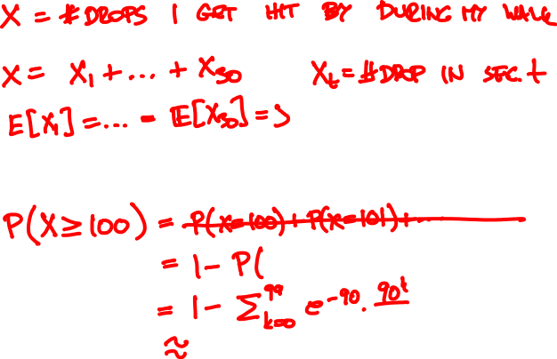
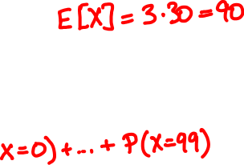

https://stattrek.com/online-calculator/poisson.aspx

Slide 30

Investments
You have three investment choices:
A: put $25 in one stock
B: put $½ in each of 50 unrelated stocks
C: keep your money in the bank
Which do you prefer?

Slide 31
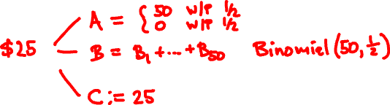
Investments
Probability model
doubles in value with probability ½
Each stock
loses all value with probability ½
Different stocks perform independently

Slide 32
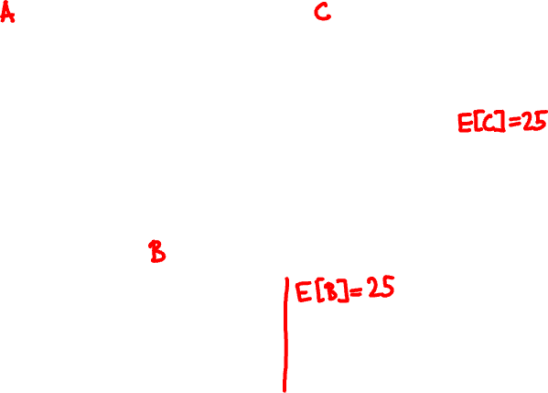
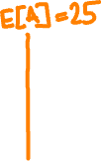

Slide 33
Variance and standard deviation
Let μ = E[X] be the expected value of X.
The variance of X is the quantity
Var[X] = E[(X – μ)²]
The standard deviation of X is σ = √Var[X]
It measures how close X and μ are typically.

Slide 34
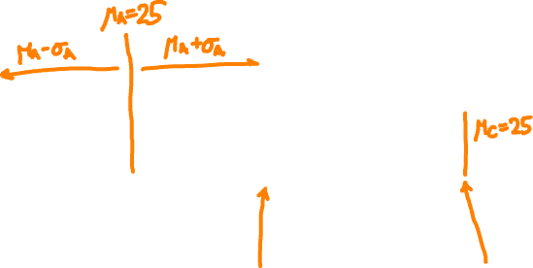
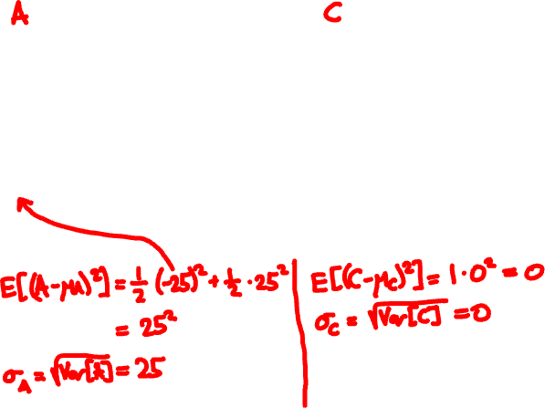

Slide 35
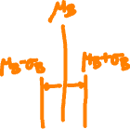
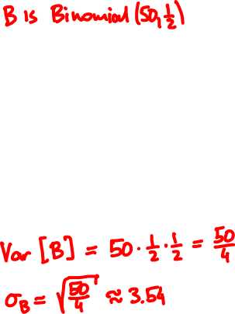
Most of the probability mass is within a few σs from μ
Var[Binomial(n, p)] = np(1 – p)
More on this in Lecture 9…

Slide 36
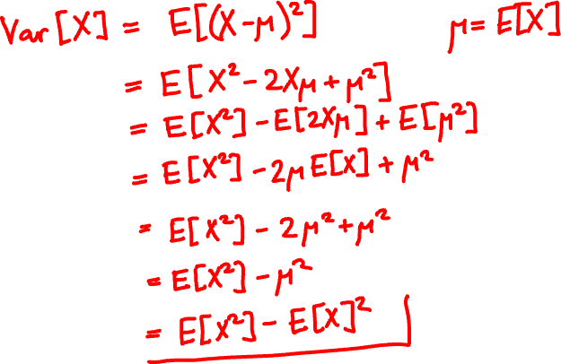
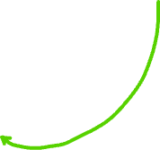
Another formula for variance

Slide 37
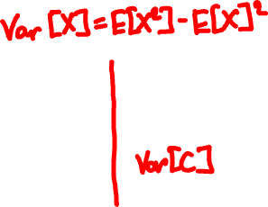
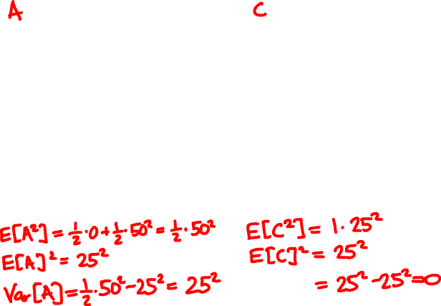

Slide 38

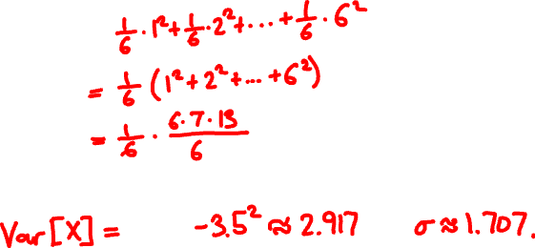
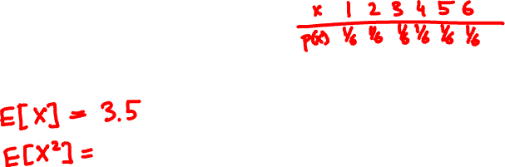
E[X] = ?
Var[X] = ?

