Slide 1
1. Probability and Counting

Slide 2
Alice
Bob

Slide 3
Can Alice and Bob connect?
In uncertain situations we want a number saying how likely something is
probability

Slide 4
The cheat sheet
1. Specify all possible outcomes
2. Identify event(s) of interest
3. Assign probabilities
4. Shut up and calculate!

Slide 6
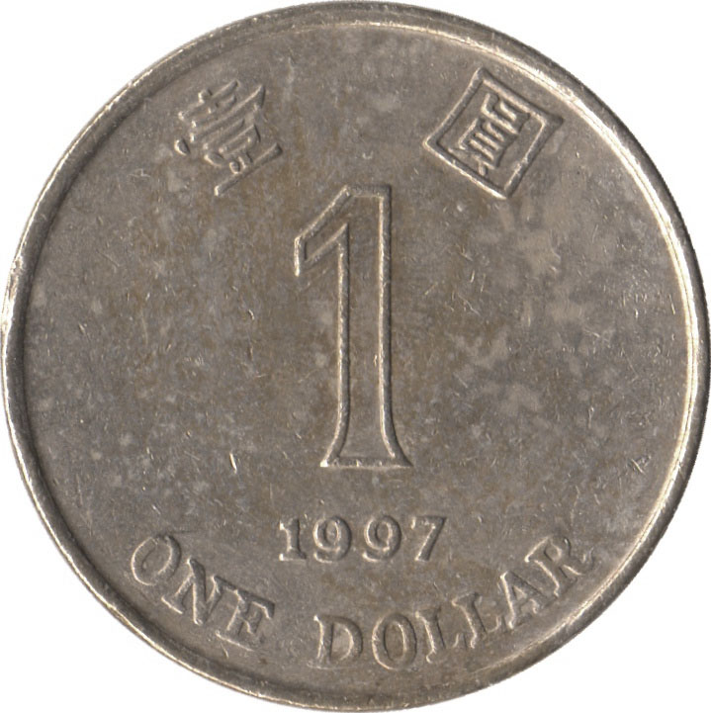
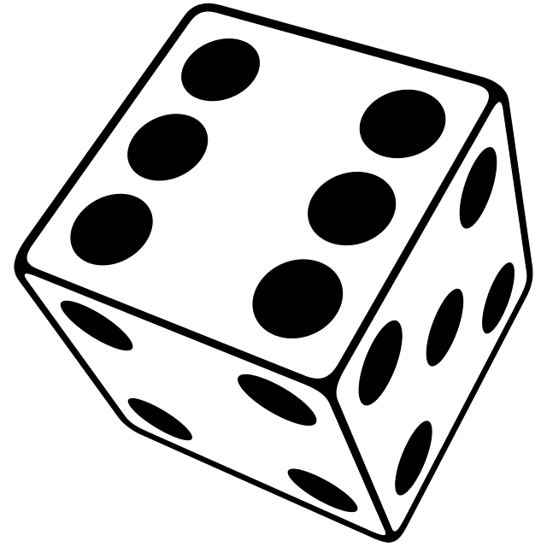
Sample spaces
The sample space is the set of
all possible outcomes.
Examples

Slide 7
Sample spaces
Ω = { HHH, HHT, HTH, HTT
THH, THT, TTH, TTT }
three coin tosses
Ω = { 11, 12, 13, 14, 15, 16,
21, 22, 23, 24, 25, 26,
31, 32, 33, 34, 35, 36,
41, 42, 43, 44, 45, 46,
51, 52, 53, 54, 55, 56,
61, 62, 63, 64, 65, 66 }
a pair of dice

Slide 8
Events
An event is a subset of the sample space.
Ω = { HHH, HHT, HTH, HTT
THH, THT, TTH, TTT }
Exactly two heads:
No consecutive tails:

Slide 9
Discrete probability
A probability model is an assignment of probabilities to elements of the sample space.
Probabilities are nonnegative and add up to one.
Example: three fair coins
Ω = { HHH, HHT, HTH, HTT, THH, THT, TTH, TTT }

Slide 10
Example:

Slide 11
Calculating probabilities
Exactly two heads:
A ={ HHT, HTH, THH }
P(A) =
No consecutive tails:
B = { HHT, HTH, THH, THH, THT }
P(B) =

Slide 12
Example:

Slide 13
Uniform probability law
If all outcomes are equally likely, then…
number of outcomes in A
P(A) =
number of outcomes in Ω
…and probability amounts to counting.

Slide 14
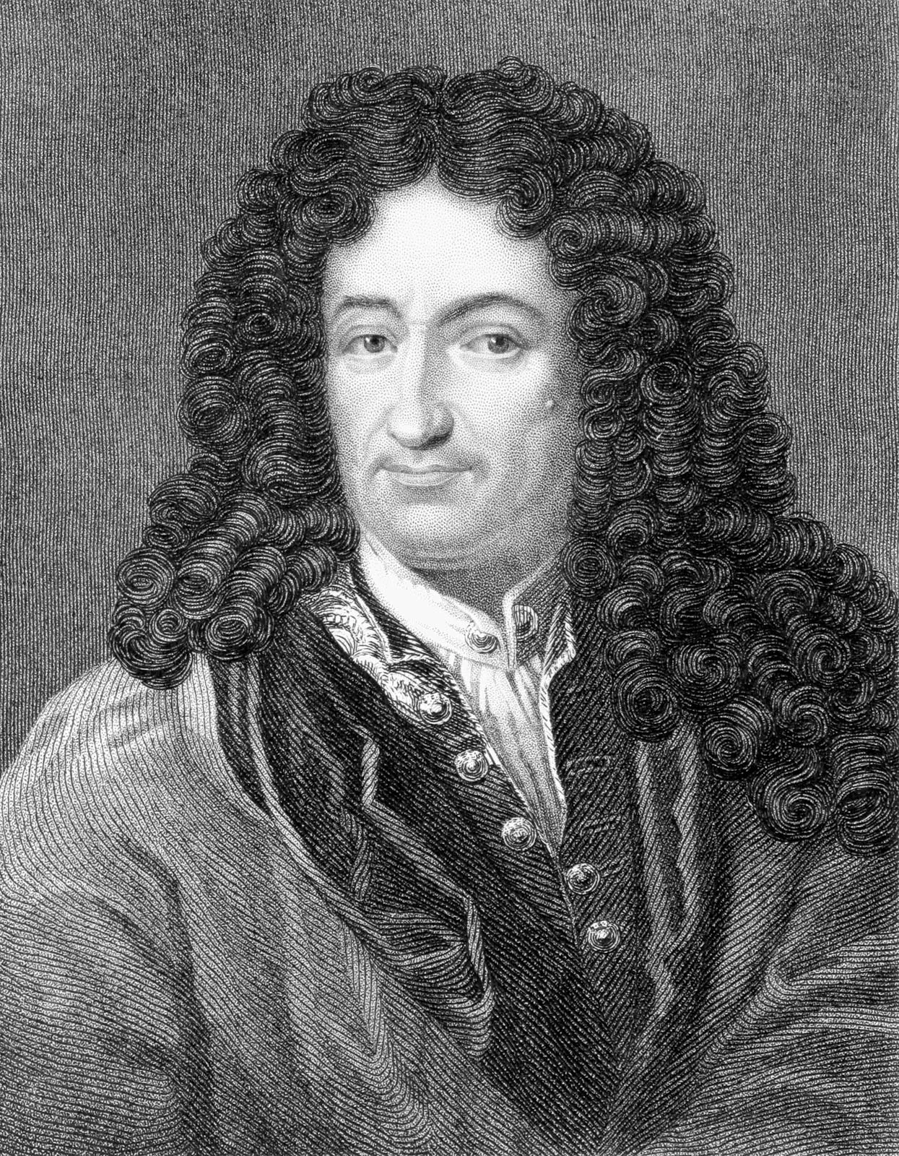
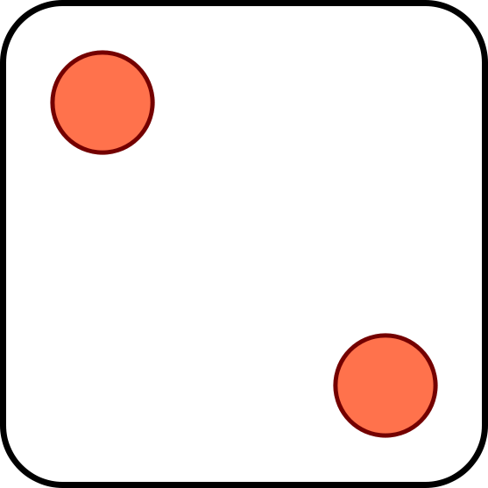
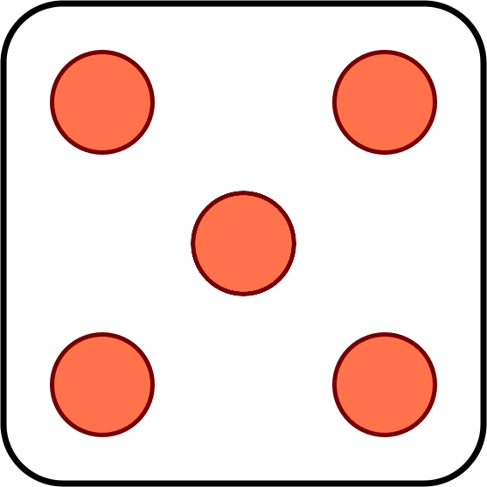
+
Is the sum of two die tosses more likely to equal:
A
B
C
11
12
both are equally likely

Slide 15
Product rule
Experiment 1 has n possible outcomes.
Experiment 2 has m possible outcomes.
Together there are nm possible outcomes.
Examples

Slide 16
Generalized product rule
Experiment 1 has n possible outcomes.
For each such outcome,
experiment 2 has m possible outcomes.
Together there are nm possible outcomes.
Example

Slide 17
You toss two dice. How many ways are there for the values to be different?

Slide 18
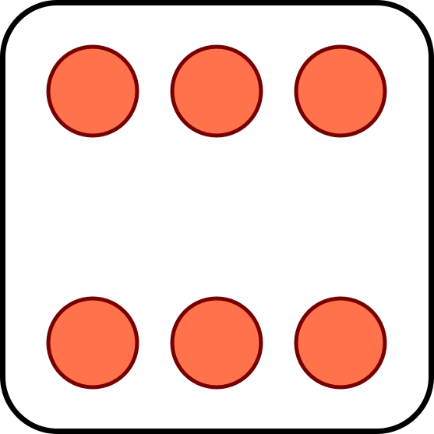
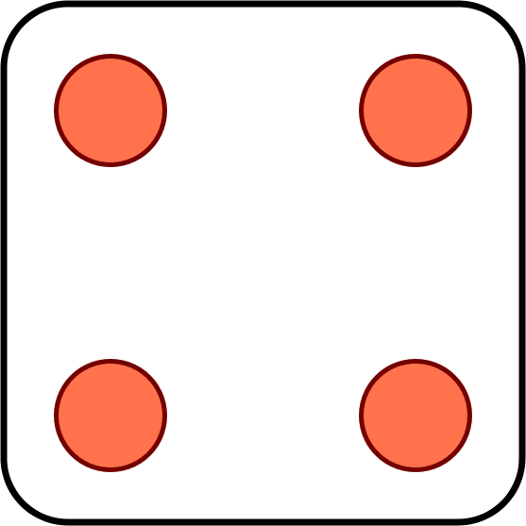
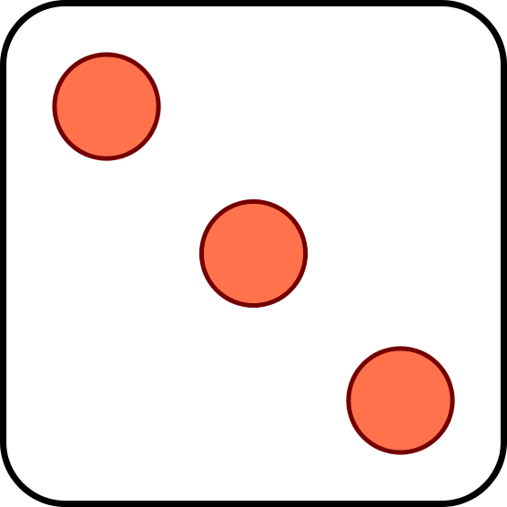
Permutations
You toss six dice. How many ways are there for all six to come out different?
The number of permutations of n different objects is

Slide 19
For two dice, the chance they come out different is
For six dice, the chance all come out different is

Slide 20
Toss two fair dice. What are the chances that…
(a) The sum is equal to 7?
(b) The sum is even?
(c) The second one is bigger?

Slide 21
11, 12, 13, 14, 15, 16,
21, 22, 23, 24, 25, 26,
31, 32, 33, 34, 35, 36,
41, 42, 43, 44, 45, 46,
51, 52, 53, 54, 55, 56,
61, 62, 63, 64, 65, 66

Slide 22
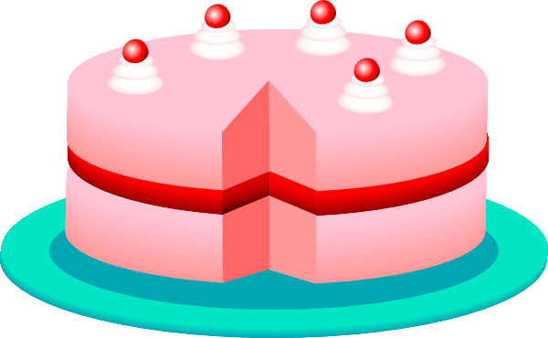
There are 3 brothers. What is the probability that
(a) All have birthdays on the same day of the week?
M T W T F S S

Slide 23
(b) All have birthdays on different days of the week?
M T W T F S S

Slide 24
(c) Exactly one birthday is on the weekend?
M T W T F S S

Slide 25
What are the chances that two people
in this room have the same birthday?
A
B
C
< 10%
≈ 50%
> 90%

Slide 27
Partitions
n
n!
(
)
=
k
k! (n - k)!
is the number of size-k subsets of a size-n set

Slide 28
Partitions and arrangements
size-k subsets of a size-n set
n
(
)
k
arrangements of k white
and n – k black balls

Slide 29
An urn has 5 white balls and 10 black balls. You draw two at random (without replacement). What is the probability that their colors are different?

Slide 30
An urn has 5 white balls and 10 black balls. You draw two at random (without replacement). What is the probability that their colors are different?

Slide 31
Partitions and arrangements
(
n
)
partitions of a size-n set into
t subsets of sizes n₁, …, n_{t}
n₁, …, n_{t}

Slide 32
Partitions and arrangements
(
n
)
arrangements of n₁ red, n₂ blue, …, n_{t} green balls
n₁, …, n_{t}

