Slide 1
5. Expectation, Variance,
Joint PMFs
ENGG 2760A / ESTR 2018: Probability for Engineers
Spring 2020

Slide 2
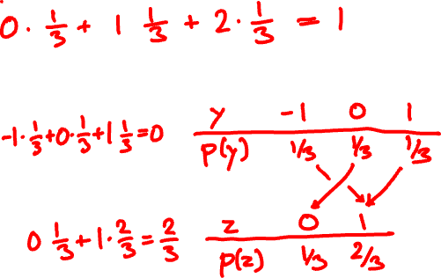
Expectation of a function
x
0 1 2
PMF of X:
p(x)
1/3 1/3 1/3
E[X] =
E[X – 1]=
E[(X – 1)²]=

Slide 3
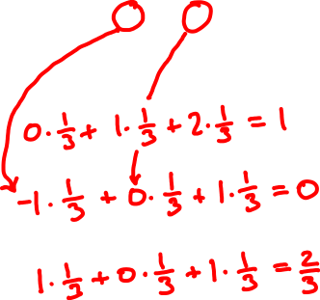
Expectation of a function, again
x
0 1 2
p.m.f. of X:
p(x)
1/3 1/3 1/3
E[X] =
E[X – 1]=
E[(X – 1)²]=
E[f(X)] = ∑_{x} f(x) p(x)

Slide 4

1km
☀️
⛈
🚶🏻‍♀️
🚍
60%
40%
5km/h
30km/h

Slide 5
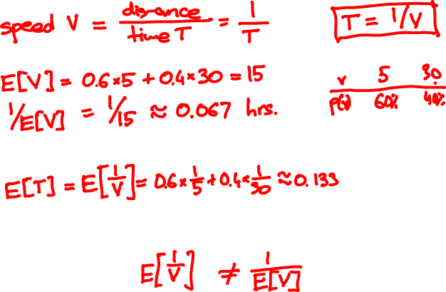

Slide 6

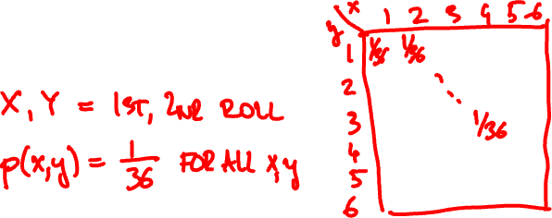
Joint probability mass function
The joint PMF of random variables X, Y is the bivariate function
p(x, y) = P(X = x, Y = y)
Example

Slide 7
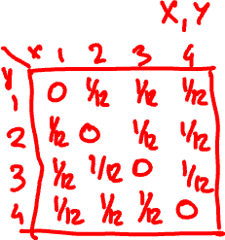
There is a bag with 4 cards:
1
2
3
4
You draw two without replacement. What is the joint PMF of the face values?

Slide 8
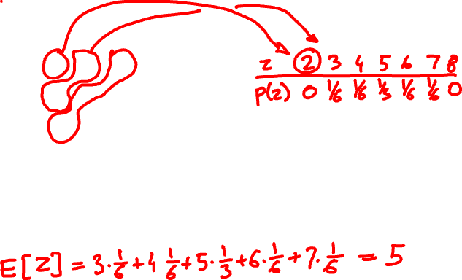
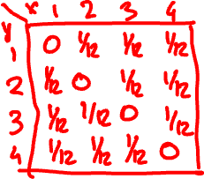
What is the PMF of the sum?
What is the expected value?

Slide 9
PMF and expectation of a function
Z = f(X, Y) has PMF
p_{Z}(z) = ∑_{x, y: f(x, y) = z} p_{XY}(x, y)
and expected value
E[Z] = ∑_{x, y} f(x, y) p_{XY}(x, y)

Slide 10
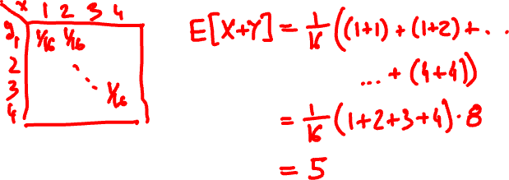
What if the cards are drawn with replacement?

Slide 11

Marginal probabilities
X
1
2
3
4
Y
0 | 1/12 | 1/12 | 1/12
1/12 | 0 | 1/12 | 1/12
1/12 | 1/12 | 0 | 1/12
1/12 | 1/12 | 1/12 | 0
1/4
1/4
1/4
1/4
1
2
P(Y = y) = ∑_{x} P(X = x, Y = y)
3
4
1/4 | 1/4 | 1/4 | 1/4
1
P(X = x) = ∑_{y} P(X = x, Y = y)

Slide 12
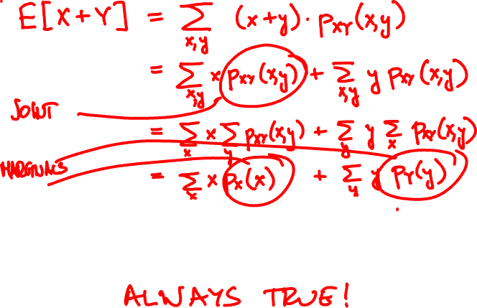
Linearity of expectation
For every two random variables X and Y
E[X + Y] = E[X] + E[Y]

Slide 13
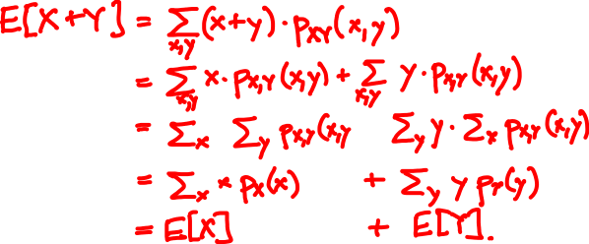

Linearity of expectation
For every two random variables X and Y
E[X + Y] = E[X] + E[Y]

Slide 14
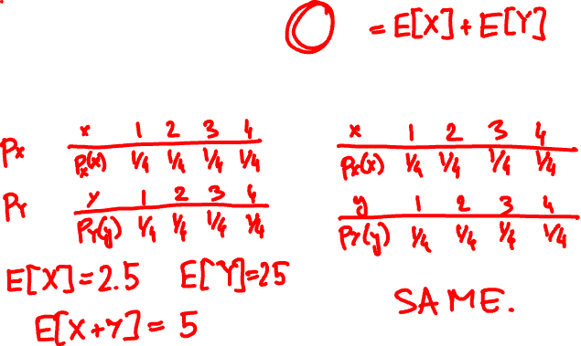
1
2
3
4
E[X + Y]
without replacement
with replacement

Slide 15

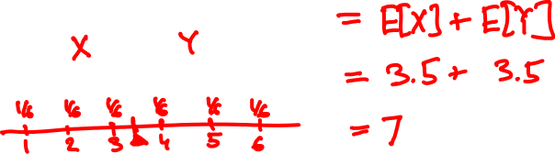
E[X + Y] = ?

Slide 16
The indicator (Bernoulli) random variable
Perform a trial that succeeds with probability p and fails with probability 1 – p.
x
0 1
p(x)
p(x)
1 – p p
p = 0.5
If X is Bernoulli(p) then
E[X] = p
p(x)
p = 0.4

Slide 17
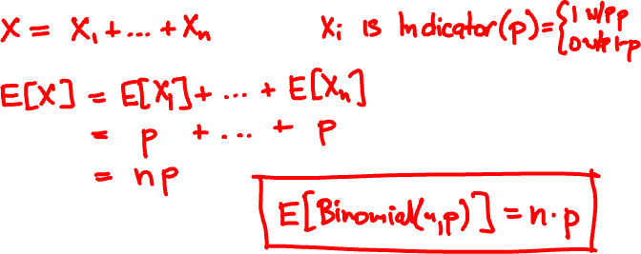
Mean of the Binomial
Binomial(n, p): Perform n independent trials, each of which succeeds with probability p.
X = number of successes

Slide 18
Binomial(10, 0.5)
Binomial(50, 0.5)
Binomial(10, 0.3)
Binomial(50, 0.3)

Slide 19
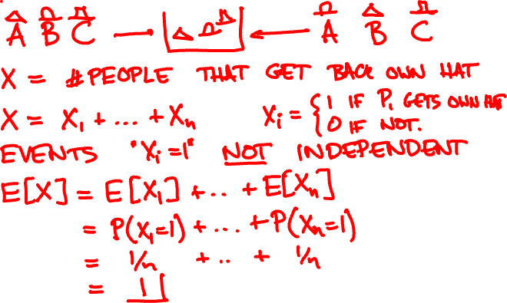
n people throw their hats in a box and each picks one out at random. On average, how many get back their own hat?

Slide 20
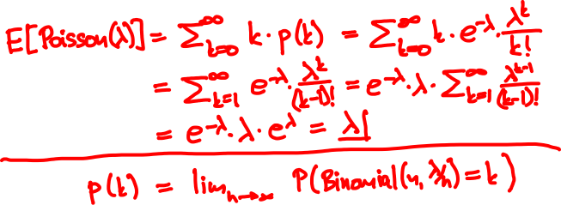

Mean of the Poisson
Poisson(λ) approximates Binomial(n, λ/n) for large n
p(k) = e^{-λ} λ^{k}/k!
k = 0, 1, 2, 3, …

Slide 21


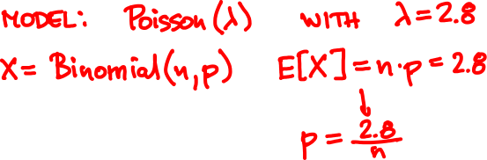
Raindrops
Rain is falling on your head at an average speed of 2.8 drops/second.
0
1

Slide 22

Raindrops
0
1
Number of drops N is Binomial(n, 2.8/n)

Slide 23

Rain falls on you at an average rate of 3 drops/sec.
When 100 drops hit you, your hair gets wet.
You walk for 30 sec from MTR to bus stop.
What is the probability your hair got wet?

Slide 24
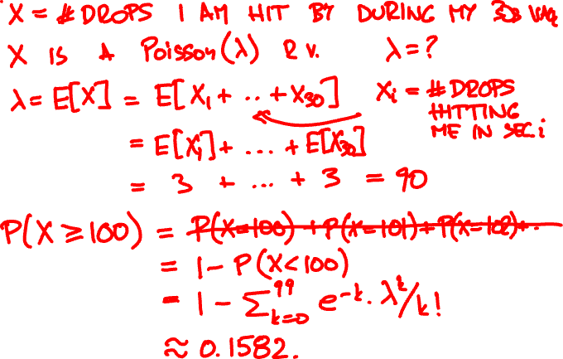

Slide 25

Investments
You have three investment choices:
A: put $25 in one stock
B: put $½ in each of 50 unrelated stocks
C: keep your money in the bank
Which do you prefer?

Slide 26
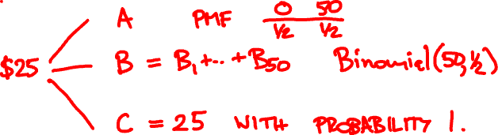
Investments
Probability model
doubles in value with probability ½
Each stock
loses all value with probability ½
Different stocks perform independently

Slide 27
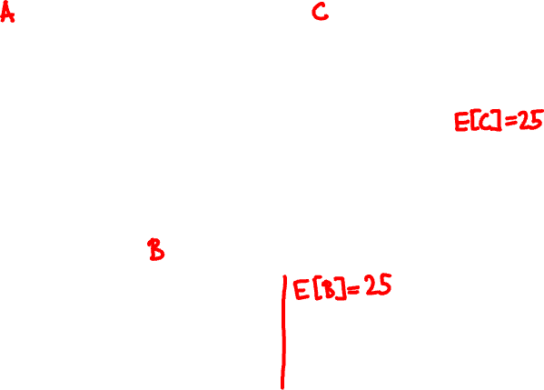
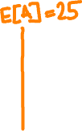

Slide 28
Variance and standard deviation
Let μ = E[X] be the expected value of X.
The variance of X is the quantity
Var[X] = E[(X – μ)²]
The standard deviation of X is σ = √Var[X]
It measures how close X and μ are typically.

Slide 29
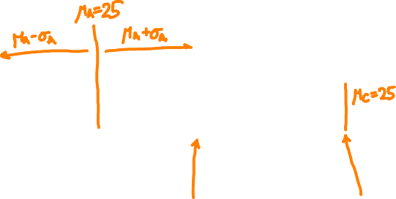
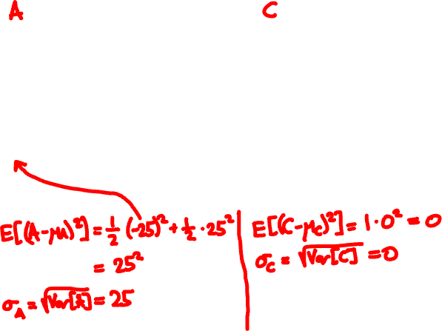

Slide 30
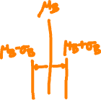
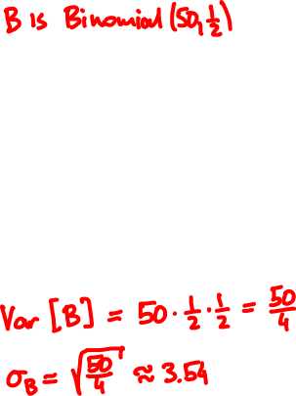
Most of the probability mass is within a few σs from μ
Var[Binomial(n, p)] = np(1 – p)
More on this in Lecture 9…

Slide 31
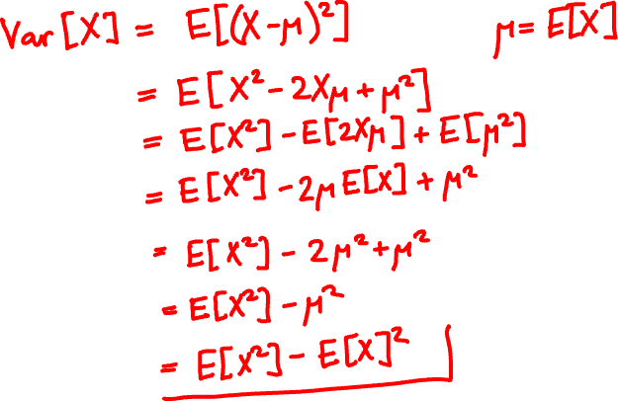

Another formula for variance

Slide 32
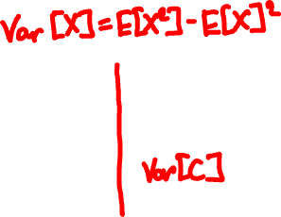
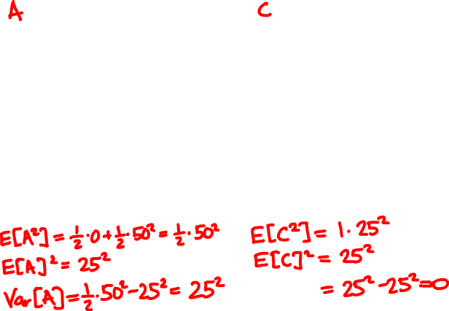

Slide 33

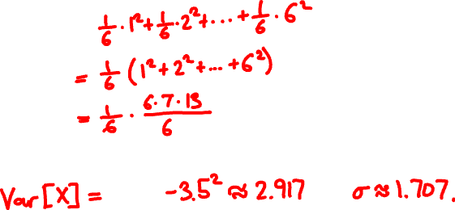
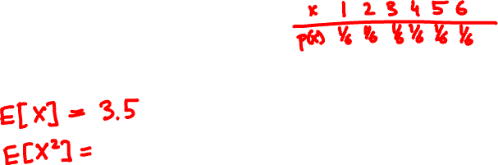
E[X] = ?
Var[X] = ?

