Slide 1
4. Random Variables
ENGG 2760A / ESTR 2018: Probability for Engineers
Spring 2020

Slide 2
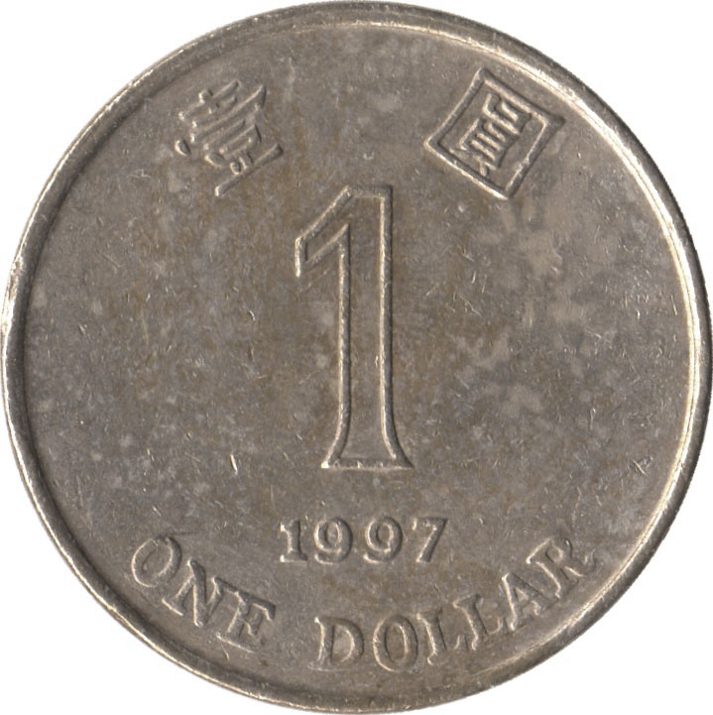
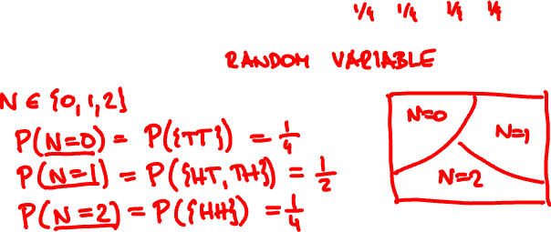
Random variable
A discrete random variable assigns a discrete value to every outcome in the sample space.
Example
{ HH, HT, TH, TT }
N = number of Hs

Slide 3
Probability mass function
We can describe the PMF by a table or by a chart.
x 0 1 2
p(x)
p(x) ¼ ½ ¼
x

Slide 4
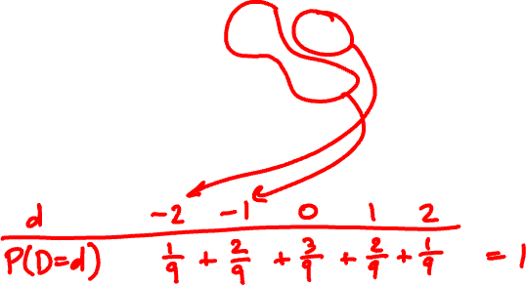
Two 3-sided dice are tossed. Calculate the PMF of the difference D of the rolls.
11 12 13
21 22 23
31 32 33

Slide 5
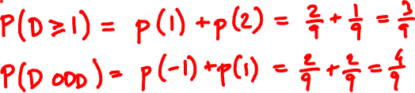
What is the probability that D ≥ 1? D is odd?

Slide 6


The binomial random variable
Binomial(n, p): Perform n independent trials, each of which succeeds with probability p.
X = number of successes
Examples
Toss n coins. “number of heads” is Binomial(n, ½).
Toss n dice. “Number of s” is Binomial(n, 1/6).

Slide 7

A less obvious example
Flip n coins. Let C be the number of consecutive changes (HT or TH).
Examples:
ω
C(ω)
HHHHHHH
0
THHHHHT
2
HTHHHHT
3
Then C is Binomial(n – 1, ½).

Slide 8
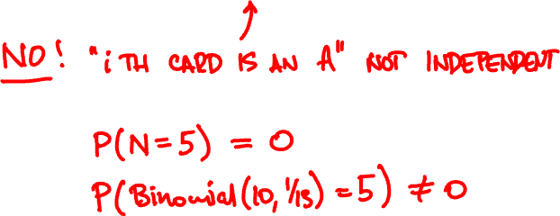
Draw a 10-card hand from a 52-card deck.
Let N = number of aces among the drawn cards
Is N a Binomial(10, 1/13) random variable?

Slide 9
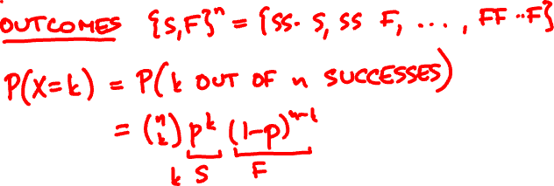
Probability mass function
If X is Binomial(n, p), its PMF is
n
(
)
p(k) = P(X = k) = p^{k} (1 - p)^{n-k}
k

Slide 10
Binomial(10, 0.5)
Binomial(50, 0.5)
Binomial(10, 0.3)
Binomial(50, 0.3)

Slide 11


Binomial random variable
P(Binomial(n, p) ≥ k) =
p = 0.6
p = 0.7
n
n
P(Binomial(n, p) ≥ (n – 1)/2)

Slide 12
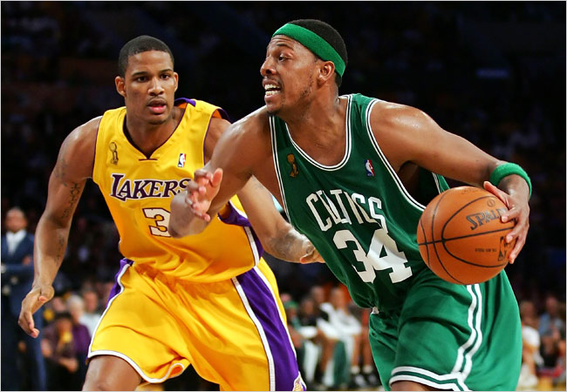

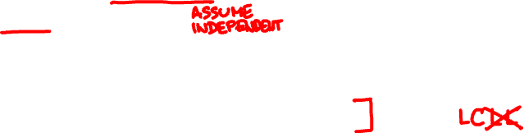
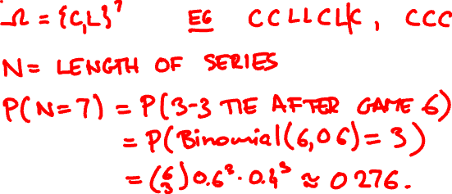
The Lakers and the Celtics meet for a 7-game playoff.
Lakers win 60% of the time. What is the probability that all 7 games are played?

Slide 13
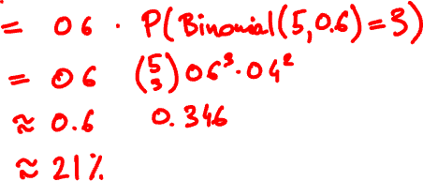

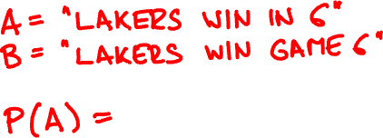

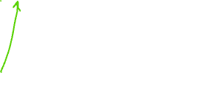
What is the probability that Lakers win in 6?
https://stattrek.com/online-calculator/binomial.aspx

Slide 14
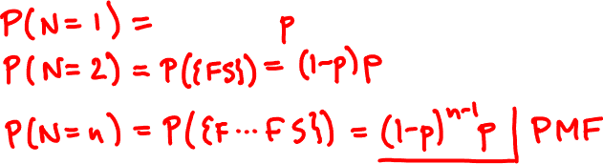

Geometric random variable
Let X₁, X₂, … be independent trials with success p.
A Geometric(p) random variable N is the time of the first success among X₁, X₂, … :
N = first (smallest) n such that X_{n} = 1.

Slide 15
Geometric(0.5)
Geometric(0.7)
Geometric(0.05)

Slide 16




Apples
About 10% of the apples on your farm are rotten.
You sell 10 apples. How many are rotten?
Probability model
Number of rotten apples you sold is
Binomial(n = 10, p = 1/10).

Slide 17

Apples
You improve productivity; now only 5% apples rot.
You can now sell 20 apples.
N is now Binomial(20, 1/20).

Slide 18
.387
Binomial(10, 1/10)
.349
.194
.001
10⁻¹⁰
.377
.354
Binomial(20, 1/20)
.189
.002
10⁻⁸
10⁻²⁶
.367
.367
Poisson(1)
.183
.003
10⁻⁷
10⁻¹⁹

Slide 19
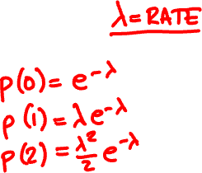
The Poisson random variable
A Poisson(λ) random variable has PMF
p(k) = e^{-λ} λ^{k}/k!
k = 0, 1, 2, 3, …
Poisson random variables do not occur “naturally” in the sample spaces we have seen.

Slide 20
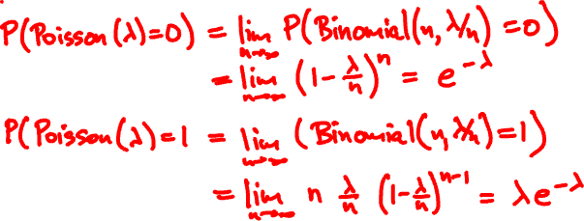
The Poisson random variable
Poisson(λ) approximates Binomial(n, p)
when λ = np is fixed and n is large (p is small)
P(Poisson(λ) = k) = lim_{n → ∞} P(Binomial(n, λ/n) = k)

Slide 21




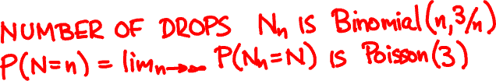
The Poisson random variable
Rain is falling on your head at a rate of 3 drops/sec.
0
1

Slide 22
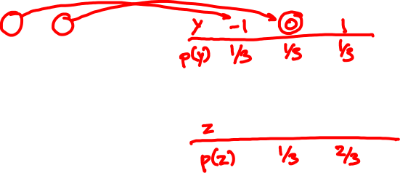
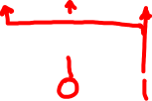
Functions of random variables
PMF of X:
PMF of X – 1?
x
0 1 2
p(x)
1/3 1/3 1/3
PMF of (X – 1)²?
If X is a random variable with p.m.f. p_{X},
then Y = f(X) is a random variable with p.m.f.
p_{Y}(y) = ∑_{x: f(x) = y} p_{X}(x).

Slide 23

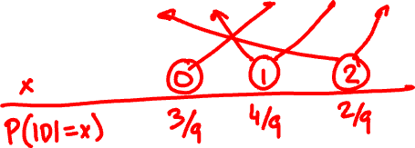
D is the difference of two 3-sided dice rolls.
Calculate the PMF of |D|.

Slide 24

Expected value
The expected value (expectation) of a random variable X with p.m.f. p is
E[X] = ∑_{x} x p(x)
Example
N = number of Hs

Slide 25
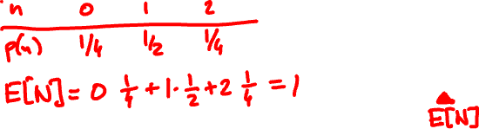
Expected value
Example
N = number of Hs
The expectation is the average value the random variable takes when experiment is done many times

Slide 26
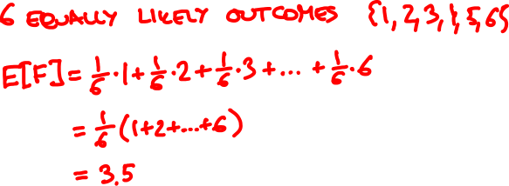

F = face value of fair 6-sided die

Slide 27

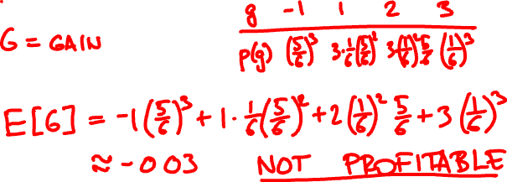
If appears k times, you win $k.
If it doesn’t appear, you lose $1.

Slide 28



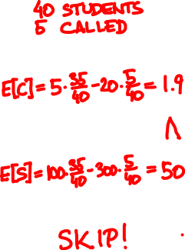
Utility
Should I go to tutorial?
not called
called
+5
-20
Come
+100
-300
Skip
F
35/40
5/40

Slide 29
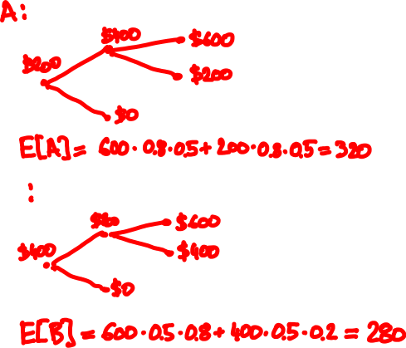
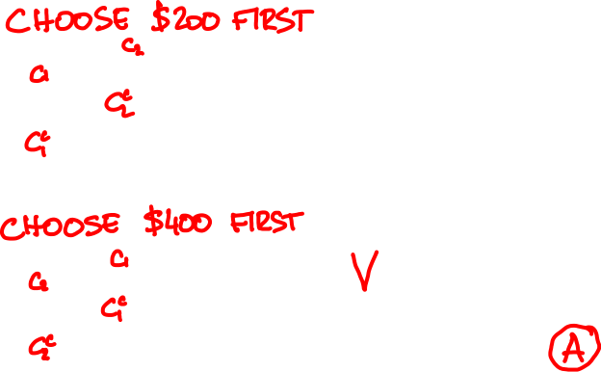
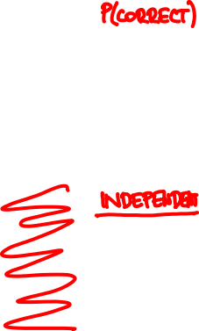
80%
50%

