Slide 1
PHYS 3061 Introduction to Computer Simulation of Physical Systems
Lab 3

Slide 2
Goal of this session
Initialize a system with center of mass velocity correction
Apply Lennard-Jones potential
Perform time evolution of the system

Slide 3
Centre of mass correction
Motivation:
In the real case: imagine a box filled with gas molecules
The box is not moving, so the center of mass velocity should be zero
However, this may not be the case under our velocity initialization. It may artificially introduce an additional degree of freedom: the center of mass movement.
Such an additional degree of freedom may affect the statistics.

Slide 4


Centre of mass correction
Apply center of mass correction before time evolution*:
Calculate the momentum of the center of mass (Identical particles are assumed)
$\vec{p_{CM}}=\sum_{i}^{n}{m}\vec{v_{i}}$#
Subtract every velocity by the center of mass velocity
$\vec{{v′}_{i}}=\vec{v_{i}}−\vec{v_{CM}}=\vec{v_{i}}−\frac{\vec{p_{CM}}}{nm}=\vec{v_{i}}−\frac{\sum_{i}^{n}{\vec{v_{i}}}}{n}$
The new velocity is the initialized velocity
One correction after the initialization will be good enough
# $i$: each component; $n$: number of particles

Slide 5
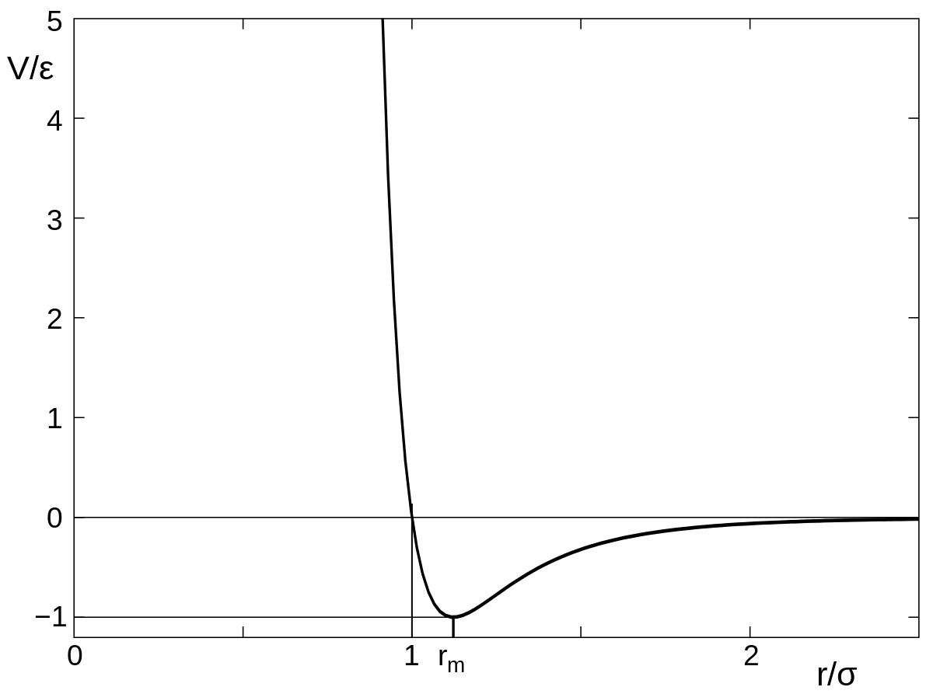

Lennard-Jones potential
$V_{LJ}=4ε\left[{(\frac{σ}{r})}^{12}−{(\frac{σ}{r})}^{6}\right]$ , where $ε$ is the depth of the potential and $σ$ is the zero-potential point
Values of $ε$ and $σ$ vary from particle to particle.
For Argon*:$σ$= 3.40 Å and $ε$= 1.65 × 10⁻²¹ J = 1.03 × 10⁻² eV
You can use other particles but find the correct values of $σ$and $ε$. Include the reference in your README
*Data from: http://stp.clarku.edu/simulations/lj/

Slide 6
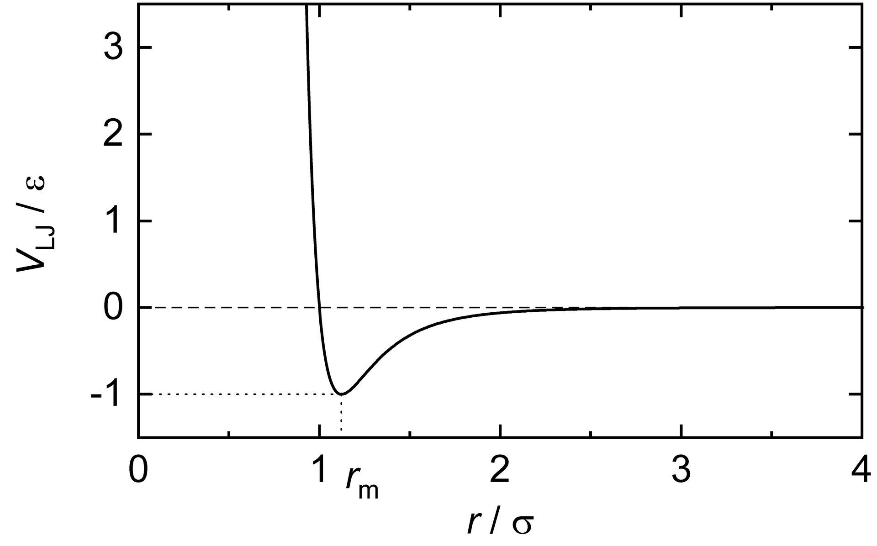

Lennard-Jones potential (cut-off and shifted form; optional)
By default, you should calculate all the pairwise force based on LJ potential. (Optional: For very large systems with more than 1000 particles, you can apply the truncation)
However, if you do the truncation, it will introduce discontinuity of LJ potential, which may affect force calculations.
One solution is to set an appropriate cut-off distance $rc$ and shift the whole L-J potential, the new shifted L-J potential is then:
$$V_{LJ−shift.}=\left\{\begin{aligned}V_{LJ}\left(r\right)−V_{LJ}\left(r_{c}\right), r ≤r_{c} \\ V_{LJ}\left(r_{c}\right)−V_{LJ}\left(r_{c}\right)=0, r>r_{c}\end{aligned}\right.$$
Note the new $V_{LJ}$ is shifted down by $V_{LJ}\left(r_{c}\right)$ to keep the continuity of $V_{LJ}$. However, it may affect the total energy calculations.

Slide 7


Force calculation
The force can be calculated by differentiating the potential (Newton third law)
$$V_{LJ}=4ε\left[{(\frac{σ}{r})}^{12}−{(\frac{σ}{r})}^{6}\right]$$
i.e.
$$\overset{⃑}{F}\left({\overset{⃑}{r}}_{ij}\right)=\frac{24ε}{r_{ij}^{2}}{\left[2{\left(\frac{σ}{r_{ij}}\right)}^{12}−{\left(\frac{σ}{r_{ij}}\right)}^{6}\right]\overset{⃑}{r}}_{ij}$$
$$\overset{⃑}{r_{j}}−\overset{⃑}{r_{i}}$$
Force felt by j^{th} particle, due to i^{th} particle

Slide 8

Time evolution (Verlet method equation)
$$\vec{r_{i}}\left(t+∆t\right)=\vec{r_{i}}\left(t\right)+\vec{v_{i}}\left(t\right)∆t+\frac{\vec{f_{i}}(t)}{2m}{∆t}^{2}$$
$$\vec{v_{i}}\left(t+∆t\right)=\vec{v_{i}}\left(t\right)+\frac{\vec{f_{i}}\left(t+∆t\right)+\vec{f_{i}}(t)}{2m}∆t$$
where $i$ stands for the $i^{th}$ particle in both equations

Slide 9


$$What you need to do in one loop (or in one time unit ∆t)$$
1. Renew positions and partial velocities
$$\vec{r_{i}}\left(t+∆t\right)=\vec{r_{i}}\left(t\right)+\vec{v_{i}}\left(t\right)∆t+\frac{\vec{f_{i}}(t)}{2m}{∆t}^{2}$$
$$\vec{v_{i}}\left(t+∆t\right)=\vec{v_{i}}\left(t\right)+\frac{\vec{f_{i}}(t)}{2m}∆t$$
2. Renew forces
$$\vec{f_{i}}\left(t+∆t\right)is only related by \vec{r_{i}}\left(t+∆t\right)$$
3. Finalize velocities
$$\vec{v_{i}}\left(t+∆t\right)=\vec{v_{i}}\left(t\right)+\frac{\vec{f_{i}}\left(t\right)}{2m}∆t+\frac{\vec{f_{i}}\left(t+∆t\right)}{2m}∆t$$
Where to check the boundary?

Slide 10

Time evolution (Verlet method implementation)
Assume we have the positions, velocities and forces of particles at time $t$.
At time $t+∆t$ :
Compute the new positions and the partial velocities
Check the boundary
Calculate the forces
Finalize the velocities

Slide 11

Units
Again, choose the meaningful units.
Eg. Å, ps, ev, etc. You need to define the conversion constants and comment properly.
Units can also be normalized to simplify calculation
Example:
Recall $V_{LJ}=4ε\left[{(\frac{σ}{r})}^{12}−{(\frac{σ}{r})}^{6}\right]$ If we set $r^{′}=\frac{r}{σ}$ , then $V_{LJ}=4ε\left[{(\frac{1}{r′})}^{12}−{(\frac{1}{r′})}^{6}\right]$
Same procedure can be done to $V_{LJ}$, which could be expressed in unit of $ε$
Notes: Explain your units and show your conversion condition in README

Slide 12

Check your result
Calculate the kinetic energy (and the temperature), the potential energy and the total energy of the system and plot them against time
Recall $<\frac{1}{2}mv^{2}>=\frac{3}{2}k_{B}T$ (or we can calculate the temperature based on the instant kinetic energy)
Compare with the $T$₀ used for initialization
The total energy should be conserved and both of the kinetic and the potential energy should be stable (with some fluctuations) after equilibrium
Any comments on this equation?
Notes: Assume the temperature after the center mass correction is the initial temperature

Slide 13
Task for lab3
Initialize a system with
Same position and velocity requirement as in lab2
Center of mass correction applied
Apply Lennard-Jones potential
Use the Verlet method to evolve your system until it reaches equilibrium
Output every 100-time steps as one frame in a .xyz file
Plot total energy, kinetic energy and potential energy against time
Plot temperature against time and compare it with the initial temperature
You need to submit the code, the plots, readme and the .xyz file before March 8th. No lab report is required for this lab

Slide 14

Flow chart
Initialize positions and velocities of particles with center of mass correction
Find new position by Verlet method after time step $∆t$
new position inside the box?
no
Suggestion:
Accumulate important physical quantities in the loop for statistic purpose.
yes
Apply boundary condition
Update positions, calculate the partial velocities, calculate the forces and finalize velocities of particles by Verlet method
Enough time?
no
yes
end

