Slide 1
NCCloud: Applying Network Coding for the Storage Repair in a Cloud-of-Clouds
Yuchong Hu¹, Henry C. H. Chen¹, Patrick P. C. Lee¹, Yang Tang²
¹The Chinese University of Hong Kong ²Columbia University
FAST’12

Slide 2
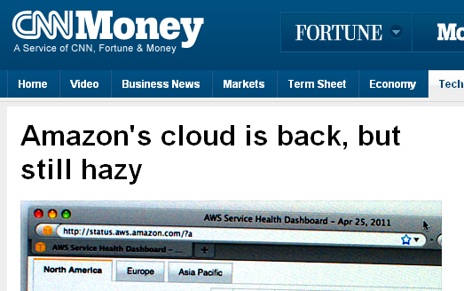
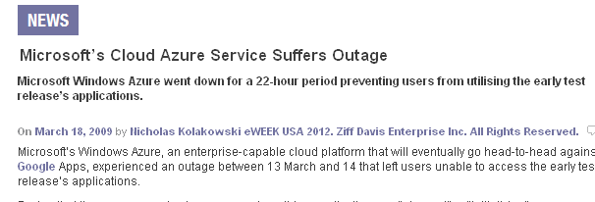
Cloud Storage
Cloud storage is an emerging service model for remote backup and data synchronization
Single-cloud storage raises concerns:
Cloud outage
Vendor lock-ins [Abu-Libdeh et al., SOCC’10]
Costly to switch cloud providers

Slide 3
Multiple-Cloud Storage
Solution: multiple-cloud storage
Deploy a proxy between users and multiple clouds
Stripe data across multiple clouds
Cloud 1
file
Cloud 2
upload
Proxy
Users
Cloud 3
file
download
Cloud 4
(n,k) MDS code: Any k out of n storage nodes (clouds) can rebuild original file.
e.g., RAID-5: k = n – 1; RAID-6: k = n – 2

Slide 4
Repairing a Failed Cloud
Cloud 1
How to repair:
Cloud 2
Proxy
Cloud 3
Cloud 4
Cloud 5
Repair traffic =
＋
＋
Goal: minimize repair traffic
Repair traffic: amount of data read from surviving clouds
Hence minimize monetary cost due to data migration

Slide 5
Reed Solomon Codes
Reed Solomon codes
Repair traffic = M
A
File of
size M
Node 1
A
B
B
Proxy
Node 2
B
Node 3
A+B
A
A
A+B
Node 4
A+2B
n = 4, k = 2
Conventional repair:
Repair whole file and reconstruct data in new node

Slide 6
Regenerating Codes
[Dimakis et al.’10]
Regenerating codes
Repair traffic = 0.75M
A
File of
size M
Node 1
A
B
B
C
Node 2
C
D
Proxy
D
Node 3
A+C
C
B+D
A
A
A+C
B
B
Node 4
A+D
A+B+C
B+C+D
n = 4, k = 2
Repair in regenerating codes:
Downloads one chunk from each node (instead of whole file)
Repair traffic: save 25% for (n=4,k=2), while same storage size
Using network coding: encode chunks in storage nodes

Slide 7
Related Work
Theoretical analysis
Regenerating codes [Dimakis et al. ’10] exploit the optimal trade-off between storage and repair traffic.
Empirical studies
e.g., [Gkantsidis & Rodriguez ’05], [Dunimuco & Biersack ’09], [Martalo et al. ’11]
Evaluate random linear codes
Based on simulations
Multiple cloud storage
e.g., HAIL [Bowers et al. ’09], RACS [Abu-Libdeh et al. ’10], DEPSKY [Bessani et al. ’11]
Based on erasure codes

Slide 8
Challenges
Implementation of regenerating codes in multiple cloud storage:
Can we eliminate encoding/decoding operations in storage nodes (clouds)?
Only standard read/write interfaces would suffice
Can we support basic upload/download operations with regenerating codes?
Can we support the repair function with regenerating codes?

Slide 9
Our Work
Build NCCloud, a proxy-based storage system that applies regenerating codes in multiple-cloud storage
Design goals:
Propose an implementable design of functional minimum-storage regenerating (F-MSR) code
Support basic read/write operations and the repair function
Preserve storage overhead as in MDS codes, while reducing repair traffic
Implement and evaluate NCCloud in real storage setting
focus on double-fault tolerance (k = n-2)
focus on single-fault recovery
built on FUSE

Slide 10
F-MSR: Key Idea
File of
size M
F-MSR codes
Repair traffic = 0.75M
P1
A
Node 1
B
P2
C
Node 2
P3
D
Proxy
P4
Node 3
P5
P3
P6
P1’
P1’
P5
P2’
P2’
Node 4
P7
P7
P8
n = 4, k = 2
Code chunk P_{i} = linear combination of original data chunks
Repair in F-MSR:
Download one code chunk from each surviving node
Reconstruct new code chunks (via random linear combination) in new node

Slide 11
F-MSR: Key Idea
F-MSR: non-systematic
Doesn’t keep original data as in systematic codes
Stores only linearly combined code chunks
while maintaining MDS property
Suitable for rarely-read long-term archival
With (non-systematic) F-MSR,
Eliminate need of encoding/decoding in clouds
Keep the benefits of network codes in storage repair
For k = n-2 (double-fault tolerance)
n = 4: repair traffic saved by 25%
For very large n: repair traffic saved by almost 50%

Slide 12
NCCloud: Upload
Storage nodes
Proxy
n(n-k) chunks
P1
k(n-k) chunks
P1
P2
P2
File
A
P3
P3
divide
B
encode
P4
distribute
P4
C
P5
P5
D
P6
P6
P7
P8
P7
P8
n=4, k=2
Encoding process:
P_{i} = ECV_{i} × [A,B,C,D]^{T}
ECV_{i} : encoding coefficient vector of P_{i}
Arithmetic operations in GF(2⁸)
EM = [ECV₁,ECV₂,…,ECV_{n}]^{T}
EM: encoding matrix is replicated to all nodes as metadata

Slide 13
NCCloud: Download
Storage nodes
P1
Proxy
P2
download
k(n-k) chunks
k(n-k) chunks
P3
File
P4
P1
A
P2
decode
B
merge
P5
P3
C
P6
P4
D
P7
P8
n=4, k=2
Decoding process:
[A,B,C,D]^{T} = EM ⁻¹× [P₁,P₂, P₃, P₄]^{T}
Download all the chunks from any k of n clouds
Multiply inverted encoding matrix with downloaded chunks

Slide 14
NCCloud: Iterative Repair
Repair: generate random linear combinations of chunks
How to keep iterative single-failure repairs sustainable?
i.e., how to ensure new code chunks don’t break MDS property?
Solution: two-phase checking
MDS property check
Current repair maintains MDS property
Repair MDS property check
Next repair for any possible failure maintains MDS property
Simulations show the importance of two-phase checking over MDS property check only
See paper for details

Slide 15
NCCloud: Iterative Repair
Proxy
Get all the existing ECVs:
ECV₃, ECV₄, ECV₅, ECV₆, ECV₇, ECV₈
Storage nodes
×
P1
Randomly select one ECV from each existing nodes:
ECV₃, ECV₅, ECV₇
P2
P3
P4
Randomly generate a repair matrix: RM
P5
P6
Obtain ECVs in new node:
[ECV’₁, ECV’₂]= RM × (ECV₃, ECV₅, ECV₇)^{T}
P7
P8
n=4, k=2
Construct a new EM’ and test it:
EM’ = [ECV’₁, ECV’₂, ECV₃, ECV₄, ECV₅, ECV₆, ECV₇, ECV₈]
Check both MDS and repair MDS property in EM’.
fail
P1’
Download P3,P5,P7; regenerate (P1’,P2’)= RM × (P₃, P₅, P₇)^{T}
P2’

Slide 16
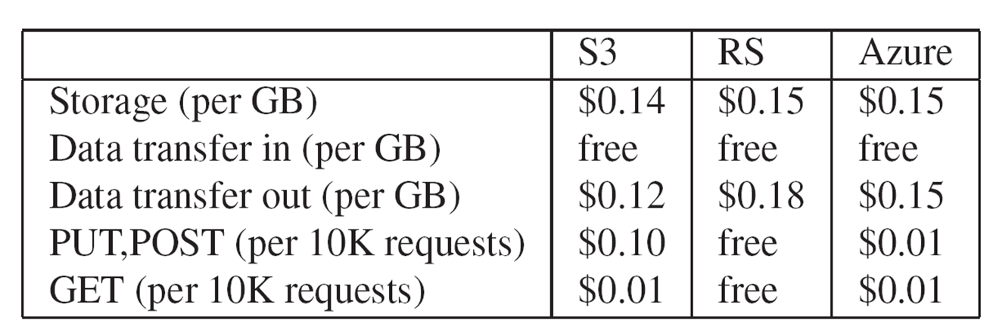
Cost Analysis
Monthly price plan as of Sep 2011
Repair traffic cost
F-MSR saves 25% (for n = 4) compared to conventional repair
Metadata of F-MSR
Metadata size = 160B; file size = several MBs
Overhead due to GET requests during repair
Assuming S3 plan in Sep 2011, n = 4, k = 2, file size = 4MB
Conventional repair: 0.427%
F-MSR repair: 0.854%

Slide 17
Experiments
NCCloud deployment
Single machine connected to a cloud-of-clouds
n = 4, k = 2
Coding schemes
Reed-Solomon-based RAID-6 vs. F-MSR
Metric
Response time
Cloud environments:
Local cloud: OpenStack Swift
Commercial cloud: multiple containers in Azure

Slide 18
Response time: Local Cloud
Response time (s)
UPLOAD
F-MSR has higher response time due to encoding/decoding overhead
F-MSR has slightly less response time in repair, due to less data download
File size (MB)
Response time (s)
DOWNLOAD
File size (MB)
Response time (s)
REPAIR
File size (MB)

Slide 19
Response time: Commercial Cloud
Response time (s)
UPLOAD
File size (MB)
No distinct response time difference, as network fluctuations play a bigger role in actual response time
Response time (s)
DOWNLOAD
File size (MB)
Response time (s)
REPAIR
File size (MB)

Slide 20
Conclusions
Propose an implementable design of F-MSR:
Preserve storage cost, but use less repair traffic
Build NCCloud, which realizes F-MSR
Source code:
http://ansrlab.cse.cuhk.edu.hk/software/nccloud/

