Slide 1


Connections between
Network Coding and Matroid Theory
Qifu Sun
Institute of Network Coding (Shenzhen), CUHK
30, Aug., 2013

Slide 2
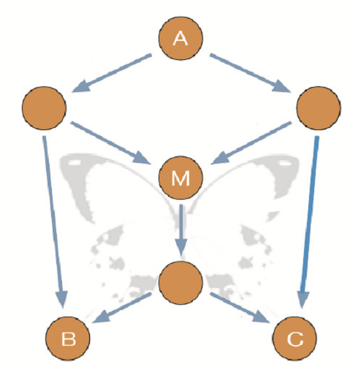
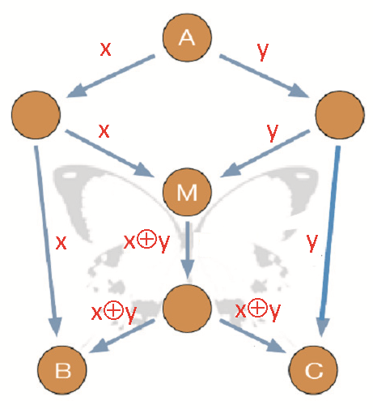
Connections between
Network Coding and Matroid Theory
Network (Graph)
Code
Notes:
数据符号

Slide 3
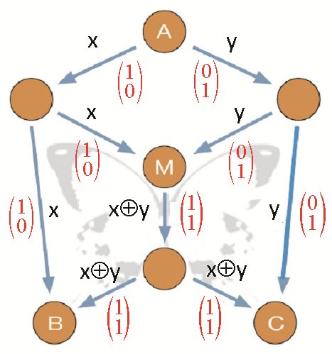
Connections between
Network Coding and Matroid Theory
Network (Graph)
Linear Code
Linear independence
Notes:
数据符号
编码向量
最基本的任务是使某一些特定的边上面的编码向量保持线性独立性，以便成功解码。

Slide 4
Connections between
Network Coding and Matroid Theory
拟阵
Matr
+
oid
矩阵
似、像
anthropoid
类人猿
spheroid
球状体
planetoid
小行星
Notes:
可能在坐的一些不是专门从事理论研究的老师们对这个词还比较陌生。
下面就先让我来分析一下matroid这个英文单词的构词法。

Slide 5
Connections between
Network Coding and Matroid Theory
拟阵
The concept of matroid generalizes the notion of linear independence among column/row vectors in a matrix.
Matroid theory is an abstract theory for independence structures.
Notes:
从拟阵的构词法不难发现，拟阵这个概念generalize了矩阵里列向量或者行向量之间的线性独立性关系。
所以拟阵论也就是关于独立性结构的一套抽象理论.

Slide 6
Connections between
Network Coding and Matroid Theory
拟阵
Given a ground set E, a matroid classifies all subsets in E as either independent or dependent s.t.
(a) φ is independent.
(b) Every subset of an independent set is independent.
(c) (Augmentation axiom) For two independent sets I₁, I₂ in E, if |I₁| < |I₂|, then there is an e ∈ I₂ \ I₁ s.t. I₁∪{e} is also independent.
Notes:
对于一个给给定的集合E，一个拟阵结构将这个集合E当中的全部子集归类为独立性子集或者非独立性子集，并且此种划分满足三个条件：
空子集一定是拟阵独立的；
每一个独立子集的子集依然是独立的；
增大公理：对于E当中两个独立集合I1和I2，如果I1里的元素少于I2中的，那么一定有一个在I2中，但是不在I1中的元素e，当将这个元素添加到独立子集I1中时，新的子集依旧是拟阵独立的。

Slide 7
Examples of Matroids
Given a ground set E, a matroid classifies all subsets in E as either independent or dependent.
  Vector Matroid:
E = {
c₁
c₂
c₃
c₄
c₅
c₆
c₇
}
1
0
0
0
1
0
0
0
1
1
1
0
1
0
1
0
1
1
1
1
1
Independence = Linear independence

Slide 8
Examples of Matroids
Given a ground set E, a matroid classifies all subsets in E as either independent or dependent.
  Graphic Matroid:
E = {e₁, e₂, e₃, e₄, e₅}
e₂
e₁
e₅
e₃
e₄
Independence = Not contain cycles

Slide 9
Examples of Matroids
Given a ground set E, a matroid classifies all subsets in E as either independent or dependent.
  Graphic Matroid:
E = {e₁, e₂, e₃, e₄, e₅}
e₂
e₁
e₅
e₃
e₄
Independence = Not contain cycles

Slide 10
Examples of Matroids
Given a ground set E, a matroid classifies all subsets in E as either independent or dependent.
  Graphic Matroid:
E = {e₁, e₂, e₃, e₄, e₅}
e₂
e₁
e₅
e₃
e₄
Independence = Not contain cycles

Slide 11
Examples of Matroids
Given a ground set E, a matroid classifies all subsets in E as either independent or dependent.
  Graphic Matroid:
E = {e₁, e₂, e₃, e₄, e₅}
e₂
e₁
e₅
e₃
e₄
Independence = Not contain cycles

Slide 12
Examples of Matroids
Given a ground set E, a matroid classifies all subsets in E as either independent or dependent.
  Transversal Matroid:
Boys
E = {
Girls
}
1
a
2
b
3
c
4
5
Independence = matchable to boys

Slide 13
Examples of Matroids
Given a ground set E, a matroid classifies all subsets in E as either independent or dependent.
  Transversal Matroid:
Boys
E = {
Girls
}
1
a
2
b
3
c
4
5
Independence = matchable to boys

Slide 14
Examples of Matroids
Given a ground set E, a matroid classifies all subsets in E as either independent or dependent.
  Transversal Matroid:
Boys
E = {
Girls
}
1
a
2
A matroid structure on a network
b
3
c
4
5
Independence = matchable to boys

Slide 15
Vector Representation of Matroids
  Both graphic and transversal matroids have vector representations, i.e.,
  their independence structure can be represented by linear independence among vectors.
e₂
e₁
e₅
e₃
e₄

Slide 16
Vector Representation of Matroids
  Both graphic and transversal matroids have vector representations, i.e.,
  their independence structure can be represented by linear independence among vectors.
e₂
e₁
e₅
e₃
e₄

Slide 17
Linear Network Coding
Matroid Theory
  Network (Graph), linear codes
  Abstraction of various notions of central importance in graph theory and linear algebra
  Founded in 1998
  Founded in 1935

Slide 18
First Connection of NC and Matroid Theory
Fundamental Theorem of LNC. For an acyclic single-source multicast network, there is a linear network coding (LNC) solution to achieve the multicast rate.
  The first proof [LYC’03] is by showing the existence of a generic LNC.
  [SLH’08] A generic LNC = a vector representation of a gammoid.
Boys
E = {
Girls
}
Gammoid = matroid dual of
1
transversal matroid
a
2
b
3
c
4
5

Slide 19
Application of Matroid Theory to NC (1)
Fundamental Theorem of LNC. For an acyclic single-source multicast network, there is a linear network coding (LNC) solution to achieve the multicast rate.
  [Jaggi et al’05][LSB’09] Based on a topological order of nodes, efficient algorithms are designed to establish an LNC solution.

Slide 20
Application of Matroid Theory to NC (1)
Fundamental Theorem of LNC. For an acyclic single-source multicast network, there is a linear network coding (LNC) solution to achieve the multicast rate.
  [Jaggi et al’05][LSB’09] Based on a topological order of nodes, efficient algorithms are designed to establish an LNC solution.
  // Not applicable to cyclic networks.
  [LS’11] Motivated by duality theorems in matroids, a general method is designed s.t. every acyclic algorithm can be adapted to cyclic networks.
  Based on matroid union theorems, a matrix completion algorithm is devised [HKM’05] to efficiently find a LNC solution.

Slide 21
Application of Matroid Theory to NC (2)
Fundamental Theorem of LNC. For an acyclic single-source multicast network, there is a linear network coding (LNC) solution to achieve the multicast rate.
  It was once a popular conjecture that LNC suffices to achieve multicast rates in a multi-source multicast network.
The first example to show the negative answer [DFZ’05] utilizes the special properties of Fano and Non-Fano matroids.

Slide 22
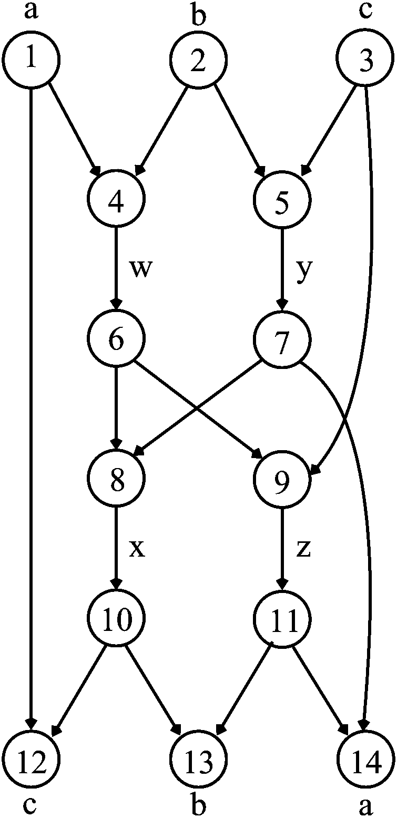
Application of Matroid Theory to NC (2)
Fano matroid
An LNC solution only when
symbol field = GF(2^{m})
Vector representable only over GF(2^{m})
Notes:
Symbol aphabet

Slide 23
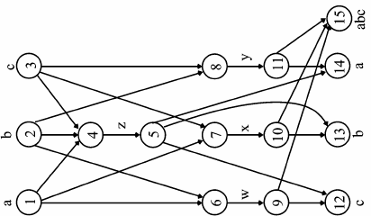
Application of Matroid Theory to NC (2)
Non-Fano matroid
An LNC solution only when
symbol field ≠ GF(2^{m})
Vector representable only over a Field ≠ GF(2^{m})

Slide 24
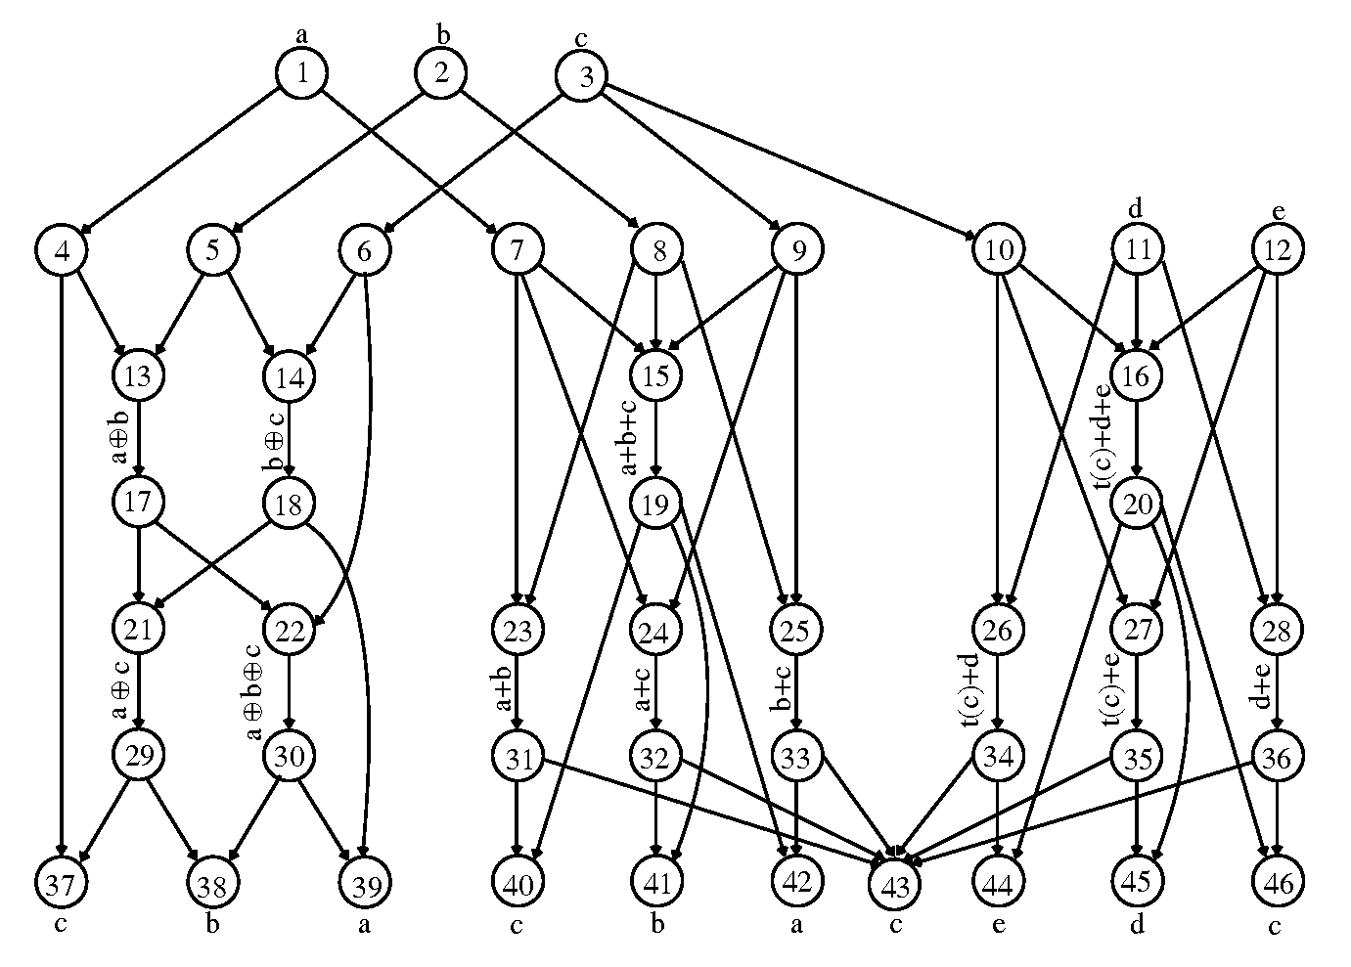
Application of Matroid Theory to NC (2)
A network with NC solution but no LNC solution

Slide 25
Other Applications of Matroid Theory to NC
  [RSG’10] Matroid structure helps to connect NC problems with index coding problems.
  [DFZ’07] Vámos matroid helps to show the insufficiency of Shannon type information inequality for characterizing general NC capacities.
  [DFZ’07] Matroid structure helps to turn the solvability problem of a polynomial collection into the NC solvability of a matroidal network.
  …
  Dougherty, Freiling, and Zeger, “Network coding and matroid theory,” Proceedings of the IEEE, vol. 99, no. 3, 2011.
Notes:
除了上述的一些经典例子，拟阵论在网络编码研究中还有一些其他的应用，比如
如果在座的老师们有兴趣进一步了解网络编码与拟阵论的联系的话，2011年Proceedings of the IEEE有一期网络编码的专刊，里面有一篇这方面的tutorial.

Slide 26
  80-year old matroid theory is very helpful to solve fundamental problems in NC theory.
Thank you !
Notes:
综上所述，拟阵论，这套在离散数学领域发展了近80年的理论，对于我们解决网络编码中许多基础理论问题有着很大的帮助。
多谢大家。

