Slide 1
6. Jointly Distributed
Random Variables

Slide 2
Cards
There is a box with 4 cards:
1
2
3
4
You draw two cards without replacement.
What is the p.m.f. of the sum of the face values?

Slide 3
Cards
Probability model
S = ordered pairs of cards, equally likely outcomes
X = face value on first card
Y = face value on second card
We want the p.m.f. of X + Y
P(X + Y = 4)
= 1/6.
= P(X = 1, Y = 3) + P(X = 2, Y = 2) + P(X = 3, Y = 1)
1/12
0
1/12

Slide 4
Joint distribution function
In general
P(X + Y = z) = ∑_{(x, y): x + y = z} P(X = x, Y = y)
to calculate P(X + Y = z) we need to know
f(x, y) = P(X = x, Y = y)
for every pair of values x, y.
This is the joint p.m.f. of X and Y.

Slide 5
Cards
2 | 0
3 | 1/6
4 | 1/6
5 | 1/3
6 | 1/6
7 | 1/6
8 | 0
joint p.m.f. of X and Y:
X
1
2
3
4
Y
2
3
4
5
0 | 1/12 | 1/12 | 1/12
1/12 | 0 | 1/12 | 1/12
1/12 | 1/12 | 0 | 1/12
1/12 | 1/12 | 1/12 | 0
1
3
4
5
6
2
4
5
6
7
3
5
6
7
8
4
p.m.f. of X + Y

Slide 6
Question for you
There is a box with 4 cards:
1
2
3
4
You draw two cards without replacement.
What is the p.m.f. of the larger face value?
What if you draw the cards with replacement?

Slide 7
Marginal probabilities
X
1
2
3
4
Y
0 | 1/12 | 1/12 | 1/12
1/12 | 0 | 1/12 | 1/12
1/12 | 1/12 | 0 | 1/12
1/12 | 1/12 | 1/12 | 0
1/4
1/4
1/4
1/4
1
2
P(Y = y) = ∑_{x} P(X = x, Y = y)
3
4
1/4 | 1/4 | 1/4 | 1/4
1
P(X = x) = ∑_{y} P(X = x, Y = y)

Slide 8
Red and blue balls
You have 3 red balls and 2 blue balls. Draw 2 balls at random. Let X be the number of blue balls drawn.
Replace the 2 balls and draw one ball. Let Y be the number of blue balls drawn this time.
X
Y
0
1
2
Y
9/50 | 18/50 | 3/50
6/50 | 12/50 | 2/50
3/5
2/5
0
1
X
3/10 | 6/10 | 1/10

Slide 9
Independent random variables
Let X and Y be discrete random variables.
X and Y are independent if
P(X = x, Y = y) = P(X = x) P(Y = y)
for all possible values of x and y.

Slide 10
Example
Alice tosses 3 coins and so does Bob. What is the probability they get the same number of heads?
Probability model
Let A / B be Alice’s / Bob’s number of heads
Each of A and B is Binomial(3, ½)
A and B are independent
We want to know P(A = B)

Slide 11
Example
Solution 1
A
0
1
2
3
B
B
1/64 | 3/64 | 3/64 | 1/64
3/64 | 9/64 | 9/64 | 3/64
3/64 | 9/64 | 9/64 | 3/64
1/64 | 3/64 | 3/64 | 1/64
1/8
3/8
3/8
1/8
0
1
2
3
A
1/8 | 3/8 | 3/8 | 1/8
P(A = B) = 20/64 = 31.25%

Slide 12
Example
Solution 2
P(A = B)
= ∑_{h} P(A = h, B = h)
= ∑_{h} P(A = h) P(B = h)
= ∑_{h} (C(3, h) 1/8) (C(3, h) 1/8)
= 1/64 (C(3, 0)² + C(3, 1)² + C(3, 2)² + C(3, 3)²)
= 20/64
= 31.25%

Slide 13

Independent Poisson
Let X be Poisson(μ) and Y be Poisson(ν). If X and Y are independent, what is the p.m.f. of X + Y?
Intuition
0
1
X is the number of blue raindrops in 1 sec
Y is the number of red raindrops in 1 sec
X + Y is the total number of raindrops
E[X + Y] = E[X] + E[Y] = μ + ν

Slide 14
Independent Poisson
The p.m.f. of X + Y is
P(X + Y = z)
= ∑_{(x, y): x + y = z} P(X = x, Y = y)
= ∑_{(x, y): x + y = z} P(X = x) P(Y = y)
= ∑_{(x, y): x + y = z} (e^{-μ} μ^{x}/x!) (e^{-ν} ν^{y}/y!)
= e^{-(μ+ν)} ∑_{(x, y): x + y = z} (μ^{x}ν^{y})/(x!y!)
The p.m.f. of a Poisson(μ + ν) r. v. Z is
=
P(Z = z)
= (e^{-(μ+ν)}/z!) (μ + ν)^{z}
= (e^{-(μ+ν)}/z!) ∑_{x = 0} z!/x!(z-x)! μ^{x}ν^{z -} ^{x}
^{z}
... so X + Y is a Poisson(μ + ν) random variable

Slide 15

Barista jam
On average a barista sells 2 espressos at $15 each and 3 lattes at $30 each per hour.
(a) What is the probability she sells fewer than
five coffees in the next hour?
(b) What is her expected hourly income?
(c) What is the probability her income falls short
of expectation in the next hour?

Slide 16
Barista jam
Probability model
X/Y is number of espressos/lattes sold in next hour
X is Poisson(2), Y is Poisson(3); X, Y independent
Solution
(a)
X + Y is Poisson(5) so
P(X + Y < 5)
= ∑_{z = 0} e⁻⁵ 5^{z}/z!
⁴
≈ 0.440

Slide 17
Barista jam
(b)
hourly income (in dollars) is 15X + 30Y
E[15X + 30Y]
= 15E[X] + 30E[Y]
= 15×2 + 30×3
= 120
(c)
P(15X + 30Y < 120)
= ∑_{z = 0} e⁻¹²⁰ 120^{z}/z!
≈ 0.488
¹¹⁹
wrong!

Slide 18
Barista jam
(c)
P(15X + 30Y < 120)
= ∑_{(x, y): 15x + 30y < 120} P(X = x, Y = y)
= ∑_{(x, y): 15x + 30y < 120} P(X = x) P(Y = y)
= ∑_{(x, y): 15x + 30y < 120} (e⁻² 2^{x}/x!) (e⁻³ 3^{y}/y!)
...using the program 14L09.py
≈ 0.480

Slide 19
Expectation
E[X, Y] doesn’t make sense, so we look at E[g(X, Y)] for example E[X + Y], E[min(X, Y)]
There are two ways to calculate it:
Method 1.
First obtain the p.m.f. f_{Z} of Z = g(X, Y)
Then calculate E[Z] = ∑_{z} z f_{Z}(z)
Method 2.
Calculate directly using the formula
E[g(X, Y)] = ∑_{x,} _{y} g(x, y) f_{XY}(x, y)

Slide 20
Method 1: Example
A
0
1
2
3
min(A, B)
B
0
0
0
0
1/64 | 3/64 | 3/64 | 1/64
3/64 | 9/64 | 9/64 | 3/64
3/64 | 9/64 | 9/64 | 3/64
1/64 | 3/64 | 3/64 | 1/64
15/64
33/64
15/64
1/64
0
0
0
1
1
1
1
1
0
1
2
2
2
2
0
1
2
3
3
3
E[min(A, B)] =
0⋅15/64 + 1⋅33/64 + 2⋅15/64 + 3⋅1/64
= 33/32

Slide 21
Method 2: Example
A
0
1
2
3
B
0
0
0
0
1/64 | 3/64 | 3/64 | 1/64
3/64 | 9/64 | 9/64 | 3/64
3/64 | 9/64 | 9/64 | 3/64
1/64 | 3/64 | 3/64 | 1/64
0
0
1
1
1
1
0
1
2
2
2
0
1
2
3
3
E[min(A, B)] =
0⋅1/64 + 0⋅3/64 + ... + 3⋅1/64
= 33/32

Slide 22
the cheat sheet
X, Y discrete
joint p.m.f. f_{XY}(x, y) = P(X = x, Y = y)
Probability of an event
(determined by X, Y)
P(A) = ∑_{(x, y) in A} f_{XY} (x, y)
Derived random variables
Z = g(X, Y)
f_{Z}(z) = ∑_{(x, y): g(x, y) = z} f_{XY}(x, y)
Marginal p.m.f.’s
f_{X}(x) = ∑_{y} f_{XY}(x, y)
Independence
f_{XY}(x, y) = f_{X}(x) f_{Y}(y) for all x, y
Expectation of Z = g(X, Y)
E[Z] = ∑_{x,} _{y} g(x, y) f_{XY}(x, y)

Slide 23
Continuous random variables
A pair of continuous random variables X, Y can be specified either by their joint c.d.f.
F_{XY}(x, y) = P(X ≤ x, Y ≤ y)
or by their joint p.d.f.
∂
∂
f_{XY}(x, y)
=
F_{XY}(x, y)
∂x
∂y
P(x < X ≤ x + ε, y < Y ≤ y + δ)
=
lim
ε, δ → 0
εδ

Slide 24
An example
Rain drops at a rate of 1 drop/sec. Let X and Y be the arrival times of the first and second raindrop.
X
Y
F(x, y) = P(X ≤ x, Y ≤ y)
f(x, y)
=
∂
∂
F(x, y)
∂x
∂y

Slide 25
Continuous marginals
Given the joint c.d.f F_{XY}(x, y) = P(X ≤ x, Y ≤ y), we can calculate the marginal c.d.f.s:
F_{X}(x) = P(X ≤ x) = lim F_{XY} (x, y)
y → ∞
F_{Y}(y) = P(Y ≤ y) = lim F_{XY} (x, y)
x → ∞
P(X ≤ x)
Exponential(1)

Slide 26
the continuous cheat sheet
X, Y continuous with joint p.d.f. f_{XY}(x, y)
Probability of an event
(determined by X, Y)
P(A) = ∫∫_{A} f_{XY} (x, y) dxdy
Derived random variables
Z = g(X, Y)
f_{Z}(z) = ∫∫_{(x, y): g(x, y) = z} f_{XY}(x, y) dxdy
Marginal p.d.f.’s
∞
f_{X}(x) = ∫_{-∞} f_{XY}(x, y) dy
Independence
f_{XY}(x, y) = f_{X}(x) f_{Y}(y) for all x, y
Expectation of Z = g(X, Y)
E[Z] = ∫∫ g(x, y) f_{XY}(x, y) dxdy

Slide 27

Independent uniform random variables
Let X, Y be independent Uniform(0, 1).
1
if 0 < x, y < 1
f_{XY}(x, y) = f_{X}(x) f_{Y}(y) =
0
if not
f_{XY}(x, y)
1
if 0 < x < 1
f_{X}(x) =
0
if not
1
if 0 < y < 1
f_{Y}(y) =
0
if not

Slide 28
Meeting time
Alice and Bob arrive in Shatin between 12 and 1pm. How likely arrive within 15 minutes of one another?
Probability model
Arrival times X, Y are independent Uniform(0, 1)
Event A: |X – Y| ≤ ¼
P(A) = ∫∫_{A} f_{XY} (x, y) dxdy
= ∫∫_{A} 1 dxdy
= area(A) in [0, 1]²

Slide 29
Meeting time
1
Event A: |X – Y| ≤ ¼
y = x + ¼
P(A) = area(A)
y
= 1 – (3/4)²
y = x – ¼
= 7/16
0
0
x
1

Slide 30
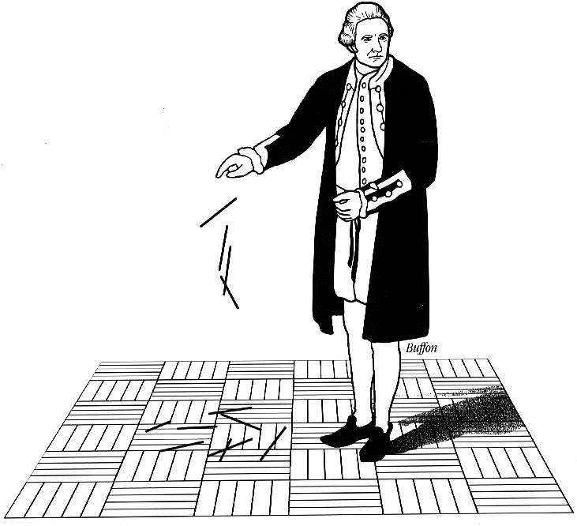
Buffon’s needle
A needle of length l is randomly dropped on a ruled sheet.
What is the probability that the needle hits one of the lines?

Slide 31
Buffon’s needle
The lines are 1 unit apart
X
Θ
X is the distance from midpoint to nearest line
1
Θ is angle with horizontal
Probability model
X is Uniform(0, ½)
Θ is Uniform(0, π)
X, Θ are independent

Slide 32
Buffon’s needle
l/2
The p.d.f. is
X
Θ
f_{XΘ}(x, θ) = f_{X}(x) f_{Θ}(θ) =
2/π
1
for 0 < x < ½, 0 < θ < π
½
l/2
The event H = “needle
hits line” happens
when X < (l/2) sinΘ
x
H
0
0
θ
π

Slide 33
Buffon’s needle
If l ≤ 1 (short needle) then (l/2) sinθ is always ≤ ½:
^{π}
^{(l/2)sinθ}
P(H) = ∫∫_{B} f_{XΘ}(x, θ) dxdθ
= ∫₀ ∫₀ 2/π dxdθ
P(H)
^{π}
^{(l/2) sinθ}
= ∫₀ ∫₀ 2/π dxdθ
^{π}
= ∫₀ (l /π) sinθ dθ
^{π}
= (l /π) ∫₀ sinθ dθ
= 2l /π.

Slide 34
Many random variables: discrete case
Random variables X₁, X₂, …, X_{k} are specified by their joint p.m.f P(X₁ = x₁, X₂ = x₂, …, X_{k} = x_{k}).
We can calculate marginal p.m.f.’s, e.g.
P(X₁ = x₁, X₃ = x₃) = ∑_{x2} P(X₁ = x₁, X₂ = x₂, X₃ = x₃)
P(X₃ = x₃) = ∑_{x1, x2} P(X₁ = x₁, X₂ = x₂, X₃ = x₃)
and so on.

Slide 35
Independence for many random variables
Discrete X₁, X₂, …, X_{k} are independent if
P(X₁ = x₁, X₂ = x₂, …, X_{k} = x_{k})
= P(X₁ = x₁) P(X₂ = x₂) … P(X_{k} = x_{k})
for all possible values x₁, …, x_{k}.
For continuous, we look at p.d.f.’s instead of p.m.f.’s

Slide 36

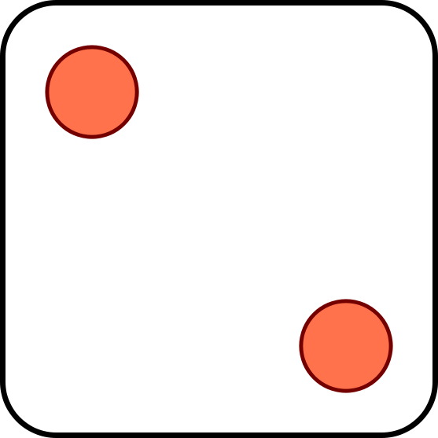
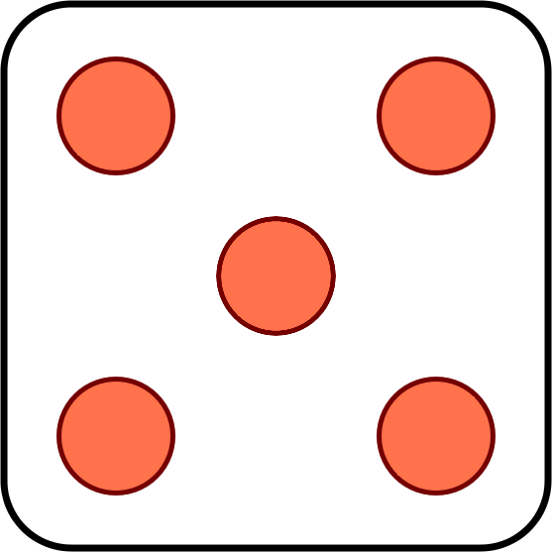
Dice
Three dice are tossed. What is the probability that their face values are non-decreasing?
Solution
Let X, Y, Z be face values of first, second, third die
X, Y, Z independent with p.m.f. p(1) = … = p(6) = 1/6
We want the probability of the event X ≤ Y ≤ Z

Slide 37
Dice
P(X ≤ Y ≤ Z)
= ∑_{(x, y, z): x ≤ y ≤ z} P(X = x, Y = y, Z = z)
= ∑_{(x, y, z): x ≤ y ≤ z} (1/6)³
= ∑_{z =} ₁ ∑_{y =} ₁ ∑_{x =} ₁ (1/6)³
⁶
^{z}
^{y}
= ∑_{z =} ₁ ∑_{y =} ₁ (1/6)³ y
⁶
^{z}
= ∑_{z =} ₁ (1/6)³ z (z + 1)/2
⁶
= (1/6)³ (1∙2 + 2∙3 + 3∙4 + 4∙5 + 5∙6 + 6∙7)/2
= (1/6)³ (1∙2 + 2∙3 + 3∙4 + 4∙5 + 5∙6 + 6∙7)/2
= 56/216 ≈ 0.259

Slide 38
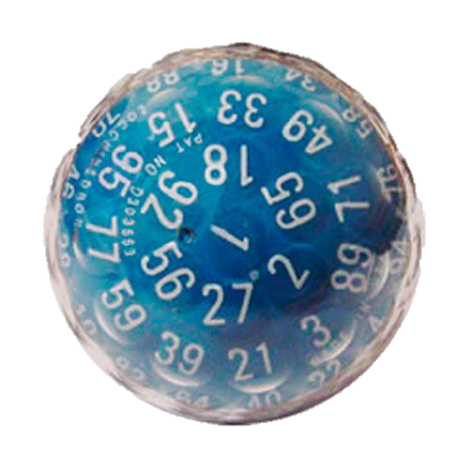
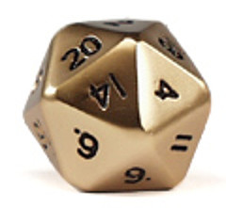
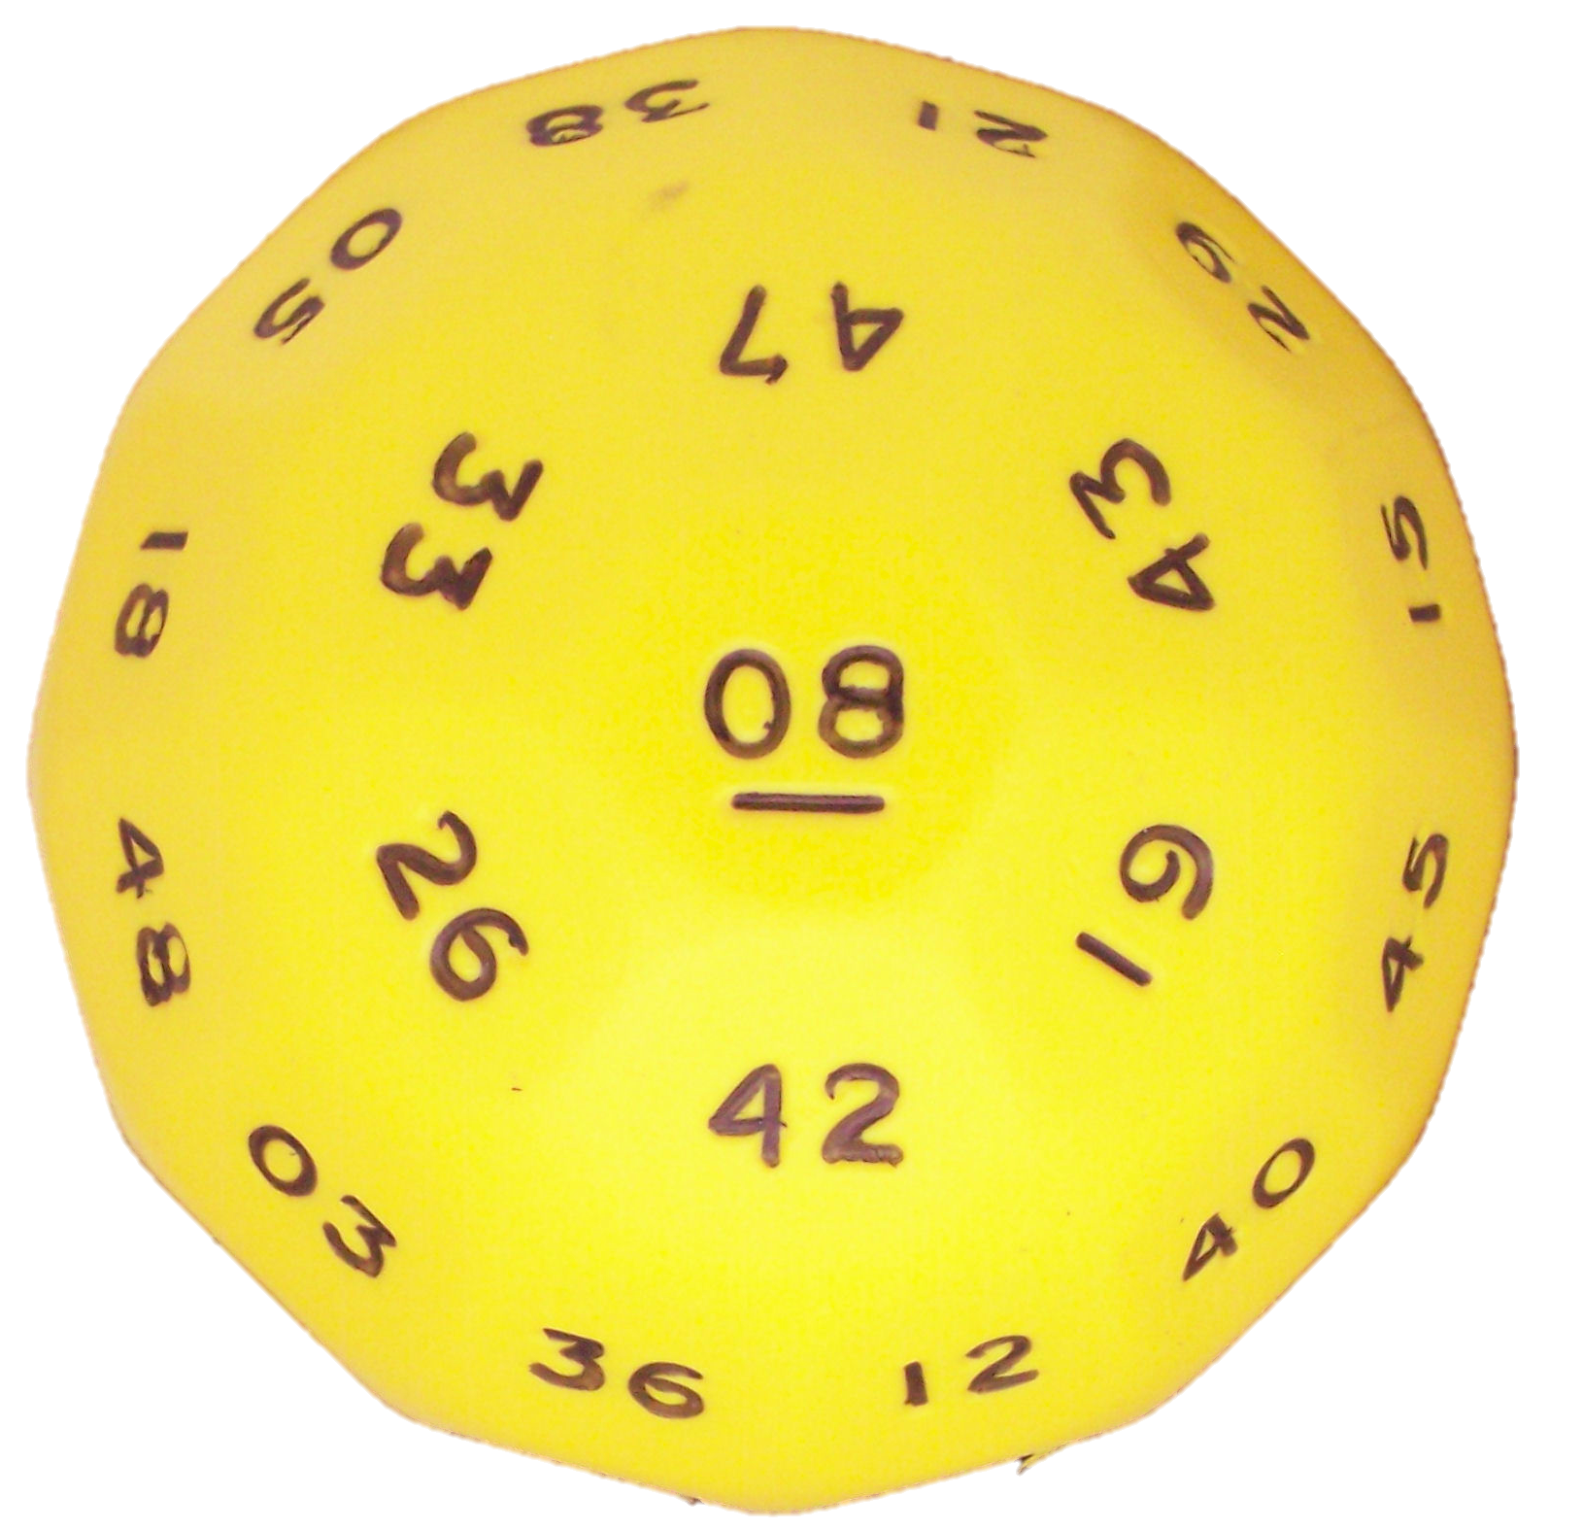

Many-sided dice
Now you toss an “infinite-sided die” 3 times.
What is the probability the
values are increasing?

