Slide 1
7. Properties of expectation

Slide 2
Calculating expectation
1. From the definition
E[X] = ∑_{x} x P(X = x)
2. Using linearity of expectation
E[X₁ + … + X_{n}] = E[X₁] + … + E[X_{n}]
3. Expectation of derived random variables
E[g(X, Y)] = ∑_{x} g(x, y) P(X = x, Y = y)

Slide 3
Runs
You toss a coin 10 times. What is the expected number of runs R with at least 3 heads?
Examples
HHHHTHHHTH
R = 2
HHHHHHHHHH
R = 1
HHHTTTTTTT
R = 1
Which method to use?
1.
Definition
2.
Linearity of
expectation
3.
Derived
random var.

Slide 4
Runs
Solution
R = I₁ + I₂ + … + I₈
where I₁ is an indicator that a run with at least 3 heads starts at position 1, and so on.
HHHHTHHHTH
In this example, I₁ and I₅ equal 1,
and all others equal 0.
E[R] = E[I₁] + E[I₂] + … + E[I₈]

Slide 5
Runs
E[I₁] = P(I₁ = 1)
= P(run of ≥ 3 Hs starts at position 1)
= 1/8.
E[I₂] = P(I₂ = 1)
= P(run of ≥ 3 Hs starts at position 2)
= 1/8
= 1/16

Slide 6
Runs
E[I₁] = 1/8
E[I₂] = 1/16
By the same reasoning:
E[I₃] =
1/16
E[I₄] = … = E[I₈] = 1/16
so
E[R] = E[I₁] + E[I₂] + … + E[I₈]
= 1/8 + 7 × 1/16 = 9/16.

Slide 7
Problem for you to solve
You toss a coin 10 times. What is the expected number of runs R with exactly 3 heads?
Examples
HHHHTHHHTH
R = 1
HHHHHHHHHH
R = 0

Slide 8

Two cars on a road
Two cars are at random positions along a 1-mile long road. Find the expected distance between them.
0
D
1
Which method to use?
1.
Definition
2.
Linearity of
expectation
3.
Derived
random var.

Slide 9
Two cars on a road
Probability model
Car positions X, Y are independent Uniform(0, 1)
The distance between them is D = |Y – X|
E[D]
¹
¹
|y – x|
= ∫₀ ∫₀ |y – x| dy dx
x
¹
= ∫₀ (x²/2 + (1 – x)²/2)dx
1 - x
= 1/3
y
x
1

Slide 10
Conditional p.m.f.
Let X be a random variable and A be an event. The conditional p.m.f. of X given A is
P(X = x and A)
P(X = x | A) =
P(A)
The conditional expectation of X given A is
E(X | A) = ∑_{x} x P(X = x | A)

Slide 11
Example
You flip 3 coins. What is the expected number of heads X given that there is at least one head (A)?
Solution
x
0
1
2
3
p.m.f. of X:
P(X = x)
1/8
3/8
3/8
1/8
P(A) = 7/8
x
0
1
2
3
p.m.f. of X|A:
P(X = x|A)
0
3/7
3/7
1/7
E[X | A] = 1 ∙ 3/7 + 2 ∙ 3/7 + 3 ∙ 1/7 = 12/7

Slide 12
Average of conditional expectations
E[X] = E[X|A] P(A) + E[X|A^{c}] P(A^{c})
More generally, if A₁,…, A_{n}
partition S then
A₁
A₃
A₄
A₅
A₂
E[X] = E[X|A₁]P(A₁) + … + E[X|A_{n}]P(A_{n})

Slide 13
Example
You flip 3 coins. What is the expected number of heads X given that there is at least one head (A)?
Solution 2
E[X] = E[X | A] P(A) + E[X | A^{c}] P(A^{c})
3/2
7/8
0
1/8
E[X | A] = (3/2)/(7/8) = 12/7.

Slide 14
Geometric random variable
Let X₁, X₂, … be independent Bernoulli(p) trials.
A Geometric(p) random variable N is the time of the first success among X₁, X₂, … :
N = first (smallest) n such that X_{n} = 1.
So P(N = n) = P(X₁ = 0, …, X_{n-1} = 0, X_{n} = 1)
= (1 – p)^{n-1}p.
This is the p.m.f. of N.

Slide 15
Geometric(0.5)
Geometric(0.7)
Geometric(0.05)

Slide 16
Geometric random variable
If N is Geometric(p), its expected value is
E[N] = ∑_{n} n P(N = n)
= ∑_{n} n (1 – p)^{n-1}p
= … = 1/p
Here is a better way:
E[N] = E[N|X₁ = 1] P(X₁ = 1) + E[N|X₁ = 0] P(X₁ = 0)
1
p
1 + E[N]
1 - p
E[N] = p + (1 + E[N])(1 – p)
so E[N] = 1/p.

Slide 17
Geometric(0.5)
Geometric(0.7)
Geometric(0.05)

Slide 18


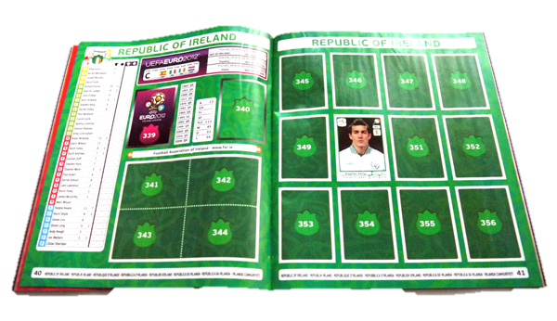
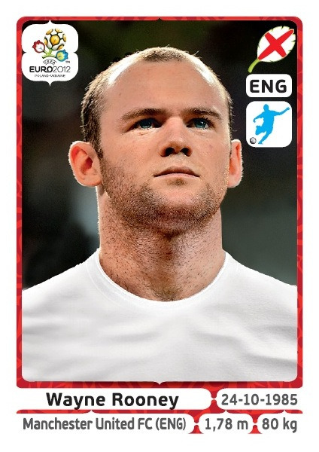
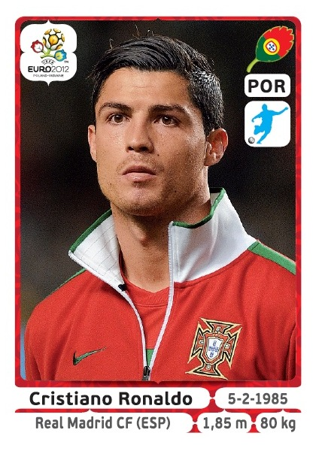
Coupon collection
There are n types of stickers. Every day you get one. When do you expect to get all the coupon types?

Slide 19
Coupon collection
Solution
Let X be the day on which you collect all coupons
Let W_{i} be the number of days you wait between sticking the i – 1st coupon and the i ^{th} coupon
X = W₁ + W₂ + … + W_{n}
E[X] = E[W₁] + E[W₂] + … + E[W_{n}]

Slide 20
Coupon collection
Let’s calculate E[W₁], E[W₂], …, E[W_{n}]
E[W₁] = 1
E[W₂] = ?
n/(n - 1)
W₂ is Geometric((n - 1)/n)
E[W₃] = ?
n/(n - 2)
W₃ is Geometric((n - 2)/n)
E[W_{n}] = ?
n/1
W_{n} is Geometric(1/n)

Slide 21
Coupon collection
E[X] = E[W₁] + E[W₂] + … + E[W_{n}]
= 1 + n/(n – 1) + n/(n – 2) + … + n
= n(1 + 1/2 + … + 1/n)
= n ln n +γn ± 1
γ ≈ 0.5772156649
(see http://en.wikipedia.org/wiki/Harmonic_number)
To collect 272 coupons, it takes about 1681 day on average.

Slide 22
Review: Calculating expectation
1. From the definition
Always works, but calculation is sometimes difficult.
2. Using linearity of expectation
Great when the random variable counts the number of events of some type. They don’t have to be independent!
3. Derived random variables
Useful when method 2 fails, e.g. E[|X – Y|]
4. Average of conditional expectations
Very useful for experiments that happen in stages

Slide 23
Expectation and independence
Random variables X and Y (discrete or continuous) are independent if and only if
E[g(X)h(Y)] = E[g(X)] E[h(Y)]
for all real valued functions g and h.
In particular, E[XY] = E[X]E[Y] for independent X and Y (but not in general).

Slide 24
Variance and covariance
Recall the variance of X is
Var[X] = E[(X – E[X])²] = E[X²] – E[X]²
The covariance of X and Y is
Cov[X, Y] = E[(X – E[X])(Y – E[Y])]
= E[XY] – E[X]E[Y]
If X = Y, then Cov[X, Y] = Var[X] ≥ 0
If X, Y are independent then Cov[X, Y] = 0

Slide 25
Variance of sums
Var[X + Y] = Var[X] + Var[Y] + Cov[X, Y] + Cov[Y, X]
For any X₁, …, X_{n}:
Var[X₁ + … + X_{n}]
= Var[X₁] + … + Var[X_{n}] + ∑_{i ≠ j} Cov[X_{i}, X_{j}]
When every pair among X₁,…, X_{n} is independent:
Var[X₁ + … + X_{n}] = Var[X₁] + … + Var[X_{n}].

Slide 26
Hats
n people throw their hats in the air. Let N be the number of people that get back their own hat.
Solution
N = I₁ + … + I_{n}
where I_{i} is the indicator for the event that person i gets their hat. Then
E[I_{i} ] = P(I_{i} = 1) = 1/n
E[N ] = n 1/n = 1.

Slide 27
Hats
E[I_{i} ] = 1/n
Var[I_{i} ] = (1 – 1/n)1/n
Cov[I_{i} , I_{j}] = E[I_{i}I_{j}] – E[I_{i}]E[I_{j}]
= P(I_{i} = 1, I_{j} = 1) – P(I_{i} = 1) P(I_{j} = 1)
= 1/n(n – 1) – 1/n²
= 1/n²(n – 1)
Var[N ] = n⋅(1 – 1/n)1/n + n(n – 1)⋅1/n²(n – 1) = 1.

Slide 28
Patterns
A coin is tossed n times. Find the expectation and variance in the number of patterns HH.
Solution
N = I₁ + … + I_{n-1}
where I_{i} is the indicator for the event that the i^{th} and (i + 1)^{st} toss both came out H.
E[I_{i} ] = P(I_{i} = 1) = 1/4
E[N ] = (n – 1)/4

Slide 29
Patterns
E[I_{i} ] = 1/4
Var[I_{i} ] = 3/4 1/4 = 3/16
Cov[I_{i} , I_{j}] = E[I_{i}I_{j}] – E[I_{i}]E[I_{j}] = P(I_{i} = 1, I_{j} = 1) – P(I_{i} = 1) P(I_{j} = 1)
1/8 – (1/4)²
HHH???????
Cov[I₁ , I₂] =
= 1/16
Cov[I₁ , I₃] =
1/16 – (1/4)²
= 0
HHHH??????
because I₁ and I₃ are independent!
Cov[I₁ , I₂] = Cov[I₂ , I₃] = … = Cov[I_{n-2}, I_{n-1}] = 1/16
Cov[I₂ , I₁] = Cov[I₃ , I₂] = … = Cov[I_{n-1}, I_{n-2}] = 1/16
all others = 0
Var[N ] =
(n – 1)⋅3/16
+ 2(n – 2)⋅1/16
= (5n – 7)/16.

Slide 30
Problem for you to solve
8 husband-wife couples are seated at a round table. Let N be the number of couples seated together.
Find the expected value and the variance of N.

