Slide 1
6. Jointly Distributed
Random Variables

Slide 2
Cards
There is a box with 4 cards:
1
2
3
4
You draw two cards without replacement.
What is the p.m.f. of the sum of the face values?

Slide 3
Cards
Probability model
S = ordered pairs of cards, equally likely outcomes
X = face value on first card
Y = face value on second card
We want the p.m.f. of X + Y
P(X + Y = 4)
= 1/6.
= P(X = 1, Y = 3) + P(X = 2, Y = 2) + P(X = 3, Y = 1)
1/12
0
1/12

Slide 4
Joint distribution function
In general
P(X + Y = z) = ∑_{(x, y): x + y = z} P(X = x, Y = y)
to calculate P(X + Y = z) we need to know
f(x, y) = P(X = x, Y = y)
for every pair of values x, y.
This is the joint p.m.f. of X and Y.

Slide 5
Cards
2 | 0
3 | 1/6
4 | 1/6
5 | 1/3
6 | 1/6
7 | 1/6
8 | 0
joint p.m.f. of X and Y:
X
1
2
3
4
Y
2
3
4
5
0 | 1/12 | 1/12 | 1/12
1/12 | 0 | 1/12 | 1/12
1/12 | 1/12 | 0 | 1/12
1/12 | 1/12 | 1/12 | 0
1
3
4
5
6
2
4
5
6
7
3
5
6
7
8
4
p.m.f. of X + Y

Slide 6
Question for you
There is a box with 4 cards:
1
2
3
4
You draw two cards without replacement.
What is the p.m.f. of the larger face value?
What if you draw the cards with replacement?

Slide 7
Marginal probabilities
X
1
2
3
4
Y
0 | 1/12 | 1/12 | 1/12
1/12 | 0 | 1/12 | 1/12
1/12 | 1/12 | 0 | 1/12
1/12 | 1/12 | 1/12 | 0
1/4
1/4
1/4
1/4
1
2
P(Y = y) = ∑_{x} P(X = x, Y = y)
3
4
1/4 | 1/4 | 1/4 | 1/4
1
P(X = x) = ∑_{y} P(X = x, Y = y)

Slide 8
Red and blue balls
You have 3 red balls and 2 blue balls. Draw 2 balls at random. Let X be the number of blue balls drawn.
Replace the 2 balls and draw one ball. Let Y be the number of blue balls drawn this time.
X
Y
0
1
2
Y
9/50 | 18/50 | 3/50
6/50 | 12/50 | 2/50
3/5
2/5
0
1
X
3/10 | 6/10 | 1/10

Slide 9
Independent random variables
Let X and Y be discrete random variables.
X and Y are independent if
P(X = x, Y = y) = P(X = x) P(Y = y)
for all possible values of x and y.

Slide 10
Example
Alice tosses 3 coins and so does Bob. What is the probability they get the same number of heads?
Probability model
Let A / B be Alice’s / Bob’s number of heads
Each of A and B is Binomial(3, ½)
A and B are independent
We want to know P(A = B)

Slide 11
Example
Solution 1
A
0
1
2
3
B
B
1/64 | 3/64 | 3/64 | 1/64
3/64 | 9/64 | 9/64 | 3/64
3/64 | 9/64 | 9/64 | 3/64
1/64 | 3/64 | 3/64 | 1/64
1/8
3/8
3/8
1/8
0
1
2
3
A
1/8 | 3/8 | 3/8 | 1/8
P(A = B) = 20/64 = 31.25%

Slide 12
Example
Solution 2
P(A = B)
= ∑_{h} P(A = h, B = h)
= ∑_{h} P(A = h) P(B = h)
= ∑_{h} (C(3, h) 1/8) (C(3, h) 1/8)
= 1/64 (C(3, 0)² + C(3, 1)² + C(3, 2)² + C(3, 3)²)
= 20/64
= 31.25%

Slide 13

Independent Poisson
Let X be Poisson(μ) and Y be Poisson(ν). If X and Y are independent, what is the p.m.f. of X + Y?
Intuition
0
1
X is the number of blue raindrops in 1 sec
Y is the number of red raindrops in 1 sec
X + Y is the total number of raindrops
E[X + Y] = E[X] + E[Y] = μ + ν

Slide 14
Independent Poisson
The p.m.f. of X + Y is
P(X + Y = z)
= ∑_{(x, y): x + y = z} P(X = x, Y = y)
= ∑_{(x, y): x + y = z} P(X = x) P(Y = y)
= ∑_{(x, y): x + y = z} (e^{-μ} μ^{x}/x!) (e^{-ν} ν^{y}/y!)
= e^{-(μ+ν)} ∑_{(x, y): x + y = z} (μ^{x}ν^{y})/(x!y!)
= (e^{-(μ+ν)}/z!) ∑_{(x, y): x + y = z} (μ^{x}ν^{y}) z!/(x!y!)
= (e^{-(μ+ν)}/z!) ∑_{(x, y): x + y = z} C(z, x) μ^{x}ν^{z -} ^{x}
= (e^{-(μ+ν)}/z!) (μ + ν)^{z}
This is the formula
for Poisson(μ + ν)

Slide 15
Expectation
E[X, Y] doesn’t make sense, so we look at E[g(X, Y)] for example E[X + Y], E[min(X, Y)]
There are two ways to calculate it:
Method 1.
First obtain the p.m.f. f_{Z} of Z = g(X, Y)
Then calculate E[Z] = ∑_{z} z f_{Z}(z)
Method 2.
Calculate directly using the formula
E(g(X, Y)) = ∑_{x,} _{y} g(x, y) f_{XY}(x, y)

Slide 16
Method 1: Example
A
0
1
2
3
min(A, B)
B
0
0
0
0
1/64 | 3/64 | 3/64 | 1/64
3/64 | 9/64 | 9/64 | 3/64
3/64 | 9/64 | 9/64 | 3/64
1/64 | 3/64 | 3/64 | 1/64
15/64
33/64
15/64
1/64
0
0
0
1
1
1
1
1
0
1
2
2
2
2
0
1
2
3
3
3
E[min(A, B)] =
0⋅15/64 + 1⋅33/64 + 2⋅15/64 + 3⋅1/64
= 33/32

Slide 17
Method 2: Example
A
0
1
2
3
B
0
0
0
0
1/64 | 3/64 | 3/64 | 1/64
3/64 | 9/64 | 9/64 | 3/64
3/64 | 9/64 | 9/64 | 3/64
1/64 | 3/64 | 3/64 | 1/64
0
0
1
1
1
1
0
1
2
2
2
0
1
2
3
3
E[min(A, B)] =
0⋅1/64 + 0⋅3/64 + ... + 3⋅1/64
= 33/32

Slide 18
the cheat sheet
X, Y discrete
joint p.m.f. f_{XY}(x, y) = P(X = x, Y = y)
Probability of an event
(determined by X, Y)
P(A) = ∑_{(x, y) in A} f_{XY} (x, y)
Derived random variables
Z = g(X, Y)
f_{Z}(z) = ∑_{(x, y): g(x, y) = z} f_{XY}(x, y)
Marginal p.m.f.’s
f_{X}(x) = ∑_{y} f_{XY}(x, y)
Independence
f_{XY}(x, y) = f_{X}(x) f_{Y}(y) for all x, y
Expectation of Z = g(X, Y)
E[Z] = ∑_{x,} _{y} g(x, y) f_{XY}(x, y)

Slide 19
Continuous random variables
A pair of continuous random variables X, Y can be specified either by their joint c.d.f.
F_{XY}(x, y) = P(X ≤ x, Y ≤ y)
or by their joint p.d.f.
∂
∂
f_{XY}(x, y)
=
F_{XY}(x, y)
∂x
∂y
P(x < X ≤ x + ε, y < Y ≤ y + δ)
=
lim
ε, δ → 0
εδ

Slide 20
An example
Rain drops at a rate of 1 drop/sec. Let X and Y be the arrival times of the first and second raindrop.
X
Y
F(x, y) = P(X ≤ x, Y ≤ y)
f(x, y)
=
∂
∂
F(x, y)
∂x
∂y

Slide 21
Continuous marginals
Given the joint c.d.f F_{XY}(x, y) = P(X ≤ x, Y ≤ y), we can calculate the marginal c.d.f.s:
F_{X}(x) = P(X ≤ x) = lim F_{XY} (x, y)
y → ∞
F_{Y}(y) = P(Y ≤ y) = lim F_{XY} (x, y)
x → ∞
P(X ≤ x)
Exponential(1)

Slide 22
the continuous cheat sheet
X, Y continuous with joint p.d.f. f_{XY}(x, y)
Probability of an event
(determined by X, Y)
P(A) = ∫∫_{A} f_{XY} (x, y) dxdy
Derived random variables
Z = g(X, Y)
f_{Z}(z) = ∫∫_{(x, y): g(x, y) = z} f_{XY}(x, y) dxdy
Marginal p.m.f.’s
∞
f_{X}(x) = ∫_{-∞} f_{XY}(x, y) dy
Independence
f_{XY}(x, y) = f_{X}(x) f_{Y}(y) for all x, y
Expectation of Z = g(X, Y)
E[Z] = ∫∫ g(x, y) f_{XY}(x, y) dxdy

Slide 23

Independent uniform random variables
Let X, Y be independent Uniform(0, 1).
1
if 0 < x, y < 1
f_{XY}(x, y) = f_{X}(x) f_{Y}(y) =
0
if not
f_{XY}(x, y)
1
if 0 < x < 1
f_{X}(x) =
0
if not
1
if 0 < y < 1
f_{Y}(y) =
0
if not

Slide 24
Meeting time
Alice and Bob arrive in Shatin between 12 and 1pm. How likely arrive within 15 minutes of one another?
Probability model
Arrival times X, Y are independent Uniform(0, 1)
Event A: |X – Y| ≤ ¼
P(A) = ∫∫_{A} f_{XY} (x, y) dxdy
= ∫∫_{A} 1 dxdy
= area(A) in [0, 1]²

Slide 25
Meeting time
1
Event E: |X – Y| ≤ ¼
y = x + ¼
P(E) = area(E)
y
= 1 – (3/4)²
y = x – ¼
= 7/16
0
0
x
1

Slide 26
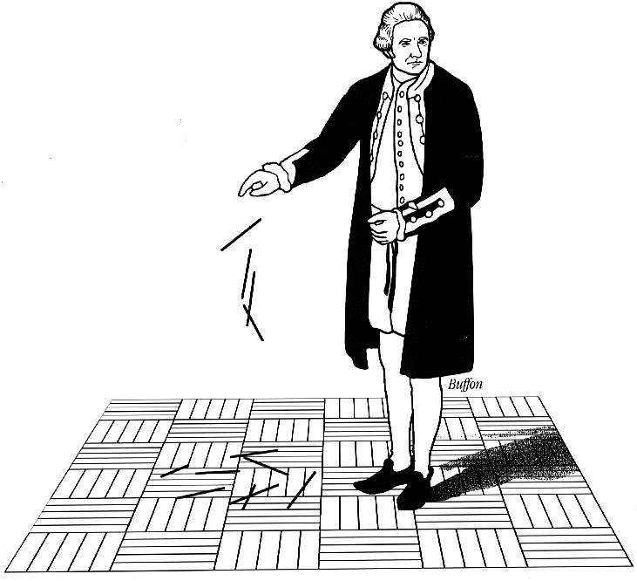
Buffon’s needle
A needle of length l is randomly dropped on a ruled sheet.
What is the probability that the needle hits one of the lines?

Slide 27
Buffon’s needle
The lines are 1 unit apart
X
Θ
X is the distance from midpoint to nearest line
1
Θ is angle with horizontal
Probability model
X is Uniform(0, ½)
Θ is Uniform(0, π)
X, Θ are independent

Slide 28
Buffon’s needle
l/2
The p.d.f. is
X
Θ
f_{XΘ}(x, θ) = f_{X}(x) f_{Θ}(θ) =
2/π
1
for 0 < X < ½, 0 < Θ < π
½
l/2
The event H = “needle
hits line” happens
when X < (l/2) sinΘ
x
H
0
0
θ
π

Slide 29
Buffon’s needle
If l ≤ 1 (short needle) then (l/2) sinθ is always ≤ ½:
^{π}
^{(l/2)sinθ}
P(H) = ∫∫_{B} f_{XΘ}(x, θ) dxdθ
= ∫₀ ∫₀ 2/π dxdθ
P(H)
^{π}
^{(l/2) sinθ}
= ∫₀ ∫₀ 2/π dxdθ
^{π}
= ∫₀ (l /π) sinθ dθ
^{π}
= (l /π) ∫₀ sinθ dθ
= 2l /π.

Slide 30
Many random variables: discrete case
Random variables X₁, X₂, …, X_{k} are specified by their joint p.m.f P(X₁ = x₁, X₂ = x₂, …, X_{k} = x_{k}).
We can calculate marginal p.m.f.’s, e.g.
P(X₁ = x₁, X₃ = x₃) = ∑_{x2} P(X₁ = x₁, X₂ = x₂, X₃ = x₃)
P(X₃ = x₃) = ∑_{x1, x2} P(X₁ = x₁, X₂ = x₂, X₃ = x₃)
and so on.

Slide 31
Independence for many random variables
Discrete X₁, X₂, …, X_{k} are independent if
P(X₁ = x₁, X₂ = x₂, …, X_{k} = x_{k})
= P(X₁ = x₁) P(X₂ = x₂) … P(X_{k} = x_{k})
for all possible values x₁, …, x_{k}.
For continuous, we look at p.d.f.’s instead of p.m.f.’s

Slide 32
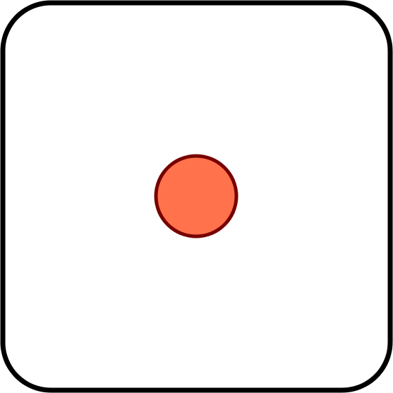
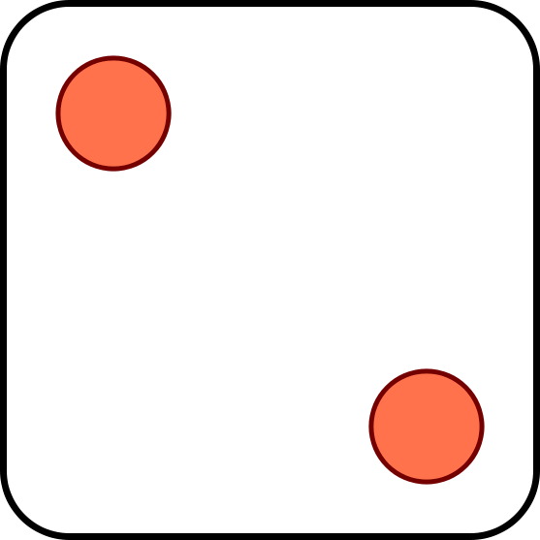
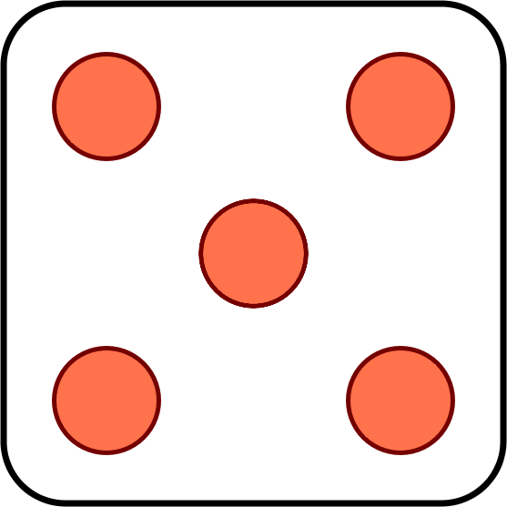
Dice
Three dice are tossed. What is the probability that their face values are non-decreasing?
Solution
Let X, Y, Z be face values of first, second, third die
X, Y, Z independent with p.m.f. p(1) = … = p(6) = 1/6
We want the probability of the event X ≤ Y ≤ Z

Slide 33
Dice
P(X ≤ Y ≤ Z)
= ∑_{(x, y, z): x ≤ y ≤ z} P(X = x, Y = y, Z = z)
= ∑_{(x, y, z): x ≤ y ≤ z} (1/6)³
= ∑_{z =} ₁ ∑_{y =} ₁ ∑_{x =} ₁ (1/6)³
⁶
^{z}
^{y}
= ∑_{z =} ₁ ∑_{y =} ₁ (1/6)³ y
⁶
^{z}
= ∑_{z =} ₁ (1/6)³ z (z + 1)/2
⁶
= (1/6)³ (1∙2 + 2∙3 + 3∙4 + 4∙5 + 5∙6 + 6∙7)/2
= (1/6)³ (1∙2 + 2∙3 + 3∙4 + 4∙5 + 5∙6 + 6∙7)/2
= 56/216 ≈ 0.259

Slide 34
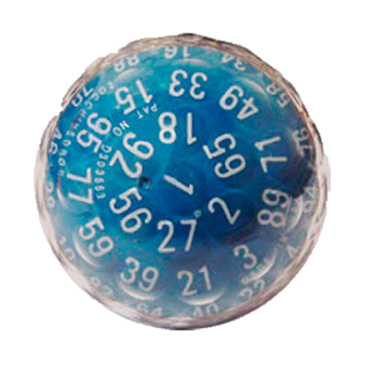
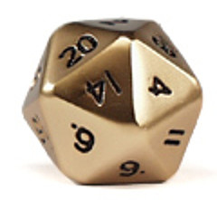
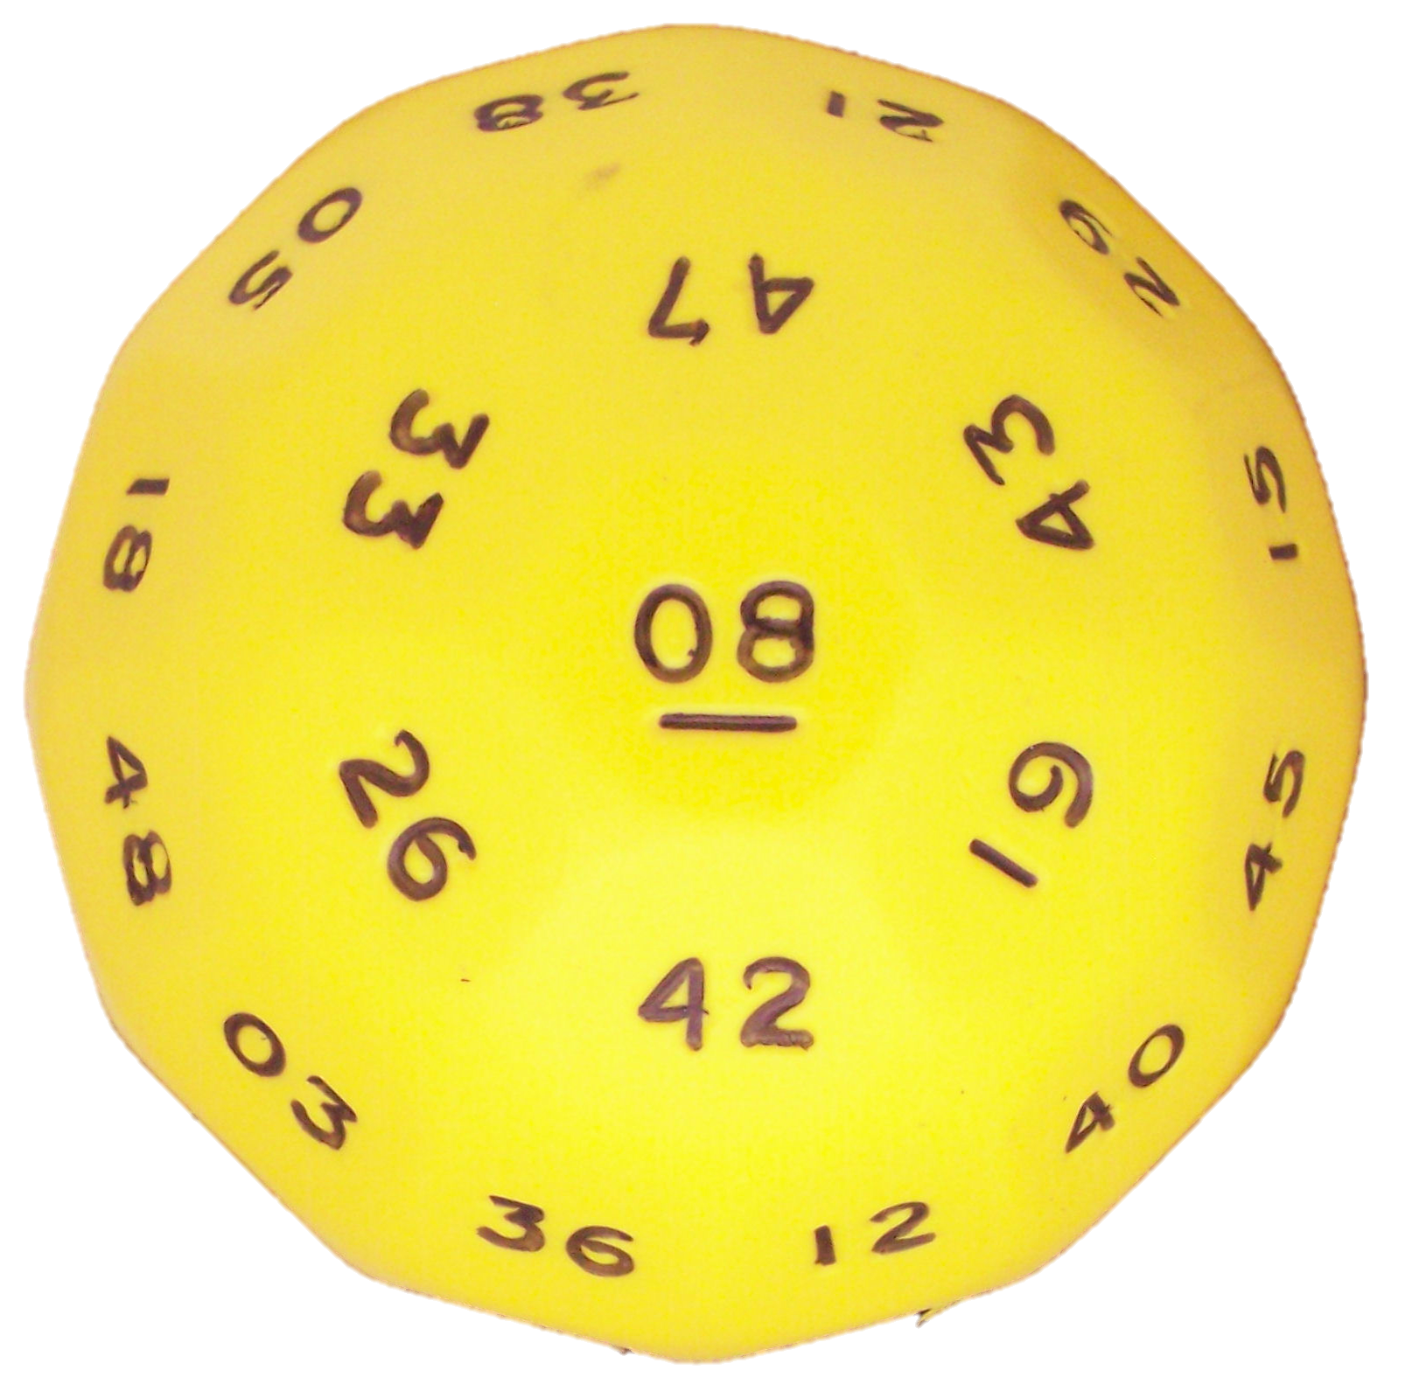

Many-sided dice
Now you toss an “infinite-sided die” 3 times.
What is the probability the
values are increasing?

