Slide 1
4. Random variables part one

Slide 2
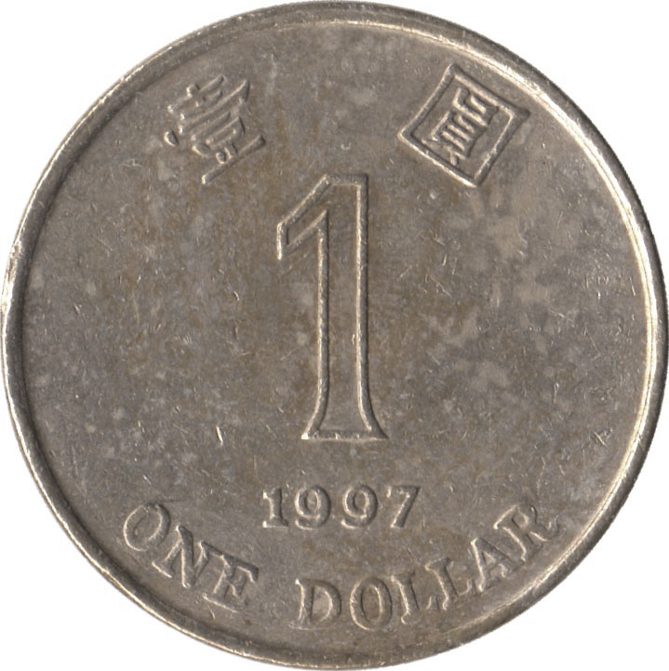
Random variable
A discrete random variable assigns a discrete value to every outcome in the sample space.
Example
{ HH, HT, TH, TT }
N = number of Hs

Slide 3
Probability mass function
The probability mass function (p.m.f.) of discrete random variable X is the function
p(x) = P(X = x)
Example
{ HH, HT, TH, TT }
¼
¼
¼
¼
N = number of Hs
p(0) = P(N = 0) = P({TT}) = 1/4
p(1) = P(N = 1) = P({HT, TH}) = 1/2
p(2) = P(N = 2) = P({HH}) = 1/4

Slide 4
Probability mass function
We can describe the p.m.f. by a table or by a chart.
x 0 1 2
p(x)
p(x) ¼ ½ ¼
x

Slide 5
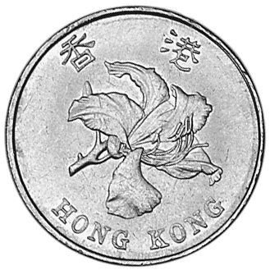
Example
A change occurs when a coin toss comes out different from the previous one.
Toss a coin 3 times. Calculate the p.m.f. of the number of changes.

Slide 6
Balls
We draw 3 balls without replacement from this urn:
0
1
-1
0
1
0
1
-1
-1
Let X be the sum of the values on the balls. What is the p.m.f. of X?

Slide 7
Balls
0
1
-1
0
X = sum of values on the 3 balls
1
0
1
E_{abc}: we chose balls of type a, b, c
-1
-1
P(X = 0)
= P(E₀₀₀) + P(E₁₍₋₁₎₀)
= (1 + 3×3×3)/C(9, 3) = 28/84
P(X = 1)
= P(E₁₀₀) + P(E₁₁₍₋₁₎)
= (3×3 + 3×3)/C(9, 3) = 18/84
P(X = -1)
= P(E₍₋₁₎₀₀) + P(E₍₋₁₎₍₋₁₎₁)
= (3×3 + 3×3)/C(9, 3) = 18/84
P(X = 2)
= P(E₁₁₀)
= 3×3/C(9, 3)
= 9/84
P(X = -2)
= P(E₍₋₁₎₍₋₁₎₀)
= 3×3/C(9, 3)
= 9/84
P(X = 3)
= P(E₁₁₁)
= 1/C(9, 3)
= 1/84
P(X = -3)
= P(E₍₋₁₎₍₋₁₎₍₋₁₎)
= 1/C(9, 3)
= 1/84
1

Slide 8
Probability mass function
p.m.f. of sum of values on the 3 balls
The events “X = x” are disjoint and partition the sample space, so for every p.m.f
∑_{x} p(x) = 1

Slide 9


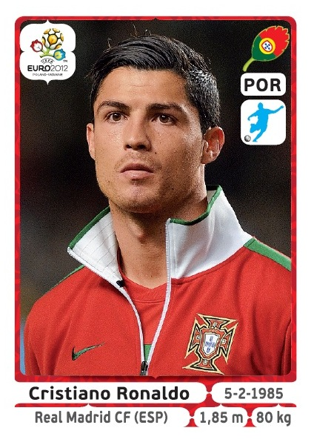
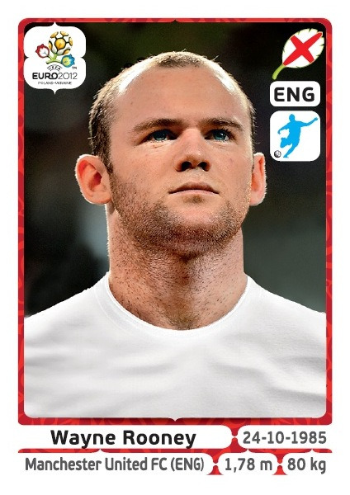
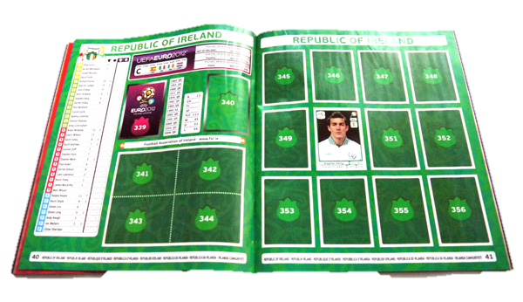
Coupon collection

Slide 10
Coupon collection
There are n types of coupons. Every day you get one. You want a coupon of type 1. By when will you get it?
Probability model
Let E_{i} be the event you get a type 1 coupon on day i
Since there are n types, we assume
P(E₁) = P(E₂) = … = 1/n
We also assume E₁, E₂, … are independent

Slide 11
Coupon collection
Let X₁ be the day on which you get coupon 1
P(X₁ ≤ d)
= 1 – P(X₁ > d)
= 1 – P(E₁^{c}E₂^{c} … E_{d}^{c})
= 1 – P(E₁^{c}) P(E₂^{c}) … P(E_{d}^{c})
= 1 – (1 – 1/n)^{d}

Slide 12
Coupon collection
There are n types of coupons. Every day you get one. By when will you get all the coupon types?
Solution
Let X_{t} be the day on which you get a type t coupon
Let X be the day on which you collect all coupons
(X ≤ d) = (X₁ ≤ d) and (X₂ ≤ d) … (X_{n} ≤ d)
not independent!
(X > d) = (X₁ > d) ∪ (X₂ > d) ∪ … ∪ (X_{n} > d)

Slide 13
Coupon collection
We calculate P(X > d) by inclusion-exclusion
P(X > d) = ∑ P(X_{t} > d) – ∑ P(X_{t} > d and X_{u} > d) + …
P(X₁ > d) = (1 – 1/n)^{d}
by symmetry P(X_{t} > d) = (1 – 1/n)^{d}
P(X₁ > d and X₂ > d)
= P(F₁ … F_{d})
F_{i} = “day i coupon is not
of type 1 or 2”
= P(F₁) … P(F_{d})
independent events
= (1 – 2/n)^{d}

Slide 14
Coupon collection
P(X > d) = ∑ P(X_{t} > d) – ∑ P(X_{t} > d and X_{u} > d) + …
P(X₁ > d) = (1 – 1/n)^{d}
P(X₁ > d and X₂ > d) = (1 – 2/n)^{d}
P(X₁ > d and X₂ > d and X₃ > d) = (1 – 3/n)^{d} and so on
so P(X > d) = C(n, 1) (1 – 1/n)^{d} – C(n, 2) (1 – 2/n)^{d} + …
= ∑_{i = 1} (-1)^{i+1} C(n, i) (1 – i/n)^{d}
^{n}

Slide 15
Coupon collection
P(X ≤ d)
n = 15
d
Probability of collecting all n coupons by day d

Slide 16
Coupon collection
.523
.520
n = 5
n = 10
10
d
27
d
.503
.500
n = 15
n = 20
46
67

Slide 17
Coupon collection
p = 0.5
p = 0.5
n
n
Day on which the probability
of collecting all n coupons
first exceeds p
n
The function
n ln
ln 1/(1 – p)

Slide 18
Coupon collection
16 teams
17 coupons per team
272 coupons
it takes 1624 days to collect all coupons.

Slide 19
Something to think about
There are 91 students in ENGG 2040C.
Every Tuesday I call 6 students to do problems on the board. There are 11 such Tuesdays.
What are the chances you are never called?

Slide 20
Expected value
The expected value (expectation) of a random variable X with p.m.f. p is
E[X] = ∑_{x} x p(x)
Example
N = number of Hs
x 0 1
p(x) ½ ½
E[N] = 0 ½ + 1 ½ = ½

Slide 21
Expected value
Example
E[N]
N = number of Hs
x 0 1 2
p(x) ¼ ½ ¼
E[N] = 0 ¼ + 1 ½ + 2 ¼ = 1
The expectation is the average value the random variable takes when experiment is done many times

Slide 22

Expected value
Example
F = face value of fair 6-sided die
1
1
1
1
1
1
E[F] = 1 + 2 + 3 + 4 + 5 + 6 = 3.5
6
6
6
6
6
6

Slide 23


Russian roulette
Alice
Bob
N = number of rounds
what is E[N]?

Slide 24
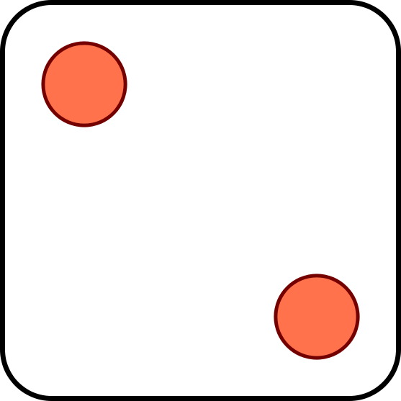
Chuck-a-luck
1
2
3
4
5
6
If appears k times, you win $k.
If it doesn’t appear, you lose $1.

Slide 25
Chuck-a-luck
Solution
P = profit
n
-1 1 2 3
5
1
1
5
5
1
( )
( )²
( )³
p(n)
( )³
3
( )²
( )
3
6
6
6
6
6
6
E[P] = -1 (5/6)³ + 1 3(5/6)²(1/6)²
+ 2 3(5/6)(1/6)² + 3 (5/6)³ = -17/216

Slide 26



Utility
Should I come to class this Tuesday?
not called
called
+5
-50
E[C]
= 1.37…
Come
5 85/91 -50 6/91
+100
-800
Skip
F
E[S]
= 40.66…
100 85/91 -800 6/91
85/91
6/91

Slide 27
Average household size
In 2011 the average household in Hong Kong had 2.9 people.
Take a random person. What is the average number of people in his/her household?
A: < 2.9
B: 2.9
C: > 2.9

Slide 28








Average household size
average
household size
3
3
3
average size of random
person’s household
4⅓

Slide 29
Average household size
What is the average household size?
household size 1 2 3 4 5 more
% of households 16.6 25.6 24.4 21.2 8.7 3.5
From Hong Kong Annual Digest of Statistics, 2012
Probability model
The sample space are the households of Hong Kong
Equally likely outcomes
X = number of people in the household
E[X]
≈ 1×.166 + 2×.256 + 3×.244 + 4×.214 + 5×.087 + 6×.035
= 2.91

Slide 30
Average household size
Take a random person. What is the average number of people in his/her household?
Probability model
The sample space are the people of Hong Kong
Equally likely outcomes
Y = number of people in household
Let’s find the p.m.f. p_{Y}(y) = P(Y = y)

Slide 31
Average household size
# people in y person households
p_{Y}(y)
=
# people
y × (# y person households)
=
# people
y × (# y person households)/(# households)
=
(# people)/(# households)
y × p_{X}(y)
=
p.m.f. of X
?
must equal ∑_{y} y p_{X}(y) = E[X]

Slide 32
Average household size
X = number of people in a random household
Y = number of people in household of a random person
y p_{X}(y)
∑_{y} y² p_{X}(y)
p_{Y}(y) =
E[Y] = ∑_{y} y p_{Y}(y)
=
E[X]
E[X]
household size 1 2 3 4 5 more
% of households 16.6 25.6 24.4 21.2 8.7 3.5
1²×.166 + 2²×.256 + 3²×.244 + 4²×.214 + 5²×.087 + 6²×.035
E[Y] ≈
≈ 3.521
2.91

Slide 33
Functions of random variables
∑_{y} y² p_{X}(y)
E[X²]
E[Y]
=
=
E[X]
E[X]
In general, if X is a random variable and f a function, then Z = f(X) is a random variable with p.m.f.
p_{Z}(z) = ∑_{x: f(x) = z} p_{X}(x).

Slide 34
Preview
X = number of people in a random household
Y = number of people in household of a random person
E[X²]
E[Y]
=
E[X]
Next time we’ll show that for every random variable
E[X²] ≥ (E[X])²
So E[Y] ≥ E[X]. The two are equal only if all households have the same size.

