Slide 1
3. Conditional probability part two

Slide 2
Boxes
1
2
3
I choose a cup at random and then a random ball from that cup. The ball is blue. You need to guess where the ball came from.
(a) Which cup would you guess?
(b) What is the probability you are correct?

Slide 3
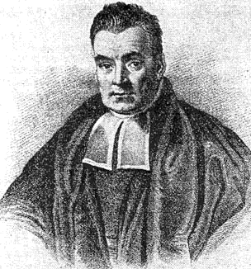
Bayes’ rule
P(E|F) P(F)
P(E|F) P(F)
P(F|E) =
=
P(E)
P(E|F) P(F) + P(E|F^{c}) P(F^{c})
More generally, if F₁,…, F_{n} partition S then
P(E|F_{i}) P(F_{i})
P(F_{i}|E) =
P(E|F₁) P(F₁) + … + P(E|F_{n}) P(F_{n})

Slide 4
Medical tests
If you are sick (S), a blood test comes out positive (P) 95% of the time.
If you are not sick, the test is positive 1% of the time.
Suppose 0.5% people in Hong Kong are sick.
You take the test and come out positive. What are the chances that you are sick?
P(P|S) P(S)
P(S|P) =
≈ 32.3%
P(P|S) P(S) + P(P|S^{c}) P(S^{c})
95% 0.5%
1% 99.5%

Slide 5
Problem for you to think about
Urn one has 9 blue balls and 1 red ball.
Urn two has 9 red balls and 1 blue ball.
I choose an urn at random and draw a ball. It is blue.
I draw another ball from the same urn (without replacement). What is the probability it is blue?

Slide 6


Russian roulette
Alice
Bob
BANG
Alice and Bob take turns spinning the 6 hole cylinder and shooting at each other.
What is the probability that Alice wins (Bob dies)?

Slide 7
Russian roulette
Probability model
S = { H, MH, MMH, MMMH, MMMH, …}
E.g. MMH: Alice misses, then Bob misses, then Alice kills
A = “Alice wins” = { H, MMH, MMMMH, …}
outcomes are not equally likely!

Slide 8
Russian roulette
outcome H MH MMH MMMH MMMH
probability
1/6
5/6 ∙ 1/6
(5/6)² ∙ 1/6
(5/6)³ ∙ 1/6
(5/6)⁴ ∙ 1/6
P(A)
= 1/6 + (5/6)² ∙ 1/6 + (5/6)⁴ ∙ 1/6 + …
= 1/6 ∙ (1 + (5/6)² + (5/6)⁴ + …)
= 1/6 ∙ 1/(1 – (5/6)²)
= 6/11

Slide 9
Russian roulette
Solution using conditional probabilities:
A = “Alice wins” = { H, MMH, MMMMH, …}
A^{c} = “Bob wins” = { MH, MMMH, MMMMMH, …}
W₁ = “Alice wins in first round” = { H }
P(A) = P(A|W₁) P(W₁) + P(A|W₁^{c}) P(W₁^{c})
1
1/6
P(A^{c})
5/6
P(A) = 1 ∙ 1/6 + (1 – P(A)) ∙ 5/6
11/6 P(A) = 1
so P(A) = 6/11

Slide 10
Infinite sample spaces
Axioms of probability:
1. for every E, 0 ≤ P(E) ≤ 1
S
E
2. P(S) = 1
S
3. If EF = ∅ then
S
P(E∪F) = P(E) + P(F)
E
F
3. If E₁, E₂, … are pairwise disjoint:
P(E₁∪E₂∪…) = P(E₁) + P(E₂) + …

Slide 11
Problem for you to solve
Charlie tosses a pair of dice. Alice wins if the sum is 7. Bob wins if the sum is 8.
Charlie keeps tossing until one of them wins.
What is the probability that Alice wins?

Slide 12
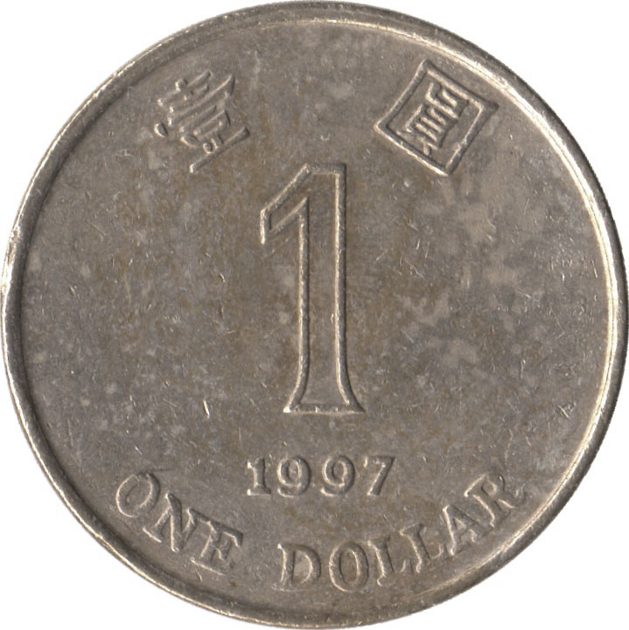
Independence of two events
Let E₁ be “first coin comes up H”
E₂ be “second coin comes up H”
Then P(E₂ | E₁) = P(E₂)
P(E₂E₁) = P(E₂)P(E₁)
Events A and B are independent if
P(A B) = P(A) P(B)

Slide 13
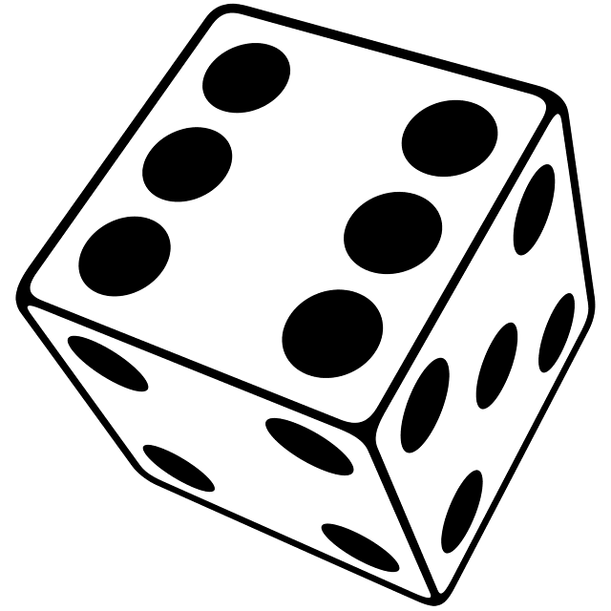
Examples of (in)dependence
Let E₁ be “first die is a 4”
S₆ be “sum of dice is a 6”
S₇ be “sum of dice is a 7”
P(E₁) = 1/6
P(E₁S₆) = 1/36
E₁, S₆ are dependent
P(S₆) = 5/36
P(S₇) = 1/6
P(E₁S₇) = 1/36
E₁, S₇ are independent
P(S₆S₇) = 0
S₆, S₇ are dependent

Slide 14


Reliability of sequential components
CUHK
Shing Mun
Tsing Ma
Airport
W_{SM}: “Shing Mun tunnel is operational”
P(W_{SM}) = 90%
W_{TM}: “Tsing Ma bridge is operational”
P(W_{TM}) = 98%
W: “The road is operational”
Assuming events W_{SM} and W_{TM} are independent:
P(W) = P(W_{SM}W_{TM}) = P(W_{SM})P(W_{TM}) = 88.2%

Slide 15
Algebra of independent events
If A and B are independent, then A and B^{c} are also independent.
Proof: Assume A and B are independent.
P(B^{c} | A)
= 1 – P(B | A)
= 1 – P(B)
= P(B^{c})
so B^{c} and A are independent.
Taking complements preserves independence.

Slide 16

Reliability of parallel components
85%
Lion Rock
95%
CUHK
Hung Hom
Tate’s Cairn
Assuming W_{LR} and W_{TC} are independent:
P(W) = P(W_{LR}∪W_{TC})
P(W^{c}) = P(W_{LR}^{c}W_{TC}^{c}) = P(W_{LR}^{c})P(W_{TC}^{c})
P(W) = 1 – P(W_{LR}^{c})P(W_{TC}^{c}) = 1 – 15% 5% = 99.25%

Slide 17
Independence of three events
Events A, B, and C are independent if
P(AB) = P(A) P(B)
P(BC) = P(B) P(C)
P(AC) = P(B) P(C)
and P(ABC) = P(A) P(B) P(C).
This is important!

Slide 18
(In)dependence of three events
Let E₁ be “first die is a 4”
E₂ be “second die is a 3”
S₇ be “sum of dice is a 7”
✔
P(E₁E₂) = P(E₁) P(E₂)
1/6
✔
E₁
P(E₁S₇) = P(E₁) P(S₇)
✔
P(E₂S₇) = P(E₂) P(S₇)
1/36
E₂
S₇
✗
P(E₁E₂S₇) = P(E₁) P(E₂) P(S₇)
1/6
1/6
1/36
1/6
1/6
1/6

Slide 19
Independence of many events
Events A₁, A₂, … are independent if for every subset A_{i1}, …, A_{ir} of the events
P(A_{i1}…A_{ir}) = P(A_{i1}) … P(A_{ir})
Algebra of independent events
Independence is preserved if we replace some event(s) by their complements, intersections, unions

Slide 20

For you to think about
85%
90%
Lion Rock
Eastern
95%
70%
CUHK
Shek O
Tate’s Cairn
Cross-Harbour
Assuming failures are independent, what is the probability that there is an operational road from CUHK to Shek O?

Slide 21

Playoffs
Alice wins 60% of her ping pong matches against Bob. They meet for a 3 match playoff. What are the chances that Alice will win the playoff?
Probability model
Let W_{i} be the event Alice wins match i
We assume P(W₁) = P(W₂) = P(W₃) = 0.6
We also assume W₁, W₂, W₃ are independent

Slide 22
Playoffs
Probability model
To convince ourselves this is a probability model, let’s redo it the usual way
S = { AAA, AAB, ABA, ABB, BAA, BAB, BBA, BBB }
the probability of AAA is P(W₁W₂W₃) = 0.6³
AAB
P(W₁W₂W₃^{c}) = 0.6² ∙ 0.4
ABA
P(W₁W₂^{c}W₃) = 0.6² ∙ 0.4
…
…
BBB
P(W₁^{c}W₂^{c}W₃^{c}) = 0.4³
The probabilities add up to one.

Slide 23
Playoffs
For Alice to win the tournament, she must win at least 2 out of 3 games. The corresponding event is
A = { AAA, AAB, ABA, BAA }
0.6³
0.6² ∙ 0.4 each
P(A) = 0.6³ + 3 ∙ 0.6² ∙ 0.4 = 0.648.
General playoff
Alice wins a p fraction of her ping pong games against Bob. What are the chances Alice beats Bob in an n match tournament (n is odd)?

Slide 24
Playoffs
Solution
Probability model similar as before.
Let A be the event “Alice wins playoff”
A_{k} be the event “Alice wins exactly k matches”
A = A_{(n+1)/2}∪…∪A_{n}
P(A) = P(A_{(n+1)/2}) + … + P(A_{n}) (they are disjoint)
P(A_{k}) = C(n, k) p^{k} (1 – p)^{n - k}
number of arrangements of k As, n – k Bs
probability of each such arrangement

Slide 25
Playoffs
P(A) = ∑ _{k = (n+1)/2}
C(n, k) p^{k} (1 – p)^{n - k}
^{n}
p = 0.6
p = 0.7
n
n
The probability that Alice wins an n game tournament

Slide 26
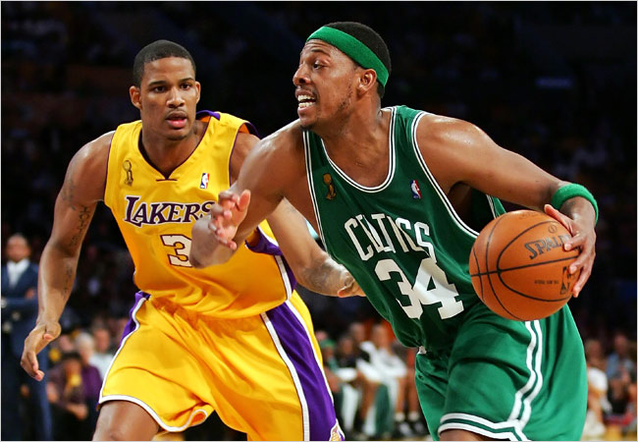
Problem for you
The Lakers and the Celtics meet for a 7-game playoff. They play until one team wins four games.
Suppose the Lakers win 60% of the time. What is the probability that all 7 games are played?

Slide 27

Gambler’s ruin
You have $100. You keep betting $1 on red at roulette.
You stop when you win $200,
or when you run out of money.
What is the probability you win $200?

Slide 28
Gambler’s ruin
Probability model
S = all infinite sequences of Reds and Others
Let R_{i} be the event of red in the ith round
(there is an R in position i)
Probabilities:
call this p
P(R₁) = P(R₂) = … = 18/37
R₁, R₂, … are independent

Slide 29
Gambler’s ruin
$n
You have $100. You stop when you win $200.
Let W be the event you win $200 and w_{n} = P(W).
w_{n} = P(W)
= P(W|R₁) P(R₁) + P(W|R₁^{c}) P(R₁^{c})
w_{n+1}
p
w_{n-1}
1-p
w_{n} = (1-p)w_{n-1} + pw_{n+1}
w₀ = 0
w₂₀₀ = 1.

Slide 30
Gambler’s ruin
w_{n} = (1-p)w_{n-1} + pw_{n+1}
w₀ = 0
w₂₀₀ = 1.
p(w_{n+1} – w_{n} ) = (1-p)(w_{n} – w_{n-1})
let λ = (1-p)/p = 19/18
w_{n+1} – w_{n} = λ (w_{n} – w_{n-1})
= λ² (w_{n-1} – w_{n-2})
= … = λ^{n} (w₁ – w₀)
w_{n+1} = w_{n} + λ^{n}w₁
= w_{n-1} + λ^{n-1}w₁ + λ^{n}w₁
= … = w₁ + λw₁ + … + λ^{n}w₁

Slide 31
Gambler’s ruin
w_{n} = (1-p)w_{n-1} + pw_{n+1}
You have $100.
w₀ = 0
w₂₀₀ = 1.
You stop when you win
$200 or run out.
λ = (1-p)/p = 19/18
The probability you win is
w_{n+1} = w₁ + … + λ^{n}w₁
w₁₀₀ ≈ 0.0045
= (λ^{n+1} – 1)/(λ – 1)w₁
w₂₀₀ = (λ²⁰⁰ – 1)/(λ – 1)w₁
λ^{n+1} – 1
w_{n+1} =
λ²⁰⁰ – 1

