Slide 1
3. Conditional probability

Slide 2
Coins game
Toss 3 coins. You win if at least two come out heads
S = { HHH, HHT, HTH, HTT, THH, THT, TTH, TTT }
equally likely outcomes
W = { HHH, HHT, HTH, THH }
P(W) = |W|/|S| = 1/2

Slide 3
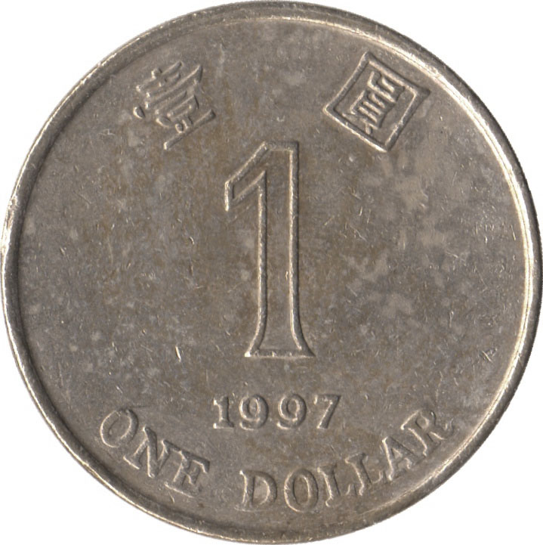
Coins game
The first coin was just tossed and it came out
tails. How does this affect your chances?
S = { HHH, HHT, HTH, HTT, THH, THT, TTH, TTT }
equally likely outcomes
reduced sample
space F
W = { HHH, HHT, HTH, THH }
P(W | F)
= |W F|/|F|
= 1/4

Slide 4
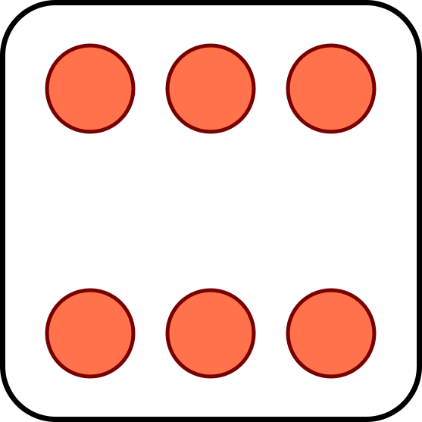
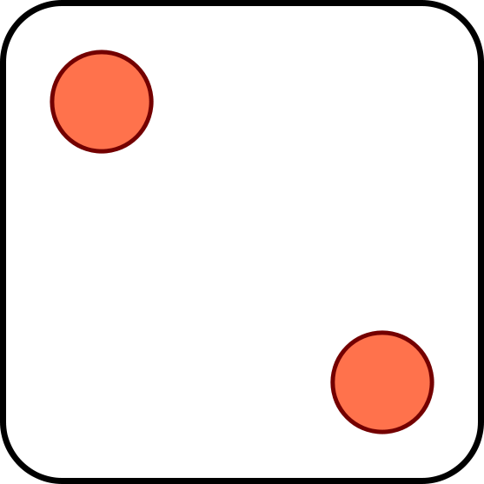
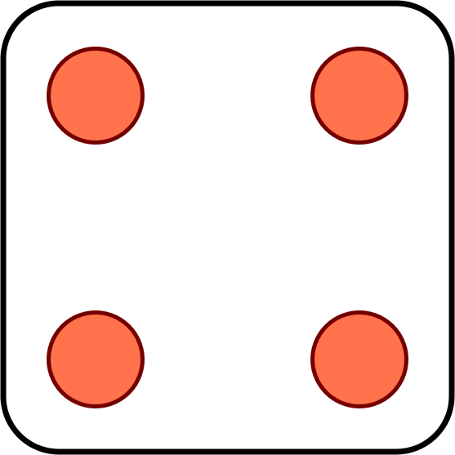
Problem for you to solve
Toss 2 dice. You win if the sum of the outcomes is 8.
The first die comes out to a 4. Should you be happy?
?
Now suppose you win if the sum is 7. Your first toss is a 4. Should you be happy?

Slide 5
Conditional probability
F
The conditional probability P(A | F) represents the probability of event A assuming event F happened.
S
A
Conditional probabilities with respect to the reduced sample space F are given by the formula
P(AF)
P(A | F) =
P(F)

Slide 6
Quiz
A box contains 3 cards. One is black on both sides. One is red on both sides. One is black on one side and red on the other.
You draw a random card and see a black side. What are the chances the other side is red?
A: 1/4
B: 1/3
C: 1/2

Slide 7
Solution
B1
B2
B3
S = { F1, B1, F2, B2, F3, B3 }
F1
F2
F3
equally likely outcomes
The event you see a black side is SB = { F1, B1, F3 }
The event the other side is red is OR = { F2, B2, F3 }
P(OR SB)
1/|S|
P(OR | SB) =
=
= 1/3
P(SB)
3/|S|

Slide 8
The multiplication rule
P(E₁E₂)
Using the formula
P(E₂|E₁) =
P(E₁)
We can calculate the probability of intersection
P(E₁E₂) = P(E₁) P(E₂|E₁)
In general for n events
P(E₁E₂…E_{n}) = P(E₁) P(E₂|E₁)…P(E_{n}|E₁…E_{n-1})

Slide 9
Using conditional probabilities
There are 8 red balls and 8 blue balls in an urn. You draw at random without replacement. What is the probability the first two balls are red?
Solution 1: without conditional probabilities
S = arrangements of r red and b blue balls
E = arrangements in which the first two are red
|E|
14! / (6! 8!)
8 ∙ 7
P(E) =
=
=
|S|
16! / (8! 8!)
16 ∙ 15

Slide 10
Using conditional probabilities
Solution 2: using conditional probabilities
R₁ = arrangements in which the first ball is red
R₂ = arrangements in which the second ball is red
P(R₁R₂) = P(R₁) P(R₂|R₁)
= (8/16) (7/15)
P(R₁) = 8/16
Given the first ball is red, we are left with 7 red and 8 blue balls under equally likely outcomes
P(R₂|R₁) = 7/15

Slide 11
Cards
You divide 52 cards evenly among 4 people. What is the probability everyone gets an ace?
S = all ways to divide 52 cards among 4 people
equally likely outcomes
E = everyone gets an ace
= A♠ A♣ A♥ A♦ are assigned to different people
E₃ = A♣ A♥ A♦ are all assigned to different people
E₂ = A♥ A♦ are all assigned to different people
P(E) = P(E₂) P(E₃|E₂) P(E|E₂E₃)

Slide 12
Cards
E₂ = A♥ A♦ are assigned to different people
After assigning A♥ it looks like this:
?
?
?
?
?
?
?
?
?
?
?
?
?
?
?
?
?
?
?
?
?
?
?
?
?
?
?
?
?
?
?
?
?
?
A♥
?
?
?
?
?
?
?
?
?
?
?
?
?
?
?
?
?
P(E₂) =
# grey cards
= 3 ∙ 13/(52 – 1) = 39/51
# of question marks

Slide 13
Cards
E₃ = A♣ A♥ A♦ are all assigned to different people
After E₂ it looks like this:
?
?
?
A♦
?
?
?
?
?
?
?
?
?
?
?
?
?
?
?
?
?
?
?
?
?
?
?
?
?
?
?
?
?
?
A♥
?
?
?
?
?
?
?
?
?
?
?
?
?
?
?
?
?
P(E₃|E₂) = 2 ∙ 13/(52 – 2) = 26/50

Slide 14
Cards
E₂ = A♥ A♦ are assigned to different people
P(E₂) = 3 ∙ 13/(52 – 1) = 39/51
E₃ = A♣ A♥ A♦ are all assigned to different people
P(E₃ | E₂) = 2 ∙ 13/(52 – 2) = 26/50
E = A♠ A♣ A♥ A♦ all assigned to different people
P(E | E₃) = 13/(52 – 3) = 13/49
P(E) = (39/51) (26/50) (13/49) ≈ .105

Slide 15
Rule of average conditional probabilities
F
F^{c}
P(E)
= P(EF) + P(EF^{c})
S
E
= P(E|F)P(F) + P(E|F^{c})P(F^{c})
F₃
F₁
F₄
More generally, if F₁,…, F_{n}
partition S then
E
F₂
F₅
P(E) = P(E|F₁)P(F₁) + … + P(E|F_{n})P(F_{n})

Slide 16
Multiple choice quiz
What is the capital of Macedonia?
A: Split
B: Struga
C: Skopje
D: Sarajevo
Did you know or were you lucky?

Slide 17
Multiple choice test
Probability model
There are two types of students:
Type K: Knows the answer
Type K^{c}: Picks a random answer
Event C: Student gives correct answer
P(C) = p = fraction of correct answers
p = P(C|K)P(K) + P(C|K^{c})P(K^{c})
= 1/4 + 3P(K)/4
1
1/4
1 - P(K)
P(K) = (p – ¼) / ¾

Slide 18
Red and blue balls again
There are 8 red balls and 6 blue balls in an urn. You draw at random without replacement. What is the probability the first two balls are of the same color?
event E
Solution:
Let R₁ be the event “the first ball is red”
R₂ be “the second ball is red”
P(E) = P(E|R₁)P(R₁) + P(E|R₁^{c})P(R₁^{c})
= P(R₂|R₁)P(R₁) + P(R₂^{c}|R₁^{c})P(R₁^{c})
= 86/182
7/13
8/14
5/13
6/14

Slide 19
Boxes
1
2
3
I choose a cup at random and then a random ball from that cup. The ball is blue. You need to guess where the ball came from.
(a) Which cup would you guess?
(b) What is the probability you are correct?

Slide 20
Boxes
1
2
22
3
32
11
21
31
34
12
23
33
S = { 11, 12, 21, 22, 23, 31, 32, 33, 34 }
outcomes are not equally likely!
The events of interest are:
BLUE = blue ball = { 11, 21, 22, 31, 32, 33 }
CUP₁ = first cup = { 11, 12 }
CUP₂ = { 21, 22, 23 }
CUP₃ = { 31, 32, 33, 34 }

Slide 21
Boxes
1
2
22
3
32
11
21
31
34
12
23
33
S = { 11, 12, 21, 22, 23, 31, 32, 33, 34 }
1/6
1/6
1/9
1/9
1/9
1/12
1/12
1/12
1/12
P(CUP₁|BLUE) = P(CUP₁ BLUE) / P(BLUE)
= 1 ∙ 1/6 / (3 ∙ 1/12 + 2 ∙ 1/9 + 1 ∙ 1/6)
= 6/23
P(CUP₂|BLUE) = 8/23
P(CUP₃|BLUE) = 9/23

Slide 22
Boxes
Another way to present the solution:
1
2
22
3
32
11
21
31
34
12
23
33
P(CUP_{i}|BLUE) = P(CUP_{i} BLUE) / P(BLUE)
P(CUP_{i} BLUE) = P(BLUE | CUP_{i} ) P(CUP_{i})
i
1
2
3
1/3
1/2
2/3
3/4
P(BLUE) = 1/2 1/3 + 2/3 1/3 + 3/4 1/3 = 23/36

Slide 23
Problem for you to solve
1
2
3
Same as before, but now the ball is red.
(a) Which cup would you guess it came from?
(b) What is the probability you are correct?

Slide 24
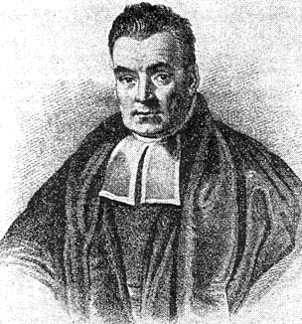
Bayes’ rule
P(E|F) P(F)
P(E|F) P(F)
P(F|E) =
=
P(E)
P(E|F) P(F) + P(E|F^{c}) P(F^{c})
More generally, if F₁,…, F_{n} partition S then
P(E|F_{i}) P(F_{i})
P(F_{i}|E) =
P(E|F₁) P(F₁) + … + P(E|F_{n}) P(F_{n})

