Slide 1
11. Classical statistics

Slide 2
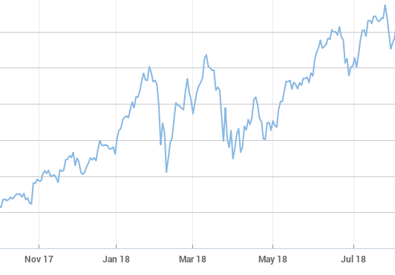
🌧
Poisson(λ)
Normal(μ, σ)
Alice PASS
Bob PASS
Charlie FAIL
Binomial(150, p)

Slide 3
Estimators
X = (X₁, …, X_{n}) independent samples
^
Unbiased: E[Θ_{n}] = θ
^
Consistent: Θ_{n} converges to θ in probability

Slide 4
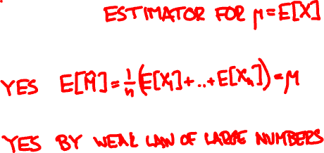

Estimating the mean
X = (X₁, …, X_{n}) independent samples of X
^
M = (X₁ + … + X_{n}) / n
Unbiased?
Consistent?

Slide 5
Maximum likelihood
Bayesian MAP estimate:
maximize f_{Θ|X}(θ | x) ∝ f_{X|Θ}(x | θ) f_{Θ}(θ)
Classical ML (maximum likelihood) estimate:
maximize f_{X}(x | θ)

Slide 6
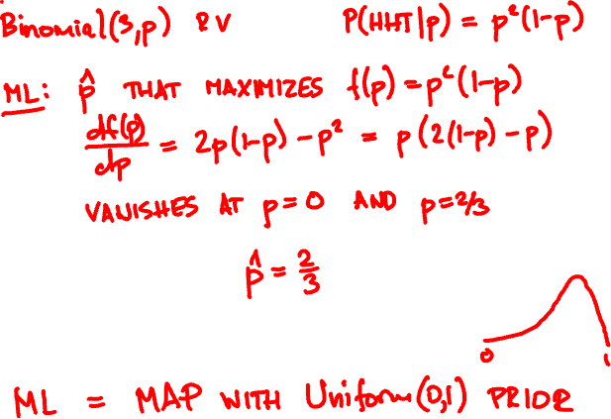
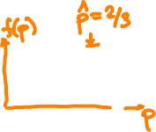

Coin flip sequence HHT. What is ML bias estimate?

Slide 7
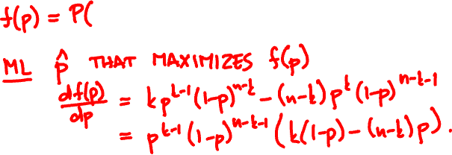

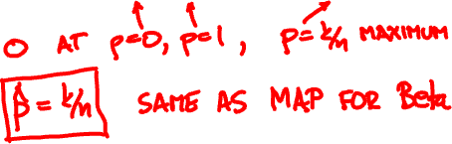
Maximum likelihood for Indicator(p)
k heads, n – k tails. ML bias estimate?

Slide 8




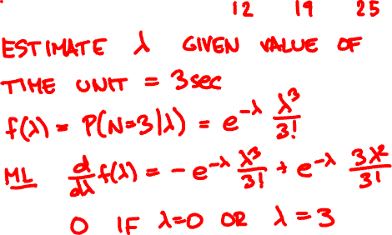
Within the first 3 seconds, raindrops arrive at times 1.2, 1.9, and 2.5. What is the estimated rate?
0
3

Slide 9


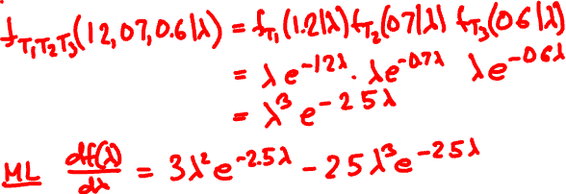
The first 3 raindrops arrive at 1.2, 1.9, and 2.5 sec. What is the estimated rate?
0

Slide 10

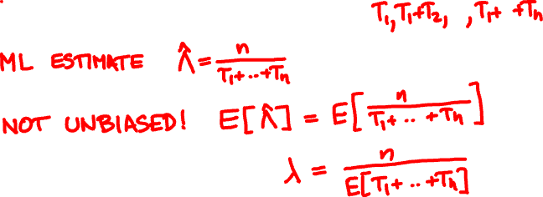

Maximum likelihood for Exponential(λ)

Slide 11
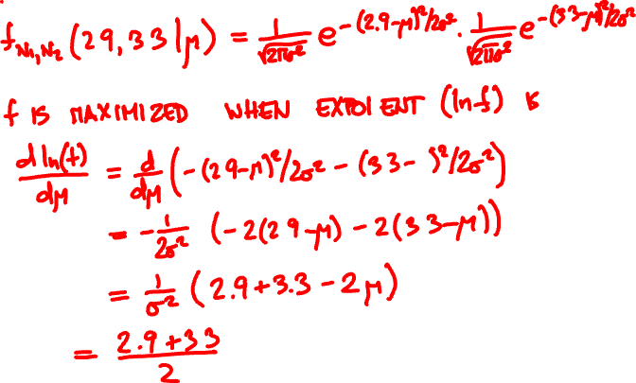

A Normal(μ, σ) RV takes values 2.9, 3.3. What is the ML estimate for μ?

Slide 12

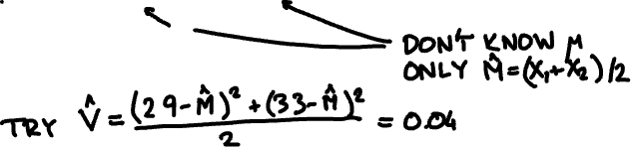
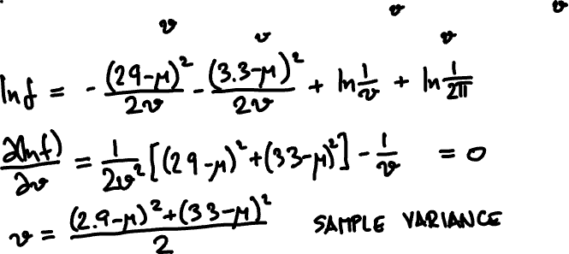
A Normal(μ, σ) RV takes values 2.9, 3.3. What is the ML estimate for v = σ²?

Slide 13

Maximum likelihood for Normal(μ, σ)
(X₁, …, X_{n}) independent Normal(μ, σ)
^
^
X₁ + … + X_{n}
ML estimate M of μ:
M =
n
ML estimate of v = σ² for known μ:
(X₁ – μ)² + … + (X_{n} – μ)²
n
^
^
^
(X₁ – M)² + … + (X_{n} – M)²
V =
n

Slide 14
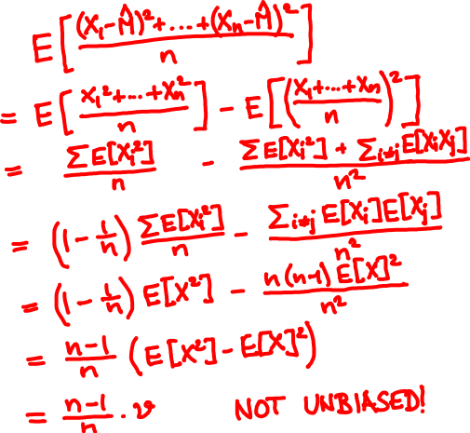
^
E[V] =

Slide 15
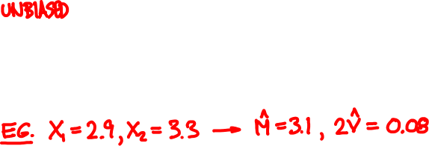

(X₁, …, X_{n}) independent Normal(μ, σ)
Estimate of v = σ² for uknown μ:
n
^
^
^
(X₁ – M)² + … + (X_{n} – M)²
V =
n – 1
n – 1

Slide 16
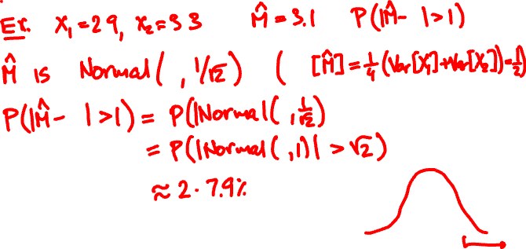





A Normal(μ, 1) RV takes values X₁, X₂. You estimate the mean by M = (X₁ + X₂)/2. What is the probability that |M – μ| > 1?
^
^

Slide 17


Confidence intervals
^
^
A p-confidence interval is a pair Θ₋, Θ₊ so that
^
^
P(θ is between Θ₋ and Θ₊) ≥ p

Slide 18
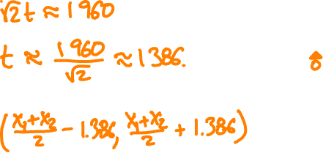


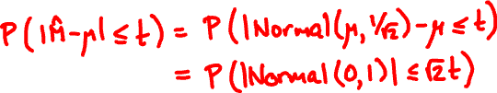

^
For which value of t can we guarantee |M – μ| ≤ t with 95% probability?

Slide 19
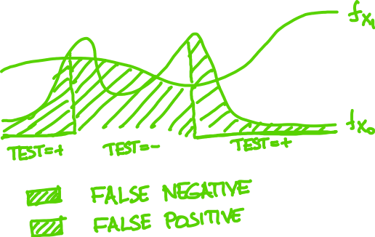
Hypothesis testing

Slide 20
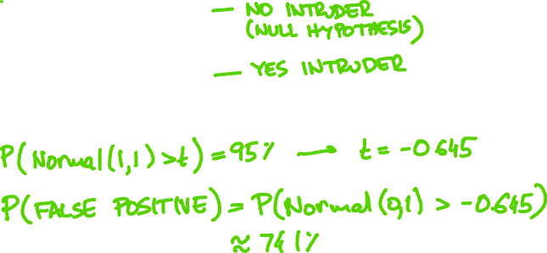
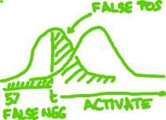
A car-jack detector outputs Normal(0, 1) if there is no intruder and Normal(1, 1) if there is.
You want to catch 95% of intrusions. What is the probability of a false positive?

Slide 21
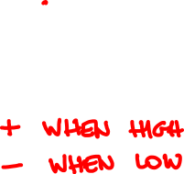

Neyman-Pearson Lemma
Among all X₁/X₀ tests with given false negative probability, the false positive is minimized by the one that picks samples with largest likelihood ratio
f_{X} (x)
₁
f_{X} (x)
₀

Slide 22


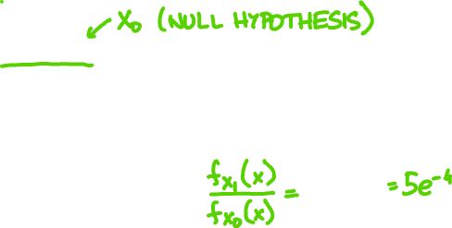
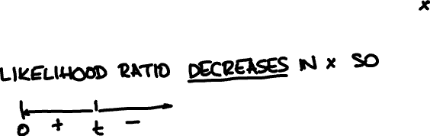
Rain usually falls at 1 drop/sec. You want to test today’s rate is 5/sec based on first drop. How to set up test with 5% false negative?

Slide 23
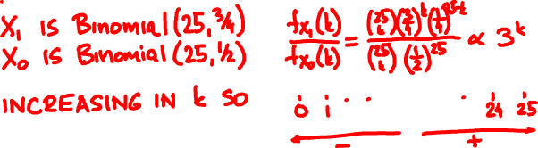

A drug is claimed effective on ¾ of patients. The null hypothesis is ½. How to set up a trial for 25 subjects with 10% false positive?

