Slide 1
10. Bayesian Statistics

Slide 2
The Central Dogma of Statistics
data = independent samples
…but we don’t know (joint) PDF/PMF

Slide 3
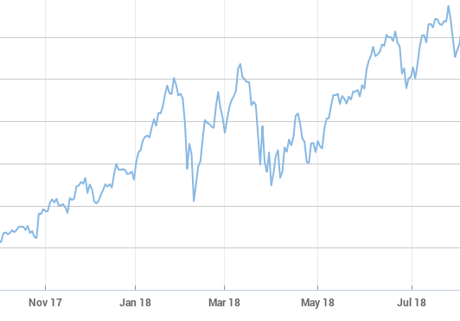

🌧
Poisson(λ)
Normal(μ, σ)
Alice PASS
Bob PASS
Charlie FAIL
Binomial(150, p)

Slide 4
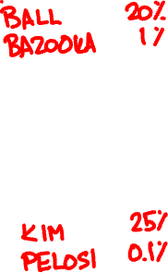
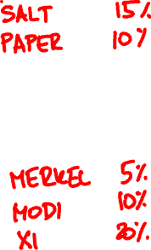
Please pass me the
?

Slide 5
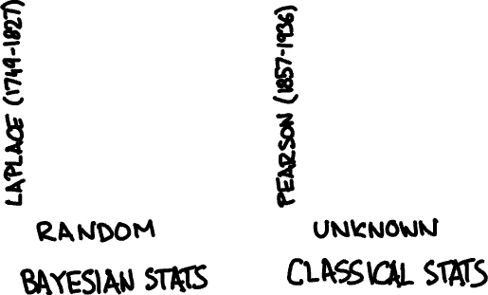
parameters λ, μ, σ, p etc. are

Slide 6
Bayesian inference
1. Assign prior probabilities to params
2. Observe data
3. Update probabilities via Bayes’ rule

Slide 7

Bayes’ rule
f_{X|Θ}(x | θ) f_{Θ}(θ)
f_{Θ|X}(θ | x) =
f_{X}(x)
f_{Θ|X …X}(θ|x₁…x_{n}) ∝ f_{X |Θ}(x₁|θ)…f_{X |Θ}(x_{n}|θ) f_{Θ}(θ)
₁
_{n}
₁
_{n}
if X₁, …, X_{n} are independent

Slide 8

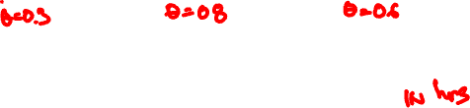
Romeo is waiting for Juliet on their first date.
👱‍♀️
👩🏾
👧🏻
X =
Uniform(0, .3)
Uniform(0, .8)
Uniform(0, .6)
girls are Uniform(0, Θ) late

Slide 9
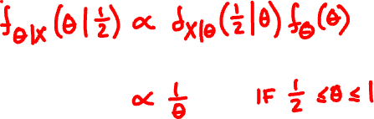
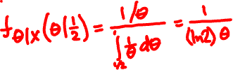
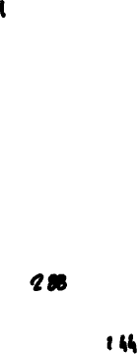

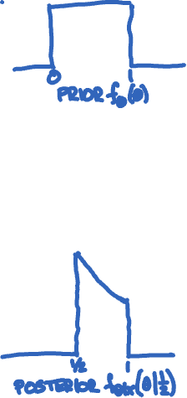
Romeo’s model
X = Uniform(0, Θ)
Θ = Uniform(0, 1)
On her first date, Juliet arrives ½ hour late.

Slide 10
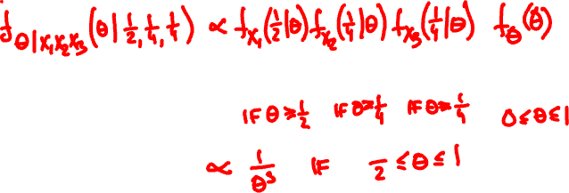
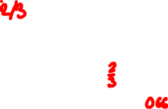
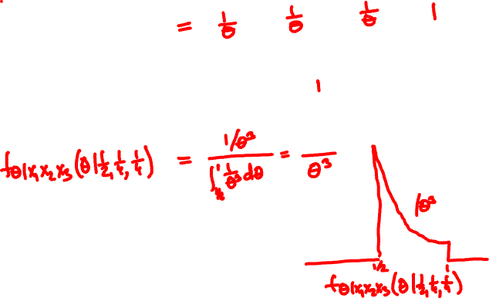
On her first 3 dates, Juliet is late by ½, ¼, ¼ hours.

Slide 11
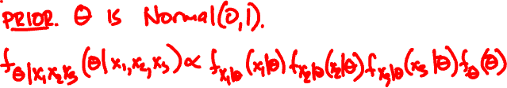

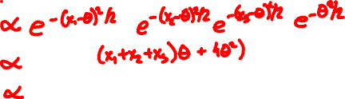
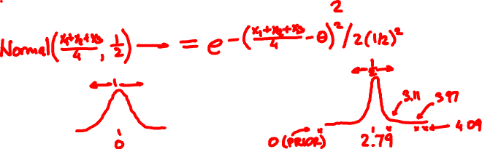
Three independent Normal(Θ, 1) RVs take values 3.97, 4.09, 3.11. What is Θ?

Slide 12

Inference for Normals
X_{i} = Normal(Θ, σ_{i}) independent given Θ
Θ is Normal(x₀, σ₀)
(Θ | X₁ = x₁, …, X_{n} = x_{n}) is Normal(x, σ) where
1/σ² = 1/σ₀² + … + 1/σ_{n}²
x/σ² = x₀/σ₀² + … + x_{n}/σ_{n}²

Slide 13

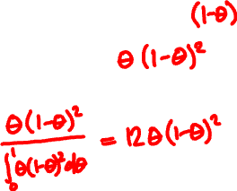
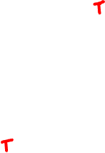
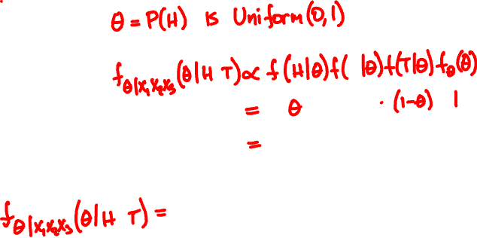
A coin of unknown bias flips HTT.
What is the bias?

Slide 14
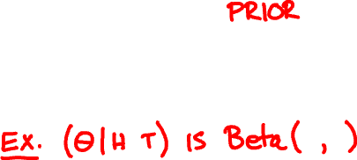
The Beta(α, β) random variable
Beta(1, 1) = Uniform(0, 1)
Θ is Beta(1, 1)
(Θ | h heads, t tails) is Beta(h + 1, t + 1)

Slide 15

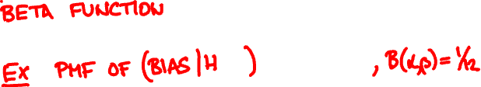
The Beta(α, β) random variable
1
f (θ) = θ^{α-1}(1-θ)^{β-1} when 0 < θ < 1
Β(α, β)
Β(α, β) = (α – 1)! (β – 1)! / (α + β – 1)!

Slide 16
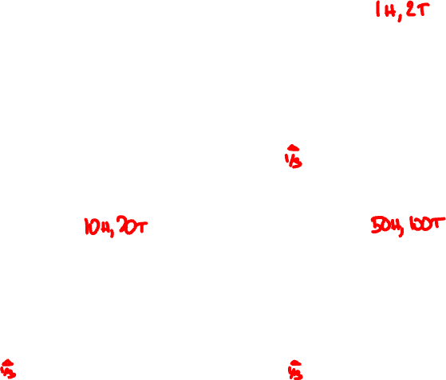
Beta(1, 1)
Beta(2, 3)
Beta(11, 21)
Beta(51, 101)

Slide 17

CONGRATULATIONS!! 3/02
from: F48E5F6BRT@vega.ocn.ne.jp
to: andrejb@cse.cuhk.edu.hk
Dear Customer,
My name is Sandra Davis, Board of Directors of United Nations and Chief Executive Officer, effective April 16, 2018,
The United Nations {UN} has giving you extra three working days to receive your fund from Citibank Plc, New york or you will lose the opportunity for ever. So you are advised to comply immediately to avoid the cancellation of your fund, follow the instruction immediately for your own good and future
The Citibank controlling department controlling of the security transfer CODE which is (CI201), the Authentication section code of this bank concludes the verification of your file. After going through all the documents of claim received by this department with justification and verification from the global strategy United States we are completely satisfied and you have been confirmed.
The Citibank concerning wire transfers of your fund. Your letter has been referred to the (JMCB) Legal Division for Funds (US$2.8 Million Dollars) Transferred code (). We are satisfied using Electronic Wire Transfer or Swift Wire Transfer and the rights and liabilities of using of electronic and Swift fund transfer systems are defined by the Electronic Fund Transfer Act... The regulation, however, which implements this statute, Regulation E. specifically states that its provisions are inapplicable to a situation such we must ensure your Funds Transferred to your destination Bank Account between 72 hours.
Considering the volume of your payment, it is right for us to seek for the approval of some money regulatory Boards here in United States before we can carry out the Transfer of an amount of such magnitude to anybody, otherwise any such transfer will be stopped by the Authorities, and the International Monetary Fund (IMF), since your
Transfer is Electronic Transfer or Swift Wire transfer is almost activated with our bank and the only thing holding the final activation of your Account are some certain Approval Documents from the concerned Authorities here in United States
NB: THIS TRANSACTION IS BEING MONITORED BY THE UNITED STATES GOVERNMENT IN ORDER TO GUARDS US FROM INTERNET IMPOSTORS.
Provide your designated bank account details for Electronic Transfer, to avoid mistake(s).
Bank Name and Address
Account Number:
Account Name:
Routing Number:
your home adress and phone number,
place of work and address.
send it the citibank remittance manager. on her email : ombes2@gmx.com
UN gives you only 3 working days to receive your fund from our bank or no more so follow the instruction by sending email to us back with the bank detail details along with your personal details.
Thank you for giving us the opportunity to serve your banking needs. ombes2@gmx.com
Yours sincerely
Board of Directors of Citibank
Sandra Davis
Chief Executive Officer, effective April 16, 2018

Slide 18
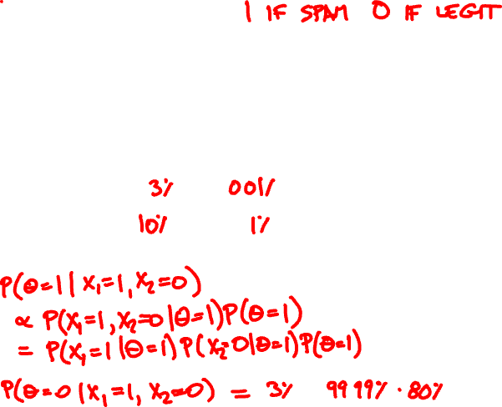
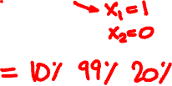

Θ = spam indicator
X₁ = contains “million dollars”
X₂ = contains “Nigerian princess”
θ
P(X₁| θ)
P(X₂| θ)
The Citibank concerning wire transfers of your fund. Your letter has been referred to the (JMCB) Legal Division for Funds (US$2.8 Million Dollars)
legit (0)
spam (1)

Slide 19

Point estimation
How to turn conditional PDF/PMF f_{Θ|X}(θ | x) estimate into one number?
Conditional expectation (CE) estimator:
Ε[θ | X = x]
Maximum a posteriori (MAP) estimator:
argmax f_{Θ|X}(θ | x)

Slide 20
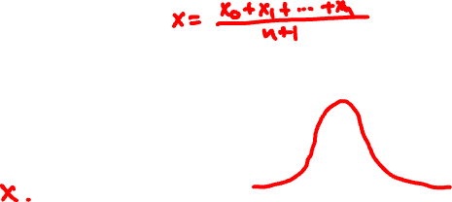


Point estimation for normals
X_{i} = Normal(Θ, 1) independent given Θ
Θ is Normal(x₀, 1)
(Θ | X₁ = x₁, …, X_{n} = x_{n}) is Normal(x, 1/√n)
CE estimate:
MAP estimate:

Slide 21
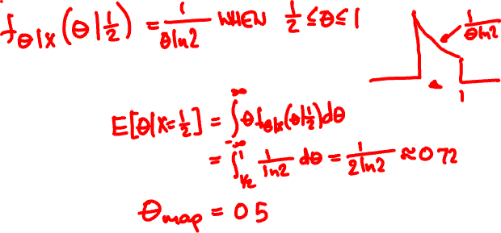

Romeo’s model
X = Uniform(0, Θ)
Θ = Uniform(0, 1)
On her first date, Juliet arrives ½ hour late.
CE estimate:
MAP estimate:

Slide 22
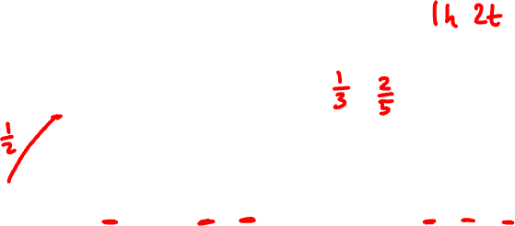
Beta(1, 1)
Beta(2, 3)
CE = α/β = (h + 1)/(h + t + 2)
MAP = h/(h + t)
Beta(11, 21)
Beta(51, 101)

Slide 23
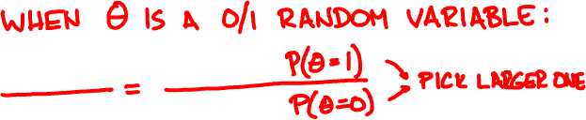

Hypothesis testing
Suppose Θ takes two values (e.g. spam / legit)
MAP = argmax f_{Θ|X}(θ | x)
Choose the one for which f_{Θ|X}(θ | x) is larger

Slide 24


Θ = 80% legit, 20% spam
The Citibank concerning wire transfers of your fund. Your letter has been referred to the (JMCB) Legal Division for Funds (US$2.8 Million Dollars)
θ
P(X₁| θ)
P(X₂| θ)
legit
0.03
0.0001
spam
0.1
0.01

Slide 25
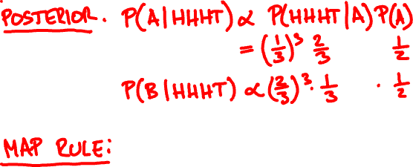



Coin A is heads with probability 1/3.
Coin B is tails with probability 1/3.
HHHT are 4 flips of a random coin. Which coin was it?

Slide 26
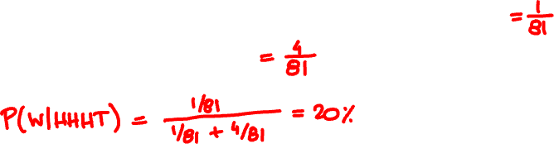

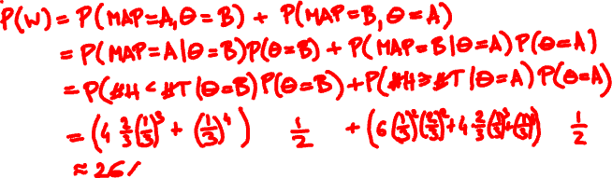
What is the probability you are wrong, given the outcome is HHHT?
What is the probability you are wrong on average?

Slide 27
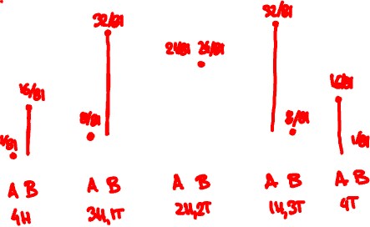




Hypothesis testing error

Slide 28
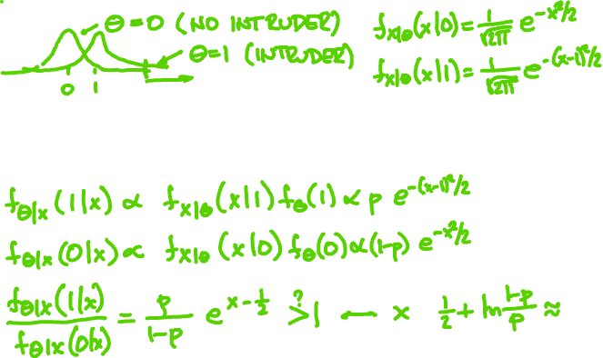


A car-jack detector X outputs Normal(0, 1) if there is no intruder and Normal(1, 1) if there is. When should alarm activate?

Slide 29


