Slide 1
9. Large Deviations and the Central Limit Theorem

Slide 2
Many times we do not need to calculate probabilities exactly
An approximate or qualitative estimate often suffices
P(magnitude 7+ earthquake within 10 years) = ?

Slide 3
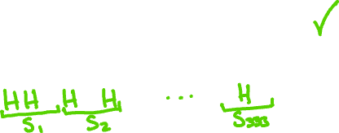

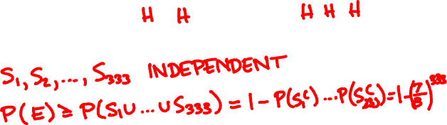
I toss a coin 1000 times. The probability that I get a streak of 3 consecutive heads is
A
B
C
< 10%
≈ 50%
> 90%

Slide 4
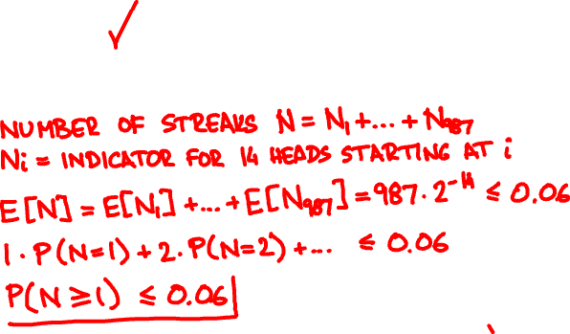
I toss a coin 1000 times. The probability that I get a streak of 14 consecutive heads is
A
B
C
< 10%
≈ 50%
> 90%

Slide 5
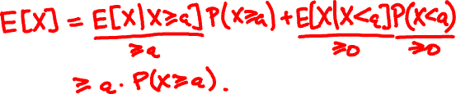
Markov’s inequality
For every non-negative random variable X and every value a:
P(X ≥ a) ≤ E[X] / a.
Proof

Slide 6

100 people randomly redistribute their hats. What is the probability at least 10 people get their hat back?

Slide 7
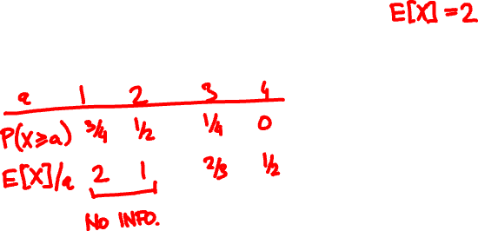
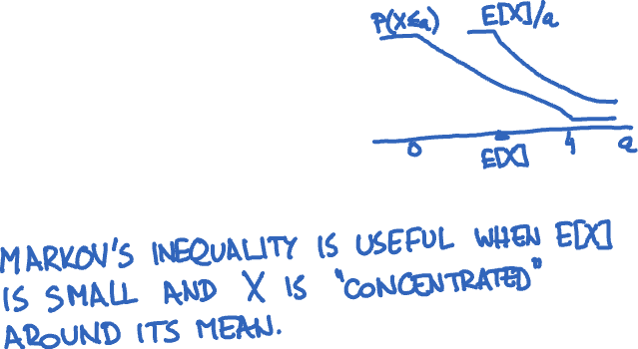
X = Uniform(0, 4). How does P(X ≥ x) compare with Markov’s inequality?

Slide 8
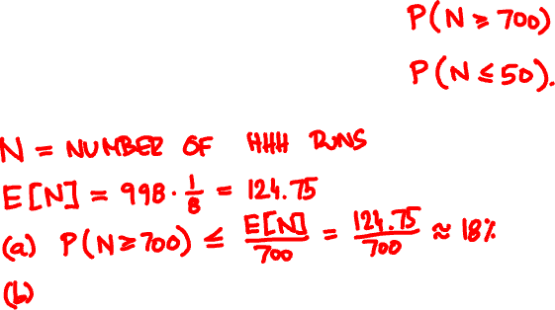


I toss a coin 1000 times. What is the probability I get 3 consecutive heads
(a) at least 700 times
(b) at most 50 times

Slide 9
Chebyshev’s inequality
For every random variable X and every t:
P(|X – μ| ≥ tσ) ≤ 1 / t².
where μ = E[X], σ = √Var[X].

Slide 10
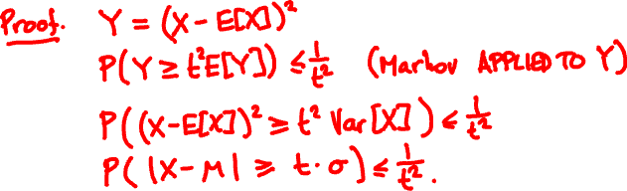
Chebyshev’s inequality
For every random variable X and every t:
P(|X – μ| ≥ tσ) ≤ 1 / t².
where μ = E[X], σ = √Var[X].

Slide 11
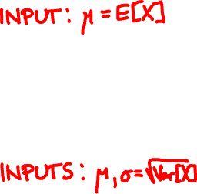
μ
a
Markov’s inequality:
P( X ≥ a ) ≤ μ / a.
p.m.f. / p.d.f. of X
0
μ – tσ
μ
μ + tσ
Chebyshev’s inequality:
P(|X – μ| ≥ tσ ) ≤ 1 / t².
σ
p.m.f. / p.d.f. of X

Slide 12

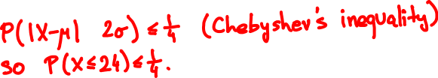

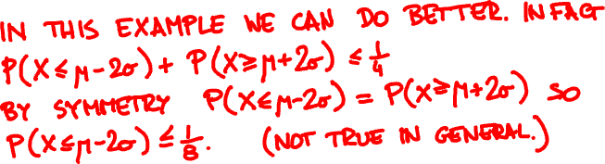
I toss a coin 64 times. What is the probability I get at most 24 heads?

Slide 13
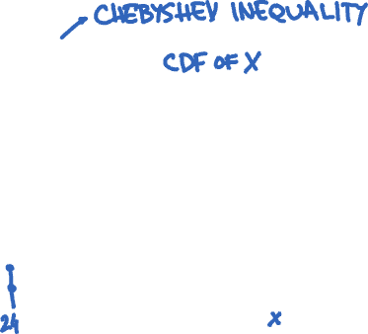

Slide 14
Polling
👩🏻‍🦳👩🏻‍🎤👵🤰🏽🧔🏼👧🏻👨🏻‍🏫🧕👨‍✈️👨🏾‍🎨
👍👍👎👍👎👎👎👎👍👎
X = X₁ + … + X_{n}

Slide 15
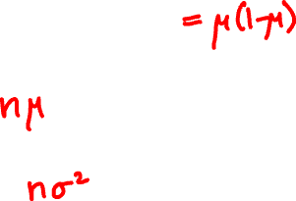
Polling
How accurate is the pollster’s estimate X/n?
μ = E[X_{i}], σ ² = Var[X_{i}]
E[X] =
Var[X] =

Slide 16
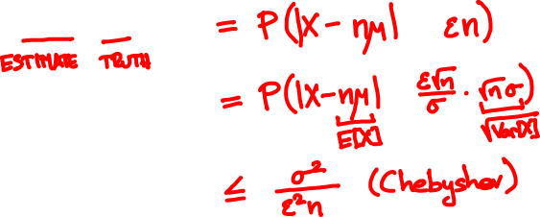
Polling
P( |X/n – μ| ≥ ε )

Slide 17
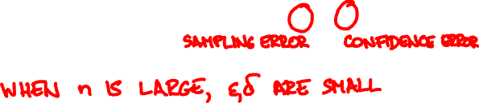
The weak law of large numbers
X₁,…, X_{n} are independent with same PMF/PDF
μ = E[X_{i}], σ = √Var[X_{i}],
X = X₁ + … + X_{n}
For every ε, δ > 0 and n ≥ σ²/(ε²δ):
P(|X/n – μ| ≥ ε) ≤ δ

Slide 18

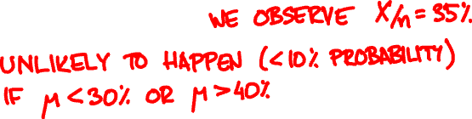

We want confidence error δ = 10% and sampling error ε = 5% . How many people should we poll?

Slide 19
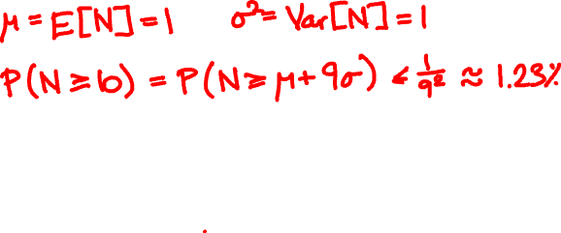
100 people throw their hats in the air. What is the probability at least 10 people get their hat back?

Slide 20
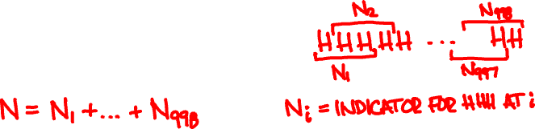
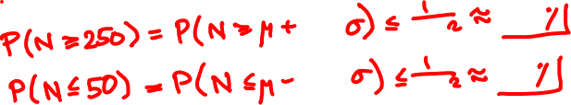



I toss a coin 1000 times. What is the probability I get 3 consecutive heads
(a) at least 250 times
(b) at most 50 times

Slide 21
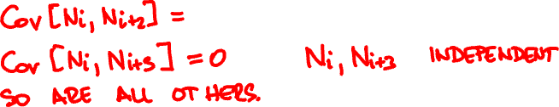
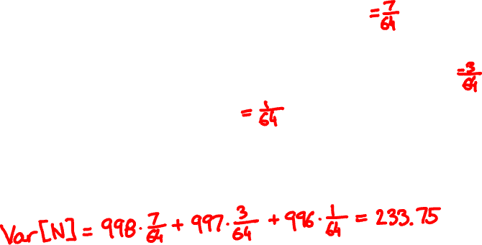
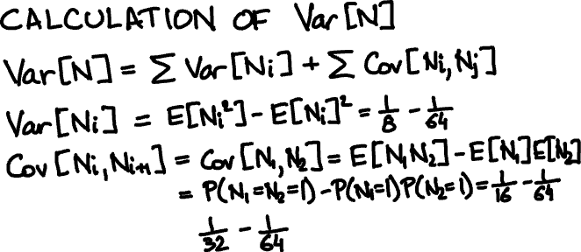

Slide 22
A polling simulation
X₁, …, X_{n} independent Bernoulli(1/2)
X₁ + … + X_{n}
n
pollster’s estimate
number of people polled n

Slide 23
A polling simulation
20 simulations
X₁ + … + X_{n}
n
pollster’s estimate
number of people polled n

Slide 24

X₁,…, X_{n} are independent with same PMF/PDF
Let’s assume n is large.
Weak law of large numbers:
X₁ + … + X_{n} ≈ μn
with high probability
P( |X – μn| ≥ tσ √n ) ≤ 1 / t².
this suggests X₁ + … + X_{n} ≈ μn + Tσ √n

Slide 25
Some experiments
X = X₁ + … + X_{n}
X_{i} independent Bernoulli(1/2)
n = 6
n = 40

Slide 26
X = X₁ + … + X_{n}
X_{i} independent Poisson(1)
n = 3
n = 20

Slide 27
X = X₁ + … + X_{n}
X_{i} independent Uniform(0, 1)
n = 2
n = 10

Slide 28
f(t) = (2π)^{-½} e^{-t /2}
²
t

Slide 29
The central limit theorem
X₁,…, X_{n} are independent with same PMF/PDF
X = X₁ + … + X_{n}
For every t (positive or negative):
lim P(X ≤ E[X] + t√Var[X] ) = P(N ≤ t)
n → ∞
where N is a Normal(0, 1) random variable.

Slide 30
eventually, everything
is normal

Slide 31


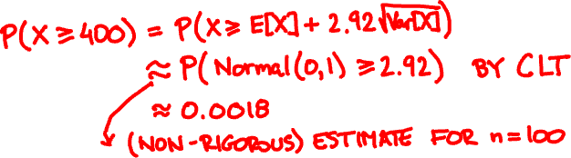
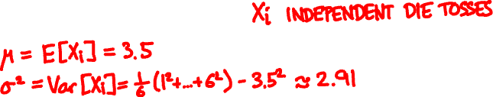
Toss a die 100 times. What is the probability that the sum of the outcomes exceeds 400?

Slide 32
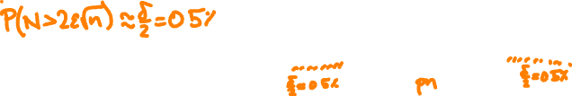
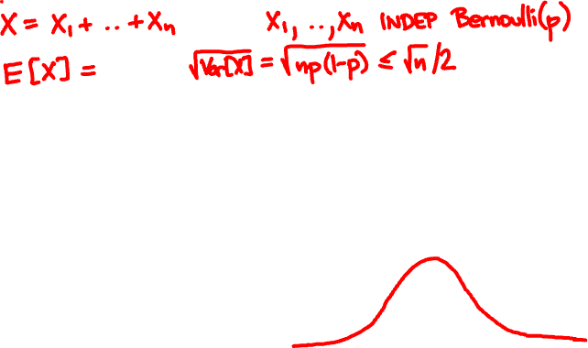






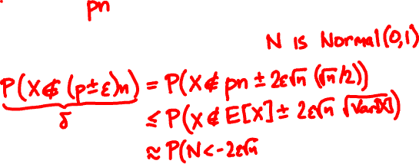
We want confidence error δ = 1% and sampling error ε = 5%. How many people should we poll?

Slide 33
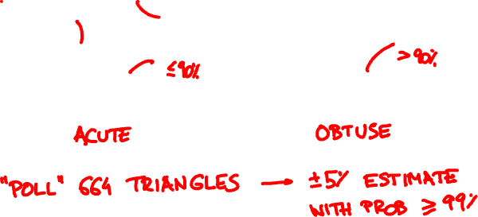
Drop three points at random on a square. What is the probability that they form an acute triangle?

Slide 34
from random import uniform
# indicate whether the triangle with the given vertices is acute
def is_acute(x1, y1, x2, y2, x3, y3):
def dot(x1, y1, x2, y2, x0, y0):
return (x1 - x0) * (x2 - x0) + (y1 - y0) * (y2 - y0)
a1 = dot(x2, y2, x3, y3, x1, y1)
a2 = dot(x3, y3, x1, y1, x2, y2)
a3 = dot(x1, y1, x2, y2, x3, y3)
return a1 > 0 and a2 > 0 and a3 > 0
# count the fraction of acute triangles among n random samples
# whose vertices are chosen uniformly at random in a square
def simulate_triangles(n):
U = lambda : uniform(0.0, 1.0)
return sum([is_acute(U(), U(), U(), U(), U(), U()) \
for i in range(n)]) / n
>>> simulate_triangles(664)
0.27259036144578314
>>> simulate_triangles(664)
0.29668674698795183
>>> simulate_triangles(664)
0.28463855421686746

Slide 35
method
requirements
weakness
Markov’s
inequality
one-sided,
often imprecise
E[X] only
Chebyshev’s
inequality
sometimes
imprecise
E[X] and Var[X]
weak law of
large numbers
pairwise
independence
often imprecise
central limit
theorem
independence
of many samples
no rigorous bound

Slide 36
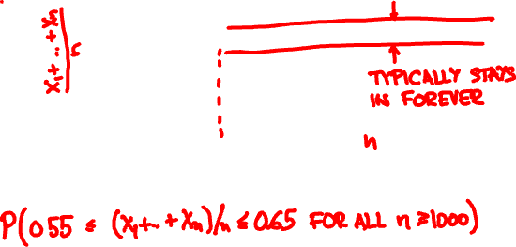
The strong law of large numbers

Slide 37
The strong law of large numbers
X₁,…, X_{n} are independent with same PMF / PDF
μ = E[X_{i}], X = X₁ + … + X_{n}
If E[X_{i}⁴] is finite then
P(lim_{n → ∞} X/n = μ) = 1

