Slide 1
6. Continuous Random Variables I

Slide 2

Delivery time
A package is to be delivered between noon and 1pm.
You go out between 12:30 and 12:45.
What is the probability you
missed the delivery?

Slide 3
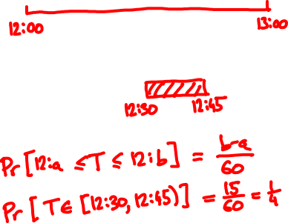
Delivery time
1. Sample space:
2. Event of interest:
3. Probabilities?

Slide 4

Uncountable sample spaces
In Lecture 1 we said:
“The probability of an event is the sum of the
probabilities of its elements”
…but all elements have probability zero!
To specify and calculate probabilites, we have to work with the axioms of probability

Slide 5
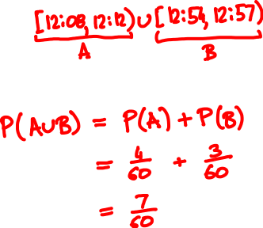
Delivery time
From 12:08 - 12:12 and 12:54 - 12:57 the doorbell wasn’t working.
Event of interest:
Probability:

Slide 6

The uniform random variable
Sample space Ω = [0, 60)
Events of interest:
intervals [x, y) ⊆ [0, 60)
their intersections, unions, etc.
Probabilities:
P([x, y)) = (y – x)/60
Random variable:
X(ω) = ω

Slide 7
Bertrand’s paradox
C
X
Y
A
B
What is the probability that |XY| > |AB|?

Slide 8
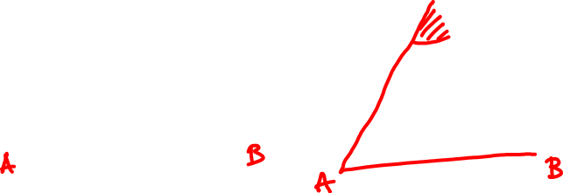

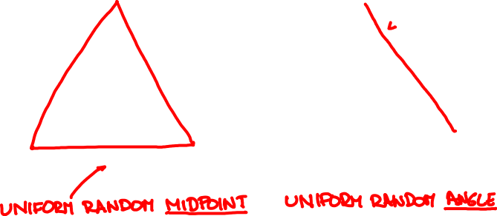
Model 1
Model 2
X
Y
X
Y

Slide 9

Cumulative distribution function
The probability mass function doesn’t make much sense because P(X = x) = 0 for all x.
Instead, we can describe X by its cumulative distribution function (CDF) F:
F_{X}(x) = P(X ≤ x)

Slide 10
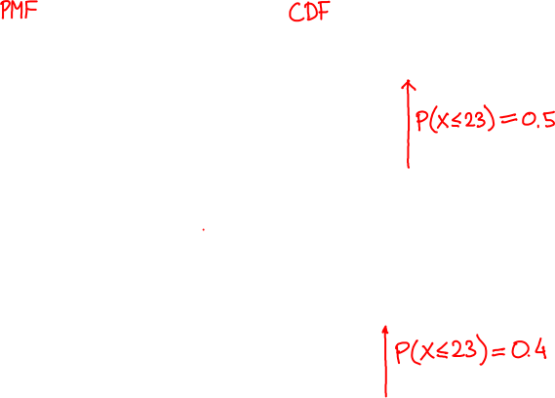
Cumulative distribution functions
f_{X}(x) = P(X = x)
F_{X}(x) = P(X ≤ x)

Slide 11
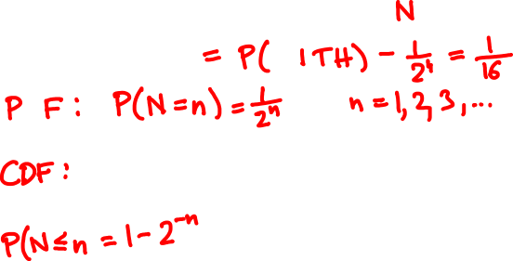
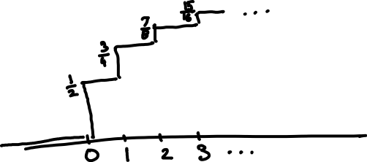

What is the Geometric(1/2) CDF?

Slide 12
Cumulative distribution functions
f(x) = P(X = x)
F(x) = P(X ≤ x)

Slide 13

Uniform random variable
If X is uniform over [0, 60) then
X ≤ x
0
x
60
F(x)
0
for x < 0
P(X ≤ x) =
x/60
for x ∈ [0, 60)
1
for x > 60
x

Slide 14
Cumulative distribution functions
discrete
CDF F(x) = P(X ≤ x)
PMF f(x) = P(X = x)
?
continuous
CDF F(x) = P(X ≤ x)

Slide 15
Discrete random variables:
PMF f(x) = P(X = x)
CDF F(x) = P(X ≤ x)
f(x) = F(x) – F(x – δ)
F(a) = ∑_{x ≤ a} f(x)
for small δ
Continuous random variables:
The probability density function (PDF) of a random variable with CDF F(x) is
F(x) – F(x – δ)
dF(x)
f(x) =
lim
=
δ
dx
δ → 0

Slide 16

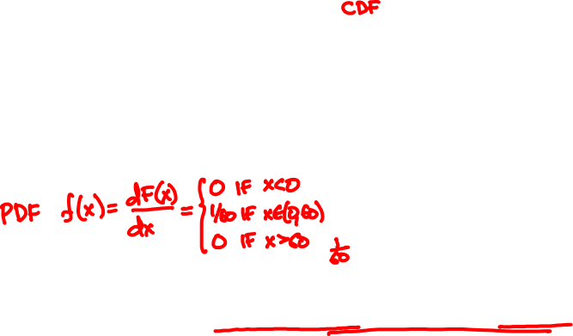
Uniform random variable
0
if x < 0
F(x) =
x/60
if x ∈ [0, 60)
1
if x ≥ 60

Slide 17
Probability density functions
discrete
CDF F(x) = P(X ≤ x)
PMF f(x) = P(X = x)
continuous
CDF F(x) = P(X ≤ x)
PDF f(x) = dF(x)/dx

Slide 18
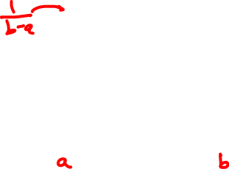
Uniform random variable
The Uniform(0, 1) PDF is
1
if x ∈ (0, 1)
f(x)
f(x) =
0
if x < 0 or x > 1
The Uniform(a, b) PDF is
1/(b - a)
if x ∈ (a, b)
f(x) =
0
if x < a or x > b
X
a
b

Slide 19
Calculating the CDF
Discrete random variables:
PMF f(x) = P(X = x)
CDF F(x) = P(X ≤ x) = ∑_{t ≤ x} f(t)
Continuous random variables:
PDF f(x) = dF(x)/dx
CDF F(x) = P(X ≤ x) = ∫_{t ≤ x} f(t)dt

Slide 20
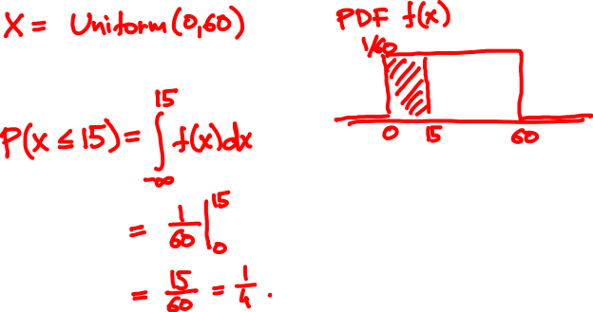
A package is to arrive between 12 and 1
What is the probability it arrived by 12.15?

Slide 21



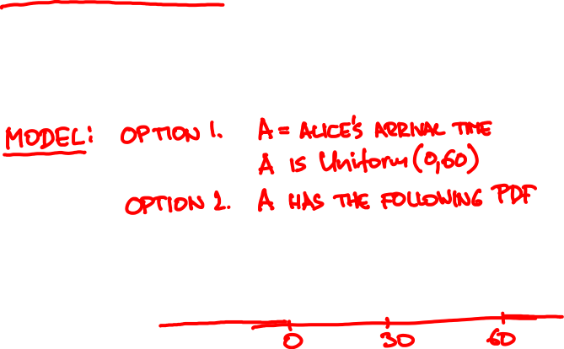
Alice said she’ll show up between 7 and 8,
probably around 7.30.
It is now 7.30. What is the probability
Bob has to wait past 7.45?

Slide 22
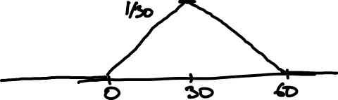
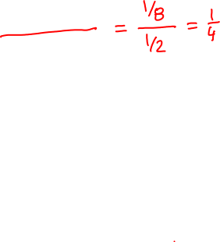
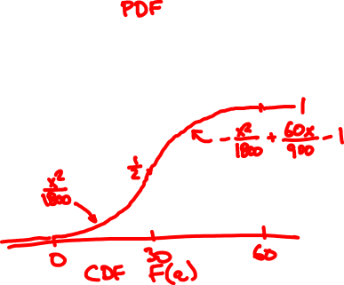
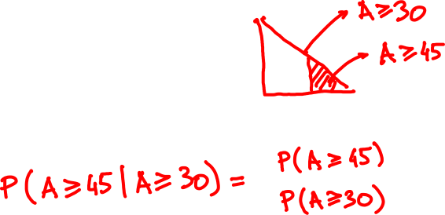

Slide 23
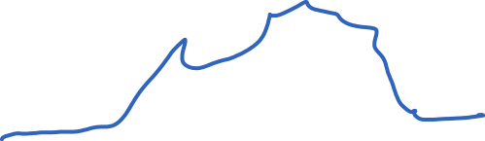
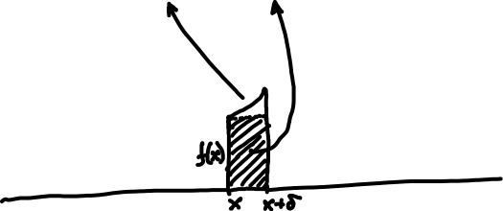
Interpretation of the PDF
The PDF value f(x) δ approximates the probability that X in an interval of length δ around x
P(x – δ ≤ X < x) = f(x) δ + o(δ)
P(x ≤ X < x + δ) = f(x) δ + o(δ)

Slide 24
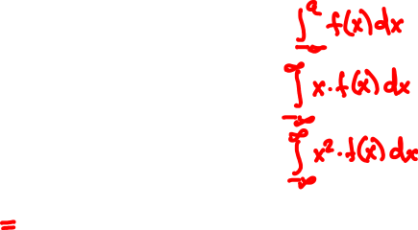

Expectation and variance
PMF f(x)
PDF f(x)
P(X ≤ a)
∑_{x ≤ a} f(x)
E[X]
∑_{x} x f(x)
E[X²]
∑_{x} x² f(x)
Var[X]

Slide 25
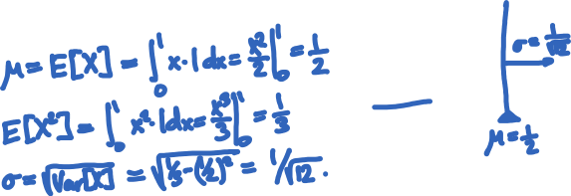

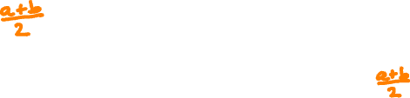
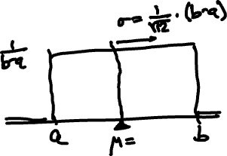
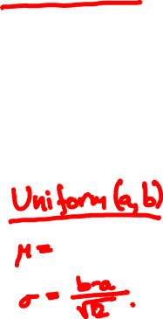
Mean and Variance of Uniform

Slide 26


Raindrops again
Rain is falling on your head at a rate of λ drops/sec.
1
2
How long do we wait until the next drop?

Slide 27
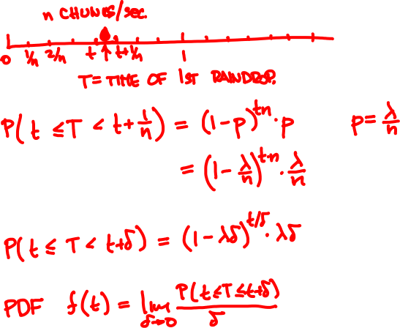



Slide 28
Geometric(3/10)
Geometric(3/100)
Geometric(3/50)
Exponential(3)

Slide 29

The exponential random variable
The Exponential(λ) PDF is
λ e^{-λt}
if x ≥ 0
f(t) =
0
if x < 0.
λ = 1
λ = 1
PDF f(t)
CDF F(t) = P(T ≤ t)

Slide 30

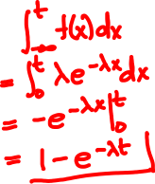
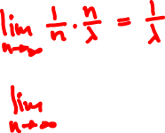

The exponential random variable
CDF of Exponential(λ):
E[Exponential(λ)] =
Var[Exponential(λ)] =

Slide 31
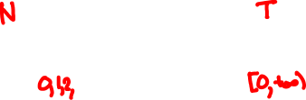
Poisson vs. exponential
N
1
2
T
Poisson(λ)
Exponential(λ)
description
number of events
within time unit
time until first
event happens
expectation
λ
1/λ
std. deviation
λ
1/λ

Slide 32
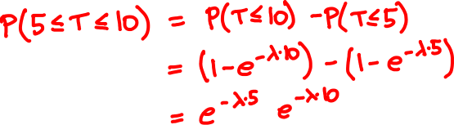
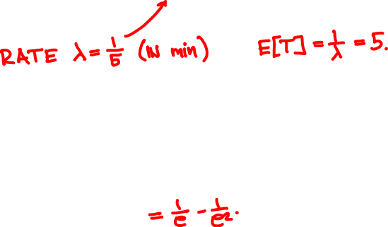

A bus arrives once every 5 minutes. How likely are you to wait 5 to 10 minutes?

Slide 33
Binomial(64, 1/2)
Binomial(1000, 1/2)
Binomial(100, 1/2)
Normal(0, 1)

Slide 34

The Normal(0, 1) random variable
PDF
CDF
f(x) = (2π)^{-½} e^{-x /2}
F(x) = (2π)^{-½} ∫_{t ≤ x} e^{-t /2} dt
²
²
E[Normal(0, 1)] =
Var[Normal(0, 1)] =

Slide 35


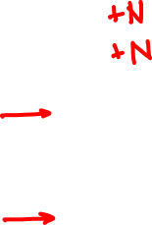

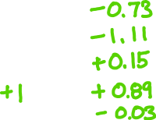
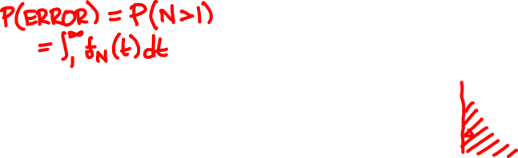
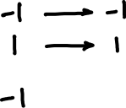
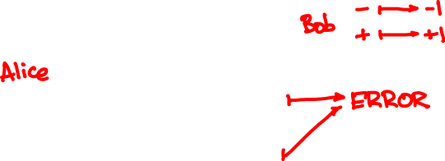
https://stattrek.com/online-calculator/normal.aspx

Slide 36
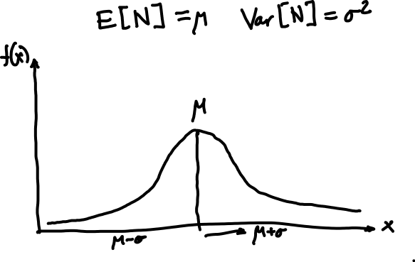
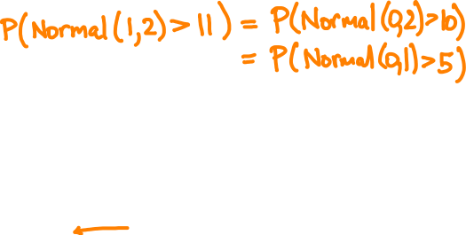
The Normal(μ, σ) random variable
f(x) = (2πσ²)^{–½} e^{– (x – μ) /2σ}
²
²

