Slide 1
3. Independence and
Random Variables

Slide 2
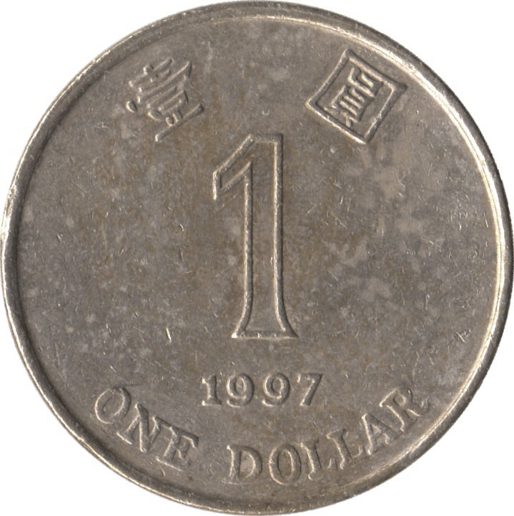
Independence of two events
Let E₁ be “first coin comes up H”
E₂ be “second coin comes up H”
Then P(E₂ | E₁) = P(E₂)
P(E₂∩E₁) = P(E₂)P(E₁)
Events A and B are independent if
P(A∩B) = P(A) P(B)

Slide 3
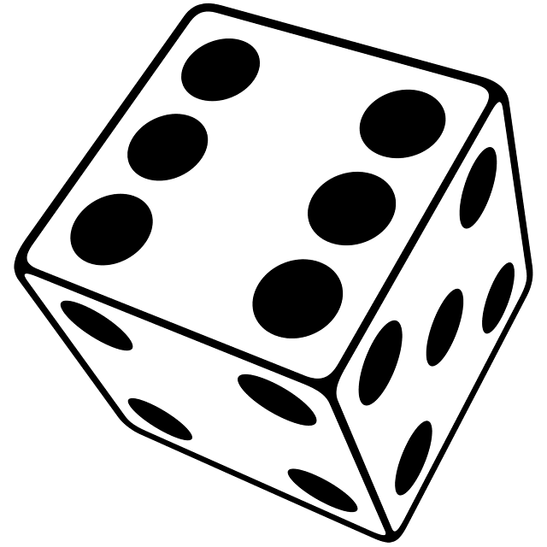
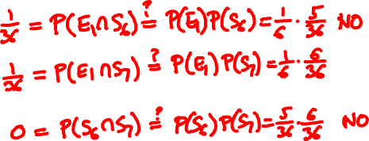
Examples of (in)dependence
Let E₁ be “first die is a 4”
S₆ be “sum of dice is a 6”
S₇ be “sum of dice is a 7”
E₁ and S₆?
E₁ and S₇?
S₆ and S₇?
Notes:
0

Slide 4
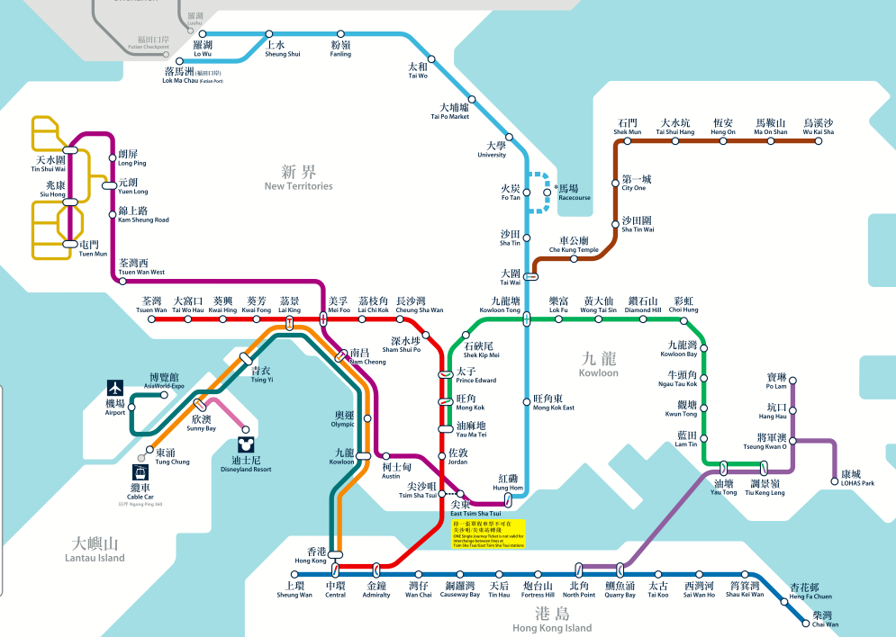

Sequential components
ER: “East Rail Line is working”
P(ER) = 70%
MS: “Ma On Shan Line is working”
P(MS) = 98%

Slide 5
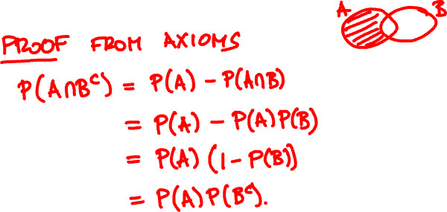
Algebra of independent events
If A and B are independent, then A and B^{c} are also independent.

Slide 6

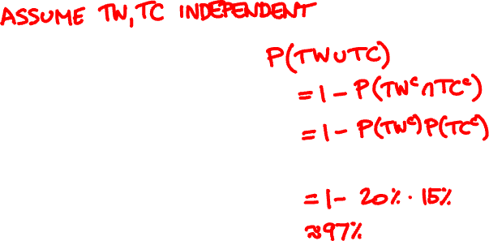
Parallel components
TW: “Tsuen Wan Line is operational”
P(TW) = 80%
TC: “Tung Chung Line is operational”
P(TC) = 85%

Slide 7
Independence of three events
Events A, B, and C are independent if
P(A∩B) = P(A) P(B)
P(B∩C) = P(B) P(C)
P(A∩C) = P(A) P(C)
and P(A∩B∩C) = P(A) P(B) P(C).

Slide 8
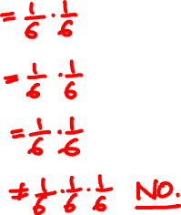

(In)dependence of three events
Let E₁ be “first die is a 4”
E₂ be “second die is a 3”
S₇ be “sum of dice is a 7”
1/6
E₁, E₂?
E₁
E₁, S₇?
1/36
E₂
S₇
E₂, S₇?
1/6
1/6
E₁, E₂, S₇?
Notes:
This example shows pairwise independence not enough for independence

Slide 9
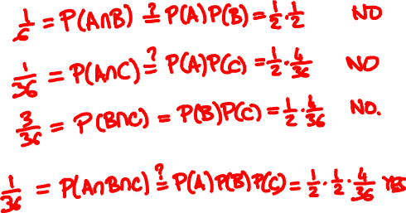
(In)dependence of three events
Let A be “first roll is 1, 2, or 3 ”
B be “first roll is 3, 4, or 5”
C be “sum of rolls is 9”
A, B?
A, C?
B, C?
A, B, C?
Notes:
This example shows P(ABC) = P(A)P(B)P(C) can hold but A, B, C still not independent

Slide 10
Independence of many events
Events A₁, A₂, … are independent if for every subset of the events, the probability of the intersection is the product of their probabilities.
Algebra of independent events
Independence is preserved if we replace some event(s) by their complements, intersections, unions

Slide 11

Multiple components
P(ER) = 70%
P(WR) = 75%
P(TW) = 85%
P(KT) = 95%

Slide 12
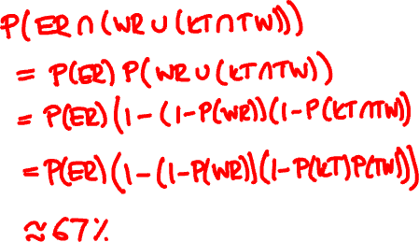
Multiple components
P(ER) = 70%
P(WR) = 75%
P(KT) = 95%
P(TW) = 85%

Slide 13


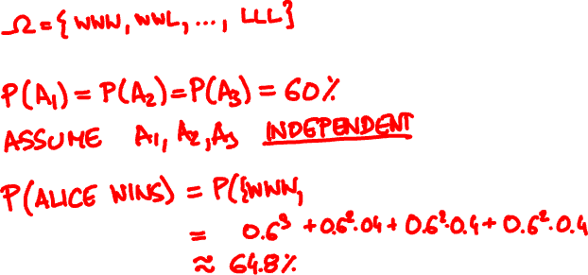

Alice wins 60% of her ping pong matches against Bob. They meet for a 3 match playoff. What are the chances that Alice will win the playoff?
Probability model
Notes:
Point out without proof that this is a valid definition of a probability model: You can calculate the probability of any outcome, and this is consistent with the axioms of probability

Slide 14
Conditional independence
A and B are independent conditioned on F if
P(A ∩ B | F) = P(A | F) P(B | F)
Alternative definition:
P(A | B ∩ F) = P(A | F)

Slide 15


today
tomorrow
☀️
80% ☀️, 20% 🌧
🌧
40% ☀️, 60% 🌧
It is ☀️ on Monday. Will it 🌧 on Wednesday?

Slide 16


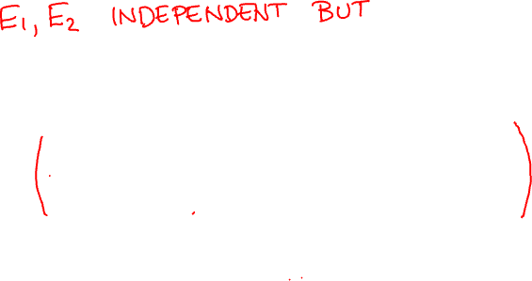
Conditioning does not preserve independence
Let E₁ be “first die is a 4”
E₂ be “second die is a 3”
S₇ be “sum of dice is a 7”
Notes:
E1, E2 are independent, but dependent conditioned on S7

Slide 17


Slide 18
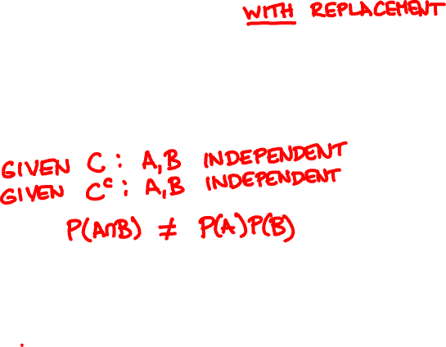
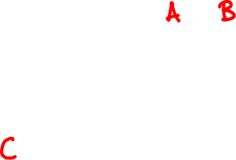
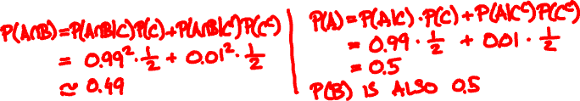
Conditioning may destroy dependence
Probability model
🙎🏻‍♂️
🙍🏻‍♀️
🇺🇸
👍
👍
99%
1%
🇨🇳
👎
👎
Notes:
The events A = “Alice likes the movie” and B = ”Bob likes the movie” are conditionally independent, but unconditionally dependent
P(A and B) = ½ * .99^2 + ½ * .01^2 very close to ½, P(A) = P(B) = 1/2

Slide 19
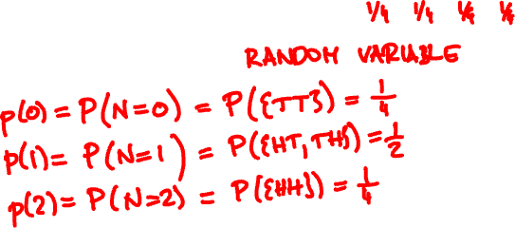
Random variable
A discrete random variable assigns a discrete value to every outcome in the sample space.
Example
{ HH, HT, TH, TT }
N = number of Hs

Slide 20
Probability mass function
We can describe the PMF by a table or by a chart.
x 0 1 2
p(x)
p(x) ¼ ½ ¼
x

Slide 21
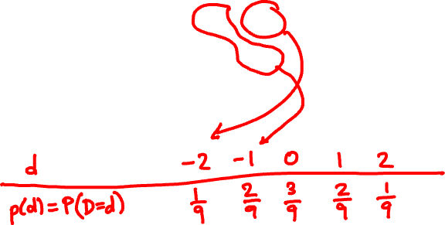
Two 3-sided dice are tossed. Calculate the PMF of the difference D of the rolls.
11 12 13
21 22 23
31 32 33

Slide 22
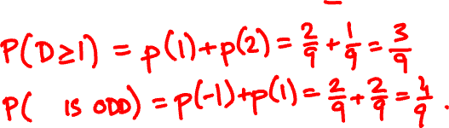
What is the probability that D > 1? D is odd?

Slide 23
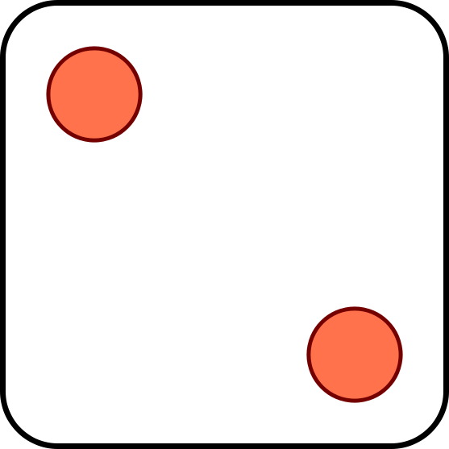
The binomial random variable
Binomial(n, p): Perform n independent trials, each of which succeeds with probability p.
X = number of successes
Examples
Toss n coins. “number of heads” is Binomial(n, ½).
Toss n dice. “Number of s” is Binomial(n, 1/6).

Slide 24
A less obvious example
Flip n coins. Let C be the number of consecutive changes (HT or TH).
Examples:
ω
C(ω)
HHHHHHH
0
THHHHHT
2
HTHHHHT
3
Then C is Binomial(n – 1, ½).

Slide 25

Draw a 10-card hand from a 52-card deck.
Let N = number of aces among the drawn cards
Is N a Binomial(10, 1/13) random variable?

Slide 26
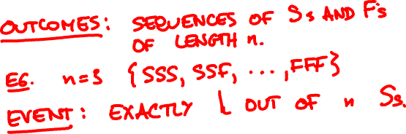
Probability mass function
If X is Binomial(n, p), its PMF is
n
(
)
p(k) = P(X = k) = p^{k} (1 - p)^{n-k}
k

Slide 27
Binomial(10, 0.5)
Binomial(50, 0.5)
Binomial(10, 0.3)
Binomial(50, 0.3)

Slide 28
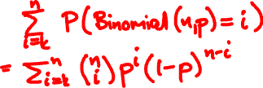
Binomial random variable
P(Binomial(n, p) ≥ k) =
p = 0.6
p = 0.7
n
n
P(Binomial(n, p) ≥ (n – 1)/2)

Slide 29
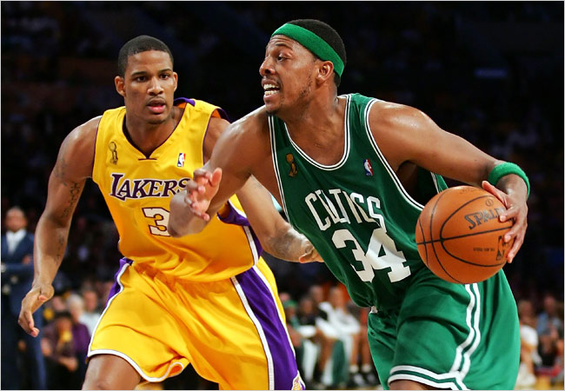
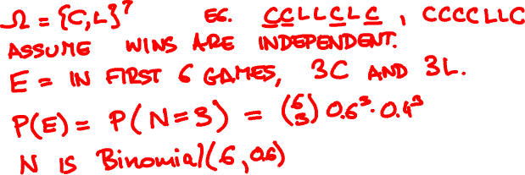
The Lakers and the Celtics meet for a 7-game playoff.
Lakers win 60% of the time. What is the probability that all 7 games are played?

Slide 30

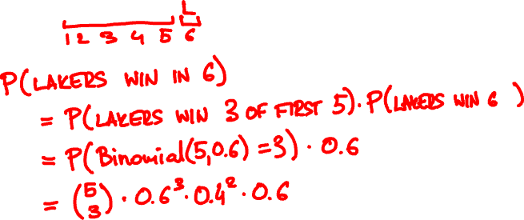

What is the probability that Lakers win in 6?
https://stattrek.com/online-calculator/binomial.aspx

Slide 31
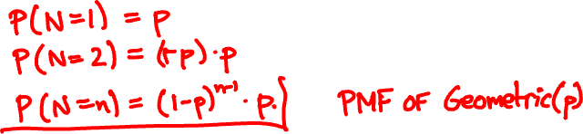
Geometric random variable
Let X₁, X₂, … be independent trials with success p.
A Geometric(p) random variable N is the time of the first success among X₁, X₂, … :
N = first (smallest) n such that X_{n} = 1.

Slide 32
Geometric(0.5)
Geometric(0.7)
Geometric(0.05)

Slide 33




Apples
About 10% of the apples on your farm are rotten.
You sell 10 apples. How many are rotten?
Probability model
Number of rotten apples you sold is
Binomial(n = 10, p = 1/10).

Slide 34

Apples
You improve productivity; now only 5% apples rot.
You can now sell 20 apples.
N is now Binomial(20, 1/20).

Slide 35
.387
Binomial(10, 1/10)
.349
.194
.001
10⁻¹⁰
.377
.354
Binomial(20, 1/20)
.189
.002
10⁻⁸
10⁻²⁶
.367
.367
Poisson(1)
.183
.003
10⁻⁷
10⁻¹⁹

Slide 36

The Poisson random variable
A Poisson(λ) random variable has PMF
p(k) = e^{-λ} λ^{k}/k!
k = 0, 1, 2, 3, …
Poisson random variables do not occur “naturally” in the sample spaces we have seen.
They approximate Binomial(n, p) random variables when λ = np is fixed and n is large (so p is small)
p_{Poisson(λ)}(k) = lim_{n → ∞} p_{Binomial(n, λ/n)}(k)

Slide 37




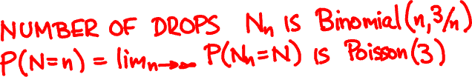
The Poisson random variable
Rain is falling on your head at a rate of 3 drops/sec.
0
1

Slide 38
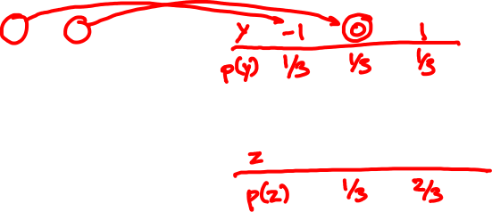
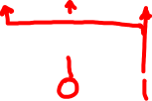
Functions of random variables
PMF of X:
PMF of X – 1?
x
0 1 2
p(x)
1/3 1/3 1/3
PMF of (X – 1)²?
If X is a random variable with p.m.f. p_{X},
then Y = f(X) is a random variable with p.m.f.
p_{Y}(y) = ∑_{x: f(x) = y} p_{X}(x).

Slide 39

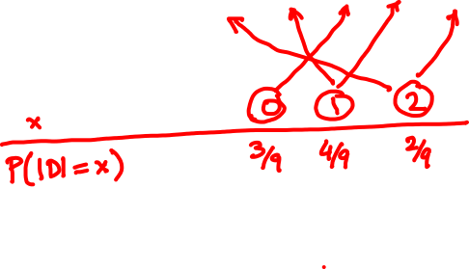
D is the difference of two 3-sided dice rolls.
Calculate the PMF of |D|.

