Slide 1
Solution of HW 5

Slide 2
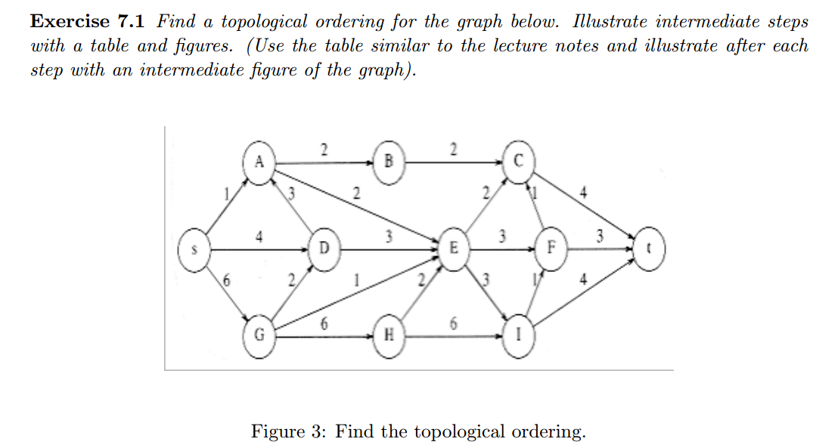

Slide 3
How to find the topological ordering?
Define the indegree of a vertex v as the # of edges (u,v). We compute the indegrees of all vertices in the graph.
Find any vertex with no incoming edges (or the indegree is 0).
We print this vertex, and remove it, along with its edges, from the graph.
Then we apply this same strategy to the rest of the graph.

Slide 4
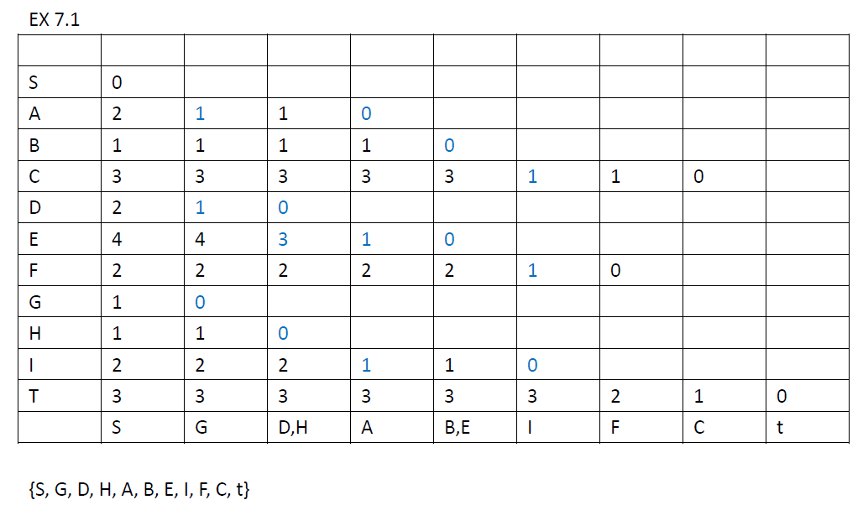

Slide 5
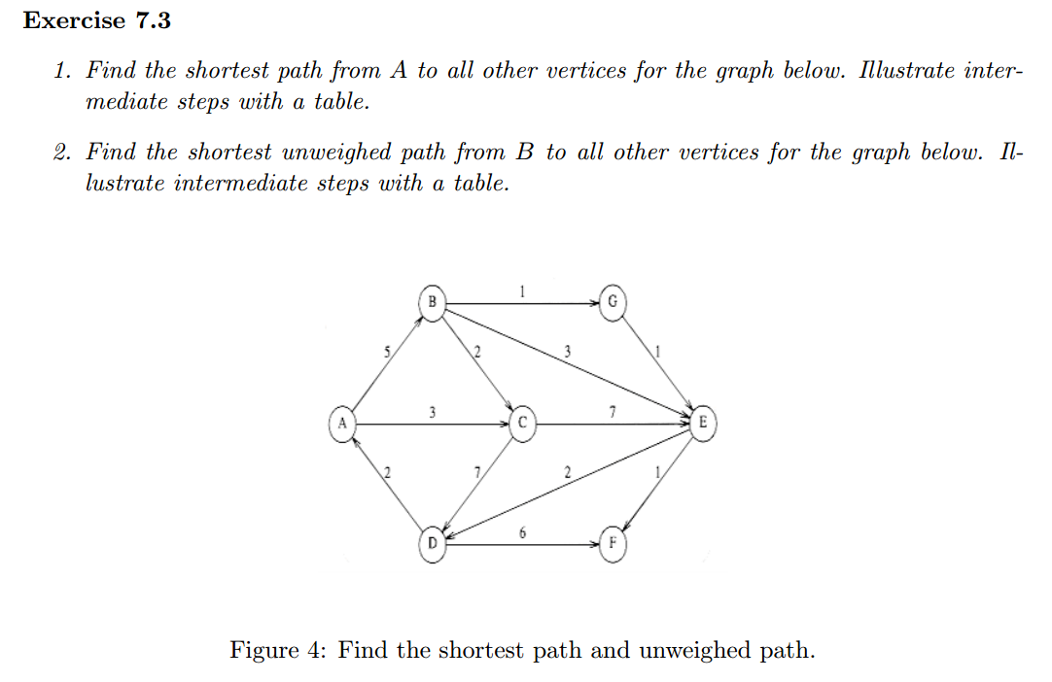

Slide 6
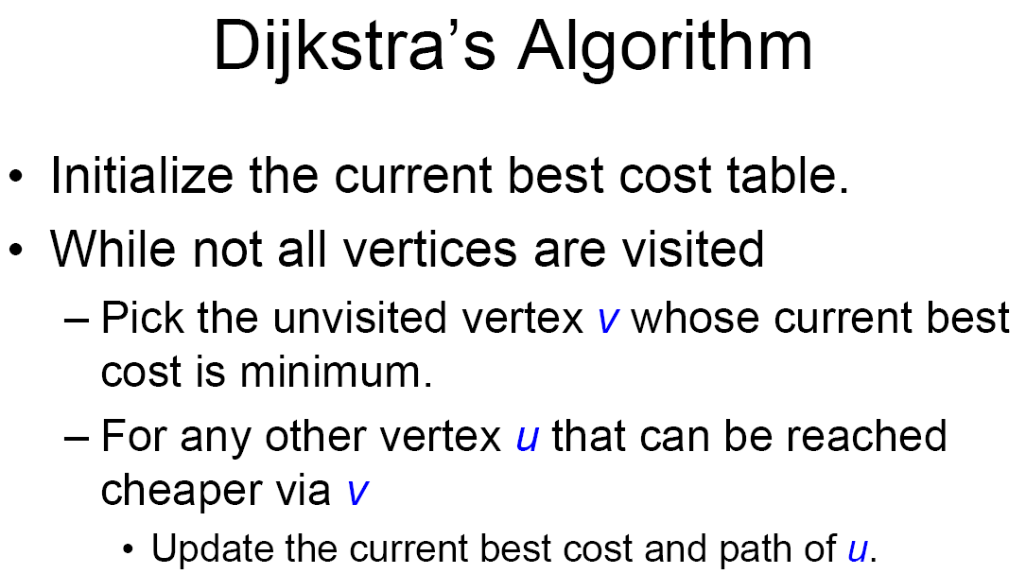

Slide 7
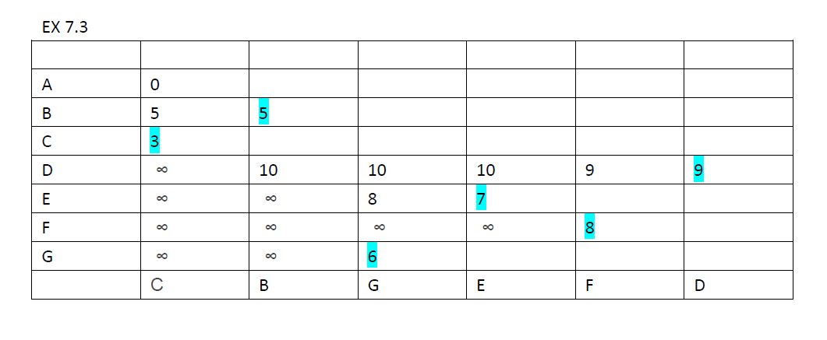

Slide 9
2
2
A
B
C
1
4
3
2
1
2
S
4
D
3
E
3
F
3
t
2
1
3
1
2
4
6
G
H
6
I
6
2
2
A
B
C
1
4
3
2
1
2
S
4
D
3
E
3
F
3
t
4
2
2
1
3
1
2
4
G
2
H
2
I
4
4

Slide 10
2
2
A
B
C
1
4
3
2
1
2
S
1
D
3
E
3
F
3
t
3
4
2
2
1
3
1
2
4
G
2
H
2
I
4
4
2
2
A
B
C
1
2
3
2
1
2
2
S
1
D
3
E
3
F
3
t
3
6
2
1
3
1
2
4
G
H
2
I
6
4

Slide 11
1
1
A
1
B
1
C
1
3
3
2
1
1
2
S
1
D
3
E
3
F
3
t
3
6
2
1
3
1
2
4
G
H
2
I
6
4
2
2
A
B
C
1
4
2
2
1
1
2
S
D
3
E
3
F
3
t
4
6
2
1
3
1
2
4
G
H
2
I
6
4

Slide 12
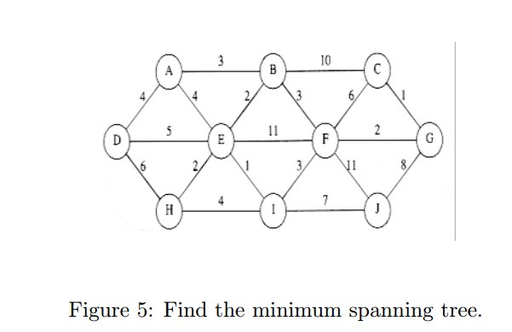

Slide 13
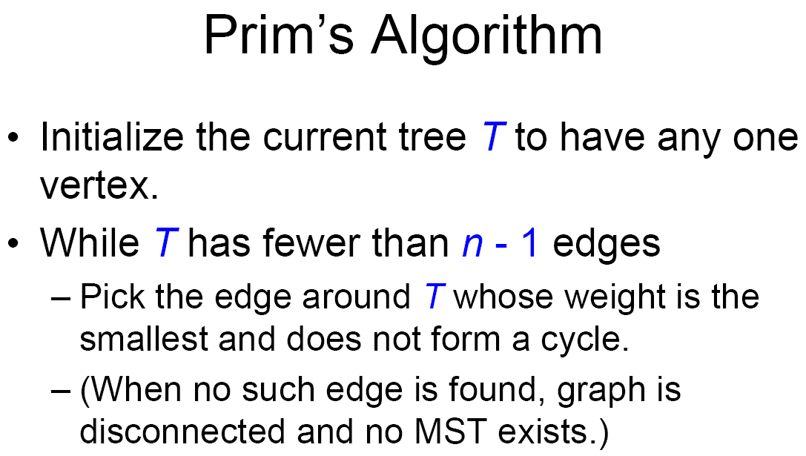

Slide 14
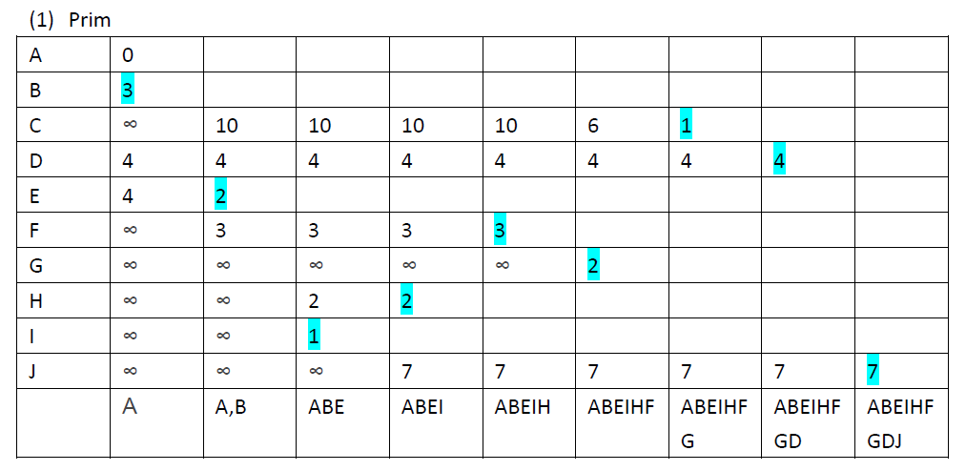

Slide 15
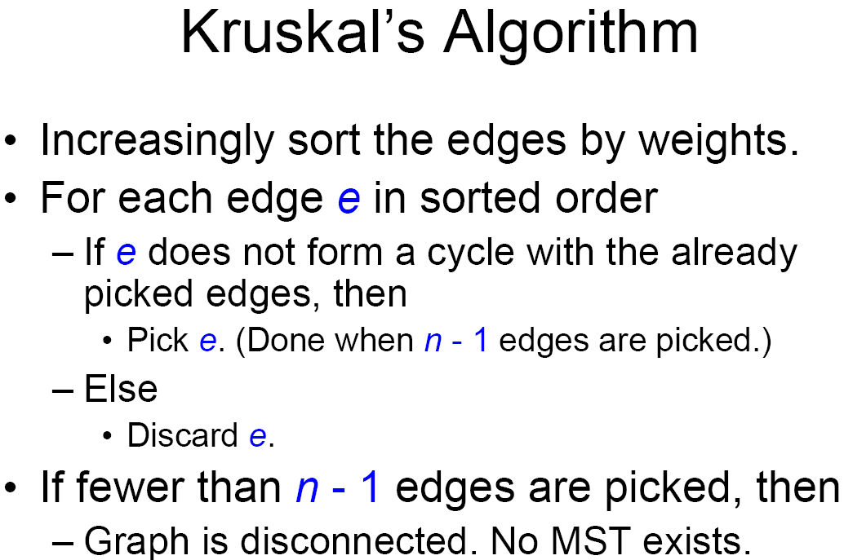

Slide 16
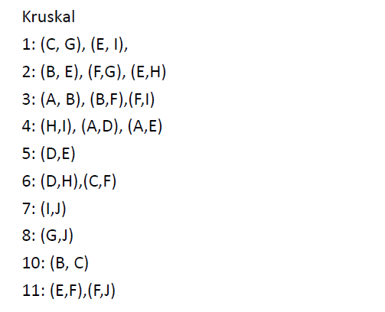

Slide 17
Final
3:30 pm to 5:30 pm Thursday,23 April 2015
Thomas H C Cheung Gymnasium, UC
One sheet of notes
No calculator

