Slide 1
PHYS 4061 Machine Learning Lab

Slide 2
Today's Content
Introduction on machine learning
Linear and nonlinear regression
Demo: linear regression with gradient descent
Fully connected neural network (FCNN)
Convolutional neural network (CNN)
Demo: example of CNN and tune of FCNN

Slide 3
Cluster Access
Temporary account, will be deleted after the lab
Try to login with
secure shell client (Lab PC), or
Mobaxterm (Lab PC, Windows), or
Terminal (Mac)
Host | cluster2.phy.cuhk.edu.hk
Username | 4061_XX
Password | phys4061_XX

Slide 4
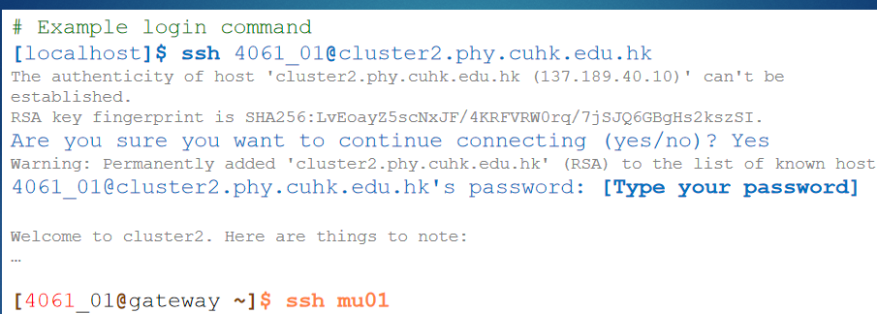

Slide 5
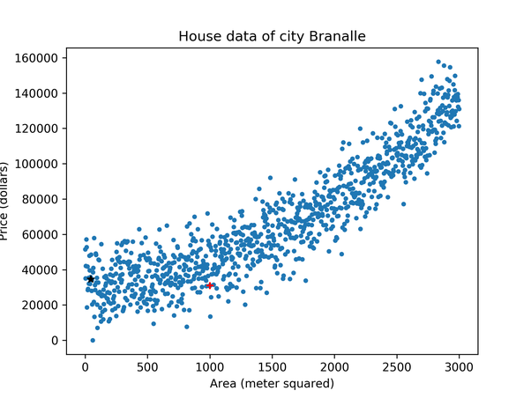
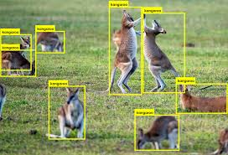
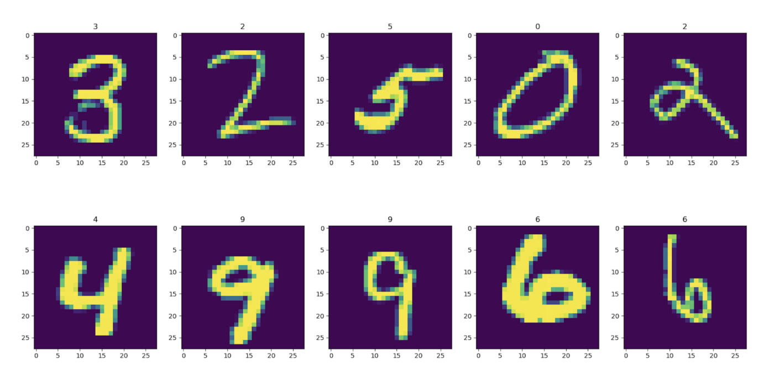
Introduction on Machine Learning
Machine learning (ML) is the study of computer algorithms that improve automatically through experience.
Three broad categories:
Supervised Learning: “Lables” are given as desired outputs, and it is to learn a general rule that maps inputs to outputs.
Examples:
- Classifiction: (category)
digits recognition
Animals identifiction
- Regression: (real value)
House prices prediction
Notes:
A teacher is supervising the learning process, the correct answers are given, the algorithms make predictions on the training dataset and is corrected by the teacher

Slide 6
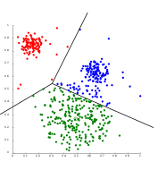
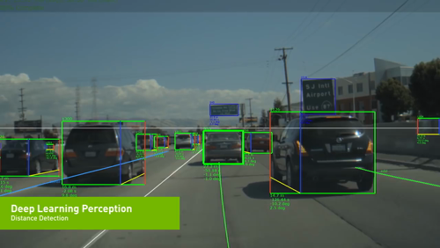
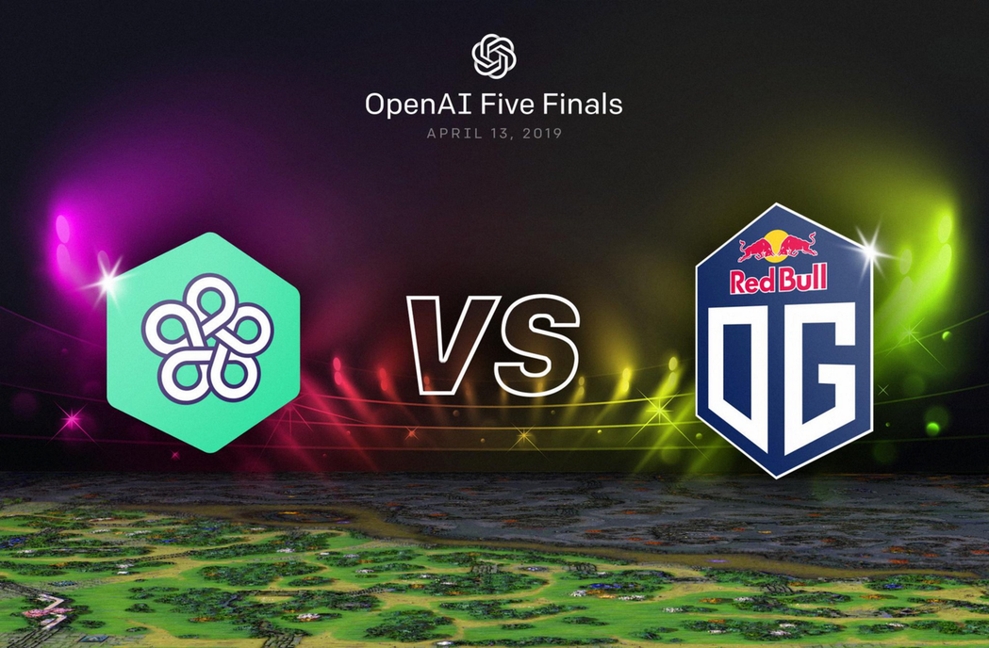
Introduction on Machine Learning
Unsupervised Learning: No labels are given to the learning algorithm, leaving it on its own to find structure in its input.
Examples:
Reinforcement Learning: A computer program interacts with a dynamic environment in which it must perform a certain goal (A game-like situation)
Examples:
- Self-driving vehicle
- AlphaGo
-OpenAI Five (Dota 2)
- Clustering: grouping of training set by analysis of their common features
Many important works arise in this category

Slide 7
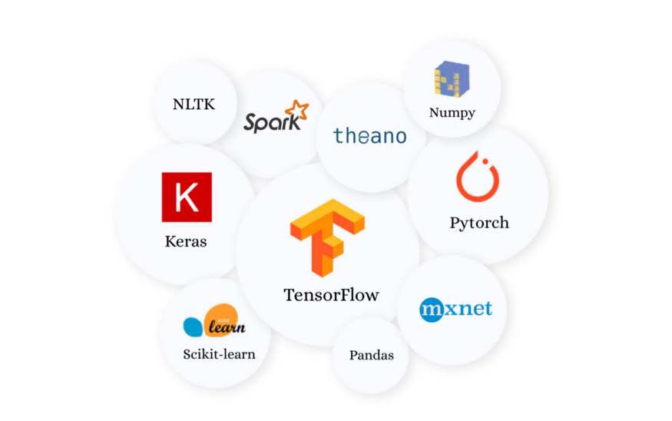
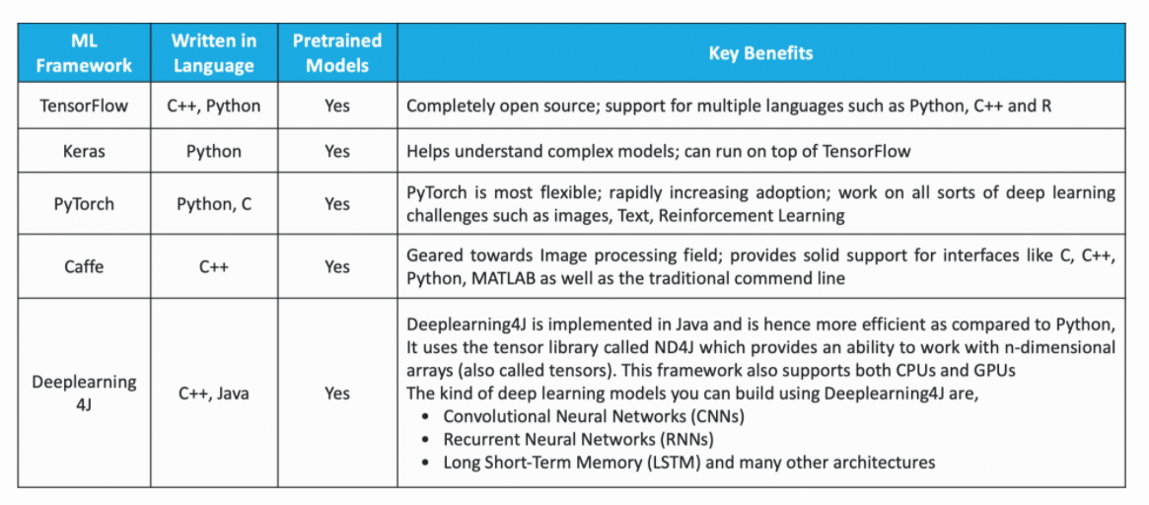
Machine Learning Frameworks
Pytorch, TensorFlow, Keras, Caffe, Scikit-Learn and so on
Python probably is most popular for ML development

Slide 8
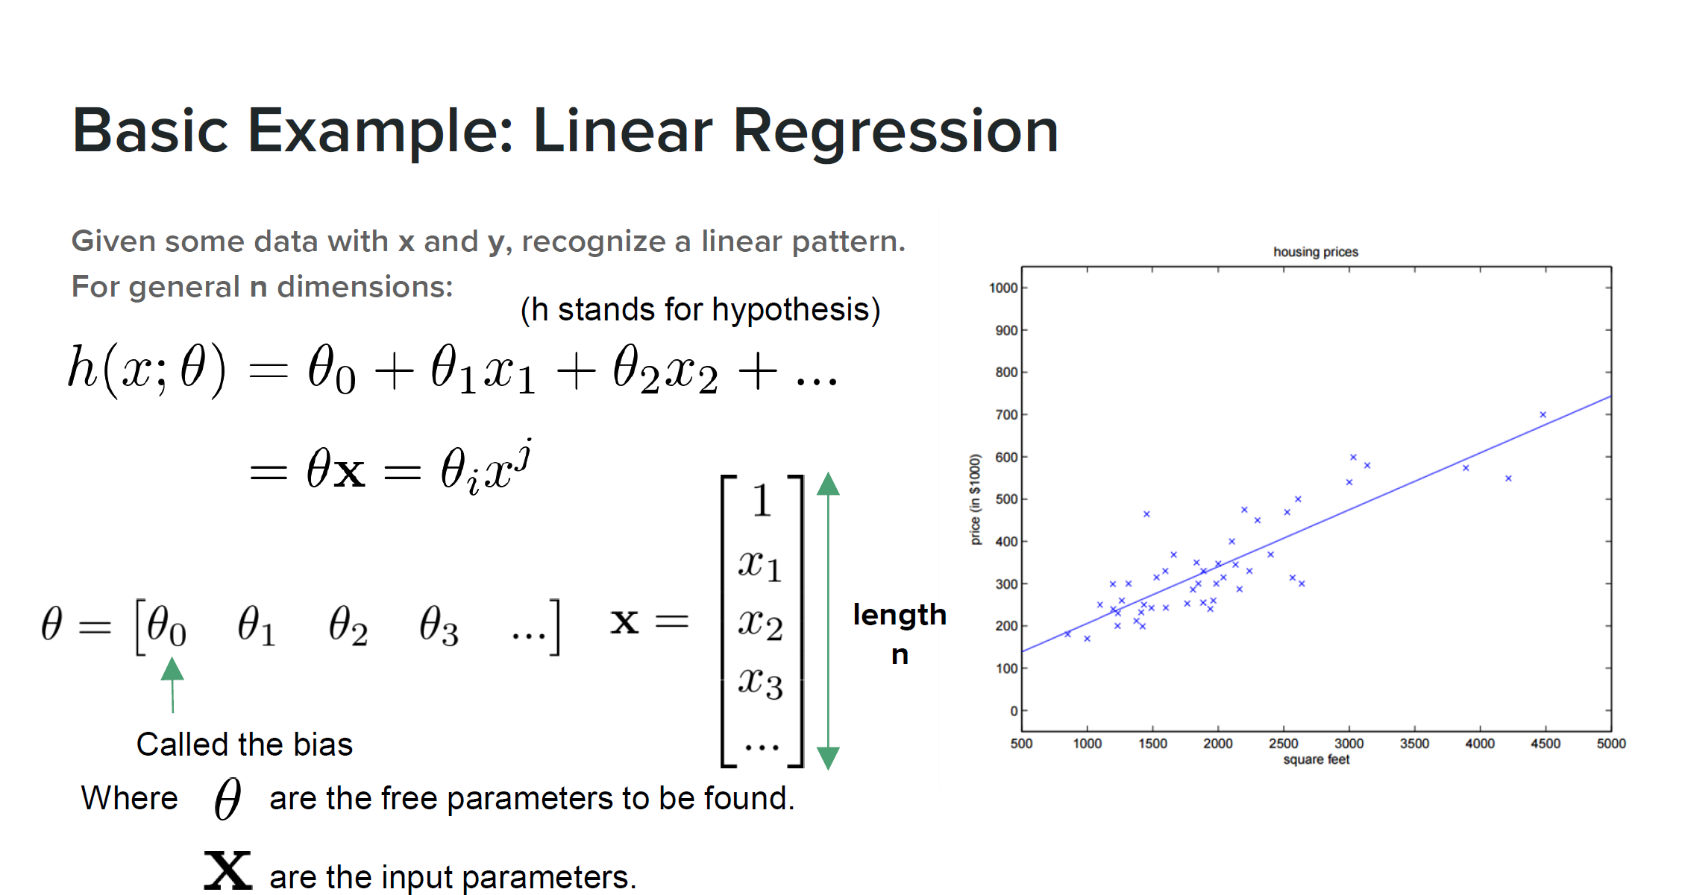
Weights:

Slide 9
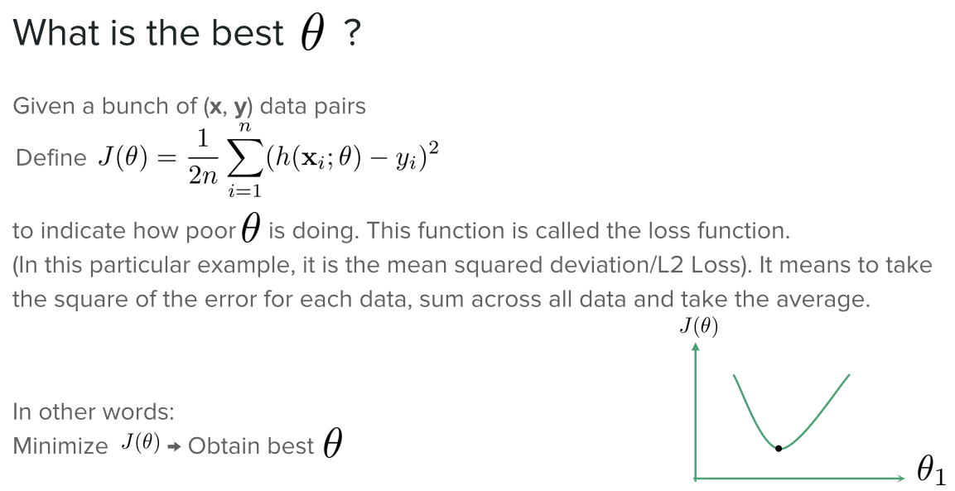

Slide 10
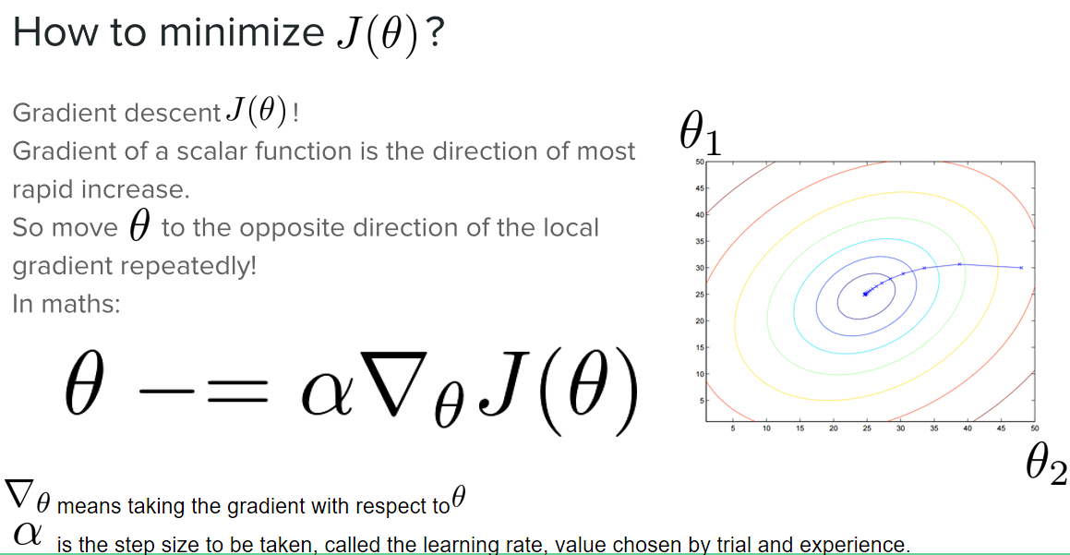

Slide 11
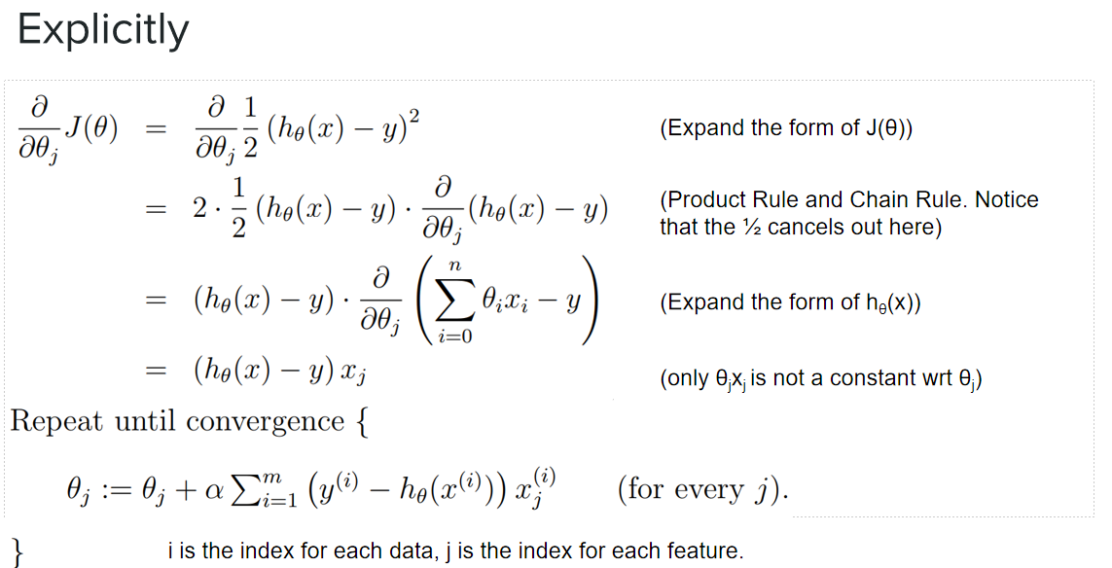

Slide 12
Demo: linear regression with gradient descent
See Instruction_of_4061_machinelearning_lab.pdf for detail
Tasks:
Run and understand the code
Tune learning rate and iterations to get a good linear fitting
Question: how do you judge it is a good fitting?

Slide 13
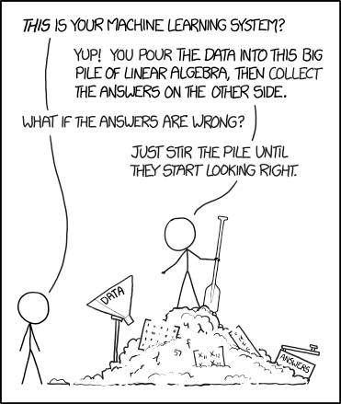
Brief on Deep learning
Glorified curve fitting with functions of high degree of freedom
A field mostly based on intuitions and lacks exact theory
Works surprisingly well
Most researchers don’t have a solid understanding of why their method works better than the others*
Black box

Slide 14
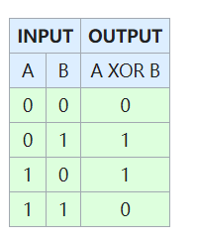
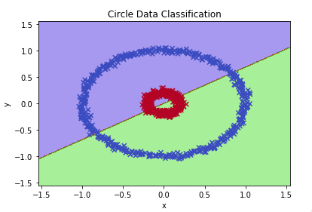
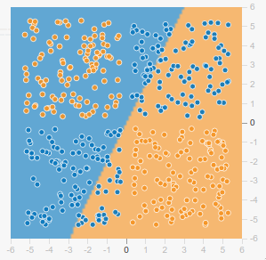
Non-linear Classification
Linear regressions cannot classify most data correctly
Logic gate
Circle
XOR gate

Slide 15
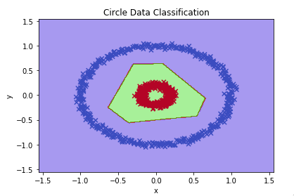
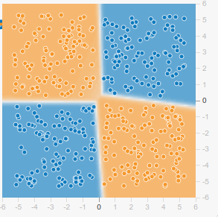
Non-linear Classification
Non-linear classifiers are required for such data
Circle
XOR

Slide 16
Adding Non-linearities
Before:
After:
For some piecewise differentiable nonlinear function σ that is called activation function

Slide 17
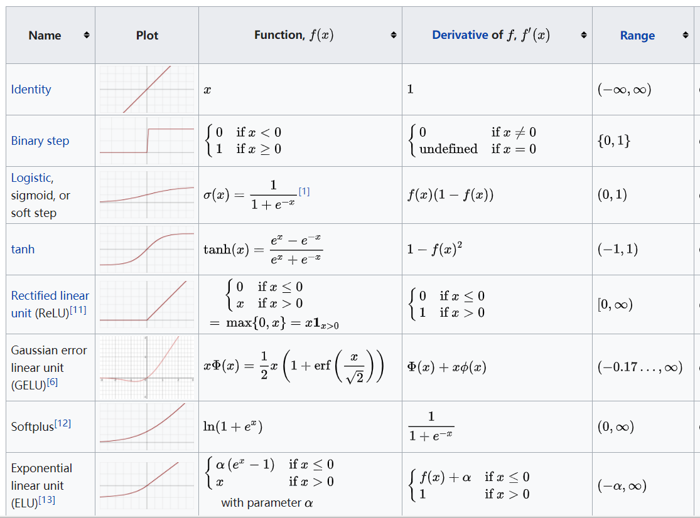
Examples of Activation functions
See more on wiki:
(https://en.wikipedia.org/wiki/Activation_function)

Slide 18
Examples of Artificial Neural network Models
Convolutional Neural Network (CNN)
https://towardsdatascience.com/a-comprehensive-guide-to-convolutional-neural-networks-the-eli5-way-3bd2b1164a53
Recurrent Neural Network (RNN)
https://www.sciencedirect.com/topics/engineering/recurrent-neural-network
Recursive Neural Network
https://www.upgrad.com/blog/introduction-to-recursive-neural-network/
Long short-term memory (LSTM)
https://medium.com/@ahmetozlu93/long-short-term-memory-lstm-networks-in-a-nutshell-363cd470ccac
Sequence-to-Sequence models
https://blog.keras.io/a-ten-minute-introduction-to-sequence-to-sequence-learning-in-keras.html
Notes:
Deep learning is a hot field in machine learning, here lists several famous ANN models

Slide 19
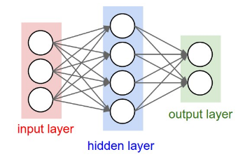

Fully Connected Neural Network
Take FCNN as an example to give you an intuitive understanding
The most basic building blocks of neural networks：
Input vector
Output vector
Weighting matrices to be learnt
Some nonlinear function (activations)
Sigmoid
Tanh
ReLU
etc...

Slide 20
Fully Connected Neural Network
You can stack as many FC-layers on top of each others as much as you want. That's why they are called ‘layers’.
8-layer Neural Network.
1 input layer
6 hidden layers
1 output layer

Slide 21
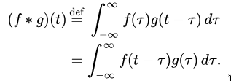
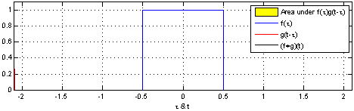
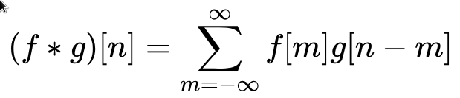
Convolutional Neural Network (CNN)
Frequently used in image and pattern recognition
What are Convolutions?
A method to check whether certain patterns appear in a signal
Slides the pattern-to-be-checked (kernel/filter) across the signal
Gives a high value when the pattern appears in the signal

Slide 22
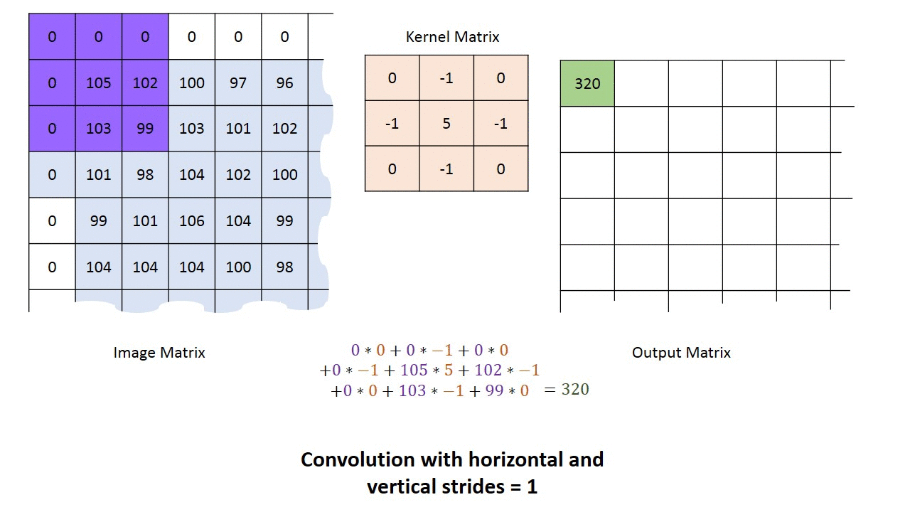
2D Discrete Convolutions

Slide 23
2D Discrete Convolutions

Slide 24
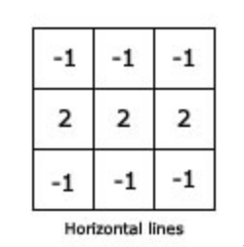
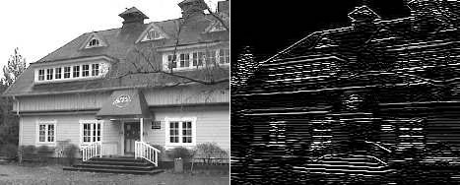
2D Discrete Convolutions
Here you can see that the patterns of a kernel will be recognized in the output image
Image filtered with a horizontal line kernel
See more on “line detection and edge detection” (http://www.bbau.ac.in/dept/CS/TM/Edge%20detection%20.pdf)

Slide 25
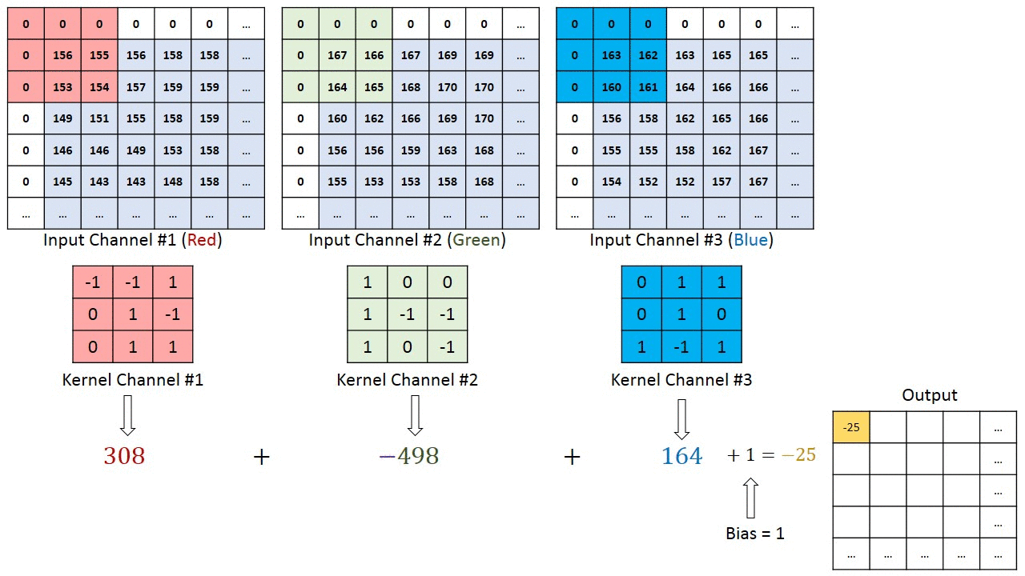
2D Discrete Convolutions with Multiple Channels
For a colored image of RGB, treat the RGB as 3 separate image (Channels) and add the resulting numbers up.
In general the kernel for each channel may not be the same.

Slide 26
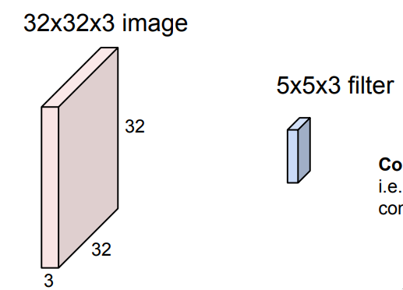
Convolution Layer
We would like the network to learn the filter, i.e. have the filter as weightings and backpropagate into filters.
Source: http://cs231n.stanford.edu/slides/2018/cs231n_2018_lecture05.pdf

Slide 27
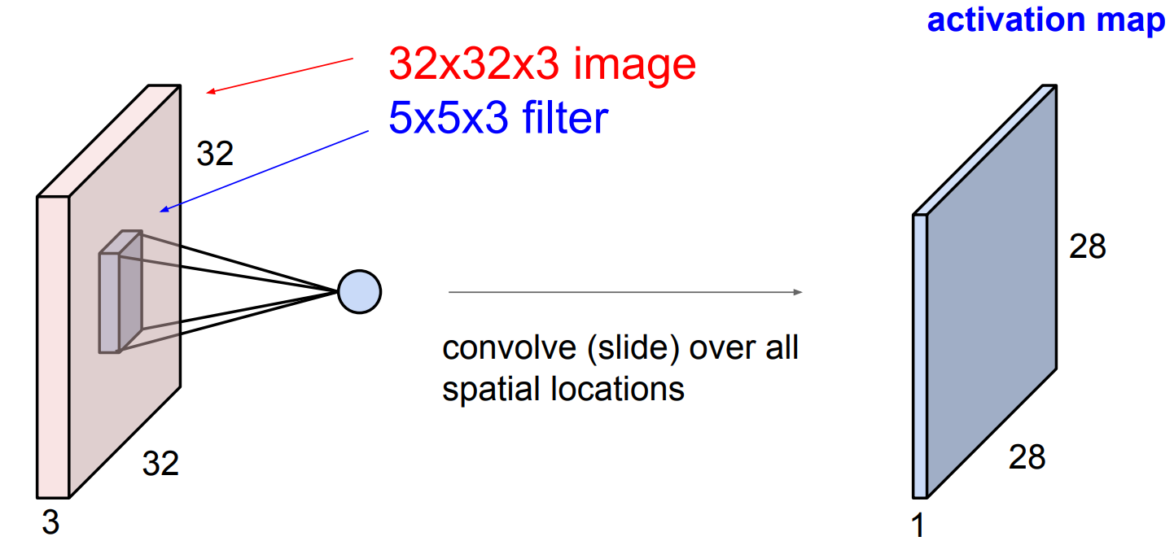
Convolution Layer
Same as a normal image convolution
Strides
28 = (32-5)/1+1

Slide 28
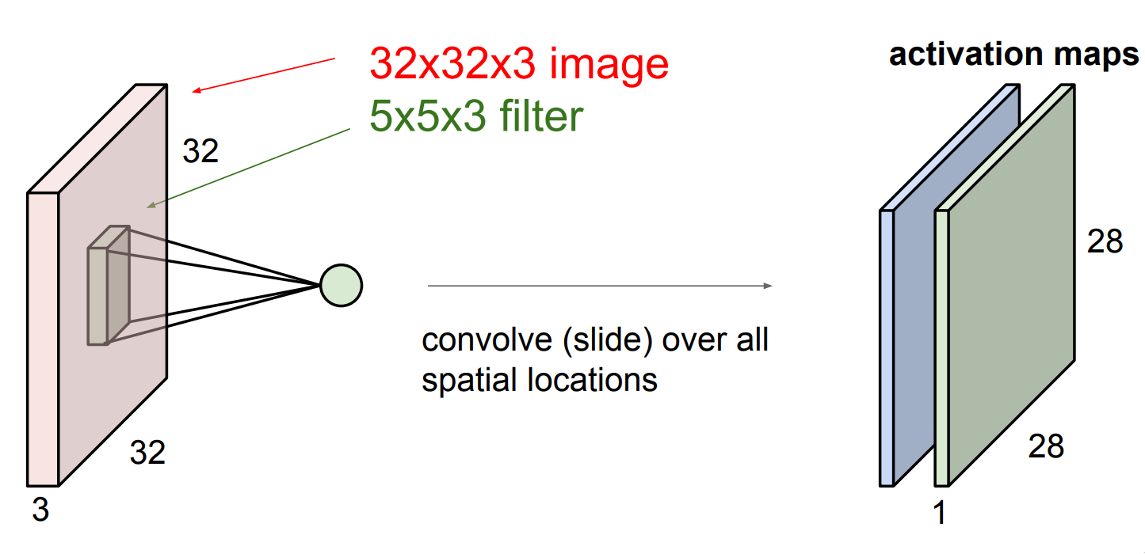
Convolution Layer
Now consider a second filter.

Slide 29
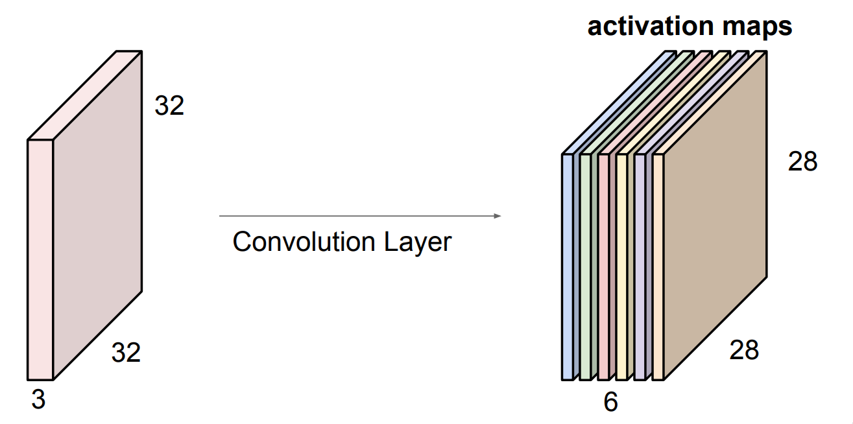
Convolution Layer
For example if we have 6 filters, we would have 6 activation maps.

Slide 30
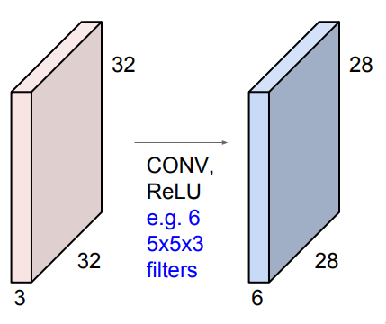
Convolution Layer
A convolution layer is a convolution operation followed by an activation function.

Slide 31
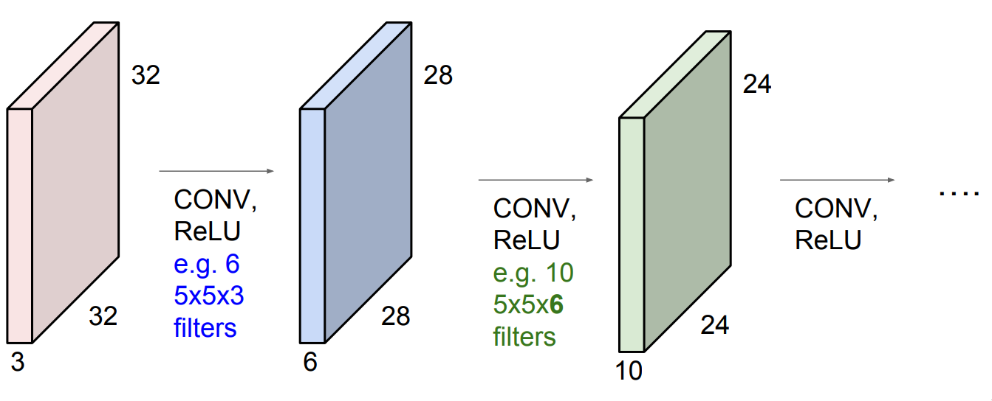
Convolution Layer
Stack convolution layers together and you will get most of the convolutional neural network.
Strides
24 = (28-5)/1 +1

Slide 32
Strides
The convolutions we have shown so far are actually stride 1, because when we slide the filter we move one pixel at a time.
For convolutions with stride S, we move S pixels at a time.

Slide 33
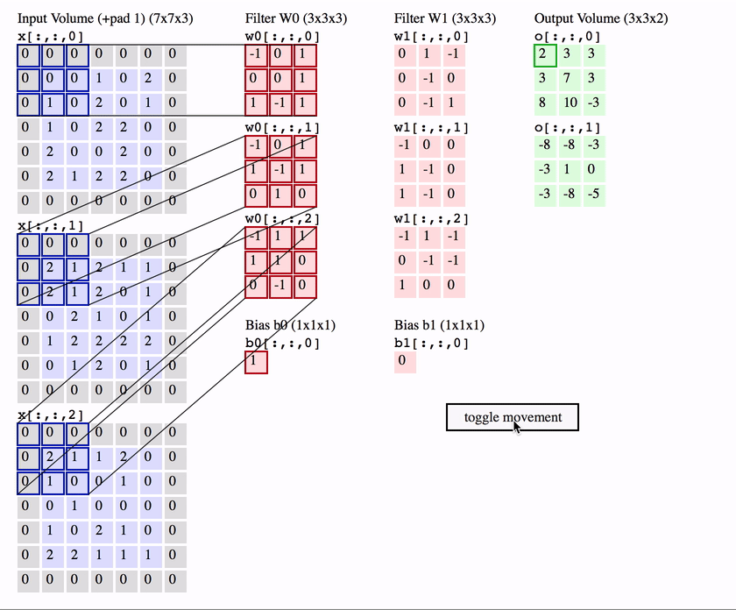
Strides 2 Example (optional)

Slide 34
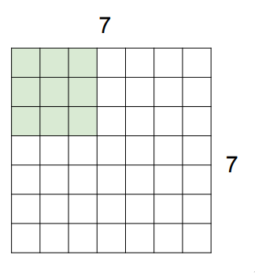
Strides (optional)
Consider a 7x7 image.
How would a stride = 1 or 2 work？
What happens when stride = 3？

Slide 35
Strides (optional)
When stride = 3 the filter doesn’t fits neatly!

Slide 36
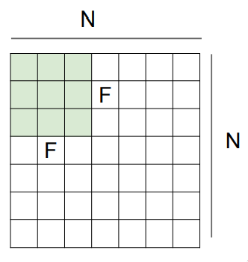
Strides (optional)
Output size: (N - F) / stride + 1
e.g. N = 7, F = 3: stride 1 => (7 - 3)/1 + 1 = 5 stride 2 => (7 - 3)/2 + 1 = 3 stride 3 => (7 - 3)/3 + 1 = 2.33

Slide 37
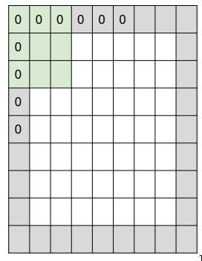
Zero padding (optional)
When the filter doesn’t fits, pad some zeroes at the boundary of the image!
Zero works because they don't contribute to value of the convolutions, like a neutral pixel. (Recall convolutions are multiplications followed by additions.)

Slide 38
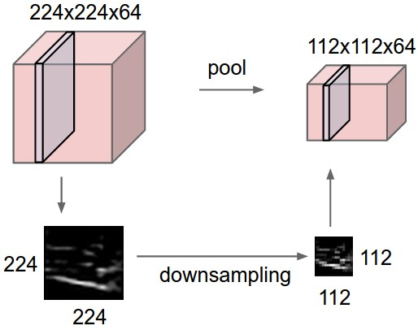
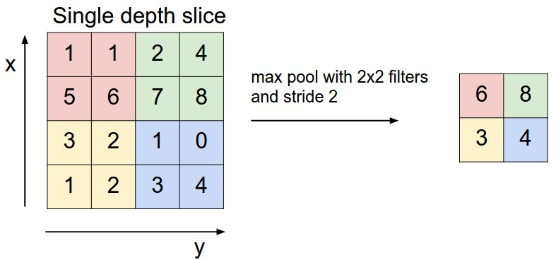
Max-Pooling (optional)
Common to insert a pooling layer between conv layers.
Benefits:
Reduce parameters
Reduce computation
Reduce overfitting(will talk later)
Max-pooling intuitively works by remaining only large activations, which means activations that have detected something. This makes sense because we only care when we have detected something, not when we have detected nothing.

Slide 39
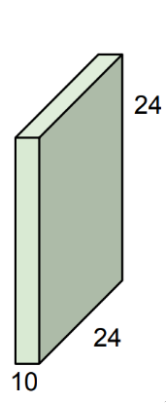
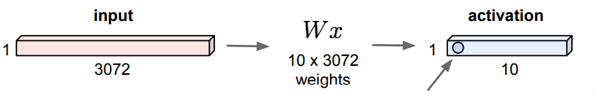
Last layer of a CNN
In order to map the last output of a convolution layer to your desired output (e.g. probabilities), flatten the last output and feed it to an FC layer (and to a softmax layer if you want probabilities as your output).
FC Layer
Flatten
10x5760
10x24x24=5760

Slide 40
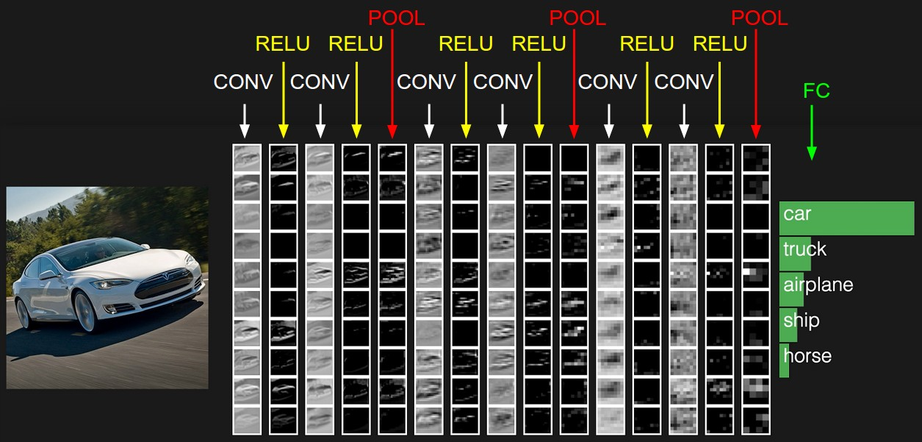
Summary Structure of a CNN
INPUT -> [[CONV -> RELU]*N -> POOL]*M -> [FC -> RELU]*K -> FC -> SOFTMAX
where the * indicates repetition

Slide 41
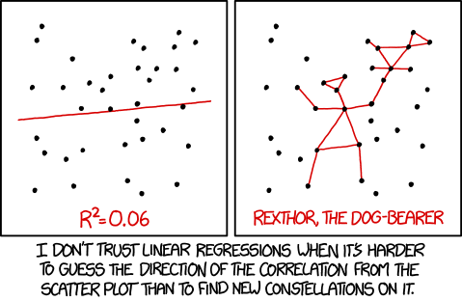
Overfitting and Underfitting
Overfitting:
Fail to generalize to testing dataset
Works very well on training dataset
Underfitting
Fail to work well on both training and testing data
Underfitting
Overfitting
To Check if overfitting/underfitting exists
Split total data set into training set (70%-90%) and test set (10%-30%)
Compare the accuracy of training set with test set

Slide 42
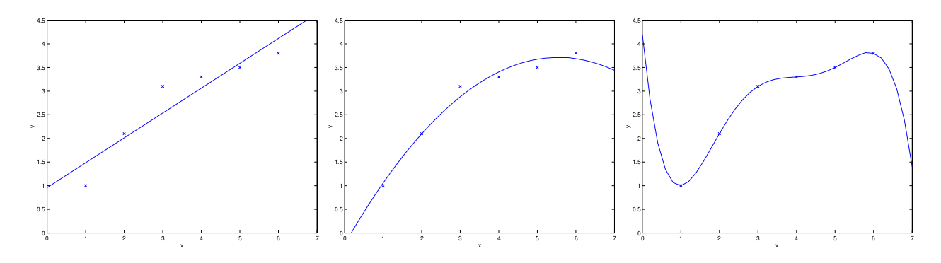
Overfitting Examples
To find a proper fitting function of the scattered dots in the plot, you can do the following:
First Order Polynomial
Second Order Polynomial
Fifth Order Polynomial
Whether it is a good fitting really depends on performance of test set
Higher order polynomial may lead to overfitting

Slide 43
Demo: example of CNN and paramters tune of FCNN
See Instruction_of_4061_machinelearning_lab.pdf for detail
Tasks:
Get a feel on neural network model construction
Run the code and play with it
Try to tune the parameters: learning rate, epochs*, number of FC layers, number of neurons in FC layers
*epochs mean how many iteraitons that you want the NN to train the dataset

Slide 44

Some words on Pytorch

