Slide 1


QC mapping
Ronald Lui
Department of Mathematics
The Chinese University of Hong Kong

Slide 2
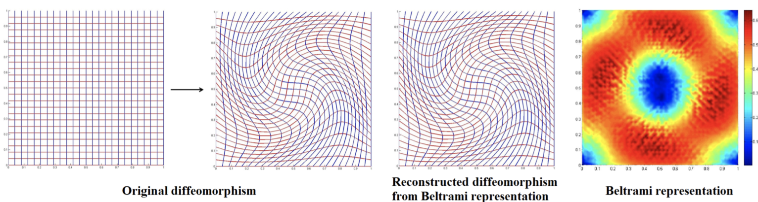
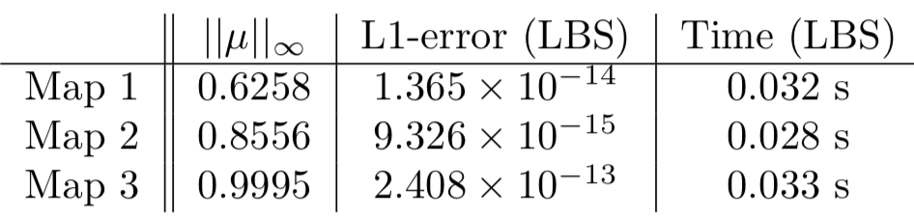
Linear Beltrami Solver

Slide 3
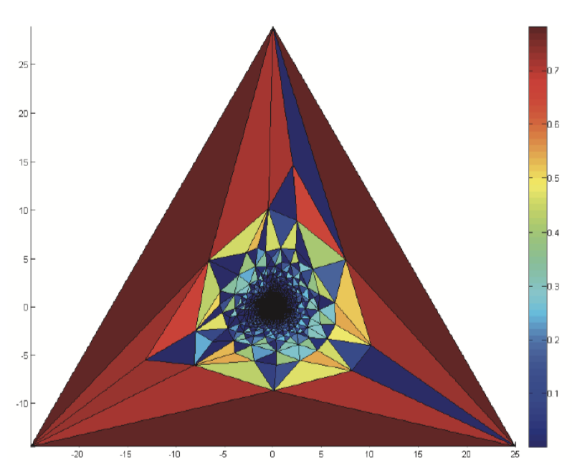
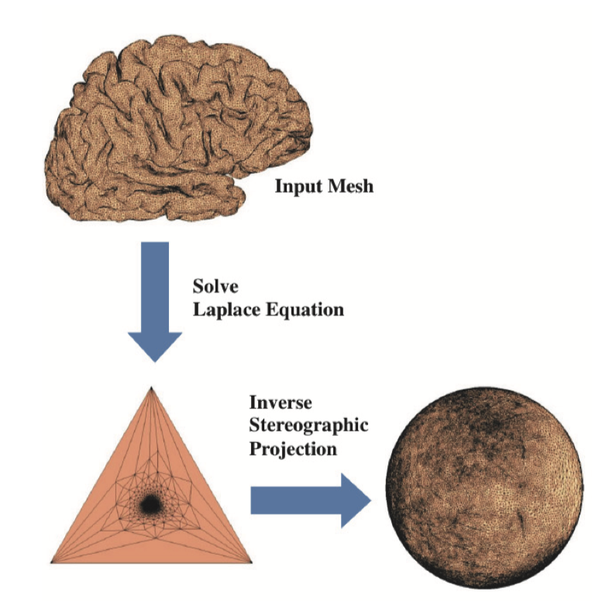
Fast Spherical Conformal Parameterization
Large conformality distortion near the north pole

Slide 4
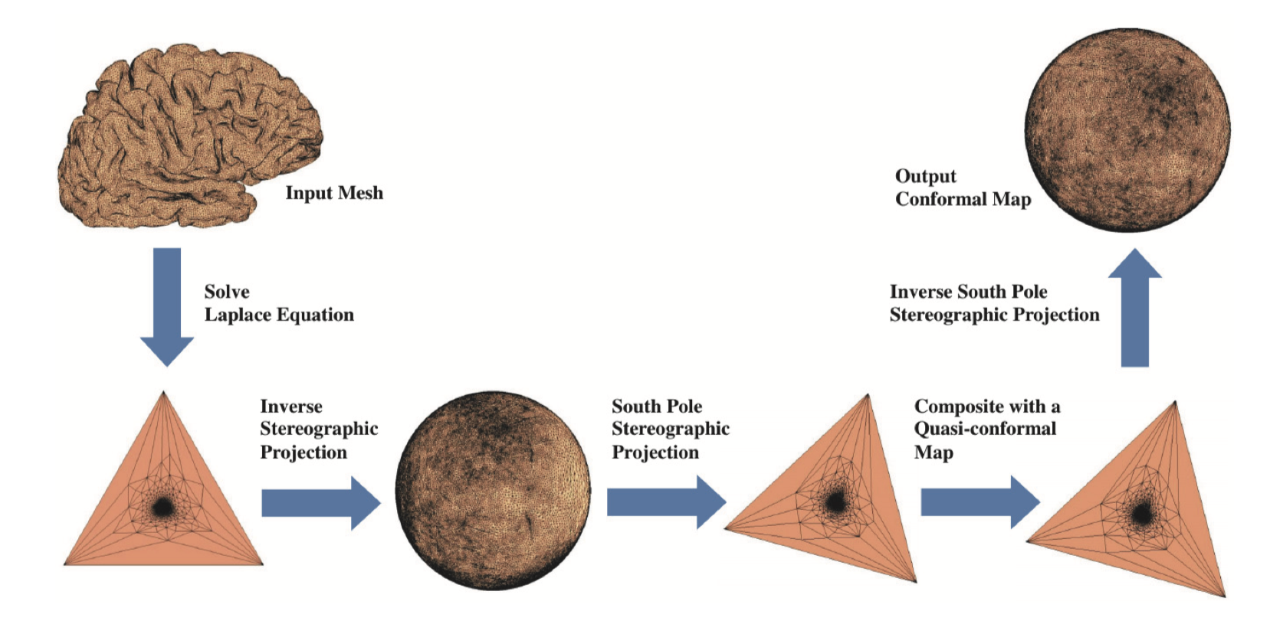
Fast Spherical Conformal Parameterization

Slide 5
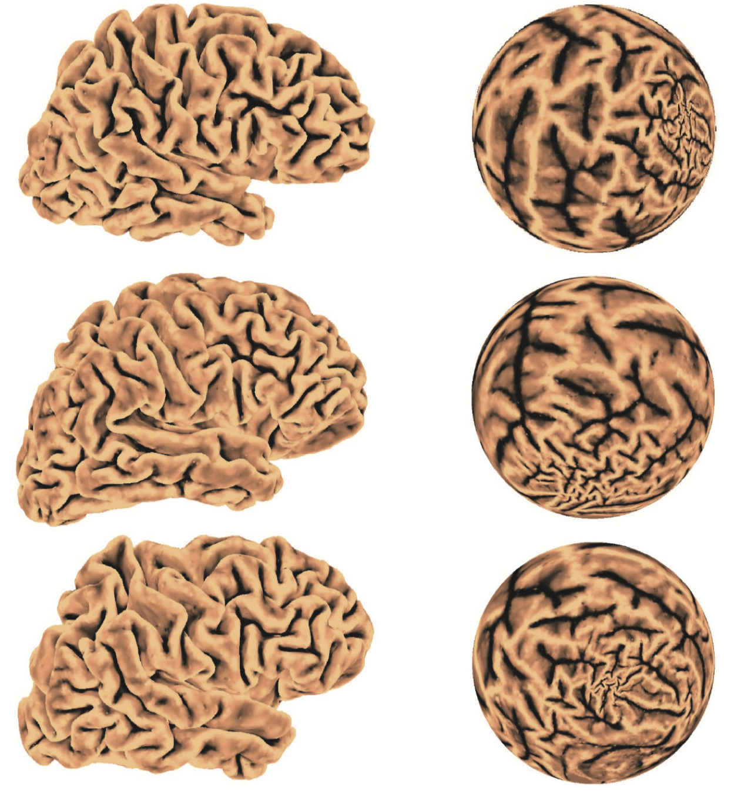
Fast Spherical Conformal Parameterization

Slide 6
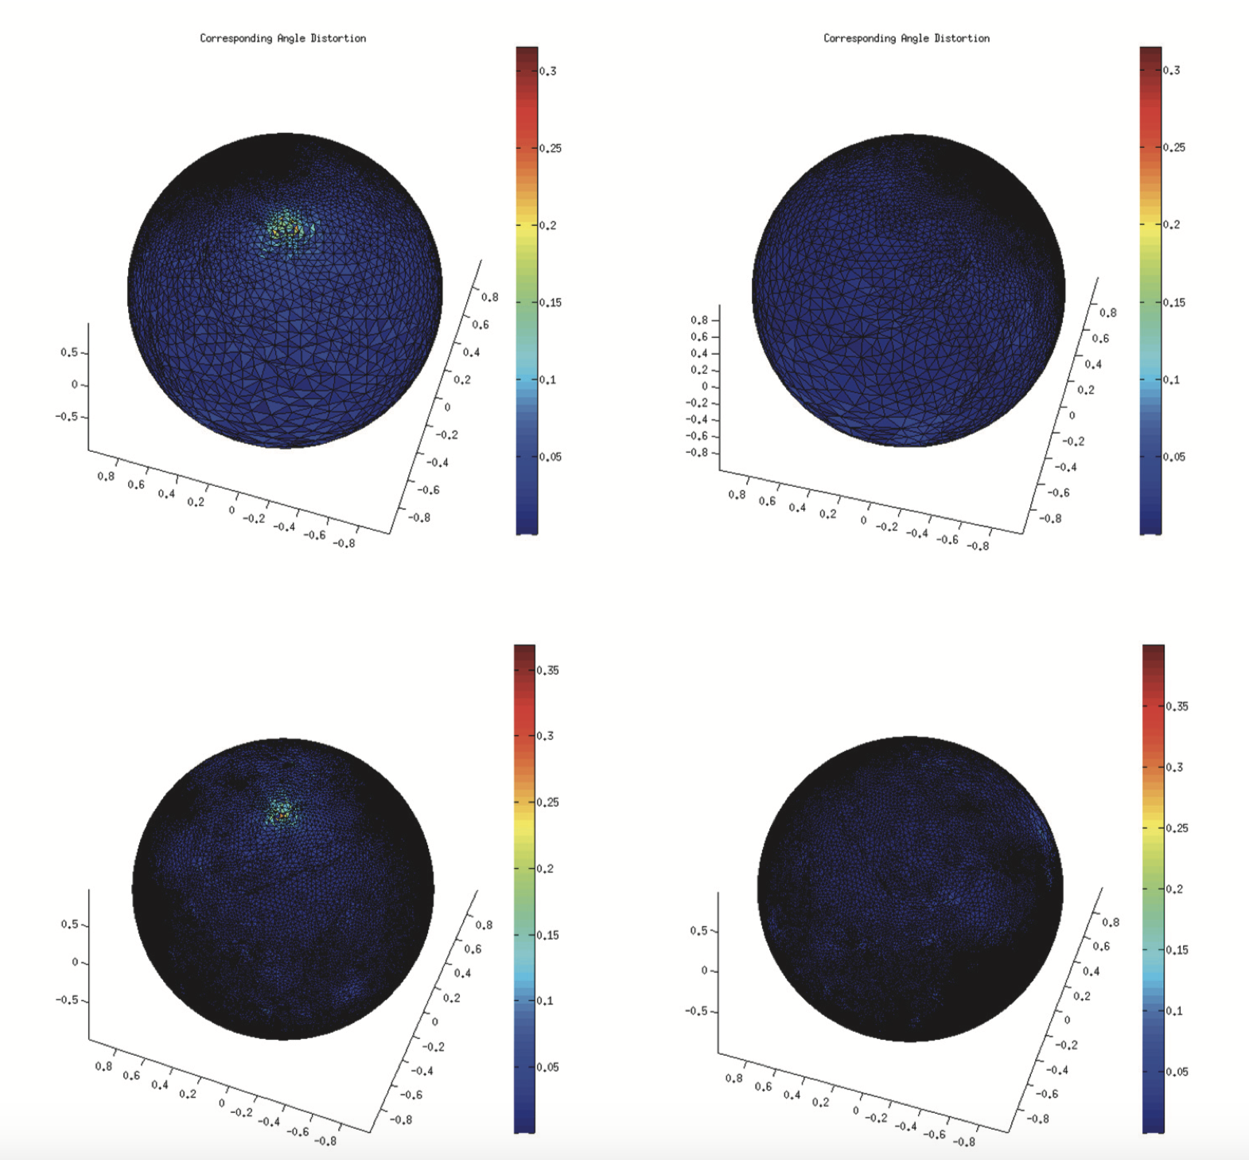
Fast Spherical Conformal Parameterization

Slide 7
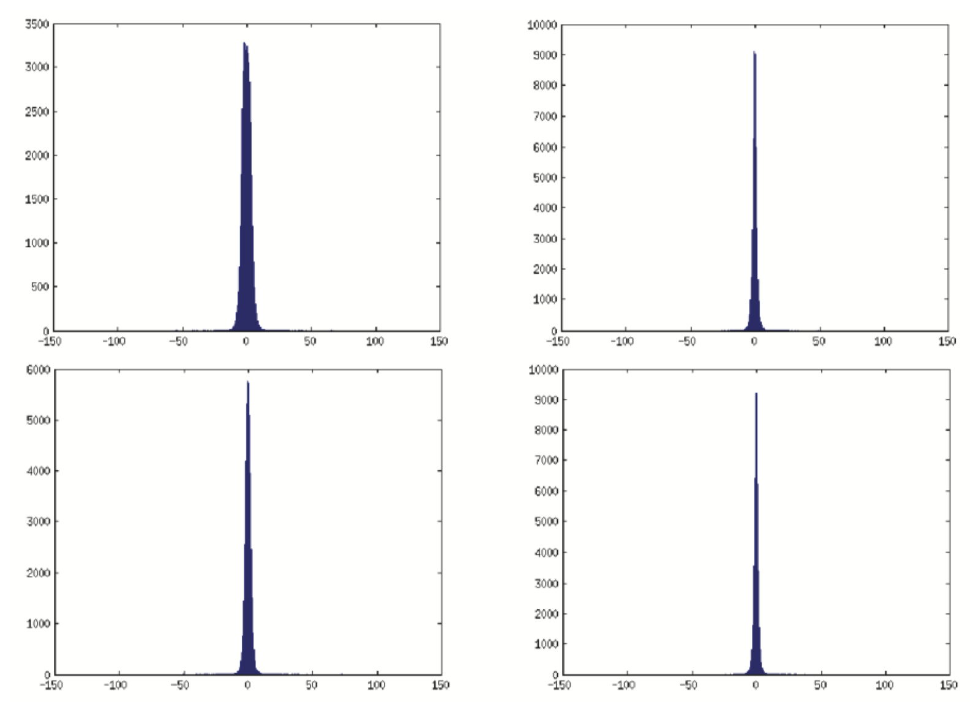
Fast Spherical Conformal Parameterization

Slide 8
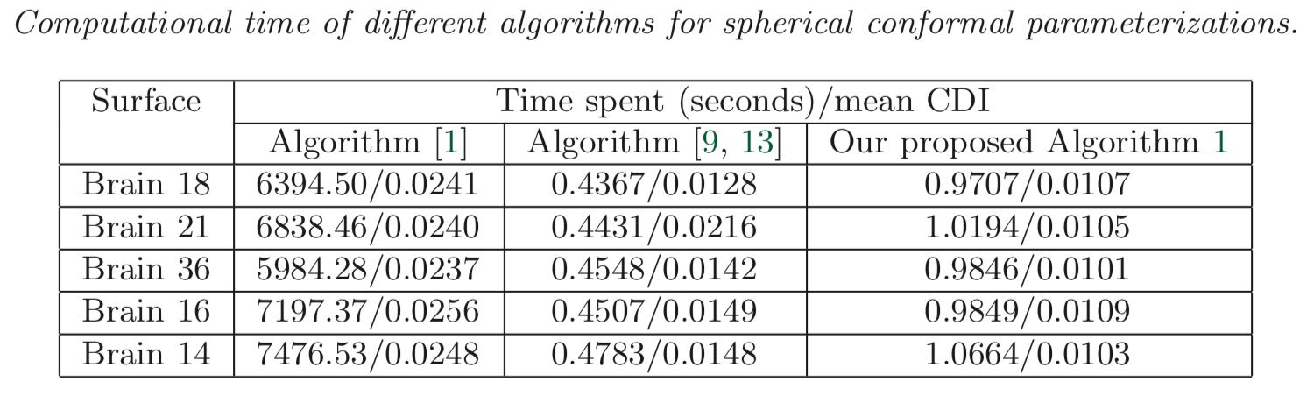
Fast Spherical Conformal Parameterization

Slide 9
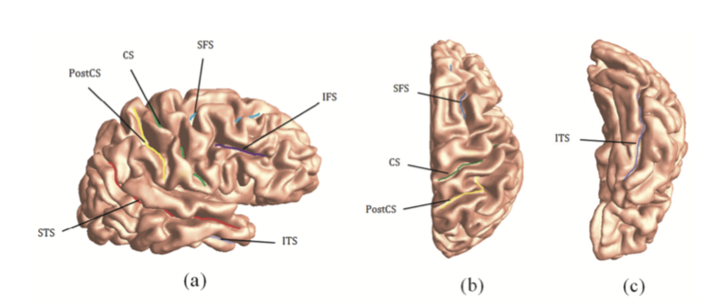
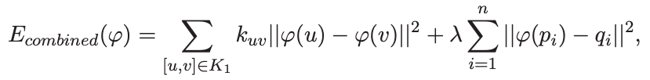
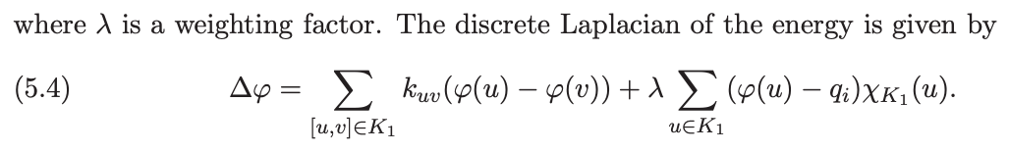

Brain landmark matching parameterization
Landmark-matching optimized spherical harmonic parameterization

Slide 10
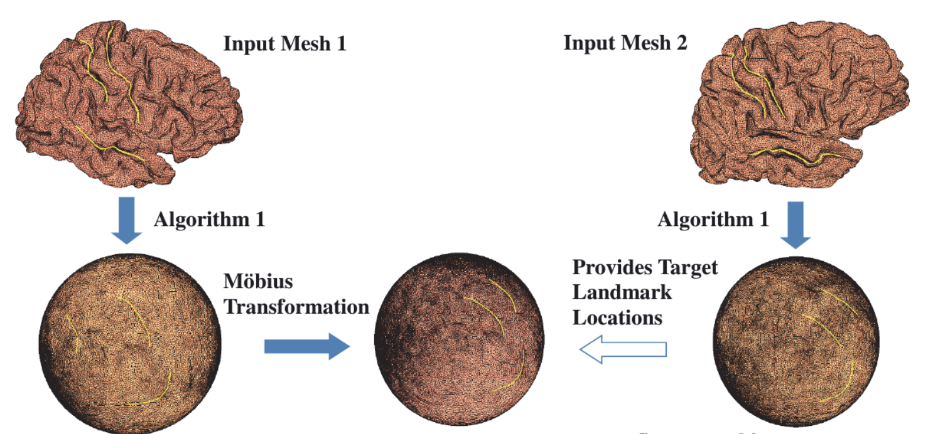
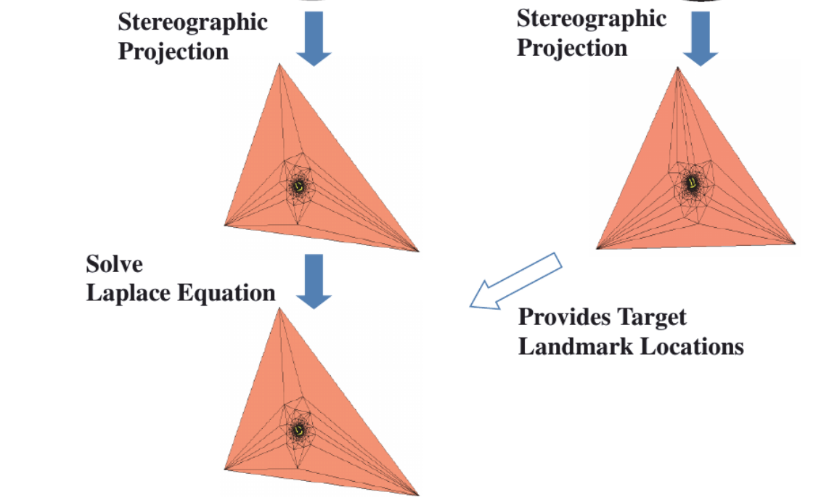
Brain landmark matching parameterization

Slide 11
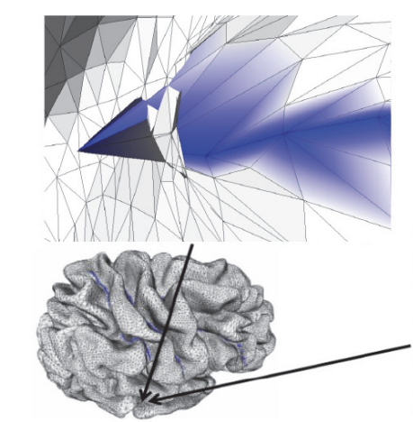
Brain landmark matching parameterization

Slide 12
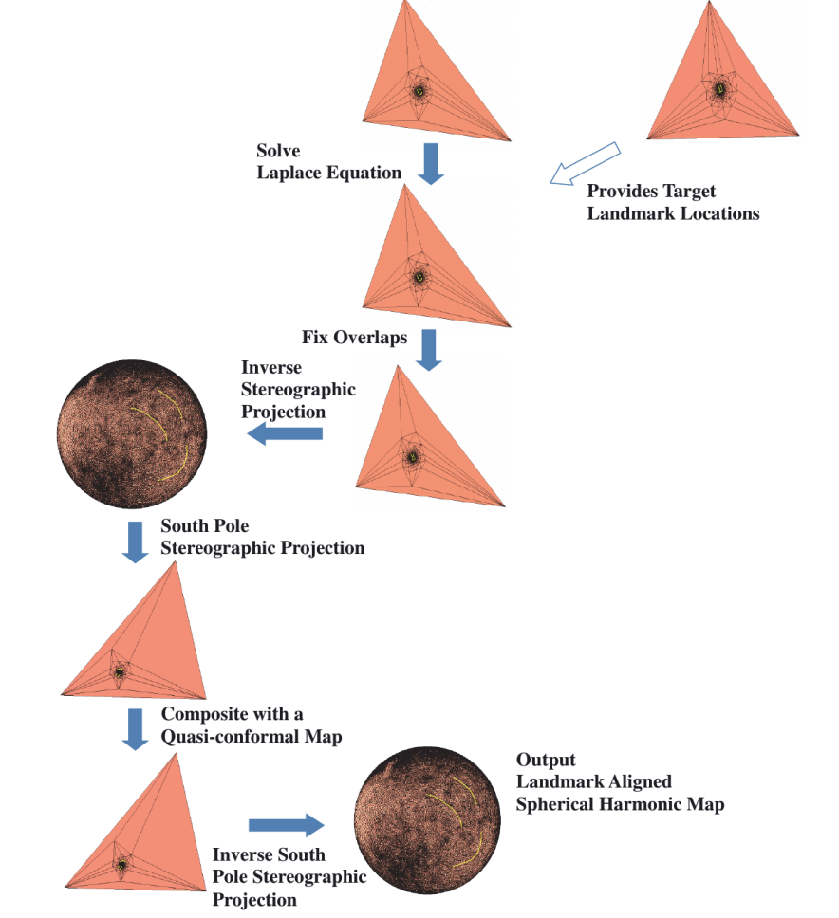

Slide 13
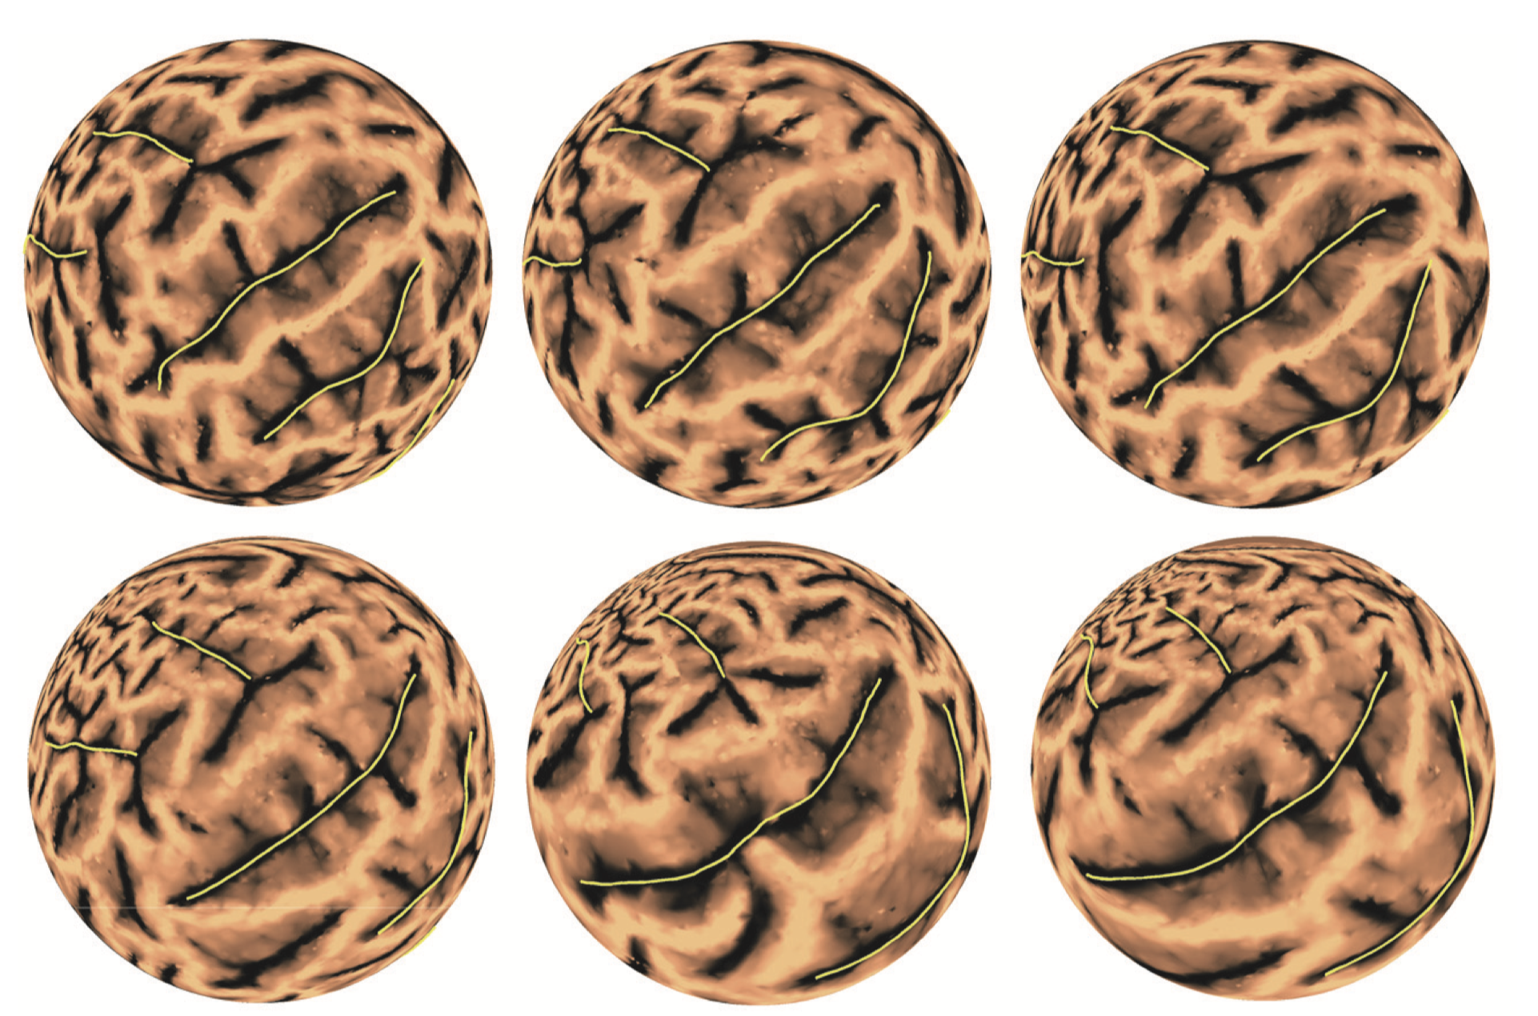
Brain landmark matching parameterization
Initial
Target
Transformed

Slide 14
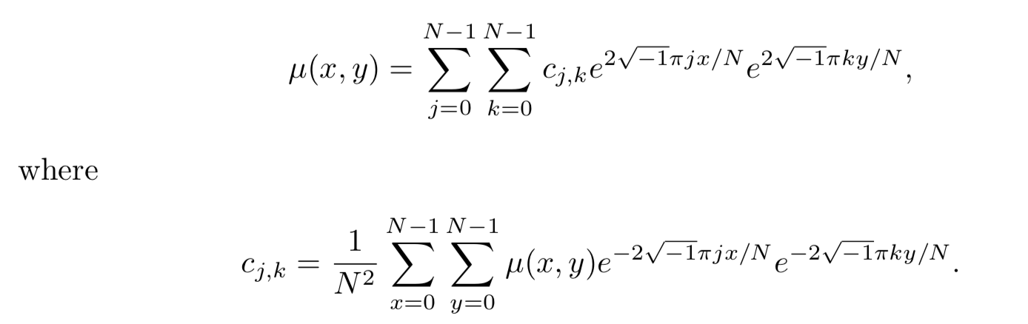
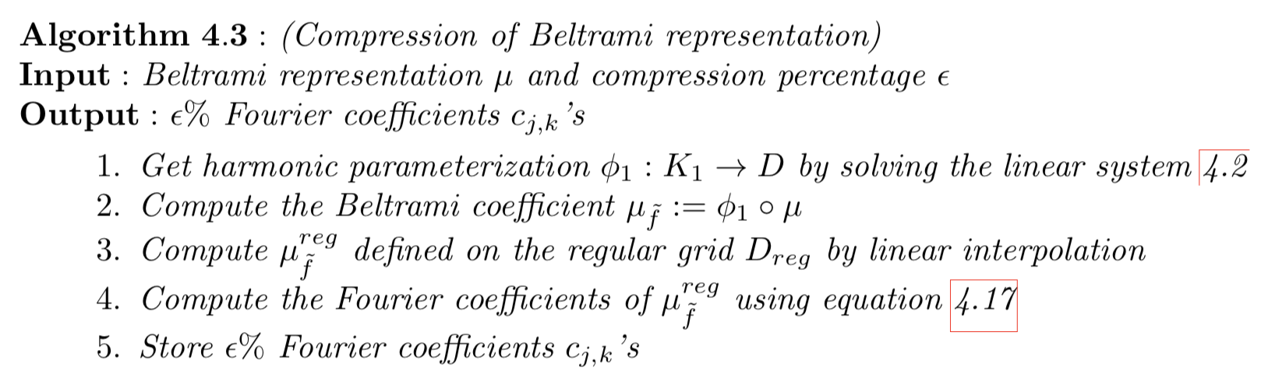

Mapping compression using Fourier transform

Slide 15
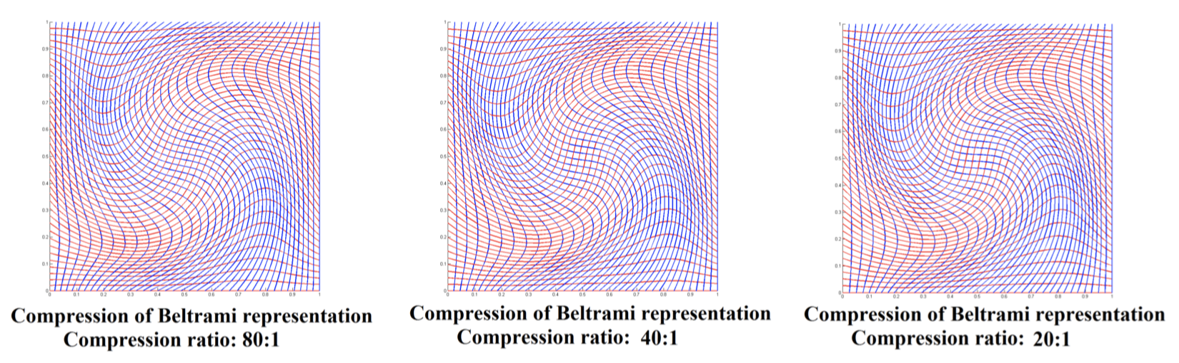
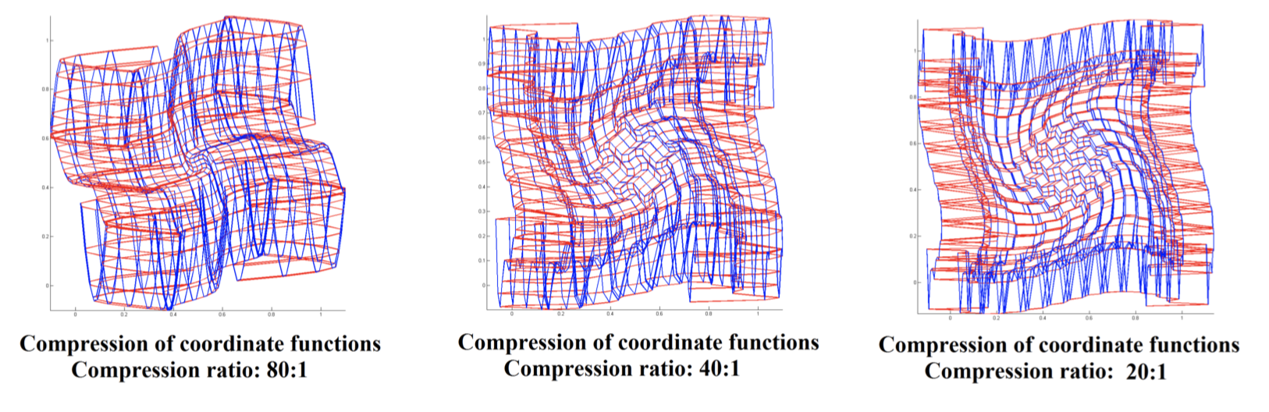
Mapping compression using Fourier transform

Slide 16
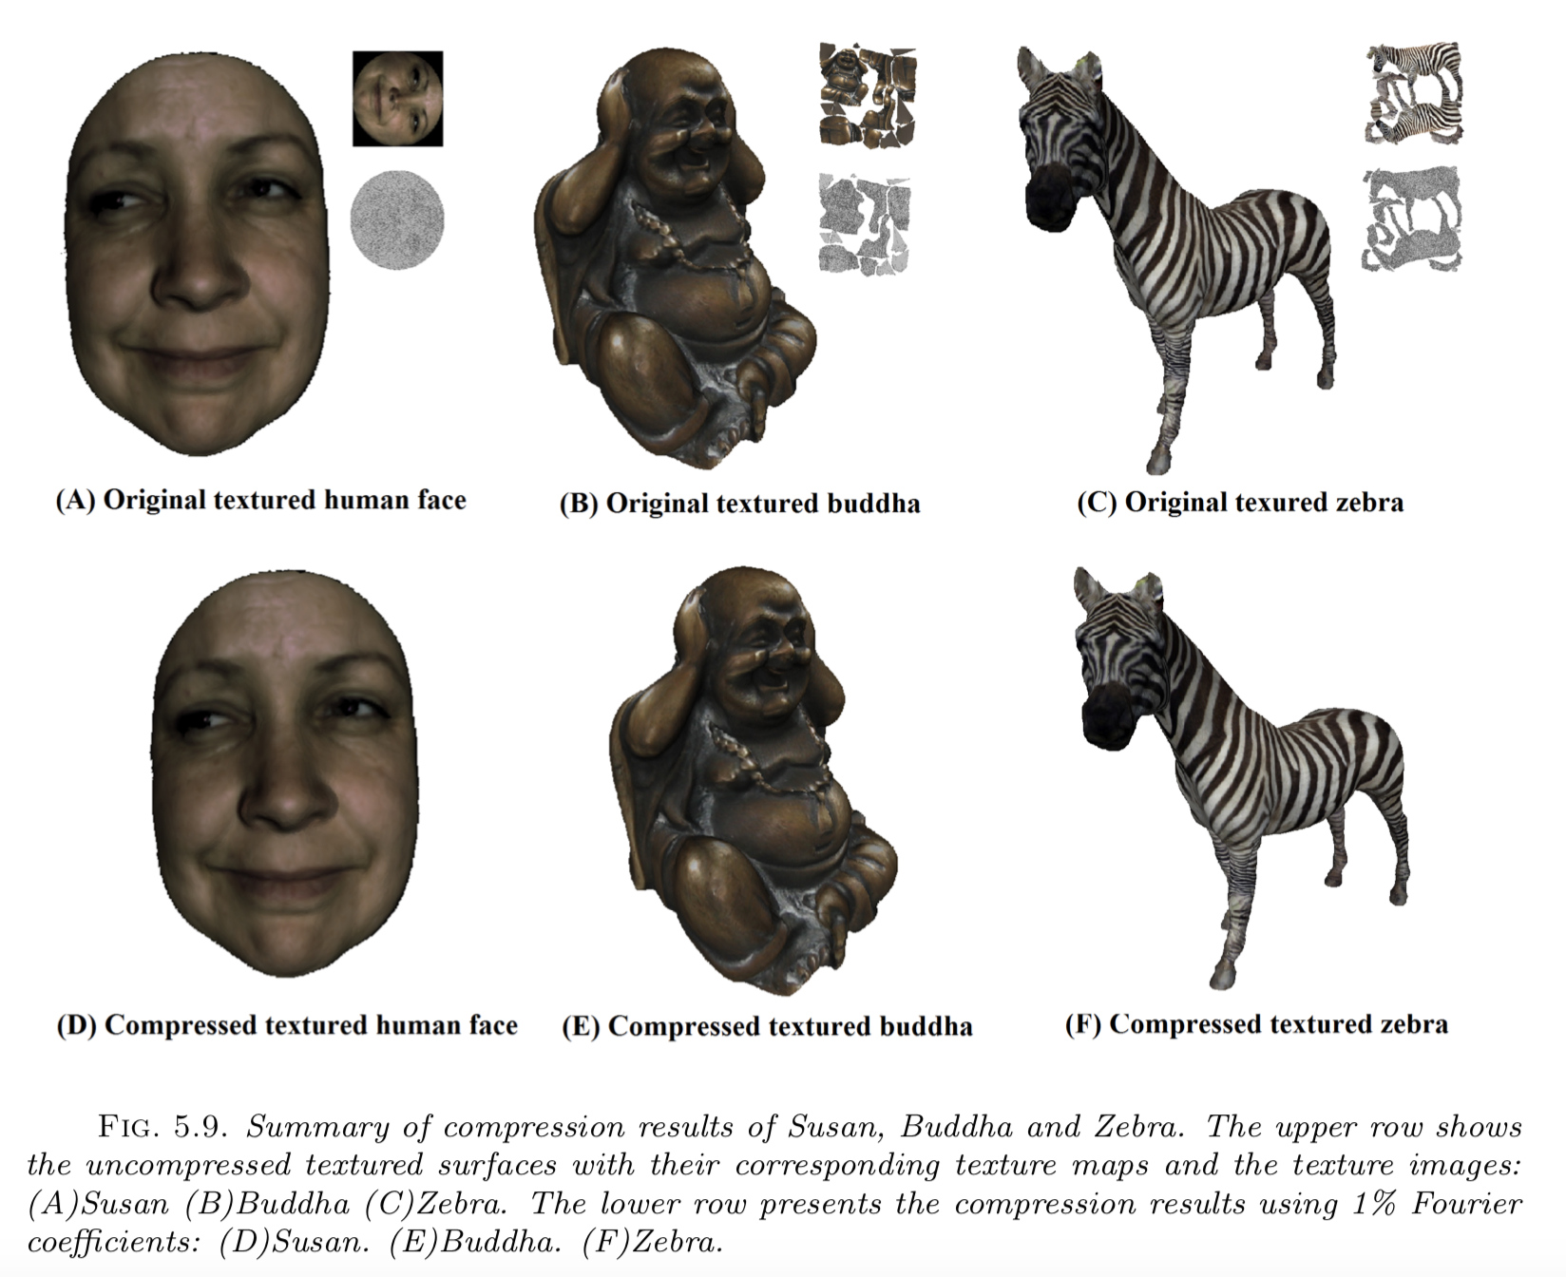
Mapping compression using Fourier transform

Slide 17
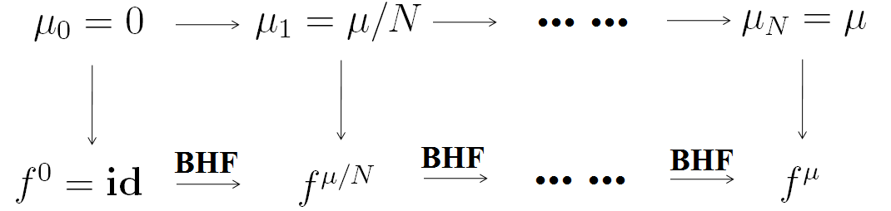
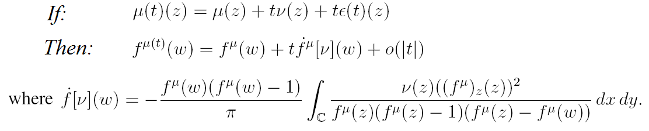
Beltrami Holomorphic Flow

Slide 18
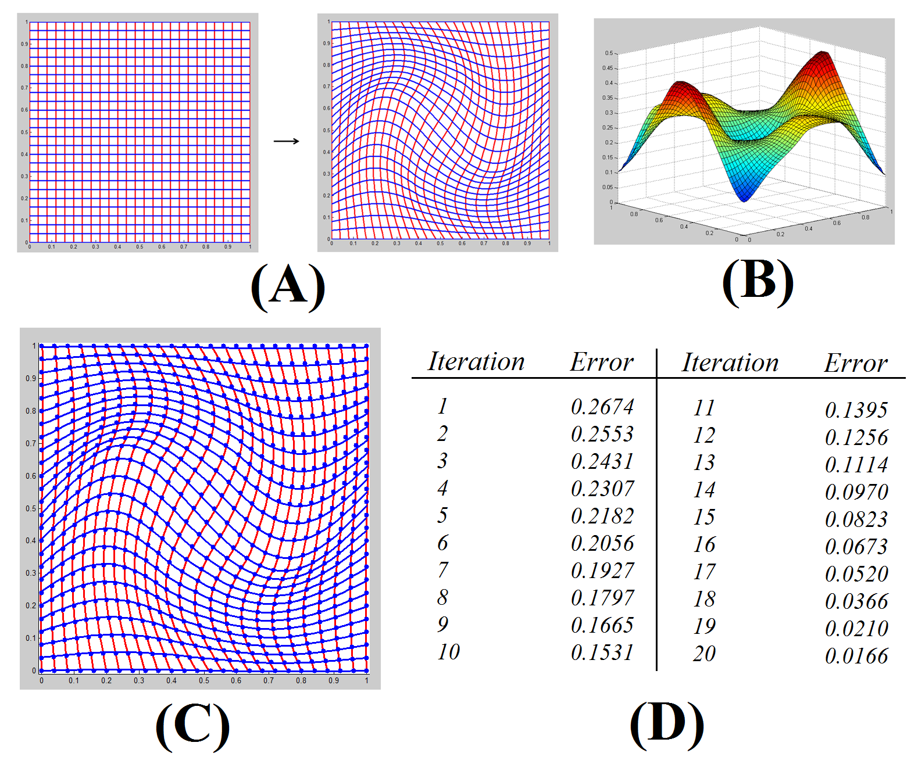
Beltrami Holomorphic Flow

