Slide 1
Tips on Written Midterm
Fei Chen

Slide 2
Goal
Understand written midterm
Show how to solve problems
Blackboard presentation

Slide 3
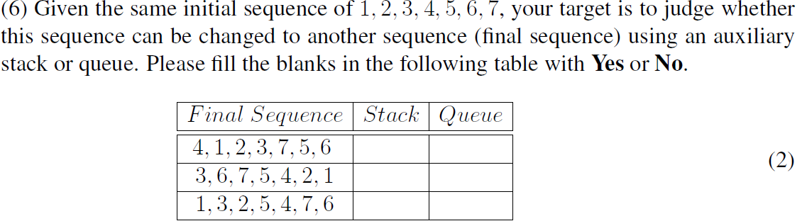
Stack and Queue

Slide 4
Idea
For each element, determine the state of the stack or the queue.
According to the state, judge whether an output is feasible.
Answer
Stack: F T T
Queue: F F T

Slide 5
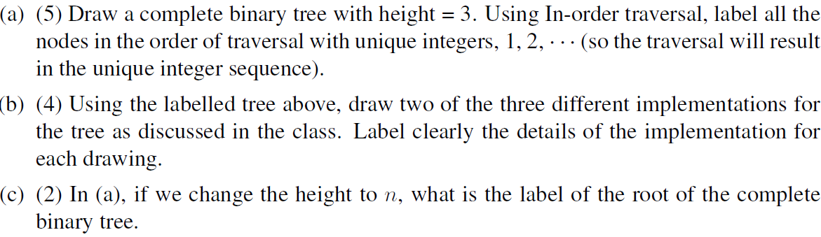
Tree

Slide 6
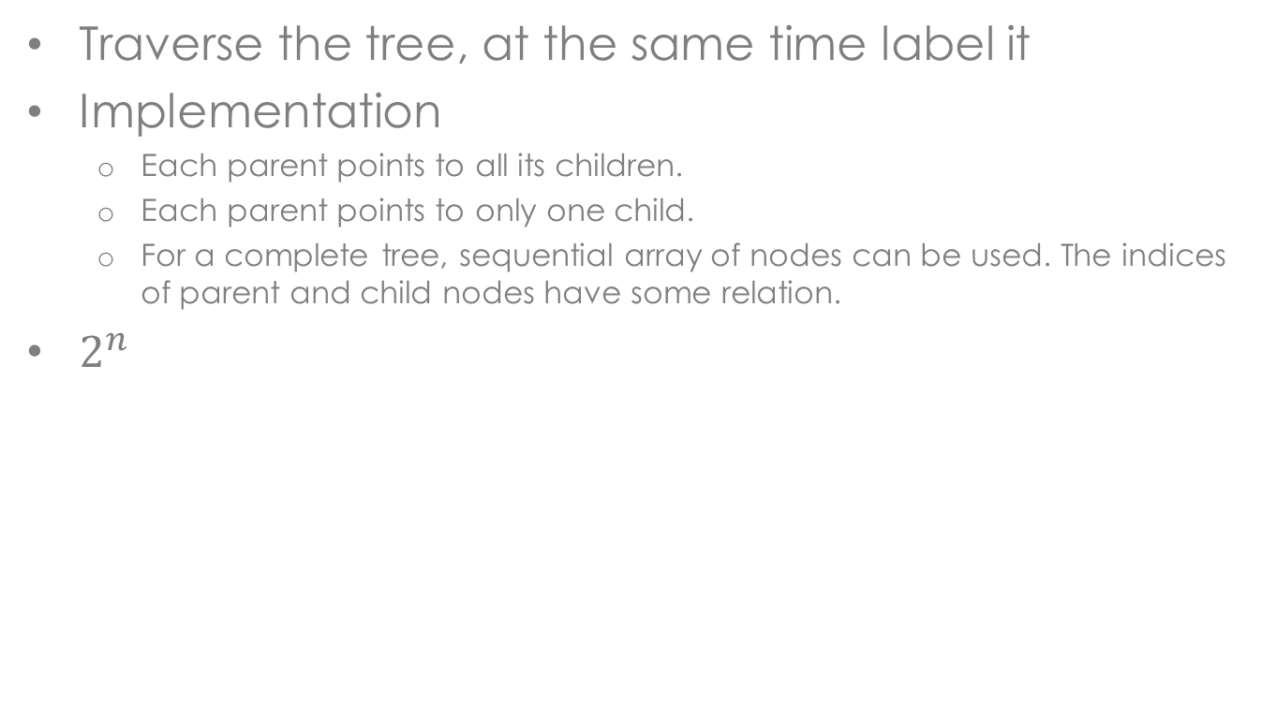
Idea
Traverse the tree, at the same time label it
Implementation
Each parent points to all its children.
Each parent points to only one child.
For a complete tree, sequential array of nodes can be used. The indices of parent and child nodes have some relation.
$2^{n}$

Slide 7
AVL Tree and Heap
We have discussed these objects in much detail in homework 2.

Slide 8
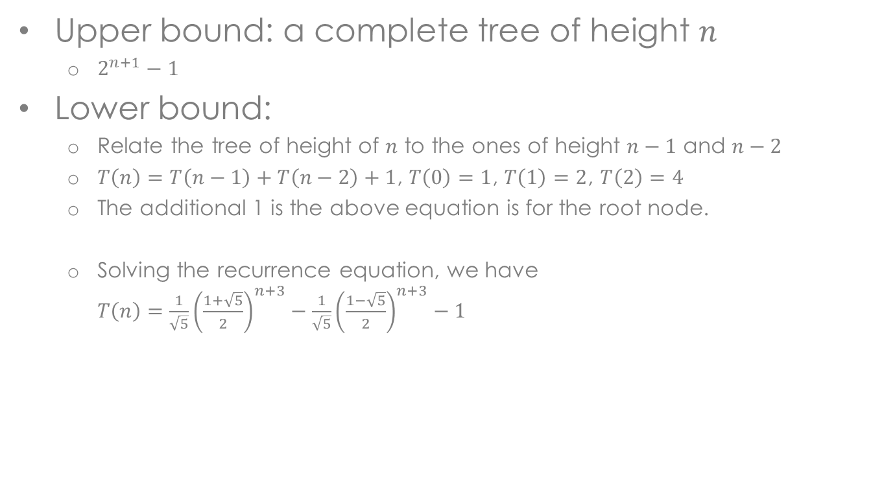
Idea
Upper bound: a complete tree of height $n$
$2^{n+1}−1$
Lower bound:
Relate the tree of height of $n$ to the ones of height $n−1$ and $n−2$
$T\left(n\right)=T\left(n−1\right)+T\left(n−2\right)+1$, $T\left(0\right)=1$, $T\left(1\right)=2$, $T\left(2\right)=4$
The additional 1 is the above equation is for the root node.
Solving the recurrence equation, we have $T\left(n\right)=\frac{1}{\sqrt{5}}{\left(\frac{1+\sqrt{5}}{2}\right)}^{n+3}−\frac{1}{\sqrt{5}}{\left(\frac{1−\sqrt{5}}{2}\right)}^{n+3}−1$

Slide 9

Short Questions
(a) $T\left(n\right)+n+\frac{3}{2}=3\left[T\left(n−1\right)+\left(n−1\right)+\frac{3}{2}\right]$ $T\left(n\right)=\frac{7}{2}⋅3^{n−1}−n−\frac{3}{2}$
(b) $\frac{16}{9}$

Slide 10
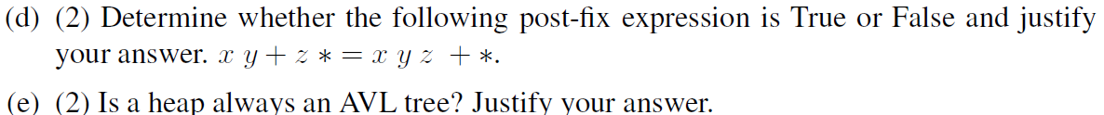
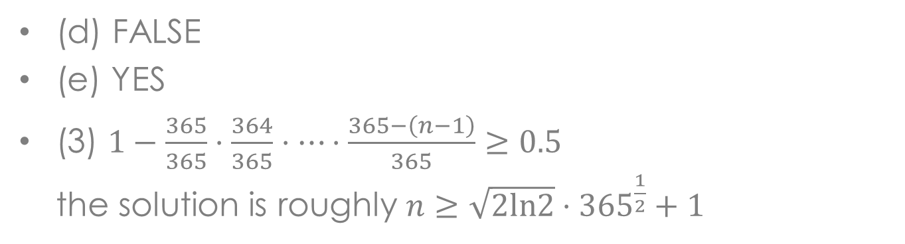
Short Questions
(d) FALSE
(e) YES
(3) $1−\frac{365}{365}⋅\frac{364}{365}⋅⋯⋅\frac{365−\left(n−1\right)}{365}≥0.5$ the solution is roughly $n≥\sqrt{2ln2}⋅{365}^{\frac{1}{2}}+1$

Slide 11
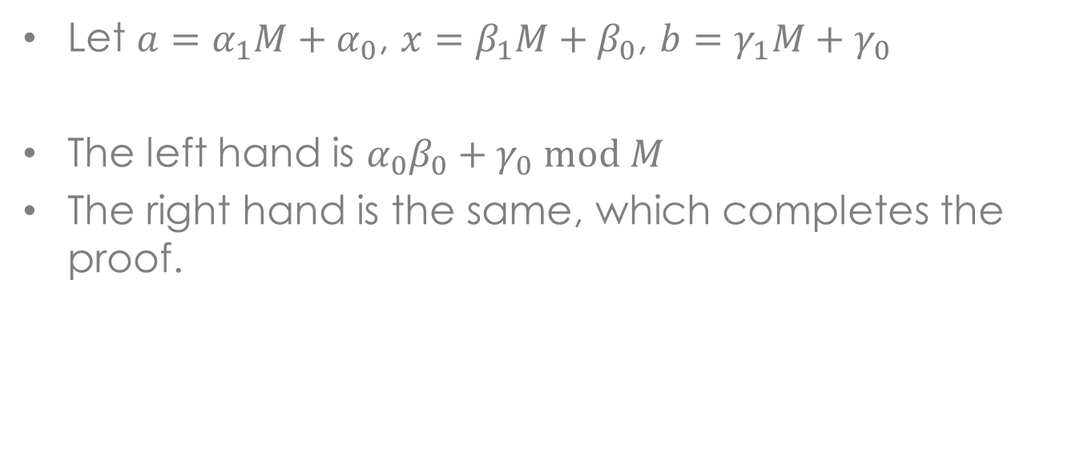
Short Questions
Let $a=α_{1}M+α_{0}$, $x=β_{1}M+β_{0}$, $b=γ_{1}M+γ_{0}$
The left hand is $α_{0}β_{0}+γ_{0} mod M$
The right hand is the same, which completes the proof.

Slide 12
Conclusion and Q&A
All the problems are somewhat easier than homework.
If you have problems understanding these material, just come to talk to the TA’s.

