Slide 1
The Cafe Problem
The new campus of the Chinese University of Hong Kong is a perfect disk of radius 1km. The Starbucks Co. plans to open 7 coffee shops on the campus.
Where do they have to be placed in order to minimize the maximum (straight-line) distance that a person anywhere on the campus has to walk to get a regular dose of caffeine?

Slide 2
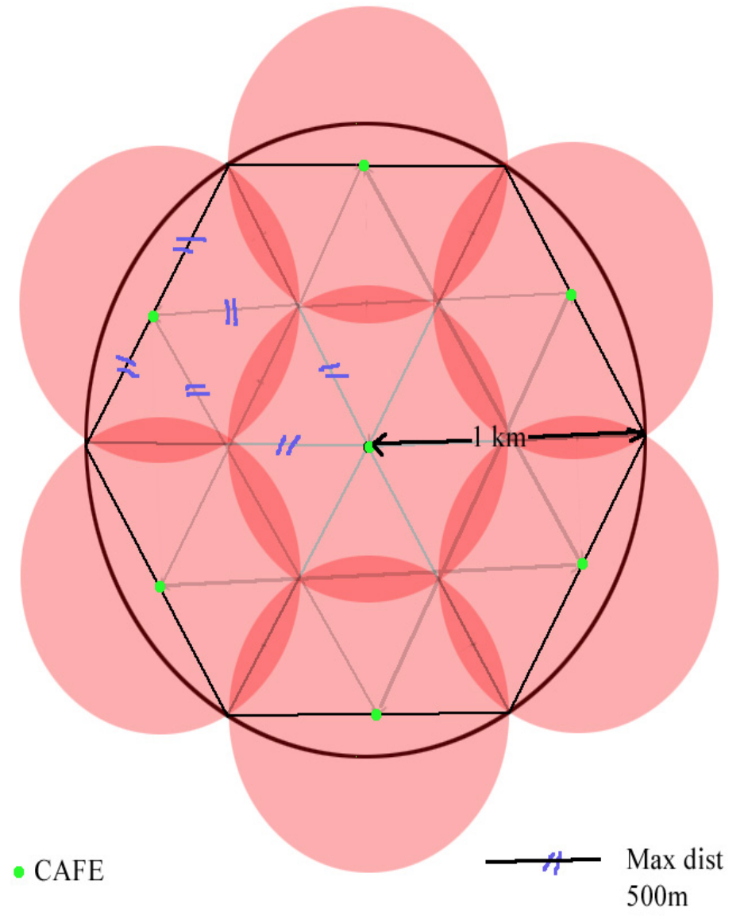
the maximum distance to a shop is .5km.

Slide 3
Suppose that we can cover the unit disk with 7 disks of radius r where r<1/2.
Observe first that a disk of radius r can only cover 2 sin⁻¹r of the circumference of the disk.
But r<1/2 implies that sin⁻¹r<π/6 and therefore all 7 of the small disks must touch the boundary of the unit disk. But then the center is not covered, contradiction.

