Slide 1
Puzzle
Problem: You are blindfolded and 10 coins are place in front of you on table. You are allowed to touch the coins, but can’t tell which way up they are by feel. You are told that there are 5 coins head up, and 5 coins tails up but not which ones are which. How do you make two piles of coins each with the same number of heads up? You can flip the coins any number of times.

Slide 2
Solution
Make 2 piles with equal number of coins. Now, flip all the coins in one of the pile.
P1 : H H T T T
P2 : H H H T T
Now when P1 will be flipped
P1 : T T H H H
P1(Heads) = P2(Heads)

Slide 3
Ten Words
1. The methodology of Monte Carlo Markov chain (MCMC) sampling has energized Bayesian statistics for more than a decade, providing a systematic approach to the computation of likelihoods and posterior distributions.
2. Off-the-shelf libraries in deep learning frameworks can be directly utilized to deploy the reduced LSTMs.
3. This flexbility often leads to overfitting when left unchecked: spurious patterns are found that happen to fit well to the training data, but are not predictive for new data.
4. Even a new crop of efficient variational inference algorithms based on stochastic gradients with mini-batches of data have not yet been shown to significantly improve upon simpler dropout-based regularization.
Notes:
1. Make sb energitic
2. 现成的, existing
3. false and not what it appears to be
4: a group of people who arrive or things that happen at the same time

Slide 4
Ten Words
5. While all of these issues are certainly related, compression and performance optimizing procedures might not always be aligned.
6. By using sparsity inducing priors for groups of weights that feed into a neuron the Bayesian mechanism will start pruning hidden units that are not strictly necessary for prediction and thus achieving compression.
7. Somewhat orthogonal to the above discussion but certainly relevant are approaches that customize the implementation of CNNs for hardware limited devices.
8. We begin by reviewing the current best practice for inference in general directed graphical models, based on amortized variational inference and efficient Monte Carlo gradient estimation
Notes:
5. properly correlated
6. Encouraging
7. Different in methods (but with the same goals)
8. to reduce a debt by paying small regular amounts/ trade off/

Slide 5
Ten Words
9. Some recent studies that embrace this approach have relied on the processor’s vector instructions to perform multiple 8 bit operations in parallel.
10. Extrapolating these results to the state-of-the-art deep neural networks that can easily contain millions of trainable parameters is non-trivial.
Notes:
9. Take
10. Make inference; to guess or think about what might happen using information that is already known

Slide 6
Soft Weight-Sharing for
Neural Network Compression
[ICLR’17]
BAI, Haoli
12-03-2018

Slide 7
Outline
Neural Network Compression: Why
How to Compress Neural Networks
Model
Experiment
Summary
Further Direction

Slide 8
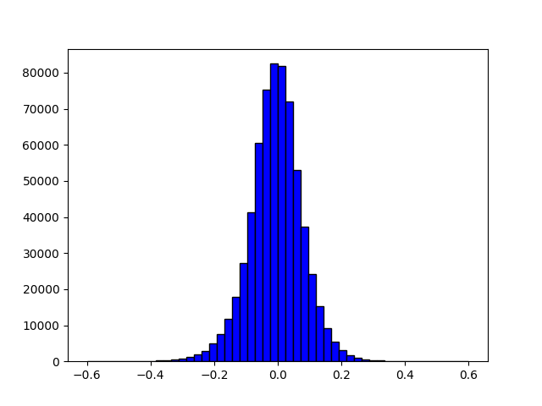
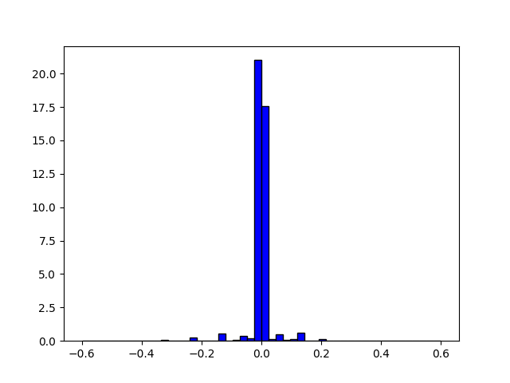
Neural Network Compression: Why
Redundant Parameters
Efficient Storage
Efficient Inference
Application in Mobile Devices
For example, in [1], the neural network can get ~32x reduction of storage, ~58x speed up of network inference.

Slide 9
How to Compress Neural Networks
Methods:
  Parameter Pruning
  Parameter Sharing, Quantization and Binarization
  Low Rank Matrix/Tensor Factorization
  Knowledge Distillation
Where to Compress:
  Weights
  Activations
  Gradients
For a survey, see [2]

Slide 10
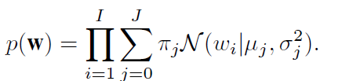
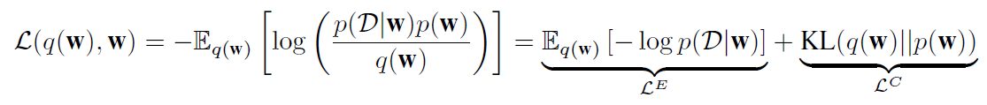
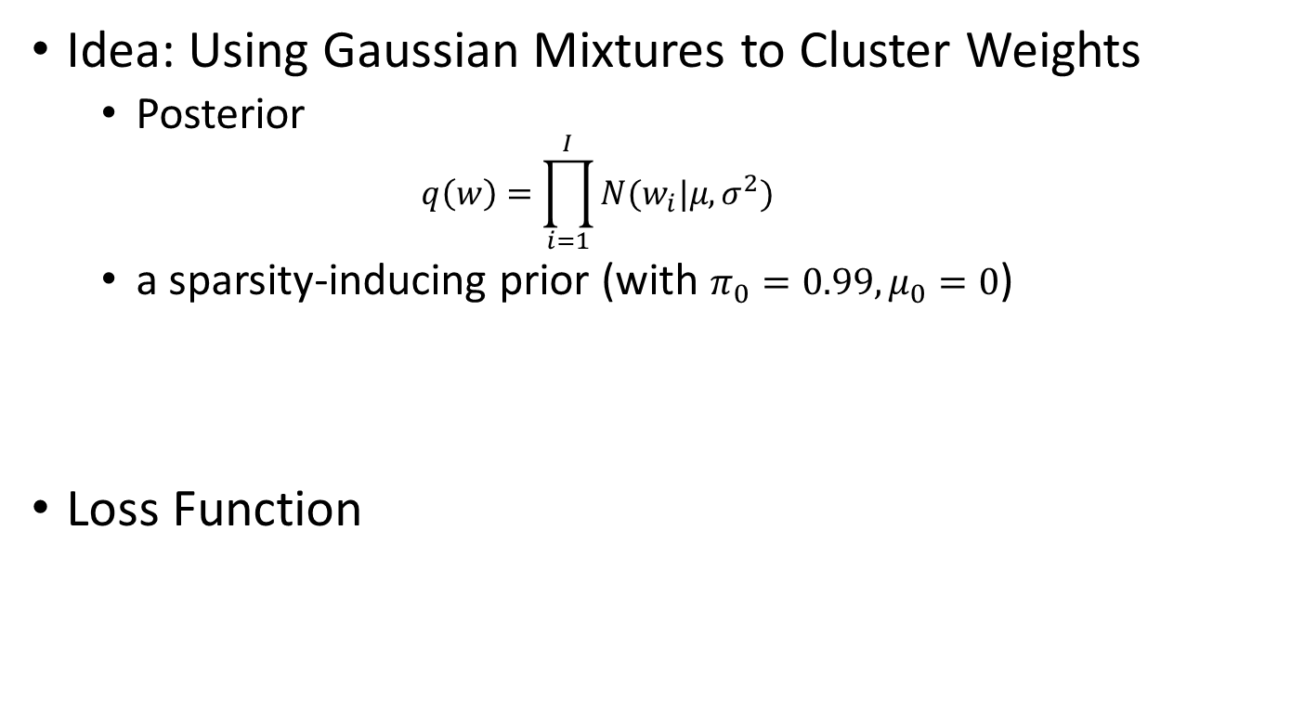
Model
Idea: Using Gaussian Mixtures to Cluster Weights
  Posterior
  $q\left(w\right)=\prod_{i=1}^{I}{N(w_{i}|μ, σ^{2}) }$
  a sparsity-inducing prior (with $π_{0}=0.99, μ_{0}=0$)
Loss Function

Slide 11
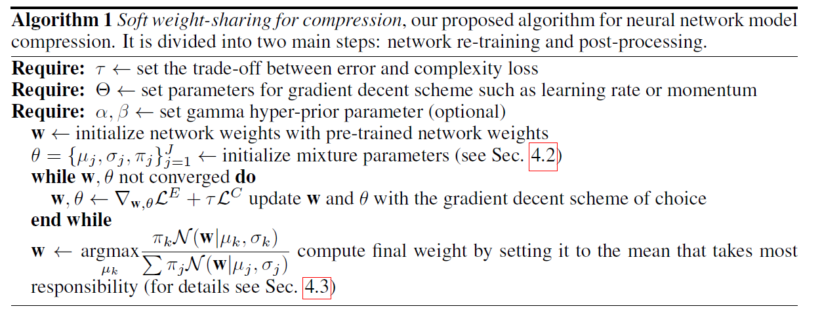
Model: Algorithm
Pretraining
Clustering
Quantization

Slide 12
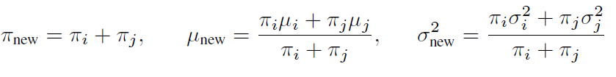
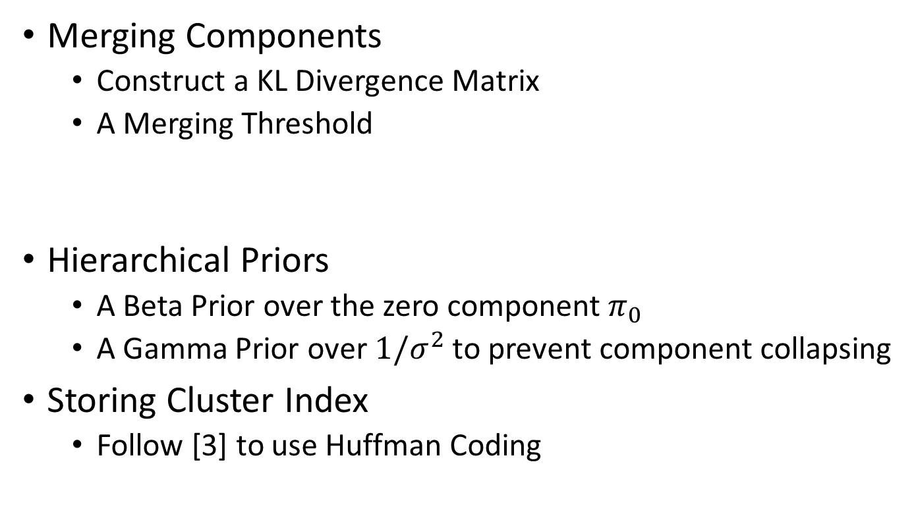
Model: Extensions
Merging Components
  Construct a KL Divergence Matrix
  A Merging Threshold
Hierarchical Priors
  A Beta Prior over the zero component $π_{0}$
  A Gamma Prior over ${1/σ}^{2}$ to prevent component collapsing
Storing Cluster Index
  Follow [3] to use Huffman Coding

Slide 13
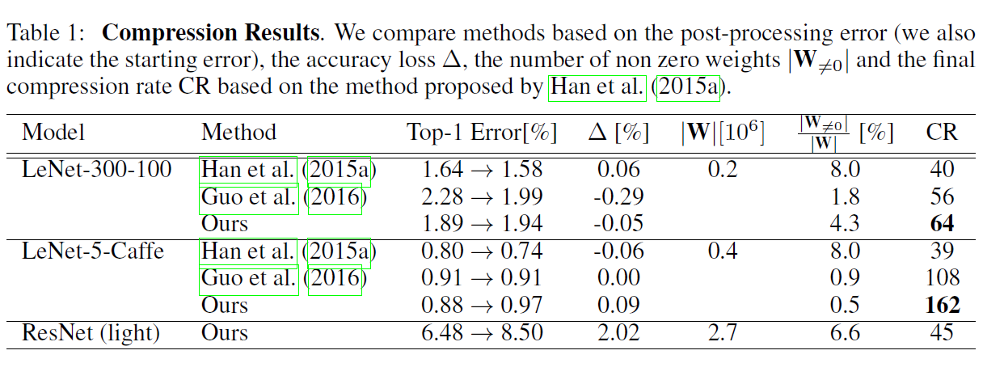
Experiment
A Demo: https://github.com/KarenUllrich/Tutorial-SoftWeightSharingForNNCompression/blob/master/tutorial.ipynb

Slide 14
Summary
Advantages:
  Simple but effective
  Attempt to learn the necessary number of components from data
Disadvantages:
  No speed up in training (The computational cost remains unchanged)
  Not scalable to large neural networks (probably due to the computational cost in calculating the ELBO)
  Redundant clusters: some clusters has no weights associated with
  No re-training after quantization

Slide 15
Future Directions
Bayesian Neural Network Compression:
  Automatically learn the necessary bits of quantization (Working on it)
  Different sparsity inducing priors
More Evaluation on NLP Tasks, such as [4, 5]
Combination with Hardware

Slide 16
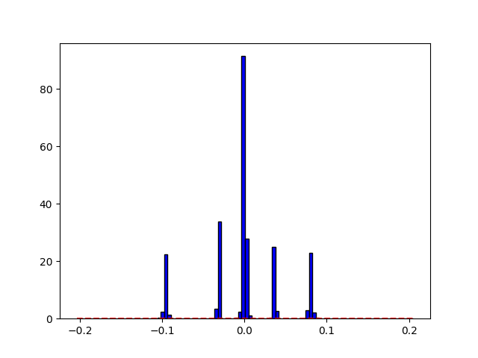
Dirichlet Process Clustering: Ongoing
A Unified Framework for Clustering with Automatic Bits Learning
  Gaussian Mixture Models [4]
  Log Uniform Mixture Models [5]
  Bernoulli Mixture Models
  Spike-and-Slab Mixture Models [6]

Slide 17
Tricks
High Precision for Gaussian Clusters
Uniform Initialization for means of priors.

Slide 18
Reference
[1]: Mohammad Rastegari, et.al., XNOR-Net: ImageNet Classification Using Binary Convolutional Neural Networks, arXiv 2016
[2]: Yu Cheng, et.al., A Survey of Model Compression and Acceleration for Deep Neural Networks, arXiv 2017
[3]: Song Han, Huizi Mao, William J.Dally, Deep Compression: Compressing Deep Neural Networks with Pruning, Trained Quantization and Huffman Coding, ICLR 2016.
[4]: Ekaterina Lobacheva, Nadezhda Chirkova and Dmitry Vetrov. Bayesian Sparsification of Recurrent Neural Networks, arXiv 2017.
[5]: Wei Wen, et.al. LEARNING INTRINSIC SPARSE STRUCTURES WITHIN LONG SHORT-TERM MEMORY
[6]: Karen Ulrich, Edward Meeds, Max Welling, Soft Weight-sharing For Neural Network Compression, ICLR 2017
[7]: Jan Achterhold, et.al., Variational Network Quantization, ICLR 2018
[8]: Kai Cui, Wenshan Cui, Spike-and-Slab Dirichlet Process Mixture Models, Open Journal of Statistics, 2012

Slide 19
Thanks!

