Slide 1
Research Trends of RNNs: Sequence to Sequence Learning Problem
Group Study on Recurrent Neural Networks
Jiani Zhang

Slide 2
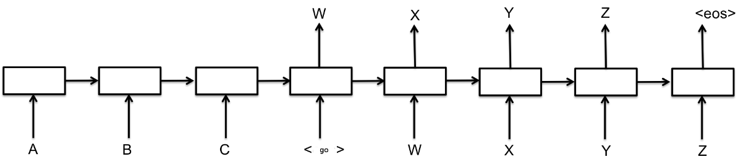

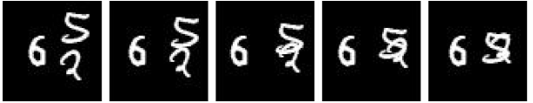
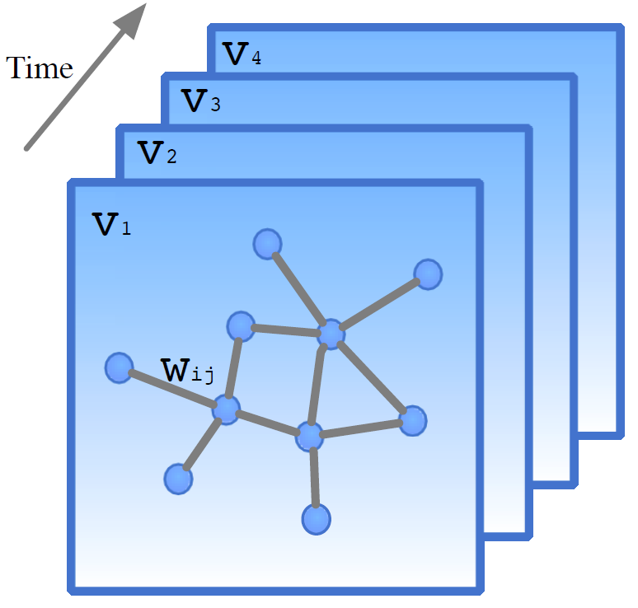
Sequence to Sequence Learning Problem
Spatiotemporal
Seq2seq Learning Problem
Irregular-grid Spatiotemporal Seq2Seq Learning Problem

Slide 3
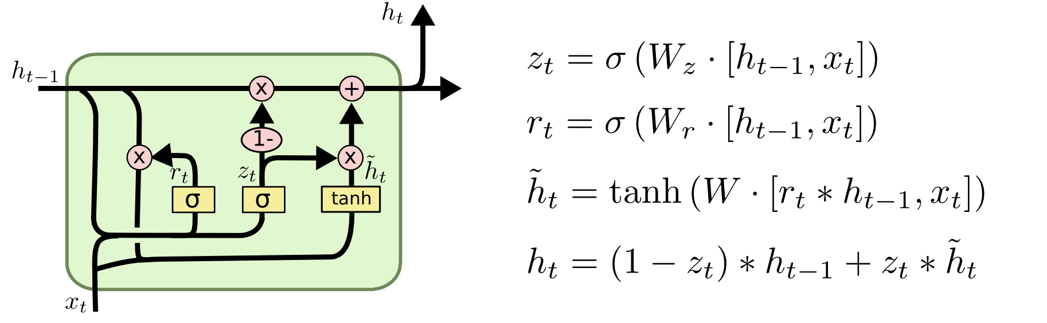
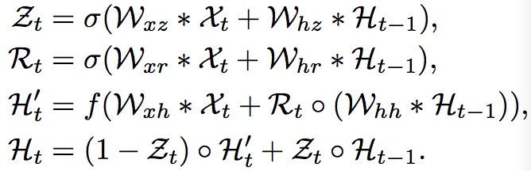
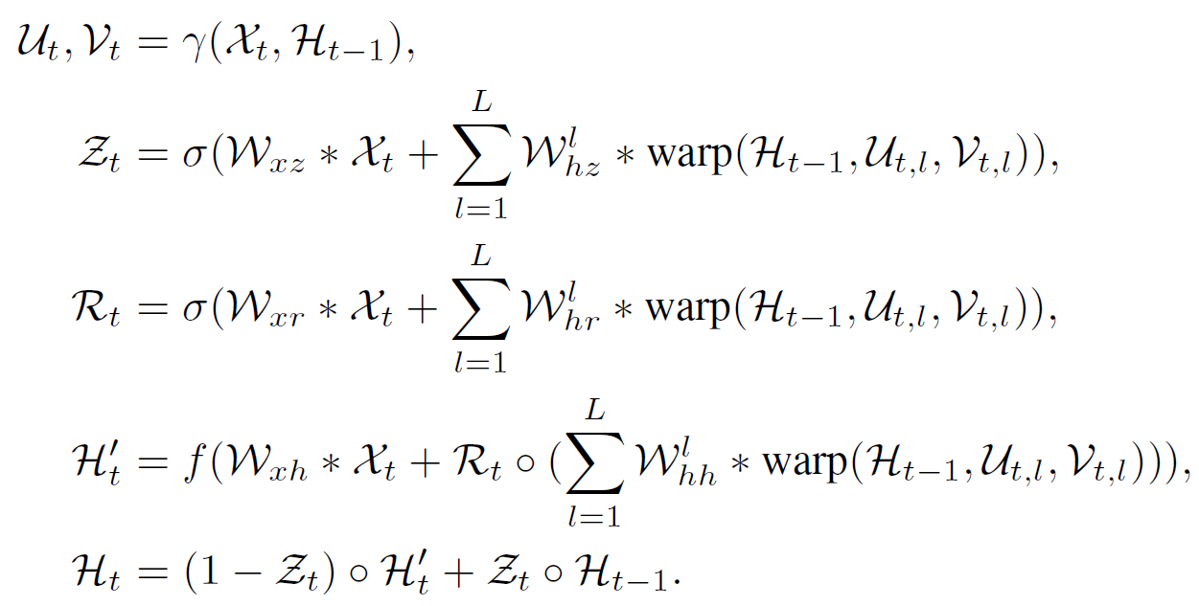
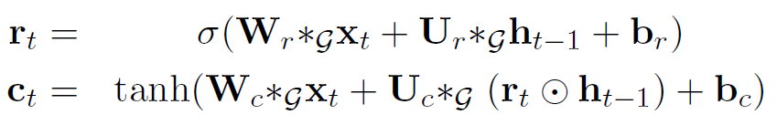
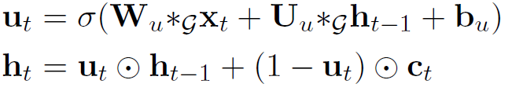
Sequence to Sequence Learning Problem
FC-GRU
+Attention
ConvGRU (Shi et.al. NIPS 2015)
TrajGRU (Shi et.al. NIPS 2017)
Spatiotemporal
Seq2seq Learning Problem
Irregular-grid Spatiotemporal Seq2Seq Learning Problem
Graph Convolutional GRU (Li et.al. Arxiv 2017)

Slide 4
Thanks!

Slide 5
Sequence Learning Problem

Slide 6
Attention-related Papers in NIPS 2017
NLP
Attention is All you Need Ashish Vaswani (Google Brain) · Noam Shazeer (Google) · Niki Parmar (Google) · Llion Jones (Google) · Jakob Uszkoreit (Google, Inc.) · Aidan N Gomez (University of Toronto) · Łukasz Kaiser (Google Brain)
Plan, Attend, Generate: Planning for Sequence-to-Sequence Models Caglar Gulcehre (Deepmind) · Francis Dutil (MILA) · Adam Trischler (Microsoft) · Yoshua Bengio (U. Montreal)
Multi-agent Predictive Modeling with Attentional CommNets Yedid Hoshen (Facebook AI Research)
Dialog
Visual Reference Resolution using Attention Memory for Visual Dialog Paul Hongsuck Seo (POSTECH) · Andreas Lehrmann (Disney Research) · Bohyung Han (POSTECH) · Leonid Sigal (Disney Research)
Image
High-Order Attention Models for Visual Question Answering Idan Schwartz (Technion) · Alexander Schwing (University of Illinois at Urbana-Champaign) · Tamir Hazan (Technion)
Learning Deep Structured Multi-Scale Features using Attention-Gated CRFs for Contour Prediction Dan Xu (University of Trento) · Wanli Ouyang (The Chinese University of Hong Kong) · Xavier Alameda-Pineda (INRIA) · Elisa Ricci () · Xiaogang Wang (The Chinese University of Hong Kong) · Nicu Sebe (University of Trento)
Spatiotemporal
Attentional Pooling for Action Recognition Rohit Girdhar (Carnegie Mellon University) · Deva Ramanan (Carnegie Mellon University)
Hierarchical Attentive Recurrent Tracking Adam Kosiorek (University of Oxford) · Alex Bewley (University of Oxford) · Ingmar Posner (Oxford University)
Variational Laws of Visual Attention for Dynamic Scenes Dario Zanca (University of Florence, University of Siena) · Marco Gori (University of Siena)
Saliency-based Sequential Image Attention with Multiset Prediction Sean Welleck (NYU) · Kyunghyun Cho (NYU) · Zheng Zhang (Shanghai New York Univeristy)
Bioinformatics
Attend and Predict: Understanding Gene Regulation by Selective Attention on Chromatin Ritambhara Singh (University of Virginia) · Jack Lanchantin (University of Virginia) · Yanjun Qi (University of Virginia)
Sparsity
A Regularized Framework for Sparse and Structured Neural Attention Vlad Niculae (Cornell University) · Mathieu Blondel (NTT)

Slide 7
Attention Trends
Attention Mechanism
Additive attention?
Dot-product attention?
Encoding and Decoding Framework
RNN?
CNN?
Attention is all you need?
Read and Write Mechanism
Weighted sum?
Neural Networks?

Slide 8
Spatiotemporal Seq2seq Learning Problem

Slide 9
Spatiotemporal Sequence Learning Problem
Xingjian Shi, Zhihan Gao, Leonard Lausen, Hao Wang, Dit-Yan Yeung. Deep Learning for Precipitation Nowcasting: A Benchmark and A New Model . NIPS. 2017.
Jianmin Wang · Mingsheng Long · Philip S Yu · Yunbo Wang. PredRNN: Recurrent Neural Networks for Video Prediction using Spatiotemporal LSTMs. NIPS. 2017.
Dario Zanca, Marco Gori. Variational Laws of Visual Attention for Dynamic Scenes. NIPS 2017
Adam Kosiorek, Alex Bewley, Ingmar Posner. Hierarchical Attentive Recurrent Tracking. NIPS 2017
Rohit Girdhar , Deva Ramanan. Attentional Pooling for Action Recognition. NIPS 2017
Yang, Yinchong, Denis Krompass, and Volker Tresp. Tensor-Train Recurrent Neural Networks for Video Classification. ICML. 2017.

Slide 10
Deep Learning Approach – Formulation
Periodic observations taken from a dynamic system over a spatial MxN grid → sequence of tensors
Predict the most likely length-K sequence in the future given the previous J observations

Slide 11
Introduction – Two Major Challenges
How to learn a model for multi-step forecasting?
One-step ahead → Multi-step ahead, More difficult
How to effectively model the spatial and temporal structures within the data?
High dimensionality: What, Where and When
Notes:
STSF has imposed two major challenges to the machine learning community.
For the 1st challenge, in STSF, we not only need to give a single-step-ahead prediction, but also need to predict for multiple steps ahead, which is more ..
For the 2nd challenge, contain more information than purely spatial data like images and purely sequential data like sentences and audios. It simultaneously gives you information about ... This makes it more comprehensive about the underlying system and also makes it have high dimensionality.

Slide 12
Model – ConvGRU (NIPS 2015)
Convolutional GRU (Similar to ConvLSTM)
Convolution applies a location-invariant filter
Update Gate
Reset Gate
The neighborhood set is fixed for all the locations
Notes:
N^h_{i,j} is the ordered neighborhood set at location (i, j) defined by the hyperparameters of the state-to-state convolution such as kernel size, dilation and padding

Slide 13
Motivation – Deficiencies of the previous model
ConvGRU is not optimal
Convolution applies a location-invariant filter. Convolutional recurrence lacks the ability to model location-variant spatiotemporal correlation patterns, e.g., rotation.
New RNN structure that can have location-variant state-state connection
Trajectory Gated Recurrent Unit (TrajGRU)
Notes:
For example, rotation and scaling generate flow fields with different angles pointing to different directions

Slide 14

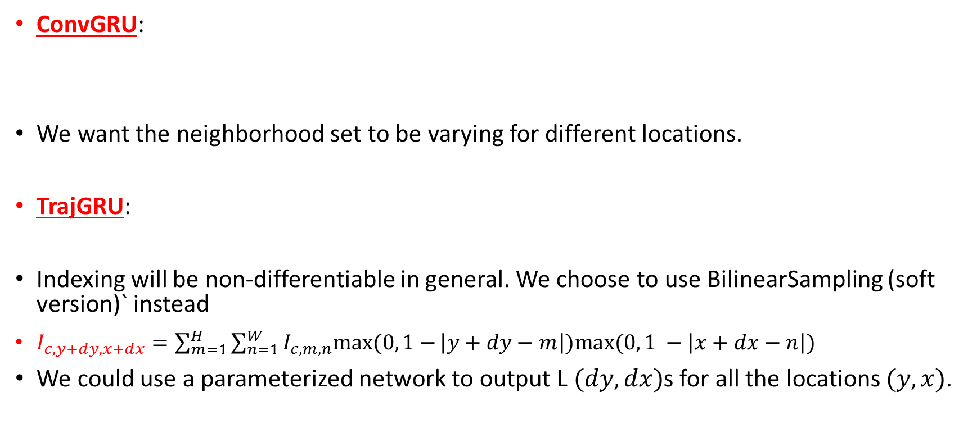
Model – From ConvGRU to TrajGRU
ConvGRU:
We want the neighborhood set to be varying for different locations.
TrajGRU:
Indexing will be non-differentiable in general. We choose to use BilinearSampling (soft version)` instead
$I_{c, y+dy,x+dx}=\sum_{m=1}^{H}{\sum_{n=1}^{W}{I_{c,m,n}max⁡(0, 1−}\left|y+dy−m\right|)max⁡(0, 1 −\left|x+dx−n\right|)}$
We could use a parameterized network to output L $(dy, dx)$s for all the locations $(y, x)$.
Size of the neighborhood set
${(p}_{l,i,j}\left(θ\right), q_{l,i,j}(θ))$ is the $l$th neighborhood

Slide 15
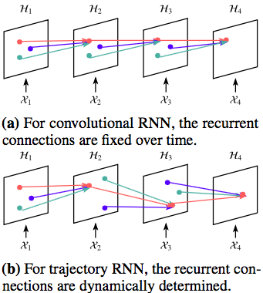
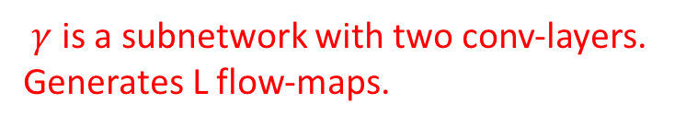
Model – TrajGRU (NIPS 2017)
$γ$ is a subnetwork with two conv-layers. Generates L flow-maps.

Slide 16
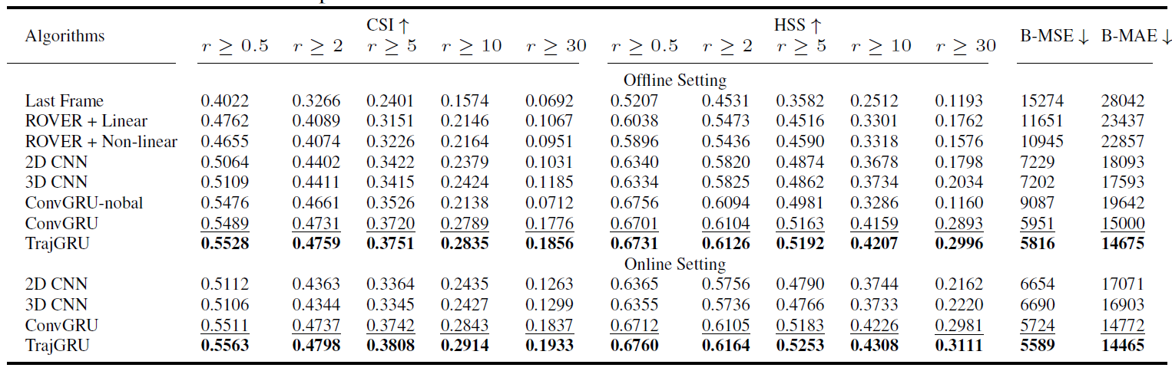
HKO-7 Benchmark – Evaluation Result
All deep models outperform optical-flow based models when trained with B-MSE + B-MAE
TrajGRU performs the best
Online fine-tuning helps

Slide 17
Irregular-grid Spatiotemporal Seq2Seq Learning Problem
Notes:
The spatial structure of many important problems may however not be as simple as regular grids.

Slide 18
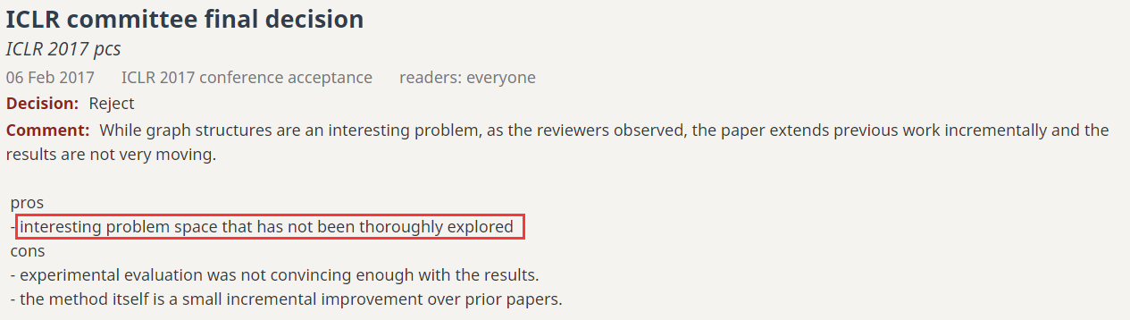
Irregular-grid Spatiotemporal Sequence Learning Problem
Li, Yaguang, Rose Yu, Cyrus Shahabi, and Yan Liu. "Graph Convolutional Recurrent Neural Network: Data-Driven Traffic Forecasting." arXiv preprint arXiv:1707.01926 (2017).
Yu, Bing, Haoteng Yin, and Zhanxing Zhu. "Spatio-temporal Graph Convolutional Neural Network: A Deep Learning Framework for Traffic Forecasting." arXiv preprint arXiv:1709.04875 (2017).
Li, Yaguang, et al. "Graph Convolutional Recurrent Neural Network: Data-Driven Traffic Forecasting." arXiv preprint arXiv:1707.01926 (2017).

Slide 19
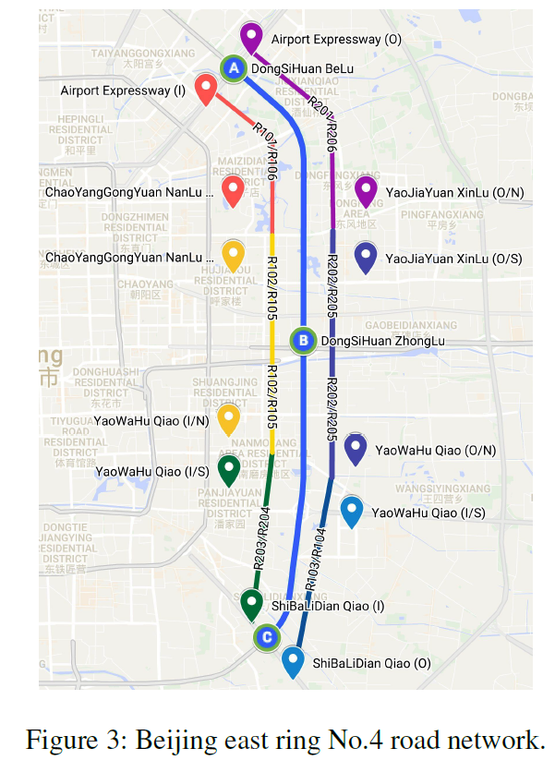


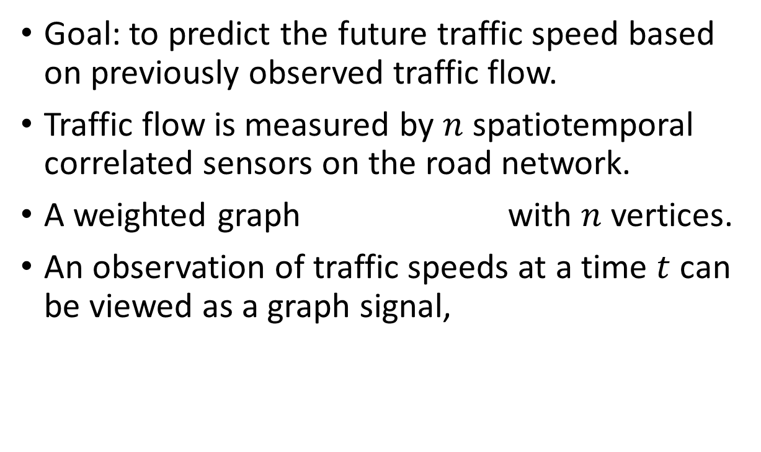
The Traffic Forecasting Problem
Goal: to predict the future traffic speed based on previously observed traffic flow.
Traffic flow is measured by $n$ spatiotemporal correlated sensors on the road network.
A weighted graph with $n$ vertices.
An observation of traffic speeds at a time $t$ can be viewed as a graph signal,
Notes:
given sensor graph G and historical traffic measurements of sensors, infer the most likely traffic measurements in the next
H time steps, i.e., ^X t+1; ; ^X t+H, where H is the forecasting horizon.

Slide 20
Motivation
Standard CNNs are restricted to processing the regular grid structure (e.g. images, videos, and speech) other than general domains.
Recent advances in the irregular or non-Euclidean domains modeling provide some useful insights on how to further study the structured data problem.
Integrate graph convolution models

Slide 21
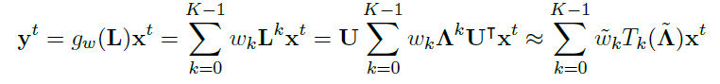
Model Intuition – Graph Convolution GRU
This is done through transformation of input sequence through a graph convolutional kernel.
Kernel → : Graph Laplacian Transformation
Notes:
GCRN is a generalization of classical recurrent neural networks (RNN) to data structured by an arbitrary graph.

Slide 22
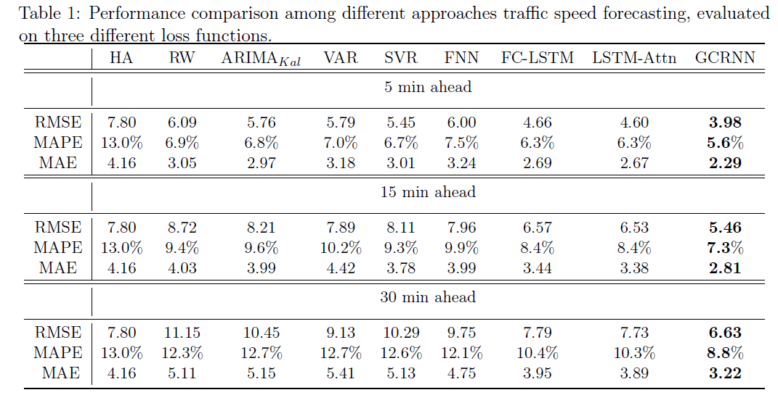
Experiment Results

Slide 25
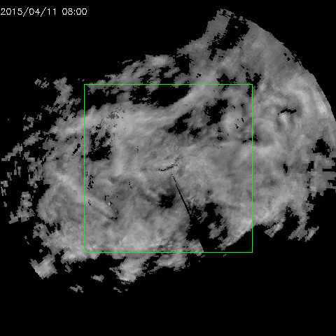
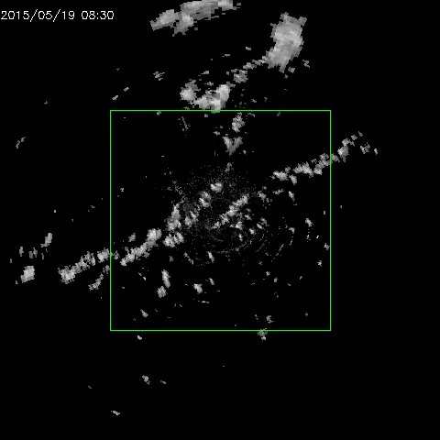
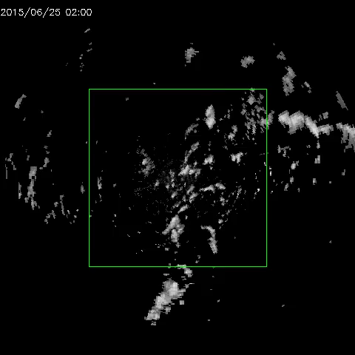
Goal of Precipitation Nowcasting
Give precise and timely prediction of rainfall intensity in a local region over a relatively short period of time (e.g., 0-6 hours)
High resolution & High Frequency
High dimensional spatiotemporal data

Slide 26

Experiment on MovingMNIST++
MovingMNIST: 2 moving digits + move in constant speed
MovingMNIST++: 3 moving digits + rotation/scaling + illumination change
Three RNN-layers for the encoder/forecaster
TrajGRU-L13 outperforms ConvGRU-5x5 while having fewer parameters.
#Param
Test MSE

Slide 27



MovingMNIST++ – Visualization
We choose to visualize the prediction result and learned links of the TrajGRU-L13 model
Next we will visualize the learned flow maps of different layers in the encoder and forecaster. (See the slides next)
For the encoder, the lower-layers tend to capture the local-correlation structure while the higher-layers are capturing the global correlation structure
For the forecaster, the higher-layers generate the global motion structure while the lower-layers generate the more motion structure with finer detail.
Input
Ground Truth
Prediction

Slide 28
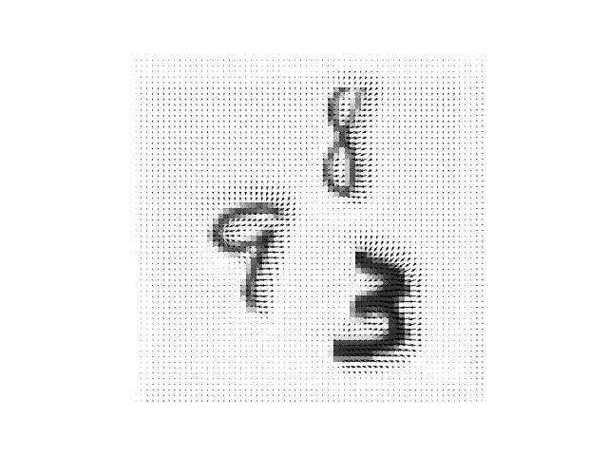
MovingMNIST++ – Visualization
Encoder Layer=1, Link ID=5

Slide 29
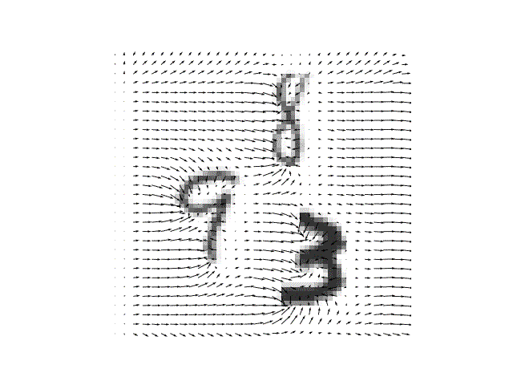
MovingMNIST++ – Visualization
Encoder Layer=2, Link ID=5

Slide 30
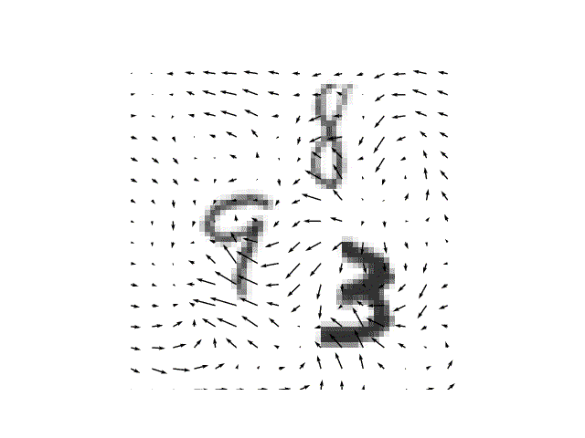
MovingMNIST++ – Visualization
Encoder Layer=3, Link ID=5

Slide 31
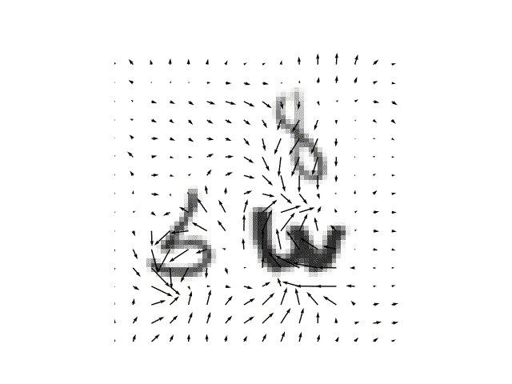
MovingMNIST++ – Visualization
Forecaster Layer=3, Link ID=9

Slide 32
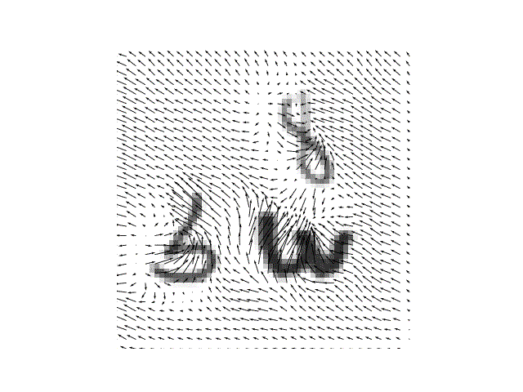
MovingMNIST++ – Visualization
Forecaster Layer=2, Link ID=9

Slide 33
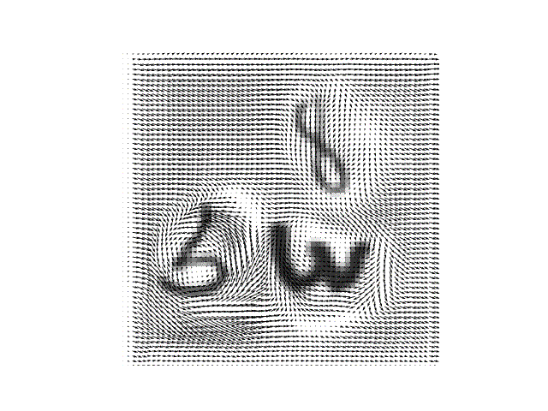
MovingMNIST++ – Visualization
Forecaster Layer=1, Link ID=9

Slide 34
HKO-7 Benchmark – Evaluation Result
All deep models outperform optical-flow based models when trained with B-MSE + B-MAE
TrajGRU performs the best
Online fine-tuning helps

